Slide 1

Motivation
HEROS AND HEROINES
Design
Avatar used Ninja (Queen)
Weapon – Shuriken
NPC’s
Ghost (throwing Shuriken)
Boss
Powerups : more powerful Shuriken

Slide 2
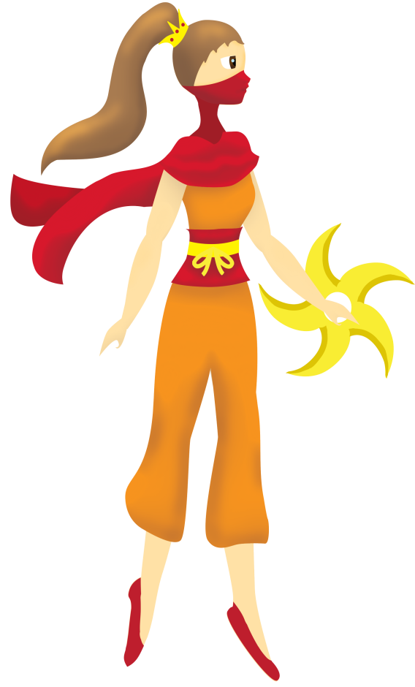

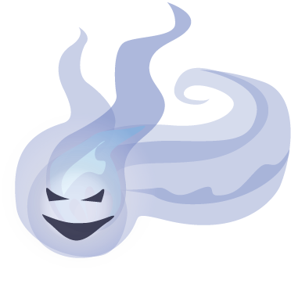

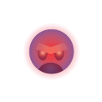
WEAPON
AVATAR
NPC 2
NPC 3
NPC 1

Slide 3
Features of Game
Simply control
Easy to Play
PROBLEMS
Overheating of CPU
Time
Logic

Slide 4
What Worked
Story Board
State machine
Animation
Boss level
NPC health
Power Up (Health)
Score
Avatar health
Credits

