Slide 1

RESUME CLASSIFICATION
Mr. Gore Mayuresh Hanumant

Slide 2
Business Objective
The document classification solution should significantly reduce the manual human effort in the HRM .It should achieve a higher level of accuracy and automation with minimal human intervention.

Slide 3
PROJECT ARCHITECTURE
Collection of Data
Business Understanding
Exploratory Data Analysis(EDA)
Deployment
Model Building

Slide 4
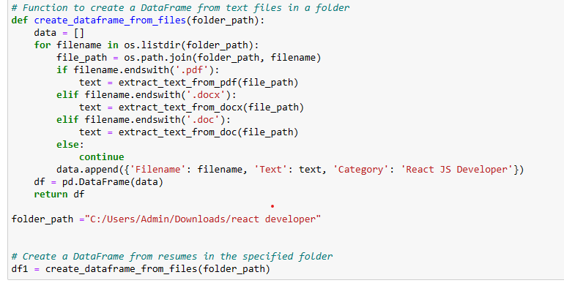
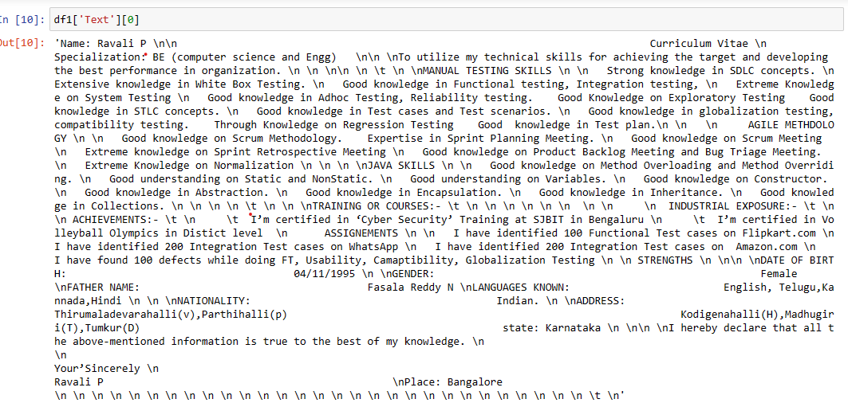
Converting all file to .txt (Process)

Slide 5
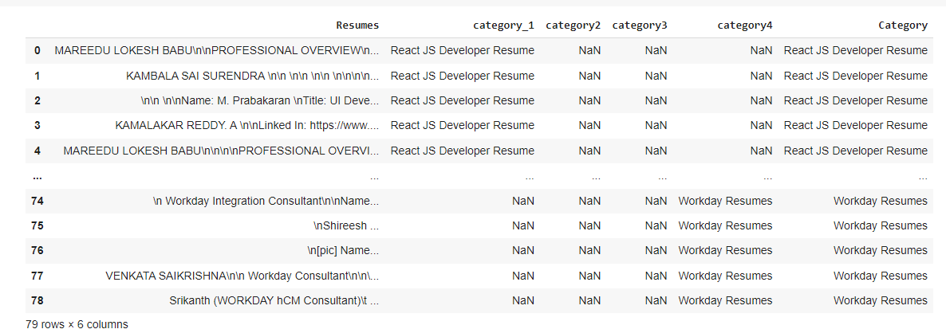
Merging all category files.

Slide 6
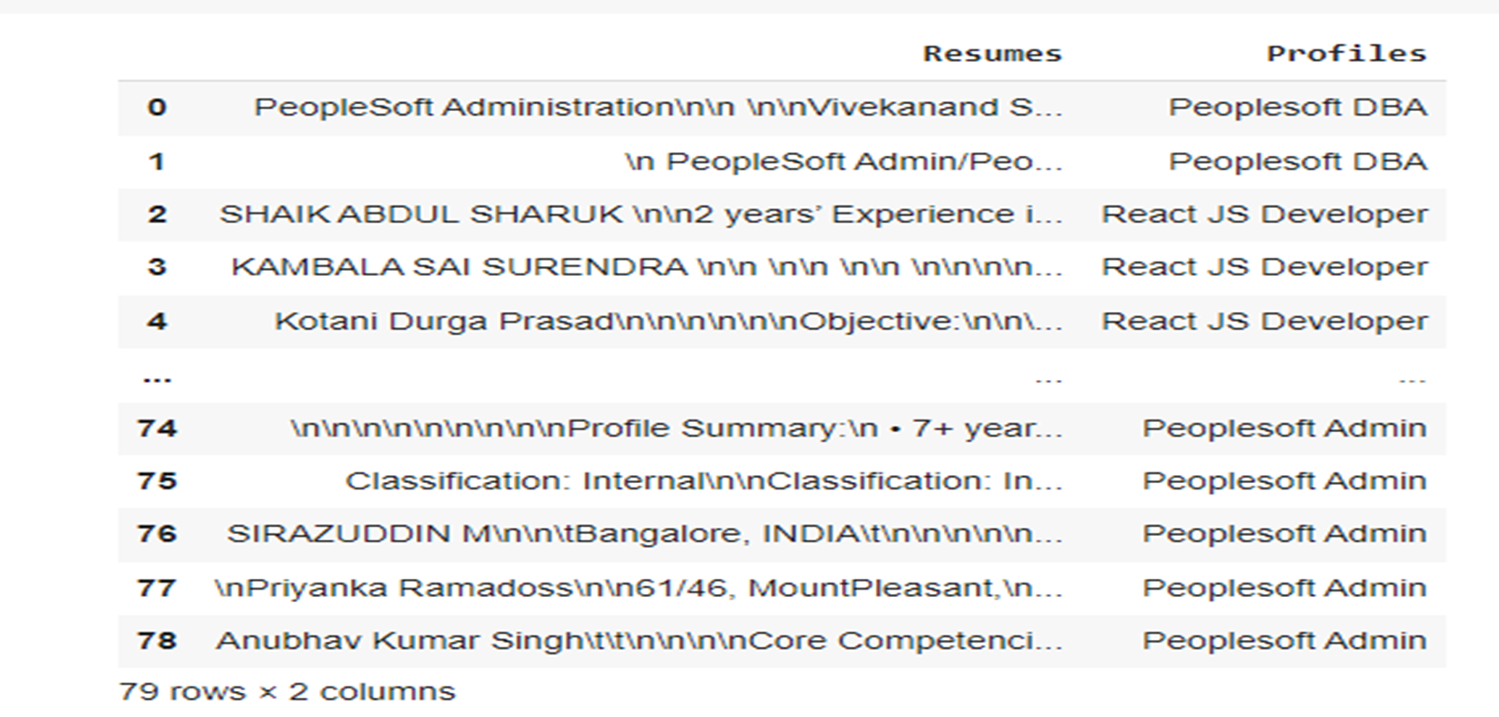
Converting text to .csv (Process)

Slide 7
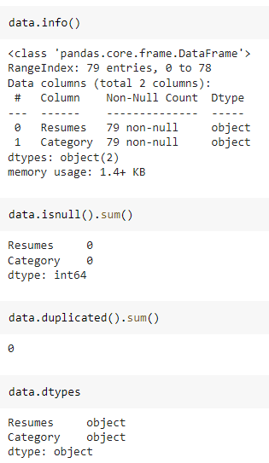
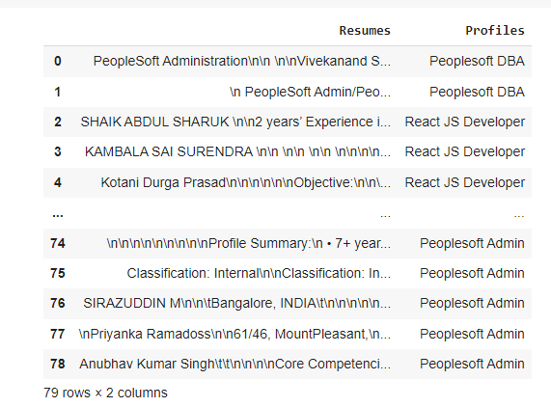
Data Set Details
After Extracting and Modifying the Dataset, given data contains a total of 4 Classes and 79 rows .

Slide 8
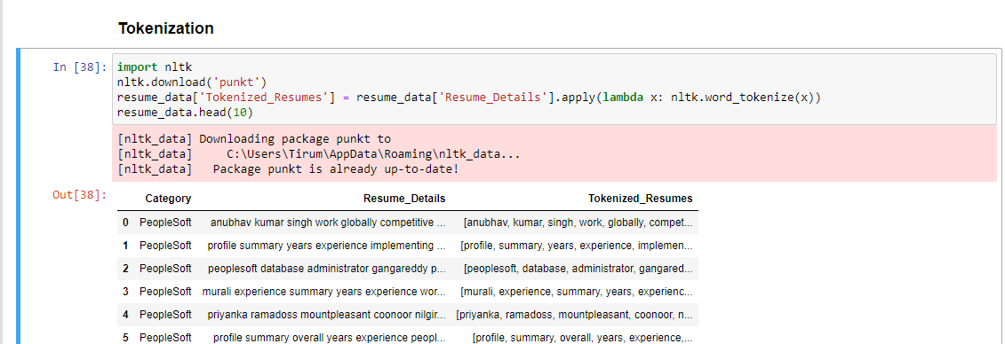
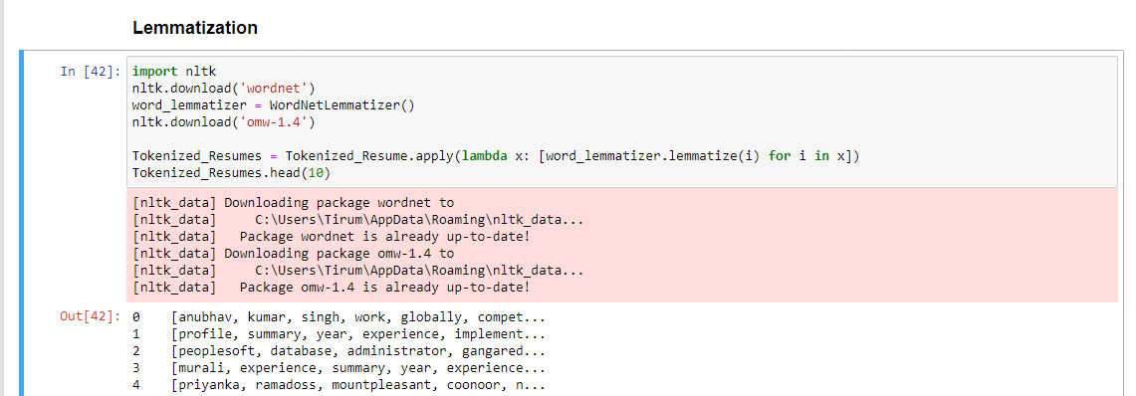
Text – Preprocessing
Clean Text from Resume

Slide 9
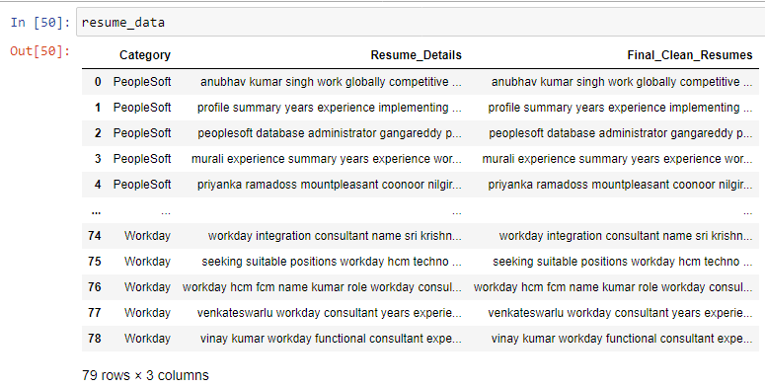
Text – Preprocessing
After Text – Preprocessing
In natural language processing, text preprocessing is the practice of cleaning and preparing text data. NLTK and re are common Python libraries used to handle many text preprocessing tasks.
The Dataset contains 79 rows and 3 Column
There are total four Classes – Peoplesoft, Workday, React JS Developer and SQL Developer.

Slide 10
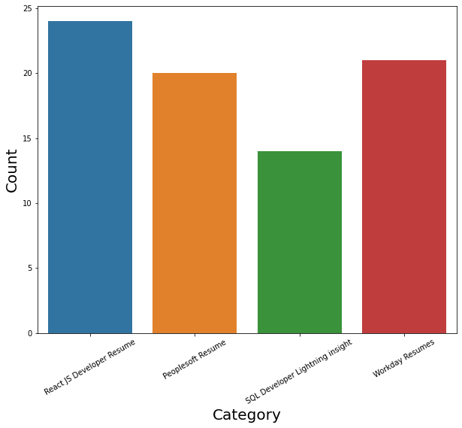
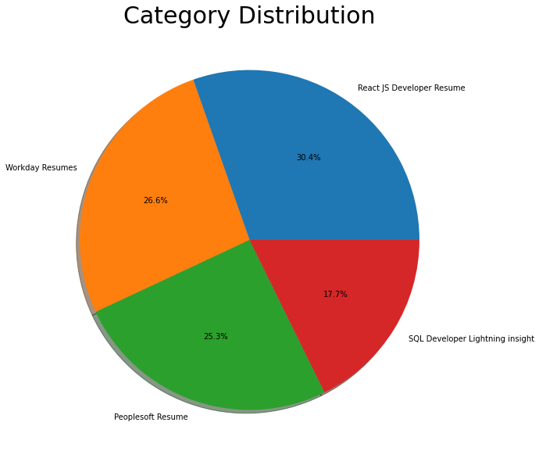
Labels
By using Histogram roles applied feature is displayed to check the job types.
By using Pie chart roles applied feature is displayed to visualize the job roles.

Slide 11
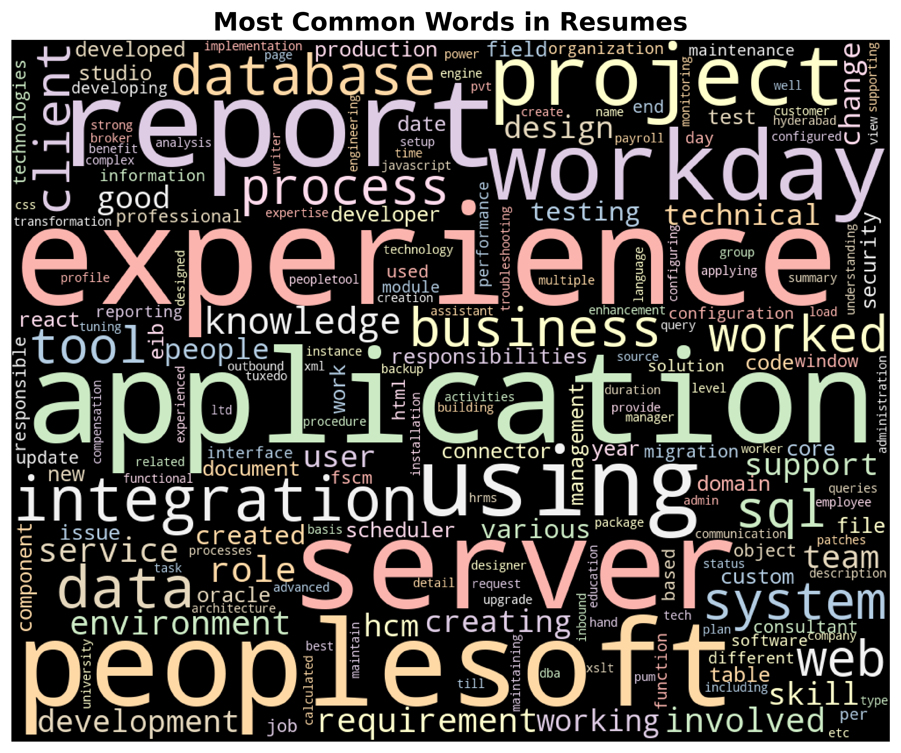
Word cloud

Slide 12
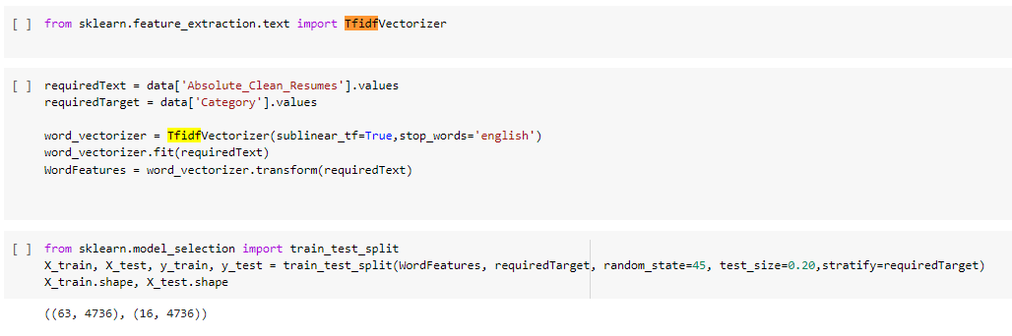
TF-IDF
TF-IDF is better than Count Vectorizers because it not only focuses on the frequency of words present in the corpus but also provides the importance of the words.
We can then remove the words that are less important for analysis, hence making the model building less complex by reducing the input dimensions.

Slide 13
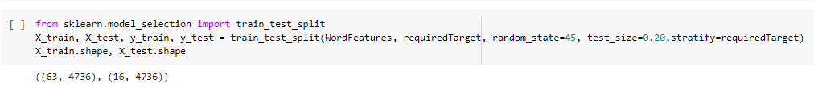
Train-Test Split
The train-test split is crucial for accurately evaluating machine learning models. Typically, data is divided into 80% for training and 20% for testing, with metrics like accuracy used to measure performance. Techniques like cross-validation help validate models and avoid overfitting. Visualizing this split is key to understanding how models are trained and evaluated.

Slide 14
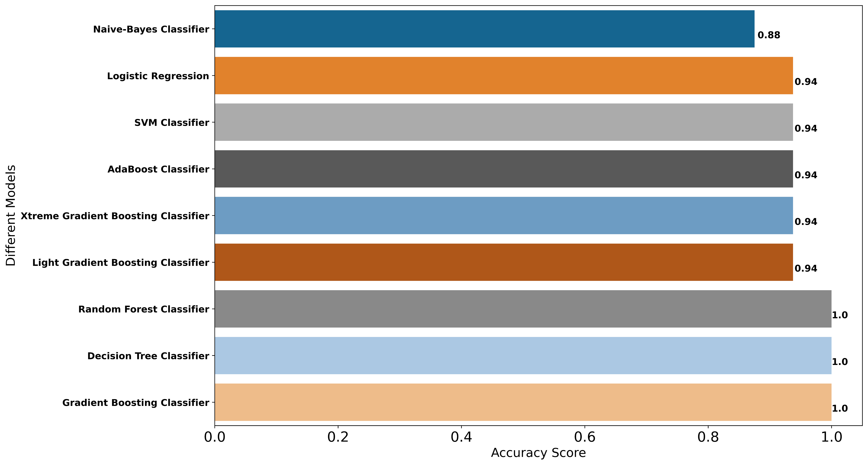
Model- Building
Accuracy on Testing Data

Slide 15
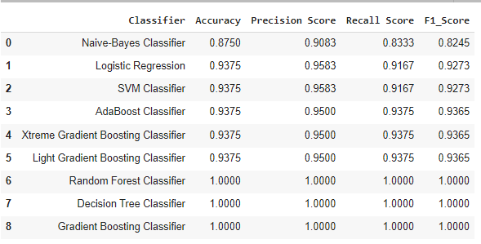
Model- Evaluation
Metrics on Testing Data
Here, we have taken Model building algorithms such as Decision Tree Classifier, Logistic Regression, SVM, Random , Forest, etc.
Among these algorithms, 100% Accuracy, Precision, Recall and F1-score have been achieved.
100% accuracy is achieved by using the model Random Forest, Decision Tree and Gradient Boosting Classifier.

Slide 16
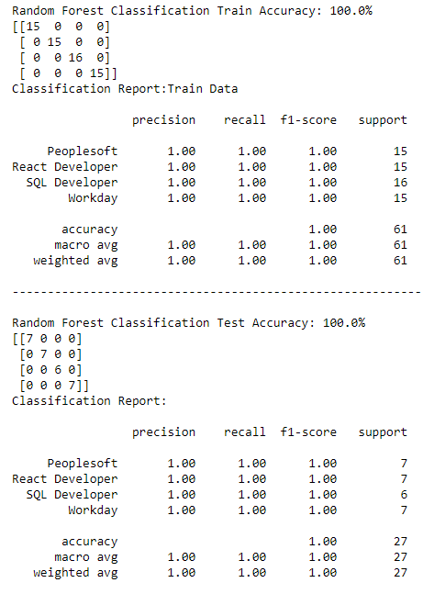
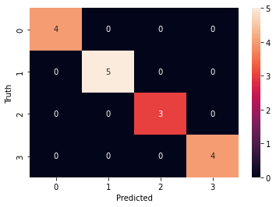
Model-Evaluation Report
Random Forest Classification
Here, we have taken Random Forest Model.
100% Accuracy, Precision, Recall and F1-score have been achieved.
No overfitting or underfitting has been found. All classes are classified correctly and no misclassification.

Slide 17
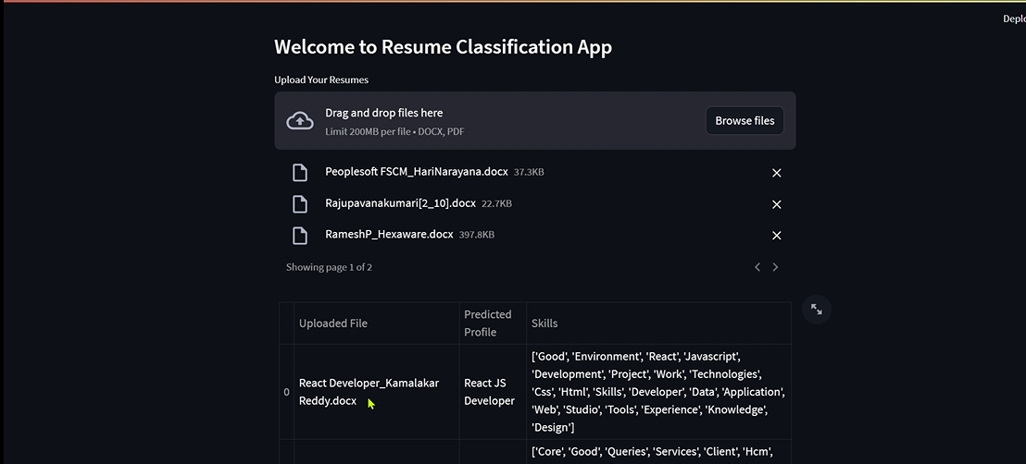
Deployment

Slide 18
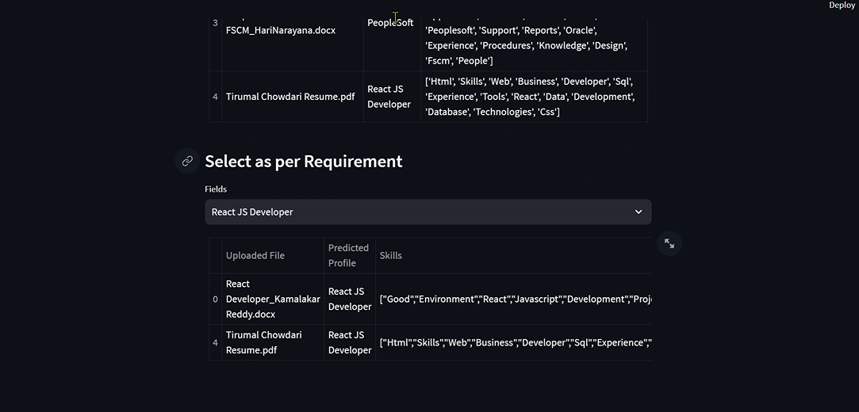
Deployment
Here, we have taken Random Forest as our Final Model algorithms for the deployment.
The algorithm has achieved 100% Accuracy, Precision, Recall and F1-score on testing data.
100% accuracy is achieved by using the model Random Forest no misclassification on validation set.
We have deployed the Resume Classification using Stream-lit as the platform

Slide 19
Thank you…

