Slide 1
Title:-Customer personality analysis
Group Members:
Ms. Farwa Rabbab
Mr. Mayuresh Gore
Mr. Allah Bakash
Mr. Adithyan K S

Slide 2
Customer Personality Analysis
This presentation provides an overview of the customer personality analysis process.

Slide 3
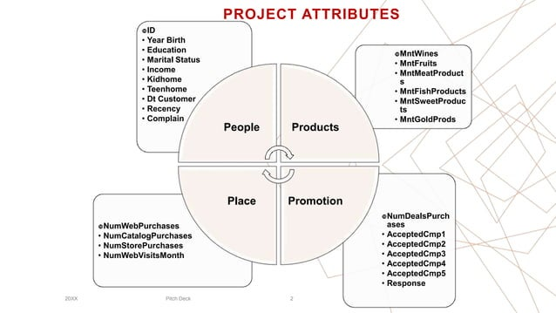

Slide 4
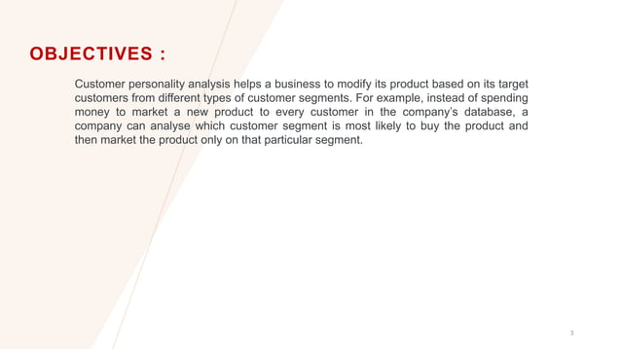

Slide 5
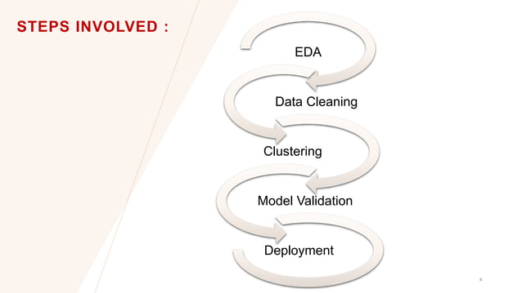

Slide 6
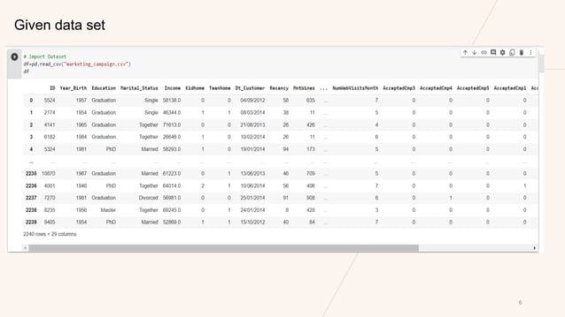

Slide 7
INTRODUCTION
This project aims to analyze customer behavior and preferences using a dataset from a marketing campaign. The dataset contains various customer attributes such as age, education, income, and spending habits on different products. By leveraging data science techniques, we intend to gain insights into customer segmentation, predict customer responses to marketing campaigns.

Slide 8
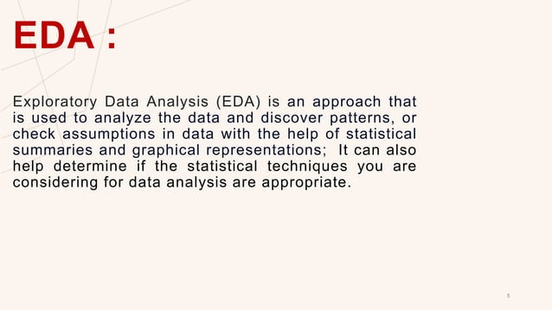

Slide 9
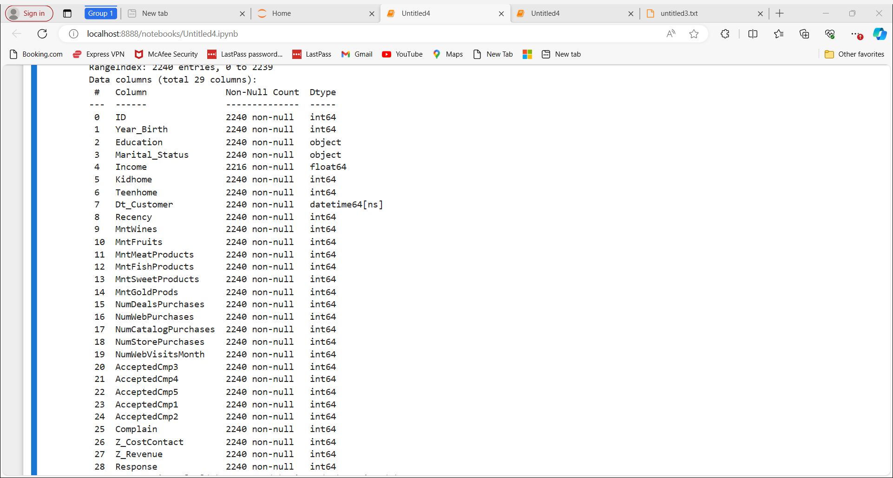

Slide 10
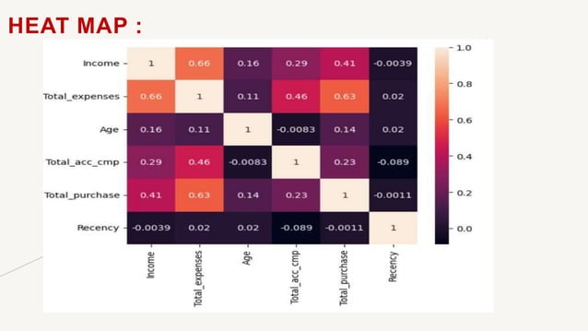

Slide 11
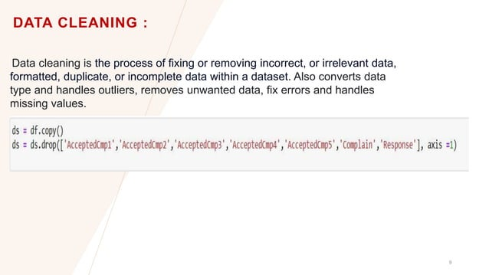

Slide 12
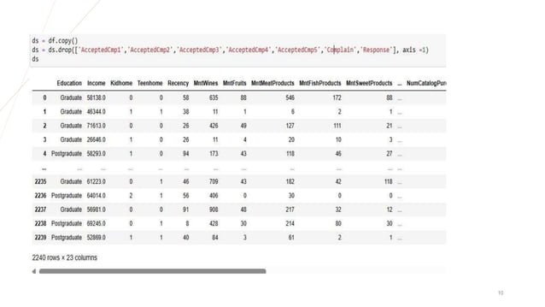

Slide 13

Customer Segmentation
Identifying different customer segments helps in targeted marketing strategies
Segmenting customers based on personality traits can provide valuable insights
Demographic segmentation is not enough, as personality plays a significant role in buying decisions

Slide 14
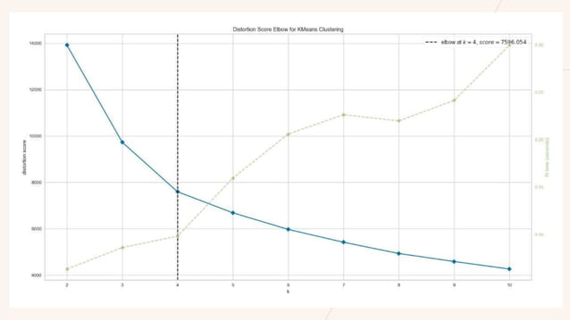

Slide 15
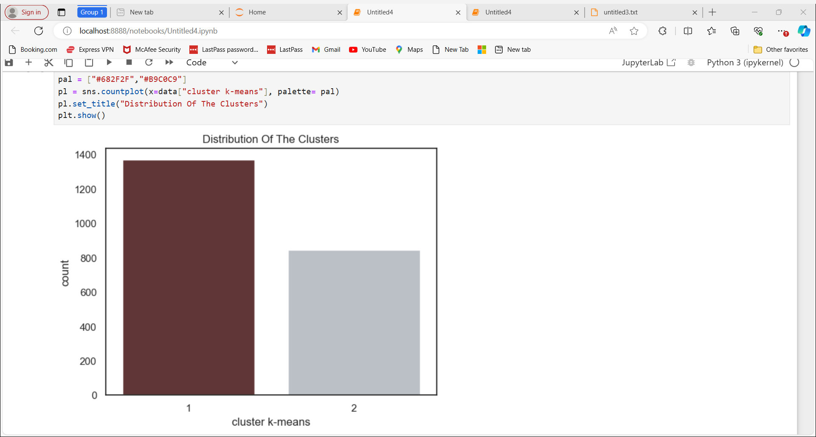

Slide 16
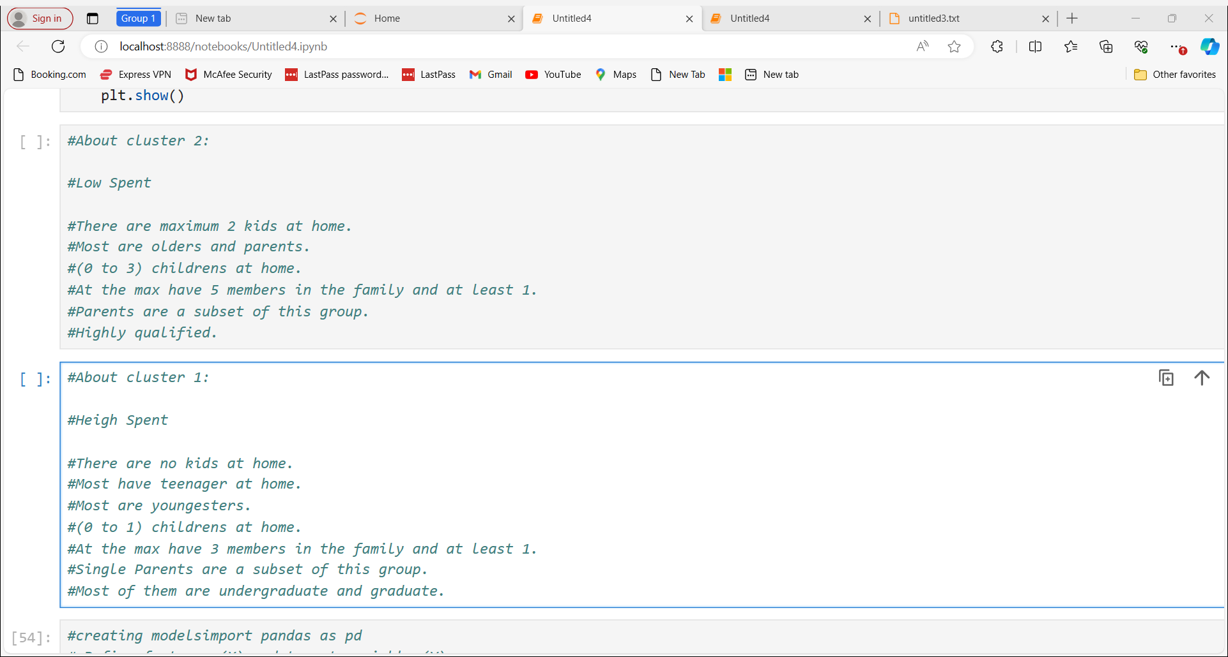

Slide 17
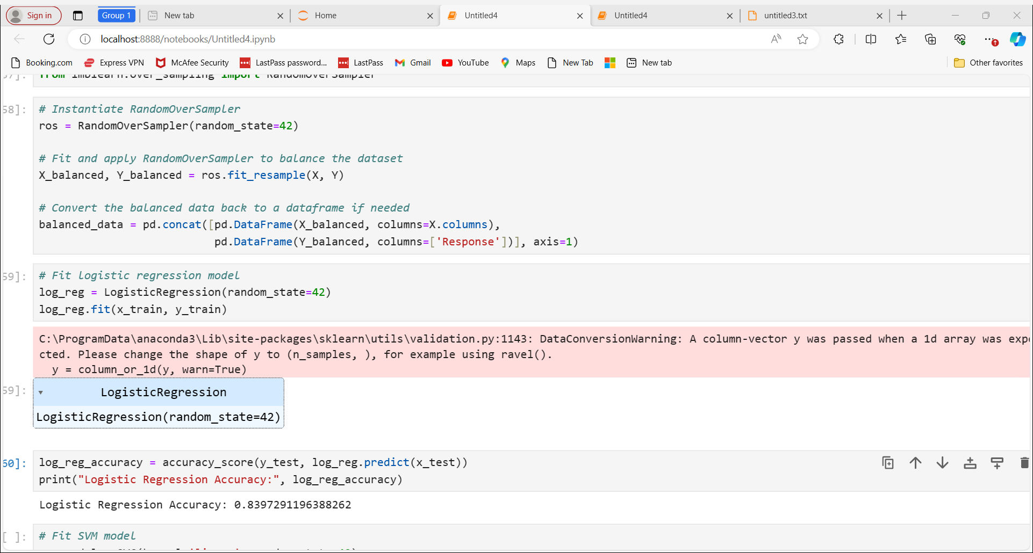

Slide 18
After the model validation,based on the accuracy scores comparing with the other models. Random forest is the better model hence it is used in the following deployment

Slide 19
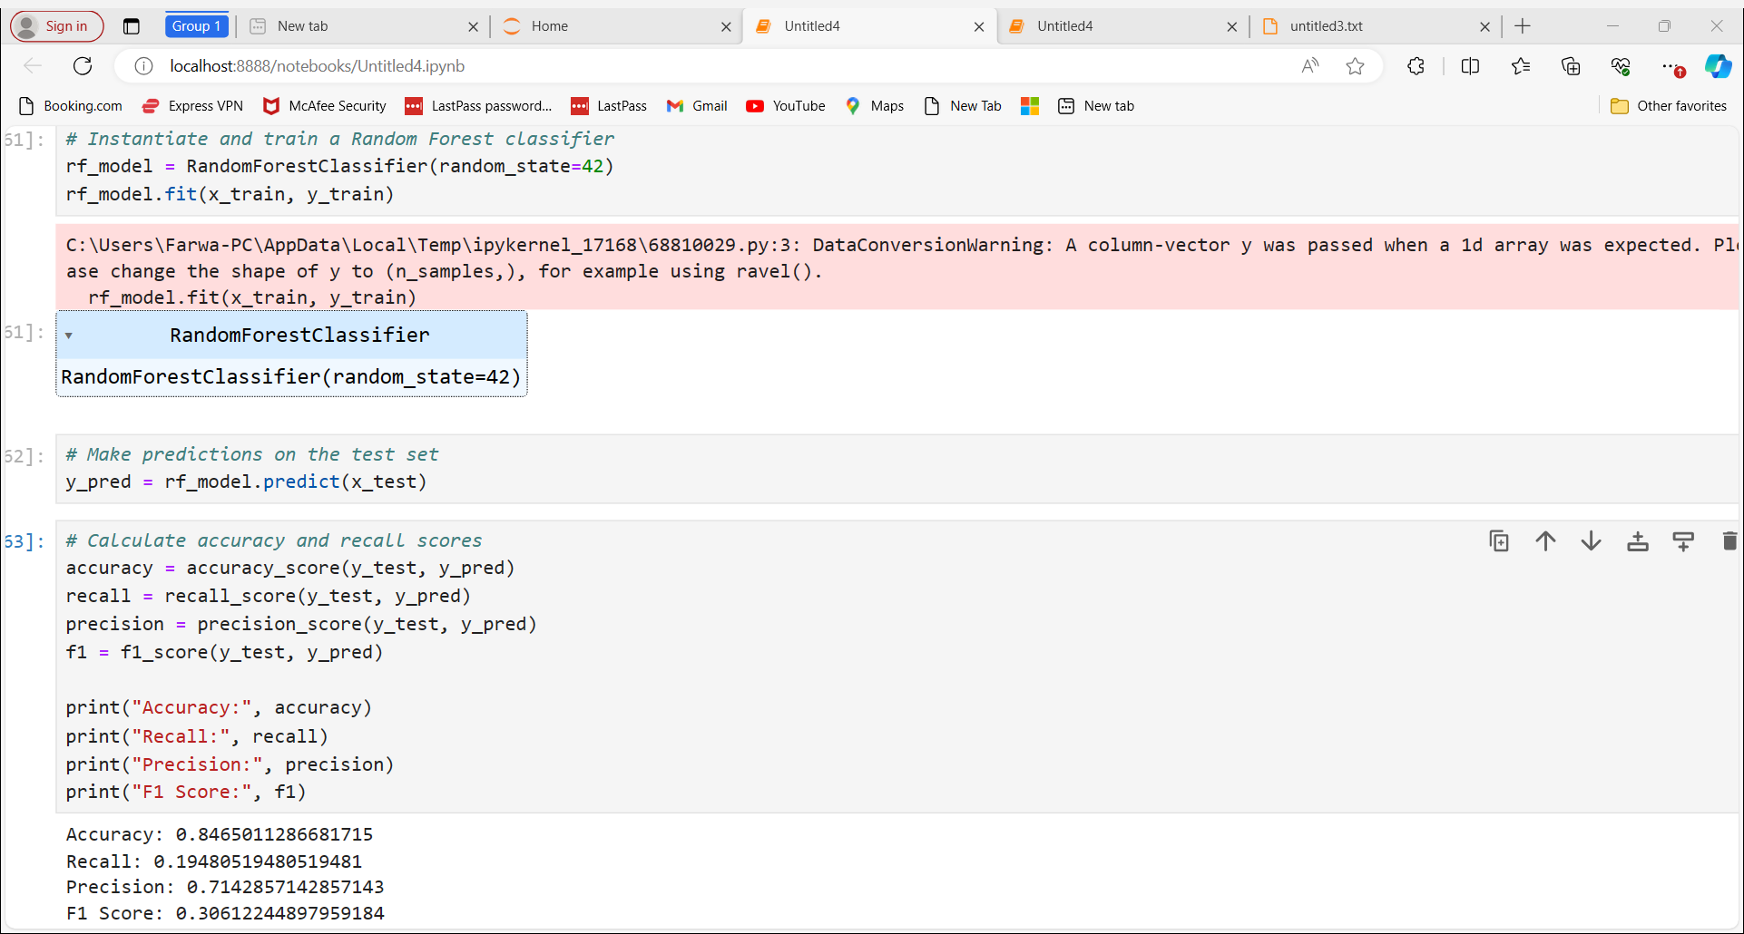

Slide 20
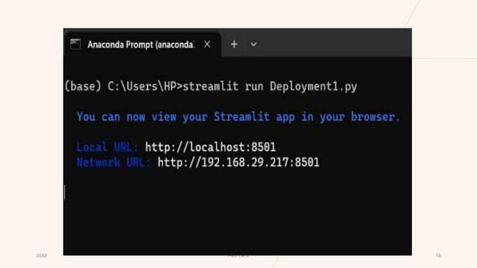

Slide 21
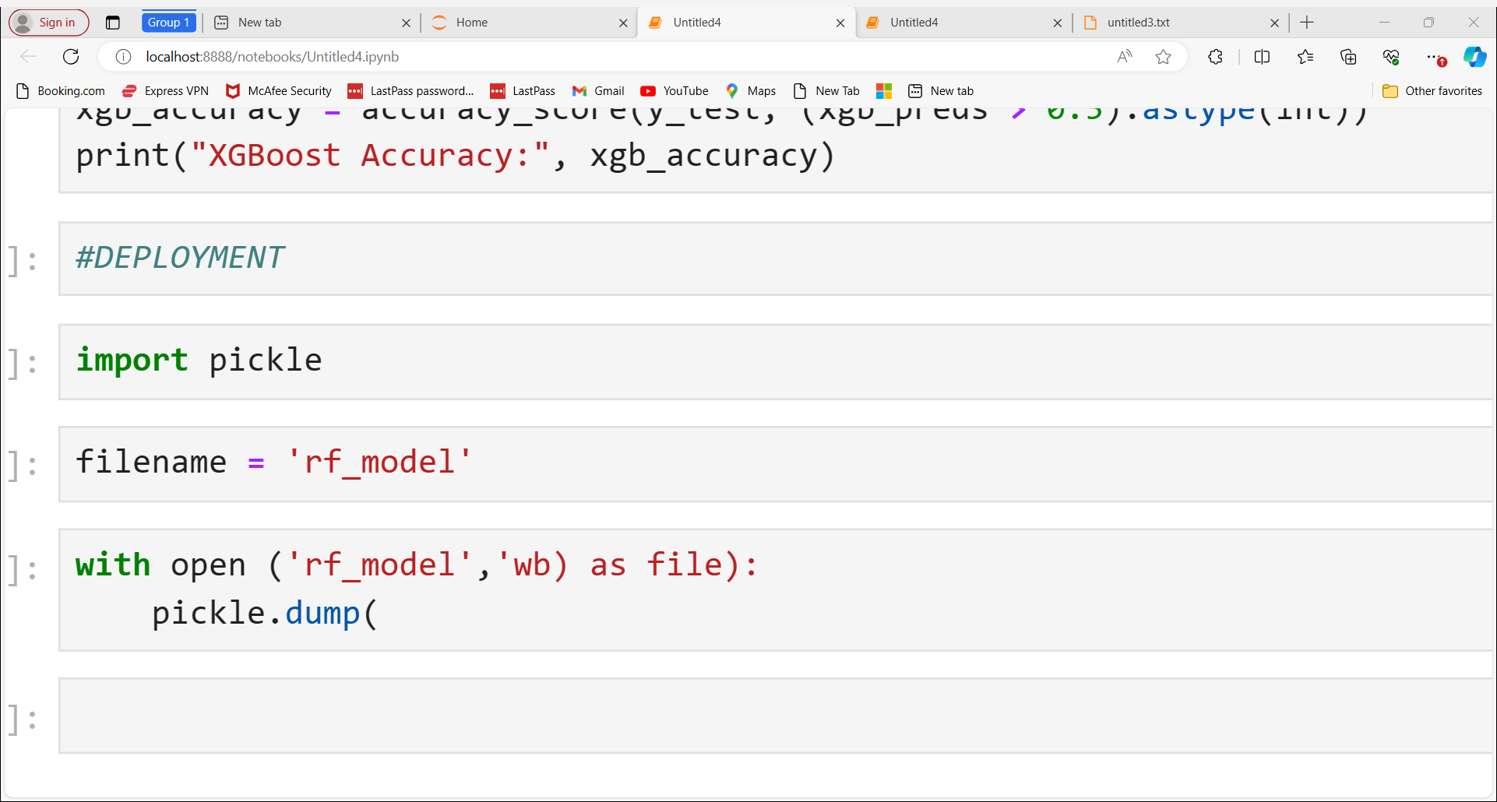

Slide 22
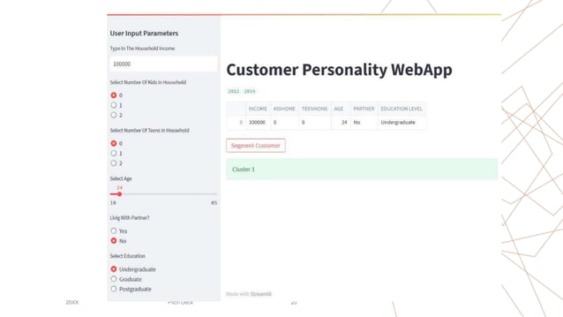

Slide 23
Conclusion
Encouraging businesses to explore this strategic approach
Recap of the importance of customer personality analysis
Highlighting the benefits and challenges

Slide 24

Thank you. Please feel free to ask any questions. 😄

