Slide 1

PRODUCT REVIEW ANALYSIS
PRESENTED BY:
Mahima Pednekar
Radheen
Nikhil Singh
Mayuresh Sarolkar
GUIDE:
Dr. Nidhi Chahal
DATE:
13/09/2022

Slide 2







01
INTRODUCTION
02
PROBLEM STATEMENT
DESCRIPTION OF THE DATASET
03
EXPLORATORY DATA ANALYSIS
04
CONTENTS
05
SENTIMENT ANALYSIS
06
SENTIMENT FORECASTING
07
CONCLUSION

Slide 3
INTRODUCTION:
Amazon Product reviews are often the deciding factor for many customers, thus it is very important to have a well-automated system for monitoring the entire review history of products to analyze tone, language, keywords and trends over time to provide valuable insights that increase the success rate of existing and new products and marketing campaigns.
PROBLEM STATEMENT:
The traditional manual process of Amazon product reviews is time-consuming and inefficient when millions of reviews are being posted all the time. It doesn’t show any trend or patterns over time. Moreover, it is tough to understand customers’ sentiment towards any product or its delivery.
TASKS INVOLVED:
To classify a review into a particular category(positive, negative, neutral etc.) based on ‘review’ and ‘summary’ columns.
To identify the names of few products by analyzing the input text data.
To predict future data trends i.e. how the sentiments of reviewers change with time.
To find any relations/buying trends of customers.
BUSINESS GOALS:
Increase the sales and customer satisfaction.

Slide 4
DESCRIPTION OF THE DATASET
DATA SOURCE:
The datasets chosen for the project are taken from Amazon review data (ucsd.edu).
From the above dataset link, 2 categories were chosen:
a) Grocery and Gourmet Food.
b) Home and Kitchen.
Data Format : JSON
Attributes : "reviewerID“: the id of the reviewer
"asin“: amazon product ID
"reviewerName“: name of the reviewer
"helpful“: the no. of times the review was thought to be helpful
"reviewText" - the content of the review
"overall" - the product rating (from 1 to 5)
"summary" - title of the review
"unixReviewTime" - the time of the review in UNIX format
"reviewTime" - the time of the review
TOOLS USED: Jupyter Notebook, Google Colab, Tableau

Slide 5
Project analysis slide 3
PROJECT FLOW
PROBLEM STATEMENT
DATA UNDERSTANDING & PREPROCESSING
EDA
SENTIMENT
ANALYSIS
SENTIMENT FORECASTING
Performing EDA to get insights & forming story on basis of visuals which can be helpful to increase the sales of the new products.
Analyzing sentiments of the customer reviews by analyzing the review texts, finding product names based on reviews and finding any relation/buying trends of customers.
With the help of time-series analysis, predicting future data trends i.e. how the sentiments of customers change with time.
Understanding the Problem statements to meet the business objective.
Forming data dictionary to understand the features, dataset & dealing with null/missing values.

Slide 6

EXPLORATORY DATA ANALYSIS
Year wise average helpful rate
Year wise review count
Top Reviewers based on review counts
Donut chart based on ratings
Month wise review count
Ratings wise helpful rate ratio
Top products based on review count
Tableau Link for EDA: https://public.tableau.com/app/profile/mayuresh.sadu.sarolkar/viz/Amazonreviewanalysis_review_new/Dashboard2?publish=yes

Slide 7
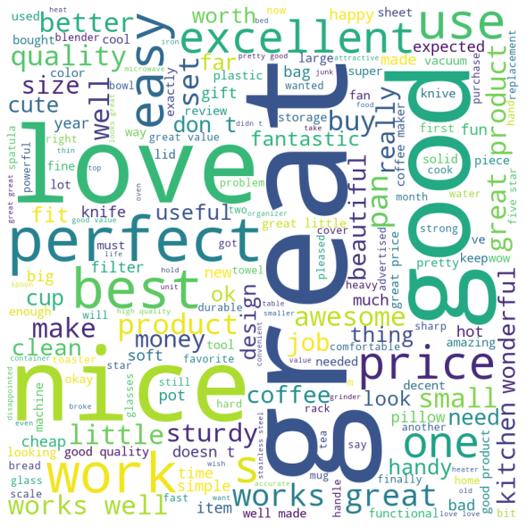
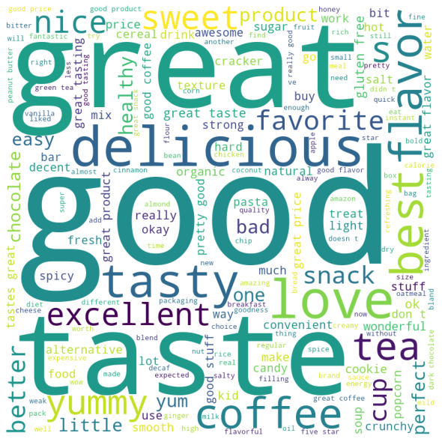
WORD CLOUD
HOME AND KITCHEN
CATEGORY
GROCERY AND GOURMET FOOD CATEGORY

Slide 8

SENTIMENT ANALYSIS
MODEL USED: "nlptown/bert-base-multilingual-uncased-sentiment" (Bidirectional Encoder Representations from Transformers)

Slide 9
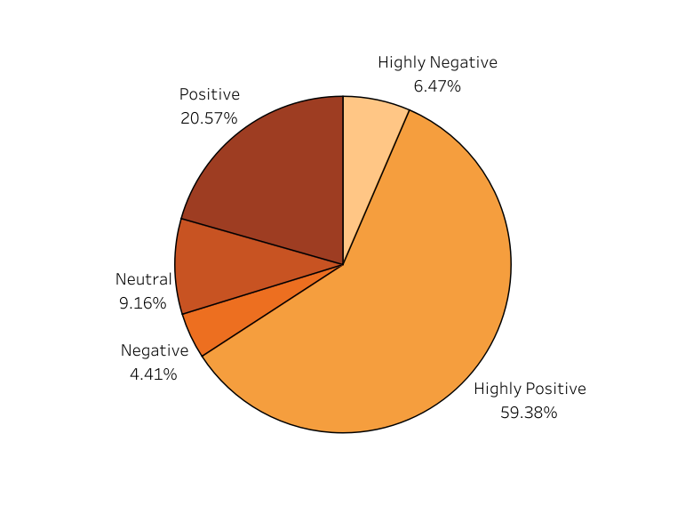
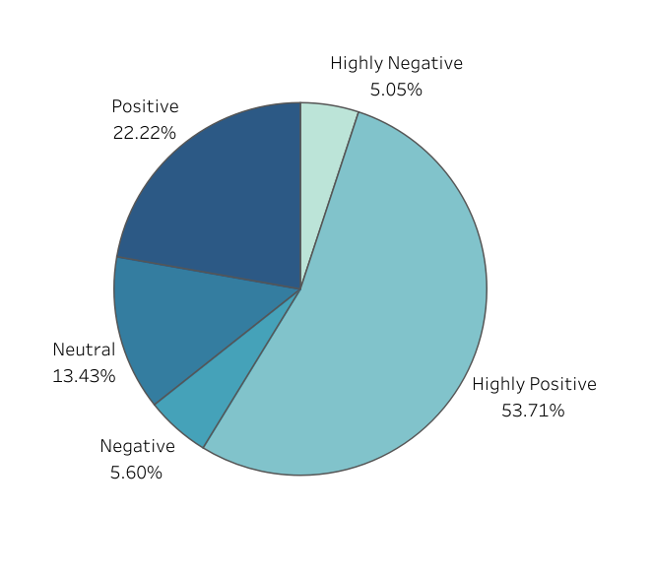
PROPORTION OF SENTIMENTS HOME AND KITCHEN & GROCERY AND GOURMET FOOD
Majority of the reviews are Highly Positive.
Lowest percentage of reviews are ‘Negative’ for ‘Home and kitchen’ and ‘Highly Negative’ for ‘Grocery and Gourmet Food’ category.
This also means that most of the reviewers are satisfied with their products and its quality.

Slide 10
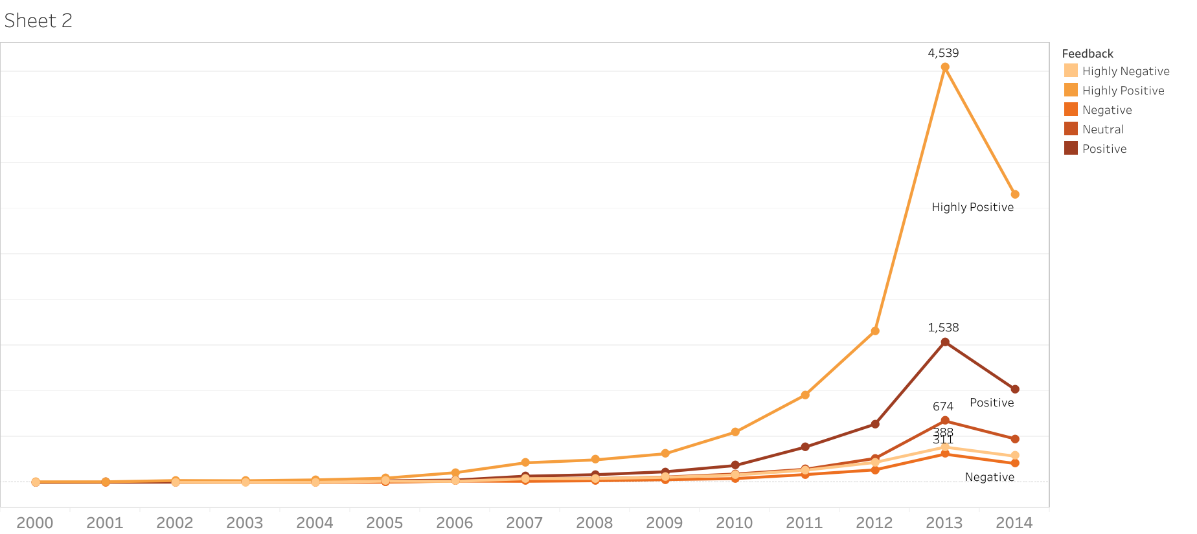
YEARLY TREND OF SENTIMENTS HOME AND KITCHEN
A positive trend is seen in the no. of reviews over the period.
A sudden increase is seen in the number of reviews from 2011-2013, indicating a sudden increase in sales of products in the particular period.
A significant change can be seen in the count of reviews for different sentiments after 2009.

Slide 11
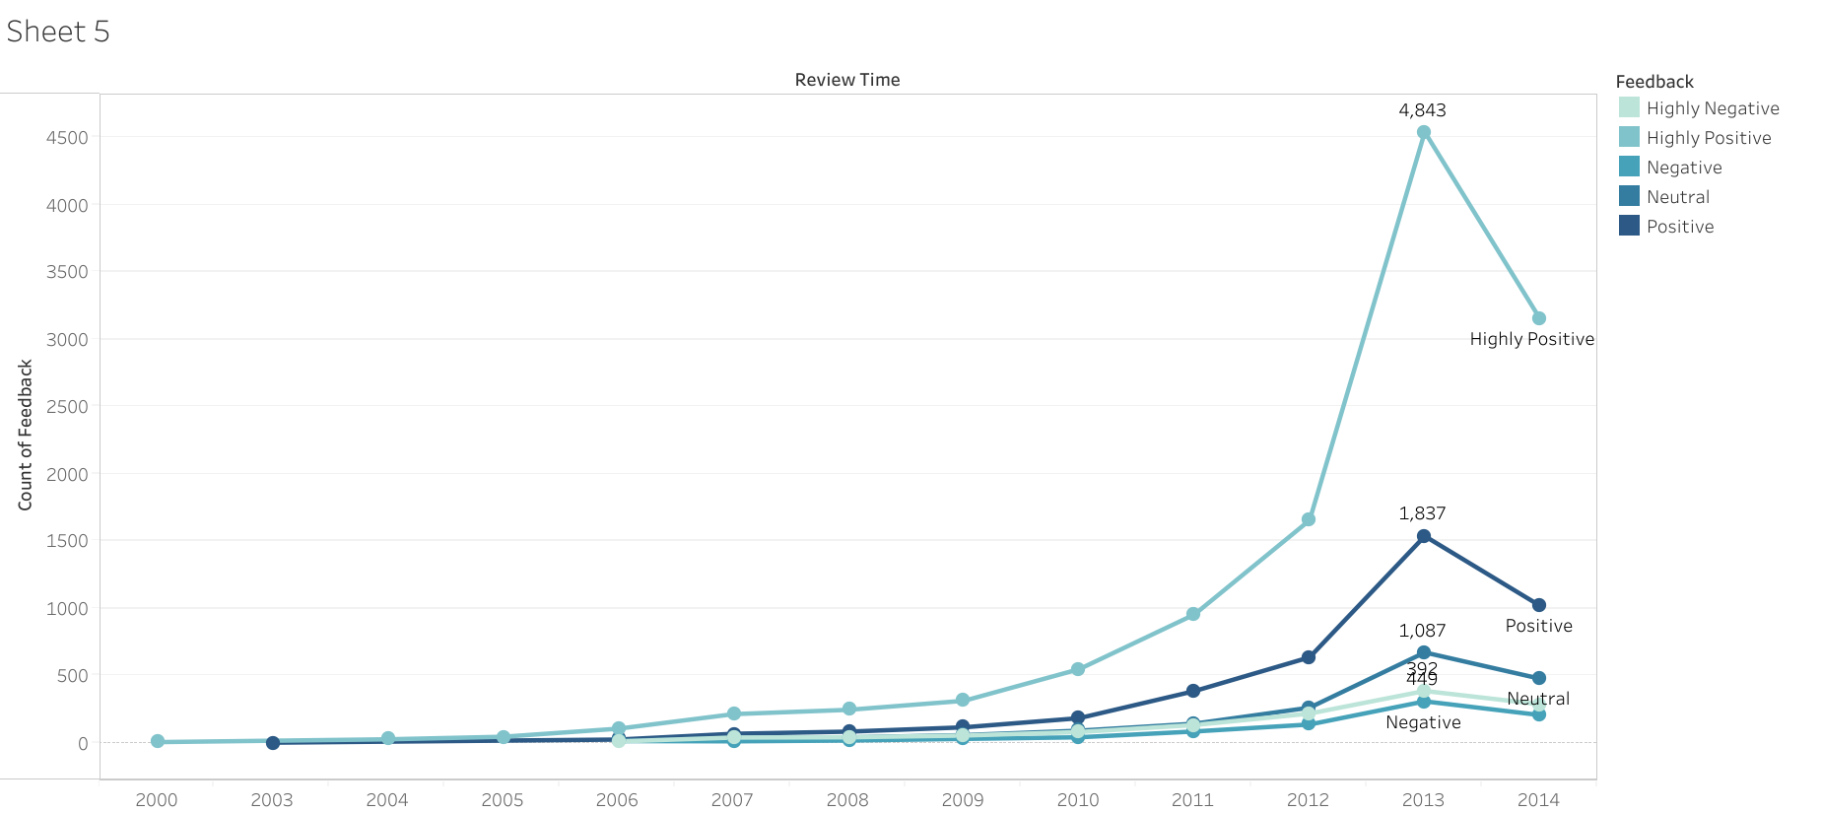
YEARLY TREND OF SENTIMENTS GROCERY AND GOURMET FOOD
For Home and Kitchen category an sudden increase in sales can be seen between years 2012-2013.
It shows that in this period, people started preferring amazon for groceries too.
The graph shows a downward trend in number of reviews in the year 2014, i.e. the reviews decreased in 2014 compared to the previous year.

Slide 12
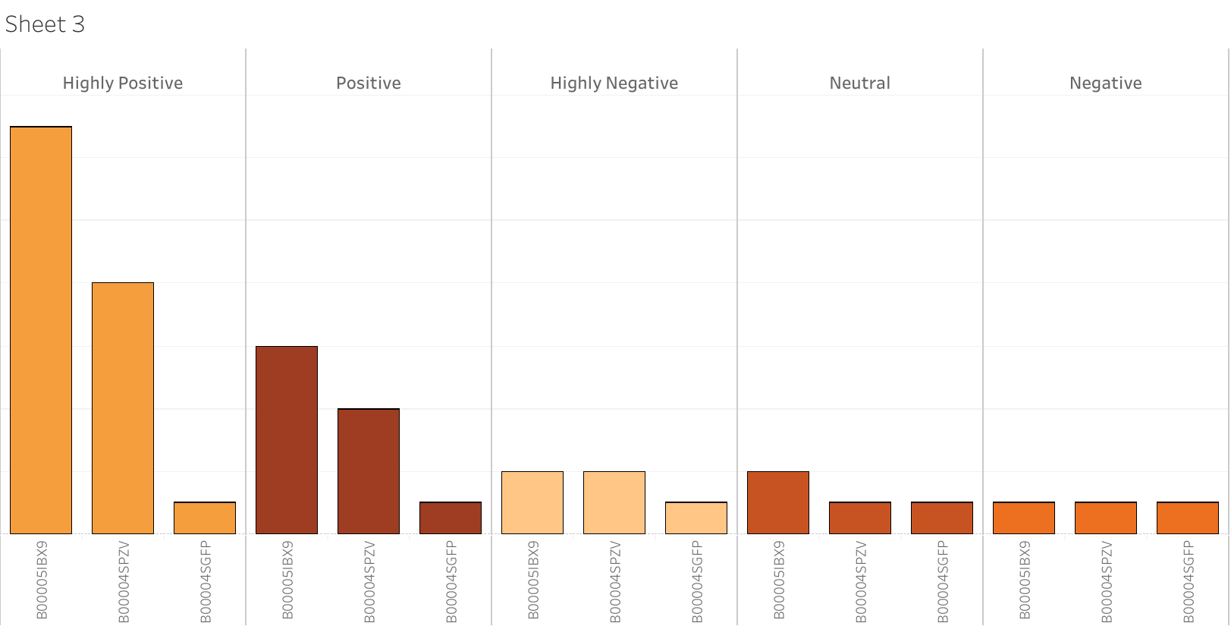
TOP - 3 PRODUCTS WITH MAXIMUM REVIEWS SENTIMENTWISE HOME AND KITCHEN CATEGORY

Slide 13
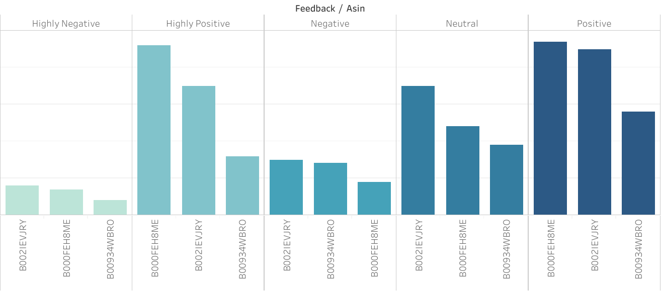
TOP - 3 PRODUCTS WITH MAXIMUM REVIEWS SENTIMENTWISE GROCERY AND GOURMET FOOD CATEGORY

Slide 14
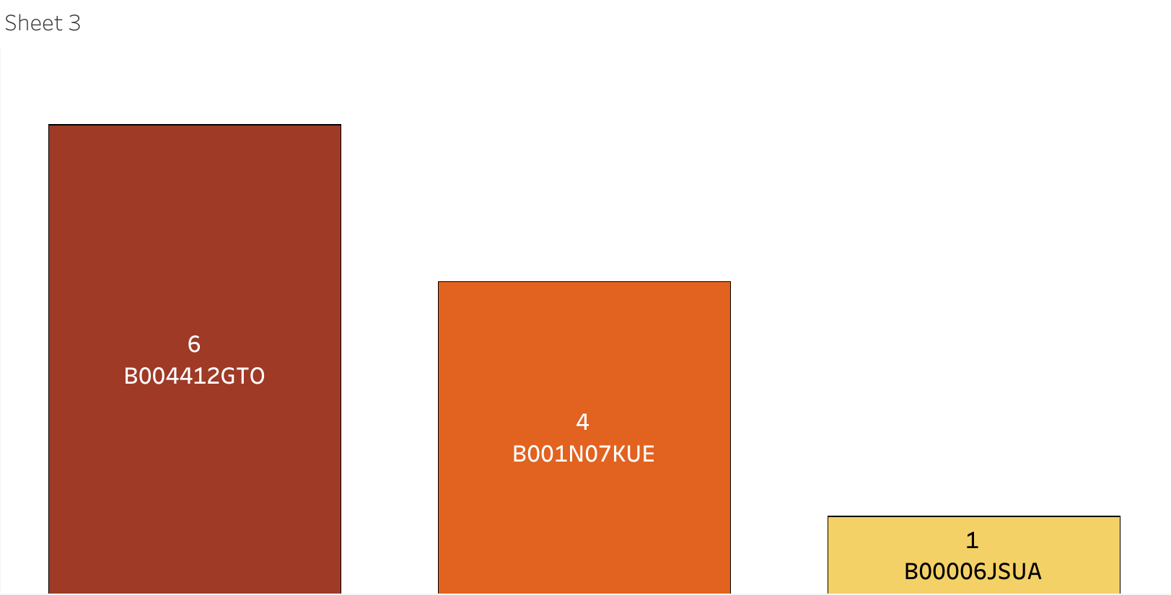
TOP 3 PRODUCTS WITH MOST NEGATIVE REVIEWS HOME AND KITCHEN CATEGORY
Most common Reviews of the Customers
Bad Design and Cheap Quality of the material used.
No sharp cutting edge.
Better Materials can be used for better build quality.
Not Portable.
Difficult to use.
Not the easiest to operate.
Product on Top:
B004412GTO
(CAST IRON UTENSIL)

Slide 15
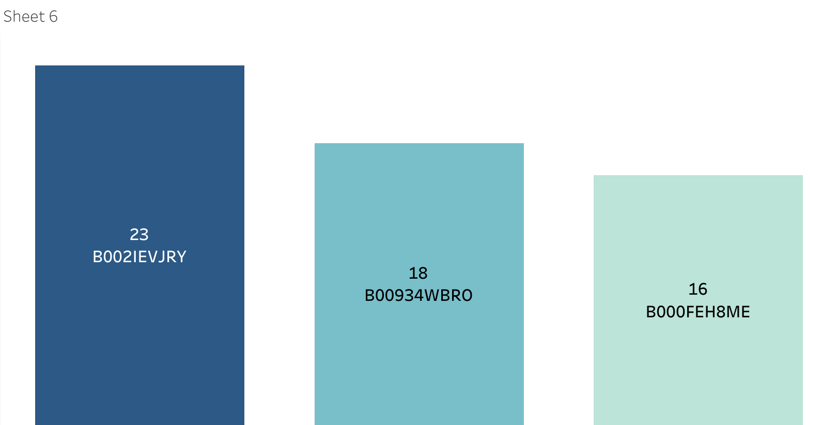
TOP PRODUCTS WITH MOST NEGATIVE REVIEWS GROCERY AND GOURMET FOOD CATEGORY
Most common Reviews of the Customers
Texture and taste is bad.
Genuinity issues and Shipment damage issues.
Quality of goods are not as mentioned.
Product ON TOP: B002IEVJRY
(COFFEE)

Slide 16
PRODUCT IDENTIFIED FROM THE INPUT REVIEW TEXT
S.NO | PRODUCT_ID | REVIEW_TEXT | PRODUCT
1 | B006GPX7VM | i decided to purchase this product after readi... | ritz royale collection
2 | B005BFZ5N6 | we ve been using this microwave only for a cou... | panasonic nn-sd681s
3 | B004M5KYM8 | though i haven t use them yet seeing how chris... | ateco
4 | B007A57IUI | i received these fans last week and found the ... | seville
5 | B000679FZ8 | i made linguini and ravioli prior to purchasing... | w motor
6 | B002S4SW6K | we have a b b and use this comforter in one of... | royal hotel
7 | B00697QA48 | so cute this was the perfect addition to the o... | kikkerland
8 | B000X8VBWU | very easy to use i find it very easy to clean ... | sanyo ecj-hc55s cup
9 | B000ND1WMO | these are great nonstick pans i use the larger... | pan set
10 | B002AHDVYS | i have to say i always love scanning the spect... | vkp1055
Mostly Utensils, Knives and Electric fans found to have Positive Reviews in Home & Kitchen Category.
Products like Chocolate Brownies also receive positive reviews than the products like Coffee and Organic snacks in Grocery and Gourmet food category.
Vegetable cutters, cast iron utensils which receive most number of negative Reviews due to Quality reasons.

Slide 17
RELATIONSHIP BETWEEN HOME & KITCHEN AND GROCERY AND GOURMET FOOD CATEGORIES
S.No | Reviewer_ID | Product_ID_Home & Kitchen | Product_ID_Grocery & Gourmet Food | Review_Time_Home & Kitchen | Review_Time_Grocery & Gourmet Food
1 | A3TB9HNQR54B5V | B00004S9GX | B000FEH8ME | 2000-10-23 | 2010-05-14
2 | A3TB9HNQR54B5V | B00004S9GX | B003JA5KBW | 2000-10-23 | 2011-05-12
3 | A3TB9HNQR54B5V | B00004S9GX | B006MONQMC | 2000-10-23 | 2012-04-30
4 | A3TB9HNQR54B5V | B00004S9GX | B004K00DGC | 2000-10-23 | 2013-01-23
5 | A3TB9HNQR54B5V | B00004S9GX | B000FEH8ME | 2000-10-23 | 2010-05-14
6 | A3TB9HNQR54B5V | B00004S9GX | B003JA5KBW | 2000-10-23 | 2011-05-12
7 | A3TB9HNQR54B5V | B00004S9GX | B006MONQMC | 2000-10-23 | 2012-04-30
8 | A3TB9HNQR54B5V | B00004S9GX | B004K00DGC | 2000-10-23 | 2013-01-23
9 | A3TB9HNQR54B5V | B008TV1OUW | B000FEH8ME | 2013-06-01 | 2010-05-14
10 | A3TB9HNQR54B5V | B008TV1OUW | B003JA5KBW | 2013-06-01 | 2011-05-12
On consideration of whole dataset for both category 9% of Reviewers have reviewed items from both Home & Kitchen and Grocery & Gourmet food Categories.

Slide 18
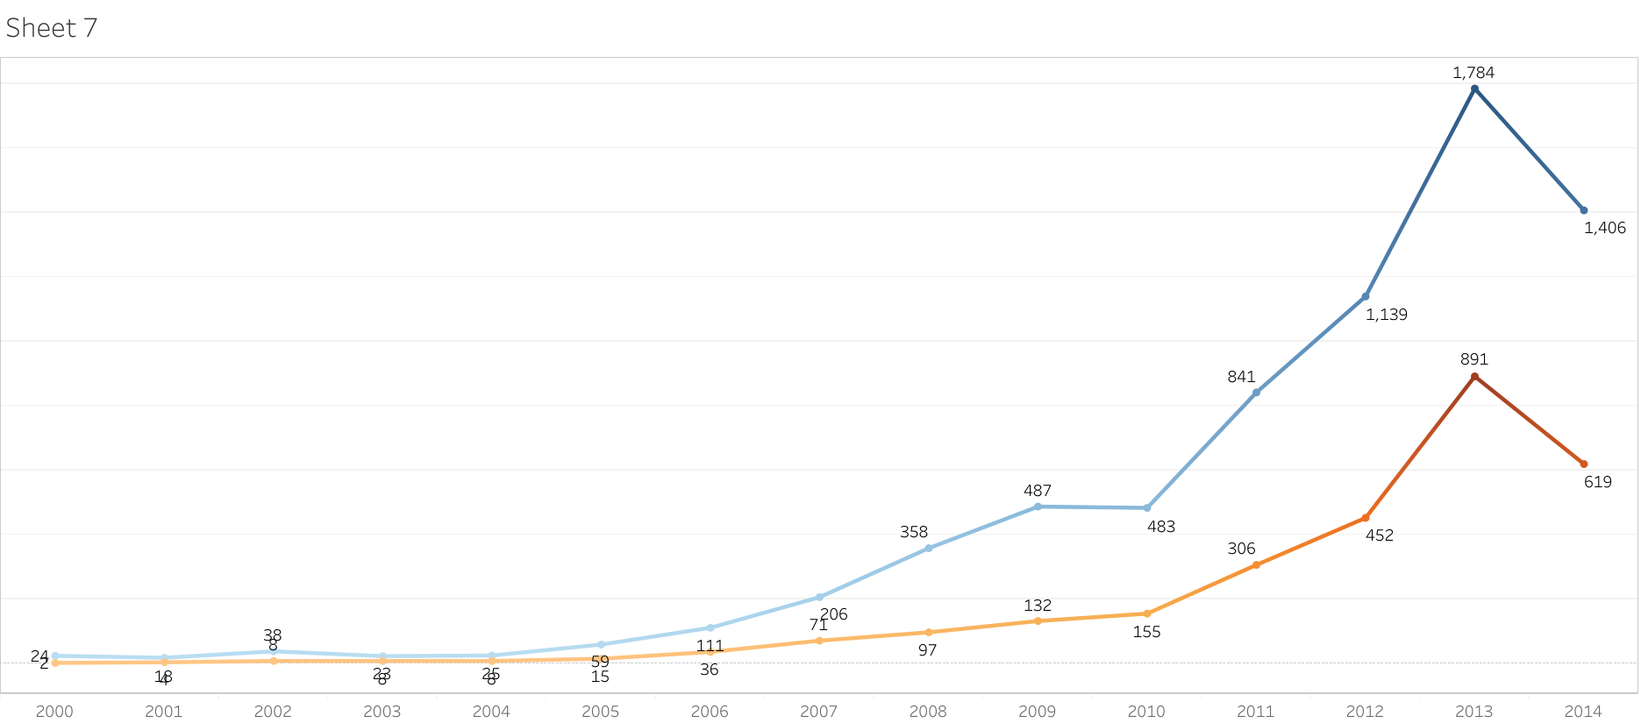
REVIEW COUNT FOR HOME & KITCHEN AND GROCERY & GOURMET FOOD
Home & Kitchen products have less reviews among the common Reviewers who reviewed products in both categories over the years.
And it shows Reviews were getting increased starting from the year 2004 for Grocery and Gourmet food

Slide 19
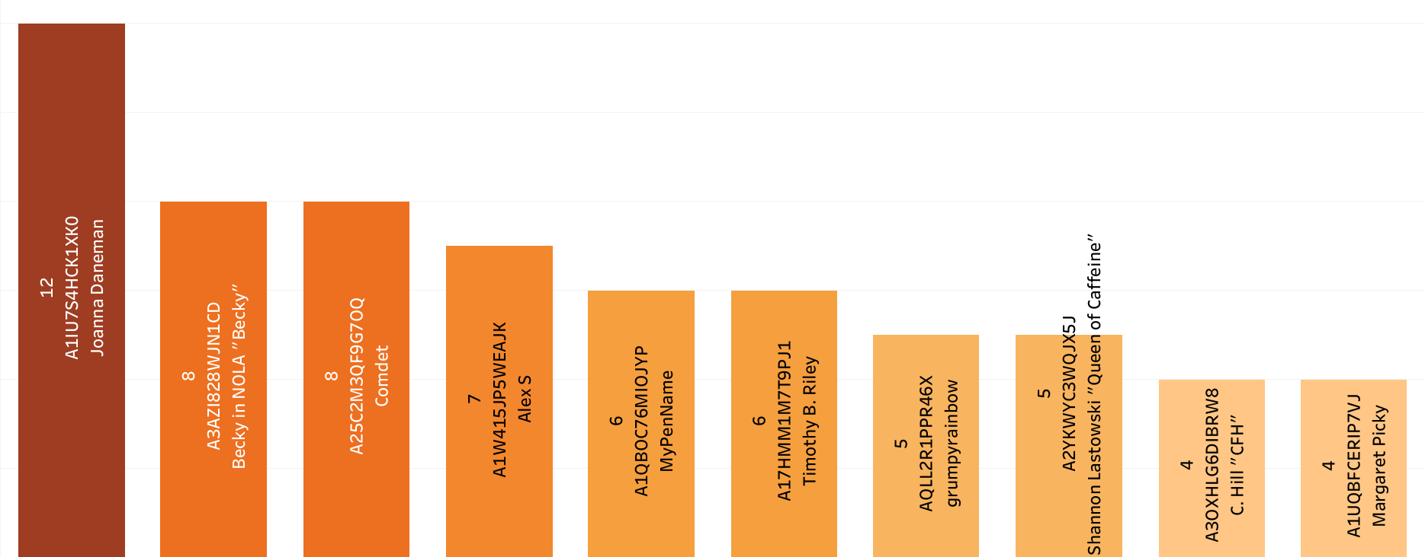
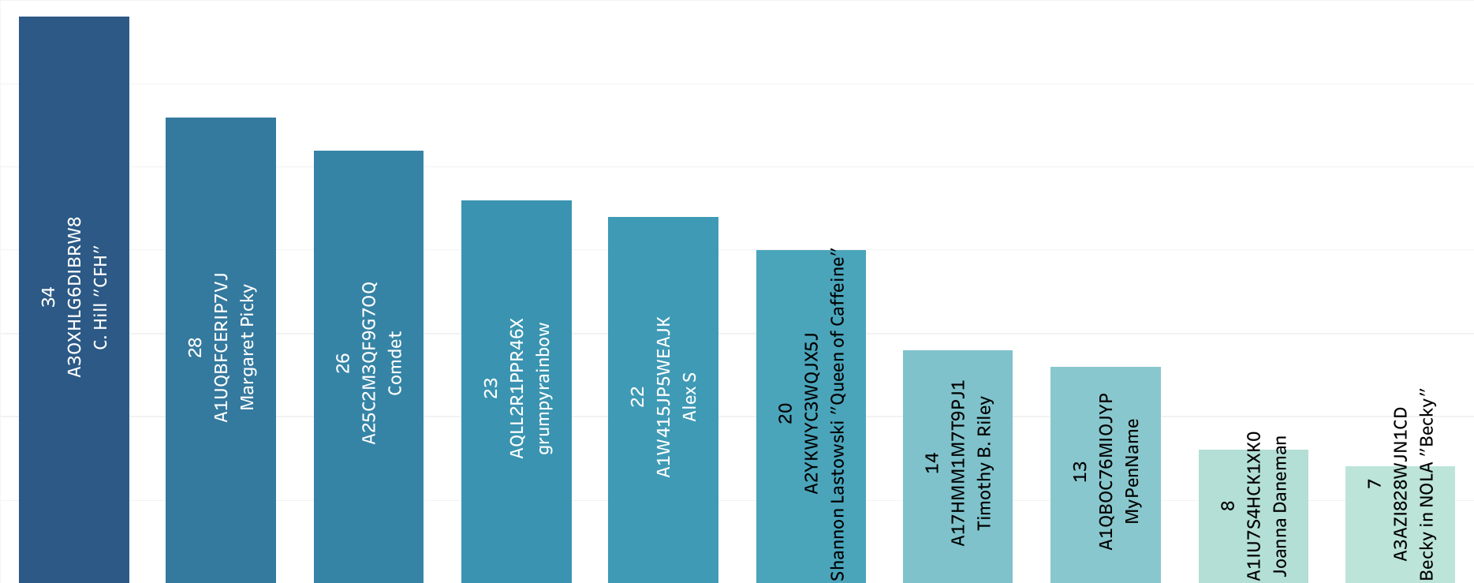
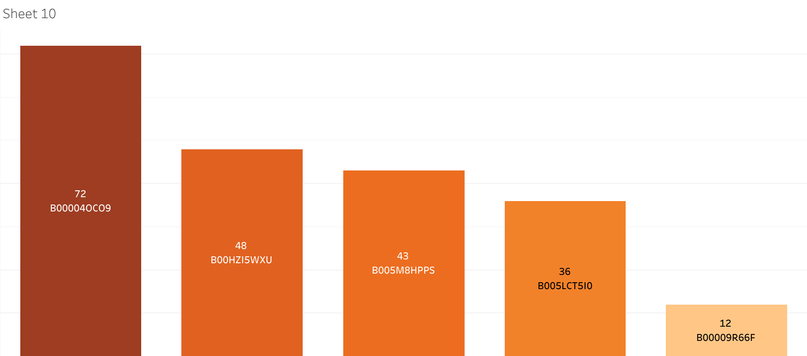
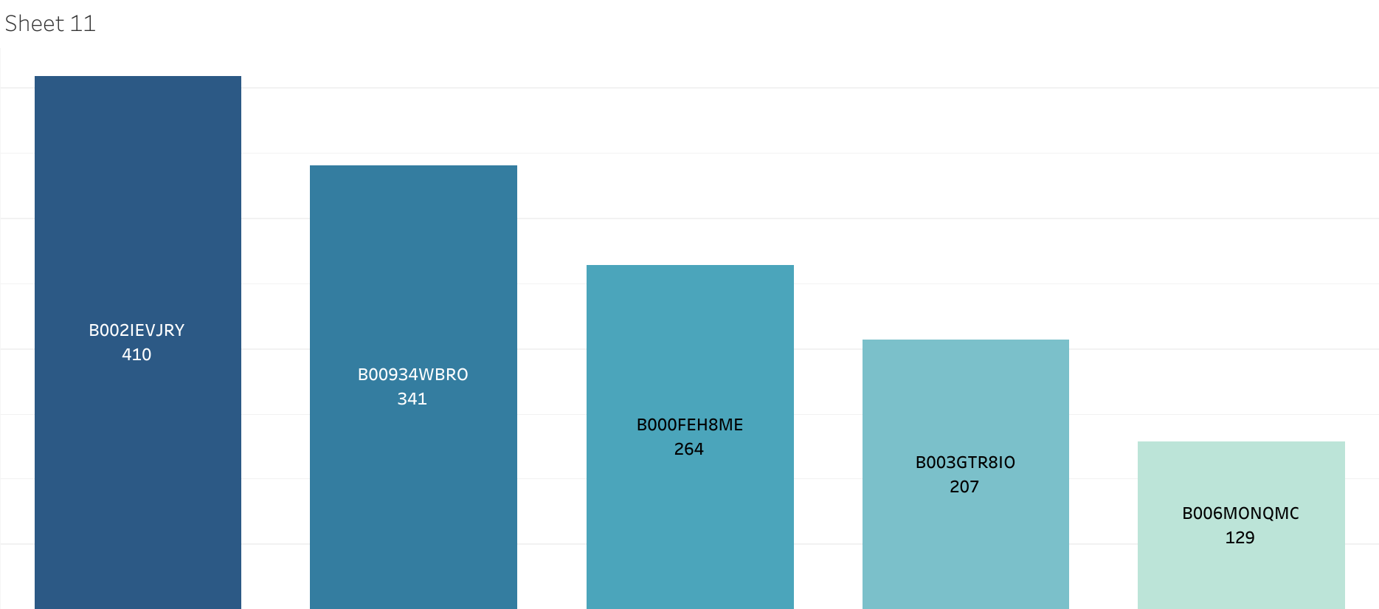
TOP REVIEWERS AND PRODUCTS FOR HOME & KITCHEN AND GROCERY & GOURMET FOOD BASED ON PRODUCT COUNT
Joanna Daneman Tops the chart based on product count.
B000040C09 (Measuring Cup) is the top product with review count
C. Hill Tops the chart based on product count.
B002IEVJRY (Coffee) is the top product with high review count

Slide 20

TIME SERIES ANALYSIS
Time series analysis is performed to predict future sentiments of the reviewers on the products.
‘Positive’ and ‘Negative’ Sentiments are considered for this analysis.
The data is resampled to month-wise data and monthly count of data is considered.
Since the data has trend and seasonality , we are using ‘SARIMA’ model to predict the future sentiments.

Slide 21
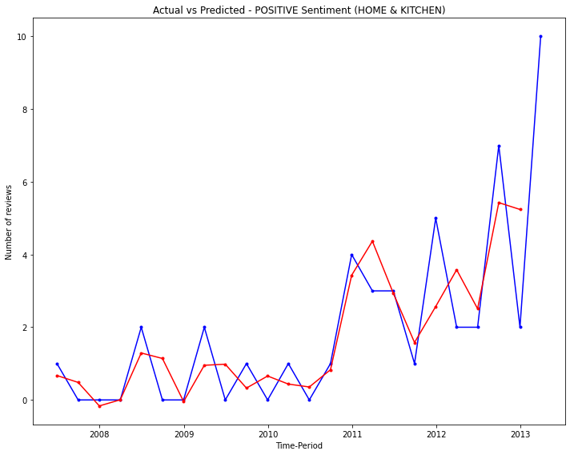
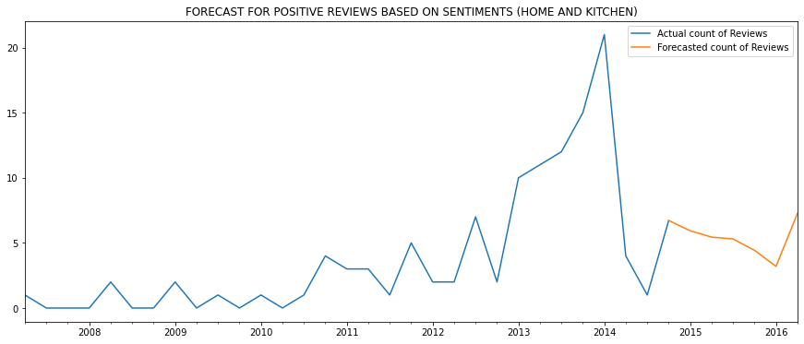
HOME AND KITCHEN DATA : TIME SERIES ANALYSIS FOR POSITIVE & NEGATIVE SENTIMENT
The actual data has a increasing trend over the years till 2014 for both the categories.
The predicted sentiment count tends to have an increasing trend as well after 2014 for both the sentiment .

Slide 22
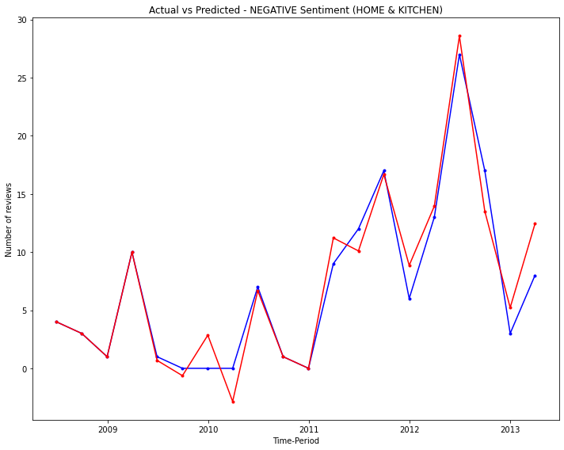
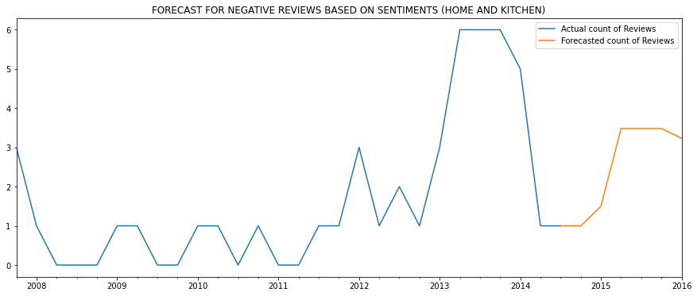
GROCERY AND GOURMET FOOD DATA : TIME SERIES ANALYSIS FOR POSITIVE & NEGATIVE SENTIMENT
The actual data has a increasing trend over the years till 2014 for both the categories.
The predicted sentiment count tends to increase for ‘positive’ sentiment and the sentiment count tends to fluctuate for the ‘negative’ sentiment.

Slide 23
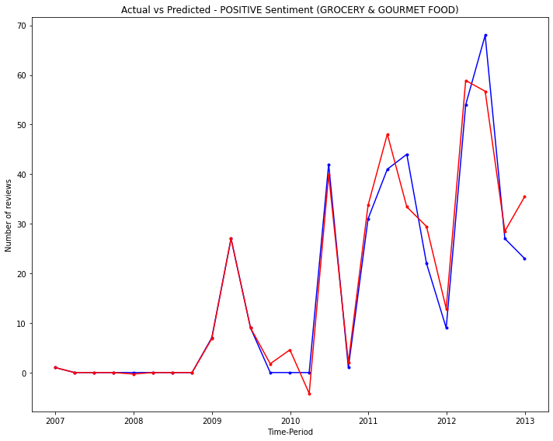
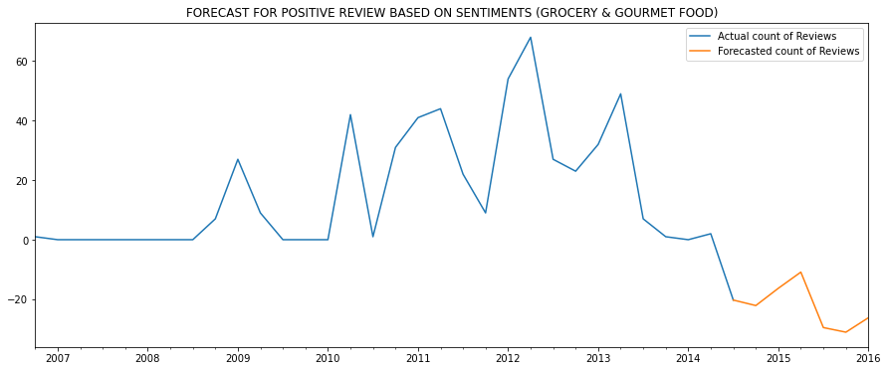
HOME AND KITCHEN DATA : TIME SERIES ANALYSIS FOR POSITIVE & NEGATIVE SENTIMENT
TOP 5 Products were considered to forecast positive and negative sentiments.
From the forecasting, Positive sentiment count is increasing and Negative sentiment count is decreasing.

Slide 24
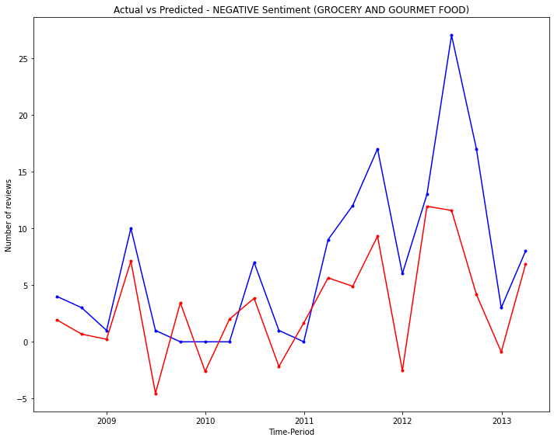
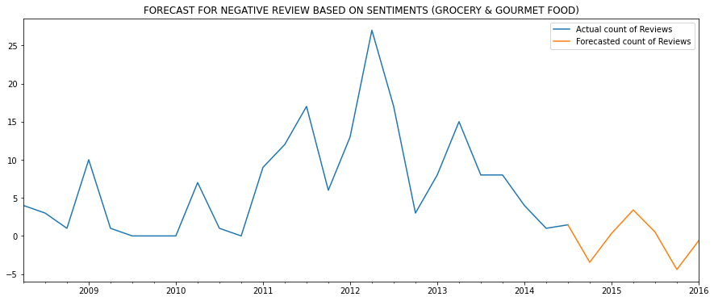
GROCERY AND GOURMET FOOD DATA : TIME SERIES ANALYSIS FOR POSITIVE & NEGATIVE SENTIMENT
Top 5 products is considered to forecast positive and negative sentiments.
Positive sentiment count tends to increase between 2014 and 2016.
Negative sentiment count have been predicted to maintain at the level of 0 constantly for the next 1 year from half way of 2014

Slide 25

CONCLUSION
The positive sentiments for Home and Kitchen products tends to increase over the years as compared to Grocery and Gourmet foods.
Customers tends to show more interest on Kitchen and Home Products, which shows there is high demand for products belongs to this category.
Also, the Negative reviews of grocery and gourmet foods products can be considered to make the products quality better.
Mostly Utensils, Knives and Electric fans found to have Positive Reviews in Home & Kitchen Category.
Products like Chocolate Brownies also receive positive reviews while products like Coffee and Organic snacks in Grocery and Gourmet food category recieves negative reviews.
Vegetable cutters, cast iron utensils which receive most number of negative Reviews due to Quality reasons.

Slide 26

THANK YOU

