Slide 1
Unix

Slide 2
Beginning
The Unix operating system found its beginnings in MULTICS, in MIT.
One of Bell Laboratories people involved in the project was Ken Thompson. He liked the potential MULTICS had, but felt it was too complex and that the same thing could be done in simpler way. In 1969 he wrote the first version of Unix, called UNICS. UNICS stood for Uniplexed Operating and Computing System. Although the operating system has changed, the name stuck and was eventually shortened to Unix.

Slide 3
History
The first version of UNIX was created in 1969 by Kenneth Thompson and Dennis Ritchie, system engineers at AT&T's Bell Labs.
It went through many revisions and gained in popularity until 1977, when it was first made commercially available by Interactive Systems Corporation.

Slide 4
Conti..
The 1978 release of Version 7 included the Bourne Shell for the first time.
By 1983 commercial interest was growing and Sun Microsystems produced a UNIX workstation.
System V appeared, directly descended from the original AT&T UNIX and the prototype of the more widely used variant today.

Slide 5
Introduction
Unix is an operating system designed for use on any kind of computer or computing device. Current versions of Unix are running on everything from supercomputers to mobile phones. It is a multi-tasking, multi-user system. This means that a person using a Unix system can run more than one job, that is do more than one task at once,

Slide 6
Unix operating systems are widely used in PCs, servers and mobile devices. The Unix environment was also an essential element in the development of the Internet and networking.

Slide 7
Linux

Slide 8

Linus Torvalds a student at the university of Helsinki, Finland, thought to have a freely available academic version of Unix started writing its own code. Later this project became the Linux kernel.
Linux is a family of open source Unix-like operating systems based on the Linux kernel, an operating system kernel first released on September 17, 1991.

Slide 9
It is distributed under an open source license.
Being open-source, anyone with programming knowledge can modify it.
Companies and individuals choose Linux for their servers because it is secure, and you can receive excellent support from a large community of users, in addition to companies like Canonical, SUSE, and Red Hat, which offer commercial support.

Slide 10
Linux is the OS of choice for Server environments due to its stability and reliability (Mega-companies like Amazon, Facebook, and Google use Linux for their Servers). A Linux based server could run non-stop without a reboot for years on end.

Slide 11
Operating System

Slide 12
Definition
An Operating System (OS) is an interface between a computer user and computer hardware.
An operating system is a software which performs all the basic tasks like file management, memory management, process management, handling input and output, and controlling peripheral devices such as disk drives and printers
An Operating System (OS) is a collection of system programs that controls and coordinates the overall operation of a computer system.

Slide 13
Example
Examples: Operating Systems include versions of Microsoft Windows (like Windows 10, Windows 8, Windows 7, Windows Vista, and Windows XP), Apple's macOS (formerly OS X), Chrome OS, BlackBerry Tablet OS, and flavours of the open source operating system Linux.

Slide 14
Why OS
The operating system sits on top of a physical system and talks to the hardware.
An operating system is the most important software that runs on a computer. It manages the computer's memory and processes, as well as all of its software and hardware. It also allows you to communicate with the computer without knowing how to speak the computer's language.

Slide 15
Goals of OS
Execute user programs and make solving user problems easier
Make the computer system convenient to use
Use the computer hardware in an efficient manner

Slide 16
Where Does an Operating System Live?
A boot up program usually stores in ROM, loads the operating system from disk into the main memory of the computer when the machine is started or reset. Once loaded, some portions of it remain permanently in RAM while the computer is running and executing different user jobs. It therefore, shares the memory with the jobs that are currently running.

Slide 17
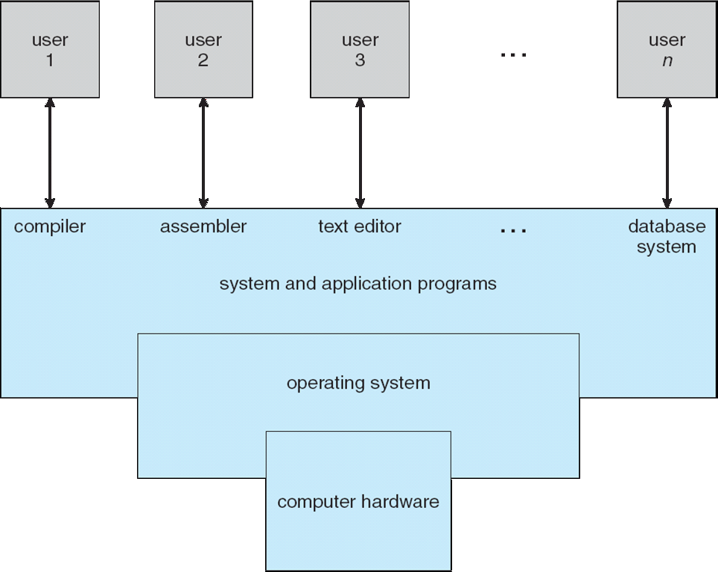

Slide 18
Computer System Structure
Computer system can be divided into four components:
Hardware – provides basic computing resources
CPU, memory, I/O devices
Operating system
Controls and coordinates use of hardware among various applications and users

Slide 19
Application programs – define the ways in which the system resources are used to solve the computing problems of the users
Word processors, compilers, web browsers, database systems, video games
Users
People, machines, other computers

Slide 20
Functions of OS
Following are some of important functions of an operating System.
Memory Management
Processor Management
Device Management
File Management
Security

Slide 21
Functions (Conti.)
Control over system performance
Job accounting
Error detecting
Coordination between other software and users

Slide 22
Memory Management
Memory management refers to management of Primary Memory or Main Memory. Main memory is a large array of words or bytes where each word or byte has its own address.
Main memory provides a fast storage that can be accessed directly by the CPU. For a program to be executed, it must in the main memory.

Slide 23
An Operating System does the following activities for memory management −
Keeps tracks of primary memory, i.e., what part of it are in use by whom, what part are not in use.
In multiprogramming, the OS decides which process will get memory when and how much.
Allocates the memory when a process requests it to do so.
De-allocates the memory when a process no longer needs it or has been terminated.

Slide 24
Processor Management
In multiprogramming environment, the OS decides which process gets the processor when and for how much time. This function is called process scheduling. An Operating System does the following activities for processor management −
Keeps tracks of processor and status of process. The program responsible for this task is known as traffic controller.
Allocates the processor (CPU) to a process.
De-allocates processor when a process is no longer required.

Slide 25
Device Management
An Operating System manages device communication via their respective drivers. It does the following activities for device management –
Keeps tracks of all devices. Program responsible for this task is known as the I/O controller.
Decides which process gets the device when and for how much time.
Allocates the device in the efficient way.
De-allocates devices

Slide 26
File Management
A file system is normally organized into directories for easy navigation and usage. These directories may contain files and other directions.
An Operating System does the following activities for file management −
Keeps track of information, location, uses, status etc. The collective facilities are often known as file system.
Decides who gets the resources.
Allocate the resources.
De-allocate the resources.

Slide 27
Following are some of the important activities that an Operating System performs −
Security − By means of password and similar other techniques, it prevents unauthorized access to programs and data.
Control over system performance − Recording delays between request for a service and response from the system.
Job accounting − Keeping track of time and resources used by various jobs and users.

Slide 28
Error detecting − Production of dumps, traces, error messages, and other debugging and error detecting aids.
Coordination between other software and users − Coordination and assignment of compilers, interpreters, assemblers and other software to the various users of the computer systems

Slide 29
Evolution of Operating Systems
History Of OS
Operating systems were first developed in the late 1950s to manage tape storage
The General Motors Research Lab implemented the first OS in the early 1950s for their IBM 701
In the mid-1960s, operating systems started to use disks

Slide 30
In 1969 a team led by computer scientists Ken Thompson and Dennis Ritchie created the first version of UNIX
The first OS built by Microsoft was DOS. It was built in 1981
The present-day popular OS Windows first came to existence in 1985 when a GUI was created and paired with MS-DOS.

Slide 31
Types Of OS
Batch System.
Multiprogramming System.
Multitasking / Time sharing System.
Network OS.
Distributed OS.
Real time Operating System.
Handheld System.

Slide 32
Batch operating system
The users of a batch operating system do not interact with the computer directly. Each user prepares his job on an off-line device like punch cards and submits it to the computer operator.
To speed up processing, jobs with similar needs are batched together and run as a group. The programmers leave their programs with the operator and the operator then sorts the programs with similar requirements into batches.

Slide 33
The problems with Batch Systems are as follows −
Lack of interaction between the user and the job.
CPU is often idle, because the speed of the mechanical I/O devices is slower than the CPU.
Difficult to provide the desired priority.

Slide 34
Multiprogramming OS
The main memory consists of jobs waiting for CPU time. The OS selects one of the processes and assigns it to the CPU. Whenever the executing process needs to wait for any other operation (like I/O), the OS selects another process from the job queue and assigns it to the CPU. This way, the CPU is never kept idle and the user gets the flavour of getting multiple tasks done at once.

Slide 35
Time-sharing operating systems
Time-sharing is a technique which enables many people, located at various terminals, to use a particular computer system at the same time.
Time-sharing or multitasking is a logical extension of multiprogramming. Processor's time which is shared among multiple users/programs simultaneously is termed as time-sharing.

Slide 36
Network operating System
A Network Operating System runs on a server and provides the server capability to manage data, users, groups, security, applications, and other networking functions. The primary purpose of the network operating system is to allow shared file and printer access among multiple computers in a network, typically a local area network (LAN), a private network or to other networks.

Slide 37
Distributed operating System
Distributed systems use multiple central processors to serve multiple real-time applications and multiple users. Data processing jobs are distributed among the processors accordingly.

Slide 38
Real Time OS
Real Time OS – Real-Time OS are usually built for dedicated systems to accomplish a specific set of tasks within deadlines.
Hard real-time systems
Soft real-time systems
Ex. Weather forecasting, Scientific Systems.

Slide 39
Mobile / Handheld OS
Ex Android, Blackberry, iOS

