Slide 1

Coders Point (E-Learning Website)
Guided By:
Dr. Jitendra Choudhary
Submitted By:
Komal Yadav (SC17CS301028)
Mayuri Giri (SC17CS301032)

Slide 2
CONTENT
Introduction.
Description of existing system.
Circumstances leading to the current new system.
Objectives.
Functionalities.
Technologies Used.
Schedule Chart.
Use-Case Diagram.
Activity Diagram.
Sequence Diagram.
ER Diagram.
Class Diagram.
DFD
Future Scope.
Conclusion.

Slide 3
INTRODUCTION
Coders Point is an e-Learning website which helps users to learn some courses available on this website like C, C++, Java and etc.
User can also download their choice of courses, add to wish list their courses they wanted to learn in future.
It reduces the risk of book lost, book damaged and time consuming.
We are providing the study materials topic-wise with their respective courses.
User can also download their choice of courses.

Slide 4
DESCRIPTION OF EXISTING SYSTEM
The problem occurred in some e-Learning website includes:
The current system is very limited to few resources, students are able to get knowledge of particular courses containing all the topics that they are provided by the faculty to them.
In some existing system the beginners get bored, due to some understanding issues, that sometimes the user unable to understand the language because of the use of some heavy words.
In some existing system users can only access the course but we are providing download facility so that user can download their choice of courses in the form of pdf and by which they can learn offline mode.

Slide 5
CIRCUMSTANCES LEADING TO THE CURRENT NEW SYSTEM
Using an Online e-learning website has many benefits. Here are some benefits are listed below:
Due to its convenience and flexibility, the courses are available from anywhere and at any time.
Web-based learning promotes active and independent learning.
As you have access to the net 24x7, you can train yourself anytime and from anywhere also.
It is a very convenient and flexible option; above all, you don't have to depend on anyone for anything.

Slide 6
OBJECTIVES
The objective of the project are as follows:
To offer flexible learning possibilities in degree and continuing education and also in lifelong learning
To decrease the proportion of lectures and increase the proportion of individual work in the study process
To make the information and study materials better available for learners
To diversify the study process and make it more interesting, efficient and contemporary

Slide 7
functionalities
E-Learning provides a single source of learning materials ensuring that the content delivered is identical for all the learners.
Managing users and courses.
Users can Sign up if he/she is already not registered.
Users can Login-in to their respective page from where they can access their choice of courses.
Users can download their choice of courses in the form of pdf.
Users can upload their contents as a suggestions.
Users can rate the courses.
Users can change their passwords.
Users can add/remove courses to wishlist.
Users can learn with videos for the better understanding and learning.
This website also provide searching option where users can search by topics.
Users can also connect with us with Facebook, Twitter, Instagram, LinkedIn and YouTube.

Slide 8
TECHNOLOGIES USED
Front End:
HTML
CSS
JavaScript
Bootstrap
PHP
Back End:
MySQL
Servers:
WAMP (Windows, Apache, MySQL, and PHP)
IDE’s / Editors and Debugging S/W:
Notepad++
NetBeans IDE 8.2
Google Chrome or Mozilla Firefox

Slide 9
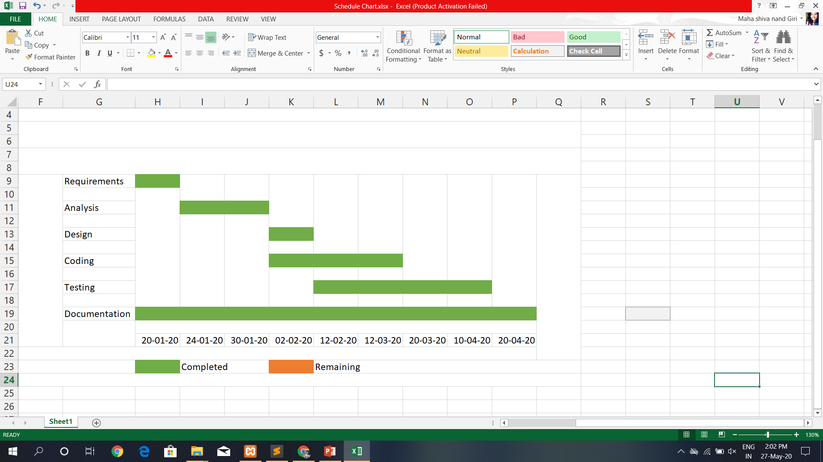
SCHEDULE CHART

Slide 10
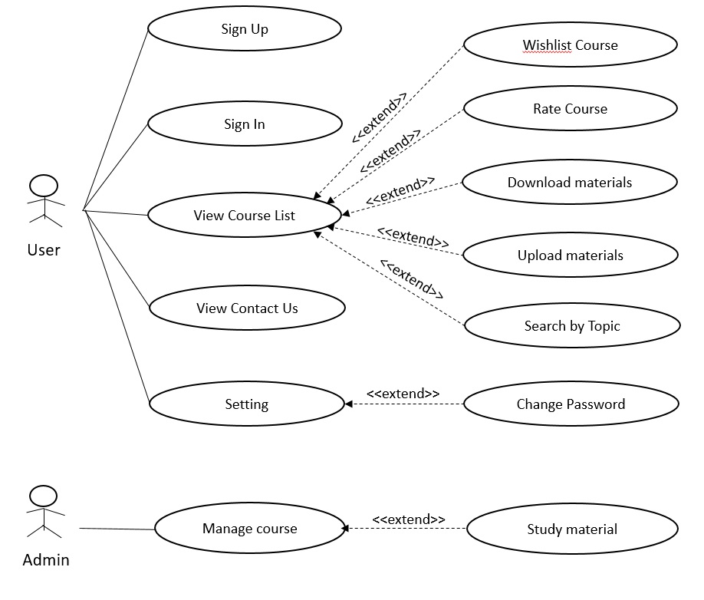
USECASE DIAGRAM
Use-case Diagram

Slide 11
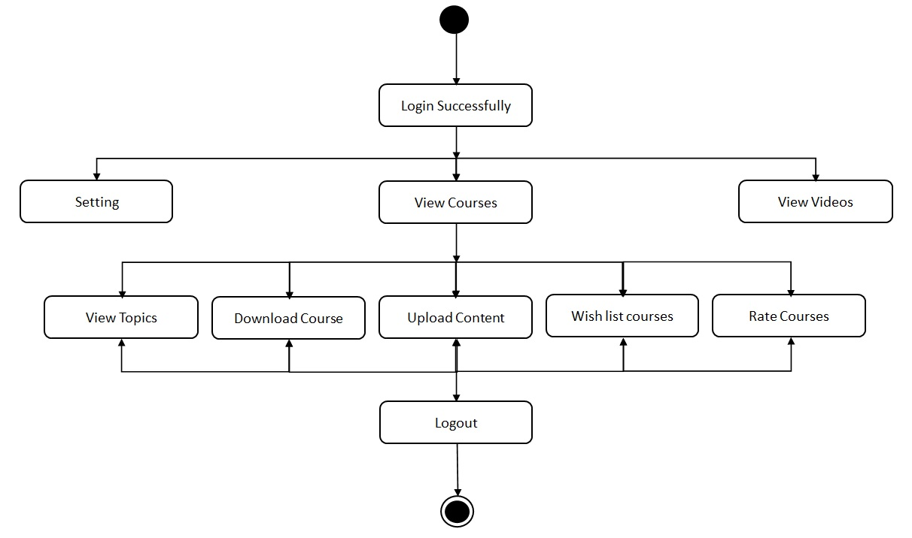
ACTIVITY DIAGRAM
Activity Diagram for overall system

Slide 12
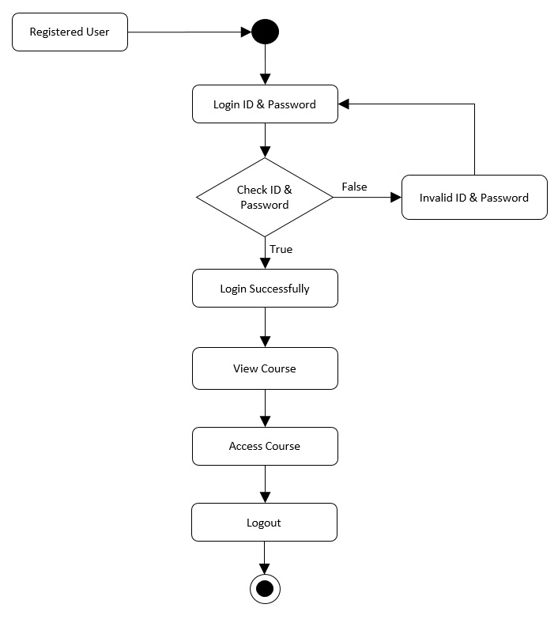
ACTIVITY DIAGRAM (Cont…)
Activity Diagram for login to the system

Slide 13
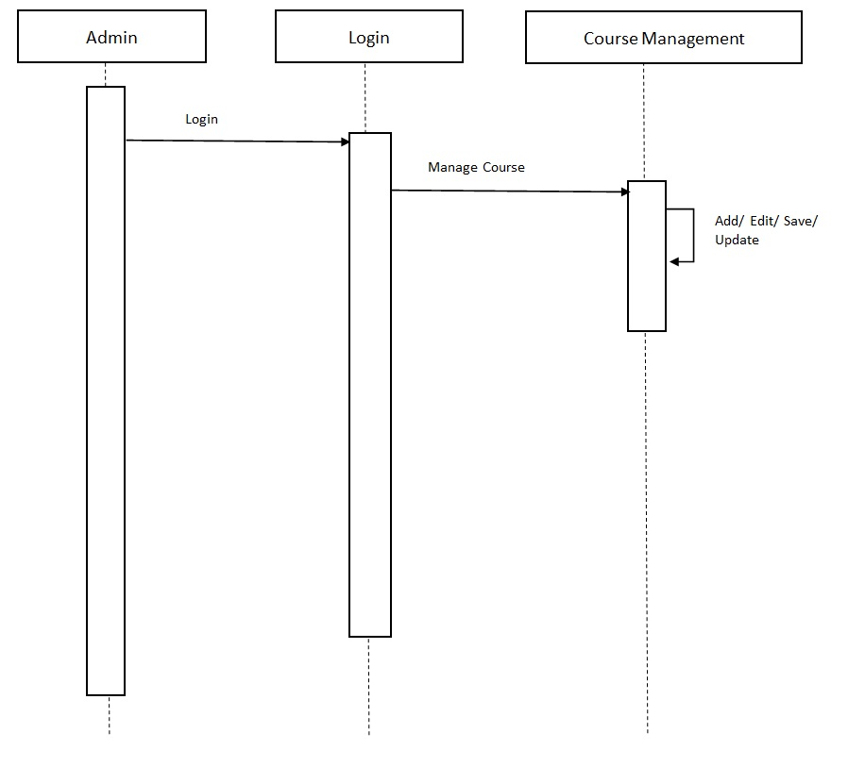
SEQUENCE DIAGRAM
Sequence Diagram for Admin

Slide 14
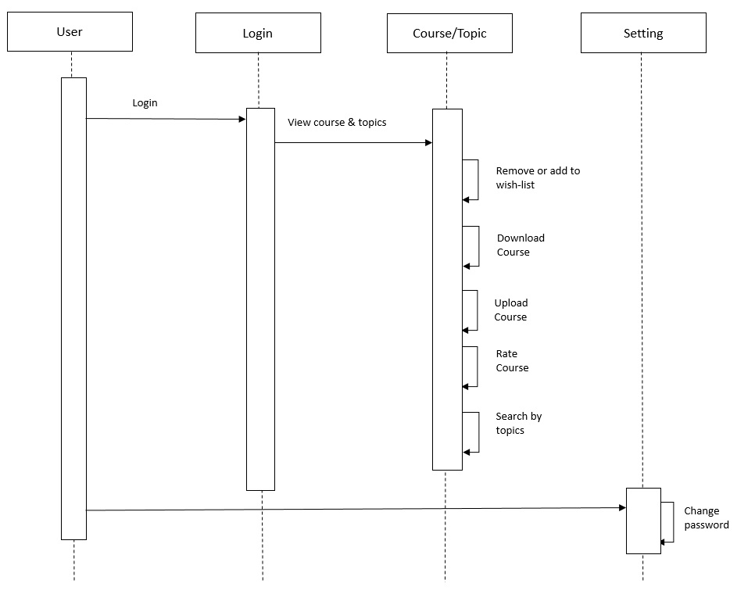
SEQUENCE DIAGRAM (Cont…)
Fig.4 Sequence diagram for the user

Slide 15
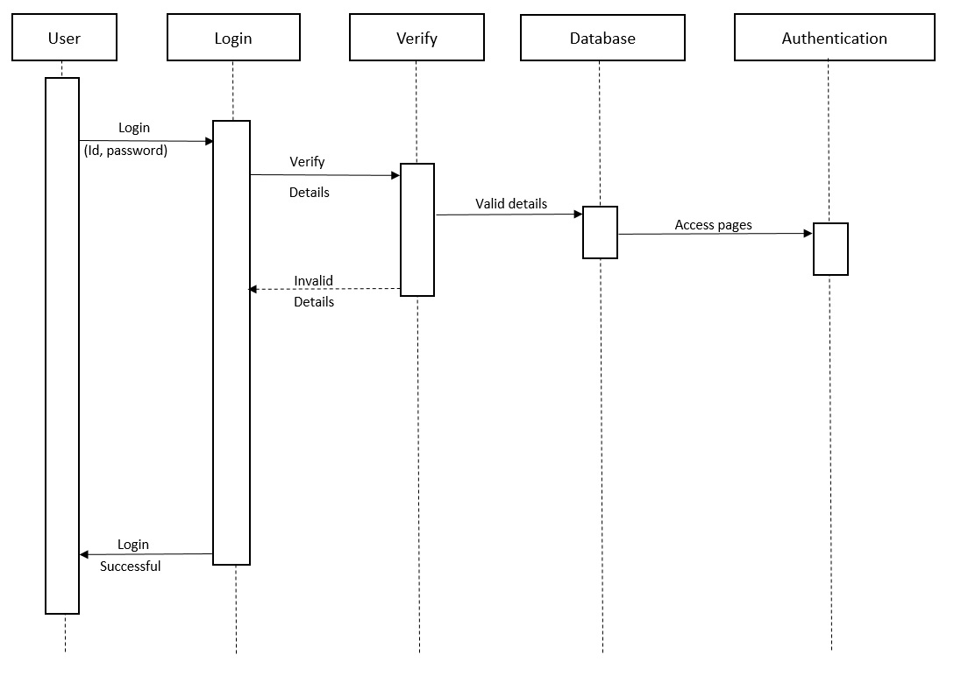
SEQUENCE DIAGRAM (Cont…)
Sequence diagram for login

Slide 16
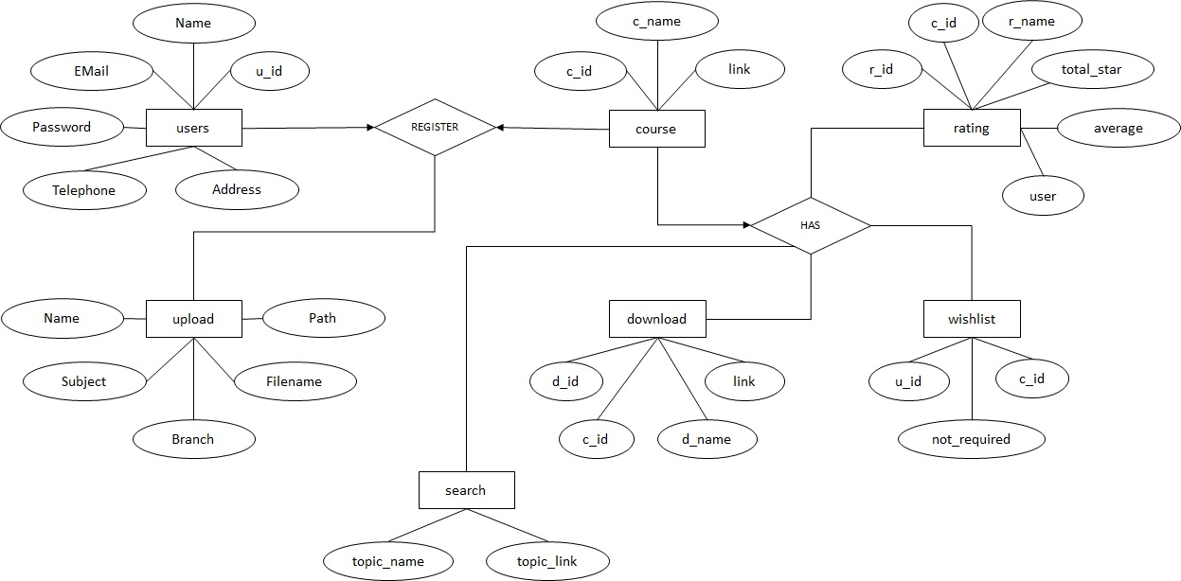
ER - DIAGRAM
Fig.2.2 ER Diagram

Slide 17
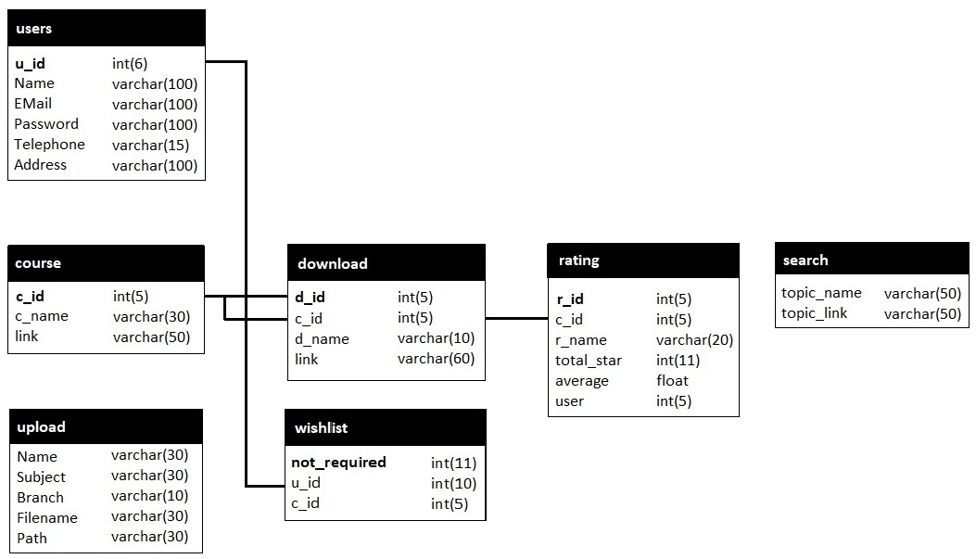
Class diagram
Class diagram

Slide 18
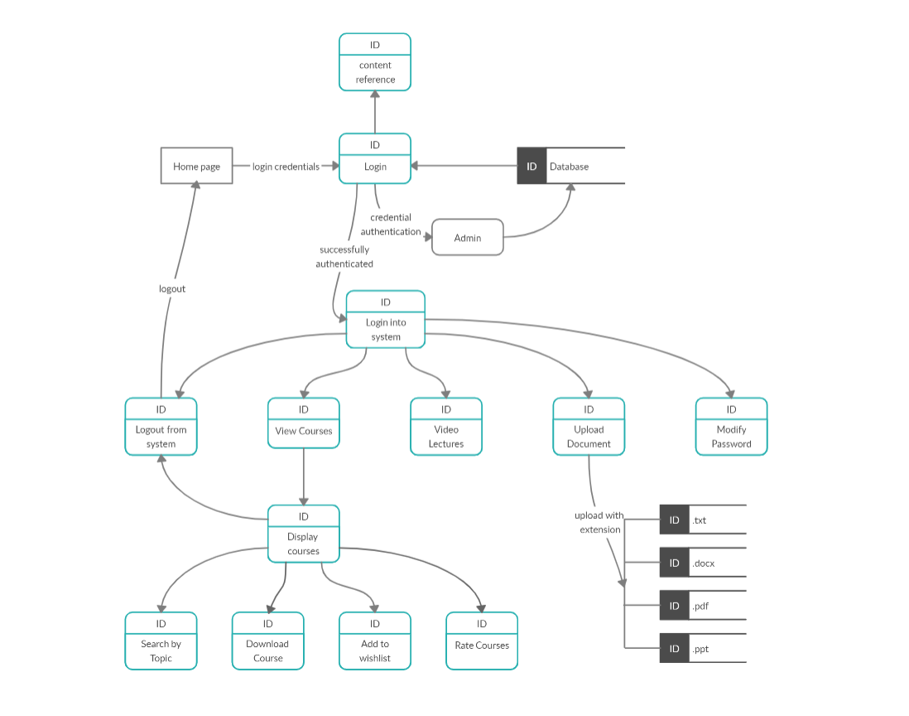
Dfd (Data Flow diagram)
DFD

Slide 19
FUTURE SCOPE
The distance mode students may face problem of technically, like internet connectivity in comparison of full time students.
The differences in content of courses bring a need to create original materials for teaching theoretical computer science disciplines like theory of formal languages and automata, logic etc.
There is an essential need to create quality learning material.
Compilers of respective language can be added to the website so that students can learn with practical implementation.

Slide 20
CONCLUSION
The above full content is basically is focused on the e-learning medium and technologies.
The term content plays a key role in e-learning, but this is not an easy process to have e-learning in all the fields of Computer Science.
Ability and sense of expert is required for developing courseware and necessary structure of the topic.
So we can say that e-learning technology is dynamic way for getting knowledge and interaction with the system. If we have distance education, different study programs applied on Computer Science may have several problems and issues, if compared with face to face education.

Slide 21
Thank you

