Slide 1

I/O Streams
I/O Streams in Java
java.io package
Part - I
Don’t write or place any image in this area

Slide 2
IO Streams
This package contains classes that are used to perform:
I/O operations on various source & destinations
Serialization & Deserialization
and RandomAccessFile.
In I/OStream topic we will deal with subclasses of 4 classes called InputStream, OutputStream, Reader and Writer
Don’t write or place any image in this area

Slide 3
IO Streams
InputStream and OutputStreams deals with stream of bytes 0-255 (ASCII range characters are 256).
https://theasciicode.com.ar/extended-ascii-code/majuscule-c-cedilla-uppercase-ascii-code-128.html
0-127 - Numbers, Lower Alpha, Upper Alpha & special characters
128-255 – Extended ASCII characters
Reader and Writer classes deals with stream of characters 0-65535 (Unicode range characters are 65536).
Don’t write or place any image in this area
https://www.rapidtables.com/code/text/unicode-characters.html

Slide 4
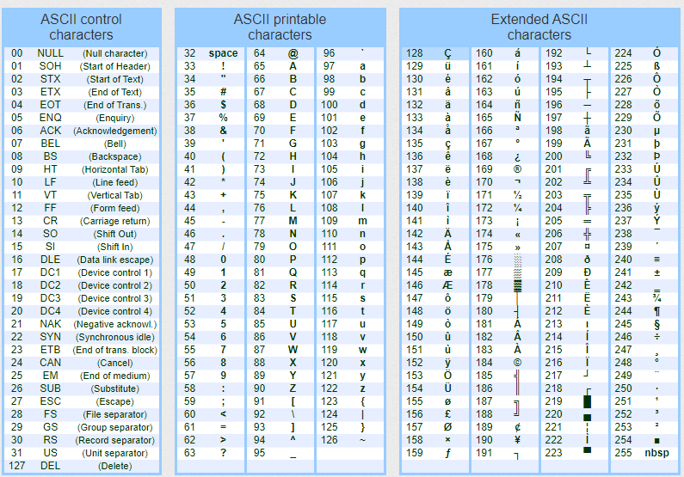
IO Streams
Don’t write or place any image in this area

Slide 5
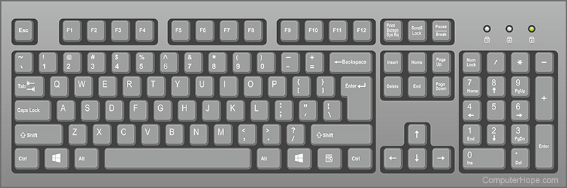

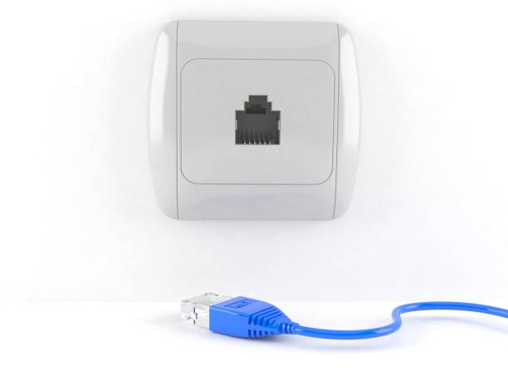
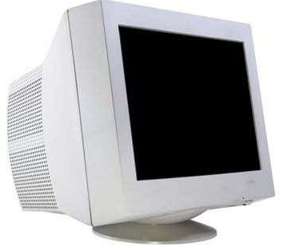
IO Streams
Various sources from which we can "read" data are keyboard/STDIN, File, Socket, byte/char array, String, Object etc.
Various destinations onto which we can "write" are Monitor/STDOUT, File, Socket, byte/char array, Object etc.
Don’t write or place any image in this area
S | u | r | y | a
83 | 117 | 114 | 122 | 97

Slide 6
IO Streams
To read input from keyboard in System class one "in“ object reference belongs to InputStream class is given. The reference is static type, hence we can call System.in and in InputStream class read() method is given to read data byte-byte (ASCII Range characters 0-255).
Hence we can write
int i=System.in.read();
Reading byte-byte doesn't mean read byte value from -128 to +127. byte can accept 256 range value. A character whose ASCII value range from 0-255 can be read through InputStream class read() method.
Don’t write or place any image in this area

Slide 7
IO Streams
public abstract class InputStream extends Object implements Closeable
InputStream() | public no parameter constructor
int available() | returns estimated number of bytes that can be read from this inputstream.
void close() | closes the inputstream
void mark(int readLimit) | Marks the current position in this inputstream
boolean markSupported() | Tests if this inputstream supports the mark and reset methods
abstract int read() | reads the next byte of data from the input stream
int read(byte[] b) | Reads some number of bytes from the inputstream
int read(byte[] b, int off, int len) | Reads upto len bytes of data from the inputstream into byte array
void reset() | repositions the mark to the beginning of the stream
long skip(long n) | Skips specified number of bytes to read from inputstream
Don’t write or place any image in this area

Slide 8
IO Streams
Similarly OutputStream class write() method can write characters up-to ASCII range. To print characters on STDOUT we can use System.out.println(int|double|char|boolean|String|Object). In System class PrintStream class static object reference name is ‘out’. Hence we can call it using System.out.println().
To read/write characters above ASCII range that means up-to Unicode range we must use Reader and Writer classes read() and write() methods.
Don’t write or place any image in this area

Slide 9
IO Streams
InputStream class heirarchy:
InputStream
FileInputStream
ByteArrayInputStream
StringBufferInputStream
SocketInputStream
ObjectInputStream
PipedInputStream
SequenceInputStream
FilterInputStream
DataInputStream
BufferedInputStream
LineNumberInputStream
PushbackInputStream
DeflaterInputStream
InflaterInputStream
CipherInputStream
DigestInputStream
Don’t write or place any image in this area

Slide 10
IO Streams
OutputStream class heirarchy:
OutputStream
FileOutputStream
SocketOutputStream
ByteArrayOutputStream
ObjectOutputStream
PipedOutputStream
FilterOutputStream
DataOutputStream
BufferedOutputStream
PrintStream
CheckedOutputStream
CipherOutputStream
InflaterOutputStream
DeflaterOutputStream
DigestOutputStream
Don’t write or place any image in this area

Slide 11
IO Streams
Reading local directory file
// FISDemo1.java
import java.io.*;
public class FISDemo1 {
public static void main(String rags[]) {
try {
FileInputStream fis=new FileInputStream("StudentDetails.txt");
int i=fis.read(); // char ascii value will be returned as int,
while(i!=-1) {
System.out.print((char)i);
Thread.sleep(100);
i=fis.read();
}
fis.close();
}
catch(FileNotFoundException e) {
e.printStackTrace();
}
catch(IOException e) {
e.printStackTrace();
}
catch(InterruptedException e) {
e.printStackTrace();
}
catch(Exception e) {
e.printStackTrace();
}
}
}
Don’t write or place any image in this area

Slide 12
IO Streams
StudentDetails.txt
1&ABC&abc@gmail.com&9848012345
2&XYZ&xyz@gmail.com&9848054321
3&LMN&lmn@gmail.com&9848014325
4&PQR&pqr@gmail.com&9848013524
5&MNO&mno@gmail.com&9848012345
Don’t write or place any image in this area

