Slide 1

JDK, JRE, JVM
Java Development Kit
Java Runtime Environment
Java Virtual Machine

Slide 2
If you are a programmer then you need JDK
The name itself tells it is need by developer
If you are user of java programs you need JRE
The name tells it is need to run java programs

Slide 3
A java software (JDK/JRE) mainly consists of 2 things
Java library files (rt.jar, dt.jar, tools.jar)
Java binary files (javac.exe, java.exe, jdb.exe, javadoc.exe, javap.exe, rmic.exe, rmid.exe, rmiregistry.exe, xjc.exe)
The library files (.jar) contains Java API (java predefined classes like String, System etc) using which we will develop our java programs (17000+ classes available in rt.jar file)
Those user defined java classes are compiled and interpreted by binary files javac.exe (java compiler) and java.exe (java interpreter) .

Slide 4
JDK consists of
all java library files (jdk\jre\lib\rt.jar, jdk\lib\tools.jar and jdk\lib\dt.jar)
and all java binary files (javac.exe, rmic.exe, jdb.exe, javadoc.exe, java.exe)
Where as JRE contains only
required library files (jdk\jre\lib\rt.jar)
and required java binary files (java.exe)
But both contains JVM

Slide 5
JVM is nothing but a java.exe (java interpreter also called as JVM launcher)
If we run java program using
java Hello
java.exe starts JVM, into JVM the Hello.class file is loaded
JVM converts java byte code into machine code
But before that we need to learn how java compiler compiles java source file (.java extension) into java byte code file (.class extension)

Slide 6
.java files are source files
javac.exe is a binary file that comes in every OS that converts the java source code into java byte code (.class file)
The .class file is a OS independent file because instead of having machine instructions specific to OS, it contains java byte code instructions.
These bye code instructions are read by java interpreter (java.exe) which is OS specific that reads common byte code instructions and converts them into machine instruction at runtime

Slide 7
Mnemonic | Opcode; (in hex) | Opcode (in binary)
aaload | 32 | 0011 0010
aastore | 53 | 0101 0011
aconst_null | 01 | 0000 0001
Java Byte Code Instructions, independent of processors instruction set
256 total, 202 are in use, 51 reserved for future use & 3 are for JVM implementation to use
Instructions fall into a number of broad groups:
Load and store (e.g. aload_0, istore)
Arithmetic and logic (e.g. ladd, fcmpl)
Type conversion (e.g. i2b, d2i)
Object creation and manipulation (new, putfield)
Operand stack management (e.g. swap, dup2)
Control transfer (e.g. ifeq, goto)
Method invocation and return (e.g. invokespecial, areturn)

Slide 8
Prefix/suffix | Operand type
i | integer
l | long
s | short
b | byte
c | character
f | float
d | double
a | reference
https://en.wikipedia.org/wiki/Java_bytecode

Slide 9
Portable/Platform Independent
(because of compiled and interpreted)
// Bytecode stream: 03 3b 84 00 01 1a 05 68 3b a7 ff f9
// Disassembly:
iconst_0 // 03
istore_0 // 3b
iinc 0, 1 // 84 00 01
iload_0 // 1a
iconst_2 // 05
imul // 68
istore_0 // 3b
goto -7 // a7 ff f9
Compiler
javac
Java
Java Source file
Hello.java
Java Byte Code file
Hello.class
java compiler compiles .java file into .class
Java
Interpreter
java.exe
.class file contains java byte code instructions
Byte Code Instructions are common to all OS
Windows OS
Linux OS
Mac OS

Slide 10
What .class file contains
ClassFile {
magic_number;
minor_version;
major_version;
constant_pool_count;
constant_pool[];
access_flags;
this_class;
super_class;
interfaces_count;
interfaces[];
fields_count;
fields[];
methods_count;
methods[];
attributes_count;
attributes[];
}
magic_number is the first 4 bytes of class file are termed as magic number. This is predefined value which the JVM use to identify whether the .class file is generated by valid compiler or not. The predefined value is hexadecimal value i:e 0XCAFEBABE
jdk1.6 compiled class can run on jdk1.8 interpreter
but jdk1.8 compiled class cannot run on jdk1.6 interpreter
error is UnSupportedClassVersionError
minor_version & major_version version of the class contains M.m, where M stands for major_version ans m stands for minor_version.
Note: Lower version compiler generated .class file can be executed by high version JVM but not vice-versa
javac –version
java –version
Internally jdk 1.5 version means 49.0 and 1.6 means 50.0 and 1.7 means 51.0 etc

Slide 11
What .class file contains
constant_pool_count represents the number of constants present in the constant pool. (When a java class is compiled, all references to variables and methods are stored in the class’s constant pool as a symbolic reference).
constant_pool[] represents the information about constants present in constant pool
access_flags it provides information about the modifiers which are declared to the class file (public, abstract).
this_class represents fully qualified name of the class file (for ex: java.lang.String, java.util.List).
super_class represents fully qualified name of the super class (if no super class exist java.lang.Object is the default super class).
interface_count number of interfaces implemented by current class
interface[] returns interfaces implemented by current class
fields_count number of static variables
fields[] information about static variables
method_count number of methods
method[] information about methods
attributes_count number of non-static variables
attributes[] information about non-static variables

Slide 12
What is JVM?
Java uses a combination of both techniques.
Java code is first compiled into byte code to generate a class file.
This class file is then interpreted by the Java Virtual Machine for the underlying platform.
The same class file can be executed on any version of JVM running on any platform and operating system.

Slide 13
What is JVM?
JVM consists of 3 main components:
Class Loader
Runtime Memory/Data Area
Execution Engine

Slide 14
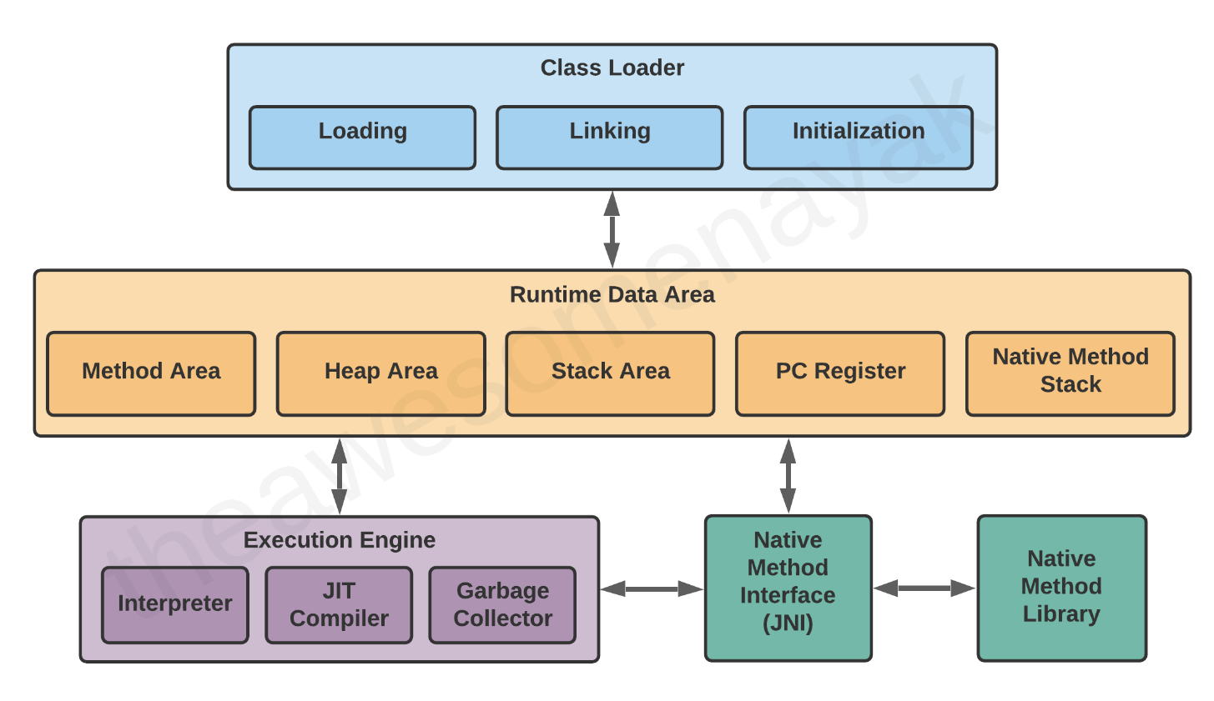
What is JVM?

Slide 15
What is JVM?
Class Loader
When you compile a .java source file, it is converted into byte code as a .class file. When you try to use this class in your program, the class loader loads it into the main memory.
The first class to be loaded into memory is usually the class that contains the main() method.
There are three phases in the class loading process: loading, linking, and initialization.

Slide 16
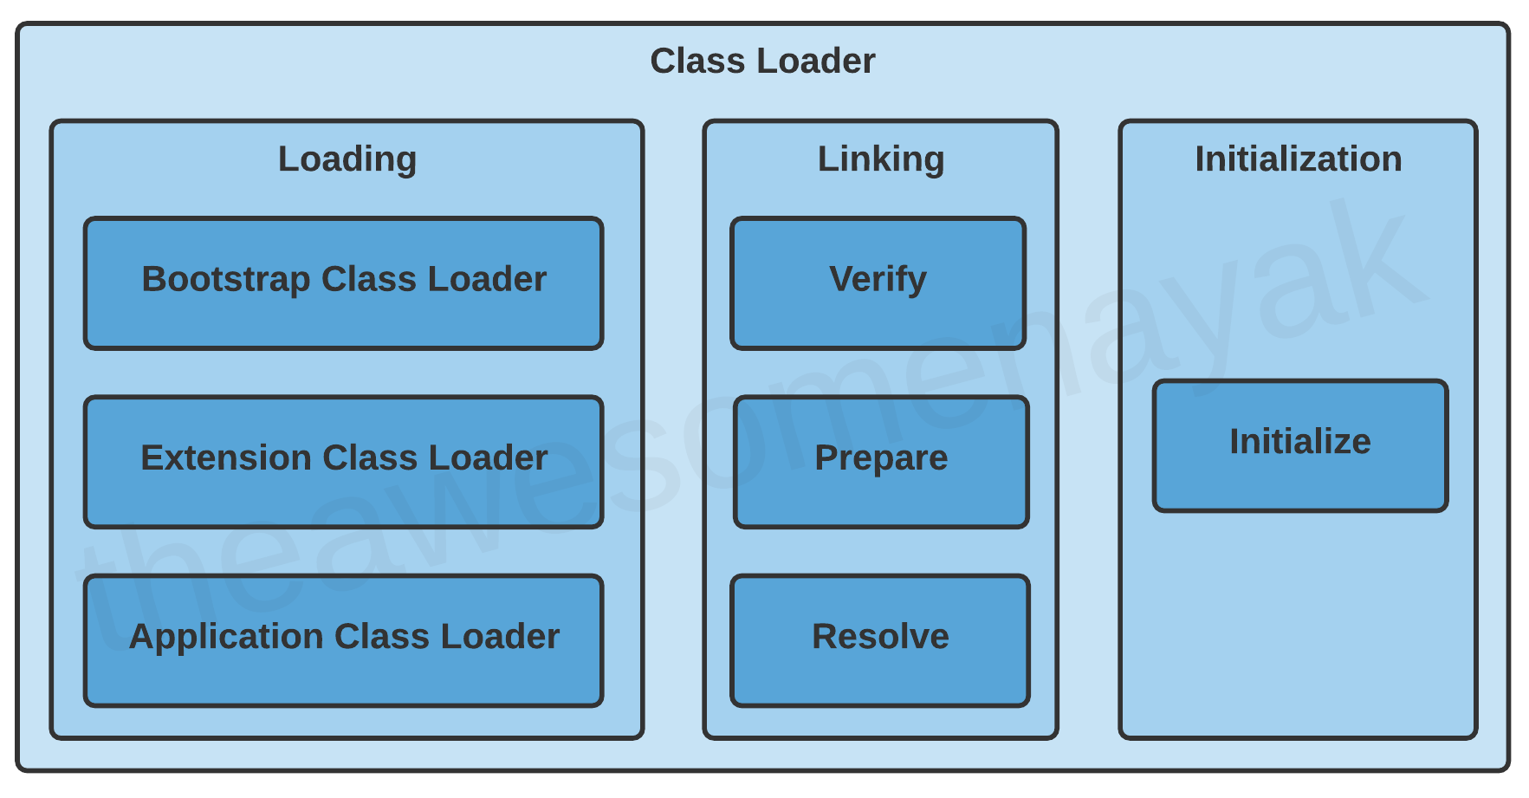
What is JVM?

Slide 17
What is JVM?
Class Loader Subsystem
It is mainly responsible for three activities.
Loading
Linking
Initialization

Slide 18
What is JVM?
Loading: The Class loader reads the “.class” file, generate the corresponding binary data and save it in the method area. For each “.class” file, JVM stores the following information in the method area.
The fully qualified name of the loaded class and its immediate parent class.
Whether the “.class” file is related to Class or Interface or Enum.
Modifier, Variables and Method information etc.
After loading the “.class” file, JVM creates an object of type Class to represent this file in the heap memory. Please note that this object is of type Class predefined in java.lang package. These Class object can be used by the programmer for getting class level information like the name of the class, parent name, methods and variable information etc. To get this object reference we can use getClass() method of Object class.

Slide 19
What is JVM?
Linking: Performs verification, preparation, and (optionally) resolution.
Verification: It ensures the correctness of the .class file i.e. it checks whether this file is properly formatted and generated by a valid compiler or not. If verification fails, we get run-time exception java.lang.VerifyError. This activity is done by the component ByteCodeVerifier. Once this activity is completed then the class file is ready for compilation.
Preparation: JVM allocates memory for class variables and initializing the memory to default values.
Resolution: It is the process of replacing symbolic references from the type with direct references. It is done by searching into the method area to locate the referenced entity.

Slide 20
What is JVM?
Initialization: In this phase, all static variables are assigned with their values defined in the code and static block(if any). This is executed from top to bottom in a class and from parent to child in the class
hierarchy.
In general, there are three class loaders :
Bootstrap class loader: Every JVM implementation must have a bootstrap class loader, capable of loading trusted classes. It loads core java API classes present in the “JAVA_HOME/jre/lib” directory. This path is popularly known as the bootstrap path. It is implemented in native languages like C, C++.
Extension class loader: It is a child of the bootstrap class loader. It loads the classes present in the extensions directories “JAVA_HOME/jre/lib/ext”(Extension path) or any other directory specified by the java.ext.dirs system property. It is implemented in java by the sun.misc.Launcher$ExtClassLoader class.
System/Application class loader: It is a child of the extension class loader. It is responsible to load classes from the application classpath. It internally uses Environment Variable which mapped to java.class.path. It is also implemented in Java by the sun.misc.Launcher$AppClassLoader class.

Slide 21
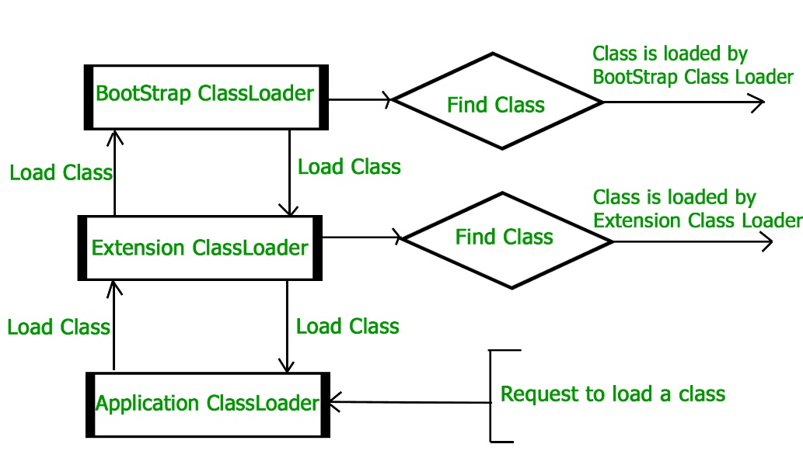
What is JVM?
Note: JVM follows the Delegation-Hierarchy principle to load classes. System class loader delegate load request to extension class loader and extension class loader delegate request to the bootstrap class loader. If a class found in the boot-strap path, the class is loaded otherwise request again transfers to the extension class loader and then to the system class loader. At last, if the system class loader fails to load class, then we get run-time exception java.lang.ClassNotFoundException.

Slide 22
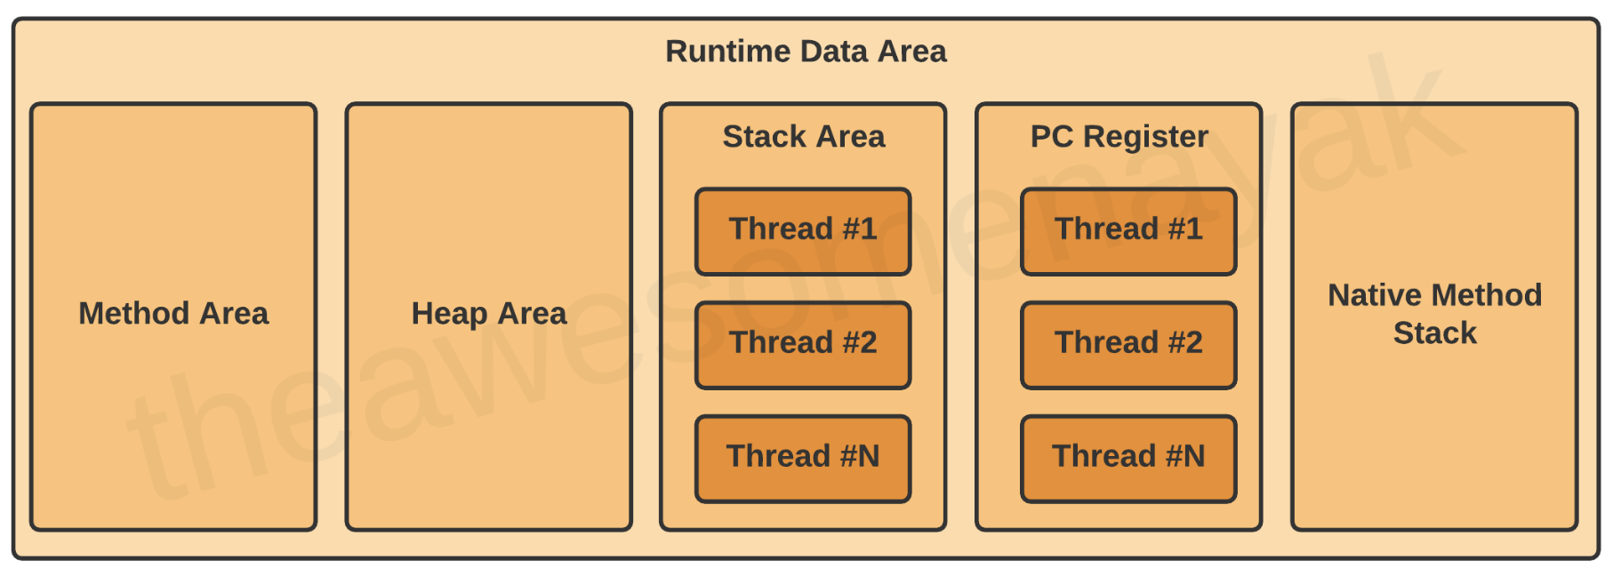
What is JVM?
Runtime Data Area
There are five components inside the runtime data area:

Slide 23
What is JVM?
JVM Memory
Method area: In the method area, all class level information like class name, immediate parent class name, methods and variables information etc. are stored, including static variables. There is only one method area per JVM, and it is a shared resource.
Heap area: Information of all objects is stored in the heap area. There is also one Heap Area per JVM. It is also a shared resource.
Stack area: For every thread, JVM creates one run-time stack which is stored here. Every block of this stack is called activation record/stack frame which stores methods calls. All local variables of that method are stored in their corresponding frame. After a thread terminates, its run-time stack will be destroyed by JVM. It is not a shared resource.
PC Registers: Store address of current execution instruction of a thread. Obviously, each thread has separate PC Registers.
Native method stacks: For every thread, a separate native stack is created. It stores native method information.

Slide 24
What is JVM?
Method Area
All the class level data such as the run-time constant pool, field, and method data, and the code for methods and constructors, are stored here.
If the memory available in the method area is not sufficient for the program startup, the JVM throws an OutOfMemoryError.
For example, assume that you have the following class definition:

Slide 25
What is JVM?
public class Employee {
private String name;
private int age;
public Employee(String name, int age) {
this.name = name; this.age = age; }
}
In this code example, the field level data such as name and age and the constructor details are loaded into the method area.
The method area is created on the virtual machine start-up, and there is only one method area per JVM.

Slide 26
What is JVM?
Heap Area
All the objects and their corresponding instance variables are stored here. This is the run-time data area from which memory for all class instances and arrays is allocated.
For example assume that you are declaring the following instance:
Employee employee = new Employee();
In this code example, an instance of Employee is created and loaded into the heap area.
The heap is created on the virtual machine start-up, and there is only one heap area per JVM.
Note: Since the Method and Heap areas share the same memory for multiple threads, the data stored here is not thread safe.

Slide 27
What is JVM?
Stack AreaSta
Stack Area
Whenever a new thread is created in the JVM, a separate runtime stack is also created at the same time. All local variables, method calls, and partial results are stored in the stack area.
If the processing being done in a thread requires a larger stack size than what's available, the JVM throws a StackOverflowError.
For every method call, one entry is made in the stack memory which is called the Stack Frame. When the method call is complete, the Stack Frame is destroyed.

Slide 28
What is JVM?
Stack AreaSta
The Stack Frame is divided into three sub-parts:
Local Variables – Each frame contains an array of variables known as its local variables. All local variables and their values are stored here. The length of this array is determined at compile-time.
Operand Stack – Each frame contains a last-in-first-out (LIFO) stack known as its operand stack. This acts as a runtime workspace to perform any intermediate operations. The maximum depth of this stack is determined at compile-time.
Frame Data – All symbols corresponding to the method are stored here. This also stores the catch block information in case of exceptions.

Slide 29
What is JVM?
For example assume that you have the following code:
double calculateNormalisedScore(List<Answer> answers) {
double score = getScore(answers);
return normalizeScore(score);
}
double normalizeScore(double score) {
return (score – minScore) / (maxScore – minScore);
}
In this code example, variables like answers and score are placed in the Local Variables array. The Operand Stack contains the variables and operators required to perform the mathematical calculations of subtraction and division.

Slide 30

What is JVM?
Note: Since the Stack Area is not shared, it is inherently thread safe.

Slide 31
What is JVM?
Program Counter (PC) Registers
The JVM supports multiple threads at the same time. Each thread has its own PC Register to hold the address of the currently executing JVM instruction. Once the instruction is executed, the PC register is updated with the next instruction.

Slide 32
What is JVM?
Native Method Stacks
The JVM contains stacks that support native methods. These methods are written in a language other than the Java, such as C and C++. For every new thread, a separate native method stack is also allocated.

Slide 33
What is JVM?
Execution Engine
Once the bytecode has been loaded into the main memory, and details are available in the runtime data area, the next step is to run the program. The Execution Engine handles this by executing the code present in each class.
However, before executing the program, the bytecode needs to be converted into machine language instructions. The JVM can use an interpreter or a JIT compiler for the execution engine.

Slide 34
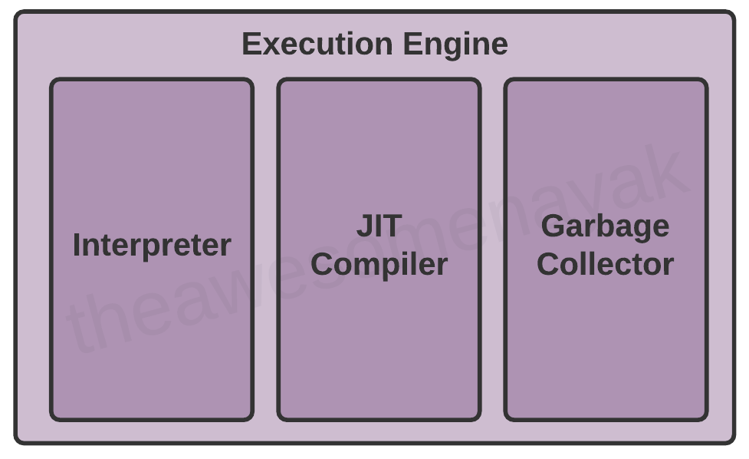
What is JVM?

Slide 35
What is JVM?
Interpreter
The interpreter reads and executes the bytecode instructions line by line. Due to the line by line execution, the interpreter is comparatively slower.
Another disadvantage of the interpreter is that when a method is called multiple times, every time a new interpretation is required.

Slide 36
What is JVM?
JIT Compiler
The JIT Compiler overcomes the disadvantage of the interpreter. The Execution Engine first uses the interpreter to execute the byte code, but when it finds some repeated code, it uses the JIT compiler.
The JIT compiler then compiles the entire bytecode and changes it to native machine code. This native machine code is used directly for repeated method calls, which improves the performance of the system.

Slide 37
What is JVM?
The JIT Compiler has the following components:
Intermediate Code Generator - generates intermediate code
Code Optimizer - optimizes the intermediate code for better performance
Target Code Generator - converts intermediate code to native machine code
Profiler - finds the hotspots (code that is executed repeatedly)

Slide 38
What is JVM?
To better understand the difference between interpreter and JIT compiler, assume that you have the following code:
int sum = 10;
for(int i = 0 ; i <= 10; i++) {
sum += i;
}
System.out.println(sum);
An interpreter will fetch the value of sum from memory for each iteration in the loop, add the value of i to it, and write it back to memory. This is a costly operation because it is accessing the memory each time it enters the loop.
However, the JIT compiler will recognize that this code has a HotSpot, and will perform optimizations on it. It will store a local copy of sum in the PC register for the thread and will keep adding the value of i to it in the loop. Once the loop is complete, it will write the value of sum back to memory.
Note: a JIT compiler takes more time to compile the code than for the interpreter to interpret the code line by line. If you are going to run a program only once, using the interpreter is better.

Slide 39
What is JVM?
Garbage Collector
The Garbage Collector (GC) collects and removes unreferenced objects from the heap area. It is the process of reclaiming the runtime unused memory automatically by destroying them.
Garbage collection makes Java memory efficient because it removes the unreferenced objects from heap memory and makes free space for new objects. It involves two phases:

Slide 40
What is JVM?
Mark - in this step, the GC identifies the unused objects in memory
Sweep - in this step, the GC removes the objects identified during the previous phase
Garbage Collections is done automatically by the JVM at regular intervals and does not need to be handled separately. It can also be triggered by calling System.gc(), but the execution is not guaranteed.

Slide 41
What is JVM?
The JVM contains 3 different types of garbage collectors:
Serial GC - This is the simplest implementation of GC, and is designed for small applications running on single-threaded environments. It uses a single thread for garbage collection. When it runs, it leads to a "stop the world" event where the entire application is paused. The JVM argument to use Serial Garbage Collector is -XX:+UseSerialGC
Parallel GC - This is the default implementation of GC in the JVM, and is also known as Throughput Collector. It uses multiple threads for garbage collection, but still pauses the application when running. The JVM argument to use Parallel Garbage Collector is -XX:+UseParallelGC.
Garbage First (G1) GC - G1GC was designed for multi-threaded applications that have a large heap size available (more than 4GB). It partitions the heap into a set of equal size regions, and uses multiple threads to scan them. G1GC identifies the regions with the most garbage and performs garbage collection on that region first. The JVM argument to use G1 Garbage Collector is -XX:+UseG1GC

Slide 42
What is JVM?
Note: There is another type of garbage collector called Concurrent Mark Sweep (CMS) GC. However, it has been deprecated since Java 9 and completely removed in Java 14 in favour of G1GC.

Slide 43
What is JVM?
Java Native Interface (JNI)
At times, it is necessary to use native (non-Java) code (for example, C/C++). This can be in cases where we need to interact with hardware, or to overcome the memory management and performance constraints in Java. Java supports the execution of native code via the Java Native Interface (JNI).
JNI acts as a bridge for permitting the supporting packages for other programming languages such as C, C++, and so on. This is especially helpful in cases where you need to write code that is not entirely supported by Java, like some platform specific features that can only be written in C.
You can use the native keyword to indicate that the method implementation will be provided by a native library. You will also need to invoke System.loadLibrary() to load the shared native library into memory, and make its functions available to Java.

Slide 44
What is JVM?
Native Method Libraries
Native Method Libraries are libraries that are written in other programming languages, such as C, C++, and assembly. These libraries are usually present in the form of .dll or .so files. These native libraries can be loaded through JNI.

Slide 45
What is JVM?
Common JVM Errors:
ClassNotFoundExcecption - This occurs when the Class Loader is trying to load classes using Class.forName(), ClassLoader.loadClass() or ClassLoader.findSystemClass() but no definition for the class with the specified name is found.
NoClassDefFoundError - This occurs when a compiler has successfully compiled the class, but the Class Loader is not able to locate the class file at the runtime.
OutOfMemoryError - This occurs when the JVM cannot allocate an object because it is out of memory, and no more memory could be made available by the garbage collector.
StackOverflowError - This occurs if the JVM runs out of space while creating new stack frames while processing a thread.

Slide 46
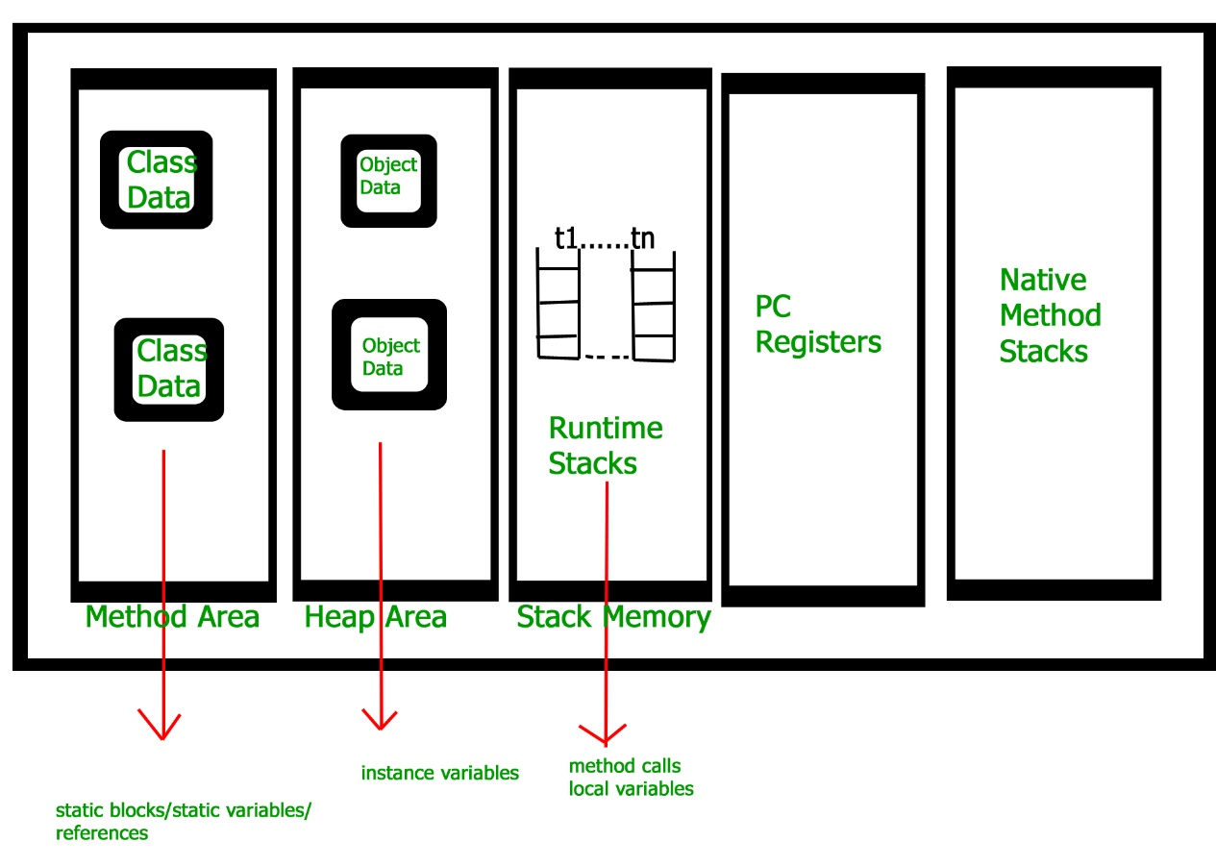
What is JVM?

Slide 47
What is JVM?
Execution Engine
Execution engine executes the “.class” (bytecode). It reads the byte-code line by line, uses data and information present in various memory area and executes instructions. It can be classified into three parts:
Interpreter: It interprets the bytecode line by line and then executes. The disadvantage here is that when one method is called multiple times, every time interpretation is required.
Just-In-Time Compiler(JIT): It is used to increase the efficiency of an interpreter. It compiles the entire bytecode and changes it to native code so whenever the interpreter sees repeated method calls, JIT provides direct native code for that part so re-interpretation is not required, thus efficiency is improved.
Garbage Collector: It destroys un-referenced objects.

Slide 48
What is JVM?
Java Native Interface (JNI) :
It is an interface that interacts with the Native Method Libraries and provides the native libraries(C, C++) required for the execution. It enables JVM to call C/C++ libraries and to be called by C/C++ libraries which may be specific to hardware.
Native Method Libraries :
It is a collection of the Native Libraries(C, C++) which are required by the Execution Engine.

