Slide 1

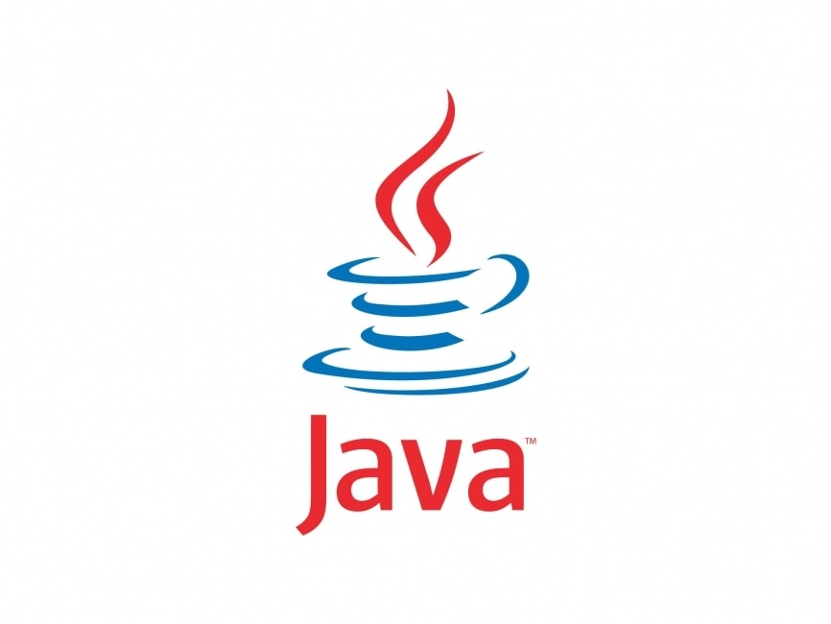
Java Introduction
Don’t write or place any image in this area

Slide 2

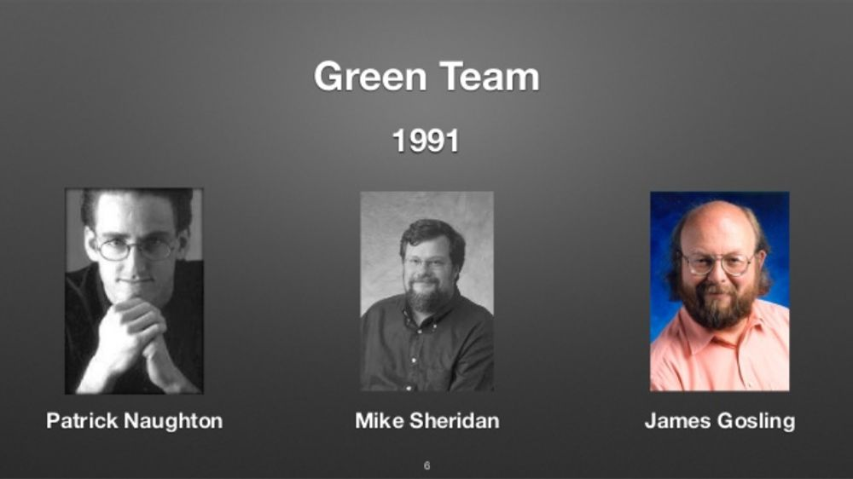
TOC
Java Language Introduction
Java Versions
Java Features
Java Software Installation
Hello Program Execution
Don’t write or place any image in this area

Slide 3
Java Language Introduction
‘C’ developed by Dennis MacAlistair Ritchie – 1973
C++ developed by ‘Bjarne Stroustrup’ – 1978
Java developed by ‘James Gosling’ – 1995 at Sun Microsystems later acquired by Oracle Corp
Desktop Applications
Web Applications
Distributed Applications
Inter-operable Applications
Mobile Applications
Big Data Applications
Cloud Applications
Data Analytics
Embedded Applications
James Gosling and his team members started the project in the early '90s. Currently, Java is used in internet programming, mobile devices, games, e-business solutions, etc.
James Gosling, Mike Sheridan, and Patrick Naughton initiated the Java language project in June 1991. The small team of sun engineers called Green Team.
Originally designed for small, embedded systems in electronic appliances like set-top boxes.
Firstly, it was called "Greentalk" by James Gosling and file extension was .gt.
After that, it was called Oak and was developed as a part of the Green project.
In 1995 OAK renamed as Java because it was already a trademark by OAK technologies
Don’t write or place any image in this area

Slide 4
Java Versions
Java SE 9 (Sept 21st 2017)
Java SE 10 (Mar 20th 2018)
Java SE 11 (Sept 2018)
Java SE 12 (Mar 19th 2019)
Java SE 13 (Sept 17th 2019)
Java SE 14 (Mar 17th 2020)
Java SE 15 (September 15th 2020)
Java SE 16 (Mar 16th 2021)
Java SE 17 (September 21st 2021)
Java SE 18 (March 22nd 2022)
Java SE 19 (Sept 20th 2022)
Java 20 (Mar 21st 2023)
Java 21 (Sept 19th 2023)
JDK Alpha and Beta (1995)
JDK 1.0 (23rd Jan 1996)
JDK 1.1 (19th Feb 1997)
J2SE 1.2 (8th Dec 1998)
J2SE 1.3 (8th May 2000)
J2SE 1.4 (6th Feb 2002)
J2SE 5.0 (30th Sep 2004)
Java SE 6 (11th Dec 2006)
Java SE 7 (28th July 2011)
Java SE 8 (18th Mar 2014)
Don’t write or place any image in this area

Slide 5

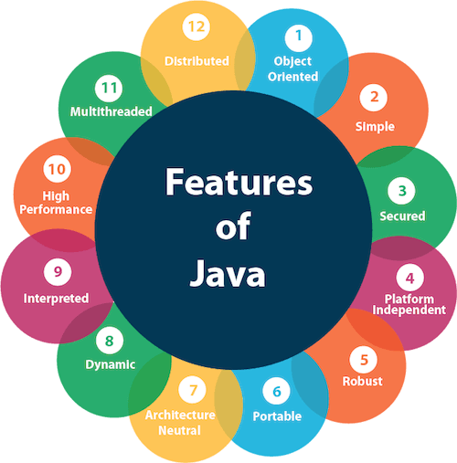
Java Features
Simple
Secure
Portable/Platform Independent
(because of compiled and interpreted)
Robust
Multithreaded
Distributed
Architecture Neutral
Object Oriented
Don’t write or place any image in this area

Slide 6
Java Features
Simple
Because Java doesn’t support complex features such as:
pointers
operator overloading
multiple inheritance
explicit memory allocation/deallocation
Don’t write or place any image in this area

Slide 7
Java Features
Secure
In Java we don’t have pointers, we cannot access memory locations directly in the programming.
That’s why several security flaws like stack corruption, buffer over flow are impossible to exploit in Java.
Don’t write or place any image in this area

Slide 8
Java Features
// Bytecode stream: 03 3b 84 00 01 1a 05 68 3b a7 ff f9
// Disassembly:
iconst_0 // 03
istore_0 // 3b
iinc 0, 1 // 84 00 01
iload_0 // 1a
iconst_2 // 05
imul // 68
istore_0 // 3b
goto -7 // a7 ff f9
Portable/Platform Independent
(because of compiled and interpreted)
Java Source file
Hello.java
Compiler
javac
Java
Java Byte Code file
Hello.class
javac Hello.java
Interpreter
java compiler compiles .java file into .class
Don’t write or place any image in this area
.class file contains java byte code instructions
java Hello
Byte Code Instructions are common to all OS
Linux OS
Mac OS
Windows OS

Slide 9
Java Features
Robust
Java is robust as it is capable of handling run-time errors, supports automatic garbage collection and exception handling, and avoids explicit pointer concept. Java has a strong memory management system. It helps in eliminating errors as it checks the code during both compile and runtime.
Unlike other programming languages in Java if any runtime error/exception arises due to because wrong input given and improper logic executes instead of terminating the program or hang-up the program, java gives detailed exception message stating reason why the program has been encountered exception and takes programmer help using try/catch block, handles exception and prevents from abnormal termination of program execution.
Don’t write or place any image in this area

Slide 10
Java Features
Multithreaded
Multithreading features allows us to run more than one method concurrently. If this feature doesn't exist methods can run sequential in the program. That means more than one method cannot run at a time, such as one method calculate employee salary, one method can print emp salary. If multithreading concept doesn't exist we need to calculate all these employee’s salary before printing employee pay slips. This slows down the emp payroll processing.
Don’t write or place any image in this area

Slide 11
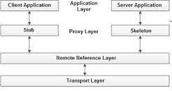
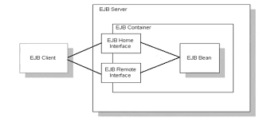
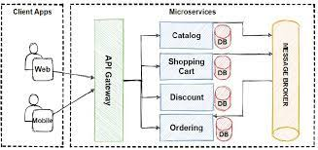
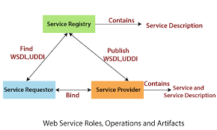
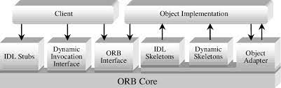
Java Features
Distributed
Because of java programming language supports distributed programming we can invoke java methods from remote systems which are very much useful in business applications. Business applications such as online ticket booking. In the online ticket booking the booking database exist in one machine, the bank & credit card applications runs on different machines. Then how these applications communicate from one machine to another machine, one machine implemented method accessed from another machine is because of distributed programming support. Internally distributed programming feature uses Socket programming. To develop distributed applications we will use RMI, CORBA, EJB, SOAP / RESTful Web Services and Microservices.
Don’t write or place any image in this area

Slide 12
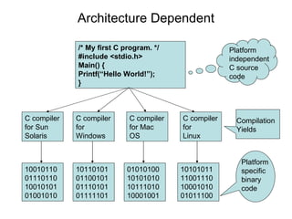
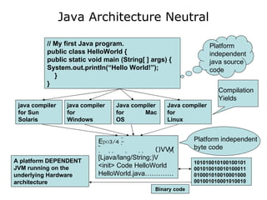
Java Features
Architecture Neutral
With architecture-neutral, the book means that the byte code is independent of the underlying platform that the program is running on. For example, it doesn't matter if your operating system is 32-bit or 64-bit, the Java byte code is exactly the same. You don't have to recompile your Java source code for 32-bit or 64-bit. (So, "architecture" refers to the CPU architecture).
Don’t write or place any image in this area

Slide 13
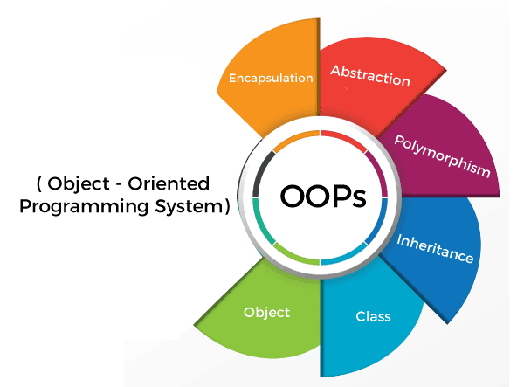
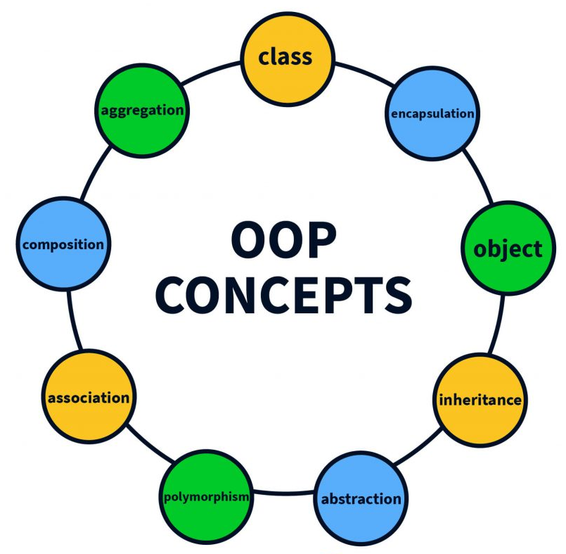
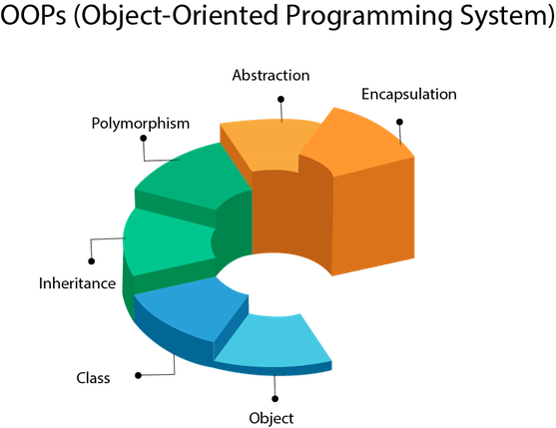
Java Features
Object Oriented
Encapsulation
Abstraction
Inheritance
Polymorphism
Message Passing
Hides method implementation
Hides data
Deriving from super class
Pass by value
Pass by reference
Don’t write or place any image in this area
Method overloading
Method overriding

Slide 14

Java Software Installation
Java Software Installation
Download and install jdk-8u20-windows-i586.exe in C:\ drive.
C:\Program Files\Java\jdk1.8.0_20\
src.zip - all java classes source code
bin\javac.exe (java compiler) and java.exe (java interpreter)
lib\tools.jar, dt.jar
jre\lib\rt.jar (192 packages 17000+ classes)
all java predefined classes are compiled and given in this file
Don’t write or place any image in this area

Slide 15
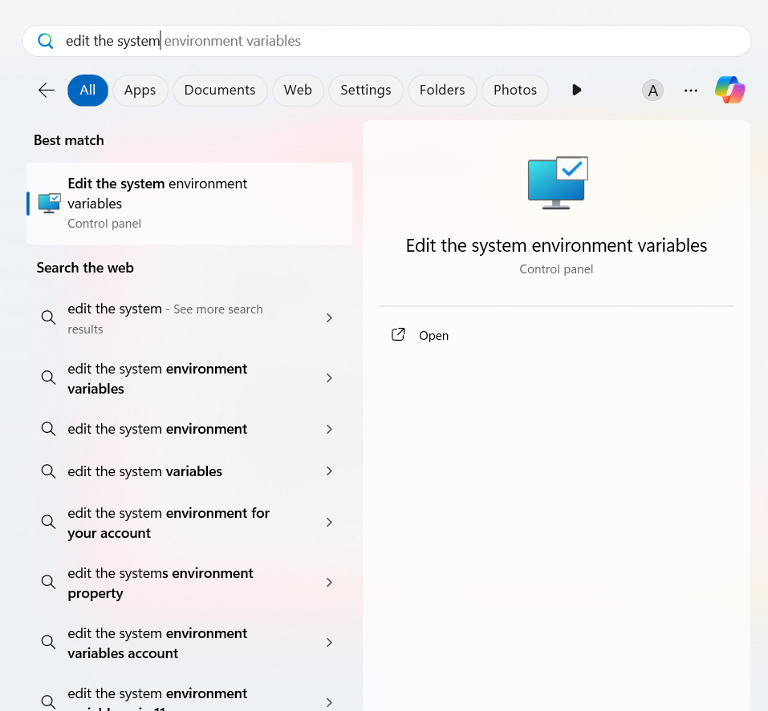
Java Software Installation
Don’t write or place any image in this area

Slide 16
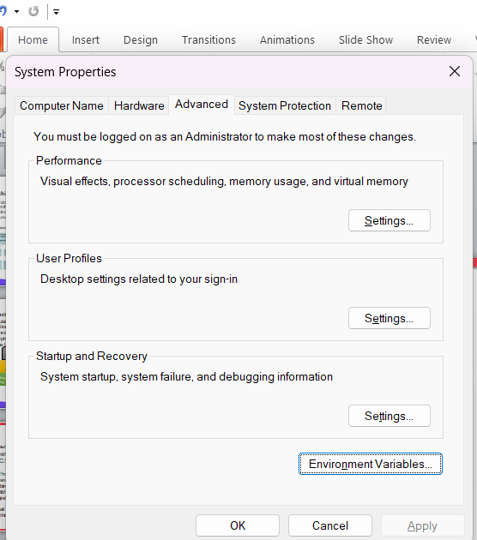
Java Software Installation
Don’t write or place any image in this area

Slide 17
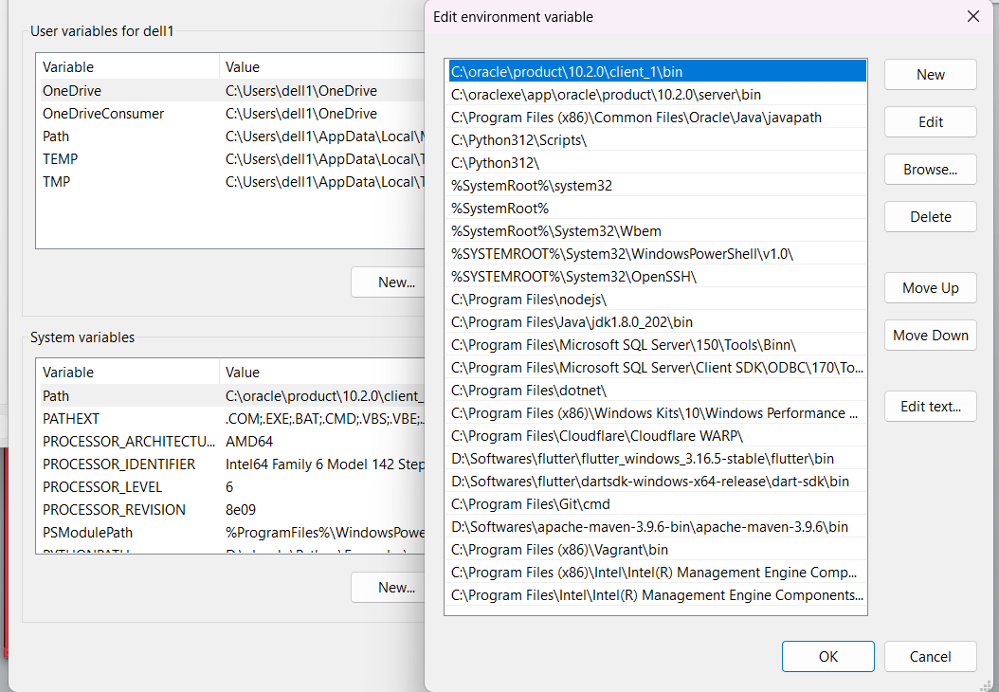
Java Software Installation
Don’t write or place any image in this area

Slide 18
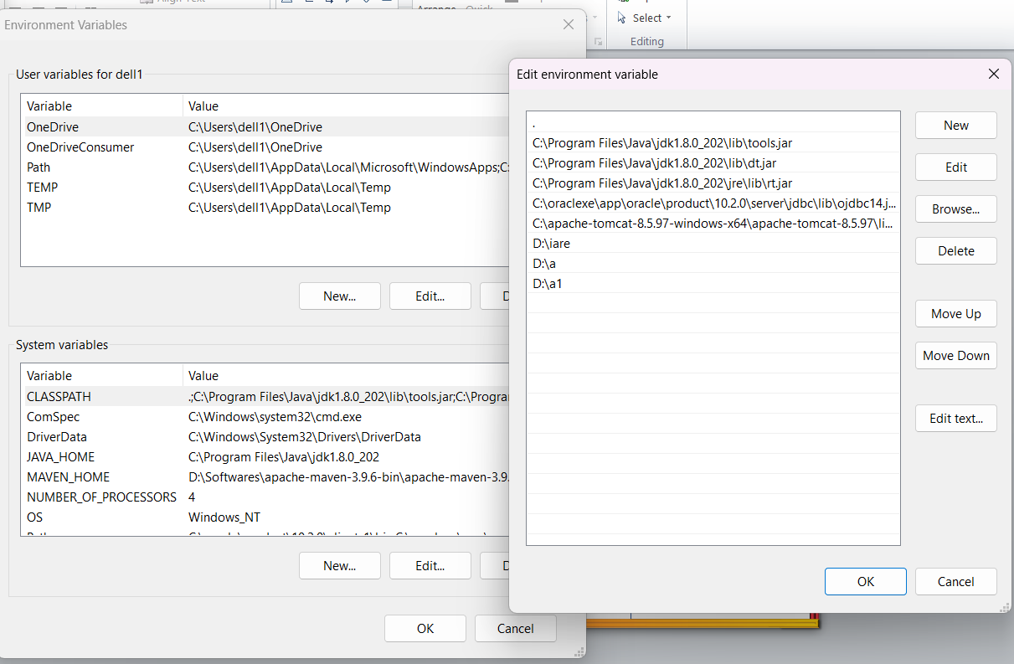
Java Software Installation
Don’t write or place any image in this area

Slide 19
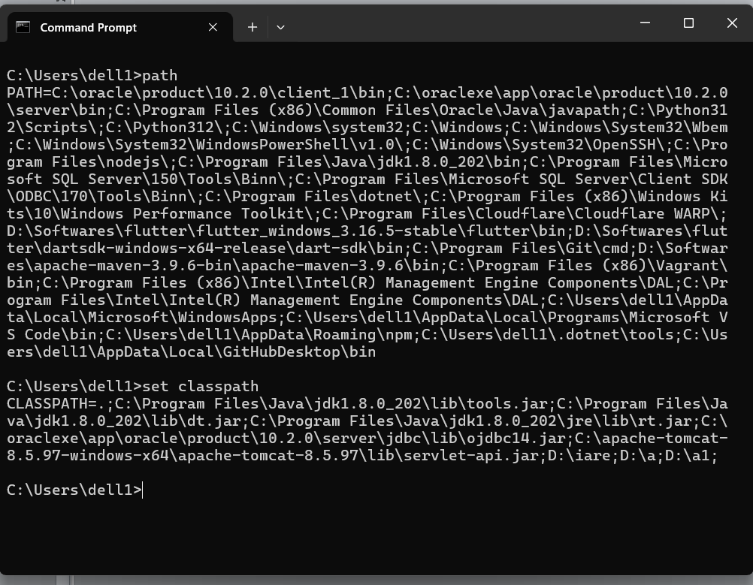
Java Software Installation
Don’t write or place any image in this area

Slide 20
Java Commands
Command | Description | Example
javac | Compiles .java extension file | javac Hello.java
java | Executes java .class file | java Hello
 | Displays java version | java -version
javap | Java disassembler Displays class variables, constructors and methods | javap java.lang.String javap java.lang.System javap java.util.Scanner
Don’t write or place any image in this area

Slide 21
Hello Program
Hello Program Execution (reading input from command line arguments)
D:\active\first\
// Hello.java
class Hello {
public static void main(String rags[]) {
System.out.println("Hello "+rags[0]);
}
}
Open command prompt, goto first directory
javac Hello.java
java Hello Suryanarayana IARE
java Hello “Suryanarayana IARE"
Don’t write or place any image in this area

Slide 22
Hello Program
Hello Program Execution (reading input from STDIN using Scanner class)
D:\active\first\
// Hello.java
import java.util.*
class Hello {
public static void main(String rags[]) {
Scanner sc=new Scanner(System.in);
System.out.println(“Enter your name”);
String name=sc.next();
System.out.println("Hello "+name);
}
}
Open command prompt, logon to hello directory
javac Hello.java
java Hello
Don’t write or place any image in this area

