Slide 1

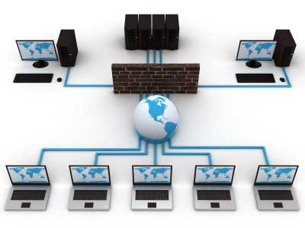
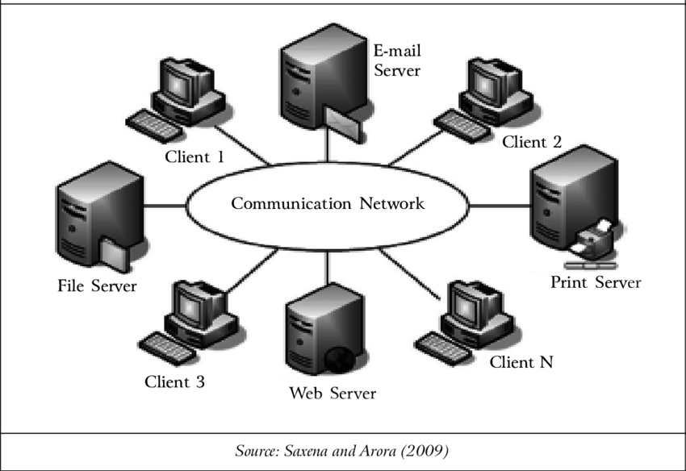
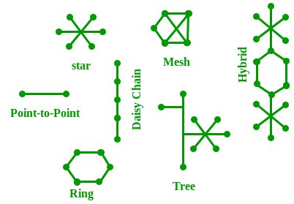
Networking
Networking in Java
java.net
Don’t write or place any image in this area

Slide 2

Networking
How two java programs running on two different machines communicate each other?
Is what we learn in Network programming.
Interprocessor Distance | Processor located in the same | Example
1 m | Square meter | Personal Area Network
10 m | Room | Local Area Network
100 m | Building
1 km | Campus
10 km | City | Metropolitan Area Network
100 km | Country | Wide Area Network
1000 km | Continent
10,000 km | Planet | The Internet
With this package classes we can develop network applications such as TCP/IP using Sockets API, UDP applications using Datagram API.
Don’t write or place any image in this area

Slide 3
Networking
The important classes in this package are:
InetAddress - We can resolve domain name into IP Address and vice-versa via DNS (Domain Naming Server) Server .
URL - We can download any files that exist on local/WWW server into our machine
URLConnection & HttpURLConnection - One way and two way interaction/communication with web applications on webserver /application server
Socket & ServerSocket - TCP/IP Client-Server Programming
DatagramSocket & DatagramPacket - UDP Sender-Receiver Programming
Don’t write or place any image in this area

Slide 4
Networking
InetAddress class is used to resolve domain name into IP Address and vice-versa by connecting to DNS Server.
Using URL class we can establish connection and read web pages or download various extension files from WWW server machine.
URLConnection class helps us to perform both read and write operations on local/WWW resources
Using Socket & ServerSocket we can implement our own TCP/IP protocol implement that also can run on both local n/w and remote n/w.
Using DatagramSocket and DatagramPacket we can implement our own UDP protocol implementations.
Don’t write or place any image in this area

Slide 5

Networking
Class ‘A’ Address:
In Class A an IP Address is assigned to those networks that contain a large number of hosts.
The N/W ID is 8 bits long
The Host ID is 24 bits long
In Class A, the first bit in higher order bits of the first octet is always set to 0 and the remaining 7 bits determine the N/W ID. The 24 bits determine the host ID in any network.
The total number of networks in Class A = 2⁷ = 128 networks
The total number of hosts in Class A = 2²⁴-2=1,67,77,214 host addresses
127.0.0.1/localhost is called as loop back address
Don’t write or place any image in this area

Slide 6

Networking
Class ‘B’ Address:
In Class B an IP Address is assigned to those networks that range from small-sized to large-sized networks.
The N/W ID is 16 bits long
The Host ID is 16 bits long
In Class B, the higher order bits of the first octet is always set to 10, and the remaining 14 bits determine the N/W ID. The other 16 bits determine the HostID.
The total number of networks in Class B = 2¹⁴=16,384 network address.
The total number of hosts in Class B =2¹⁶-2=65,534 hosts
127.0.0.1/localhost is called as loop back address
Don’t write or place any image in this area

Slide 7

Networking
Class ‘C’ Address:
In Class C an IP Address is assigned to only small sized networks.
The N/W ID is 24 bits long
The Host ID is 8 bits long
In Class C, the higher order bits of the first octet is always set to 110, and the remaining 21 bits determine the N/W ID. The other 8 bits determine the HostID.
The total number of networks in Class B = 2²¹=20,97,152 network address.
The total number of hosts in Class B =2⁸-2=254 hosts
127.0.0.1/localhost is called as loop back address
Don’t write or place any image in this area

Slide 8

Networking
Class ‘D’ Address:
In Class D an IP Address is reserved for multicast addresses. It does not posses subnetting. The higher order bits of the first octet is always set to 1110, and the remaining bits determines the Host Id in any network.
127.0.0.1/localhost is called as loop back address
Don’t write or place any image in this area

Slide 9

Networking
Class ‘E’ Address:
In Class E an IP Address is used for further use or for the research and development purposes. It doesn’t posses any subnetting. The higher order bits of the first octet is always set to 1111 and the remaining bits determines the HostID in any network.
127.0.0.1/localhost is called as loop back address
Don’t write or place any image in this area

Slide 10
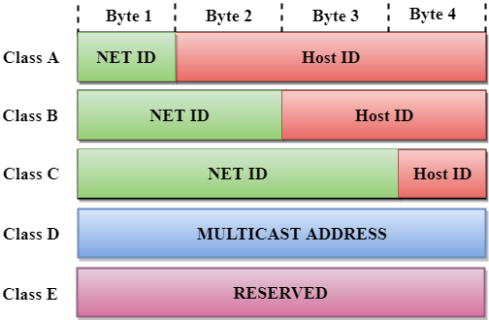
Networking
IPv4 (32-bit) Addresses:
Class | Higer order bits | NetID | HostID bits | No of networks | No of hosts per network | Address from range | Address to range
Class A | 0 | 8 | 24 | 2⁷ | 2²⁴ | 1.0.0.0 | 126.255.255.255
Class B | 10 | 16 | 16 | 2¹⁴ | 2¹⁶ | 128.0.0.0 | 191.255.255.255
Class C | 110 | 24 | 8 | 2²¹ | 2⁸ | 192.0.0.0 | 223.255.255.255
Class D | 1110 | Not defined | Not defined | Not defined | Not defined | 224.0.0.0 | 239.255.255.255
Class E | 1111 | Not defined | Not defined | Not defined | Not defined | 240.0.0.0 | 255.255.255.255
Don’t write or place any image in this area
Packets sent to this address never reach the network but are looped through the NIC card only. Its primary purpose is to test the communication infrastructure with the machine. It has only one end point.
127.0.0.1/localhost is called as loop back address
IPv4 reserves all addresses range from 127.0.0.1 to 127.255.255.255 for use in loopback testing

Slide 11
Networking
IPv4 (32-bit) Addresses:
The networks uses 3 ranges of IP Addresses. Networks use them as they wish. But the only rule is that no packet containing these addresses may appear on the Internet itself. The 3 reserved ranges are:
127.0.0.1/localhost is called as loop back address
From Addressro | To Address | Total no of hosts
10.0.0.0 | 10.255.255.255/8 | 1,67,77,216 hosts
172.16.0.0 | 172.31.255.255/12 | 10,48,576 hosts
192.168.0.0 | 192.168.255.255 | 65,536 hosts
Don’t write or place any image in this area
Class A, B, C are used in unicast addressing, Class D is for multicast addressing and Class E is meant for experimental purpose.
Unicast address is for Point-To-Point/One-One communication. That means only one sender, one receiver within and outside n/w
Multicast – 1/* senders
1/* receivers
Broadcast – One-To-All
Limited Broadcast – 1..* within n/w
Direct Broadcast – 1..* outside n/w

Slide 12




Networking
www.google.com
===================
class InetAddress
===================
Stands for Internet Address. Like other classes InetAddress class cannot be instantiated directly through its public no parameter constructor. 4 static methods are provided in this class to instantiate InetAddress class object.
static InetAddress getByName(String host)
static InetAddress getByAddress(String host
,byte addr[])
static InetAddress getByAddress(byte addr[])
static InetAddress[] getAllByName(String host)
The methods are:
byte[] getAddress()
String getCanonicalHostName()
String getHostAddress()
String getHostName()
static InetAddress getLocalHost() - localhost/127.0.0.1 (loopback)
172.217.163.164
1
2
3
DNS Server..n
6
DNS Server1
5
4
DNS Server2
Client
7
Don’t write or place any image in this area
Client lookups domain into DNS server
DSN1 lookups into DSN2 and so on up to DNS is resolved into IP address
DSN1 sends IP address back to client
Client connects server using that IP
Server

Slide 13
Networking
javac IADemo.java
java IADemo www.google.com
142.250.195.100
java IADemo www.ibm.com
104.120.161.65
java IADemo www.oracle.com
104.120.169.88
java IADemo 104.120.169.88
java IADemo www.facebook.com
java IADemo www.youtube.com
// IADemo.java
import java.net.*;
public class IADemo {
public static void main(String rags[]) throws Exception {
InetAddress ia=InetAddress.getByName(rags[0]);
System.out.println(ia.getHostName());
System.out.println(ia.getHostAddress());
System.out.println("******************************");
InetAddress ia1[]=InetAddress.getAllByName(rags[0]);
int len=ia1.length;
for(int i=0;i<len;i++) {
System.out.println(ia1[i].getHostName()+" / "+ia1[i].getHostAddress());
}
System.out.println("******************************");
InetAddress ia2=InetAddress.getLocalHost();
System.out.println(ia2.getHostAddress()+" "+ia2.getHostName());
}
}
Don’t write or place any image in this area

Slide 14
Networking
=================================
URL (Uniform Resource Locator)
=================================
With the help of URL class we can point to any resource on www server such as a web page (.html extension page) or any file (audio, video, pdf, docx, jpg, ppt, .fla, .swf, rm, .mp4).
URL stands for Uniform Resource Locator which is a subset of URI Uniform Resource Identifier/Indicator.
with the help of url.openStream() method that returns InputStream object, we can read/download the file.
If the file is text file we have to use DataInputStream with InputStream object, if the file is binary file we have to use BufferedInputStream with InputStream object to read file content.
Don’t write or place any image in this area

Slide 15
Networking
===========
URL contains:
===========
protocol://domainname:portnumber/path/filename
http://www.google.com:80/index.html
http://www.activenetinformatics.com:80/index.html
// important methods
String getProtocol()
int getPort()
String getHost()
String getFile()
String getRef()
String getPath()
// setter methods are also available
public class URL {
// constructors
URL(String url) throws MalformedURLException
URL(String protocol, String host, int port, String file) throws MalformedURLException
If protocol/www/host_name is missing in URL MalformedURLException raises.
If the specified host_name is unknown then UnknowHostException comes
// important methods
InputStream openStream()
URLConnection openConnection()
Don’t write or place any image in this area

Slide 16
Networking
// URLDemo.java
import java.net.*;
public class URLDemo {
public static void main(String rags[]) throws Exception {
URL u=new URL(rags[0]);
InputStream is=u.openStream();
DataInputStream dis=new DataInputStream(is);
FileOutputStream fos=new FileOutputStream(rags[1]);
PrintStream ps=new PrintStream(fos);
http://www.abcsite.com:80/training/batches.html
<html>
<body>
Welcome to our batch schedules
</body>
</html>
String line=dis.readLine();
while(line!=null) {
ps.println(line);
line=dis.readLine();
}
ps.close();
fos.close();
dis.close();
is.close();
}
}
Don’t write or place any image in this area
javac URLDemo.java
java URLDemo http://www.abcsite.com/training/batches.html abcsite_batches.com.html

Slide 17
Networking
The limitations of URL class is that it can only read WWW resources / local resources into our program/system, but it cannot perform both read and write operations onto server resources (.html, servlets, .jsp, .asp, .php, .cfm, .xsql, .py, .pdf, docx, .xlsx, .pptx, .rm, .mp4, .mkv, .mp3, .mpg, .mpeg, .au, .wav, .iso, .rar, .zip, .exe, ).
All Download Manager softwares uses URL class.
URLConnection and HttpURLConnection classes can only perform both read-write operations on server resources.
Don’t write or place any image in this area
All HttpClients like cURL, POSTMAN, Insomnia REST Client etc.

Slide 18
Networking
The limitations of URL class is that it can only read WWW resources / local resources into our program/system, but it cannot perform both read and write operations onto server resources (.html, servlets, .jsp, .asp, .php, .cfm, .xsql, .py, .pdf, docx, .xlsx, .pptx, .rm, .mp4, .mkv, .mp3, .mpg, .mpeg, .au, .wav, .iso, .rar, .zip, .exe, ).
All Download Manager softwares uses URL class.
Don’t write or place any image in this area
URLConnection and HttpURLConnection classes can only perform both read-write operations on server resources.
All HttpClients like cURL, POSTMAN, Insomnia REST Client etc.

Slide 19
Networking
About URLConnection
URLConnection class is a abstract class, hence it can’t be instantiated through constructor.
Instead URL class is having one method called openConnection() that returns URLConnection object that points to url pointing by URL class object.
It is mainly having 4 methods which are required to use in the program they are:
setDoOutput(boolean flag)
setDoInput(boolean flag)
OutputStream getOutputStream()
InputStream getInputStream()
and so many other setter and getter methods to know information about the URL pointing file.
Don’t write or place any image in this area

Slide 20


Networking
About HttpURLConnection
HttpURLConnection class supports HTTP specific features such as supporing GET, POST, PUT, DELETE methods. Sending request data through QueryString (in case of GET method) or via Payload (in case of POST).
HttpURLConnection class also contains all HTTP status code, status message and their description.
Don’t write or place any image in this area
Client
Standalone
Program
web Server
running
Servlet/JSP
consists of
emp and depts
data

Slide 21
Networking
// URLConnectionDemo.java
import java.net.*;
import java.io.*;
import java.util.*;
public class URLConnectionDemo {
public static void main(String rags[]) throws Exception {
URL u=new URL("http://localhost:8081/am3/FindEmpsByDeptno.jsp?deptno="+rags[0]);
/* Note: In URL class constructor if URL is not properly formed, MalformedURLException raises */
// using URLConnection we can perform both read and write operations
URLConnection uc=u.openConnection();
// HttpURLConnection is having additional benefit of Http protocol such as we can change the method from GET to POST
HttpURLConnection huc=(HttpURLConnection)uc;
huc.setRequestMethod("GET");
Client
Standalone
Program
web Server
running
Servlet/JSP
consists of
emp and depts
data
Don’t write or place any image in this area

Slide 22
Networking
// the following statement requests URLConnection objec to perform both write and read operations
huc.setDoOutput(true);
huc.setDoInput(true);
// opens OutputStream to write data onto server resource like servlet/jsp
OutputStream os=huc.getOutputStream();
PrintStream ps=new PrintStream(os);
/* ps.println() with no argument we are calling because we are submitting the form data through GET, hence form data sent as queryString. If the method is POST the form data goes through HTTP request body that we have to pass through ps.println() */
ps.println();
System.out.println("after request");
Client
Standalone
Program
web Server
running
Servlet/JSP
consists of
emp and depts
data
Don’t write or place any image in this area

Slide 23
Networking
/* whatever output the JSP writes back to client usually comes to browser if the request is made from browser. In this program we should read through InputStream. */
InputStream is=huc.getInputStream();
DataInputStream dis=new DataInputStream(is);
String line=dis.readLine();
System.out.println("after getting response "+line);
while(line!=null) {
StringTokenizer st=new StringTokenizer(line,"\n");
while(st.hasMoreTokens()) {
String emp=st.nextToken();// one-one line
StringTokenizer st1=new StringTokenizer(emp,"&");
while(st1.hasMoreTokens()) {
System.out.print(st1.nextToken()+"\t");
}
System.out.println();
}
line=dis.readLine();
}
dis.close(); is.close(); ps.close(); os.close();
}
}
Client
Standalone
Program
web Server
running
Servlet/JSP
consists of
emp and depts
data
Don’t write or place any image in this area

Slide 24
Networking
C:\Program Files\apache-tomcat-6.0.37-windows-x86\apache-tomcat-6.0.37\webapps\ROOT\am2\
<%-- FindEmpsByDeptno.jsp --%>
<%
int deptno=Integer.parseInt(request.getParameter("deptno"));
Class.forName(“oracle.jdbc.driver.OracleDriver");
java.sql.Connection con=java.sql.DriverManager.getConnection("jdbc:oracle:thin:@localhost:1521:XE","am36","am36");
Statement stmt=con.createStatement();
ResultSet rs=stmt.executeQuery("SELECT * FROM employee WHERE deptno="+deptno);
Client
Standalone
Program
web Server
running
Servlet/JSP
consists of
emp and depts
data
Don’t write or place any image in this area

Slide 25
Networking
String responseStr="";
while(rs.next()) {
responseStr+=rs.getInt(1)+"&";
responseStr+=rs.getString(2)+"&";
responseStr+=rs.getString(3)+"&";
responseStr+=rs.getString(4)+"&";
responseStr+=rs.getString(5)+"&";
responseStr+=rs.getString(6)+"&";
responseStr+=rs.getString(7)+"&";
responseStr+=rs.getString(8)+"\n";
}
rs.close(); stmt.close(); con.close();
%>
<%=responseStr%>
Client
Standalone
Program
web Server
running
Servlet/JSP
consists of
emp and depts
data
Don’t write or place any image in this area
To start tomcat web server
C:\Program Files\apache-tomcat-6.0.37-windows-x86\apache-tomcat-6.0.37\bin\startup.bat
tomcat.exe

Slide 26
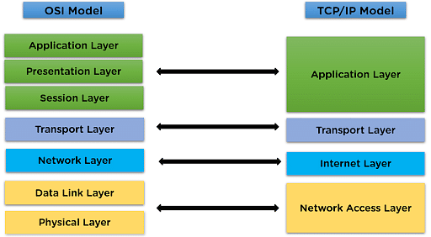
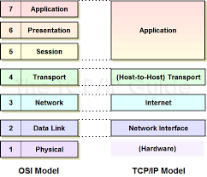
Networking
=============================================
Socket Programming / TCP/IP Programming using
Socket and ServerSocket classes
=============================================
There are two protocol models exist:
- TCP/IP model
- ISO-OSI model
Don’t write or place any image in this area

Slide 27
Networking
Each machine is having 65536 ports range from port number 0 to port number 65535. 0-1023 ports are reserved ports.
HTTP - 80 (Hyper Text Transfer Protocol) purpose is to browse web sites
SMTP – 25 sending mail (Simple Mail Transfer Protocol)), POP3 (Post Office Protocol) - receiving mail
FTP - 21 (File Transfer Protocol) uploading files to server
XMPP - Whatsapp protocol (Extensible Messaging and Presence Protocol)
SMPP (Short Message Peer-to-Peer Protocol) sends SMS (Short Message Service) text messages.
Tomcat WS - 8080
Weblogic AS – 7001
IBM WebSphere AS – 8008
JBoss AS - 9990
Oracle DB/orcl - 1521
MySQL DB/mysql - 3306
MS-SQL Server/sql - 1431
IBM DB2 DB/db2 – 50000
Flask – 5000
Django – 8000
Don’t write or place any image in this area

Slide 28
Networking
We use different protocols to connect to different server for different purposes using different TCP/IP based protocols. All the above said protocols are predefined protocols.
Transmission Control Protocol (TCP) is a connection-oriented protocol that provides reliable and ordered delivery of data from one computer to another.
In other words, TCP is the transport protocol you use whenever you want to ensure that all the bytes you send from one point reach the other completely and in the correct order.
One client program and one server program together called as one protocol.
Don’t write or place any image in this area

Slide 29
Networking
Http protocol comprises of one client/Http client (browser) and one server/Http server (web server on WWW machines)
These two together called as Http protocol. That means two - client and server programs are together called as protocol.
To implement custom protocols we need to use ServerSocket and Socket classes.
In java.net package ServerSocket and Socket named two classes are given to implement TCP/IP protocol. ServerSocket class is also called as ListenerSocket class because it binds on to one port, listens for client requests, for each Socket client request it creates one Socket object on server system through which actual communication between client and server will take place.
Don’t write or place any image in this area

Slide 30
Networking
ServerSocket class
This class is used to run on machine which is intended as server. To run ServerSocket port number is required as argument. We can give any port from 128 - 65535 (because 0-127 ports are reserved ports).
ServerSocket class constructors & methods:
ServerSocket(int port)
binds ServerSocket on given port number
Socket accept()
this method accepts client request on server, creates a Socket object for client on server.
InetAddress getInetAddress()
returns InetAddress object of the machine on which current ServerSocket is running
int getLocalPort()
returns port number of which ServerSocket is running
close()
closes ServerSocket object
Don’t write or place any image in this area

Slide 31
Networking
Socket class
This class is used to run on machine which is intended as client. To run Socket both hostname and port number are required as arguments.
Socket(String hostName, int port)
binds ServerSocket on given port number
OutputStream getOutputStream()
returns OutputStream on client system to write request to server
InputStream getInputStream()
returns InputStream on client system to read response from server
InetAddress getInetAddress()
returns InetAddress object of the machine to which our Socket is connected
int getPort()
returns port number of which Socket is connected on server
close()
closes Socket object
Don’t write or place any image in this area

Slide 32
Networking
// HelloServer.java
import java.net.*;
import java.io.*;
public class HelloServer {
public static void main(String rags[]) throws Exception {
// 0 - 65535 ports exist; 0-1023 ports are reserved; remaining are unreserved
// port number other than 0-65535 causes IllegalArgumentException
ServerSocket ss=new ServerSocket(65000);
// the following method waits for the client request
// a Socket object created on server system for each client
// a ss object can accepts 50 max number of client requests at a time
Socket s=ss.accept();
// SocketInputStream sis=s.getInputStream();
DataInputStream dis=new DataInputStream(s.getInputStream());
String line=dis.readLine();
line="Hello "+line;
PrintStream ps=new PrintStream(s.getOutputStream());
ps.println(line);
ps.close();
dis.close();
s.close();
}
}
javac *.java
start java HelloServer
java HelloClient ActiveNET
Don’t write or place any image in this area

Slide 33
Networking
// HelloClient.java
import java.net.*;
import java.io.*;
public class HelloClient {
public static void main(String rags[]) throws Exception {
Socket s=new Socket("localhost", 65000);
// SocketOutputStream sos=s.getOutputStream();
PrintStream ps=new PrintStream(s.getOutputStream());
ps.println(rags[0]);
// reading some string from command line argument and sending that string to server
DataInputStream dis=new DataInputStream(s.getInputStream());
String responseText=dis.readLine();
System.out.println(responseText);
dis.close();
ps.close();
s.close();
}
}
Don’t write or place any image in this area

Slide 34
Networking
Above HelloServer program processes only one client request, once one client request process is completed the server terminates.
But we are writing following program there the server will process multiple client requests.
Don’t write or place any image in this area

Slide 35
Networking
// MHelloServer.java
import java.net.*;
import java.io.*;
class MHelloServer {
public static void main(String rags[]) throws Exception {
ServerSocket ss=new ServerSocket(65000);
// infinite loop
while(true) {
Socket s=ss.accept();
// this program only accepts client requests, but doesn't process request here
// the request is processed in thread
// hence for each client we need to create and start one-one thread
HelloThread ht=new HelloThread(s);
ht.start();
}
}
}
Don’t write or place any image in this area

Slide 36
Networking
// HelloThread.java
import java.net.*;
import java.io.*;
class HelloThread extends Thread {
Socket s;
HelloThread(Socket s) {
this.s=s;
}
public void run() {
try {
// read the client request
InputStream in=s.getInputStream();
DataInputStream dis=new DataInputStream(in);
String line=dis.readLine();
// process client request
line="Hello "+line;
// send response back to client
OutputStream out=s.getOutputStream();
PrintStream ps=new PrintStream(out);
ps.println(line);
// close all the objects
ps.close();
out.close();
dis.close();
in.close();
s.close();
} catch(Exception e) {
e.printStackTrace();
}
}
}
Don’t write or place any image in this area

Slide 37
Networking
FTPServer, FTPClient and Multithreaded FTPServer
Client establishes Socket connection to server
Client wants to reads one file from the server, client sends filename/filepath onto server
Server opens the file, send file content line-line
Client must read line-line until line reaches to null and print it on console or write it into another local file
Don’t write or place any image in this area

Slide 38
Networking
FTPServer:
Create ServerSocket that runs on port number 21
ss should wait for the client request
The moment client request comes ss will create a Socket object on server system for client
Server should read filepath sent by client from s.inputstream
Using FileInputStream and DataInputStream server must line-line (use while loop and str!=null) from file
Such a each line must be send to client via s.outputstream
close all the streams and socket
Don’t write or place any image in this area

Slide 39
Networking
FTPClient:
Client should request Socket object with hostname and port number, Socket object connects to ServerSocket, that inturn creates one Socket object for client on server
Client side Socket now connects/points to Socket object on server
Client should sent filename or file path to server via socket.outputstream
Client should read file content line-line from server using while loop and str!=null using s.inputstream
close all the streams and socket
Don’t write or place any image in this area

Slide 40
Networking
// FTPServer.java
import java.net.*;
import java.io.*;
public class FTPServer {
public static void main(String rags[]) throws Exception {
ServerSocket ss=new ServerSocket(21);
Socket s=ss.accept();
DataInputStream dis=new DataInputStream(s.getInputStream());
String fileName=dis.readLine(); // reading client send filename
// opening PrintStream to write response to client
PrintStream ps=new PrintStream(s.getOutputStream());
// opening DataInputStream to read line-line from file
DataInputStream dis1=new DataInputStream(new FileInputStream(fileName));
String line=dis1.readLine();
while(line!=null) {
ps.println(line); // print line to client
line=dis1.readLine(); // read next line
}
dis1.close();
ps.close();
dis.close();
}
}
Don’t write or place any image in this area

Slide 41
Networking
// FTPClient.java
import java.net.*;
import java.io.*;
import java.util.*;
class FTPClient {
public static void main(String rags[]) throws Exception {
Socket s=new Socket("localhost", 21);
Scanner sc=new Scanner(System.in);
System.out.println("Enter filename/filepath to download from server");
String fileToDownload=sc.next();
System.out.println("Enter filename/file to save it on local machine");
String fileToSave=sc.next();
PrintStream ps=new PrintStream(s.getOutputStream());
ps.println(fileToDownload);
PrintStream ps1=new PrintStream(new FileOutputStream(fileToSave));
DataInputStream dis=new DataInputStream(s.getInputStream());
String line=dis.readLine();
while(line!=null) {
ps1.println(line);
line=dis.readLine();
}
dis.close();
ps1.close();
ps.close();
s.close();
}
}
Don’t write or place any image in this area

Slide 42
Networking
The above FTP Server is processing single client request. In order to process multiple client requests we need to make the server side socket implementation multithreaded.
// MFTPServer.java
import java.net.*;
public class MFTPServer {
public static void main(String rags[]) throws Exception {
ServerSocket ss=new ServerSocket(21);
System.out.println("FTPServer running on port 21, waiting for client requests");
while(true) {
Socket s=ss.accept();
FTPThread ftpt=new FTPThread(s);
ftpt.start();
}
// dont write any statement after infinite loop, if do so Unreachable statement compilation error will come.
}
}
Don’t write or place any image in this area

Slide 43
Networking
// FTPThread.java
import java.net.*;
import java.io.*;
public class FTPThread extends Thread {
Socket s;
public FTPThread(Socket s) {
this.s=s;
}
public void run() {
try {
DataInputStream dis=new DataInputStream(s.getInputStream());
PrintStream ps=new PrintStream(s.getOutputStream());
String fileName=dis.readLine();
DataInputStream dis1=new DataInputStream(new FileInputStream(fileName));
String line=dis1.readLine();
while(line!=null) {
ps.println(line);
line=dis1.readLine();
}
dis1.close();
ps.close();
dis.close();
s.close();
}
catch(Exception e) {
e.printStackTrace();
}
}
}
Don’t write or place any image in this area

Slide 44
Networking
UDP (User Datagram Protocol)
TCP/IP
Server-Client
UDP:
Sender-Receiver
Socket and ServerSocket are connection oriented protocols. UDPSocket and UDPPacket classes are used to implement UDP Protocol (User Datagram Protocol) also called connection less / unreliable protocol.
In Socket (TCP/IP Protocol) programming one Socket connection will be established to ServerSocket running on server system, that will open one Socket connection for each client on server system through which client will send and receive information.
The Socket connection exist as long as communication takes place.
Whereas in UDP, in UDPPacket itself contains the "data" and to which "IPAddress machine" and "port number" the request want to be sent contains.
Don’t write or place any image in this area

Slide 45
Networking
On receiver system UDPSocket is used only to receive UDPPacket objects.
On server system, UDPSocket(int port) must be used to listen UDPPacket, one UDPPacket object must be created with empty byte array once such as UDPPacket object is passed as argument into UDPSocket class receive method, UDPPacket object populated with client's data.
This is how Packets are individually delivered to server. Packet itself routes the n/w communication.
Don’t write or place any image in this area

Slide 46
Networking
// SMSUDPServer.java (Receiver)
import java.net.*;
public class SMSUDPServer {
public static void main(String rags[]) throws Exception {
DatagramSocket dgs=new DatagramSocket(65000);
byte b[]=new byte[1024];
DatagramPacket dgp=new DatagramPacket(b, b.length);
dgs.receive(dgp);
String str=new String(b);
System.out.println(str.trim());
}
}
Don’t write or place any image in this area

Slide 47
Networking
// SMSUDPClient.java (Sender)
import java.net.*;
public class SMSUDPClient {
public static void main(String rags[]) throws Exception {
DatagramSocket dgs=new DatagramSocket();
String msg="Hello this is the test message from my SMSUDPClient";
DatagramPacket dgp=new DatagramPacket(msg.getBytes(), msg.length(), InetAddress.getLocalHost(), 65000);
dgs.send(dgp);
System.out.println("Message delivered");
}
}
Don’t write or place any image in this area

