Slide 1

java.lang package classes
java.lang package classes
Object
System
Class
Process
Runtime
Don’t write or place any image in this area

Slide 2
java.lang package classes
In java.lang package classes
Wrapper classes (Byte, Short, Integer, Long, Float, Double, Character, Boolean)
String, StringBuffer, StringBuilder
Exception classes (Throwable, Error, Error sub classes, Exception, Exception sub classes, RuntimeException,RuntimeException sub classes
Thread class & Runnable interface
Object, System, Class, Process, Runtime
Don’t write or place any image in this area

Slide 3
java.lang package classes
public class Object
User defined classes such as:
Java Bean/POJO/DTO, VO/BO/Entity/Domain classes
Standalone classes (class containing main() method)
Factory classes (creates objects of other classes)
Validator classes (NotNull, MinLength, MaxLength, Date, Email, URL, CreditCard, PANCard, AadharCardNo, SSNo, ZIP, Pattern/RegExpr validatons)
Business logic classes (calSal(), calTax(), calPercentage(), authenticate(), isAuthroized())
DAO classes (contains CRUD operations)
Thread & Runnable sub classes
Comparable classes (compareTo(Object o)
Comparator classes (compare(Object lhs, Object rhs)
Remote components (RMI, CORBA, EJB)
Web components (Servlets, JSP, Struts Action, Spring Controller, JSF ManagedBean classes)
Inter-operator components (SOAP, RESTful webservices)
Don’t write or place any image in this area

Slide 4
java.lang package classes
public class Object
public boolean equals()
public int hashCode()
public String toString()
Object clone()
void finalize()
Class getClass()
void wait()
void wait(long milliSecs)
void wait(long milliSecs, int nanoSecs)
void notify()
void notifyAll()
Don’t write or place any image in this area

Slide 5
java.lang package classes
public class Object
java.lang.Object is the root most class to all the java classes in class hierarchy.
Root most class to all Java predefined & user defined classes
If we write a class without extending from any super class, during compilation time the class by default derives from java.lang.Object
For example
class Hello {
p void sayHello(String name) {
}
}
javac Hello.java
Don’t write or place any image in this area
class Hello extends Object {
// default constructor
Hello() {
super();
}
public void sayHello(String name) {
}
}

Slide 6
java.lang package classes
public class Object
class HelloClient {
public static void main(String rags[]) {
Hello hello=new Hello();
Hai hai=new Hai();
System.out.println(hello instanceof Hello);
System.out.println(hello instanceof Object);
System.out.println(hai instanceof Hai);
System.out.println(hai instanceof Hello);
System.out.println(hai instanceof Object);
}
}
class Hai extends Hello {
p v sayHai(String name) {
}
}
javac Hai.java
class Hai extends Hello {
Hai() {
super();
}
p v sayHai(String name) {
System.out.println(name+" "+name.toLowerCase());
}
}
Don’t write or place any image in this area

Slide 7
java.lang package classes
public class Object
To bring all Java classes under one roof java.lang.Object acts as super most class. For marking/recognizing the class as a Java class.
The another reason is Object class provides common functionalities/methods to all the Java class.
equals(), hashCode(), toString(), wait(), wait(long ms), wait(long ms, int nanos), notify(), notifyAll(), getClass(), finalize(), clone()
All most all sub classes of Object class overrides equals(), hashCode() and toString() methods according to their class instance variables.
For example in String class these 3 methods are implemented on char array.
In Date class these 3 methods are implemented by using date, month, year, hours, minutes, seconds and milliseconds.
If we write user defined class like Emp we will implement equals(), toString(), hashCode() methods using eid, ename, sal and desig variables.
Don’t write or place any image in this area

Slide 8
java.lang package classes
public class Object
Why every class need to override equals() method because if two objects of the same class want to compared then equals() method is used not ==.
== operator compares address of object, == operator compares values of primitive members
String str1=“Surya”; String str2=“surya”;
if(str1.equals(str2)) {}
if(emp1.equals(e2)) {}
if(date1.equals(date2)) {}
Don’t write or place any image in this area

Slide 9
java.lang package classes
public class Object
public String toString() {
return sid+" "+sname+" "+email+" "+mobile+" "+course;
}
public int hashCode() {
return toString().hashCode();
}
public Object clone() {
// shallow cloning
// return this;
// deep cloning
Emp e1=new Emp();
e1.setEid(this.eid);
e1.setEname(this.ename);
e1.setSal(this.sal);
e1.setDesig(this.desig);
return e1;
}
class Emp {
int eid; String ename; double sal; String desig;
public boolean equals(Object o) {
boolean flag=false;
if(o instanceof Emp) {
Emp e1=(Emp)o;
if(this.eid==e1.getEid() && this.ename.equals(e1.getEname()) && this.sal==e1.getSal() && this.desig.equals(e1.getDesig()) {
flag=true;
}
}
return flag;
}
public void finalize() {
this.eid=0;
this.ename=null;
this.sal=0.0;
this.desig=null;
}
}
Don’t write or place any image in this area
wait(), notify() and notifyAll() methods are used in method & object synchronization.

Slide 10
java.lang package classes
public class Object
public Class getClass()
getClass() method is used for two purposes:
i) to retrieve the class name for ex: e1.getClass().getName()
ii) to introspect the Class
Introspection is a method to retrieve the details of a class, its super class, super interfaces, variables, constructors and methods exist in the class. At runtime whatever class name we give to Class object using
Class c=Class.forName(rags[0]); // pass fully qualified class name of the class
Don’t write or place any image in this area

Slide 11
java.lang package classes
public class Class
The class Class is having following methods:
Package getPackage()
int getModifiers()
String getName()
Class getSuperClass()
Class[] getInterfaces()
Field[] getFields()
Constructor[] getConstructors()
Method[] getMethods()
Don’t write or place any image in this area

Slide 12
java.lang package classes
public class Class
All the above said classes exist in java.lang.reflect package.
Package class is having
String getName() method
Field class is having
String getName()
Class getType()
int getModifiers()
Method class is having
String getName()
Class getReturnType()
int getModifiers()
Class[] getParameterTypes()
Class[] getExceptionTypes()
Constructor class having
String getName()
int getModifiers()
Class[] getParameterTypes()
Don’t write or place any image in this area

Slide 13
java.lang package classes
// ReflectionDemo.java
import java.lang.reflect.*;
public class ReflectionDemo {
public static void main(String rags[]) throws Exception {
Class c=Class.forName(rags[0]);
System.out.println("Class Name is "+c.getName());
System.out.println("instance is "+c.newInstance());
try {
System.out.println("super class "+c.getSuperclass().getName());
} catch(Exception e) {}
System.out.println("access modifiers "+c.getModifiers());
Class c1[]=c.getInterfaces();
int len1=c1.length;
for(int i=0;i<len1;i++){
System.out.println("super interface is "+c1[i].getName());
}
Field f1[]=c.getFields();
len1=f1.length;
for(int i=0;i<len1;i++){
System.out.println("Field Name is "+f1[i].getName()+", field type is "+f1[i].getType()+", modifiers are "+f1[i].getModifiers());
}
Don’t write or place any image in this area

Slide 14
java.lang package classes
Constructor con1[]=c.getConstructors();
len1=con1.length;
for(int i=0;i<len1;i++){
System.out.println("Constructor name is "+con1[i].getName()+", modifiers are "+con1[i].getModifiers());
Class[] ptc=con1[i].getParameterTypes();
for( int j=0;j<ptc.length;j++) {
System.out.println("\t\t parameter type is "+ptc[j].getName());
}
}
Method met1[]=c.getMethods();
len1=met1.length;
for(int i=0;i<len1;i++){
System.out.println("Method name is "+met1[i].getName()+", modifiers are "+met1[i].getModifiers()+", return type is "+met1[i].getReturnType().getName());
Class[] ptc=met1[i].getParameterTypes();
for( int j=0;j<ptc.length;j++) {
System.out.println("\t\t parameter type is "+ptc[j].getName());
}
}
}
}
Don’t write or place any image in this area

Slide 15
java.lang package classes
Another example on introspection:
import java.lang.Class;
import java.lang.reflect.Field;
import java.lang.reflect.Constructor;
import java.lang.reflect.Method;
class IntrospectionDemo {
public static void main(String rags[]) {
// Class c=Class.forName("java.lang.String");
Class c=Class.forName(rags[0]);
int i=c.getModifiers();
Class sc=c.getSuperClass();
System.out.println(sc.getPackage().getName()+" "+sc.getName());
Class intfs[]=c.getSuperInterfaces();
for(Class intf:intfs) {
System.out.println(intf.getPackage().getName()+" "+intf.getName());
}
Don’t write or place any image in this area

Slide 16
java.lang package classes
Field fs[]=c.getFields();
for(Field f:fs) {
System.out.println("Modifiers "+f.getModifiers());
System.out.println("Datatype "+f.getType());
System.out.println("Var name "+f.getName());
}
Constructor constrs[]=c.getConstructors();
for(Constructor constr:constrs) {
System.out.println("Modifiers "+constr.getModifiers());
System.out.println("Name "+constr.getName());
System.out.println("Parameters count "+constr.getParameterCount());
System.out.println("Exceptions count "+constr.getExceptionTypes().length);
}
Don’t write or place any image in this area

Slide 17
java.lang package classes
Method mets[]=c.getMethods();
for(Method met:mets) {
System.out.println("Modifiers "+met.getModifiers());
System.out.println("Name "+met.getName());
System.out.println("Return type "+met.getReturnType().getName());
System.out.println("Parameters count "+met.getParameterCount());
System.out.println("Exceptions count "+met.getExceptionTypes().length);
}
}
}
Don’t write or place any image in this area

Slide 18
java.lang package classes
java.lang package classes
Object
Class
System
Process
Runtime
Don’t write or place any image in this area
Part II

Slide 19
java.lang package classes
class System
public static InputStream in;
public static PrintStream out;
public static PrintStream err;
public static void arrayCopy(Object srcArray, int srcIndex, Object destArray, int destIndex, int length)
public static long currentTimeMillis()
public static void exit(int status)
public static void gc()
public static Properties getProperties()
public static String getProperty(String propertyName)
public static Map<String,String> getenv()
public static SecurityManager getSecurityManager()
public static void load(String fileName)
public static void loadLibrary(String libName)
public static void setIn(InputStream is)
public static void setOut(OutputStream os)
public static void setErr(OutputStream os)
public static Console getConsole()
Don’t write or place any image in this area

Slide 20
java.lang package classes
class System
public static InputStream in;
Also called as standard input stream STDIN. This stream is already open and ready to supply user input. This stream by default points to STDIN keyboard. Through setIn(InputStream is) function we can change the input stream object pointing by System.in.
public static PrintStream out;
Also called as standard output stream STDOUT. This stream is already opened to ready to write data onto any standard output device monitor. Through setOut(OutputStream os) function we can change the outputstream object pointing by System.out.
public static PrintStream err;
This stream is used to display error messages on STDERR device typical our system monitor by default. using setErr(OutputStream os) function we can change STDERR device pointing to error log file onto any output device.
Don’t write or place any image in this area

Slide 21
java.lang package classes
class System
System.out.println("*********************");
System.out.println("Current Time in Millisecond "+System.currentTimeMillis());
System.out.println("date and Time "+new java.util.Date(System.currentTimeMillis()));
PrintStream ps=new PrintStream(new FileOutputStream("STDOUT.txt"));
System.setOut(ps);
System.out.println("Hello");
System.out.println("Hai");
System.out.println("Bye");
}
}
// DisplaySystemPropertiesEnvVars.java
import java.util.*;
import java.io.*;
public class DisplaySystemPropertiesEnvVars {
public static void main(String rags[]) throws Exception {
Properties p=System.getProperties();
Enumeration en=p.propertyNames();
while(en.hasMoreElements()) {
String name=en.nextElement().toString();
String value=p.getProperty(name);
System.out.println(name+"\t\t\t"+value);
}
System.out.println("*********************");
Map<String,String> map=System.getenv();
Set<String> set=map.keySet();
for(String key:set) {
System.out.println(key+"\t\t\t"+map.get(key));
}
Don’t write or place any image in this area

Slide 22
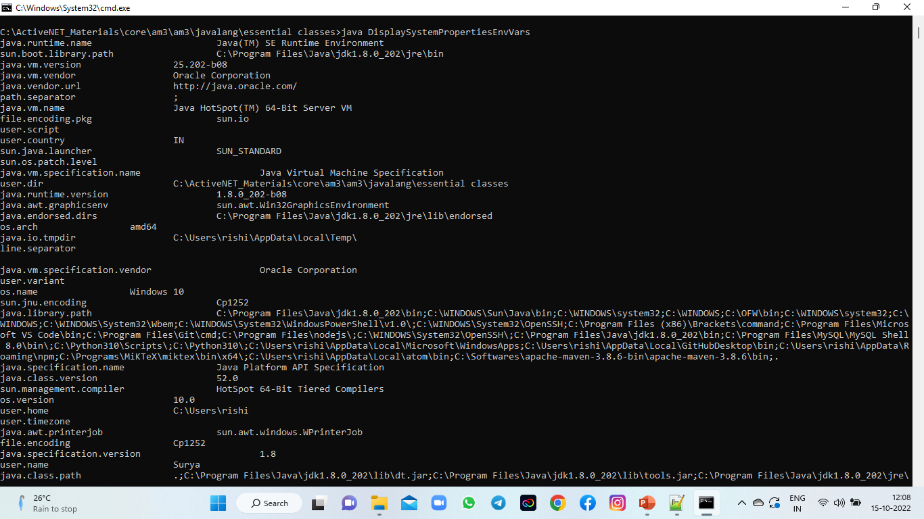
java.lang package classes
Don’t write or place any image in this area

Slide 23
java.lang package classes
Process and Runtime classes
Process class is a abstract class which cannot be directly instantiated, instead this class object is returned to Runtime class exec() method.
Runtime class also cannot be directly instantiated because there is no public constructor exist in this class. The constructor is made as private.
Then how Runtime class can be instantiated and why is its constructor is made as private?
The actual purpose of Runtime class is to access the current JVM runtime environment. The current JVM env is nothing but from command prompt we will start java ClassName. JVM starts and ClassName will run in the JVM, in whichever JVM the ClassName is running in that class if we write Runtime.getRuntime() that corresponding JVM reference will be returned into java program.
class SomeClass {
public static void main(String rags[]) {
Runtime rt=Runtime.getRuntime();
}
}
Don’t write or place any image in this area
javac SomeClass.java
java SomeClass

Slide 24
java.lang package classes
Because we donot want a new JVM instead in whichever JVM our Java program is running if that JVM want to be fetched instead of creating Runtime class object using new operator and constructor, its static method must be used.
Runtime rt=Runtime.getRuntime();
The purpose of getting current JVM reference is to invoke the native components of the current OS from java program.
In Windows .exe, cmd, .bat are self executable files. In Unix and Linux .sh files, in Solaris .so files are OS native files. These files can run from the command prompt of Windows OS, shell prompt of Unix and Linux OSs. But if these programs want to run from java program we need current JVM object reference.
Don’t write or place any image in this area

Slide 25
java.lang package classes
Important methods of Runtime class:
Runtime getRuntime()
void exit(int status)
void halt(int status)
exec(String file) - will take .exe filename if its directory is updated in the PATH, if .exe containing directory is not updated in the PATH then the entire .exe file path including filename must be passed as argument into exec() method.
int availableProcessors()
long freeMemnory()
long maxMemory()
long totalMemory()
void gc() - calls garbage collector explicitly
traceInstructions(boolean on)
traceMethodCalls(boolean on)
Don’t write or place any image in this area

Slide 26
java.lang package classes
// RuntimeDemo.java
public class RuntimeDemo {
public static void main(String rags[]) throws Exception {
Runtime rt=Runtime.getRuntime();
rt.traceInstructions(true);
rt.traceMethodCalls(true);
System.out.println(rt.availableProcessors());
System.out.println(rt.freeMemnory());
System.out.println(rt.maxMemory());
System.out.println(rt.totalMemory());
Process p=rt.exec(rags[0]);
rt.exit(0);
}
}
Don’t write or place any image in this area

Slide 27
java.lang package classes
JVM starts, in that JVM the given class will be loaded and executed from main() method. In that program if we want to access current JVM we must get the instance/object of Runtime class.
How to get the JVM/ Runtime object?
Runtime rt=Runtime.getRuntime();
Runtime class is a singleton class, no public constructor exist in this class. One static method/factory method is provided in the same class called getRuntime() that returns the same Runtime class object.
Why Runtime class is singleton?
Because the classes running in one JVM wants to access the same currently running JVM object but not new object. Hence no public constructor is give, instead factory method is given to obtain the object.
What is the purpose of Runtime class?
i) To access the available memory, allotted memory, consumed memory, left over memory
long tm=rt.totalMemory();
long mm=rt.maxMemory();
long fm=rt.freeMemory();
Don’t write or place any image in this area

Slide 28
java.lang package classes
ii) To call the garbage collector
rt.gc()
iii) We can run OS native components also
Process p1=rt.exec("notepad");
System.out.println(p1.getClass().getName());
Process p2=rt.exec("calc");
Process p3=rt.exec("mspaint");
InputStream is=p1.getInputStream();
is object is used to get the output gerenerated by notepad process. is object is having read() method.
String output=new DataInputStream(is).readLine();
OutputStream os=p1.getOutputStream();
os object is used to write some input into process. OutputStream class is having write() method.
new DataOutputStream(os).writeBytes("mylog.log");
InputStream es=p1.getErrorStream();
String error=new DataInputStream(es).readLine();
Don’t write or place any image in this area

