Slide 1
Collection Framework java.util.*
Dr. B Padmaja
Dean, Career Development Centre
IARE

Slide 2
Java Collection Framework (JCF)
The Java Collection Framework (JCF) is a set of classes and interfaces that helps you store, manipulate, and retrieve groups of objects efficiently.
Instead of writing your own data structures (like arrays, linked lists, stacks, etc.), Java provides ready-made implementations in the java.util package.
Java provides built-in collection classes like List, Set, Map and Queue, so developers don’t need to write their own data management algorithms.
The Collection Framework improves productivity by making code more reusable, maintainable and faster to develop.
Cmd: javap java.util.ArrayList

Slide 3
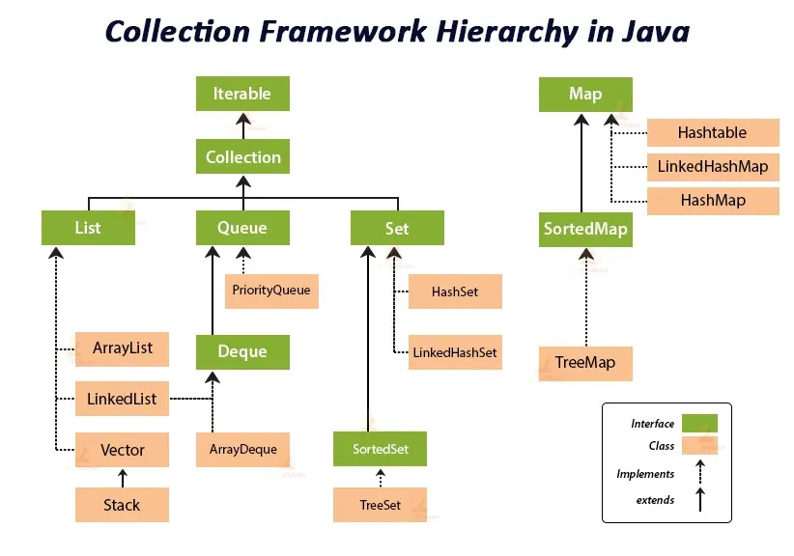

Slide 4
List Interface
The List interface in Java is a fundamental part of the Java Collections Framework, residing in the java.util package.
It represents an ordered collection of elements, also known as a sequence, that allows duplicate values.

Slide 5
Key Characteristics of List Interface
Ordered Collection: List maintains the insertion order of elements, meaning the order in which elements are added to the list is preserved.
Allows Duplicates: Unlike Set, a List can store multiple instances of the same element.
Index-Based Access: Elements in a List can be accessed, inserted, or removed based on their numerical position (index), starting from zero.
Extends Collection: The List interface extends the Collection interface, inheriting its methods for basic collection operations like add(), remove(), size(), isEmpty(), etc.
Specific List Methods: In addition to inherited methods, List provides its own methods for positional access (get(int index), set(int index, E element)), searching (indexOf(Object o), lastIndexOf(Object o)), and range-view operations (subList(int fromIndex, int toIndex)).
Implementations: Common concrete classes that implement the List interface include ArrayList, LinkedList, Vector, and Stack. Each implementation offers different performance characteristics based on underlying data structures.

Slide 6
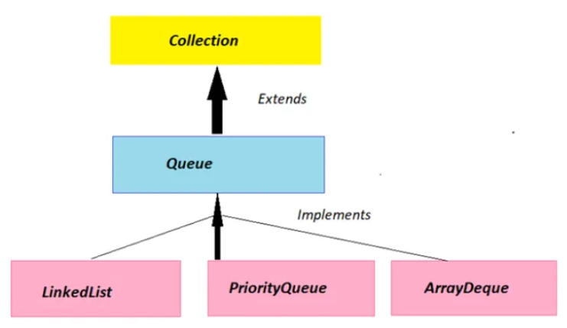
Queue Interface
The Queue interface in the Java Collections Framework represents an ordered collection that is typically processed in a First-In, First-Out (FIFO) manner.
It extends the Collection interface and is used to hold elements before they are processed, with new elements added at the end and removed from the beginning.
Common implementations include LinkedList, PriorityQueue, and ArrayDeque.

Slide 7
Copying Arrays
Using for loop
int[] arr = new int[5];
int[] copy = new int[arr.length];
for(int i = 0; i < arr.length; i++)
copy[i] = arr[i];
Using System.arraycopy()
System.arraycopy (arr, 0, copy, arr.length);
Using clone()
int[] copy = arr.clone();

Slide 8
Passing Arrays to Methods
Arrays can be passed to emthods just like other objects.
public static void printArray (int[] arr) {
for (int val: arr) {
System.out.print(val + “ ”);
}
Returning Arrays from Methods
public static int[] getArray() {
return new int[] {10, 20, 30};
}
Anonymous Arrays: used when you don’t want to store the array reference.
printArray (new int[] {1, 2, 3, 4});

Slide 9
Default Values in Arrays
Data Type | Default Value
int, long, short, byte | 0
float, double | 0.0
boolean | False
char | ‘\u0000’
Object types | null

Slide 10
Array Class (java.util.Arrays)
Java provides a utility class java.util.Arrays for easy operation.
Method | Description
Arrays.toString(arr) | Converts array to string
Arrays.sort(arr) | Sorts array in ascending order
Arrays.equals(a, b) | Checks if arrays are equal
Arrays.copyOf(arr, n) | Copies first n elements
Arrays.copyOfRange() | Extract subset
Arrays.fill(arr, val) | Fills array with given value
Arrays.binarySearch(arr, key) | Searches for a value (array must be sorted)
Arrays.stream() | Apply stream operations

Slide 11
Advantages and Disadvantages of Java
Easy to access elements using index.
Efficient memory usage for fixed-size collections.
Supports iteration with loops.
Limitations
Fixed size (cannot grow or shrink dynamically).
Can store only one type of data.
Insertion / deletion is costly compared to lists.

Slide 12
ArrayList
An ArrayList in Java is a resizable (dynamic) array — part of the java.util package — that allows you to store, access, and manipulate a list of elements just like an array, but without a fixed size.
ArrayList is a class in Java that implements the List interface and provides dynamic arrays that can grow or shrink in size as needed.
import java.util.ArrayList;
ArrayList<Type> listName = new ArrayList<Type>();
Example:
ArrayList<String> students = new ArrayList<String>();

Slide 13
Why use ArrayList instead of Arrays
Java provides a utility class java.util.Arrays for easy operation.
Feature | Array | ArrayList
Size | Fixed | Dynamic
Type Safety | Can store primitives | Stores objects only
Insertion / Deletion | Manual shifting needed | Handled automatically
Built-in Methods | Limited | Many
Flexibility | Low | High

Slide 14
Built-in ArrayList Methods
Method | Description
add(element) | Adds an element to the list
add(index, element) | Inserts element at specific index
get(index) | Retrieves element at index
set(index, element) | Updates element at index
remove(index) | Removes element at given index
size() | Returns number of elements
clear() | Removes all elements
contains(element) | Checks if list contains given element
isEmpty() | Checks if list is empty
indexOf(element) | Returns index of first occurrence
toArray() | Converts to regular array

