Slide 1


Slide 2
In this Section we will learn about
Our Brand
Our Company
Our Core Values what inspires us to do business everyday

Slide 3
Introduction to Firefly Diamonds
India's premier Lab-grown diamond (LGD) jewellery brand
Firefly is a new venture spun off from Prism Jewellery - one of India's largest natural diamond jewellery manufacturers.
The founders of Firefly have been involved in the diamond industry for over 3 generations with over 6 decades worth of experience.
Mission Statement: To Democratize access to diamonds, and help turn dreams into a reality for millions of Indians.
Move towards a greener and more sustainable future.

Slide 4

Brand Inspiration
Captivating Glow
Inspired by fireflies that stand out in darkness, drawing attention and curiosity.
Luminous Shine
Each diamond's "fire" mirrors the distinctive allure of fireflies.
Timeless Luxury
Pieces embody elegance, allowing wearers to stand out gracefully.

Slide 5






What makes Firefly Special?
Unique product focus on rings
Omni-channel strategy focused on first touch point online and then driving customer to store
Premium brand positioning within LGD industry
Modernizing jewellery purchase experience
Sustainable and Ethical brand and product
High-quality craftsmanship leveraging decades of experience making fine jewellery in India
Mission & Vision
Democratizing Diamonds
Making dreams reality for millions of Indians through accessible luxury.
Sustainable Future
Moving toward greener practices in the jewelry industry.

Slide 6
Trust
Our Values
Customer Delight
Excellence
Innovation

Slide 7
Brand Values: Trust
Transparency
Clear, honest communication throughout all processes.
Quality
Uncompromising standards in craftsmanship and materials.
Social Responsibility
Active engagement in community initiatives.
Ethical
Prioritizing ethical sourcing and production methods.

Slide 8
Brand Values: Innovation
Creative
Inspiring designs that challenge traditional norms.
Sustainable
Eco-conscious practices minimizing environmental impact.
Progressive
Embracing contemporary trends with a youthful approach.

Slide 9
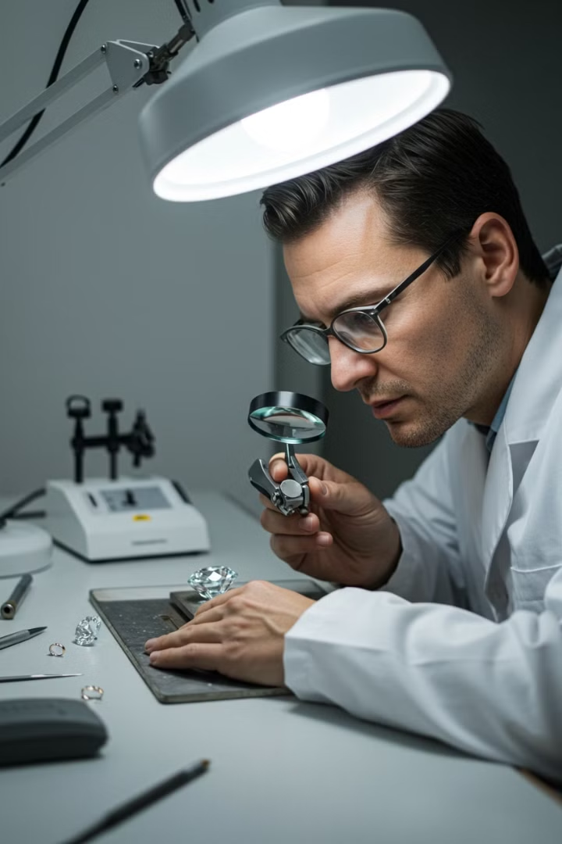




Brand Values: Excellence
Standard Operating Procedures
Ensuring consistency, quality, and reliability in all operations.
Product Excellence
Exquisite lab-grown diamond creations reflecting timeless elegance.
Quality Standards
Uncompromising attention to flawless craftsmanship and brilliance.
Artisan Craftsmanship
Meticulously handcrafted pieces embodying sophistication.

Slide 10






Customer Delight
After Sales
Lifetime warranties and hassle-free exchanges.
In-store Experience
Luxurious, personalized shopping journey.
Customer Satisfaction
Ongoing support ensuring loyalty and delight.

