Slide 1
What is CabinIQTM
A modular, AI-powered in-cabin intelligence platform that unifies Driver Monitoring (DMS), Occupant Monitoring (OMS), Health Monitoring and Mood-Based Personalization, designed for seamless integration into vehicle infotainment and zonal architectures.
Platform Type |  | Primary Interface | Protocols Used | ECU Control Scope
🤖 | Android IVI Systems | VHAL (Vehicle HAL) | AIDL, Binder, VHAL abstraction | HVAC, Lighting, Seats, Audio
🐧 | Linux IVI Systems | SocketCAN / Custom HAL | SocketCAN, MQTT, gRPC, custom IPC | HVAC, Lighting, Seats, Audio
🧊 | QNX IVI Systems | QNX Resource Manager | POSIX, QDB, QNX Messaging | HVAC, Lighting, Seats, Audio
📡 | Non-Android Zonal ECUs | CAN / ACN (Automotive Ethernet) | CAN, SOME/IP, DoIP, UDP-based services | HVAC, Lighting, Seats, Audio
Segment | Need | Features | CabinIQ Fit
EV Startups | Distinctive interiors, rapid development | CabinIQ = Fast, modular, infotainment-based | Positioned at the intersection of safety and personalization. Tailored for next-gen cockpits with Android, QNX, or zonal architectures
Mass OEMs | Regulation compliance (Euro NCAP, child detection) | DMS/OMS module ready-to-deploy | Modular enough to serve entry trims to flagship EVs
Premium OEMs | AI-based comfort, voice personalization, OTA UX | Full-stack CabinIQ with Mood AI & Cloud | Cloud-optional architecture supports both low-cost and premium configurations
Tier-1s | Integrated cabin domain controllers | Drop-in Android or Linux module for cockpit ECUs | Reduces OEM dependency on multiple vendors — one stack, many functions

Slide 2
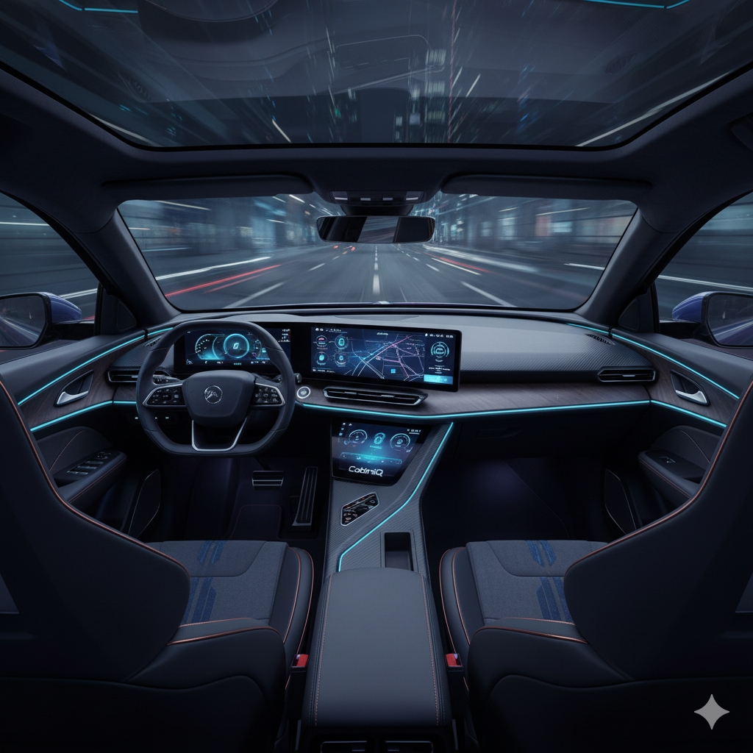
samsan CabinIQ
A modular, AI-powered in-cabin intelligence platform that unifies Driver Monitoring (DMS), Occupant Monitoring (OMS), Health Monitoring and Mood-Based Personalization, designed for seamless integration into vehicle infotainment and zonal architectures.

