Slide 1

BlogApp – Student
(FUTURE FINDERS ORGANISATION)

Slide 2
MERN Stack for Blog APP
To create a blog app using the MERN stack (MongoDB, Express, React, Node), here are the basic outlines that you can follow:
Plan and Define Project Scope: Before starting any project, you should have a clear understanding of your goals and objectives, the scope of the project, the features and functionalities that you want to include, and the target audience.
Set up the Environment: To start building the app, you need to set up the development environment. You need to install Node.js and npm, MongoDB, and other required dependencies.
Create Database Schema: The next step is to define the database schema for your blog app. You can use MongoDB as your database and Mongoose as the ORM (Object-Relational Mapping) library.
Implement Backend: You need to develop the backend of your blog app using Node.js and Express. The backend should include the APIs (Application Programming Interfaces) for handling user authentication, blog post management, and other necessary functionalities.

Slide 3
5. Develop Frontend: Once the backend is ready, you can start building the frontend of your blog app using React. You can use various libraries and frameworks such as Material UI, Bootstrap, and React Router to make the development process faster and easier.
6. Implement User Authentication: To enable users to create and manage their own blog posts, you need to implement user authentication. You can use libraries such as Passport.js and bcrypt to handle user authentication and authorization.
7. Add Blog Post Creation and Management: You can create a form for users to create blog posts and add functionality for managing posts. You can use libraries such as Formik and Yup to handle form validation.
8. Test and Deploy: After completing the development, you need to test your blog app to ensure that it is working correctly and is free from any bugs or errors. Once you are satisfied with the app's functionality, you can deploy it to a production environment.
9. Continuous Integration and Continuous Deployment (CI/CD): Finally, you can set up a CI/CD pipeline to automate the deployment process and make it faster and more efficient.

Slide 4
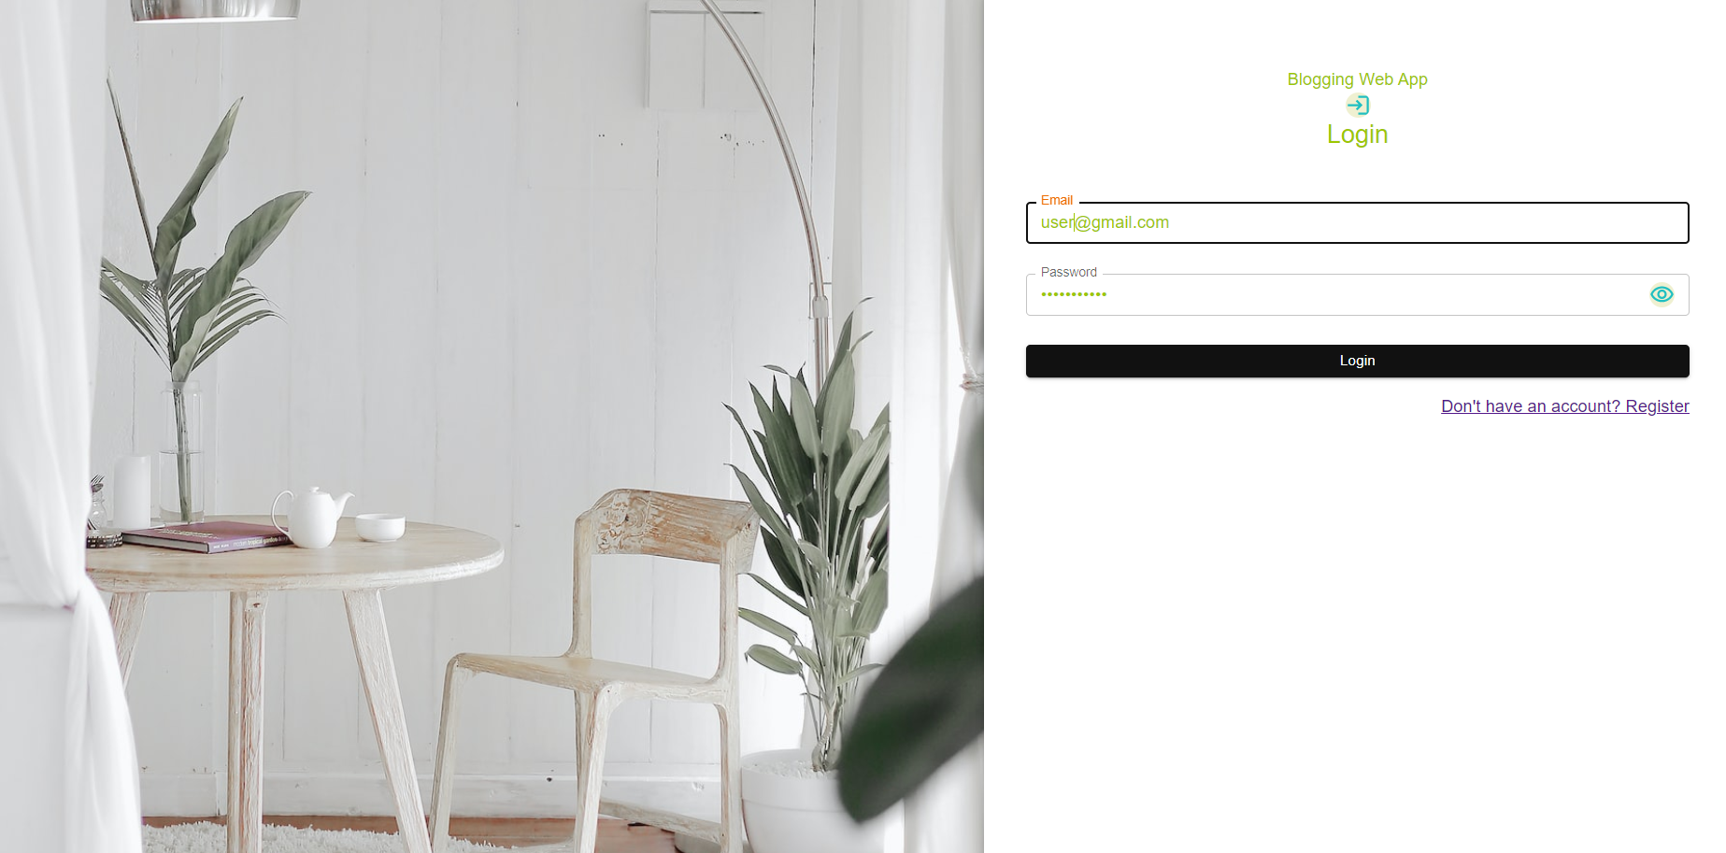
Home page:

Slide 5
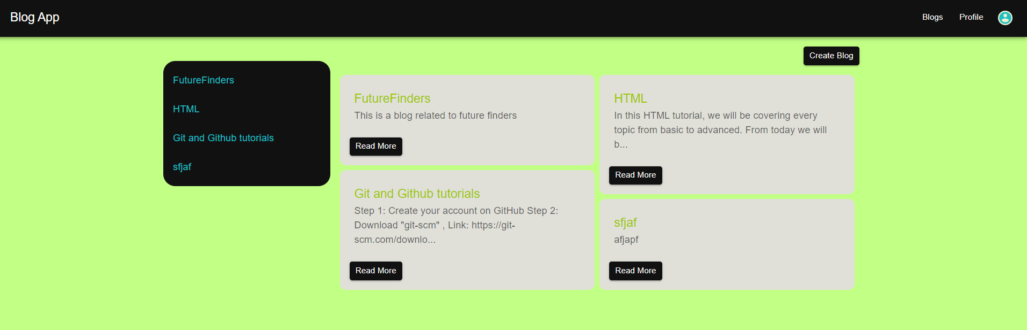
Blogs:

Slide 6
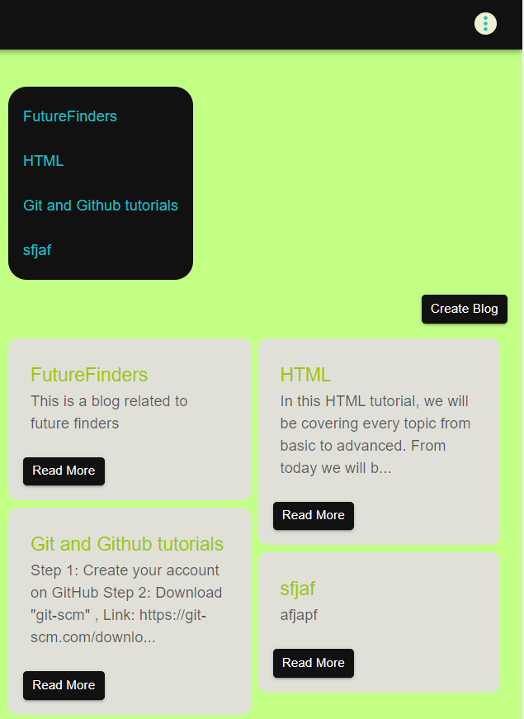
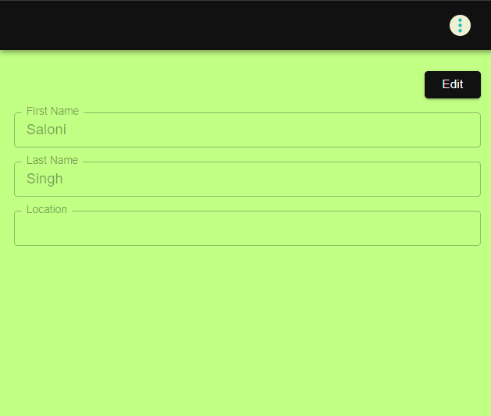
Blogs
User Profile component

Slide 7
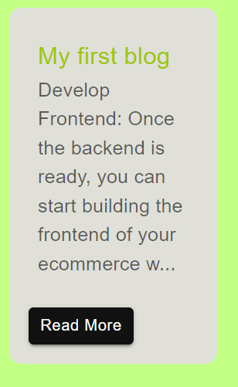
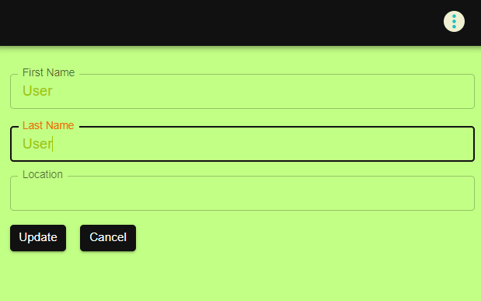
Blog content component
Update user Information component

Slide 8
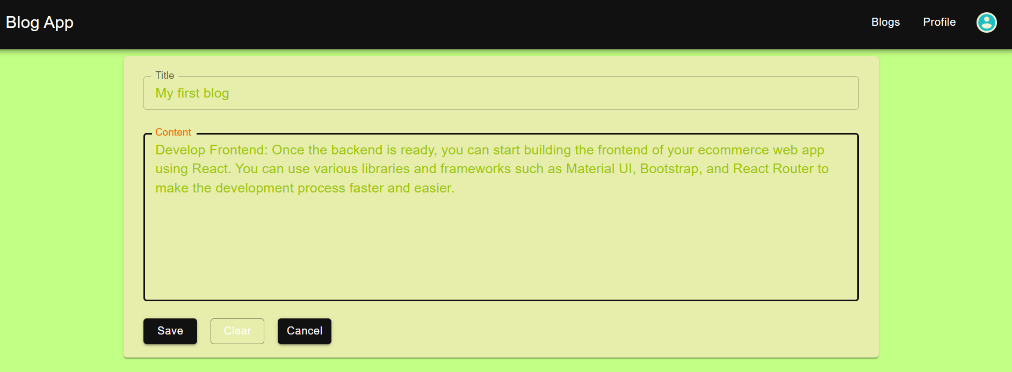
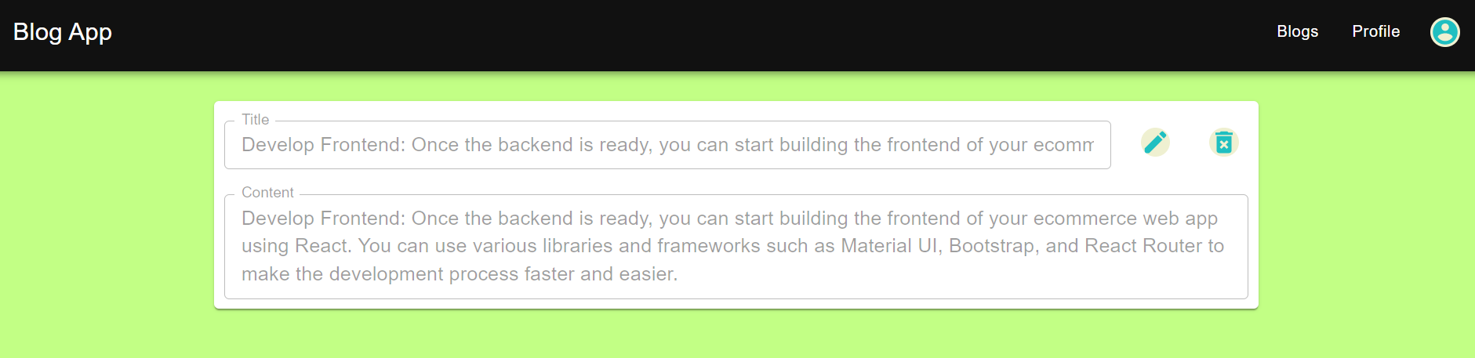
Create Blog:
After Saving Blog:

Slide 9
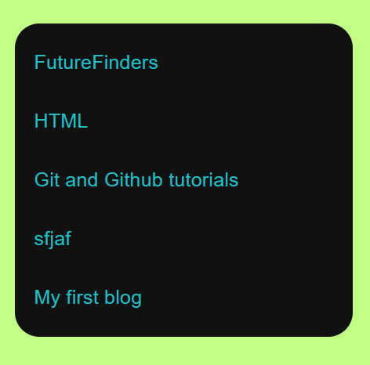
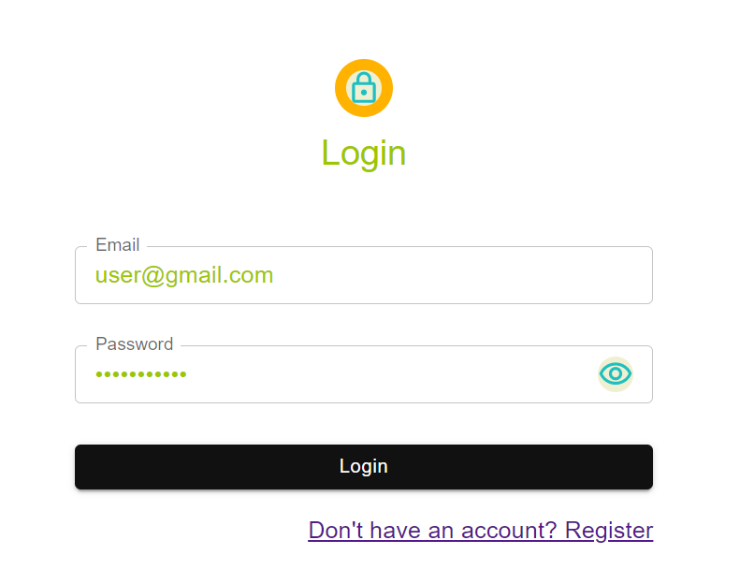
Sidebar component
Login page only

Slide 10
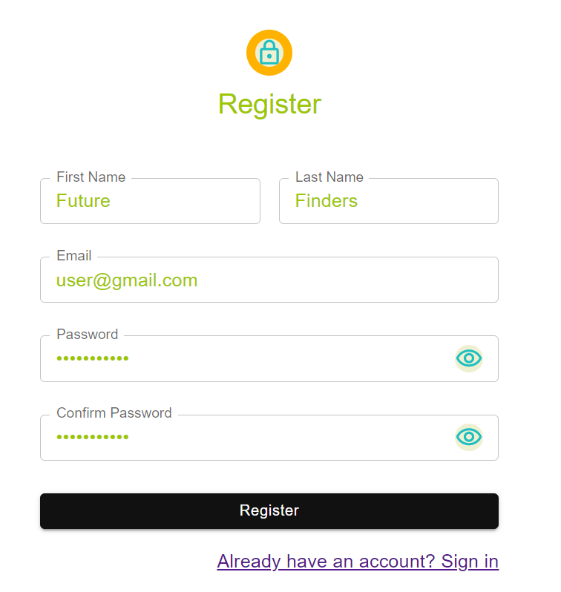
Registration Page

