Slide 1
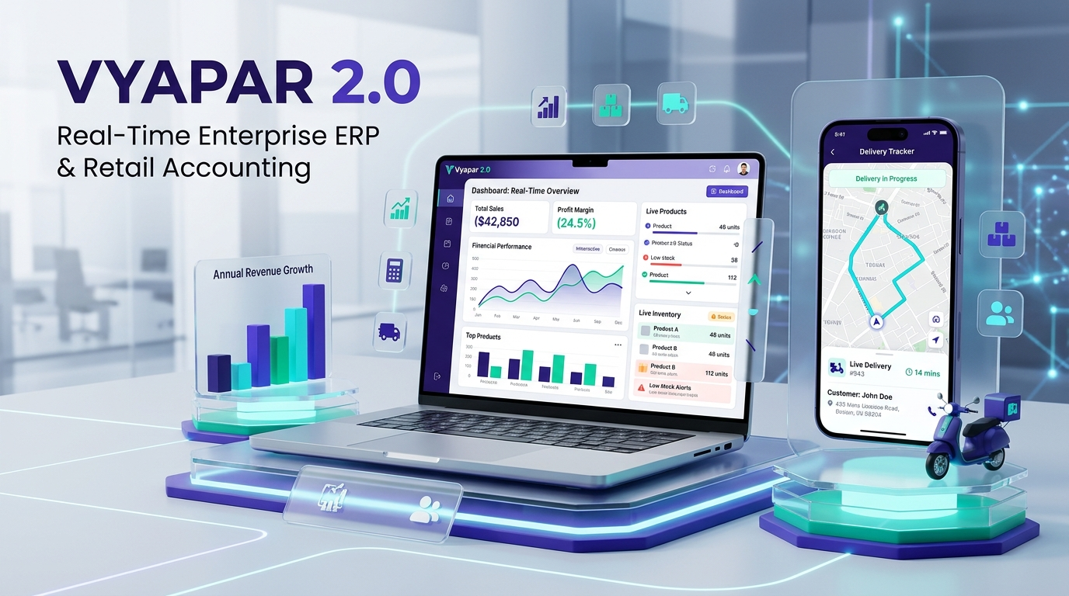
ENTERPRISE 2.0 RELEASE
VYAPAR 2.0
Smart Accounting, Inventory & Real-Time Delivery Operating System for Modern Indian Merchants.
⚡ Real-Time GPS Tracking | 🧾 GST Invoices & POS | 📦 Barcode Engine | 📒 Digital Khata
PRESENTED BY:
• 01 - Pranali Bhagat
• 06 - Hrutuja Champanerkar
• 31 - Mayur Pandav
• 37 - Mol Patil

Slide 2
⚠️ THE EVERYDAY STRUGGLE
Why Indian Merchants Struggle Today
Traditional paper books and legacy desktop tools create friction and loss every single day.
📒 Messy Paper Khata
Customer credit entries get lost, forgotten, or disputed. Manual phone calls for payment collection feel awkward and waste hours.
📦 Blind Inventory Control
Popular items run out of stock without notice, while slow-moving items expire unnoticed in the back warehouse.
⏳ Slow Counter Queues
Typing prices by hand during peak rush hours creates long customer queues, manual calculation mistakes, and missed sales.
🚚 Zero Delivery Visibility
Customers constantly call asking 'Where is my parcel?' Merchants have no idea where delivery drivers are located.

Slide 3
💡 THE MODERN SOLUTION
Introducing Vyapar 2.0
A unified, web-first platform designed to run an entire business from a single screen.
⚡ Instant GST Billing & Thermal Slips
Generate professional A4 Tax Invoices or instant 58mm/80mm counter POS thermal receipts with automated GST compliance.
🏷️ Barcode Generation & Scan Engine
Automatically generate standard EAN-13 barcodes and QR codes. Print full A4 barcode sticker sheets in one click.
💳 Digital Ledger & WhatsApp Reminders
Track real-time customer balances. Send automated WhatsApp payment reminders with direct online payment links.
👥 Multi-Role Counter Interfaces
Clean, dedicated portals for Store Owners, Cashier POS counters, Delivery Partners, and Accountants.

Slide 4
📊 CORE ARCHITECTURE
Key Operational Modules
Four powerful pillars working together seamlessly in real-time.
🧾 Sales & Invoicing Module
Create customized invoices with dynamic discounts, multi-tax GST slabs, and instant PDF downloads with one click.
🛒 Purchase & Vendor Tracking
Record supplier stock-in orders, manage accounts payable, and track supplier payment histories with zero errors.
💰 Expense & Cash Flow Ledger
Categorize daily shop expenses (rent, salaries, utilities) to get an accurate daily net profit and cash-in-hand calculation.
🤝 Parties & Khata Management
Complete 360-degree CRM with detailed credit ledgers, contact directories, and automated settlement tracking.

Slide 5
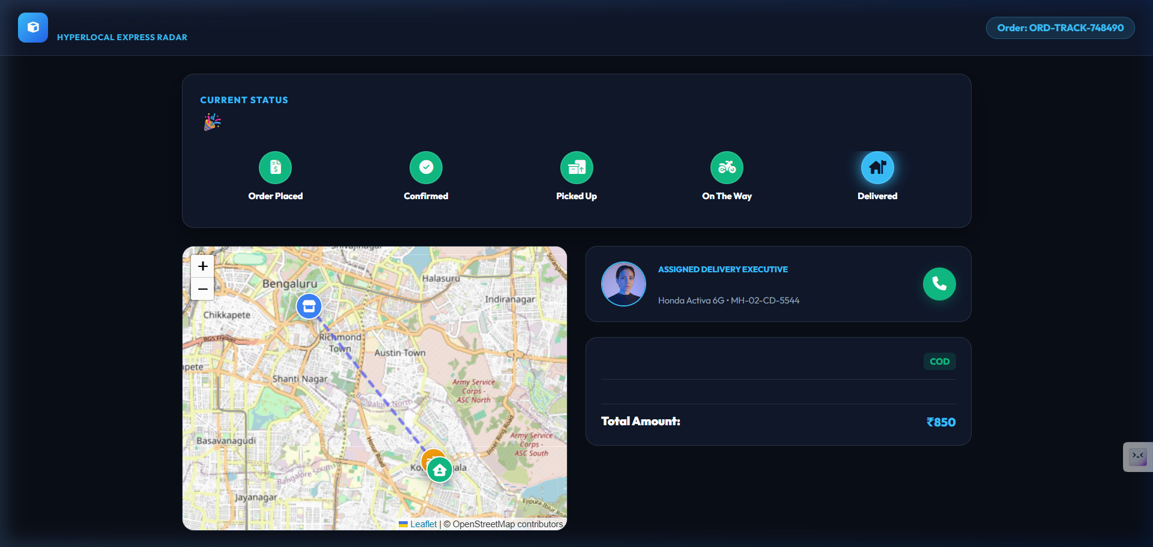
🌟 THE SHOWSTOPPER FEATURE
Real-Time GPS Delivery Tracking
The competitive edge that traditional software like Tally or Marg completely lack.
🔗 Public Link — Zero Login Required
Customers receive an SMS or WhatsApp link to view live tracking directly in their mobile browser.
🗺️ Live GPS Telematics & Leaflet Map
Live moving driver marker displaying actual route geometry, speed, and real-time vehicle coordinates.
⏱️ Dynamic Real-Time ETA
Calculates remaining distance in kilometers and updates estimated delivery time dynamically.

Slide 6
🛠️ ARCHITECTURE & TECH STACK
Built on Rock-Solid Modern Tech
Designed for sub-second response times, zero server crashes, and enterprise scalability.
⚛️ Frontend: React 19 + Vite
Blazing-fast client bundle, instant route transitions, zero page reloads, and seamless responsiveness across laptops, tablets, and mobile.
🟢 Backend: Node.js & Express
High-throughput RESTful architecture powering live GPS streams, PDF invoice generators (PDFKit), and barcode rendering.
🍃 Database: MongoDB Atlas
Cloud-native NoSQL database handling dynamic catalog structures, nested ledger transactions, and geospatial delivery points.
🔒 Enterprise Security & Compliance
Strict JWT role-based access control (Admin, Driver, Cashier), encrypted credentials, and automated GSTR-1 audit exports.

Slide 7
🎯 BUSINESS VALUE & IMPACT
Real-World Business Impact
Measurable returns on investment for retail merchants and distributors.
2+ Hours
Daily Time Saved
Automated day-end book closing, tax calculation, and inventory reconciliation eliminate manual paperwork.
40%
Faster Debt Recovery
Automated WhatsApp payment links and instant online settlement reduce unpaid credit and overdue accounts.
95%
Fewer Support Calls
Customers track their own packages on live GPS maps, eliminating endless 'Where is my parcel?' inquiries.
100%
Audit & Tax Ready
Single-click GSTR-1 summaries, P&L reports, and catalog exports make tax filing completely painless.

Slide 8
✨ CONCLUSION & DEMO ✨
Thank You!
Questions & Live Demonstration
Project Team:
01 - Pranali Bhagat | 06 - Hrutuja Champanerkar | 31 - Mayur Pandav | 37 - Mol Patil
Live App: http://localhost:5173 • Live GPS Portal: http://localhost:5173/track/ORD-TRACK-748490

