Slide 1

ENTERPRISE 2.0 RELEASE
VYAPAR 2.0
Smart Accounting, Inventory & Real-Time Delivery Operating System for Modern Indian Merchants.
⚡ Real-Time GPS | 🧾 GST POS | 📦 Barcodes | 📒 Digital Khata
PRESENTED BY:
• 01 - Pranali Bhagat
• 06 - Hrutuja Champanerkar
• 31 - Mayur Pandav
• 37 - Mol Patil

Slide 2

⚠️ THE EVERYDAY STRUGGLE
Why Indian Merchants Struggle Today
Traditional paper books and legacy desktop tools create friction and loss every single day.
📒 Messy Paper Khata
Credit entries get lost or disputed. Awkward manual calls for payments waste hours.
📦 Blind Inventory
Stock runs out without notice, while slow items expire unnoticed in warehouses.
⏳ Slow Counter Queues
Manual pricing during rush hours creates billing errors and customer frustration.
🚚 Zero Delivery Visibility
Customers constantly ask 'Where is my order?' Merchants have no way to track drivers.

Slide 3
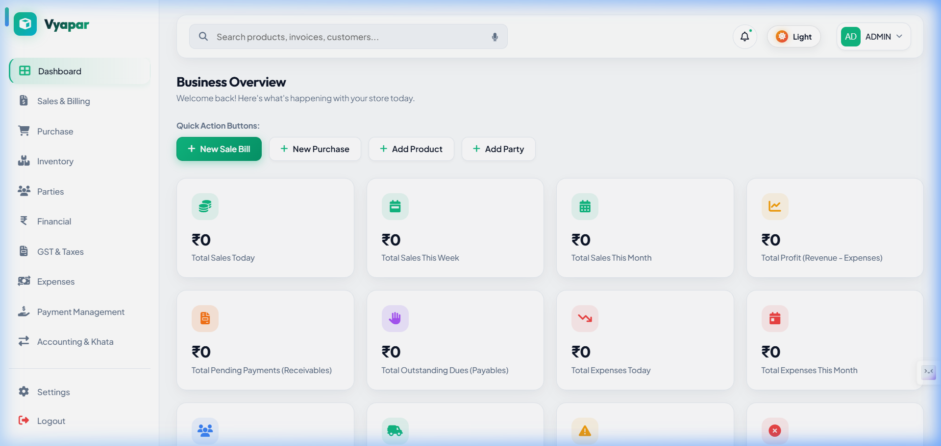
💡 THE MODERN SOLUTION
Introducing Vyapar 2.0
A unified, web-first platform designed to run an entire business from a single screen.
⚡ Instant GST Billing
Generate A4 Tax Invoices or instant 58mm/80mm counter thermal slips with automated GST calculations.
🏷️ Barcode Scan Engine
Auto-generate EAN-13 barcodes & QR codes. Print full A4 barcode sticker sheets in 1 click.
💳 Digital Ledger Khata
Real-time party balances with automated WhatsApp payment links and instant settlement.
👥 Multi-Role Portals
Tailored views for Store Owners, Cashier POS counters, Delivery Partners, and Accountants.

Slide 4
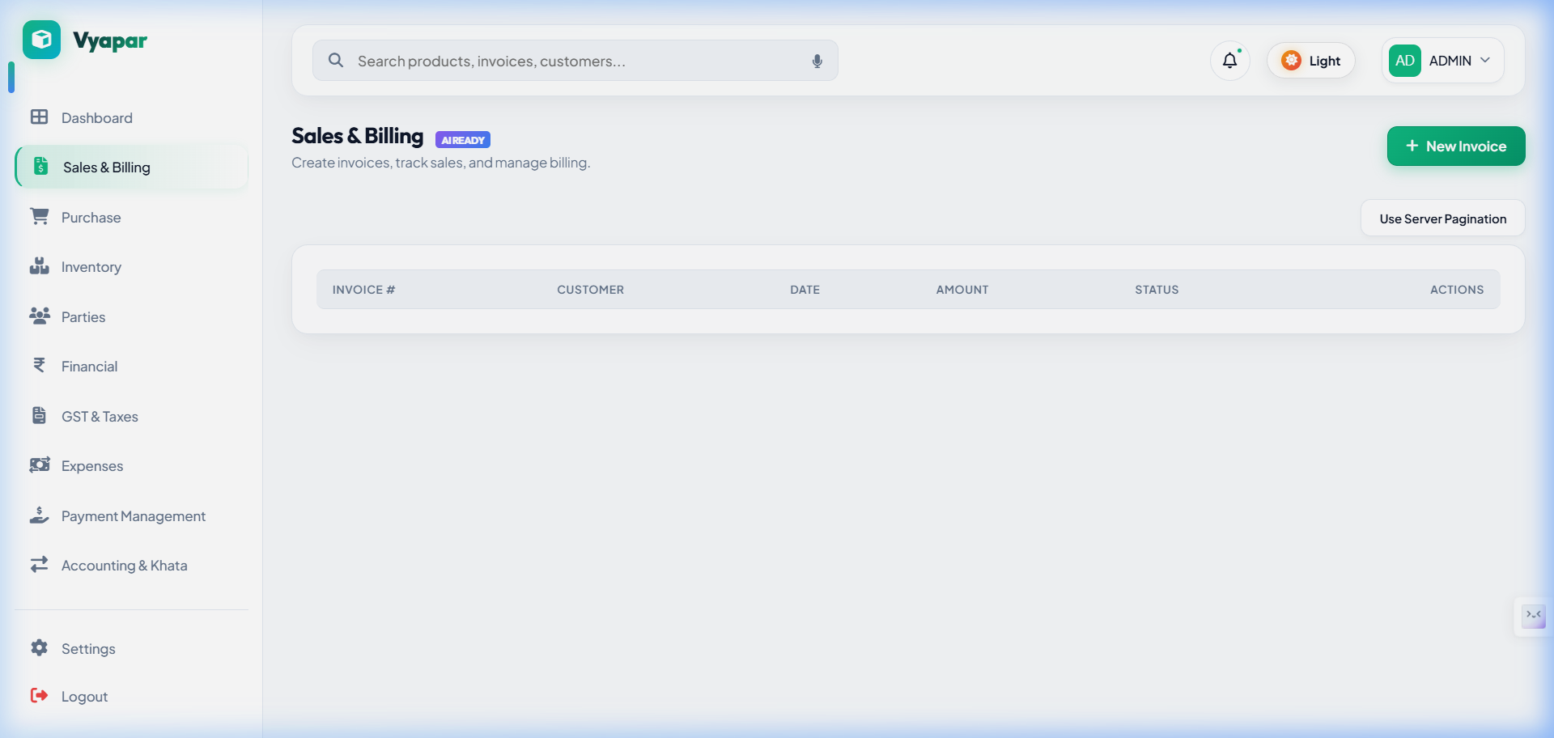
📊 CORE ARCHITECTURE
Key Operational Modules
Four powerful pillars working together seamlessly in real-time.
🧾 Sales & Invoicing
Fast billing counter with barcode scanner support, line discounts, and PDF downloads.
🛒 Purchase & Suppliers
Track vendor stock-in shipments, payment terms, and accounts payable automatically.
💰 Expense Ledger
Track daily operational expenses (rent, salaries, utilities) for true net profit tracking.
🤝 Parties & Khata CRM
Complete directory with credit limits, transaction histories, and digital ledger statements.

Slide 5
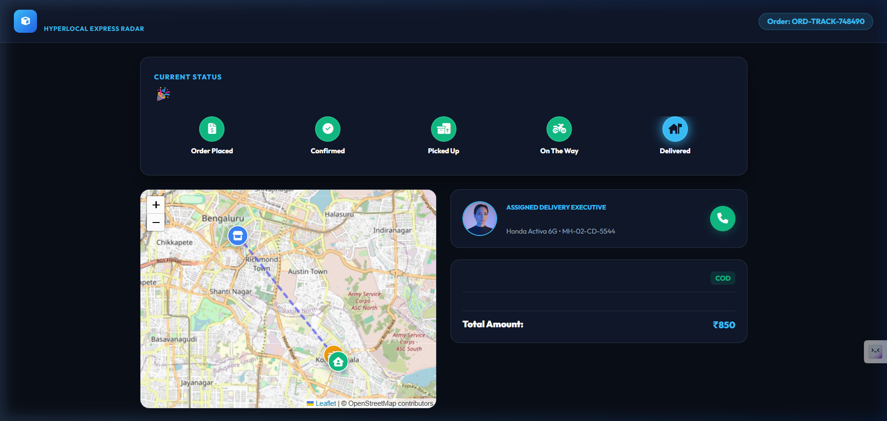
🌟 THE SHOWSTOPPER FEATURE
Real-Time GPS Delivery Tracking
The competitive edge that traditional software like Tally or Marg completely lack.
🔗 Public Link — Zero Login Required
Customers receive an SMS or WhatsApp link to view live tracking directly in their mobile browser.
🗺️ Live GPS Telematics & Interactive Map
Live moving driver marker powered by Leaflet, displaying actual route geometry and coordinates.
⏱️ Dynamic Real-Time ETA
Calculates remaining distance in kilometers and updates estimated delivery time dynamically.

Slide 6

🛠️ ARCHITECTURE & TECH STACK
Built on Rock-Solid Modern Tech
Designed for sub-second response times, zero server crashes, and enterprise scalability.
⚛️ React 19 + Vite Frontend
Sub-second transitions, responsive UI on laptops, tablets, and phones.
🟢 Node.js & Express Backend
High-throughput REST APIs powering live telematics and PDFKit rendering.
🍃 MongoDB Atlas Cloud
Cloud NoSQL database handling dynamic catalogs and geospatial coordinates.
🔒 Enterprise Security
JWT role-based access control, encrypted sessions, and automated GSTR-1 exports.

Slide 7
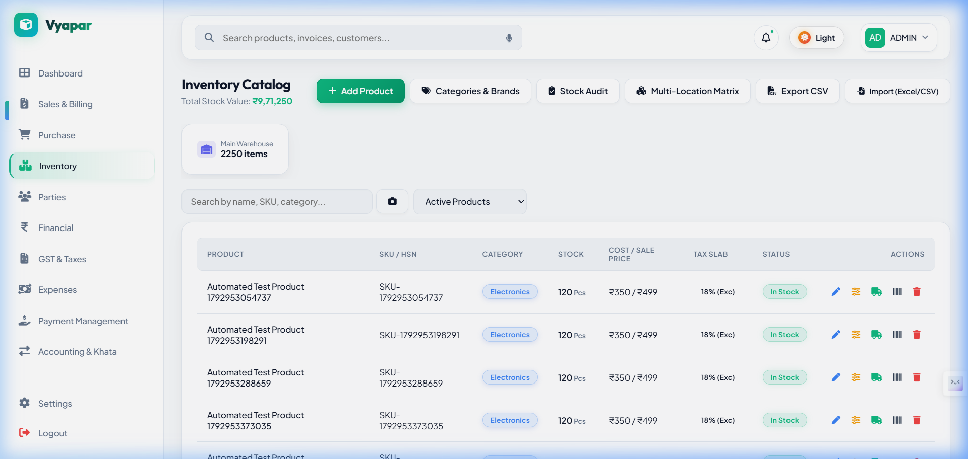
🎯 BUSINESS VALUE & IMPACT
Real-World Business Impact
Measurable returns on investment for retail merchants and distributors.
2+ Hours
Daily Time Saved
Automated day-end book closing and stock reconciliation eliminate manual paperwork.
40%
Faster Debt Recovery
Automated WhatsApp payment links and instant settlement recover credit 40% faster.
95%
Fewer Support Calls
Customers track their own packages on live GPS maps, eliminating endless inquiries.
100%
Audit & Tax Ready
Single-click GSTR-1 summaries, P&L reports, and catalog exports make filing simple.

Slide 8
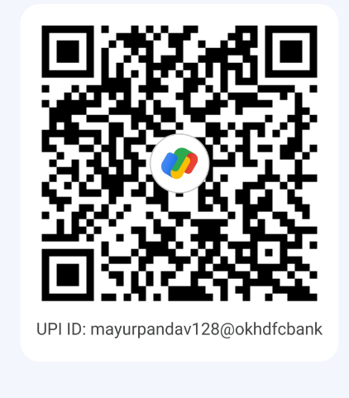
✨ CONCLUSION & Q&A ✨
Thank You!
Questions & Live Demonstration
Project Team:
01 - Pranali Bhagat | 06 - Hrutuja Champanerkar
31 - Mayur Pandav | 37 - Mol Patil
• Live App: http://localhost:5173
• Live GPS Tracking: http://localhost:5173/track/ORD-TRACK-748490
• Merchant UPI ID: mayurpandav128@okhdfcbank
📲 LIVE UPI SCANNER
Scan to Test Real Settlement
UPI ID: mayurpandav128@okhdfcbank
⚡ Google Pay • PhonePe • Paytm • BHIM

