Slide 1
Lecture II: Granular Gases & Hydrodynamics
Igor Aronson
Materials Science Division
Argonne National Laboratory
Supported by the U.S. Department of Energy

Slide 2
Outline
Definitions
Continuum equations
Transport coefficients: phenomenology
Examples: cooling of granular gas
Kinetic theory of granular gases
Transport coefficients: kinetic theory

Slide 3
large conglomerates of discrete macroscopic particles
Jaeger, Nagel, & Behringer, Rev. Mod.Phys. 1996
Kadanoff Rev. Mod. Phys.1999
de Gennes Rev. Mod. Phys.1999
non-solid
no tensile stresses
non-gas
inelastic collisions
Gran Mat
non-liquid
critical slope

Slide 4
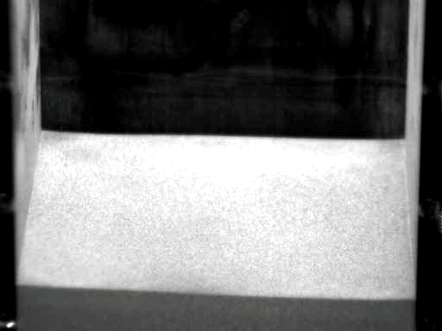
Dropping a Ball
Granular eruption http://www.tn.utwente.nl/pof/
Loose sand with deep bed (it was fluffed before dropping the ball)
Group of Detlef Lohse, Univ. Twenta

Slide 5
Granular Hydrodynamics
Let’s live in a perfect world
-continuum coarse-grained description
-ignore intrinsic discrete nature of granular liquid
-ignore absence of scale separation
But, we include inelasticity of particles

Slide 6
Granular gases
Definition:
Collections of interacting discrete solid particles. Under influence of gravity particles can be fluidized by sufficiently strong forcing: vibration, shear or electric field.
Granular gas is also called “rapid granular flow”

Slide 7
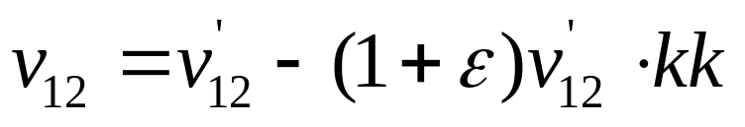
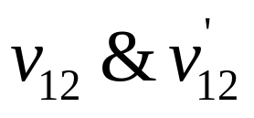
Comparison with Molecular Gases
Main difference – inelasticity of collisions and dissipation of energy
Common paradigm – granular gas is collection of smooth hard spheres with fixed normal restitution coefficient ε
are post /pre collisional relative velocities
k is the direction of line impact
v₁’
v₂’
v₁
v₂

Slide 8
The Basic Macroscopic Fields
Velocity V
Mass density ρ (or number density n)
Granular temperature T (average fluctuation kinetic energy)
Granular temperature is very different from thermodynamic temperature

Slide 9
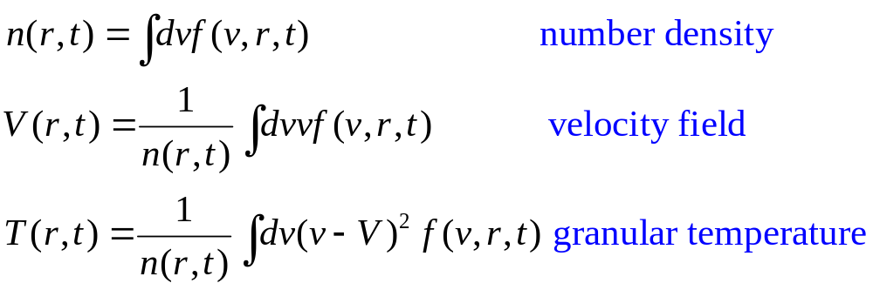
Distribution Functions
Single-particle distribution function
f(v,r,t) = number density of particles having velocity v at r,t
Relation to basic fields
V, v, and r are vectors

Slide 10
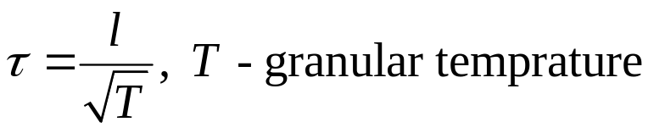
Applicability of continuum hydrodynamics
Absence of scale separations between macroscopic and microscopic scales:
Hydrodynamics is applicable for time/length scale S,L >> τ,l
τ,l – mean free time/path
For simple shear flow with shear rate γ : V_{x}=γy
Macroscopic time scale S=1/γ
Granular temperature T~γ²l²
τ/S~τγ~O(1) – formally no scale separation
V_{x}
Restitution coefficient is in the prefactor
Restitution coefficient is a function of velocity
Leo Kadanoff, RMP (1999): skeptic pint of view

Slide 11
Long-Range Correlations and Aging of Granular Gas
Inelasticity of collisions leads to long-range correlations
Example: fast particle chases slow particle
elastic case – no correlation
inelastic case (sticking) – correlations
Lasting velocity correlations between different particles
Usually particles don’t stick

Slide 12
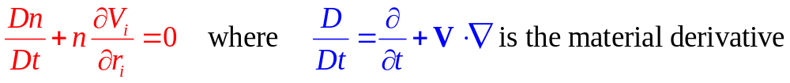
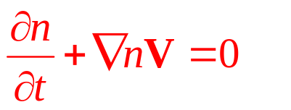

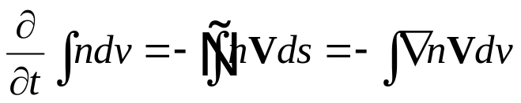
Continuum equations
Continuity equation
Traditional form
Flux of particles J=nV, V – velocity vector
Number of particles:
Particles balance:

Slide 13
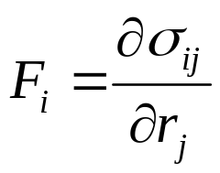

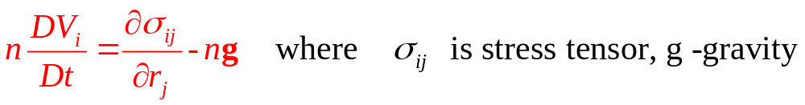
Momentum Density Equations
force on small volume: ∫Fdv
acceleration: ∫nDV/dt dv
relation between force F and stress tensor σ_{ij}:
Momentum balance:
Compare in ideal fluid , p is pressure

Slide 14
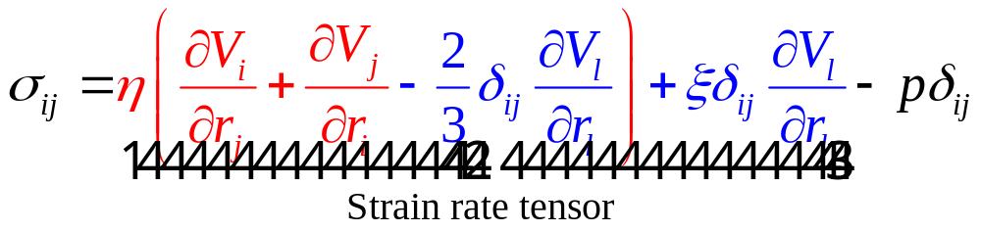
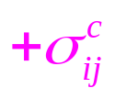

The Stress Tensor
Compare hydrodynamic stress tensor, Landau & Lifshitz
η,ξ – first (shear) and second viscosities (blue term disappear in incompressible flow)
p – pressure (hydrostatic)
contact part
Only appears when contact duration > 0
Appears in dense flows, in granular gases ~0

Slide 15
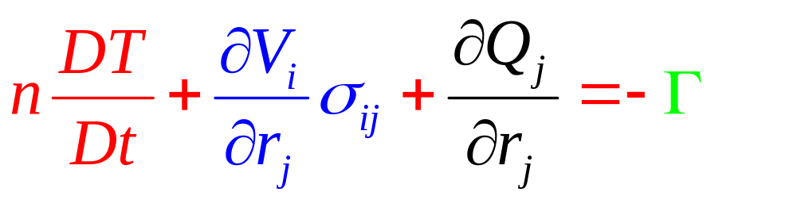

Granular Temperature Equation
Note: energy is not conserved, but mass and momentum are
Detail derivation in L&L, Hydrodynamics
Γ ~n(1-ε²) – energy sink term (absent in hydrodynamics)
granular heat flux,
κ – thermal conductivity
energy sink
(From inelastic collisions)
heat flux
shear heating

Slide 16
Constitutive Relations: Phenomenology
relate η,κ,Γ materials parameters (restitution ε, grain size d and separation s) and variables in conservation laws n,V,T
Typical time of momentum transfer τ~s/u
u ~T^{1/2} – typical (thermal) velocity
Collision rate = u/s
d
s
d

Slide 17
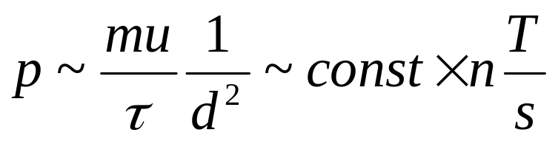
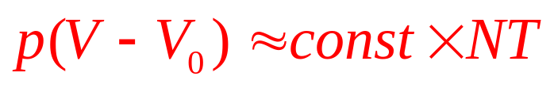
Equation of state
Pressure on the wall for s<<d using n~1/d³
Volume V=N/n, N – total number of grains
s~V-V₀; V₀ – excluded volume
Analog of Van der Waal’s equation of state

Slide 18
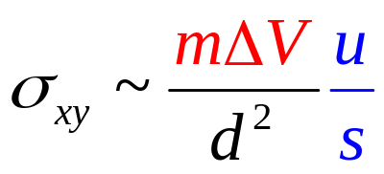
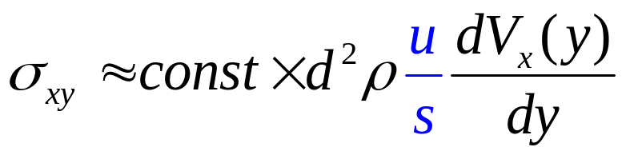
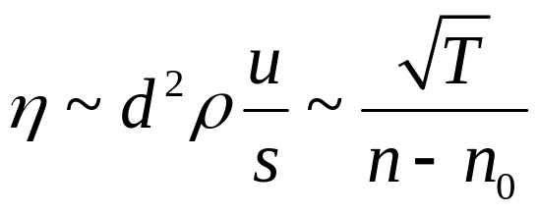
Viscosity coefficient
V_{x}(y)
y
Two adjacent layers of grains
shear stress from upper to lower layer
velocity gradient ΔV/d ~dV/dy
viscosity
x
momentum transfer
collision
rate
ρ=m/d³ – density, n₀- closed packed concentration

Slide 19
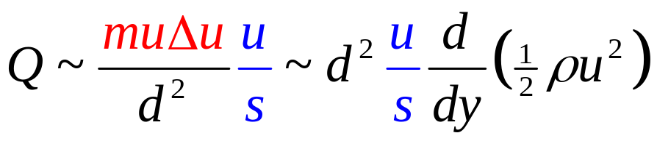
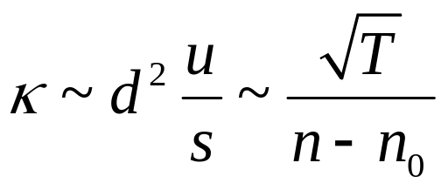
Thermal diffusivity
mean energy transfer between neigh layers muΔu
Mean energy flux
Thermal diffusivity
The ratio of the two viscosities is constant, like in fluids

Slide 20
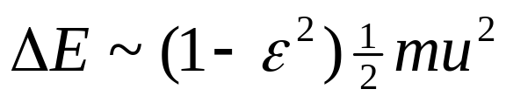
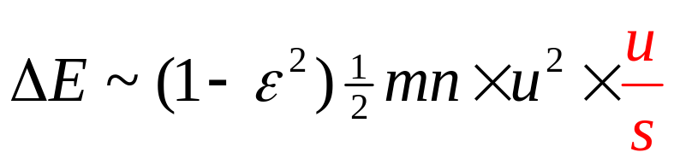
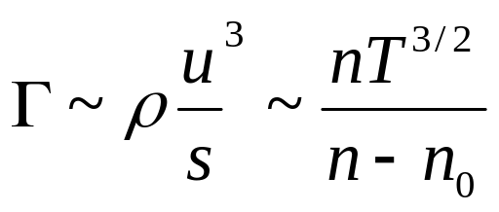
Energy Sink
The temperature rise from collisions is very small
energy loss per collision
Energy loss rate per unit volume
Energy sink coefficient

Slide 21
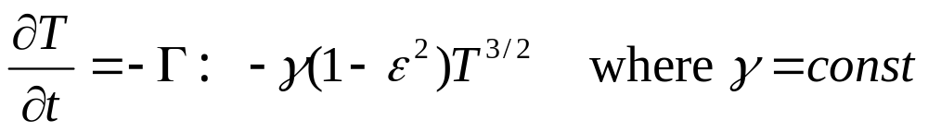
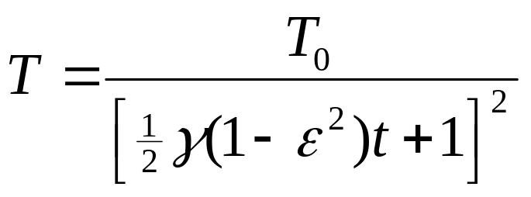
Example: Cooling of Granular Gas
Let’s for t=0 T=T₀, V=0, n=const
temperature evolution
asymptotic behavior T ~ 1/t²
homogeneous cooling is unstable with respect to clustering!!!

Slide 22
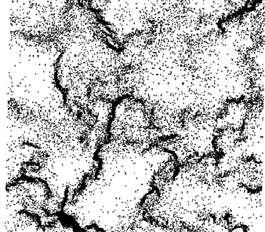
Clustering Instability
Q: Does the temperature reach 0 in finite time?
R: Difficult to say, in simulations sometimes it does.
Simulations of 40,000 discs, ε=0.5
Init. Conditions: uniform distribution
Time 500 collisions/per particle
Mechanism of instability:
decrease in temperature →
decrease in pressure→
increase in density→
increase in number of collisions →
increase of dissipation→
decrease in temperature ….
MacNamara & Young, Phys. Fluids, 1992
Goldhirsch and Zanetti, PRL, 70, 1619 (1993)
Ben-Naim, Chen, Doolen, and S. Redner
PRL 83, 4069 (1999)

Slide 23
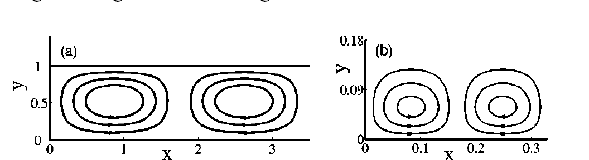
Thermo-granular convection
inversed temperature profiles:
temperature is lower at open surface
due to inelastic collisions
Consideration of convective instability
Shaking
A=A₀ sin(ωt)
Theory:Khain and Meerson PRE 67, 021306 (2003)
Experiment: Wildman, Huntley, and Parker, PRL 86, 3304 (2001)

Slide 24
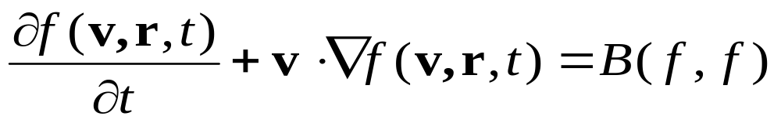
Kinetic Theory
Boltzmann Equation for inelastically colliding spherical particles of radius d
f(v,r,t) – single-particle collision function,

Slide 25
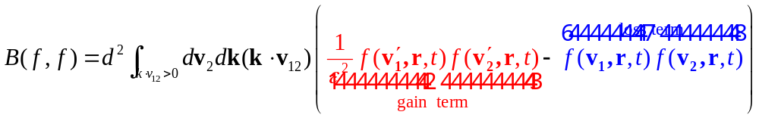
Collision integral
binary inelastic collisions
molecular chaos
splitting of correlations: f(v₁,v₂,r₁,r₂,t)= f(v₁,r₁,t) f(v₂,r₂,t)
k – vector along impact line
v’_{1,2} –precollisional velocities
v_{1,2} –postcollisional velocities

Slide 26
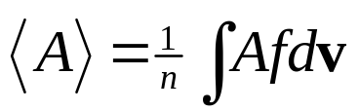
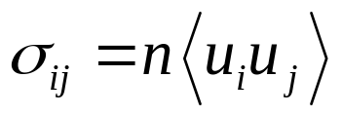
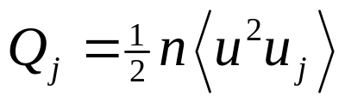
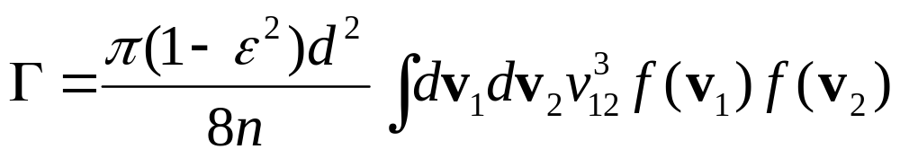
Macroscopic variables
averaged quantity
stress tensor
heat flux
energy sink
approximations for f(v,r,t) in Eli’s lecture

Slide 27
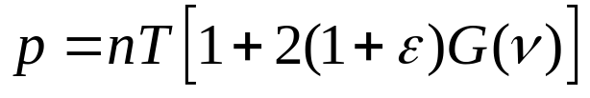
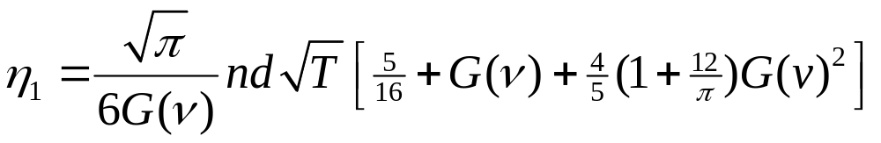
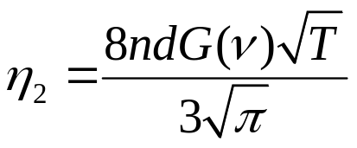
Expressions for smooth inelastic spheres
Copied from Bougie et al, PRE 66, 051301 (2002)
equation of state
shear viscosities
bulk viscosity
Smooth inelestic spheres, from Jenkins & Richman, Arch. Ration. Mech. Anal. 87, 355 (1985).

Slide 28
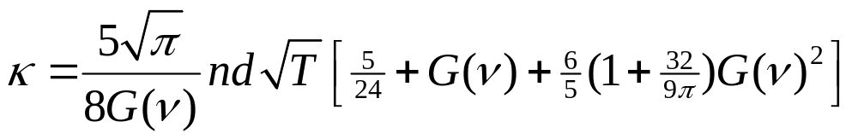
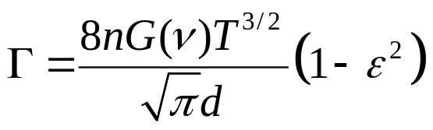
Expressions for smooth inelastic spheres
Copied from Bougie et al, PRE 66, 051301 (2002)
heat conductivity
energy sink
Smooth inelastic spheres, from Jenkins & Richman, Arch. Ration. Mech. Anal. 87, 355 (1985).

Slide 29
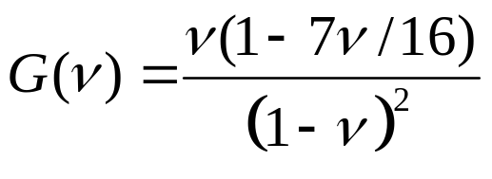
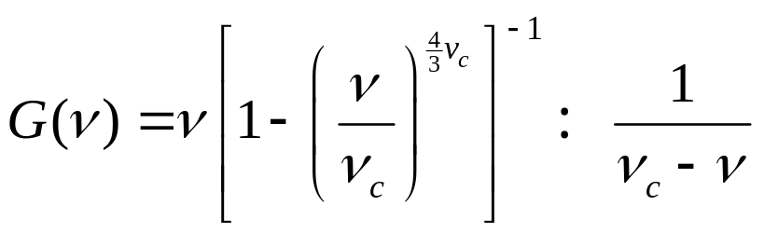
Radial distribution function
ν=(π/6)nd³-packing fraction
dilute elastic hard disks (Carnahan & Starling)
High densities (ν~ν_{c} =0.65 closed-packed density in 3D)

Slide 30
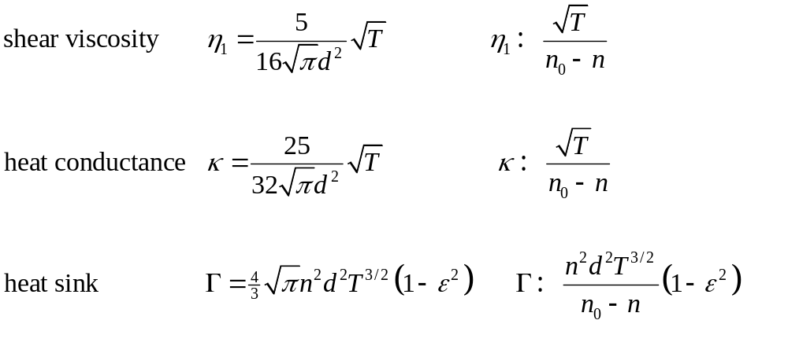
Asymptotic behaviors
Works pretty well for sheared granular flows
Dilute Nearly closed packed

Slide 31
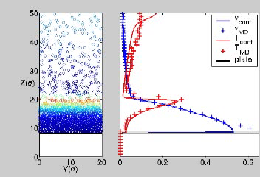
Comparison with MD: Dynamics of Shocks
Q: Why is there not a big temperature gradient?
R: There is a slow vibration, fast vibrations have a large temperature gradient
J. Bougie, Sung Joon Moon, J. B. Swift, and Harry L. Swinney Phys. Rev. E 66, 051301 (2002)

Slide 32
References
Q: Do these equations predict oscillons, waves, etc?
R: Oscillons no, waves and bubbles yes.
Comment: These equations work well for low density and restitution coefficient near 1.
Review:
-I. Goldhirsch, Annu. Rev. Fluid Mech 35,267 (2003)
Phenomenological Hydrodynamics:
-P.K. Haff, J. Fluid Mech 134, 401 (1983)
Derivation from kinetic theory:
-J. Jenkins and M. Richman, Arch. Ration. Mech. Anal. 87, 355 (1985).
-J.T. Jenkins and M.W. Richman, Phys. Fluids 28, 3485 (1985)
-N. Sela, I. Goldhirsch, J. Fluid Mech 361, 41 (1998)
Comparison with simulations:
-J. Bougie, Sung Joon Moon, J. B. Swift, and Harry L. Swinney Phys. Rev. E 66, 051301 (2002)
-S. Luding, Phys. Rev. E 63, 042201 (2001)
-B. Meerson, T. Pöschel, and Y. Bromberg Phys. Rev. Lett. 91, 024301 (2003)

