Slide 1


Minor Project ETE viva voce
School of Computer Science and Engineering
B.Tech (CSE) — 4th Semester
Project ID: ATE-DB-2026
Project Title: Airline Ticket Booking System
Team Members:
Mayank Gautam
Aman Kushwaha
Aditya Pandey
Priyanshu
Submitted To: Atul Singh

Slide 2
Airline Ticket Booking System
Outlook of Presentation
Abstract
Introduction
Database Architecture
ER Diagram
Implementation (SQL Tables & Data)
Results
Key SQL Capabilities
Conclusion & Future Scope

Slide 3
Abstract
Abstract
This project presents a relational database system for an Airline Ticket Booking platform, built and implemented on MariaDB. The system is designed around five core entities — Passenger, Flight, Booking, Payment, and Payment_Mode — following principles of database normalisation and referential integrity.
The database captures the end-to-end booking workflow: from passenger registration and flight selection to payment processing across multiple modes including UPI, Card, Net Banking, and Cash. The schema demonstrates real-world application of primary keys, foreign keys, one-to-many relationships, and multi-table JOIN queries.

Slide 4
Introduction
What We Built
Passenger Management
Flight Information
Registration and profile storage for every traveller — Name, Age, Gender.
Routes, airlines, source and destination city tracking across 10 flights.
Booking Tracking
Payment Processing
Creation and management of bookings linking passengers to specific flights.
Transactions recorded with 4 payment modes: UPI, Card, Net Banking, Cash.

Slide 5
Database Architecture
Database Architecture
Our system is structured around 5 core entities, each with clearly defined roles and relationships.
Passenger
Flight
Booking
Payment_Mode
Passenger_ID, Name,
Age, Gender
Flight_ID, Flight_Name,
Source, Destination
Booking_ID, Passenger_ID (FK),
Flight_ID (FK), Booking_Date
Payment_Mode_ID,
Mode_Name
Payment
Payment_ID, Booking_ID (FK),
Amount, Payment_Mode_ID (FK)

Slide 6
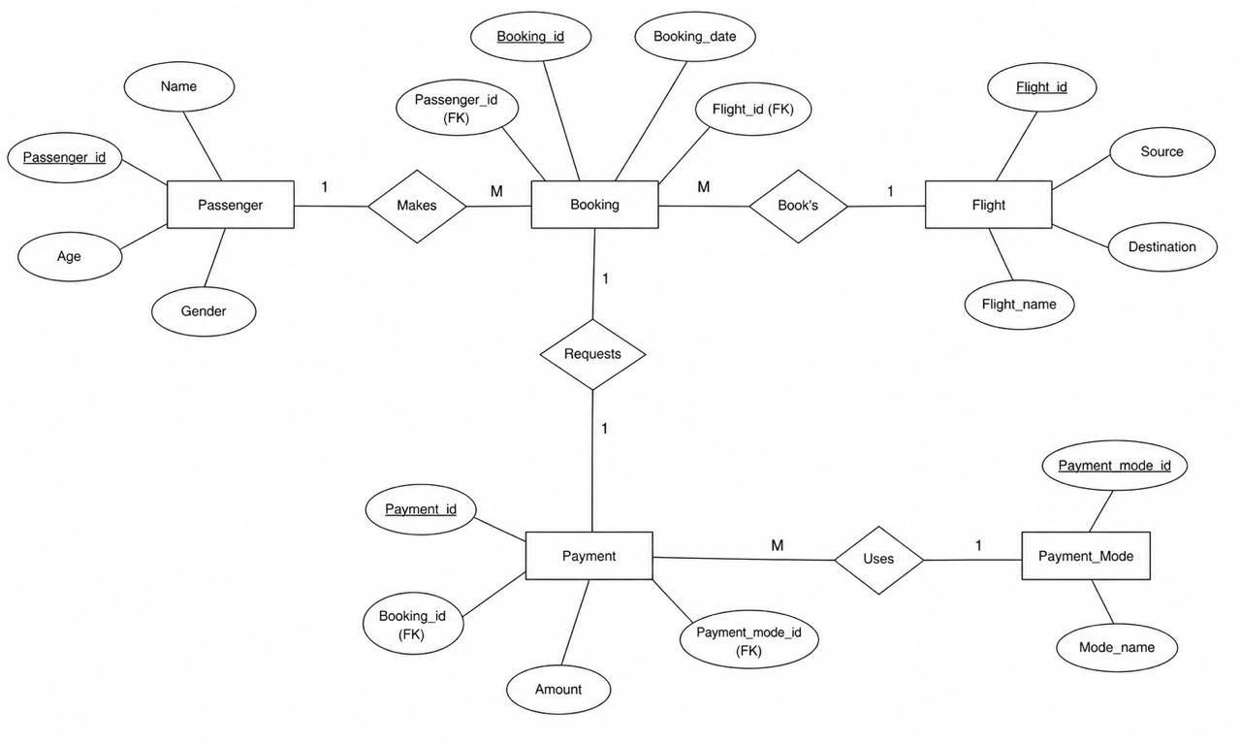
ER Diagram
Entity-Relationship Diagram

Slide 7
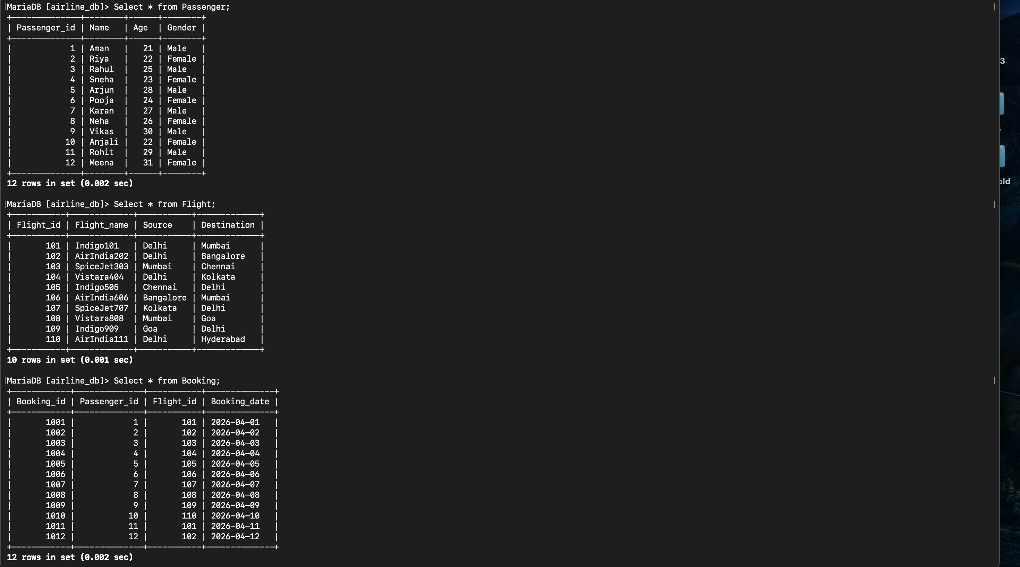
Implementation
Implementation — Passenger, Flight & Booking Tables

Slide 8
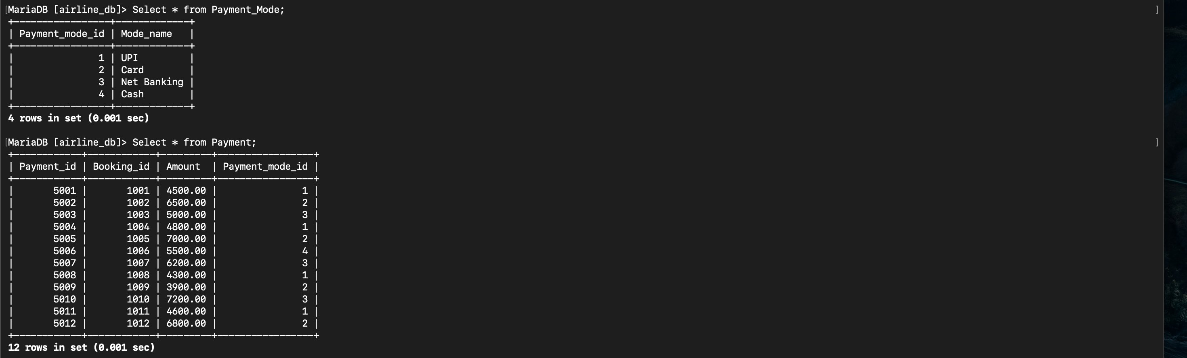
Implementation
Implementation — Payment Mode & Payment Tables

Slide 9
Results
Results — Data at a Glance
12
10
12
Passengers
Registered
Flights
Operating
Bookings
Made
Ages 21–31, mix of male & female travellers
Delhi, Mumbai, Bangalore, Chennai, Kolkata, Goa, Hyderabad
Recorded across April 1–12, 2026
Payment Modes Supported:
UPI
Card
Net Banking
Cash

Slide 10
SQL Capabilities
Key SQL Capabilities
Our query library demonstrates the full power of relational joins and aggregations across all five tables.
Passenger + Flight Lookup
Date & Destination Filters
Retrieve all passengers alongside their booked flight details in a single JOIN query.
Filter bookings by date range or destination city for operational reporting.
Revenue Aggregation
Full 5-Table JOIN
Calculate total revenue collected using SUM() across the payments table.
Retrieve complete booking details — passenger, flight, payment, and mode — in one result set.

Slide 11
Conclusion
Summary & Learnings
Normalised Schema
Keys & Integrity
Future Scope
Designed a fully normalised relational database from scratch.
Implemented Primary Keys, Foreign Keys, and Referential Integrity.
Seat selection and class management
Booking cancellation and refund workflows
Admin dashboard for operational oversight
Live availability and pricing engine
ER Modelling
Cardinality
Mapped real-world relationships through entity-relationship diagrams.
Understood and applied 1:M and M:1 relationships in practice.

Slide 12
THANK YOU
Airline Ticket Booking System — MariaDB Project
Mayank Gautam | Aman Kushwaha | Aditya Pandey | Priyanshu

