Slide 1
RULE → CACHE → AI
Invoice Risk Scanner
An AI-Powered Invoice Risk Screening Module for MSMEs and Audit Teams
TetraTHON 2026 — Indo-French AI Innovation Sprint Navrachana Innovation Foundation · Navrachana University, Vadodara 31 July – 2 August 2026 · Track C — FinTech · Problem Statement 1
Team Phishers – TETRA016
Yash Jadhav, Ananya Yadav, Jaivin Vachhani
Reliable invoice risk screening — not a full audit platform.

Slide 2
THE PROBLEM
Manual vouching can't keep up with invoice volume
Audit teams and MSMEs process large volumes of invoices, vouchers, and accounting entries across mixed formats. Manual vouching is slow and sample-based — leaving duplicate invoices, incorrect tax details, unsupported transactions, and ledger mismatches undetected.
BUILD BRIEF
Read invoices in PDF/image form, extract key fields, and reconcile against the purchase ledger and vendor master.
Data Extraction Engine
THE HIDDEN MSME EXPOSURE
Reconciliation & Anomaly Detection
Section 43B(h): if an MSME buyer doesn't pay a registered MSME vendor within 45 days of the invoice date, that expense becomes a disallowed tax deduction — a real, dated financial penalty that's usually invisible until tax filing time.
Audit Trail & Risk Scoring
Dashboarding & Exception Queue
Explicit note: the objective is a reliable screening module — not a complete audit platform.
Invoice Risk Scanner · TetraTHON 2026 · Track C — FinTech
2

Slide 3
CORE ARCHITECTURAL PRINCIPLE
Rule → Cache → AI
Every invoice runs through free, deterministic rule-based checks first. Cached prior decisions are reused. AI is called only on what genuinely remains.
01
02
03
Rule
Cache
AI
→
→
Deterministic, instant checks: GSTIN checksum, math validation, duplicate hashing, sequence gaps.
Prior decisions are reused rather than recomputed — no redundant processing.
Gemini is invoked only for fields OCR couldn't confidently read — never full-document re-extraction.
A SECOND ARCHITECTURAL RULE
Risk Score (rule-violation likelihood) and Confidence Score (OCR read quality) are two separate axes — never blended. A badly-scanned but legitimate invoice gets low confidence, not high risk.
Invoice Risk Scanner · TetraTHON 2026 · Track C — FinTech
3

Slide 4
EXPECTED OUTCOMES — MAPPED
What the brief asked for, and what we built
Data Extraction Engine
Tesseract OCR + Gemini Vision fallback, field parser, per-field confidence scoring
Reconciliation & Anomaly Detection
Full reconciliation suite — GSTIN, duplicates, ledger match, vendor anomalies
Audit Trail & Risk Scoring
SHA-256 sealed audit trail, ticket system, dual risk + confidence scoring
Dashboarding
Charts, prioritized Exception Queue with filters, search, and grouping
Invoice Risk Scanner · TetraTHON 2026 · Track C — FinTech
4

Slide 5
FEATURE SET
A full screening pipeline, not a demo script
Ingestion & Extraction
Forensics & Reconciliation
Scoring, Audit & Dashboard
Batch multi-format upload (PDF/PNG/JPEG)
PDF metadata tamper detection (pikepdf)
Weighted, explainable risk aggregation
Tesseract OCR + Gemini Vision fallback
Invisible-text detection (PyMuPDF)
ITC-at-risk & MSME penalty exposure ₹
Per-field confidence scoring
GSTIN mod-36 checksum validation
SHA-256 sealed, append-only audit trail
Internal math validation
Hash + fuzzy duplicate detection
Exception Queue: filter, search, group
needs_review routing, never guessed
Phantom vendor & typo-squatting checks
MSME 45-Day Payment Deadline Center
Invoice Risk Scanner · TetraTHON 2026 · Track C — FinTech
5

Slide 6
THE AI LAYER
Gemini is scoped tightly — and never judges fraud
01
Narrative generator
GUARDRAILS
Turns pre-computed rule findings into plain auditor-facing language, batched per invoice.
AI never determines whether something is fraudulent
Every flag traces to a deterministic, auditable rule
02
MSME translator
Renders the same findings in non-technical, action-oriented language for a business owner.
Human-in-the-loop: resolution & merges need explicit action
Minimal data exposure — only low-confidence fields sent
03
Merge suggester
Proposes — never auto-executes — ticket merges for likely-duplicate exceptions.
Retry-with-backoff; system stays functional at zero AI
Unrecoverable fields return null + needs_review, never guessed
Invoice Risk Scanner · TetraTHON 2026 · Track C — FinTech
6

Slide 7
TECH STACK
Chosen for hackathon speed and production runway
BACKEND
ORM / DB
FastAPI
SQLAlchemy + SQLite
Async, auto-generated OpenAPI docs used constantly for testing
Fast to iterate; drops into PostgreSQL with just a connection string
OCR
AI / LLM
Tesseract (pytesseract)
Gemini (flash-latest)
PaddleOCR failed silently on Windows; Tesseract was clean & reliable
Priced for high-volume, low-complexity recovery & rephrasing tasks
PDF FORENSICS
IMAGE FORENSICS
pikepdf, PyMuPDF
Pillow (EXIF)
Metadata inspection and invisible-text detection
Same tamper-signal capability extended to PNG/JPEG
FUZZY MATCHING
FRONTEND
RapidFuzz
React + Vite + Tailwind
Vendor typo-squatting & near-duplicate invoice detection
Fast dev iteration matching FastAPI's async responsiveness
Invoice Risk Scanner · TetraTHON 2026 · Track C — FinTech
7

Slide 8
COST-EFFECTIVENESS
Rule → Cache → AI is the entire cost strategy
83 / 83
100%
Field-level
Batched
invoices screened with 0 required
AI vision fallbacks (demo run)
of invoices handled by free,
deterministic rule logic
AI calls — only missing fields,
never full re-extraction
narrative calls — one Gemini call
per invoice, not per flag
LIVE DASHBOARD METRIC — REAL, NOT ASSERTED
In our demo run, 83/83 invoices were processed with zero required Gemini vision fallbacks. This ratio is surfaced live on the dashboard as an "AI cost savings" metric, computed from real data. Cost scales sub-linearly with invoice volume — most invoices never touch the AI layer at all.
Invoice Risk Scanner · TetraTHON 2026 · Track C — FinTech
8

Slide 9
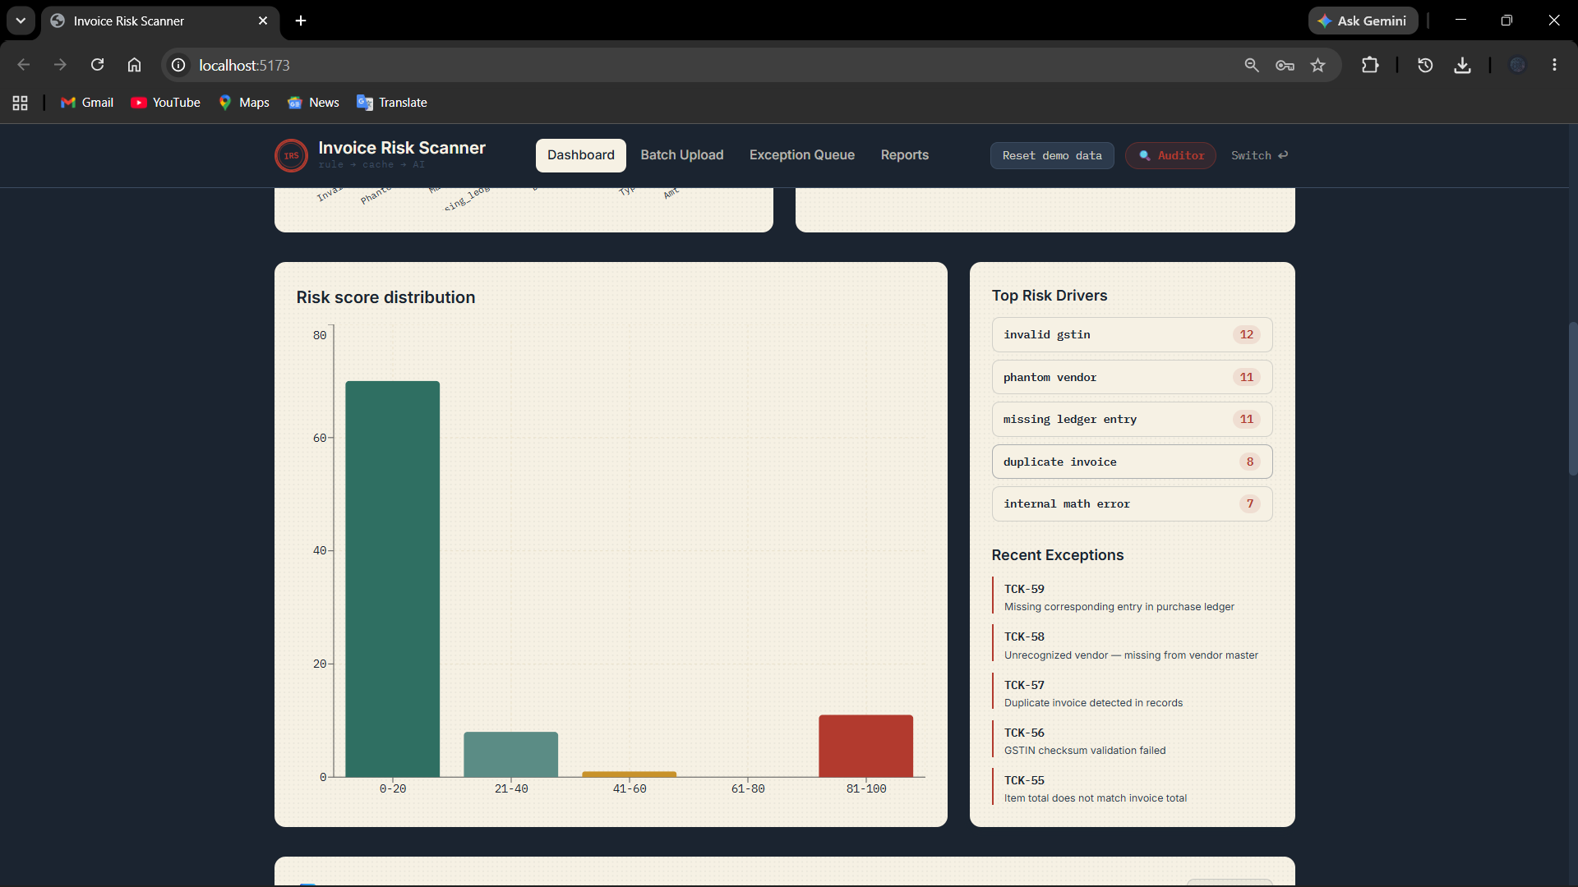
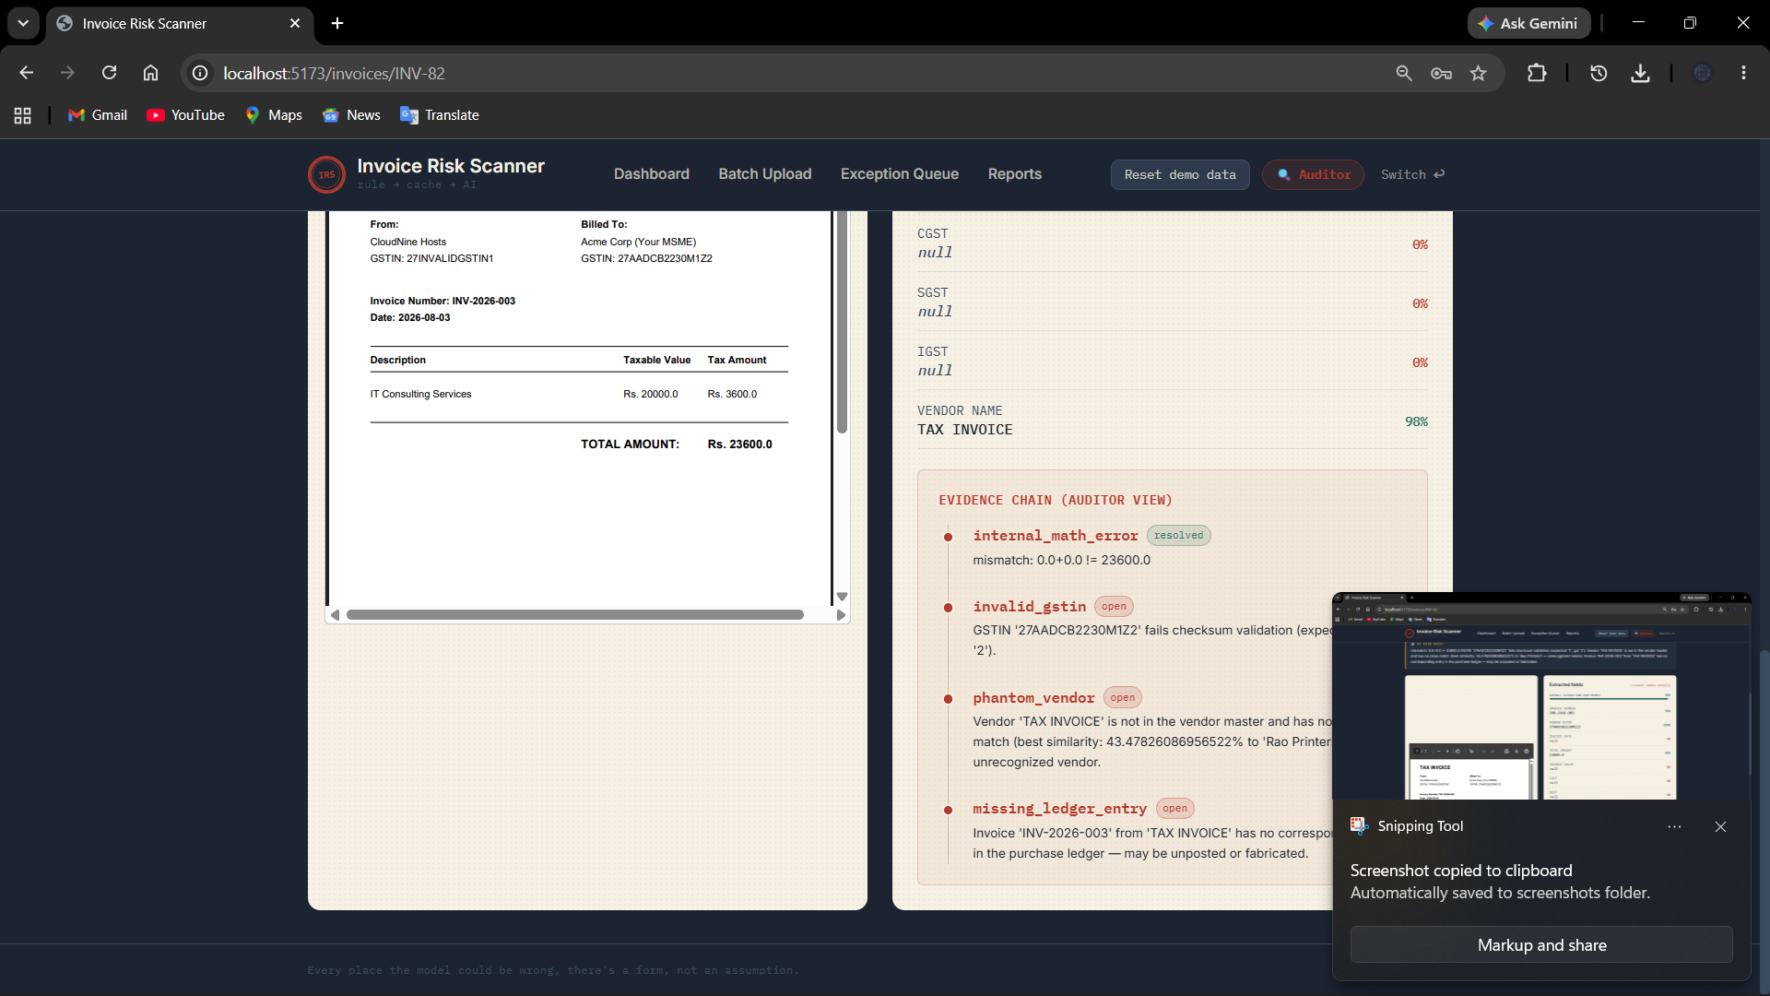
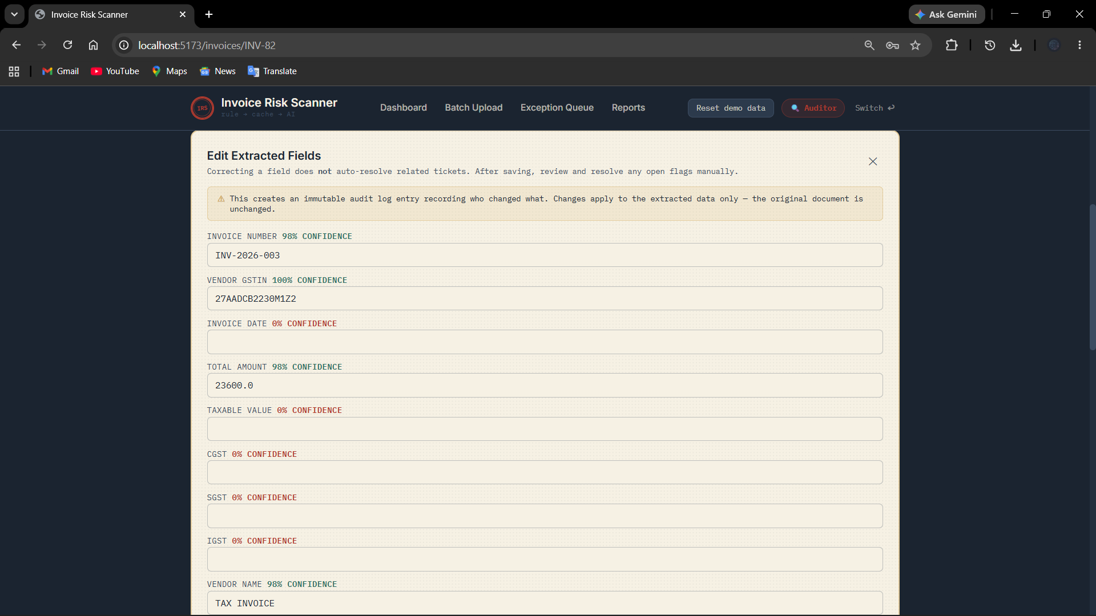
PRODUCT SNAPSHOT
From dashboard to evidence chain
Screening overview dashboard
Exception Queue, grouped by category
Invoice investigation & evidence chain
Invoice Risk Scanner · TetraTHON 2026 · Track C — FinTech
9

Slide 10
ETHICAL & SECURE USE OF AI
Explainable by design, honest about its limits
AI never makes the fraud determination — every flag is rule-derived and traceable
DEPLOYMENT & DATA POSTURE
Today: a personal Gemini API key under standard developer terms — appropriate for a 36-hour sprint on synthetic data with no real financial exposure. For real deployment, we'd move to:
Human-in-the-loop by design for resolution, false-positives, and merges
An enterprise API agreement with a contractual no-training-on-data guarantee, formalized in a DPA
Careful language throughout: "risk," "potential duplicate," never certain fraud
Self-hosted, open-weight models on our own infrastructure for organizations with strict data-residency needs
Honest statistical rigor — reports "insufficient evidence" rather than guessing
The ethical posture of an AI system depends on the deployment model beneath it — a deliberate choice, not a hackathon default.
Invoice Risk Scanner · TetraTHON 2026 · Track C — FinTech
10

Slide 11
SCALABILITY & IMPACT
A screening layer built to grow into production
SCALABILITY PATH
INCLUSIVE GROWTH
SQLite → PostgreSQL: zero code changes, just a connection string
MSMEs form a large share of India's GST-registered businesses but typically lack in-house audit capacity. 100% invoice screening at near-zero marginal AI cost lets even small businesses catch duplicate billing, GSTIN errors, and — critically — missed MSME payment deadlines before they become real financial losses.
Rule-first design keeps AI cost sub-linear as volume grows
Reconciliation modules generalize beyond the sectors demoed
The dual-mode Auditor / MSME interface acknowledges that the same risk intelligence needs to speak two different languages — technical auditor and non-technical business owner — to the same underlying finding.
Est. ₹8–15 lakh, 3–4 months, 2–3 engineers to production MVP
Cut deliberately (candidates for future work): E-way bill API, FX API, WHOIS lookup, circular-billing graph, custom OCR training.
Invoice Risk Scanner · TetraTHON 2026 · Track C — FinTech
11

Slide 12
DELIVERABLES
Working prototype, ready to demo
Full-stack prototype — FastAPI + SQLAlchemy backend, React/Vite frontend
Demo video and pitch deck
GitHub source code repository
Synthetic test dataset with engineered fraud/error scenarios — duplicates, invalid GSTIN, ledger mismatches, vendor anomalies, sequence gaps, tamper signals
Every place the model could be wrong, there's a form — not an assumption.
Invoice Risk Scanner · rule → cache → AI

