Slide 1

Dept. of Computer Science
& Engineering
Puzzle game using C++ (SFML)
Presented By:
Mazedul
Roll : 1737820124
2th year, 1nd semester.
Session : 2016-17
Dept. of CSE
TMSS Engineering College
Project Supervisor
Subrata Kumer Paul
Lecturer
Dept. of CSE
TMSS Engineering College
Notes:
<number>

Slide 2
Content
What is the project? Why need it?
Language and tools
Requirement analysis
UML diagram
Time- Scheduling
Outcome
Impact on the society
Major References
Sreen shots of project
Thanks! Any Question?

Slide 3
1.
What is the project? Why need it?
<> The project is puzzle game (in a 4x4 board)
<> For entertainment

Slide 4
2.
Language and tools
<> The project done using c++ language
<> SFML graphics

Slide 5
3.
Requirement analysis
<> Requirement for Development :
Area of project : linux OS
IDE : Clion

Slide 6
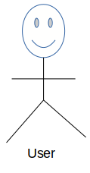
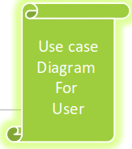
4.
UML diagram
Play
Move
Instraction
Exit
About me

Slide 7
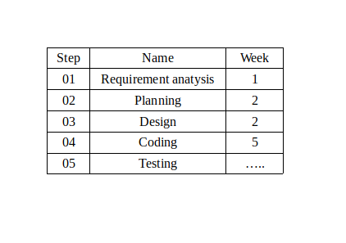
5.
Time-Scheduling

Slide 8
6.
Outcome
<> User friendly.
<> User can play this game on his Linux OS anywhere he wants.
<> Give challenges to the user’s brain.
<> There is also a timer to count that in how much times the user complete the game.

Slide 9
7.
Impact on the society
<> Puzzles are also an important educational learning
tool for toddlers and young children as they provide
many skills and mental learning benefits and
opportunities.

Slide 10
8.
Major References
Reference :
Link[1]
Link[2]
1. https://github.com/MORTAL2000/15-Puzzle-Game
2. https://en.sfml-dev.org/forums/index.php?topic=20245.0

Slide 11
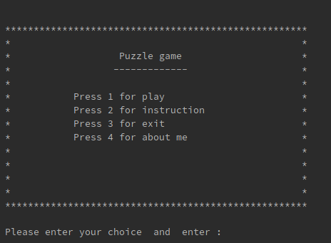
9.1
Sreen shots of project
Home

Slide 12
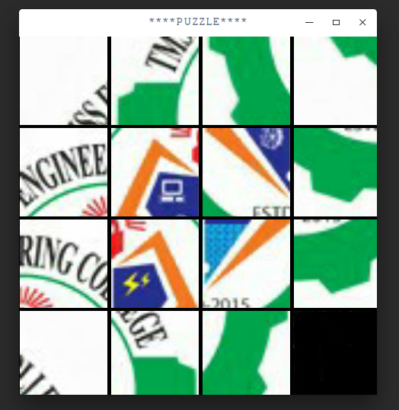
9.2
Sreen shots of project
Play Game

Slide 13
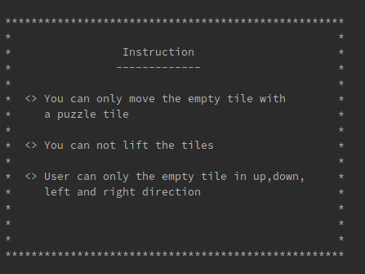
9.3
Sreen shots of project
Instruction

Slide 14

9.4
Sreen shots of project
No. of move

Slide 15
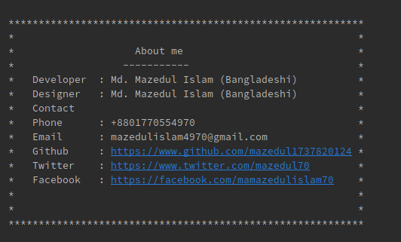
9.5
Sreen shots of project
About me

Slide 16

10.
Thanks! Any Question?
Thanks for listening
Any question!!

Slide 17
--END--

