Slide 1

Dept. of Computer Science
& Engineering
Puzzle game using C++ (SFML)
Presented By:
Mazedul
Roll : 1737820124
2th year, 1nd semester.
Session : 2016-17
Dept. of CSE
TMSS Engineering College
Project Supervisor
Subrata Kumer Paul
Lecturer
Dept. of CSE
TMSS Engineering College
Notes:
<number>

Slide 2
Content
Introduction
What is this project? Why we need it?
Language and tools
Requirement analysis
UML diagram
Time- Scheduling
Outcome
Impact on the society
Major References
Sreen shots of project
Thanks! Any Question?

Slide 3
1.
Introduction
The application starts by giving user name. After giving user name user can play game
The puzzle consists 15 numbered square tiles (in a 4x4 square) in random
order with one tile empty.
The user has to move the tiles to get them into consecutive order with the space in the bottom right.
user can also check their minimum score.

Slide 4
2.
What is this project? Why we need it?
<> The project is puzzle game (in a 4x4 square)
<> For entertainment

Slide 5
3.
Language and tools
<> The project done using c++ language
<> SFML graphics

Slide 6
4.
Requirement analysis
<> Requirement for Development :
Area of project : Arch Linux
IDE : Clion

Slide 7
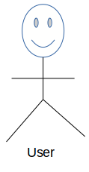
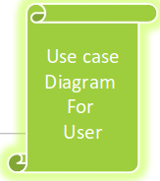
5.
UML diagram
Play
Move
Instruction
Exit
About me

Slide 8
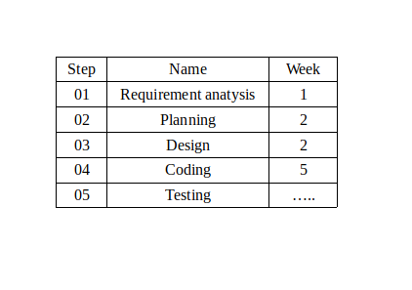
6.
Time-Scheduling

Slide 9
7.
Outcome
<> User friendly.
<> User can play this game on his Linux OS anywhere he wants.
<> Give challenges to the user’s brain.
<> There is also a timer to count that in how much times the user complete the game.

Slide 10
8.
Impact on the society
<> Puzzles are also an important educational learning
tool for toddlers and young children as they provide
many skills and mental learning benefits and
opportunities.

Slide 11
9.
Major References
Reference :
Link[1]
Link[2]
1. https://github.com/MORTAL2000/15-Puzzle-Game
2. https://en.sfml-dev.org/forums/index.php?topic=20245.0

Slide 12
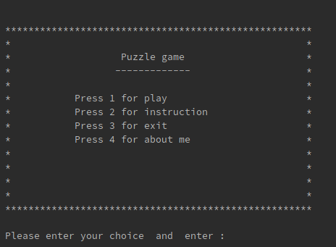
10.1
Sreen shots of project
Home

Slide 13
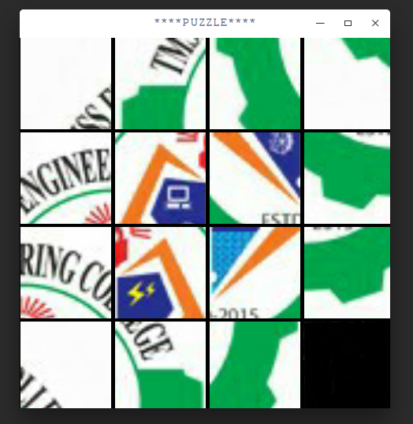
10.2
Sreen shots of project
Play Game

Slide 14
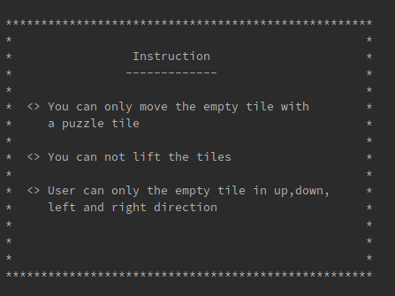
10.3
Sreen shots of project
Instruction

Slide 15

10.4
Sreen shots of project
No. of move

Slide 16
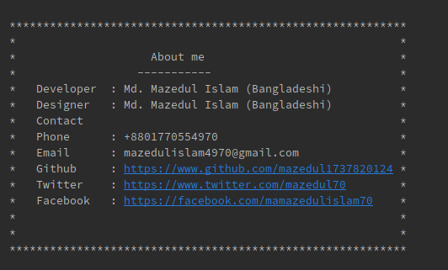
10.5
Sreen shots of project
About me

Slide 17

11.
Thanks! Any Question?
Thanks for listening
Any question!!

Slide 18
--END--

