Slide 1

Dept. of Computer Science
& Engineering
Puzzle game using C++ (SFML)
Presented By:
Mazedul
Roll : 1737820124
2th year, 1nd semester.
Session : 2016-17
Dept. of CSE
TMSS Engineering College
Project Supervisor
Subrata Kumer Paul
Lecturer
Dept. of CSE
TMSS Engineering College
Notes:
1

Slide 2
Content
What is the project? Why need it?
Language and tools
Requirement analysis
UML diagram
Time- Scheduling
Outcome
System Testing
Impact on the society
Major References
Thanks! Any Question?

Slide 3
1.
What is the project? Why need it?
<> The project is puzzle game (in a 4x4 board)
<> For entertainment

Slide 4
2.
Language and tools
<> The project done using c++ language
<> SFMl graphics

Slide 5
3.
Requirement analysis
<> Requirement for Development :
Area of project : linux OS
IDE : Clion

Slide 6
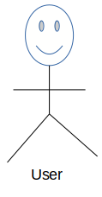
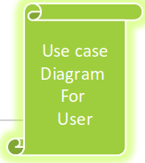
4.
UML diagram
Play
Move
Instraction
Exit
About me

Slide 7
5.
Time-Scheduling

Slide 8
6.
Outcome

Slide 9
7.
System Testing

Slide 10
8.
Impact on the society

Slide 11
9.
Major References

Slide 12

10.
Thanks! Any Question?
Thanks for listening
Any question!!

Slide 13
--END--

