Slide 1
Diabetes Classification Project
Dataset link :https://www.kaggle.com/datasets/iammustafatz/diabetes-prediction-dataset

Slide 2
Mazen Hamed Wahbi
Computer & AI Graduate form Helwan University

Slide 3
Agenda:
Introduction to the Dataset
Loading Data
EDA (Exploratory Data Analysis)
Univariate
Bivariate
Data Preprocessing
Handling Missing Data
Dealing With Outliers
Dealing With Imbalance Problem
Model Building
Model Choosing
Fine Tuning
Model Evaluation
Dataset Description
Dataset Info

Slide 4
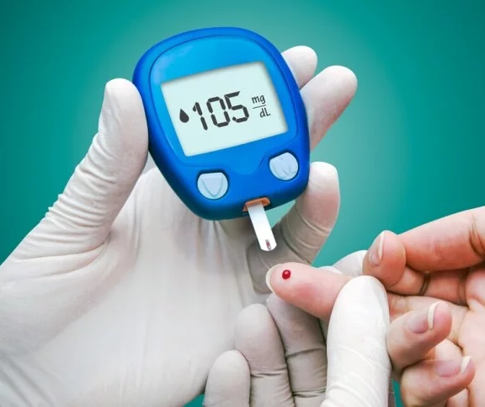
Introduction To the Dataset:
What is the Diabetes:
Diabetes is a health condition characterized by high blood sugar levels over a prolonged period.
Notes:
This occurs when there is a deficiency in insulin or when the body does not effectively use insulin.

Slide 5
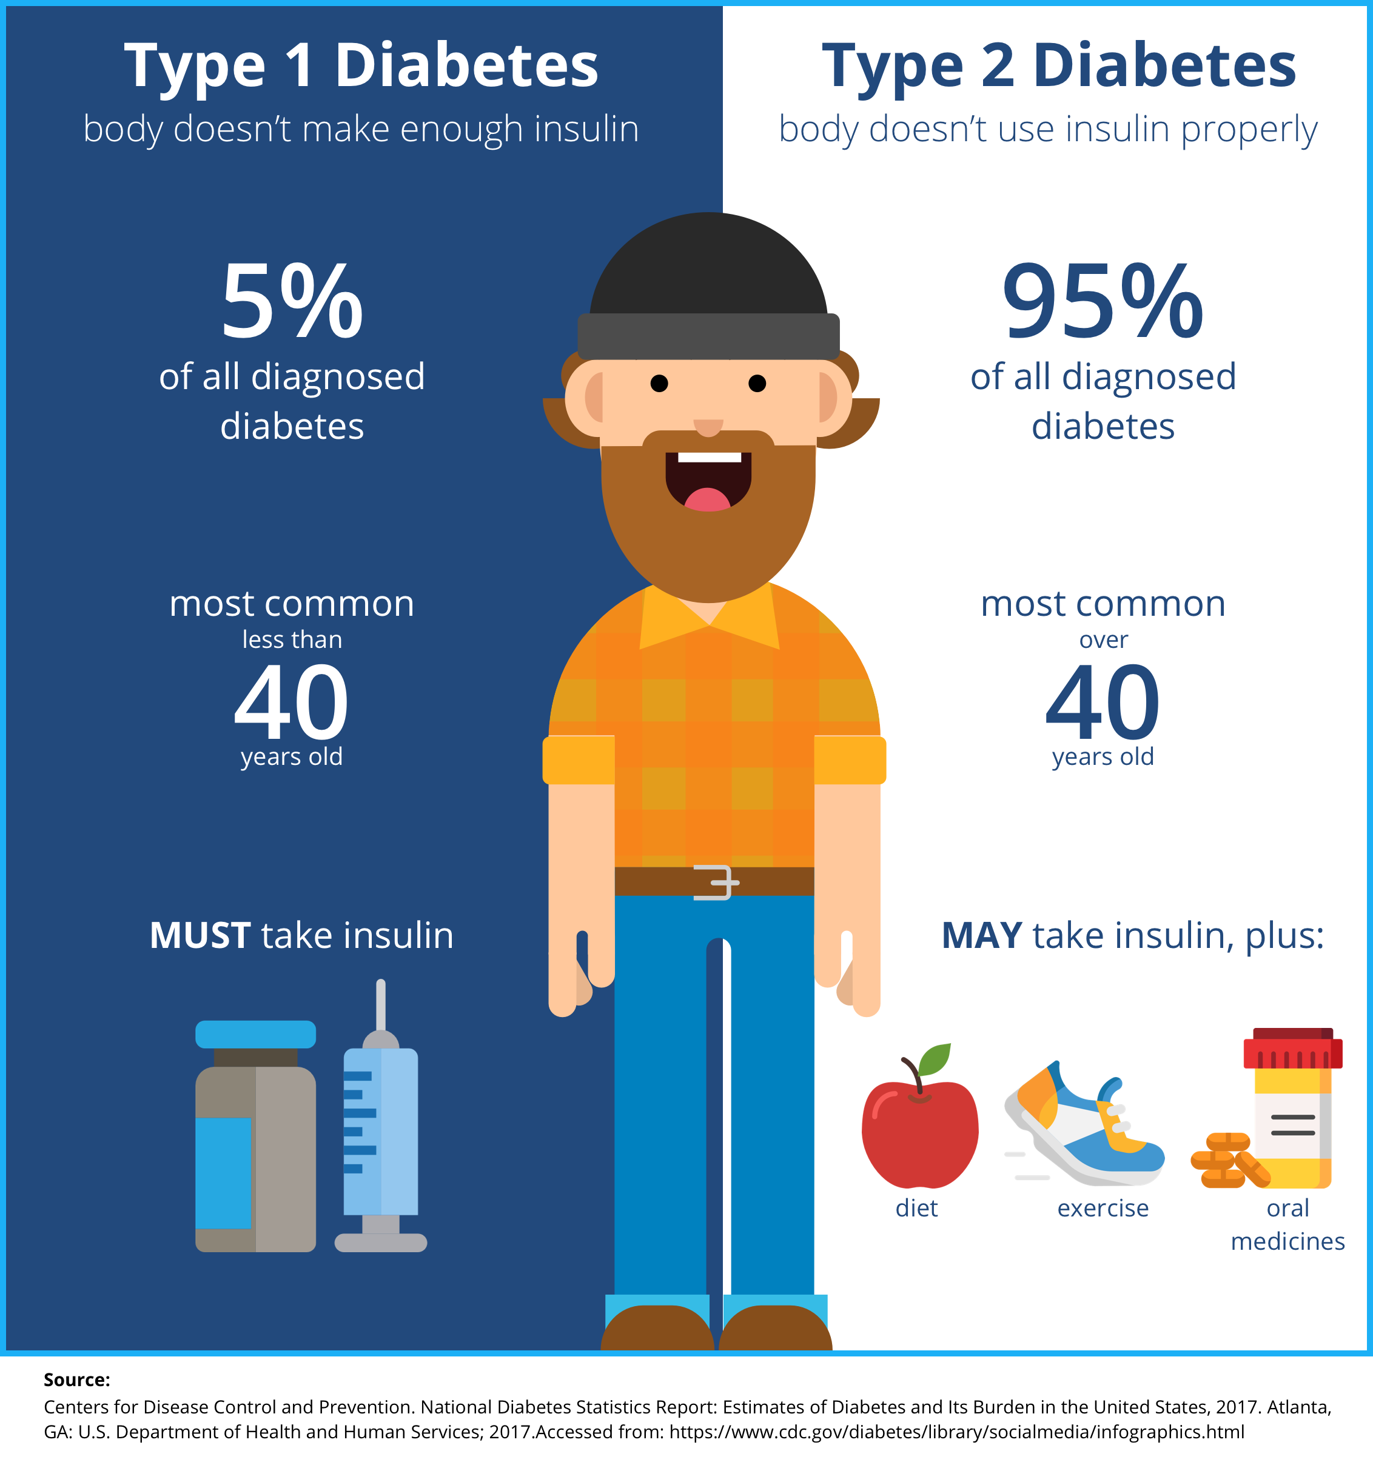
Introduction To the Dataset:
Types of Diabetes:
Type 1 diabetes: Occurs when the pancreas stops producing insulin altogether.
Type 2 diabetes: Occurs when the body is unable to use insulin properly or does not produce enough of it.
Notes:
Types of Diabetes:
There are two main types of diabetes:
Type 1 diabetes: It occurs when the pancreas stops producing insulin altogether.
Type 2 diabetes: It occurs when the body is unable to use insulin properly or does not produce enough of it.

Slide 6
Dataset Features:
There are 8 Features in the dataset and 1 Label:
Gender → Categorical
Age → Numerical Continuous
Hypertension → Numerical Binary
Heart Disease → Numerical Binary
Smoking History → Categorical
BMI (Body Mass Index) → Numerical Continuous
HbA1C Level → Numerical Continuous
Blood Glucose Level → Numerical Continuous
Diabetes (Label) → Numerical Binary

Slide 7
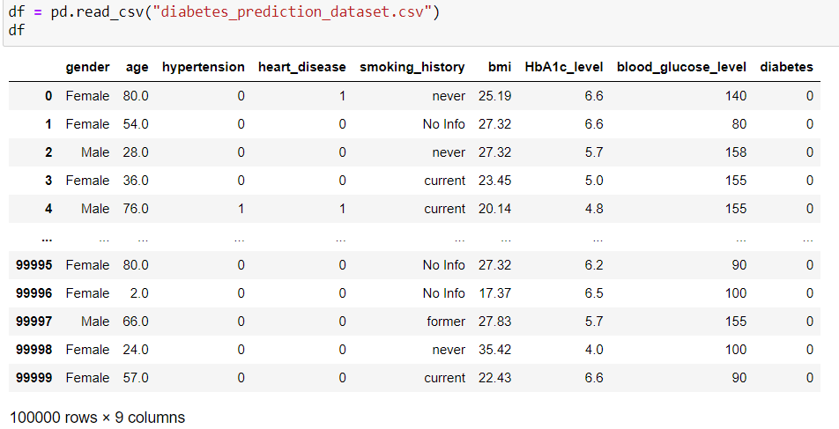
Loading The Dataset:
The dataset contains 100000 rows and 9 columns

Slide 8
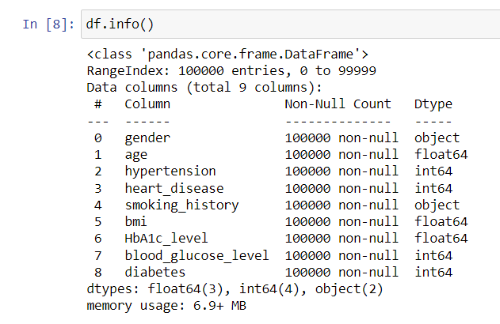
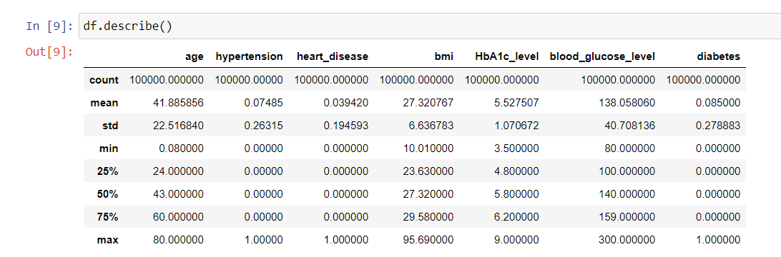
Dataset Description & Info
Dataset Info: Dataset Description:

Slide 9
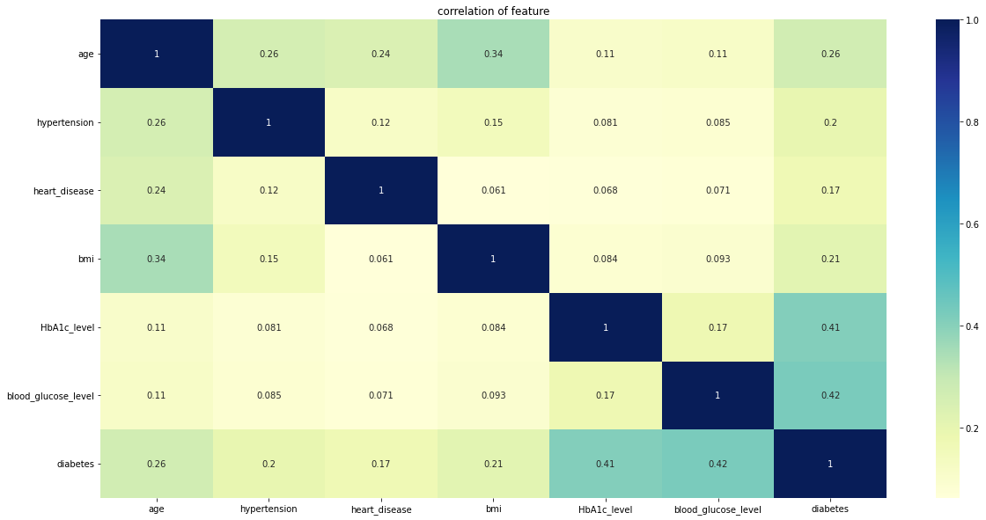
Correlation Matrix:

Slide 10
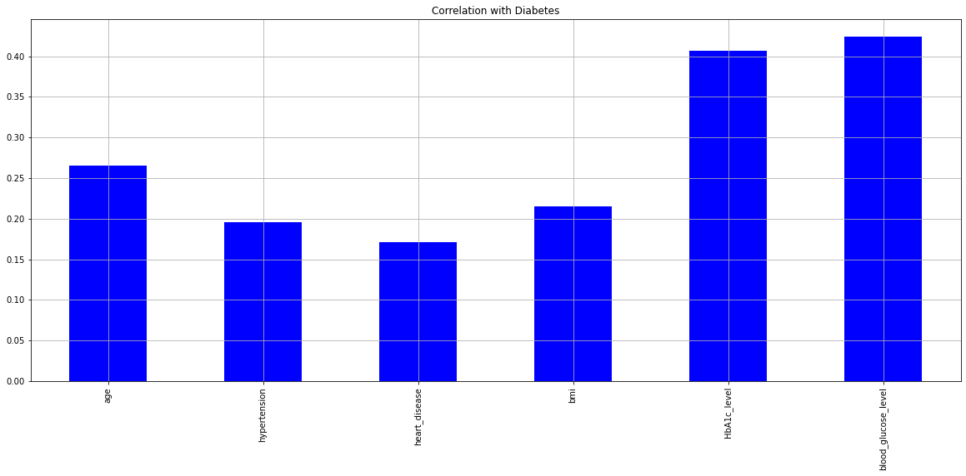
Correlation With label:

Slide 11
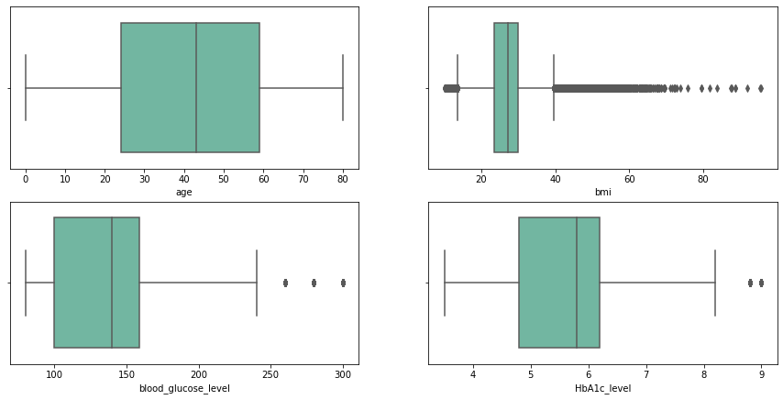
Numerical Plotting:

Slide 12
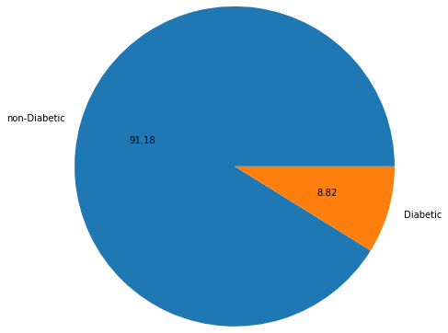
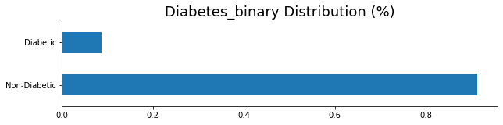
Label Plot:

Slide 13
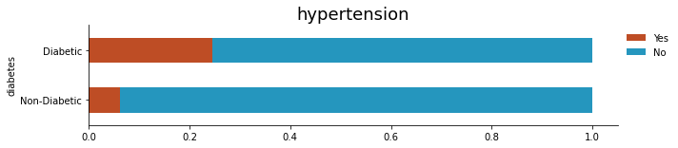
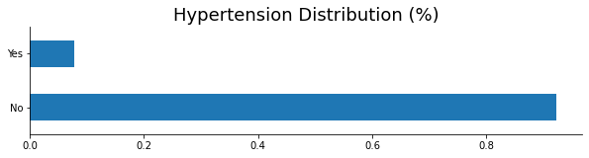
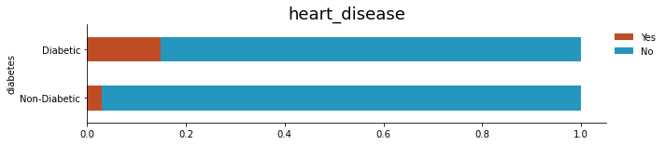
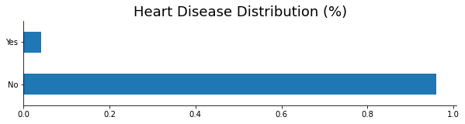
Hypertension:
Heart Disease:

Slide 14

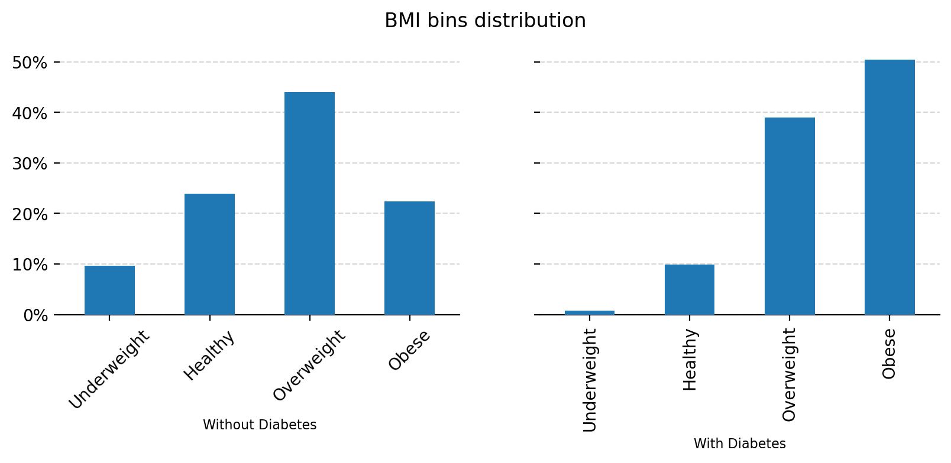
BMI:
Body Mass Index is a measure of body fat based on a person's weight and height.
If your BMI is less than 18.5, it falls within the underweight range.
If your BMI is 18.5 to 24.9, it falls within the Healthy Weight range.
If your BMI is 25.0 to 29.9, it falls within the overweight range.
If your BMI is 30.0 or higher, it falls within the obese range.

Slide 15
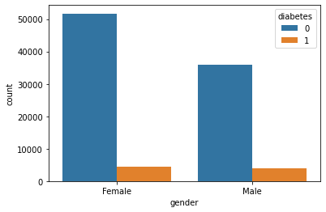
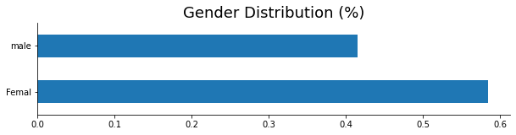
Gender Distribution:

Slide 16
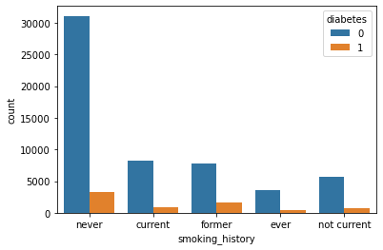
Smoking and Diabetes:
Notes:
Smoking has minor effect on whether the person has diabetes or not.

Slide 17
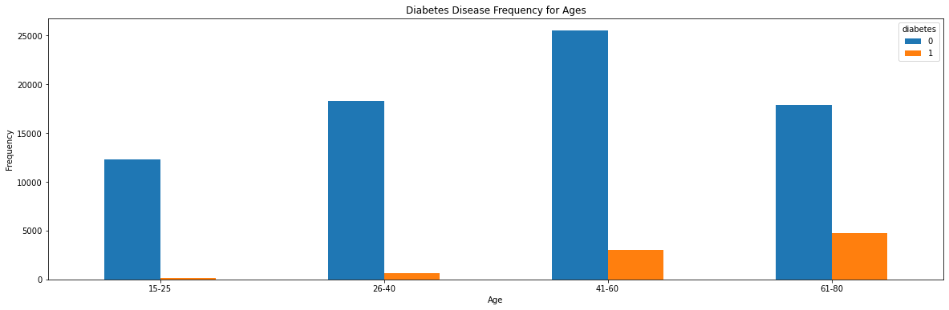
Age and Diabetes:
Notes:
Here we can see that age has major effect on whether the person has diabetes or not. People in the range of [40-60] are more likely to get diabetes.

Slide 18
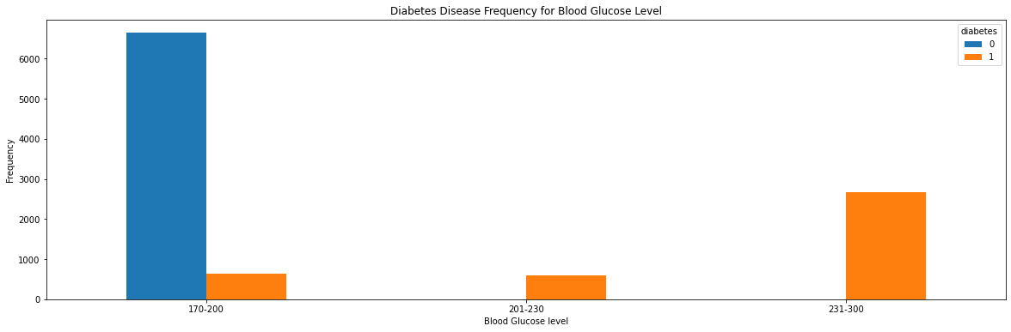
Blood Glucose Level and Diabetes:
Notes:
Here we can see that age has major effect on whether the person has diabetes or not. People in the range of [40-60] are more likely to get diabetes.

Slide 19
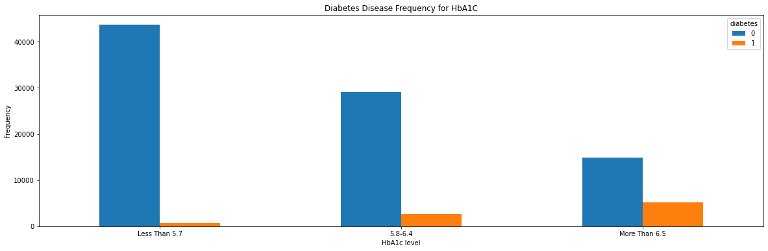
HbA1C Level and Diabetes:
What is HbA1c?:
HbA1c is your average blood glucose (sugar) levels for the last two to three months
Source: https://medlineplus.gov/lab-tests/hemoglobin-a1c-hba1c-test/#:~:text=Normal%3A%20A1C%20below%205.7%25,A1C%20of%206.5%25%20or%20higher
Notes:
. If you have diabetes, an ideal HbA1c level is 48mmol/mol (6.5%) or below.
Here we can see that HbA1C has major effect on whether the person has diabetes or not. People in the range more than 6.5 are more likely to be diabetic.

Slide 20
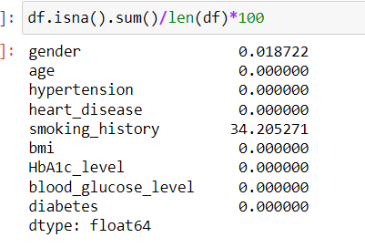
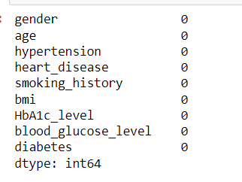
Data Preprocessing:
Handling Missing Values:
There are hidden missing values in the 2 features (gender, smoking_levels), which values are (other, no_info) respectively.
Before → After
Notes:
Since the 2 feature are Categorical, I replaced the wrong values with NAN to see the percent of missing values. The missing values were more than 30% of the data so I imputed it with the mode

Slide 21
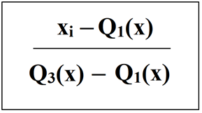
Dealing With Outliers & Encoding the Data :
For Outliers there are 2 ways to deal with them:
Removing Them
Scaling
For Categorical Data there are 2 ways to encode them:
Label Encoder
OneHot Encoder
Robust Scaling Equation

Slide 22
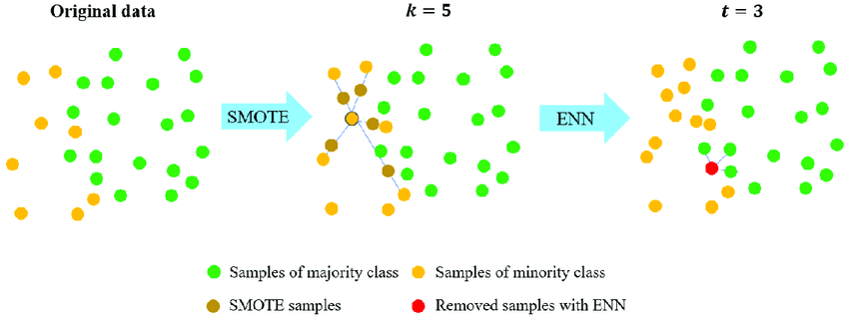
Dealing with Imbalanced Data:
As we saw the dataset was imbalances, there are 2 techniques to deal with this problem:
Undersampling
Oversampling
SMOTE+ENN
Notes:
In my dataset I have combined both techniques using SMOTEENN and NearMiss as it provided me with the best accuracy.

Slide 23
Modeling:
In the dataset I have used GridSearch Cross validation to test multiple models and choose the best one out of them and to fine tune their parameters:
DecisionTreeClassifier , KNeighborsClassifier, RandomForestClassifier.
The best output model with 98% Accuracy was (RandomForestClassifier): with parameters:(max_depth=20, n_estimators=20)

Slide 24
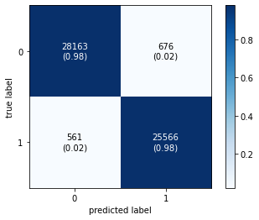
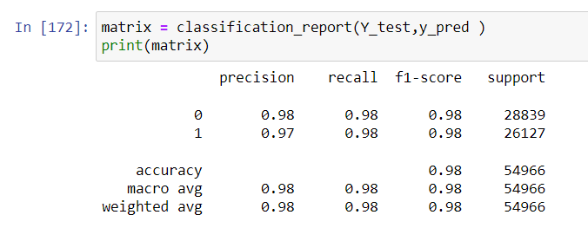
Model Evaluation:
Confusion Matrix
Classification Report

Slide 25
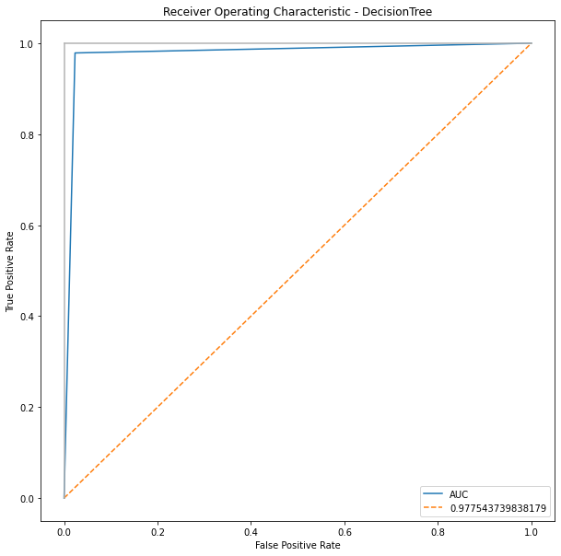
ROC Curve & AUC

Slide 26
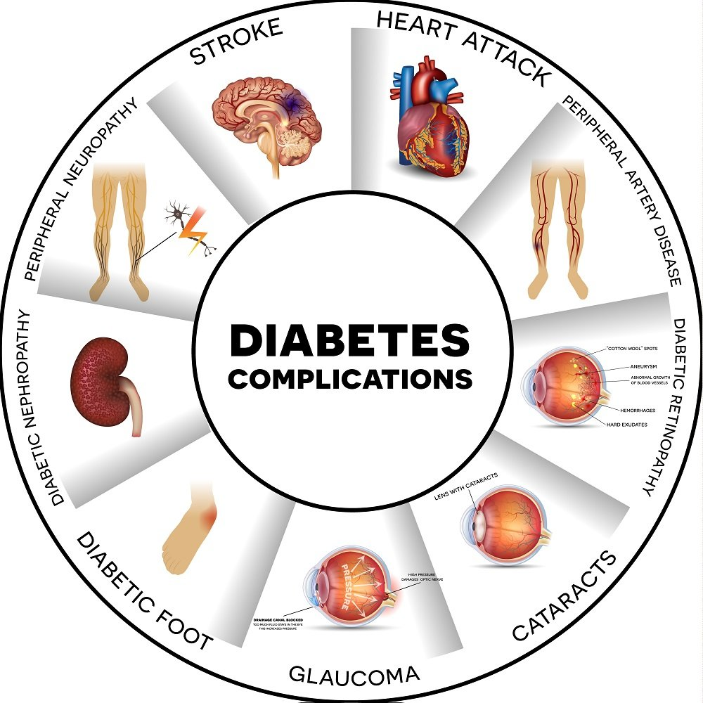
Now that we've manipulated the data and explained what diabetes is, we've struck a balance in the data. This is a summary:
1: Diabetes is a serious disease, and we must deal with it early. We must pay attention to health, and it is considered the main factor after the genetic factor.
2: To reduce the susceptibility to infection, we must take care of our life system and stay away from the factors that affect our health.

Slide 27


Slide 28


