Slide 1

Prospect Argentina Branch MNC Corp
Prepared By:
Mazen Alhaffar – Raheela Charania – Neha Chowke – Sharon Nancy Burgula

Slide 2
INTRODUCTION
Aspects to consider while starting a business in Argentina include:
Unprecedented bureaucracy rate
Barriers to import
Difficulty in accessing foreign currency
Inflation rate
Complex tax system
Cross-border trade barriers
Sovereign debt-crisis
Argentina is a part of MESCOSUR alliance.

Slide 3
ANALYSIS BREAKDOWN

Slide 4

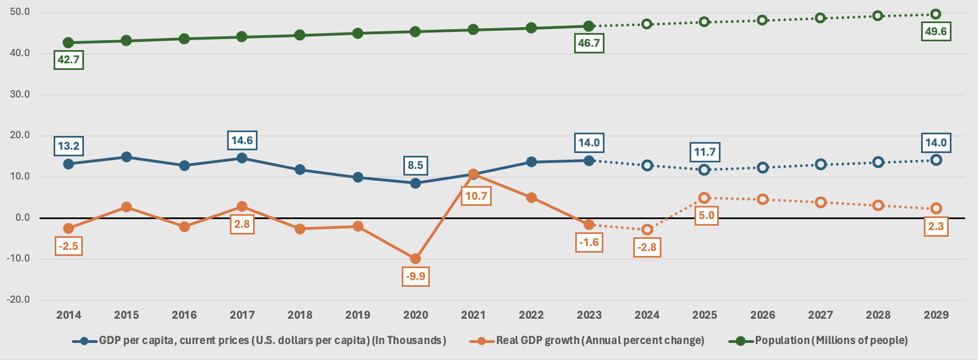
GDP PER CAPITA & REAL GDP GROWTH
Argentina’s GDP fluctuations occurred in the past ten years.
Covid-19 affected the real GDP growth and slowed down commercial movement.
GDP per capita stabilized after Covid due to population growth.
Argentina has the third-highest GDP per Capita among Latin American countries.
Prediction of negative to stable trend of GDP per capita.

Slide 5
UNEMPLOYMENT RATE
Unemployment reached it’s peak during the pandemic.
Unemployment rate gradually decreased since 2020 due to government intervention.
IMF predicts that unemployment rate will return to the same level as ten years ago due to instability.
People’s purchasing power will be affected.

Slide 6
EXCHANGE RATE
High exchange rate leads to more expensive imports.
Exchange rate raises the selling price of the product in the country.
Common class would be affected the most which will impact sales.
Stable exchange rate from 2014 – 2017.
Depreciating currency will negatively impact profits due to higher costs.

Slide 7
INFLATION RATE
Inflation increased drastically in the last two years.
Uncertainty about the economy’s health leads to businesses’ hesitation to start operation.
Ambiguity over future cost and prices.
No data provided in 2015 and 2016 which is suspicious behavior.
Whether Argentina is able to bounce back is still uncertain.

Slide 8
INTEREST RATE
Between the years 2016-2019, the interest rates were rising high which resulted in low investments.
However, in the past few years, interest rates have declined and became negative which encourages investors to borrow capital.
Argentina has a competitive interest as compared to the Latin American countries.

Slide 9
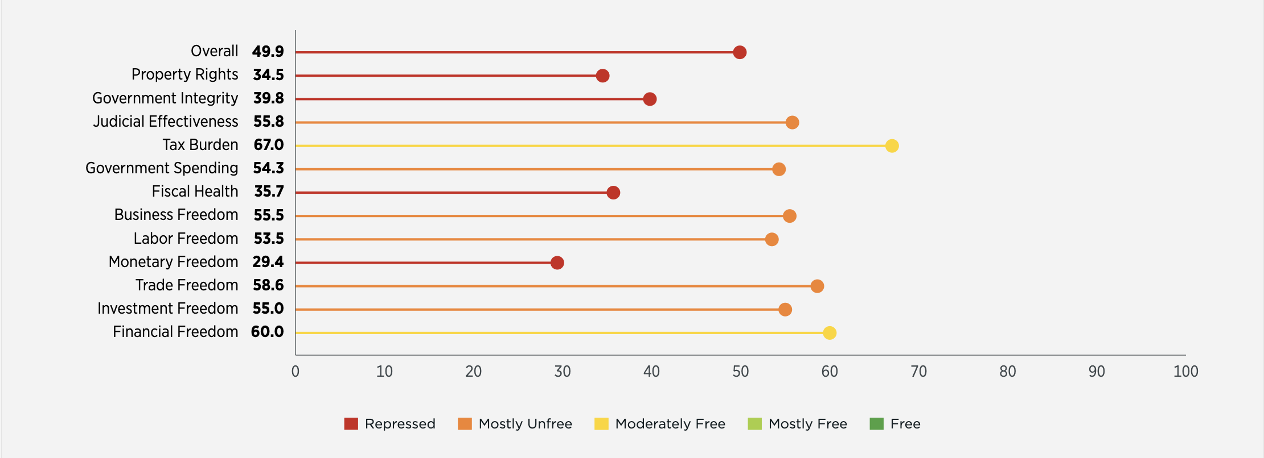
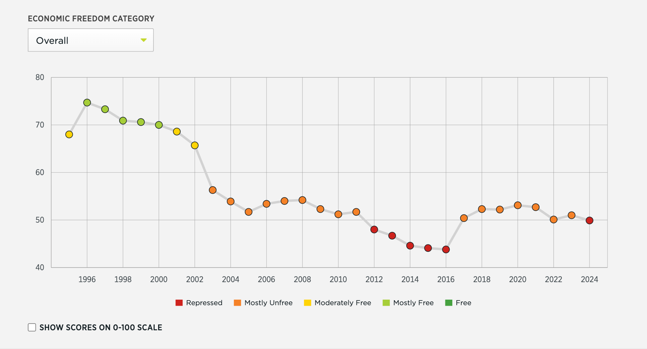
ECONOMIC FREEDOM
Economic Freedom is in a repressed state with monetary freedom, property rights, fiscal health and government effectiveness affecting the score the most.
Not a single metrics is in mostly free or free category.
Declining economic freedom.
The government failed to create an enticing environment for local and foreign investors.

Slide 10
HUMAN DEVELOPMENT INDEX RATE (HDI)
Argentina has a stable HDI of 84% which falls under the very high human development tier.
This means the country has a higher standard of living, access to health and education and a decent income.
This contributes to the business development as well as the economic growth.

Slide 11
LITERACY RATE
Argentina has a high literacy rate due to policies requiring mandatary education.
Indicates gender equality and growing working force.
Availability of well-educated individuals with high capabilities that can be beneficial to hire experts.
Given there is no data after 2021, it is hard to predict the affect of covid on literacy rate after 2021.

Slide 12
Through our research and analysis, we have found that while Argentina is stable in certain aspects of its economy, there is still much uncertainty with the direction of other major factors that could impact our sales and revenue; therefore, we do not recommend that the business be expanded into Argentina at this moment, especially after the economic uncertainty brought upon by COVID-19. Having said that, we plan on continuing to monitor the economy of Argentina and perhaps, barring any outside factors or calamities, we can expand into Argentina in the future.
SUMMARY
Fluctuations in GDP in recent years.
GDP per capita has been stable in the past few years.
There is a gradual decline in the Unemployment Rate.
There is a high Human Development Index.
An increase in Exchange Rates in the last few years.
An increase in Inflation Rate.
A negative Interest Rate.
The Economic Freedom is repressed.
Overall - Argentina’s economy is unstable.
RECOMMENDATIONS
Notes:
To summarize, Argentina has had multiple fluctuations in GDP in the recent years; however, the GDP per capita has been stable the past few years, most likely due to increasing population.
There is a gradual decline in unemployment rate which is suitable since the population will be able to and more likely to purchase our products.
There is a high Human Development Index, indicating that the country of Argentina is socially developed.
However, the increasing exchange rates in the last few years will decrease our profits.
There is an increase in inflation rate indicating that Argentina’s economic situation is worsening.
However, a negative interest rate encourages investors to borrow capital which is beneficial for our company.
Still, the economic freedom is repressed indicating that the economy of Argentina is suffering.

