Slide 1
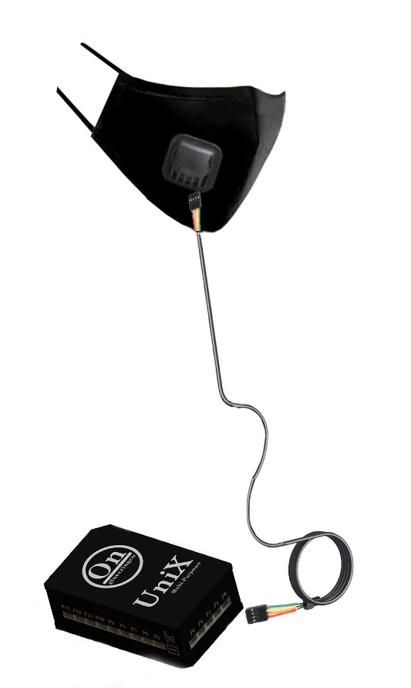

Smart Mask Idea
The idea of smart mask is that it warns the consumer that he or she came into contact with extra virus or bacteria than the normal days or came into contact with a lethal virus or bacteria such as, COVID-19 or Virus C, so they can take the precautions and know that they came in contact with someone or something that caries a virus or a bacteria.
It consists of 6 things which are a cotton mask, Biosensors, water PMMA material proof case, a belt and 3 wires,3.7 Micro Lipo Battery , and a remote controller.
Biosensors are the sensors that are responsible for classifying and counting the viruses and the bacteria.
Water PMMA material proof case is responsible for protecting the circuit while washing the mask.
UniX multi purposes controller is used as a programing processor that process the data ( Virus or Bacteria type-Number of viruses or bacteria) from the Biosensors to send a warning that you have been in contact with a type virus or bacteria that can be lethal and the number of viruses or bacteria if it exceeded the normal daily limit by Bluetooth to a mobile device.

