Slide 1

LLM–DBMS Semantic Processing: Comparative Evaluation
Prepared by: Mazen El Sedfy
Led by: Kerem Akillioglu — Supervised by: Tamer Özsu
Date: September 11, 2025

Slide 2
Summary
Lotus delivered the lowest latency and cost across all five query shapes.
DocETL provided agentic control and guardrails but incurred planning/validation overhead.
Palimpsest improved robustness via rewriting/selection but significantly increased tokens and cost.
Recommendation: Use Lotus by default; apply Palimpsest surgically; reserve DocETL for mandatory guardrails.

Slide 3
Systems Overview (Claims vs Observed)
Lotus — Natural mapping to SQL-shaped logic; minimal orchestration; strong reliability.
DocETL — Rapid prototyping of flows; SQL-like execution required extra glue; overhead from plan/validate loops.
Palimpsest — Rewriting/selection improved robustness but raised latency and cost.
ELEET — Setup hurdles prevented fair comparison; concept promising for learned rewrite policies.

Slide 4
System Patterns at a Glance
Lotus (Algebraic)
• SQL-shaped operators
• Low orchestration overhead
• Best latency & cost
DocETL (Agentic)
•plan→execute→validate
• Guardrails & control
• Higher overhead
Palimpsest (Rewriting)
• k rewrites + select + final
• Robust on messy inputs
• Highest tokens/cost

Slide 5
Methodology
Inference: Enterprise GPT-4o across all systems for apples-to-apples comparisons.
1
Measurement: Wall-clock latency and API billing for cost; identical input rows and output schemas.
2
Fairness: Same RAG top-k/chunking; fixed max_tokens/temperature; stable JSON schemas.
3

Slide 6
Datasets & Workloads
Rotten Tomatoes (movies + reviews) for Q1–Q4, 1000 samples per query.
SQuAD subset for Q5 (RAG), 1000 samples per query.
Query Shapes: Projection, Filter, Multi-LLM, Aggregation, RAG.

Slide 7
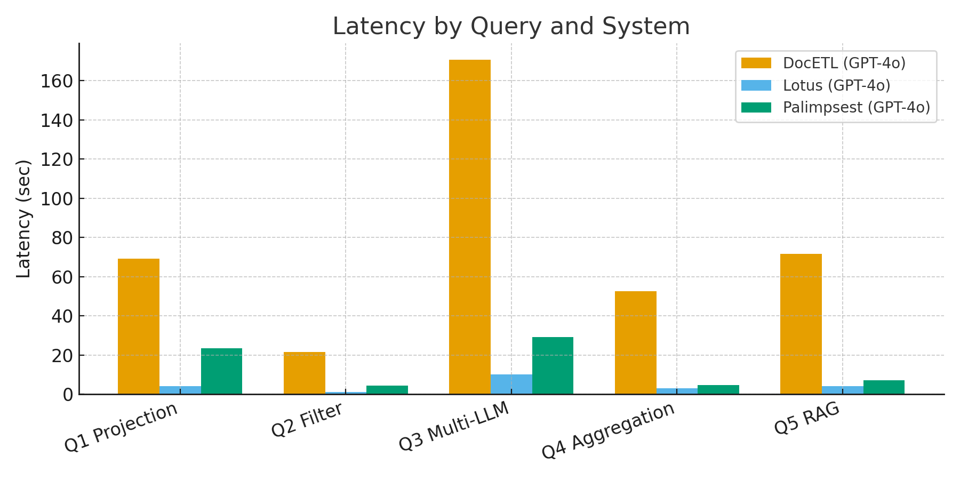
Results — Latency by Query and System

Slide 8
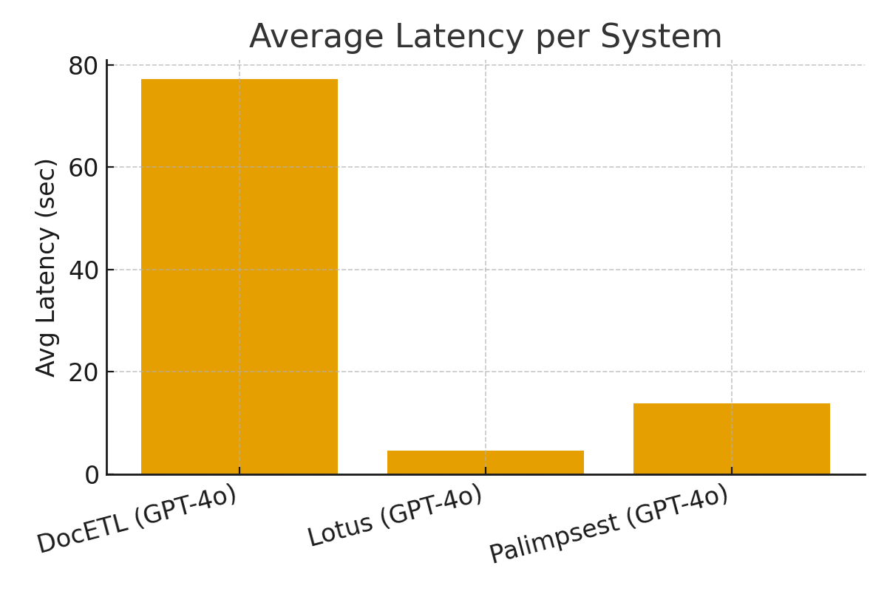
Results — Average Latency per System

Slide 9
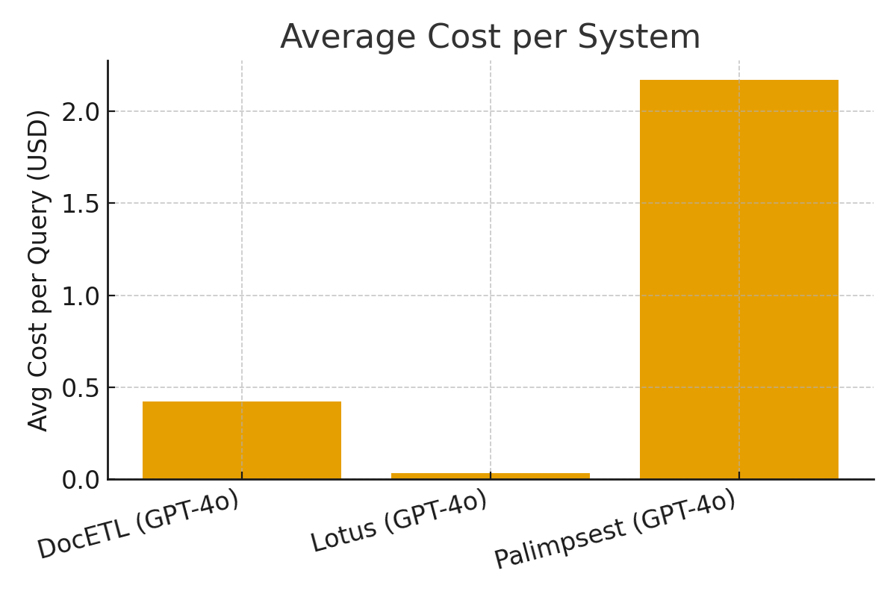
Results — Average Cost per System

Slide 10
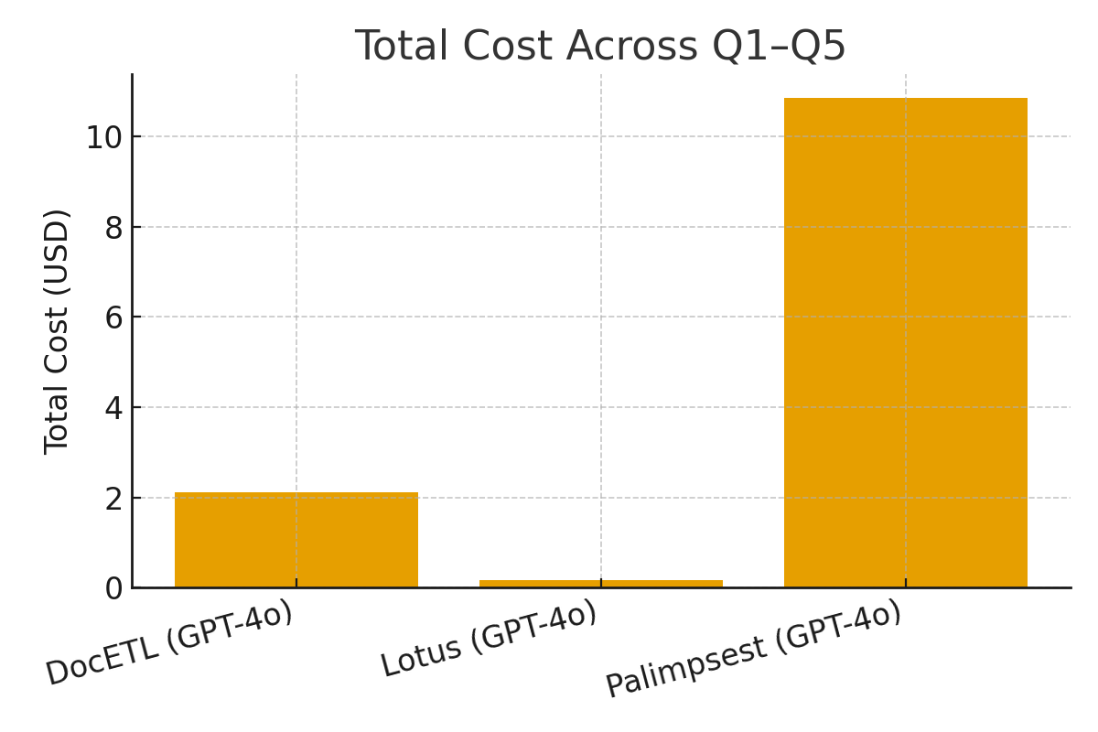
Results — Total Cost Across Q1–Q5

Slide 11
Why Do Prices Differ (Same Logical Query)?
Cost ≈ (number of LLM calls) × (tokens_in + tokens_out) × (price per token).
Drivers: extra planning/validation or rewrite/selection calls; longer prompt shells; retries/guardrails; RAG context size; output schema verbosity.

Slide 12
Typical Call Counts per Row
Lotus: Q1=1, Q2=1, Q3=2, Q4=1/row, Q5=1 (generate).
DocETL: Q1=2–3, Q2=3, Q3=4–6, Q4=2–3/row, Q5=2–3 (plan/QA).
Palimpsest: Q1=4–5, Q2=4–5, Q3=7–9, Q4=4–5/row, Q5=4–5 (rewrite+select+final).

Slide 13
Operator Differences by System
Composition: Lotus (declarative, vectorizable) vs DocETL (imperative control-flow) vs Palimpsest (prompt augmentation).
Batching/Cache: Lotus native; DocETL step-limited; Palimpsest multiplies tokens with k selection.
Schema enforcement: Lotus with strict prompts/JSON; DocETL post-hoc validation/repair; Palimpsest via better rewrites.

Slide 14
Engineering & Operational Notes
Setup: ELEET and DocETL setup was difficult; SQL-like execution in DocETL required custom glue.
Reliability: Lotus matched docs with observed behavior; easiest to reason about and operate.
Instrumentation: Trace latency, tokens, retries, cache hits; enforce JSON to reduce re-asks.
Cost control: Cap candidates/tokens; disable planning for trivial cases; standardize prompt shells.

Slide 15
Recommendations
Default
Default to Lotus for Projection/Filter/Aggregation/RAG on tables.
Reserve
Reserve Palimpsest for hard/heterogeneous rows with k ≤ 2 and strict budgets.
Use
Use DocETL where agentic control & guardrails are mandatory; accept overhead.
Normalize
Normalize RAG top‑k/chunking; cap max_tokens; unify JSON schemas; add operator-level caching.

Slide 16
Impact on Kerem’s PhD & Future Work
Empirical cost/latency profiles for LLM operators inform optimizer design and runtime policies.
Roadmap: operator-level caching; token-aware cost models; adaptive routing (send only 'hard' rows to Palimpsest).
Provenance & validation operators; benchmark pack for reproducibility; learned rewrite policies (ELEET) when stable.

Slide 17
Conclusion
Across Q1–Q5 on enterprise GPT‑4o, Lotus was most reliable and efficient.
DocETL offered control but added overhead and friction for SQL-like execution in this environment.
Palimpsest increased robustness at significantly higher cost; apply selectively.

Slide 18
Appendix A — Query Shapes (Summary)
Q1 — Projection: LLM in SELECT to synthesize recommendations from movie_info + review_content.
Q2 — Filter: LLM in WHERE to classify kid‑suitability (restrict to Fresh reviews).
Q3 — Multi‑LLM: SELECT recommendations + WHERE kid‑suitability (two LLM calls per row).
Q4 — Aggregation: LLM rates satisfaction 0–5 per review; AVG by title.
Q5 — RAG: Retrieve context via similarity search; LLM answers using provided context.

