Slide 1
Book activities
Lesson 1&
Lesson 2

Slide 2
Activity 1:
Write a Python script to create a file named my_diary.txt and write a few sentences about your day.
notes:
Create the file within the code
Remember to close the file after writing

Slide 3
Activity 1 solution:
file = open("my_diary.txt", "w")
file.write(“I had a nice day\n" \
“I leant something new that day")
file.close()

Slide 4
Activity 2:
Read data from a file and count the number of words in it.

Slide 5
Activity 2 solution:
file = open("data.txt")
string = file.read()
words = string.split()
print(len(words))

Slide 6
Activity 3:
Create a script to calculate the average of numbers stored in a text file in which the file had each number in a row.

Slide 7
Activity 3 solution:
numbers = []
with open("numberss.txt", "r") as file:
f = file.readlines()
for line in f:
numbers.append(int(line))
print(sum(numbers)/len(numbers))

Slide 8
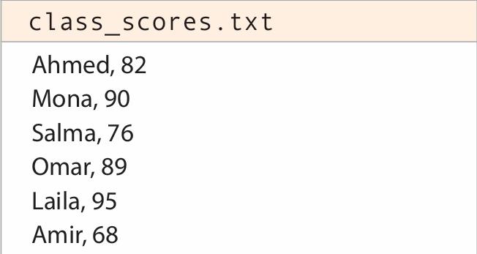
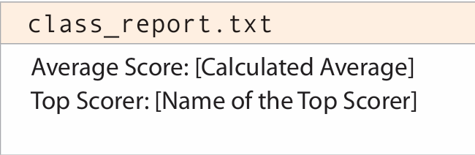
Activity 4:
Create a Python script that reads a file containing a list of names and scores,
then write the average
score and the highest
scoring individual in a
New file.

Slide 9
Activity 4 solution:
names = []
scores = []
with open("class_scores.txt") as file:
with open("class_report.txt", "w") as file2:
for line in file:
names.append(f"{line.split(",")[0]}")
scores.append(int(line.split(",")[1]))
file2.write(f"Average score :{sum(scores)//len(scores)}\n")
file2.write(f"Top scorer :{names[scores.index(max(scores))]}\n")

Slide 10
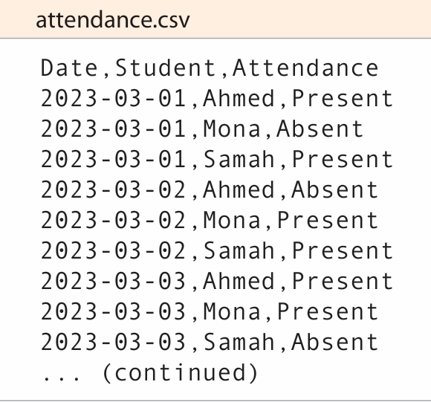
Activity 5:
attendance.csv, contains attendance records for students over a month. Here's the format
Calculate Attendance Rates: For each student, calculate the percentage of days they were present.

Slide 11
Activity 5 solution:
import csv
uniqe_names = []
with open("attendance.csv") as f:
data = list(csv.reader(f))
for row in data[1:]:
if row[1] in uniqe_names:
continue
else:
uniqe_names.append(row[1])
for num in range(0,len(uniqe_names)):
attendance = []
for i , row in enumerate(data):
if row[1].lower() == uniqe_names[num].lower():
attendance.append(row[2])
print(f"{uniqe_names[num]} has attendance rate of: {round(attendance.count("Present")/len(attendance) * 100,2)}%")

Slide 12
Activity 6:
a file named event_attendees.json, which contains information about attendees at various school events. Here's a sample of the file content:
Iterate over each event and list its name. • Within each event, list the names of all attendees. • Think about how the nested structure (events and attendees) is represented and accessed in JSON.
{ "events": [ { "event": "Science Fair", "attendees": [ {"name": "Ahmed", "grade": 10, "section": "A"}, {"name": "Mona", "grade": 11, "section": "B"}, {"name": "Youssef", "grade": 10, "section": "A"} ] }, { "event": "Math Olympiad", "attendees": [ {"name": "Laila", "grade": 12, "section": "C"}, {"name": "Sara", "grade": 11, "section": "D"}, {"name": "Omar", "grade": 10, "section": "E"} ] } // Additional events and attendees... ] }

Slide 13
Activity 6 solution:
import json
with open("attendees.json") as file:
data = json.load(file)
for value in data.values():
for event in value:
print(f"{event["event"]}:")
for dict in event["attendees"]:
print(f"\t\t{dict["name"]}")

Slide 14
Thank you

