Slide 1
Steam website project
Made with ♥ by: Mazen Yasser
University: Al-azhar university
Supervised by: Dr/ Kamal radwan

Slide 2
Why Steam?
Steam is an online digital game store and a game publishing platform with community features like friends and messaging.
It has features of an e-commerce website since it sells games.
It has a lot of features and subtle design traits like dim backgrounds and animations that blend well into the website making it look simple but beautiful.

Slide 3
Our Implementation
We created pages for login, browsing, viewing game, checkout and an about page.
This implementation will focus on the front end side of steam.
We created a simple database for some operations that would take place on an e-commerce site like steam.
Users will be able to purchase games from the site.

Slide 4
Features
Login page.
Displayed games and offers.
Product page for each game containing info and highlights.
Checkout page.
About steam page.

Slide 5
Technologies:
Languages and Frameworks:
HTML 5
CSS
Bootstrap 4
JavaScript
Django
SQLite
Software
VS Code
PHPMyAdmin
XAMPP

Slide 6
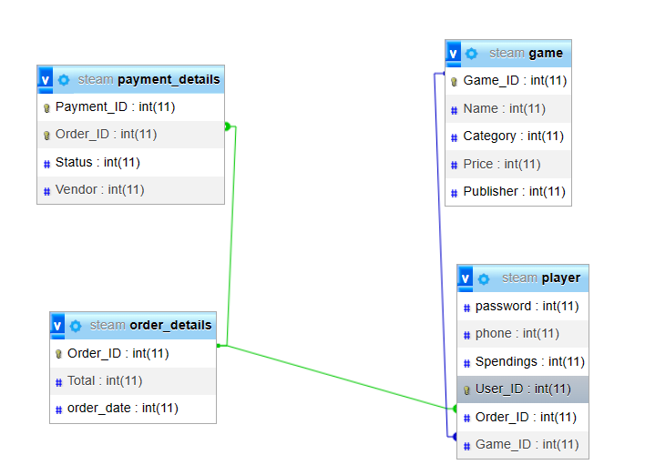
Relational Database Schema

Slide 7
Service Diagram
Login
Browse Games
View
Payment
Game sent
Purchase

Slide 8
Advantages of Steam vs Physical stores
Players can view more info about the game such as trailers and screenshots
Players can see other buyer’s reviews of the game
We can build a recommender system on top of the website to recommend games to each specific player’s preferences, which is hard to do in a physical game store
Games are not limited by the production of physical copies

Slide 9
Disadvantages
Need high security to maintain integrity of the games since it’s accessible online

Slide 10
Pages
Layout

Slide 11
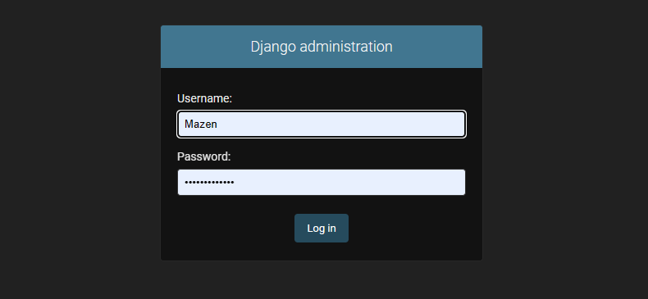
Admin Login

Slide 12
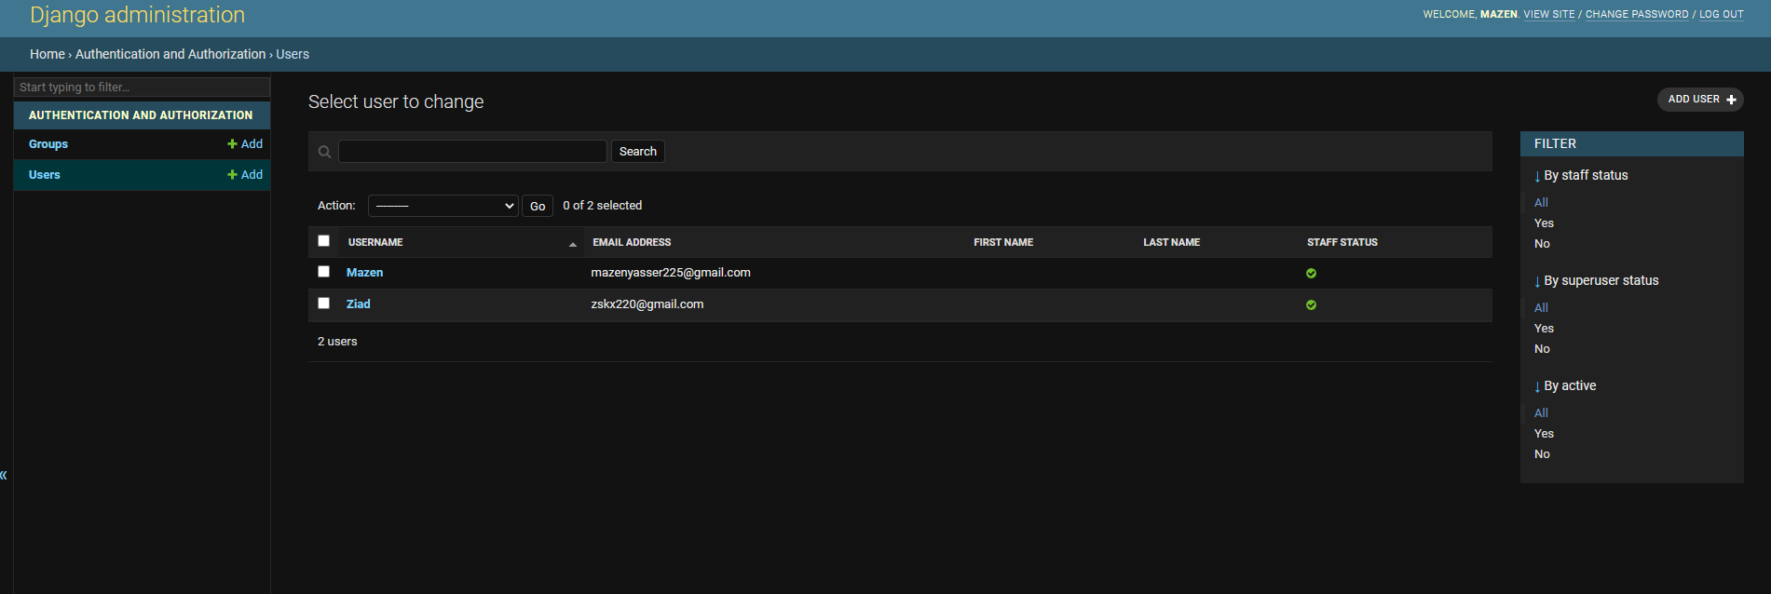
Adding users with Django

Slide 13
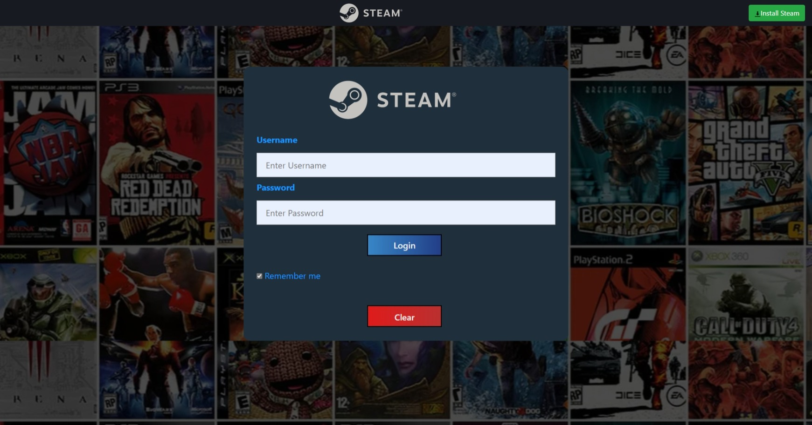
Login Page

Slide 14
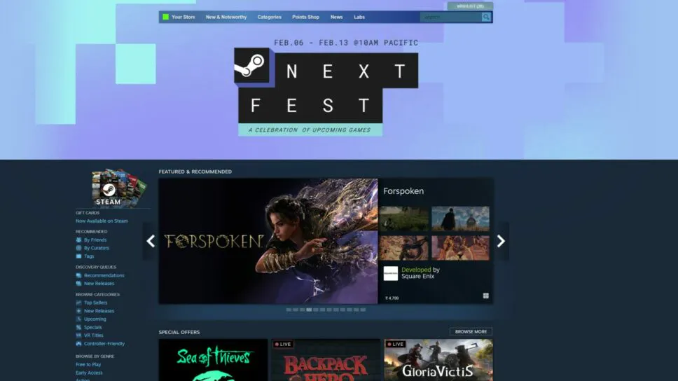
Steam Home Page

Slide 15

Home Page

Slide 16

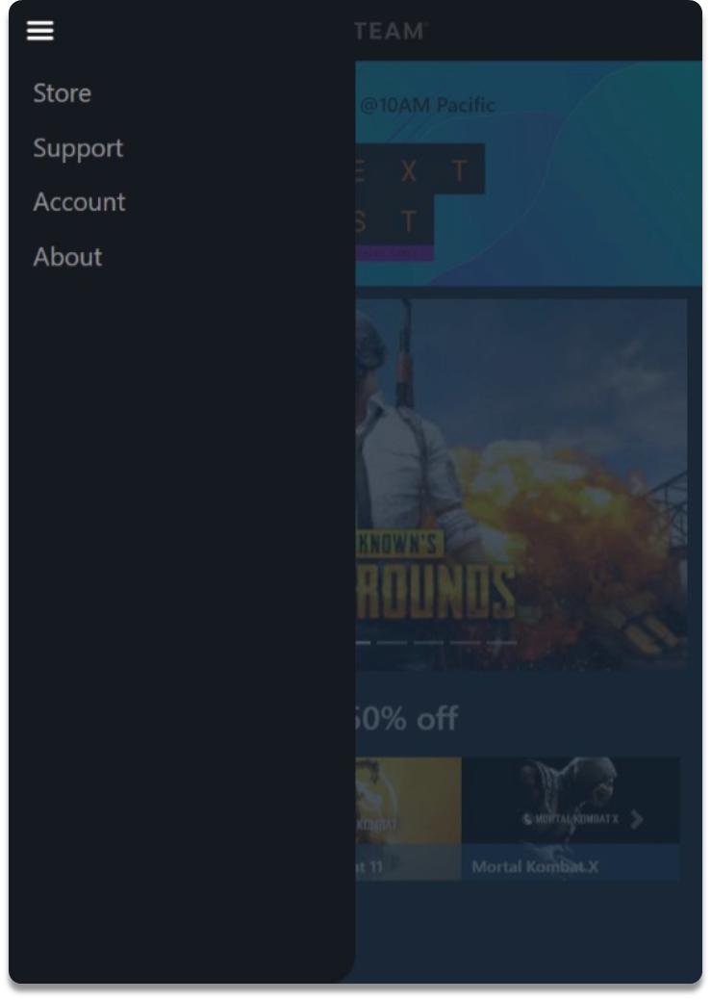
Home page (Phone Layout)

Slide 17
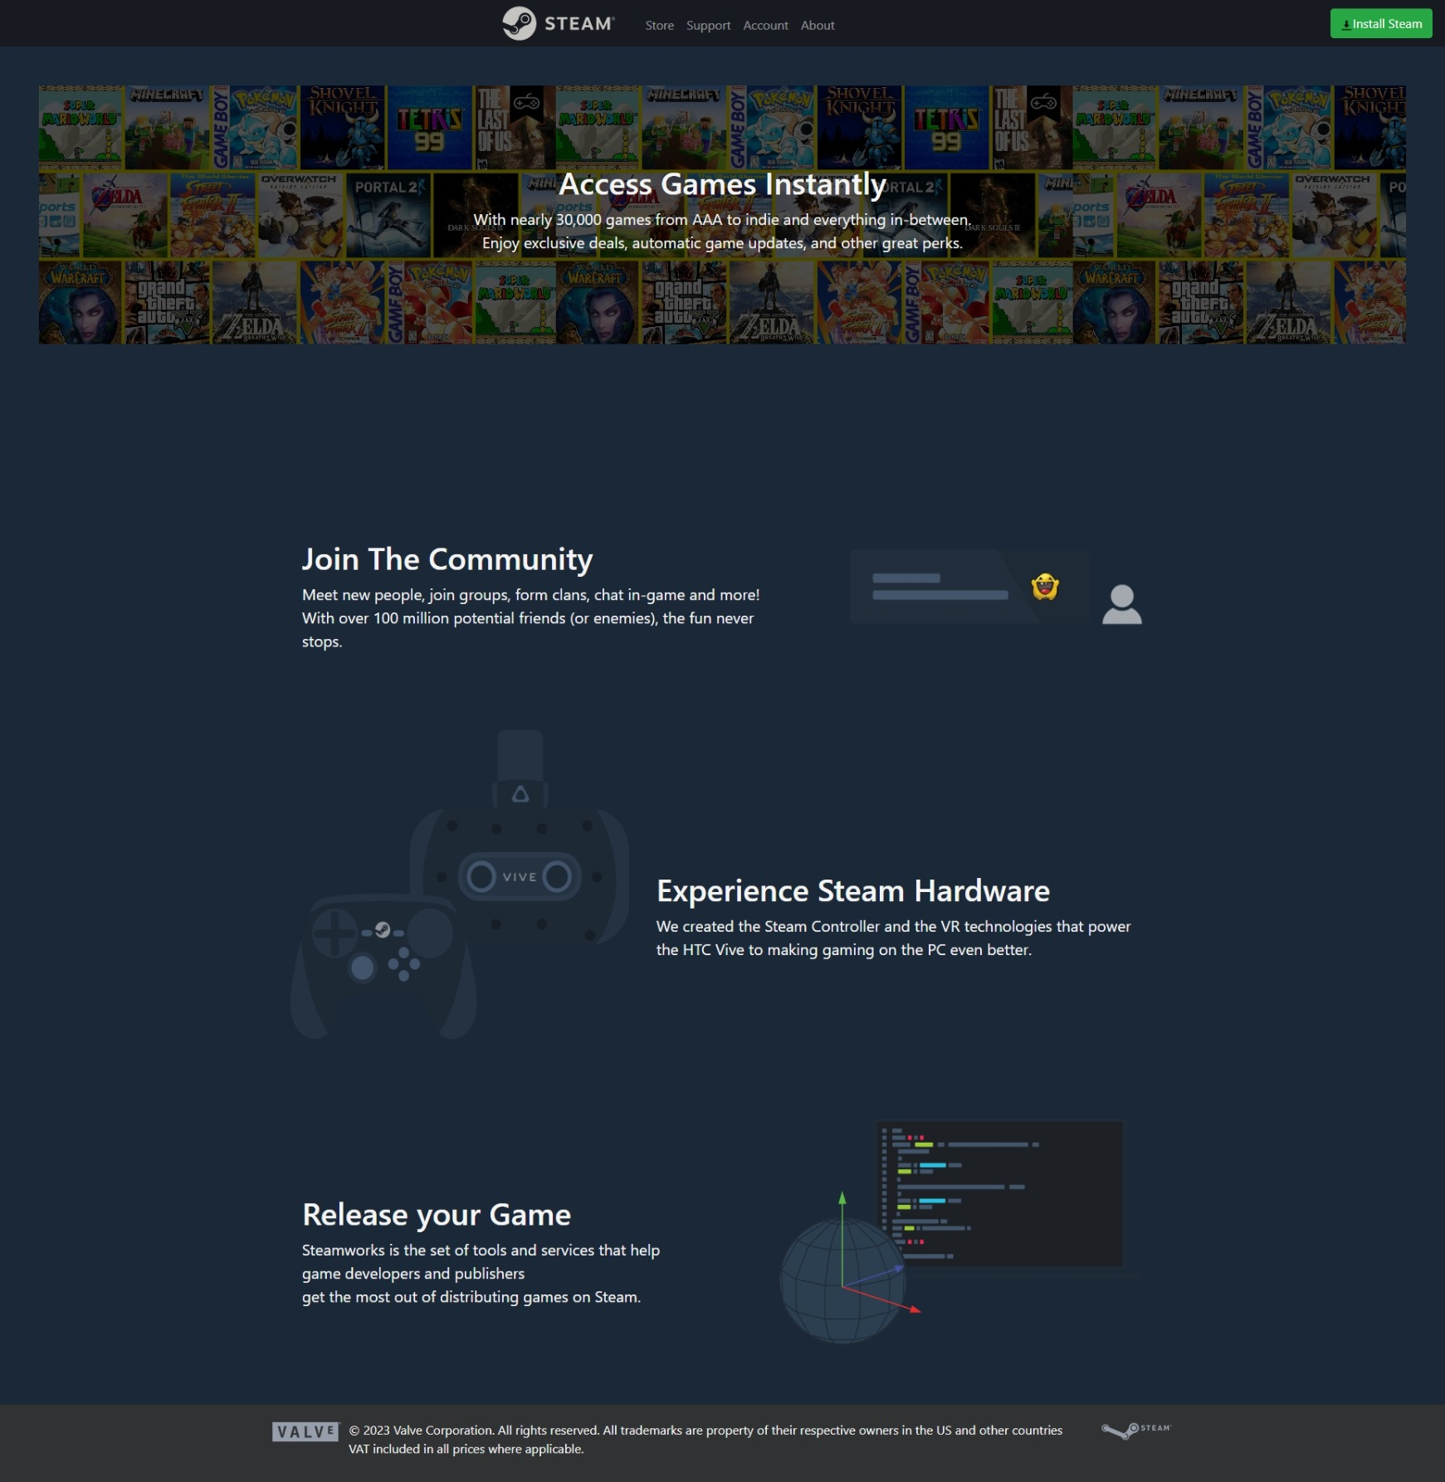
About Page

Slide 18
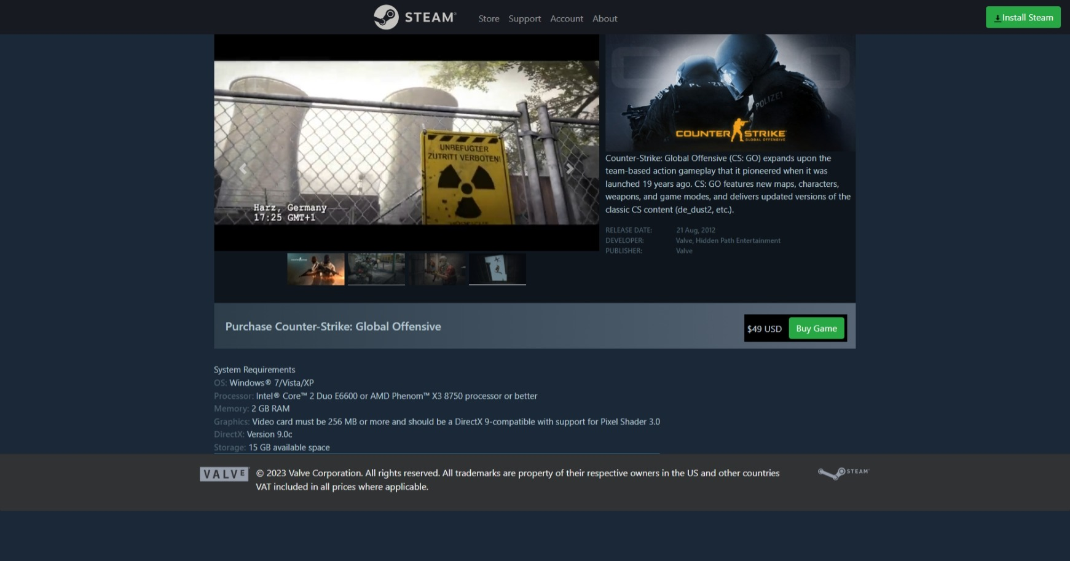
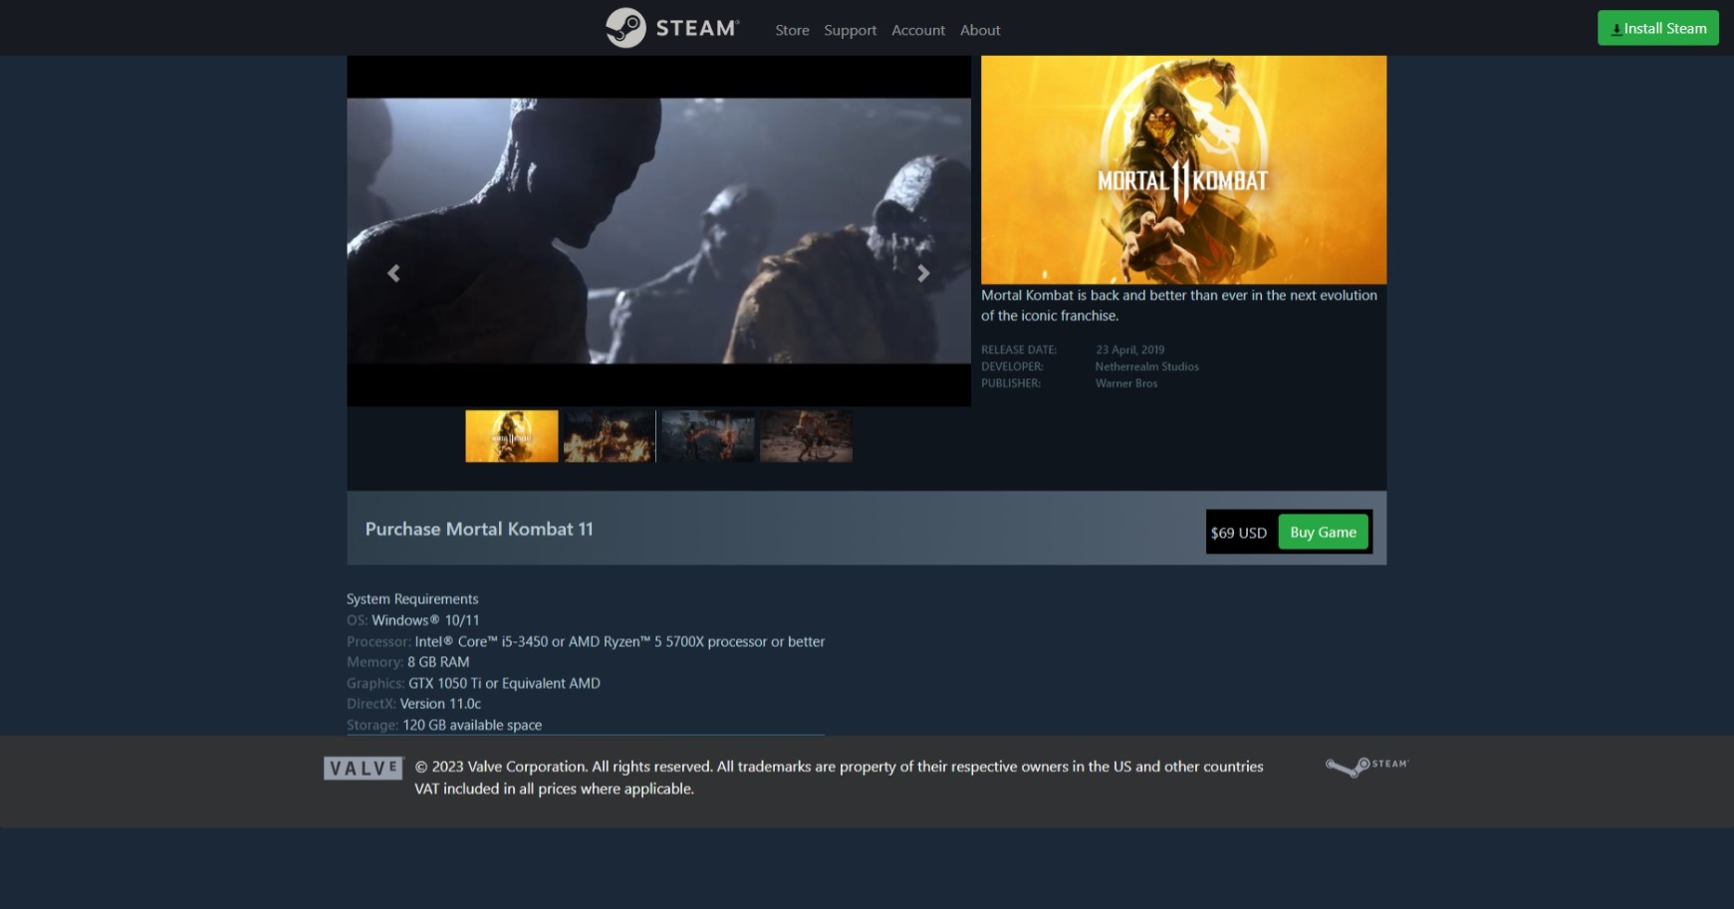
Products Pages Layout

Slide 19
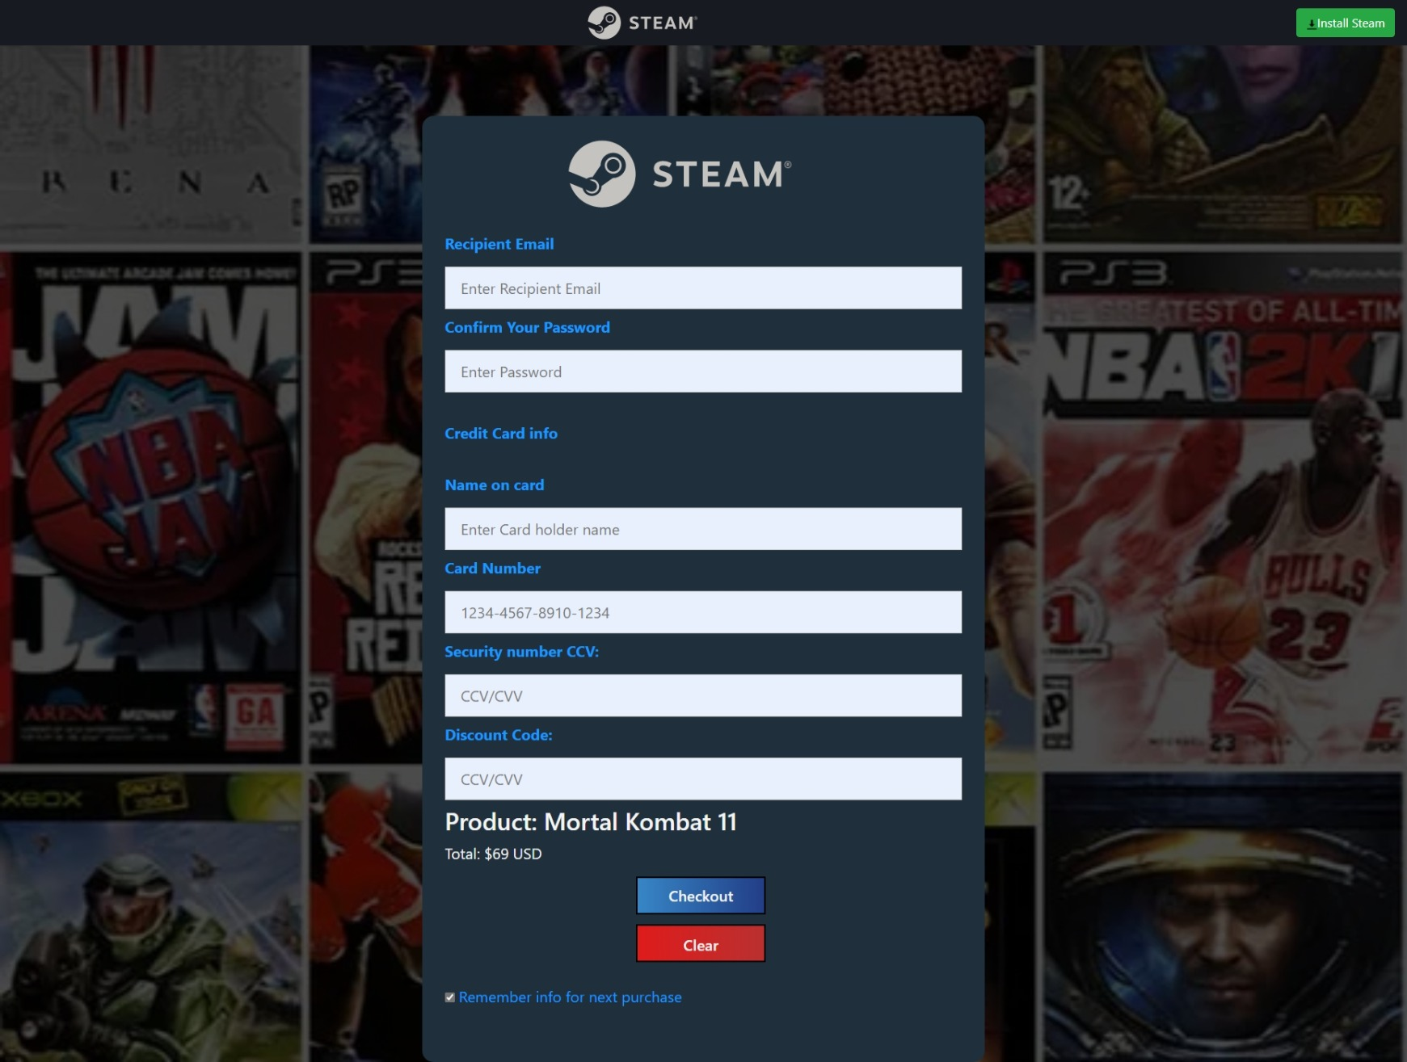
Checkout Page

Slide 20
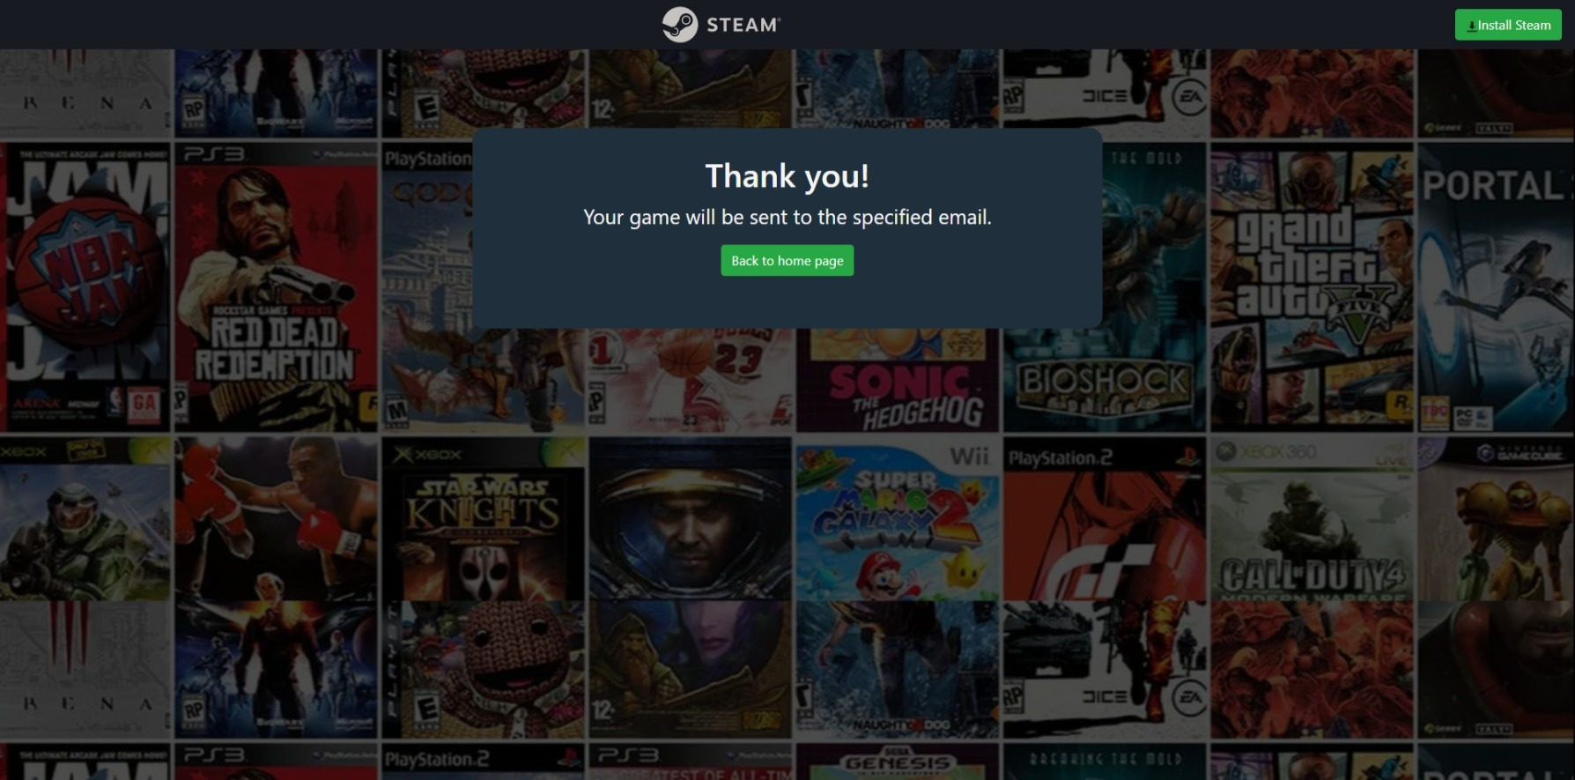
Purchase Success

Slide 21
Resources
Welcome to Steam (steampowered.com)
Welcome to SteamClone (bkiggen.github.io)
Stack overflow for help with animations and transitions

Slide 22
Thank you!

