Slide 1

Airline Booking Data Analysis Report
By: Mazen Tamer
Mail : tmazen638@gmail.com
Date: 8/30/2025

Slide 2
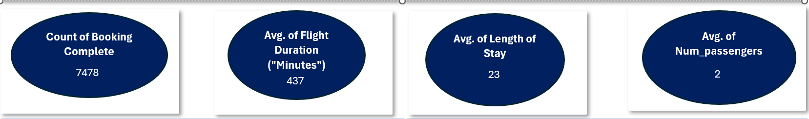
Key Performance Indicators
Total Bookings
7478
Avg. Flight Duration ("Minutes”)
437
Avg. Passengers per booking
2
Avg. Length of Stay (days)
23
Insights
Strong demand; optimize top booking channels
Mostly international flights; upsell onboard services
Long trips; opportunity for travel & hotel packages
Mainly couples/families; promote group discounts.

Slide 3
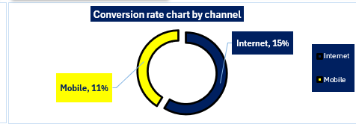
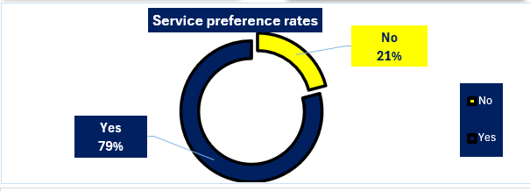
Charts Overview
Internet channel has the highest conversion rate → customers prefer booking online via web platforms, indicating strong digital adoption
Mobile channel shows lower conversion → highlights an opportunity to improve the mobile app experience and marketing
Most passengers (Yes) add extra services → strong demand for add-ons like baggage, meals, and seat Selection
Few passengers (No) skip extra services → opportunity to push upselling with bundled offers or Discounts

Slide 4
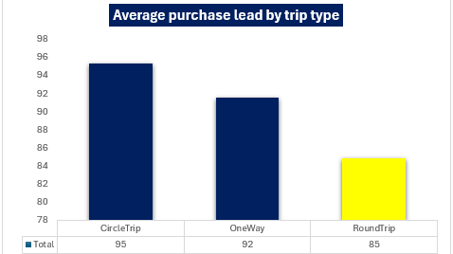
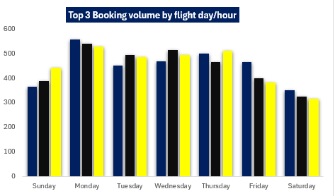
Charts overview
Circle trips have the highest purchase lead → passengers plan and book these complex trips well in Advance
One-way trips show medium purchase lead → often a mix of planned and last-minute bookings
Round trips have the lowest purchase lead → customers tend to book them closer to departure, possibly for short holidays
Friday 08:00 → clearly the peak booking slot; should be the focus for marketing pushes.
Thursday 08:00 → strong demand, tied to pre-weekend travel behavior
Monday 08:00 → consistent demand likely from business travelers starting the week
All top 3 slots are in the morning (08:00 AM) → mornings are the prime time for bookings

Slide 5
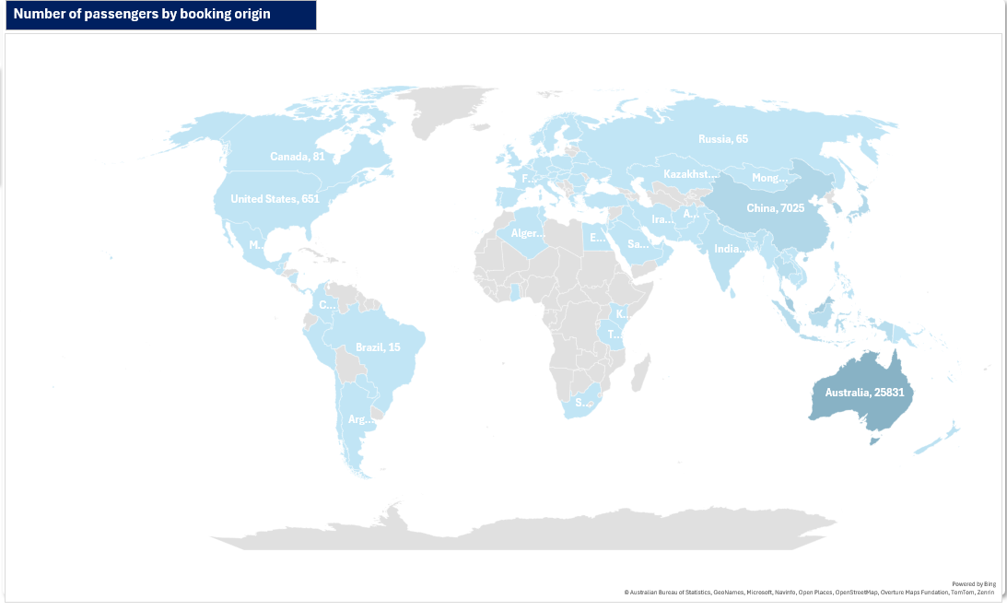
Map Chart
Australia has the largest booking volume (25,831) → clearly the dominant market.
Malaysia ranks second (12,025) → shows strong regional demand.
South Korea is third (7,979) → an important contributor but smaller compared to Australia.
Asia-Pacific region dominates the bookings → focus marketing and partnerships in this region.

Slide 6
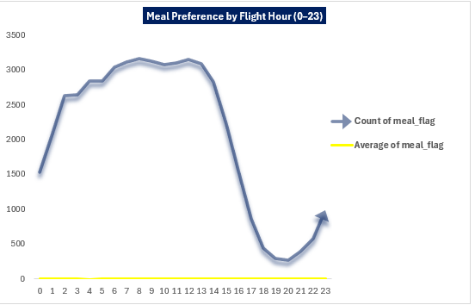
Impact of Flight Time on Meal Preference
Morning flights (07:00–09:00) show the highest meal preference → strong demand for breakfast service
12:00 noon is another peak → reflects passengers aligning with lunchtime
Meal preference is time-sensitive → demand clearly follows daily eating patterns, suggesting airlines Should optimize catering by flight hour.

Slide 7
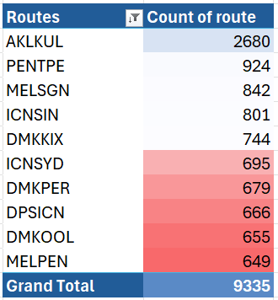
Top 10 Most Frequent Flight Routes – Heat Map
AKL → KUL is the leading route (2,680 bookings) → far higher than any other, making it the dominant connection
the next two routes, PEN → TPE (924) and MEL → SGN (842), are significantly lower → showing a sharp drop after the top route
Multiple Australian routes appear in the Top 10 (MEL, SYD, PER, OOL) → Australia is a key hub for frequent flight demand
Several East Asia–Southeast Asia connections (ICN → SIN, DPS → ICN, PEN → TPE) are among the top highlighting strong regional travel demand
Top 3 routes together account for ~45% of total Top 10 bookings → showing how concentrated demand is in a few key routes

Slide 8
Executive Summary
Booking Trends: Highest bookings occur in the morning hours (07:00–09:00) and midday (12:00), showing strong passenger preference for morning travel
Customer Services: Meal preference is clearly time-dependent, with demand peaking during breakfast and lunch hours, while extra services (baggage & seat selection) remain essential add-ons
Market Insights: Australia and East Asia routes dominate demand – e.g., AKL → KUL is the top route (2,680 bookings), with multiple Australian connections in the Top 10
Booking Channels & Behavior: Conversion rates vary across sales channels, with online booking showing the highest share, and average purchase lead time differing between one-way, round-trip, and circle trips (circle trips book earliest)

