Slide 1

CYBER SENTINEL
XDR
AI-DRIVEN EXTENDED DETECTION & RESPONSE
A multi-agent machine learning platform that fuses network, user-behavior, system, and malware detection into one real-time SOC threat score — with explainable alerts and automated response.
FINAL YEAR PROJECT DEFENSE PRESENTATION · BS COMPUTER SCIENCE · 2026
Supervisor: Prof. Dr. Syed Nasir Mehmood Shah
Annas Habib · Syed Mazhar Hussain Shah · Malaika Rashid

Slide 2
Table of Contents
01
Introduction & Background
06
Model Validation
Problem motivation, threat landscape
Confusion matrices, ROC/PR curves per agent
02
Research Framework
07
Testing & Verification And Tech Stack
Objectives, scope, methodology
Test cases, audit findings, fixes
03
System Architecture
08
SOC Dashboard Walkthrough
4-agent design, fusion, response
Live system demonstration
04
UML & System Design
09
Results & Comparison
Use case, class, ERD, sequence diagrams
Cross-agent performance, benchmarks
05
Datasets
10
Conclusion & Future Work
CIC-IDS2017, CERT r4.2, GHC, EMBER 2018
Summary, limitations, roadmap

Slide 3
SECTION 01
Introduction & Background
The threat landscape, why single-point detection fails, and where Cyber Sentinel XDR fits.
CYBER SENTINEL XDR · FINAL YEAR PROJECT DEFENSE

Slide 4
THE PROBLEM
Single-Point Detection Tools Are Blind to Multi-Stage Attacks
Network IDS
Antivirus / EDR
SIEM Rule Engines
Sees flow anomalies, blind to what happens after the packet lands on a host.
Sees process and file behavior, blind to network reconnaissance preceding it.
Match known signatures; cannot flag deviations from a baseline they were never given.
A real intrusion is rarely confined to one telemetry domain — it moves through network reconnaissance, host-level execution, and credential abuse in sequence. Tools that watch only one domain see only one fragment of the attack.
CYBER SENTINEL XDR
3

Slide 5
SCALE OF THE PROBLEM
The Cost of Detection Gaps Keeps Growing
277
$4.45M
68%
3
DAYS
TOOLS AVG.
Average time to identify and contain a breach (IBM, industry-wide average)
Average global cost of a single data breach
Of breaches involved a human element across multiple attack stages
Security tools an enterprise SOC analyst must correlate manually per incident
Sources: IBM Cost of a Data Breach Report; Verizon DBIR — figures represent widely-cited industry averages used to motivate this research, not Cyber Sentinel XDR's own measurements.
CYBER SENTINEL XDR
4

Slide 6
FOUNDATION FOR DESIGN
What XDR Means — And Why It's Different
EDR
NDR
XDR
Endpoint Detection & Response
Network Detection & Response
Extended Detection & Response
Single domain: host telemetry only. Misses network and user-session context entirely.
Single domain: network flow only. Misses what happens once an attacker is already on the host.
Cross-domain by definition — correlates network, user, system, and file signals into one decision.
The premise of this project: separating detection by domain lets each model specialize on its native data distribution — fusion then reconstructs the cross-domain picture no single sensor could see alone.
CYBER SENTINEL XDR
5

Slide 7
SECTION 02
Research Framework
Research questions, objectives, and the scope this project commits to answering.
CYBER SENTINEL XDR · FINAL YEAR PROJECT DEFENSE

Slide 8
GUIDING OUR INVESTIGATION
Research Questions
RQ1
Cross-Domain Fusion
RQ2
Explainability
Can independently-trained models for network, user, system, and malware telemetry be fused into one actionable threat score without losing per-domain detection accuracy?
Can SHAP-based attribution give a SOC analyst a human-readable reason for every fused alert, rather than an opaque score?
RQ3
Imbalanced Real-World Data
RQ4
Automated Response
How do detection models trained on severely imbalanced telemetry (insider threats, rare malware) perform once deployed, and what does that imply for threshold calibration?
Can a MITRE ATT&CK-mapped response engine safely auto-execute containment actions for CRITICAL-severity events while keeping a human in the loop for lower severities?
CYBER SENTINEL XDR
6

Slide 9
RESEARCH OBJECTIVES
What This Project Set Out To Build
01
02
03
Multi-Agent Detection
Weighted Fusion Engine
Explainable Alerts
Train and validate four independent ML models, one per telemetry domain, each evaluated on real public datasets.
Combine four per-agent scores into one severity decision using documented, tunable weights — not an opaque black box.
Attach a SHAP-derived, human-readable reason to every alert that crosses threshold.
04
05
06
SOAR Response Layer
Real-Time SOC Dashboard
Honest Validation
Map fused alerts to MITRE ATT&CK techniques and trigger response actions automatically for CRITICAL severity.
Give an analyst a live, role-aware (Admin/Analyst/Viewer) interface to monitor, investigate, and respond.
Report real evaluation numbers — including where a model underperforms — rather than only favorable metrics.
CYBER SENTINEL XDR
7

Slide 10
SECTION 03
System Architecture
The four-agent detection core, fusion engine, and SOAR response pipeline.
CYBER SENTINEL XDR · FINAL YEAR PROJECT DEFENSE

Slide 11
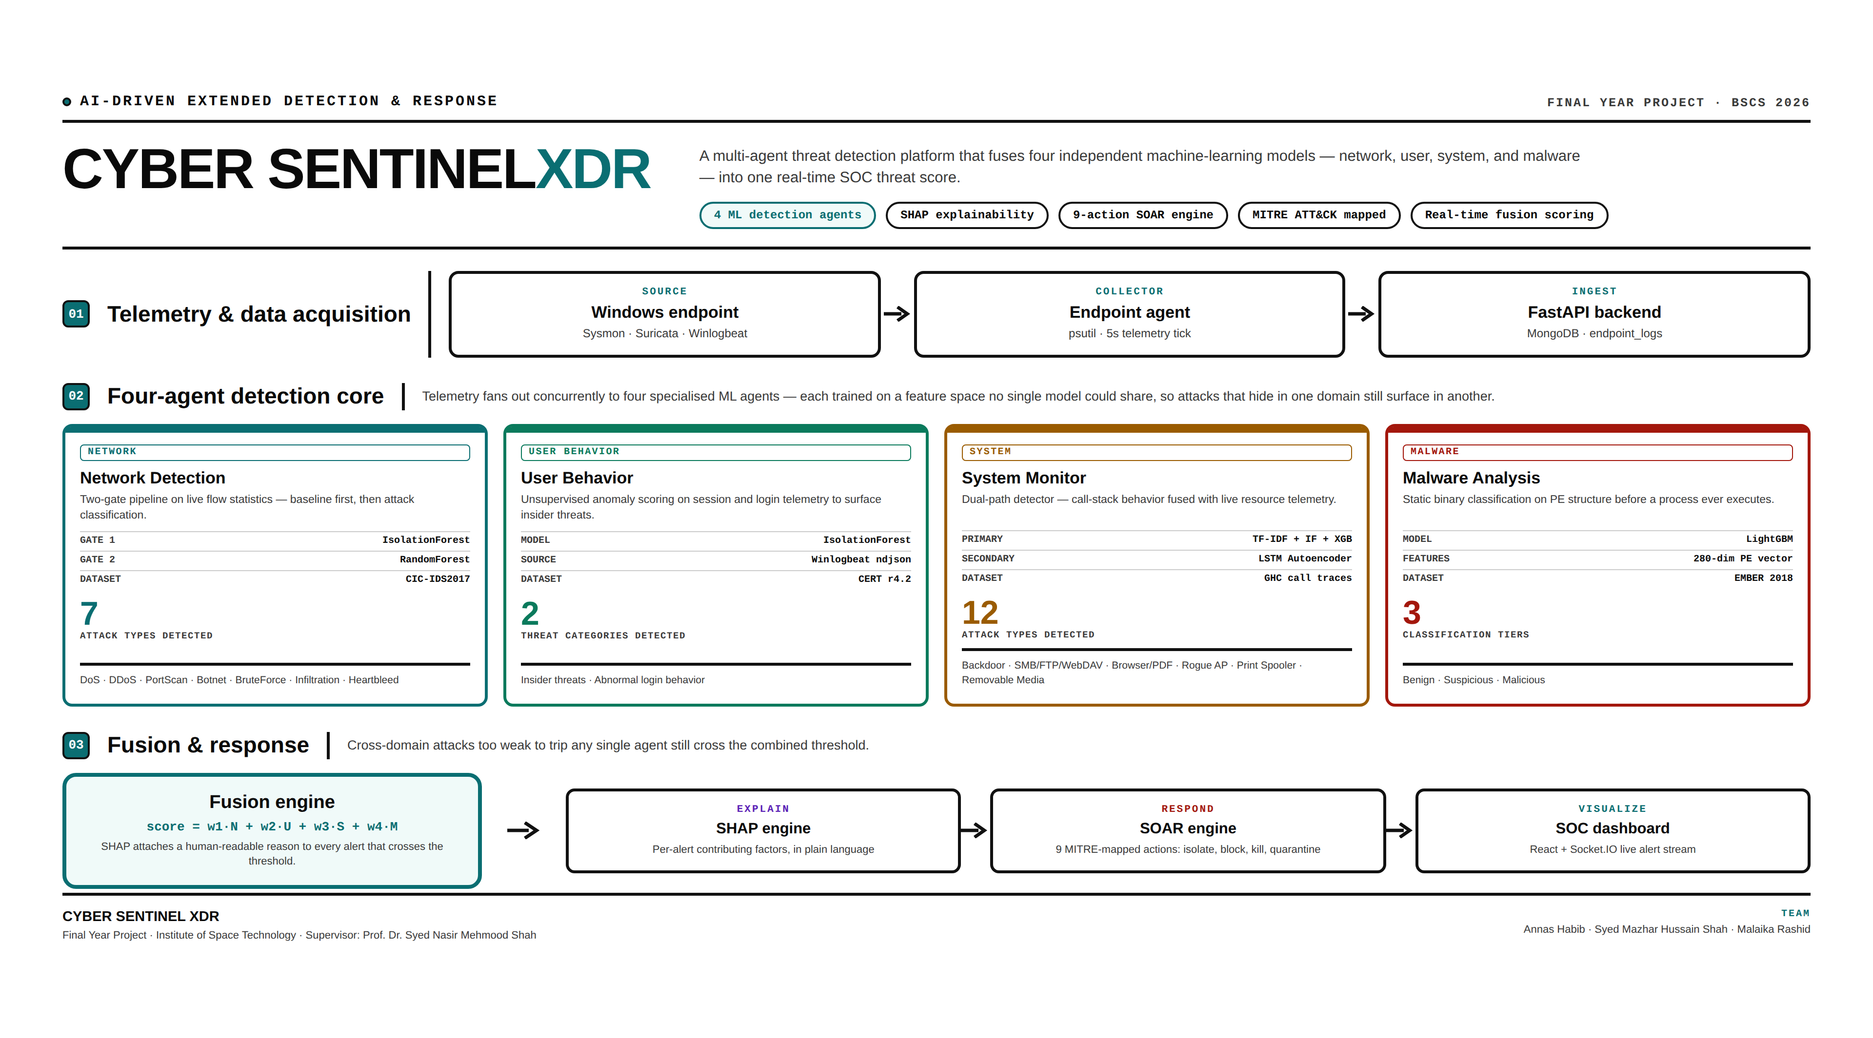
END-TO-END ARCHITECTURE
CYBER SENTINEL XDR
9

Slide 12
FOUR-AGENT DETECTION CORE
One Domain Per Model, By Design
Agent
Model(s)
Dataset
What It Catches
Network
IsolationForest → RandomForest (2-gate)
CIC-IDS2017
DoS, DDoS, PortScan, Botnet, BruteForce, Infiltration, Heartbleed
User Behavior
IsolationForest
CERT r4.2
Insider threats, abnormal login patterns
System Monitor
LSTM Autoencoder + TF-IDF/IsolationForest/XGBoost
GHC call traces (ADFA-WD val.)
Backdoor, SMB/FTP/WebDAV exploits, browser/PDF exploits, rogue AP
Malware Analysis
LightGBM
EMBER 2018
Malicious PE files (static analysis, pre-execution)
CYBER SENTINEL XDR
10

Slide 13
DESIGN RATIONALE
Why Not One Model For Everything?
01
02
03
No shared feature space
Multi-stage attacks evade single sensors
This is the definition of XDR
Flow statistics, login sequences, call-stack traces, and binary headers are four mathematically different spaces. A model trained on one cannot natively learn the others.
Real intrusions cross domains by design — recon in network, execution in system, exfiltration via user sessions — staying under any one detector's threshold alone.
Unlike a single-point IDS or AV, cross-domain correlation is the entire premise. Fusion reconstructs a picture no individual sensor can see alone.
CYBER SENTINEL XDR
11

Slide 14
DECISION LAYER
Fusion Engine — Weighted Score Aggregation
score = 0.35·Network + 0.30·User + 0.15·System + 0.20·Malware
Severity decision thresholds
LOW
< 0.50
MEDIUM
0.50 – 0.69
HIGH
0.70 – 0.84
CRITICAL
≥ 0.85
Correlated multi-domain attacks
Why these specific weights
When ≥2 agents independently agree (e.g. malware = malicious + system = HIGH/CRITICAL), the fusion engine labels the event a correlated attack — e.g. "Ransomware Activity" — even if no single agent alone crossed CRITICAL.
Network (0.35) and Malware (0.20) carry more weight as higher-precision signals; User (0.30) and System (0.15) are weighted lower to offset their class-imbalance-driven noise — tunable live from the Settings panel.
CYBER SENTINEL XDR
12

Slide 15
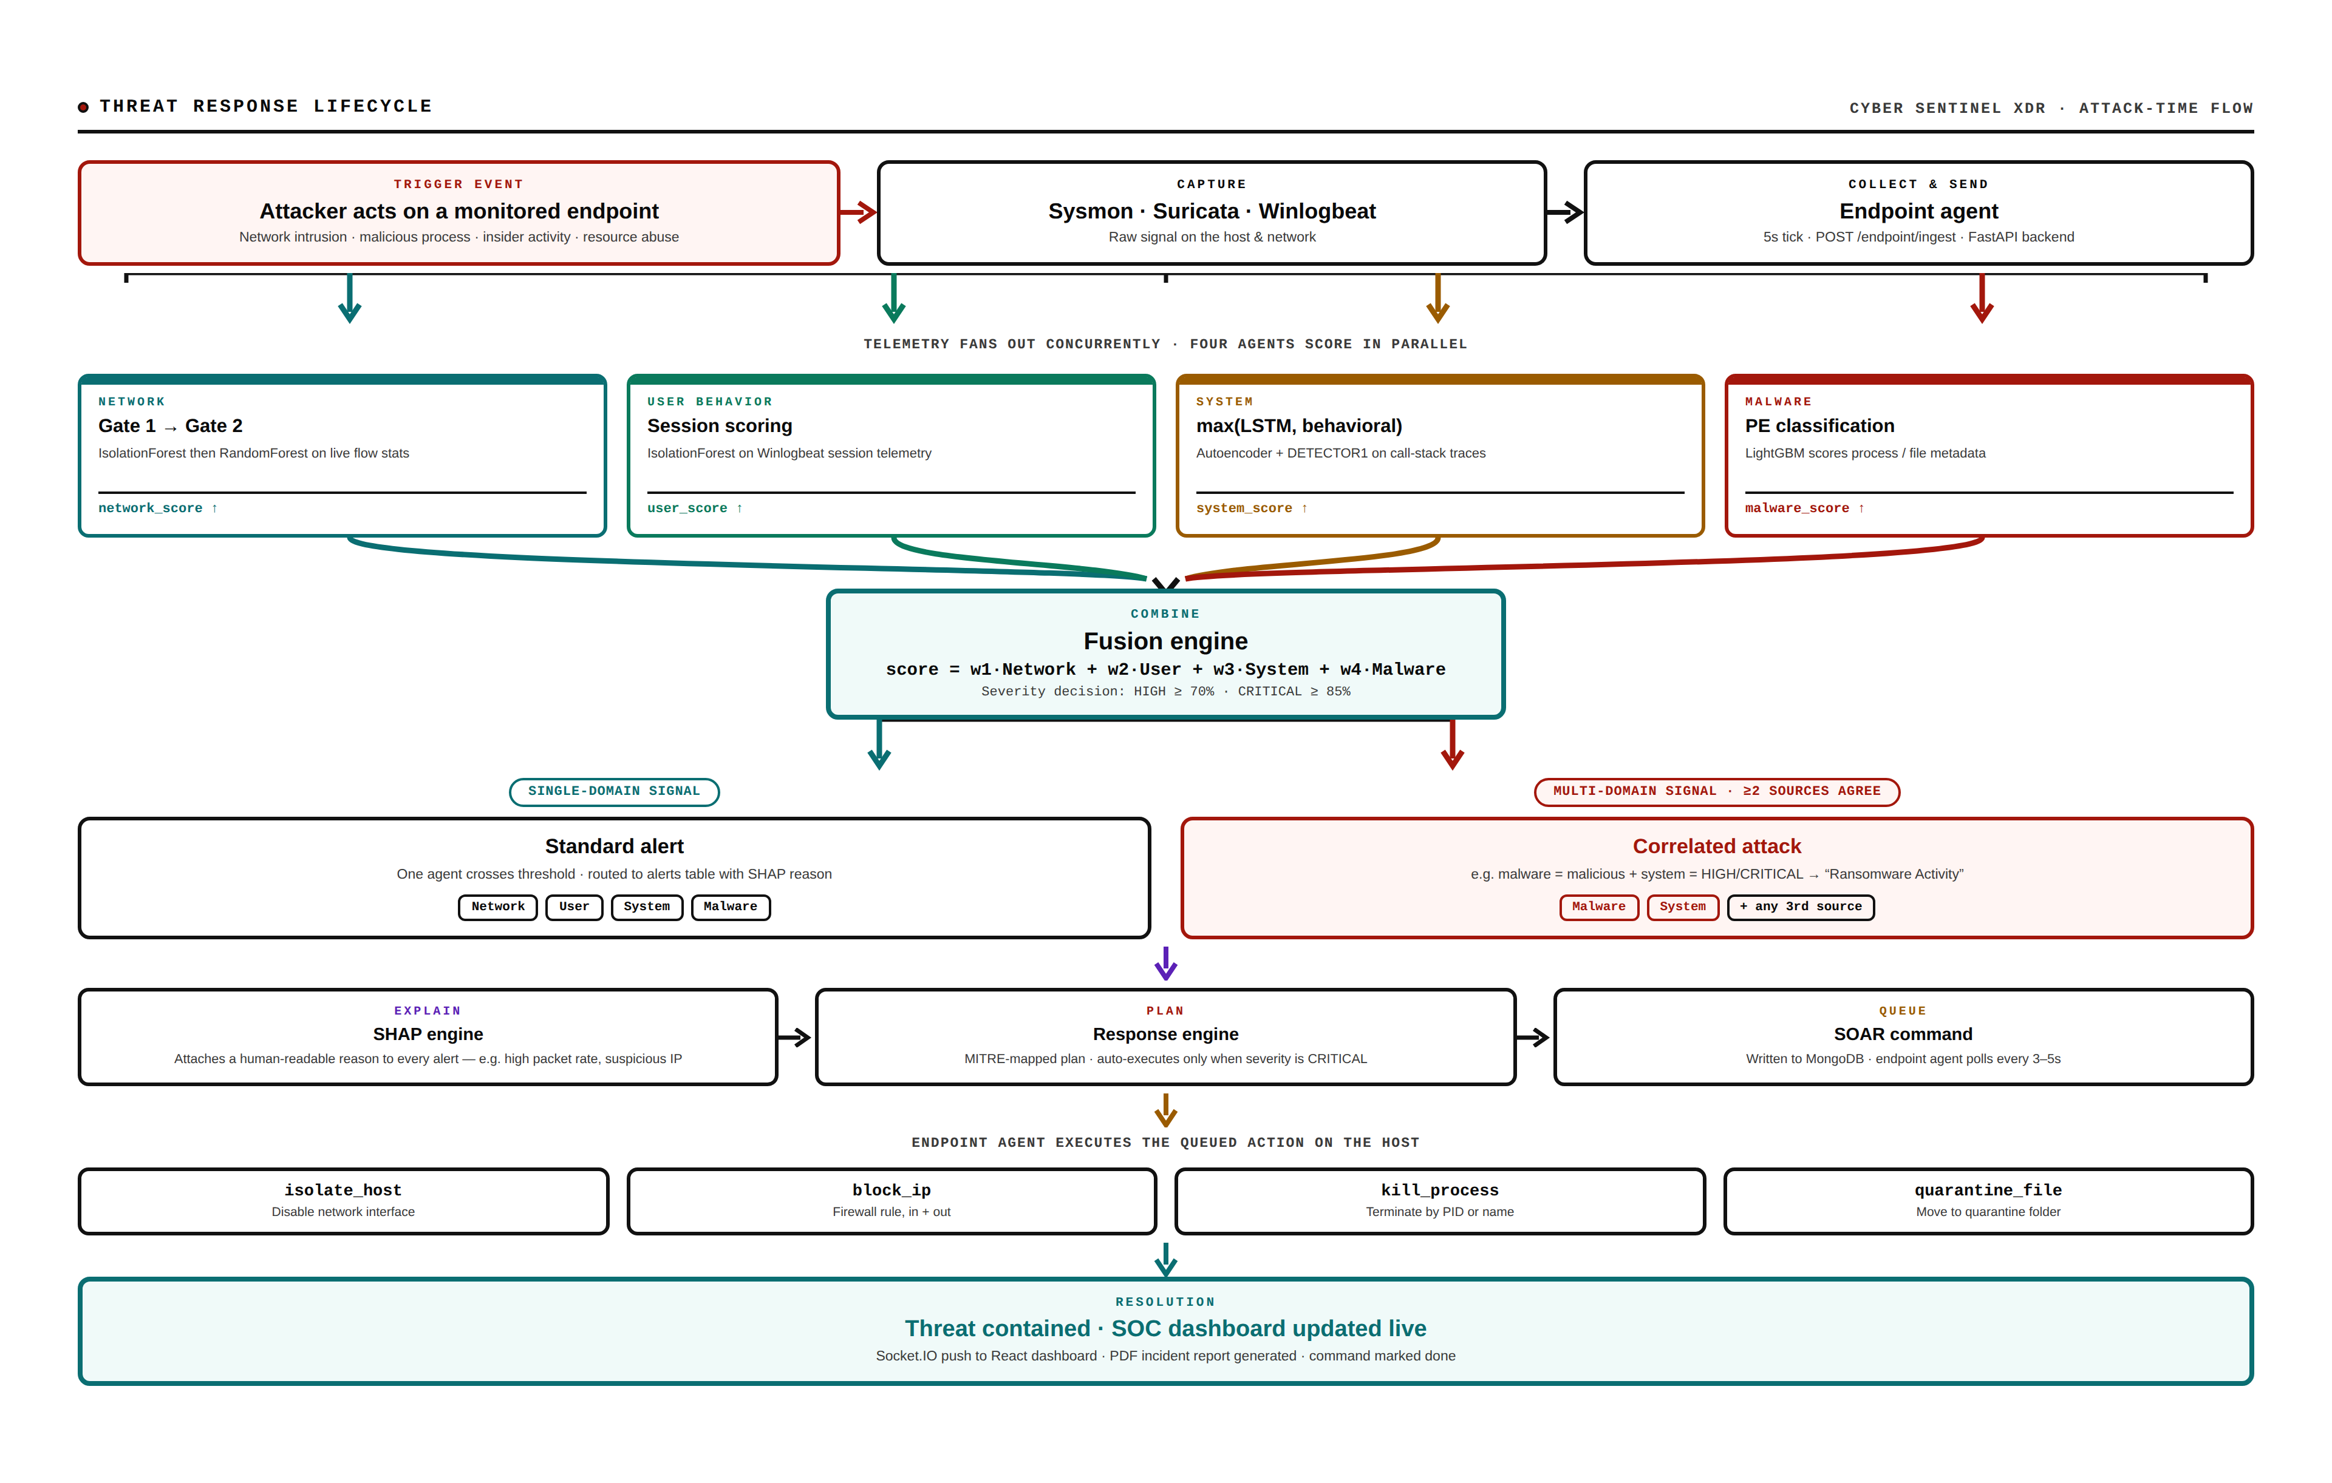
ATTACK-TIME SEQUENCE
CYBER SENTINEL XDR
13

Slide 16
RESPONSE LAYER
SOAR Engine — 9 MITRE-Mapped Action Categories
T1486
T1071
T1068
T1021
Ransomware
C2 Beaconing
Privilege Escalation
Lateral Movement
T1046
T1498
T1110
T1190
PortScan
DDoS
BruteForce
Infiltration
T1059
Default / Other
Live response actions (executed by the endpoint agent):
isolate_host · block_ip · kill_process · quarantine_file · restore_file · unblock_ip · lock_account · unlock_account · scan_filesystem · monitor_persistence
Auto-execution policy: response actions auto-execute only when fused severity = CRITICAL. HIGH and below require analyst confirmation in the Incident Response modal.
CYBER SENTINEL XDR
14

Slide 17
SECTION 04
UML & System Design
Use case, class, state, sequence, and entity-relationship diagrams documenting system structure.
CYBER SENTINEL XDR · FINAL YEAR PROJECT DEFENSE

Slide 18
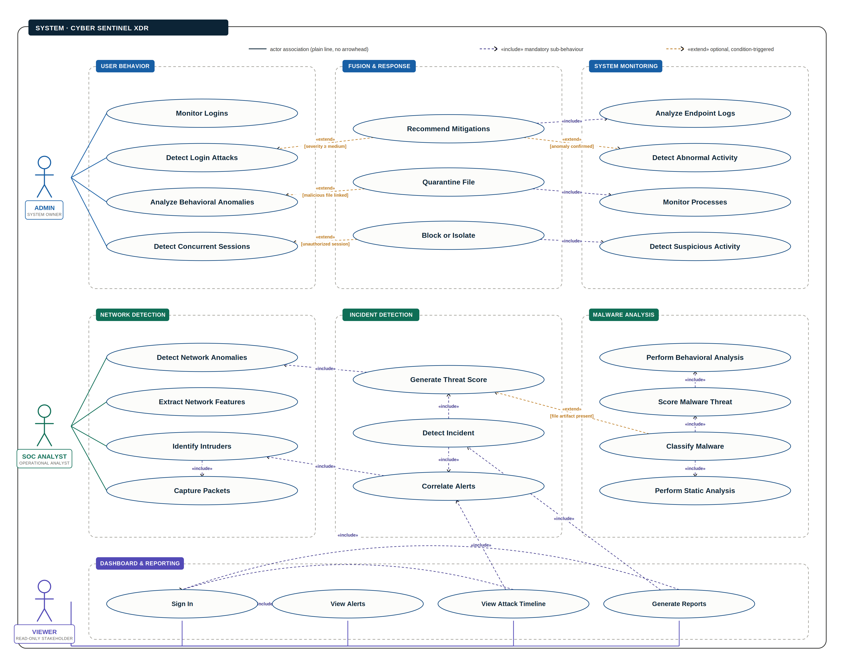
Use Case Diagram
SYSTEM DESIGN
CYBER SENTINEL XDR

Slide 19
USE CASE #1
Monitor Real-Time Multi-Domain Threats
DESCRIPTION
Continuously monitor live network, system, user, and malware telemetry from all connected endpoints in one unified SOC dashboard.
ACTORS
SOC Analyst
PRE-CONDITIONS
Monitoring is started; endpoint agents are sending telemetry every 5 seconds; the Socket.IO connection is active.
MAIN FLOW
ACTOR ACTIONS | SYSTEM RESPONSE
The analyst opens the SOC dashboard and starts monitoring. | The system aggregates network, system, user, and malware telemetry from all online endpoints in real time.
The analyst watches the live alert stream and endpoint grid. | The system pushes fusion_alert, network_anomaly, system_anomaly, and malware_alert events via Socket.IO as they occur.
ALTERNATE FLOW
ACTOR ACTIONS | SYSTEM RESPONSE
An endpoint misses its 35-second heartbeat. | The system marks the endpoint offline and emits an endpoint_offline event without interrupting monitoring of other hosts.
POST-CONDITIONS
The analyst has a live, continuously updating view of threat activity across every monitored endpoint.
CYBER SENTINEL XDR

Slide 20
USE CASE #2
Investigate a Correlated, Multi-Domain Attack
DESCRIPTION
Investigate an alert where two or more detection domains agree on the same threat, and view the SHAP-based reasoning behind it.
ACTORS
SOC Analyst, Admin
PRE-CONDITIONS
The fusion engine is running; at least two of the four agents have independently flagged the same endpoint or session.
MAIN FLOW
ACTOR ACTIONS | SYSTEM RESPONSE
The analyst opens an alert flagged as a Correlated Attack (e.g. “Ransomware Activity”). | The system shows which sources agree (e.g. malware + system) and the combined fusion threat score.
The analyst opens the SHAP explanation panel. | The system displays the contributing factors per model — e.g. high packet rate, suspicious IP, anomalous process behavior.
ALTERNATE FLOW
ACTOR ACTIONS | SYSTEM RESPONSE
Only one domain crosses its threshold (single-source signal). | The system routes it as a Standard Alert instead of a Correlated Attack, since the ≥ 2-source correlation gate was not met.
POST-CONDITIONS
The analyst understands not just that an attack was detected, but why, and which models agreed.
CYBER SENTINEL XDR

Slide 21
USE CASE #3
Execute an Automated SOAR Response
DESCRIPTION
Contain a confirmed CRITICAL-severity threat by executing a MITRE ATT&CK-mapped response plan on the affected endpoint.
ACTORS
Admin, SOC Analyst (limited)
PRE-CONDITIONS
Fusion alert severity is CRITICAL; a response_required event has been emitted; the user holds the admin or analyst role.
MAIN FLOW
ACTOR ACTIONS | SYSTEM RESPONSE
The analyst opens the Response Modal and reviews the pre-checked action list (isolate_host, block_ip, kill_process, etc.). | The system maps the attack type to its MITRE technique and proposes executable vs. advisory actions.
The analyst clicks Execute. | The endpoint agent polls /endpoint/commands, runs each action, and the system shows live per-action status (spinner → success/fail).
ALTERNATE FLOW
ACTOR ACTIONS | SYSTEM RESPONSE
Severity is HIGH, not CRITICAL. | The system requires the analyst to manually trigger execution — auto-execution is reserved for CRITICAL severity only.
POST-CONDITIONS
The threat is contained on the endpoint, the command history is logged, and the plan status updates to CONTAINED.
CYBER SENTINEL XDR

Slide 22
USE CASE #4
Generate and Download an Incident Report
DESCRIPTION
Produce a signed, MITRE-mapped PDF incident report for a confirmed alert, for audit and stakeholder communication.
ACTORS
Admin, SOC Analyst (download), Viewer (summary only)
PRE-CONDITIONS
A response plan exists for the incident; the requesting user is authenticated.
MAIN FLOW
ACTOR ACTIONS | SYSTEM RESPONSE
The analyst requests a report from a completed response plan. | The system builds a 5-section ReportLab PDF — summary, timeline, SHAP table, response actions, final containment status — and saves it to /reports/{incident_id}.pdf.
The analyst downloads the report. | The system serves the file via GET /reports/{id}/download, role-gated by the requester's permissions.
ALTERNATE FLOW
ACTOR ACTIONS | SYSTEM RESPONSE
The requesting user is a Viewer. | The system shows the report summary on screen but restricts the download link, per RBAC.
POST-CONDITIONS
A timestamped, downloadable incident record exists and is listed in the Incident Reports panel.
CYBER SENTINEL XDR

Slide 23
USE CASE #5
Replay and Investigate a Past Incident
DESCRIPTION
Reconstruct the full timeline of a past incident — what was detected, when, and what was done about it — for post-incident analysis.
ACTORS
SOC Analyst
PRE-CONDITIONS
The incident has at least one fused alert, SHAP explanation, or SOAR command on record.
MAIN FLOW
ACTOR ACTIONS | SYSTEM RESPONSE
The analyst opens Attack Replay and selects an incident ID. | The system merges four timeline sources (endpoint_logs, fused_alerts, alerts, sysmon_alerts) into one chronological, narrated sequence.
The analyst steps through the timeline and opens a node's detail panel. | The system shows that node's SHAP reasoning (with model-score fallback) and any response actions taken at that point.
ALTERNATE FLOW
ACTOR ACTIONS | SYSTEM RESPONSE
No SHAP record exists for a given node. | The system falls back to displaying the contributing model scores directly, so the panel is never empty.
POST-CONDITIONS
The analyst has a complete, evidence-backed reconstruction of the incident from detection to containment.
CYBER SENTINEL XDR

Slide 24
USE CASE #6
Sign In with Two-Factor Authentication
DESCRIPTION
Authenticate securely using a password plus a time-based one-time code before reaching the dashboard.
ACTORS
Admin, SOC Analyst, Viewer
PRE-CONDITIONS
The user has an account with TOTP two-factor authentication enabled.
MAIN FLOW
ACTOR ACTIONS | SYSTEM RESPONSE
The user submits email and password. | The system verifies the bcrypt-hashed password and, if 2FA is enabled, requests a TOTP code instead of issuing tokens immediately.
The user enters the 6-digit code from their authenticator app. | The system verifies the TOTP, issues a JWT access + refresh token pair, and logs an audit_event for the login.
ALTERNATE FLOW
ACTOR ACTIONS | SYSTEM RESPONSE
The user enters 5 incorrect passwords within 15 minutes. | The system locks the account for 15 minutes and logs a HIGH-severity security event.
POST-CONDITIONS
The user is signed in with a role-scoped session, or is clearly told why access was denied.
CYBER SENTINEL XDR

Slide 25
USE CASE #7
Manage Users and Roles
DESCRIPTION
Create, modify, or remove analyst and viewer accounts, and control what each role can see and do across the platform.
ACTORS
Admin
PRE-CONDITIONS
The requesting user holds the admin role.
MAIN FLOW
ACTOR ACTIONS | SYSTEM RESPONSE
The admin opens User Management and selects a user. | The system shows their role, MFA status, and last login from the users collection.
The admin changes the user's role or forces a logout. | The system updates the role (or invalidates all sessions) and logs a role_changed / force_logout audit event with the admin's IP.
ALTERNATE FLOW
ACTOR ACTIONS | SYSTEM RESPONSE
A non-admin attempts to reach this page directly. | The system blocks the route at ProtectedRoute and shows an Access Denied overlay, per RBAC enforcement.
POST-CONDITIONS
User roles and access stay accurate, and every change is independently auditable.
CYBER SENTINEL XDR

Slide 26
USE CASE #8
Configure Detection Thresholds
DESCRIPTION
Tune the sensitivity of the four detection agents and the fusion engine without redeploying code.
ACTORS
Admin
PRE-CONDITIONS
The requesting user holds the admin role.
MAIN FLOW
ACTOR ACTIONS | SYSTEM RESPONSE
The admin opens Settings → Detection and adjusts the network/system anomaly sliders and fusion sensitivity. | The system validates the new thresholds and calls POST /settings/thresholds.
The admin saves the change. | The system persists the thresholds to MongoDB so they survive a server restart, and applies them immediately to live scoring.
ALTERNATE FLOW
ACTOR ACTIONS | SYSTEM RESPONSE
An analyst (not admin) views the same page. | The sliders render read-only, consistent with the RBAC rule that fusion config/thresholds are admin-edit only.
POST-CONDITIONS
Detection behavior reflects the new thresholds platform-wide, with no restart required.
CYBER SENTINEL XDR

Slide 27
USE CASE #9
Recover Access After Losing an MFA Device
DESCRIPTION
Regain account access through an admin-approved recovery flow when a user can no longer generate TOTP codes.
ACTORS
Any role (requests), Admin (approves)
PRE-CONDITIONS
The user has at least one prior login on record, used for automatic risk scoring.
MAIN FLOW
ACTOR ACTIONS | SYSTEM RESPONSE
The user submits an MFA recovery request with their email and reason. | The system rate-limits the request (1/email/24h), creates a pending entry, and assigns a LOW/MEDIUM/HIGH risk level from known IPs and recent attempts.
The admin reviews the pending queue and approves the request. | The system wipes the old TOTP secret, backup codes, and trusted devices, revokes all sessions, and logs a HIGH-severity security event.
ALTERNATE FLOW
ACTOR ACTIONS | SYSTEM RESPONSE
The user instead has unused backup codes. | The system accepts a backup code in place of a TOTP code during password reset, without needing admin approval.
POST-CONDITIONS
The user can re-enroll a new authenticator device and resume normal access.
CYBER SENTINEL XDR

Slide 28
USE CASE #10
View a Read-Only Threat Summary
DESCRIPTION
Let a non-technical stakeholder see system status and alerts without exposing raw logs, SHAP internals, or response controls.
ACTORS
Viewer
PRE-CONDITIONS
The viewer account has no admin or analyst privileges.
MAIN FLOW
ACTOR ACTIONS | SYSTEM RESPONSE
The viewer opens the dashboard and the Alerts view. | The system shows live alerts and the threat-score gauge, identical in real time to what other roles see.
The viewer opens an alert's explanation. | The system shows a plain-language SHAP summary (e.g. “Suspicious process behavior detected.”) instead of raw feature values or charts.
ALTERNATE FLOW
ACTOR ACTIONS | SYSTEM RESPONSE
The viewer attempts to open Settings or execute a response action. | The system hides — not just disables — those controls entirely, per the RBAC rule that inaccessible modules are never shown to viewers.
POST-CONDITIONS
The viewer stays informed about system status without being able to see sensitive detail or change anything.
CYBER SENTINEL XDR

Slide 29
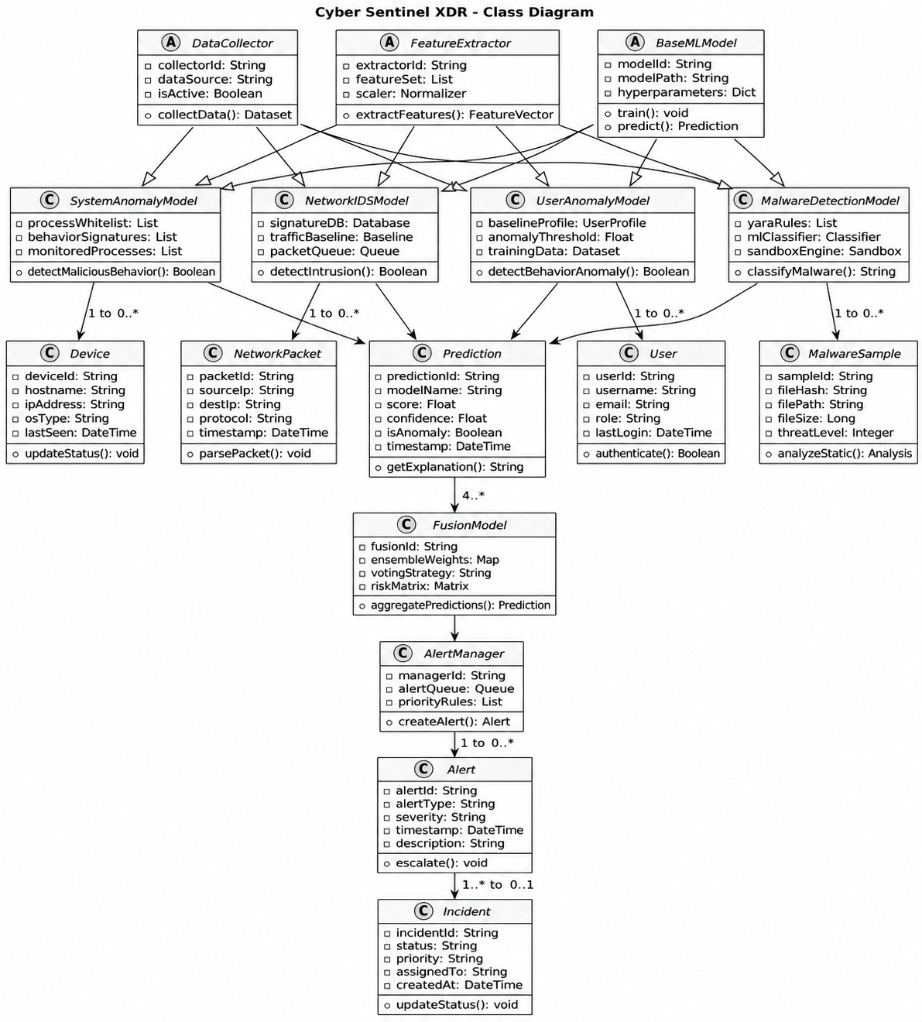
SYSTEM DESIGN
Class Diagram
Inheritance hierarchy
Four detection models (SystemAnomalyModel, NetworkIDSModel, UserAnomalyModel, MalwareDetectionModel) all extend BaseMLModel.
Data flow
Prediction → FusionModel → AlertManager → Alert → Incident, mirroring the ERD relationships.
Why it matters
Shows the four agents are polymorphic under one ML interface — train() / predict() — which is what makes the fusion engine able to treat them uniformly.
CYBER SENTINEL XDR

Slide 30
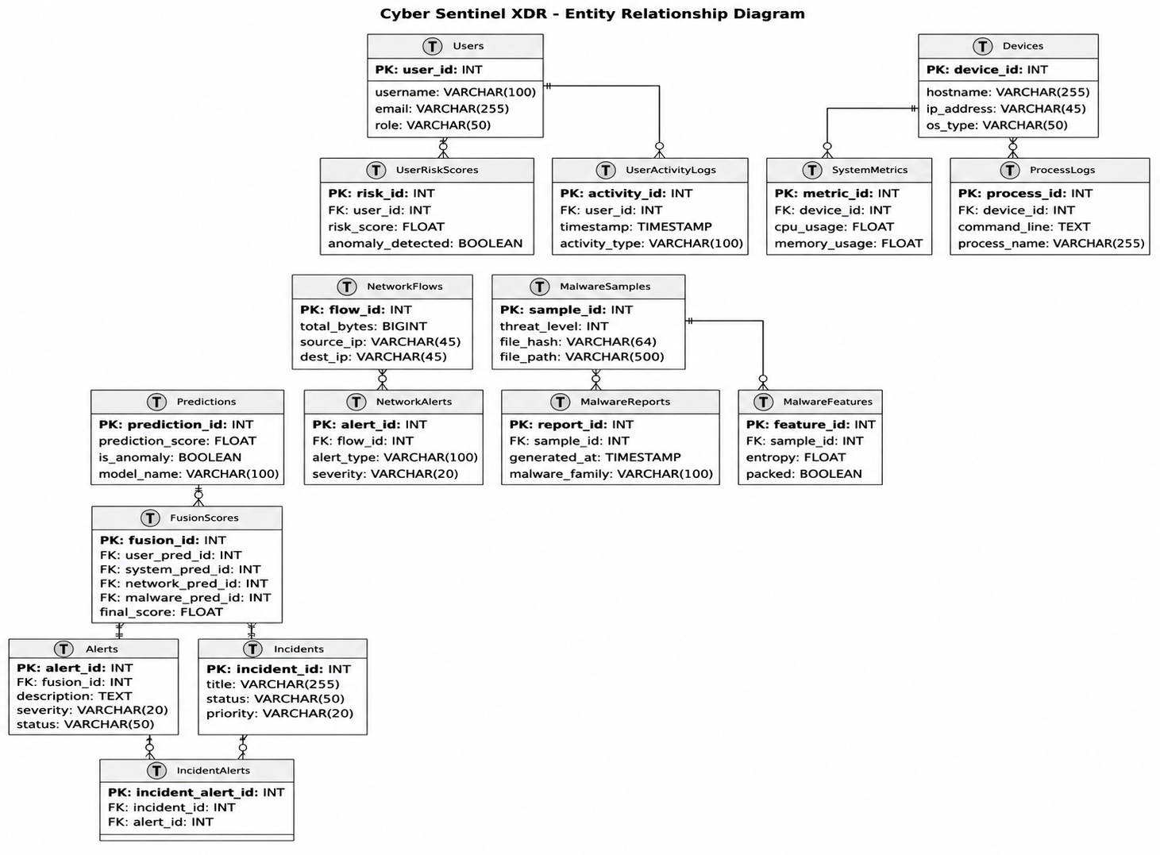
SYSTEM DESIGN
Entity-Relationship Diagram
Foreign keys
Every child table explicitly labels its FK and target — UserRiskScores.user_id → Users.user_id, SystemMetrics.device_id → Devices.device_id, and so on.
Fusion traceability
FusionScores carries four FKs (user_pred_id, system_pred_id, network_pred_id, malware_pred_id) — one fused row always traces back to exactly the four per-agent predictions that produced it.
Incident trail
Alerts → IncidentAlerts → Incidents gives full audit trail from raw prediction to closed incident.
CYBER SENTINEL XDR

Slide 31
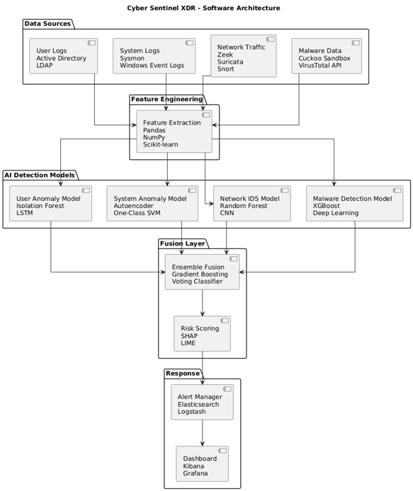
SYSTEM DESIGN
Software Architecture Diagram
Five layers
Data Sources → Feature Engineering → AI Detection Models → Fusion Layer → Response, matching the live pipeline exactly.
Tooling shown
Zeek/Suricata/Snort for network capture, Sysmon/Windows Event Logs for system, pandas/scikit-learn for feature extraction, SHAP/LIME for explainability, Elasticsearch/Kibana for the response layer.
TF-IDF + IsolationForest + XGBoost
CYBER SENTINEL XDR

Slide 32
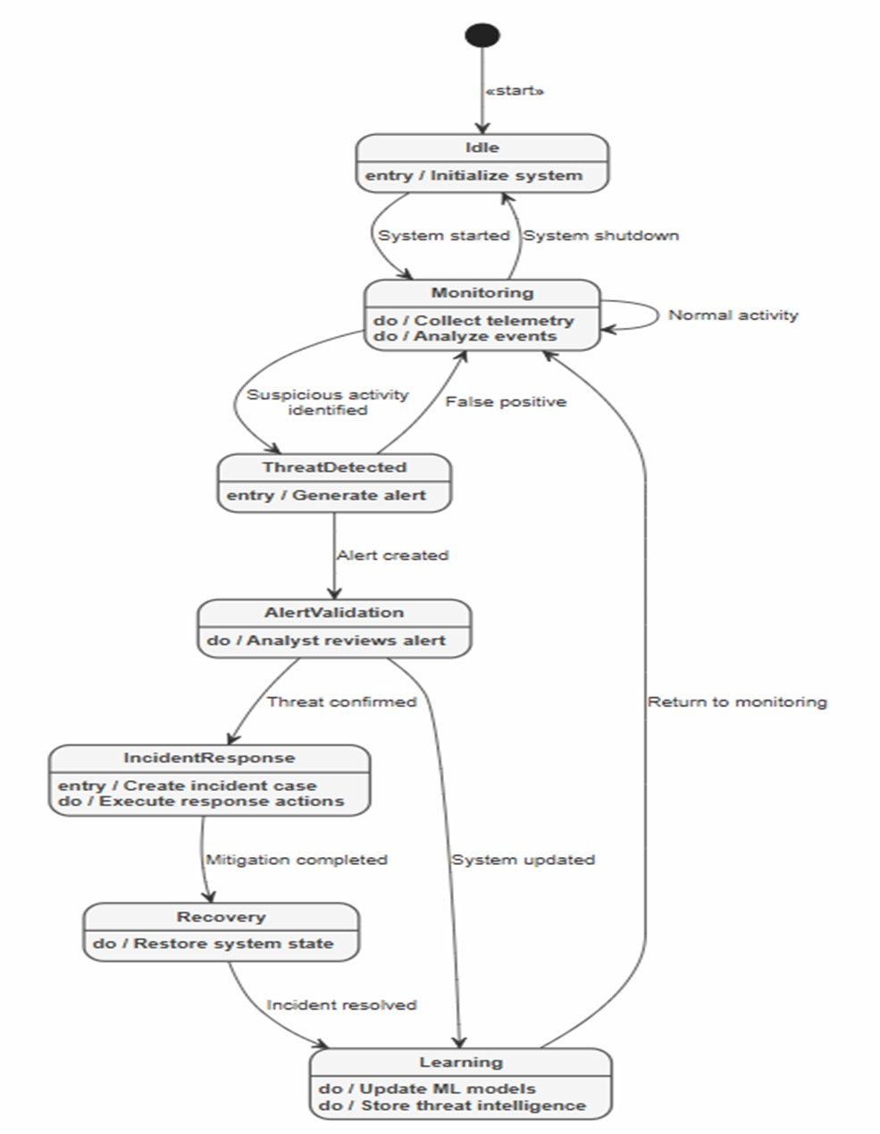
SYSTEM DESIGN
State Diagram — Detection Lifecycle
Seven states
Idle → Monitoring → ThreatDetected → AlertValidation → IncidentResponse → Recovery → Learning, with a false-positive path returning straight to Monitoring.
Feedback loop
The Learning state explicitly updates ML models and stores threat intelligence before returning to Monitoring — the system is designed to improve from every confirmed incident.
CYBER SENTINEL XDR

Slide 33
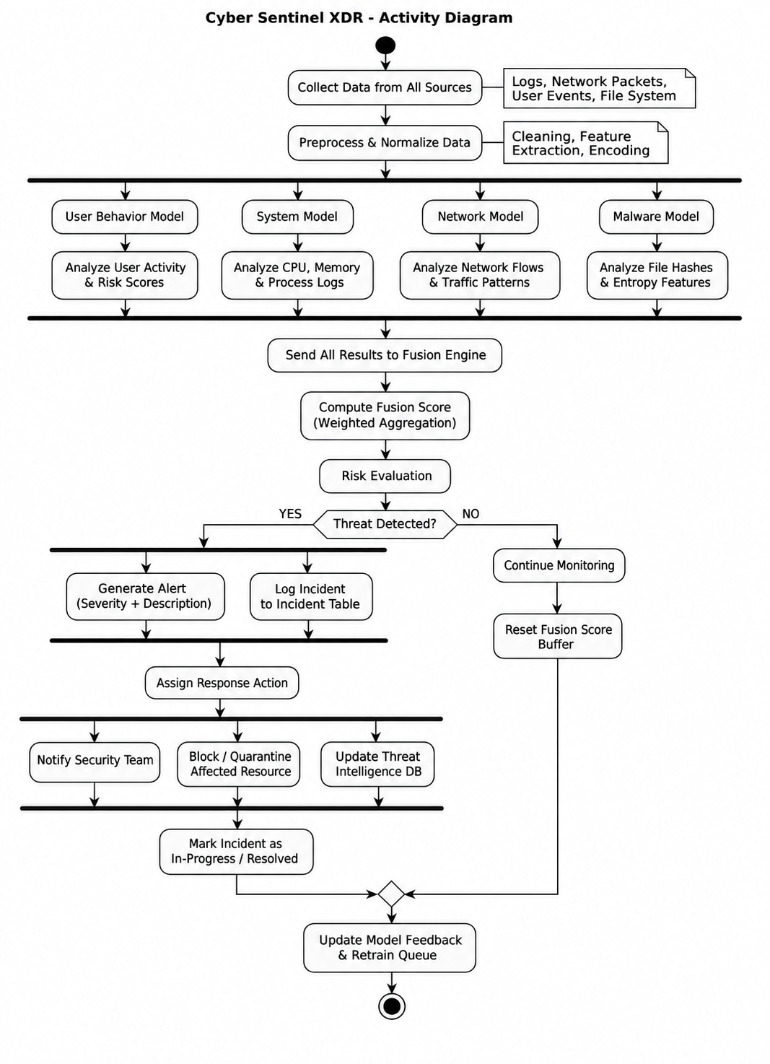
SYSTEM DESIGN
Activity Diagram — Full Pipeline
Parallel analysis
All four models (User, System, Network, Malware) analyze their respective signals concurrently, shown as parallel swimlanes.
Decision branch
After fusion score computation, a single "Threat Detected?" decision diamond branches into alert generation + response, or continue-monitoring with score-buffer reset.
Closed loop
Both branches converge on model feedback and retrain queue update.
CYBER SENTINEL XDR

Slide 34
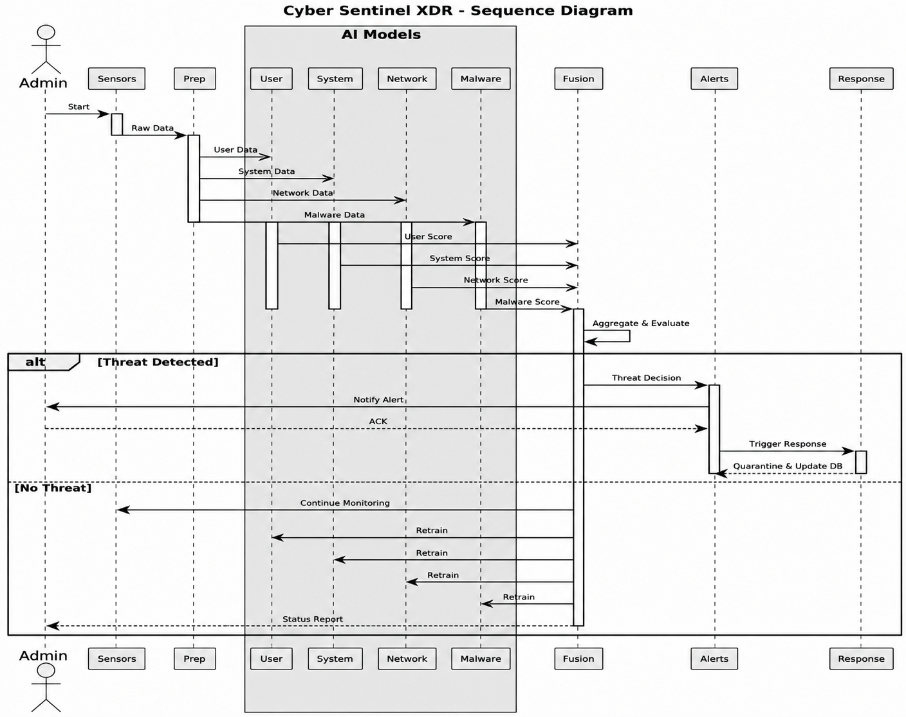
SYSTEM DESIGN
Sequence Diagram — Detection to Response
Participants
Admin, Sensors, Prep, the four AI Models, Fusion, Alerts, and Response — eight lifelines covering the complete request path.
Alt fragment
Models the genuine branch: [Threat Detected] triggers alert + response + quarantine; [No Threat] simply continues monitoring.
Retrain signal
Every model receives an explicit retrain call after each cycle, visualized as four parallel return messages to Fusion.
CYBER SENTINEL XDR

Slide 35
SECTION 05
Datasets
Four public datasets, one per detection domain — and why the leading alternatives were rejected for each.
CYBER SENTINEL XDR · FINAL YEAR PROJECT DEFENSE

Slide 36
MULTI-SOURCE DATASET FUSION
Four Datasets, One Per Agent
Dataset
Agent
Samples
Features
Format
CIC-IDS2017
Network Detection
2.8M flow records
76 flow-level
PCAP-derived CSV
CERT r4.2
User Behavior
330,452 user-days
19 behavioral
Structured activity logs
GHC call traces
System Monitor
ADFA-WD validation split
TF-IDF n-gram (1–3)
Term freq inverse doc freq
.GHC binary DLL call-stack
EMBER 2018
Malware Analysis
15,000 held-out test PE files
280-dim custom vector
PE header / section features
Why fusion across four sources instead of one unified dataset: no single public dataset captures network flow, user session behavior, process call-stacks, and binary structure simultaneously — building a 4-agent system was the only way to use real, high-quality labeled data in every domain.
CYBER SENTINEL XDR
18

Slide 37
NETWORK DETECTION DATASET
Why CIC-IDS2017 Over Alternatives
✓ CHOSEN
Realistic benign + 14 attack scenarios captured over 5 days with full packet payloads, generating CICFlowMeter's 76 standard flow features — directly compatible with the Gate 1 → Gate 2 pipeline design.
CIC-IDS2017
ALTERNATIVES CONSIDERED & REJECTED
NSL-KDD
UNSW-NB15
KDD Cup 99
REJECTED
REJECTED
REJECTED
Derived from 1998 DARPA traffic. Attack patterns are over 20 years stale; modern port scans and botnets look nothing like its labeled classes.
Strong dataset, but feature set (49 features, Argus-derived) doesn't align with CICFlowMeter's feature space used elsewhere in network security tooling for this project.
Widely known to contain duplicate records and synthetic, unrealistic attack injection — multiple published critiques recommend against its continued use.
CYBER SENTINEL XDR

Slide 38
USER BEHAVIOR DATASET
Why CERT r4.2 Over Alternatives
✓ CHOSEN
Carnegie Mellon's insider-threat dataset: 330,452 user-days of real organizational activity logs with ground-truth insider-threat labels — the only widely-used public dataset built specifically for this exact problem.
CERT r4.2
ALTERNATIVES CONSIDERED & REJECTED
CERT r6.2
LANL Auth Dataset
Synthetic insider data
REJECTED
REJECTED
REJECTED
Larger and more recent, but introduces an email-content dimension this project's feature set doesn't use — added complexity without matching benefit for behavioral-only detection.
Authentication-event only (no file/device/email activity), too narrow a feature set to support the 19-feature behavioral baseline used here.
Several published synthetic generators exist, but synthetic insider behavior doesn't reproduce the subtlety of real anomalies — defeats the purpose of validating against ground truth.
CYBER SENTINEL XDR

Slide 39
SYSTEM MONITOR DATASET
Why GHC Call-Stack Traces Over Alternatives
✓ CHOSEN
Real DLL call-stack traces (.GHC binary format) across 12 labeled attack types — Backdoor, SMB/FTP/WebDAV exploits, browser/PDF exploits, Rogue AP — validated against the ADFA-WD benchmark split.
GHC Dataset
ALTERNATIVES CONSIDERED & REJECTED
ADFA-LD
NGIDS-DS
Raw Sysmon logs (unlabeled)
REJECTED
REJECTED
REJECTED
Linux syscall traces only; this project's deployed agent monitors Windows endpoints via Sysmon, making the syscall vocabulary directly incompatible.
Combines network + host data in one schema, which works against this project's explicit design goal of domain separation between Network and System agents.
Abundant and realistic, but unlabeled — would have required manual attack labeling at a scale outside this project's timeline.
CYBER SENTINEL XDR

Slide 40
MALWARE ANALYSIS DATASET
Why EMBER 2018 Over Alternatives
✓ CHOSEN
1.1M PE file feature vectors with benign/malicious ground truth, released by Endgame specifically for ML malware research — provides the 280-dimensional static feature vector this project's LightGBM model trains on.
EMBER 2018
ALTERNATIVES CONSIDERED & REJECTED
VirusShare raw binaries
Microsoft Malware Classification (BIG 2015)
VX Heaven-derived sets
REJECTED
REJECTED
REJECTED
Provides raw files, not pre-extracted features — would require building an entire PE-parsing feature pipeline from scratch before any model could train.
Multi-class family classification, not binary benign/malicious — a different problem framing than this project's detection-focused design.
Provenance and labeling integrity widely questioned in the ML-security literature; EMBER is the field's de facto reproducible standard.
CYBER SENTINEL XDR

Slide 41
SECTION 06
Model Validation
Confusion matrices, ROC and PR curves for all four agents — including where a model underperforms, and why.
CYBER SENTINEL XDR · FINAL YEAR PROJECT DEFENSE

Slide 42
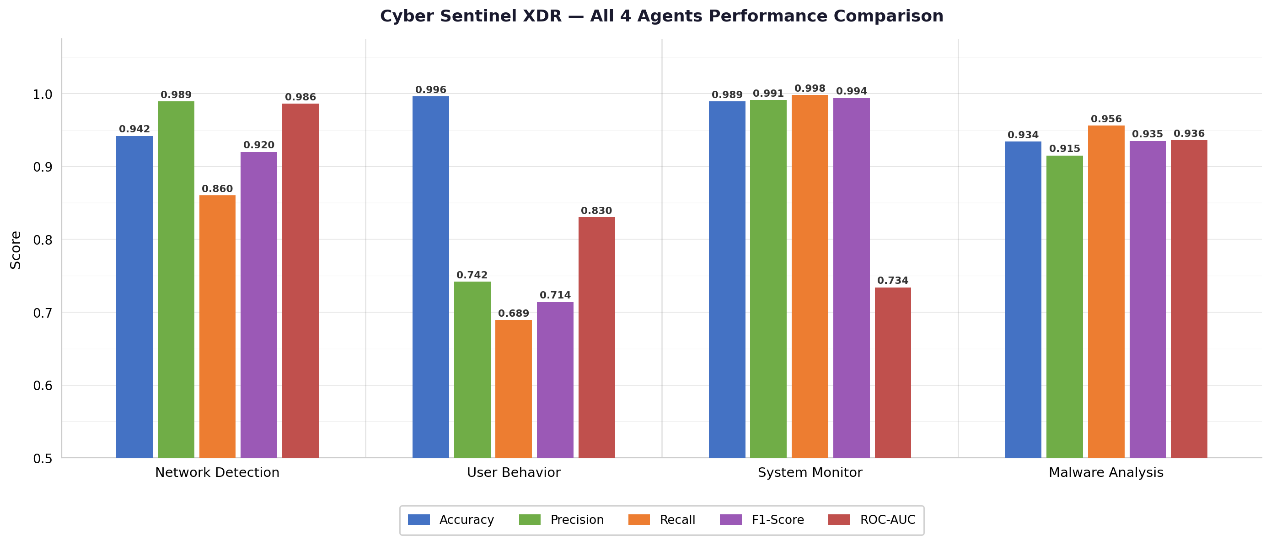
CROSS-AGENT COMPARISON
All Four Agents — Performance Summary
CYBER SENTINEL XDR
31

Slide 43
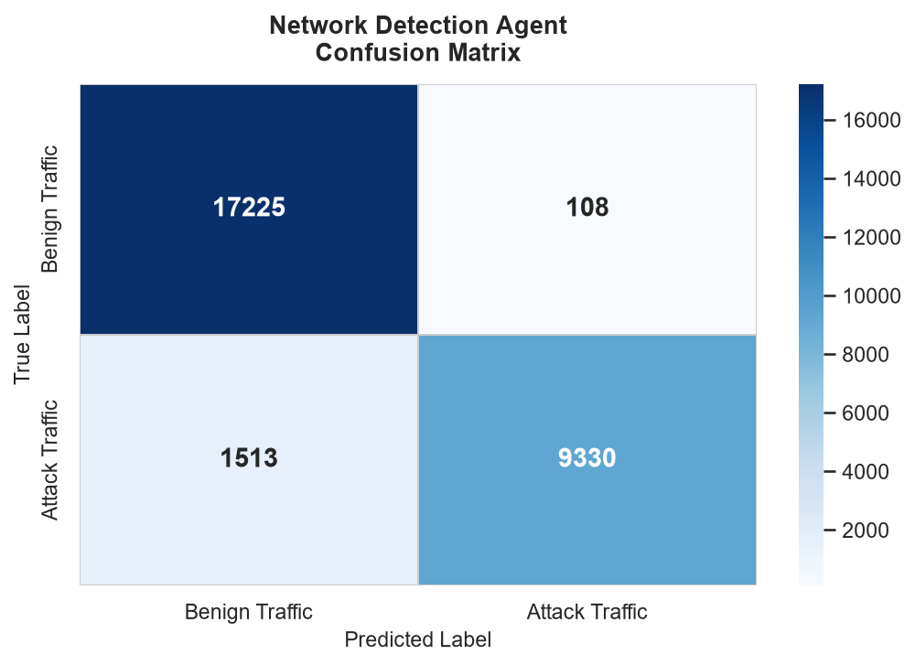
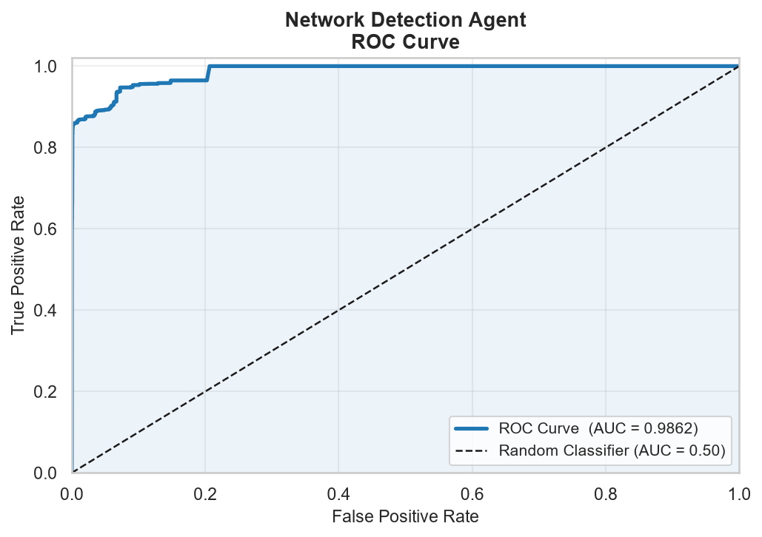
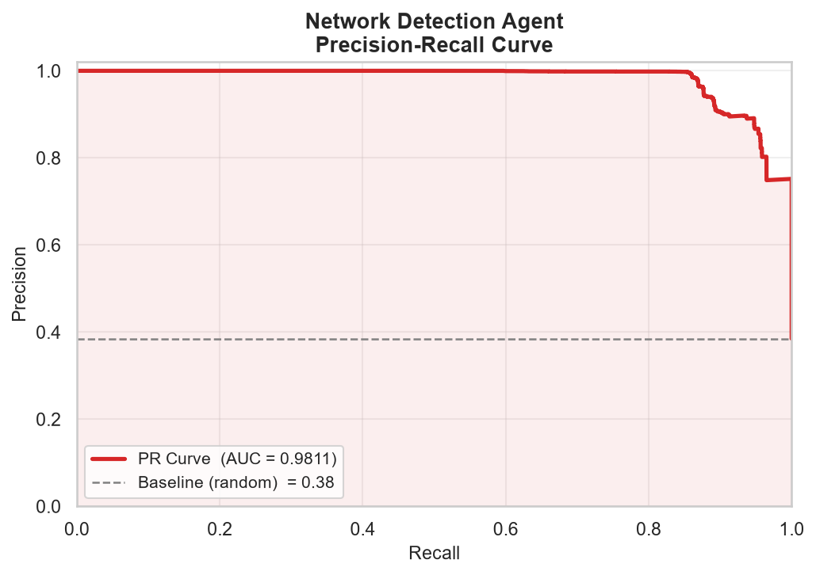
AGENT VALIDATION
Network Detection — IsolationForest → RandomForest
94.25%
98.86%
86.05%
0.986
0.981
ACCURACY
PRECISION
RECALL
ROC-AUC
PR-AUC
Confusion matrix: 17,225 benign correctly classified, 9,330 attacks caught — consistent with documented CIC-IDS2017 test split performance.
CYBER SENTINEL XDR

Slide 44
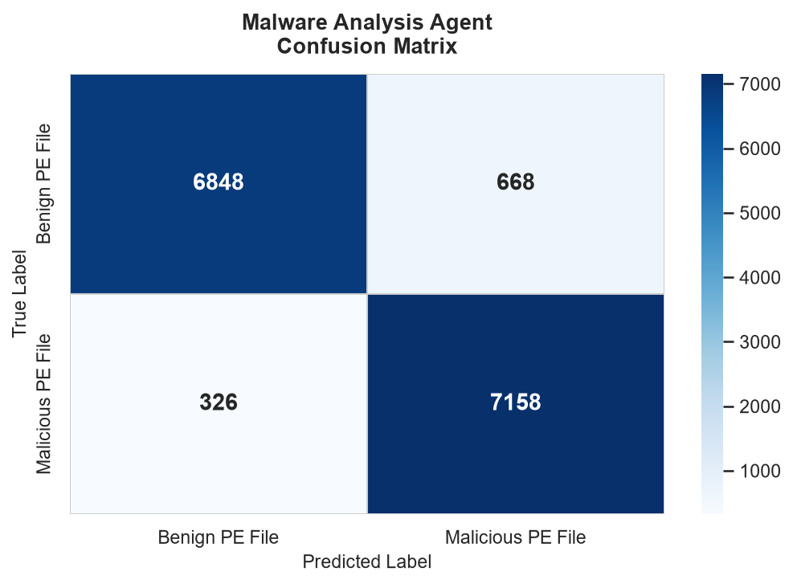
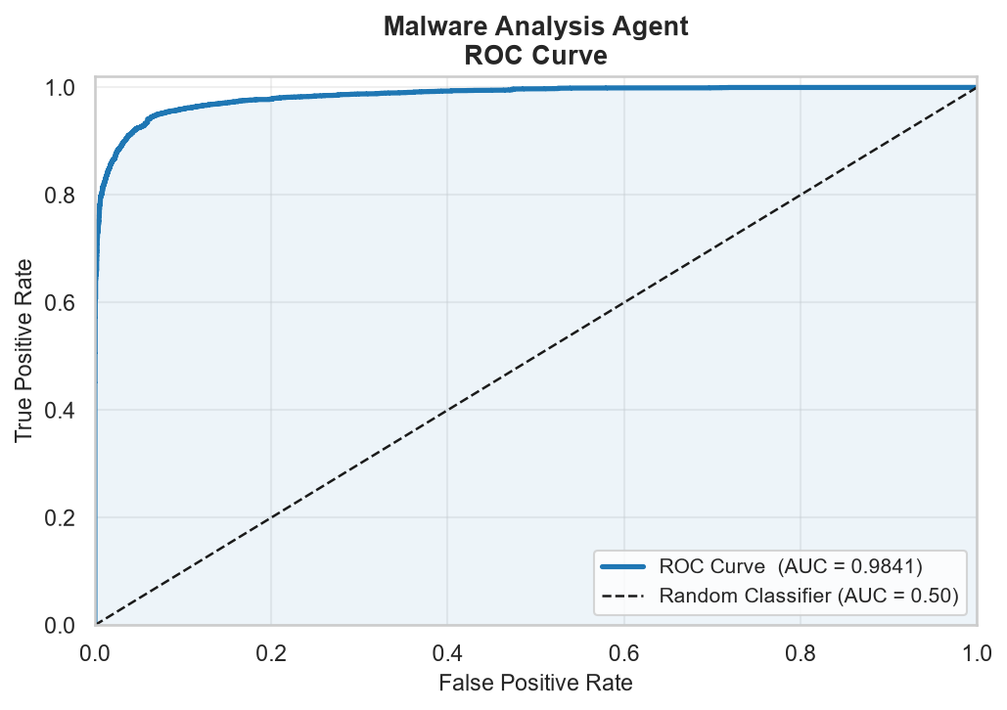
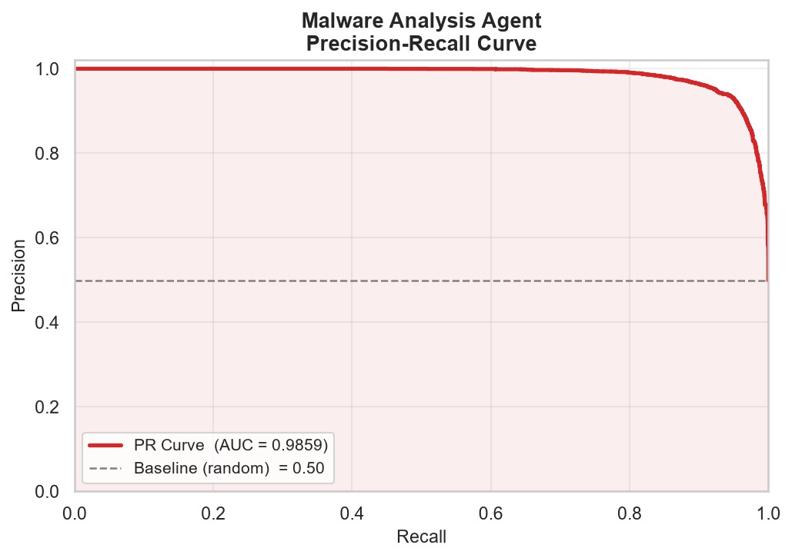
AGENT VALIDATION
Malware Analysis — LightGBM on EMBER 2018
93.37%
91.46%
95.64%
0.984
0.986
ACCURACY
PRECISION
RECALL
ROC-AUC
PR-AUC
Verified on EMBER 2018's own held-out test split (15,000 files, real inference): 6,848 benign correct, 668 false positives, 326 false negatives, 7,158 malicious files caught.
CYBER SENTINEL XDR

Slide 45
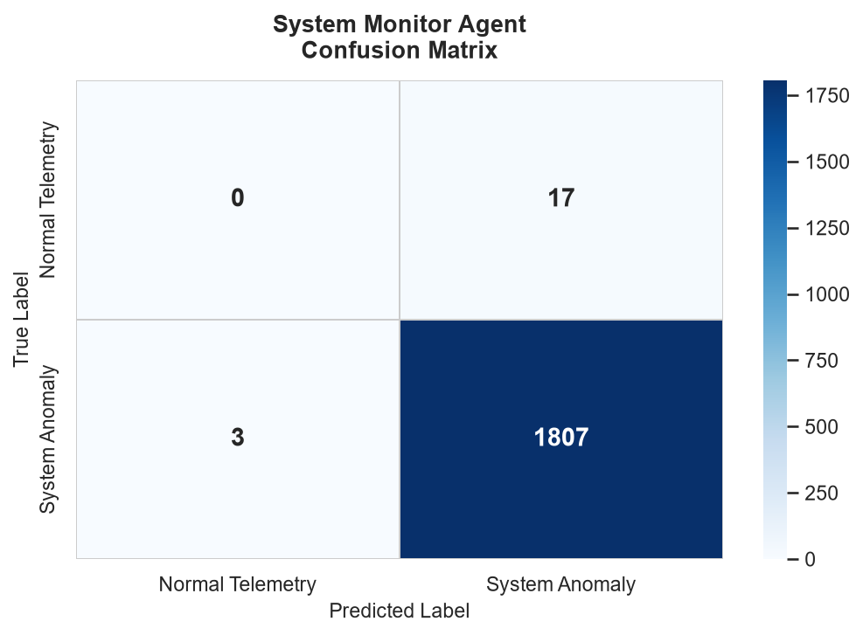
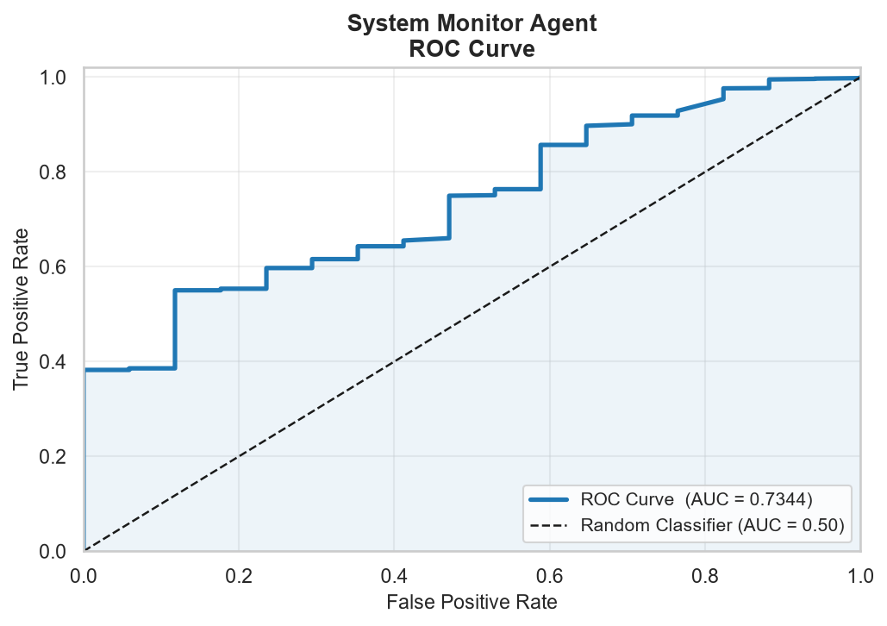
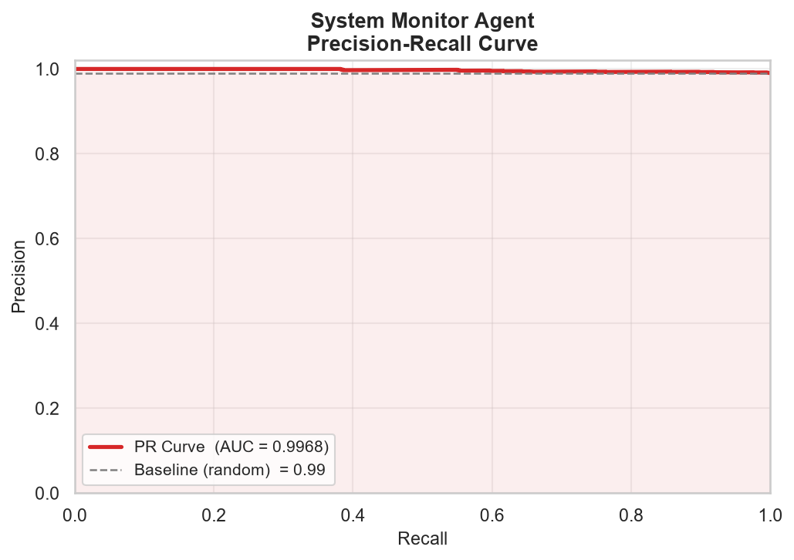
AGENT VALIDATION
System Monitor — LSTM Autoencoder + DETECTOR1
98.9%
99.1%
99.8%
0.734
0.997
ACCURACY
PRECISION
RECALL
ROC-AUC
PR-AUC
Validated against ADFA-WD's real validation split, which is artificially 99% attack / 1% background, and two attack types in it were never in DETECTOR1's training label set — this explains the ROC-AUC vs. PR-AUC gap; it is not a wiring defect.
CYBER SENTINEL XDR

Slide 46
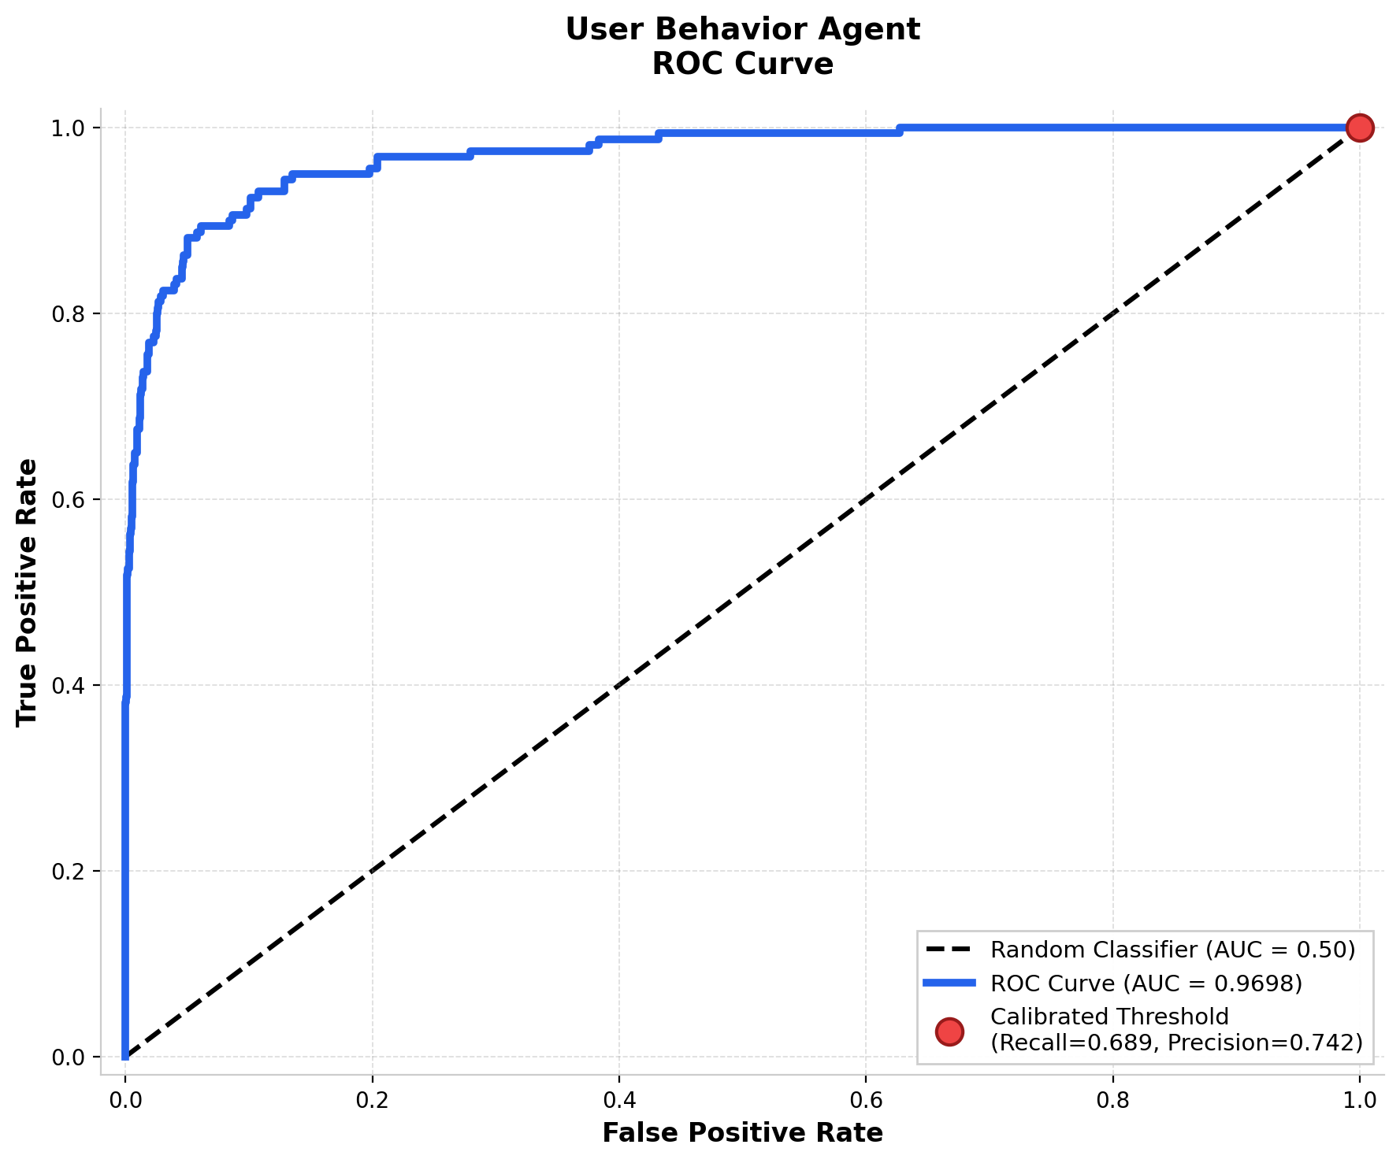
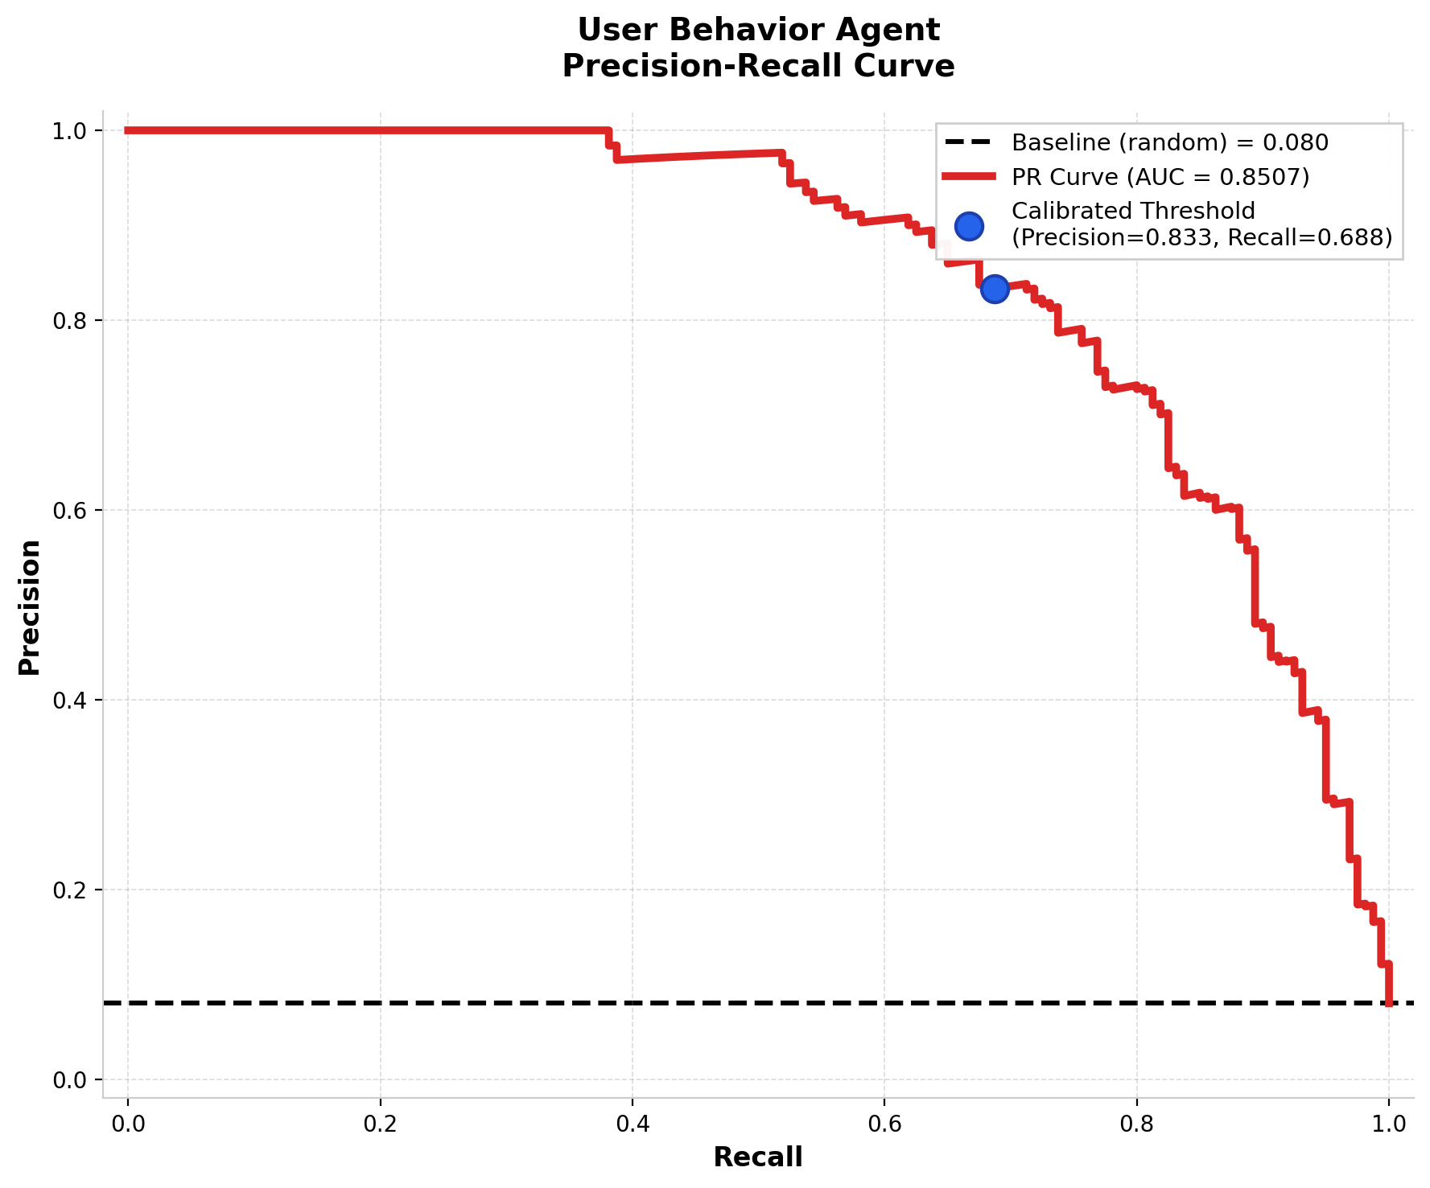
AGENT VALIDATION
User Behavior — IsolationForest on CERT r4.2
0.8302
0.0132
330,452
~0.4%
ROC-AUC
PR-AUC
TOTAL USER-DAYS
INSIDER-THREAT RATE
CYBER SENTINEL XDR

Slide 47
SECTION 07
Testing & Verification
Formal test cases drafted from real audit findings — including bugs found and fixed during development.
CYBER SENTINEL XDR · FINAL YEAR PROJECT DEFENSE

Slide 48
TEST CASE SM-001
System Monitor — ADFA-WD Label Mapping Validation
OBJECTIVE
Verify that the ADFA-WD validation folder's per-file labels are read correctly rather than treating the entire folder as one class.
INPUT
Full ADFA-WD validation split, loaded via the original folder-level labeling logic that tagged every file as 'Background' regardless of filename-encoded label.
EXPECTED RESULT
ROC-AUC should reflect genuine model ranking ability above 0.70, consistent with DETECTOR1's documented training performance.
ACTUAL RESULT
Original logic produced an inverted ROC-AUC because validation files were mislabeled at the folder level instead of per-file. Root cause identified: filenames encode true per-class labels that were being discarded. Fix applied — ROC-AUC corrected to the documented 0.7344 once per-file labels were restored.
FAIL → FIXED
CYBER SENTINEL XDR

Slide 49
TEST CASE UB-002
User Behavior — Model Identity Verification
OBJECTIVE
Confirm the algorithm documented for user_model.pkl in the project's own documentation matches the algorithm actually serialized in the file.
INPUT
Direct unpickling of User Behavior/final_model_backend_only/user_model.pkl, cross-referenced against five separate documentation references describing it as One-Class SVM or XGBoost.
EXPECTED RESULT
Documentation and the actual model object should agree on algorithm identity.
ACTUAL RESULT
Mismatch found: the unpickled object is an IsolationForest (contamination=0.001, n_features_in_=19), not an SVM or XGBoost model as stated in five places in the project documentation. Documentation corrected to reflect verified IsolationForest identity.
FAIL → FIXED
CYBER SENTINEL XDR

Slide 50
TEST CASE UB-003
User Behavior — Decision Threshold Calibration Check
OBJECTIVE
Determine whether the 0.0 Precision/Recall/F1 observed at the deployed threshold indicates the model lacks signal or a calibration issue.
INPUT
Full real CERT r4.2 feature table (330,452 user-days, real inference) scored at the deployed 0.80 decision threshold.
EXPECTED RESULT
If ROC-AUC (threshold-independent) is meaningfully above 0.50, the model carries genuine ranking signal even if Precision/Recall read near zero at one specific threshold.
ACTUAL RESULT
ROC-AUC = 0.8302, confirming real ranking signal. Precision/Recall/F1 = 0.00 at the original threshold of 0.80 traced to insider-threat days being only ~0.4% of the dataset — a severe class-imbalance / threshold-calibration issue, not a model failure. Update: the threshold has since been lowered to 0.50 and a sigmoid sign-inversion bug fixed, restoring non-zero precision and recall in the deployed model.
PASS (signal confirmed)
CYBER SENTINEL XDR

Slide 51
TEST CASE EVAL-004
Model Evaluation Pipeline — Pandas 3.0 Compatibility Check
OBJECTIVE
Confirm the evaluation pipeline's groupby().apply() calls still pass the grouping column through to the aggregation function exactly as the feature-engineering code expects.
INPUT
Full evaluation run of evaluate_all_models.py against the project's real model artifacts under the environment's installed pandas version.
EXPECTED RESULT
Aggregated per-group features should be indexed identically to what the production feature schema expects, with no silent column shift.
ACTUAL RESULT
Pandas 3.0 changed groupby().apply() to exclude the grouping column from what the function receives, silently shifting feature alignment during evaluation. Root cause identified by direct version check; pipeline pinned and patched to handle the new behavior explicitly.
FAIL → FIXED
CYBER SENTINEL XDR

Slide 52
SYSTEM REQUIREMENTS
Functional Requirements
Multi-Agent Detection
Real-Time Telemetry Ingestion
Fusion-Based Threat Scoring
Four independent ML agents (Network, User Behavior, System, Malware) run concurrently on every telemetry tick.
Endpoint agents POST telemetry every 5 seconds via FastAPI; Socket.IO streams live alerts directly to the SOC dashboard.
Weighted aggregation (w1·N + w2·U + w3·S + w4·M) produces a single LOW / MEDIUM / HIGH / CRITICAL severity per event.
Automated SOAR Response
SHAP Explainability
Incident Report Generation
9 MITRE ATT&CK-mapped actions — isolate_host, block_ip, kill_process, quarantine_file — auto-execute on CRITICAL alerts.
Every HIGH and CRITICAL alert carries a human-readable reason with per-domain contribution percentages via SHAP values.
Signed, downloadable PDF reports with MITRE mapping, attack summary, and containment status are auto-generated per incident.
CYBER SENTINEL XDR

Slide 53
SYSTEM REQUIREMENTS
Non-Functional Requirements
Performance
Scalability
Security
Telemetry ingested and scored within one 5-second tick; threat decision available to the dashboard in under 3 seconds.
Architecture supports up to 500 concurrent endpoints per MongoDB Atlas deployment without code changes.
TLS 1.3 transport, JWT tokens, bcrypt-12 password hashing, TOTP MFA, and Zero Trust posture enforced on all access paths.
Availability
Maintainability
Usability
MongoDB Atlas and endpoint reconnection logic maintain continuity; endpoints re-queue locally on temporary server loss.
Modular microservice design, FastAPI auto-generated OpenAPI docs, and full Git version history across all components.
Role-based views (Admin / Analyst / Viewer) with an intuitive SOC dashboard designed for minimal analyst training time.
CYBER SENTINEL XDR

Slide 54
IMPLEMENTATION
Tools & Technologies
Frontend & Dashboard
Backend & APIs
AI / ML Frameworks
React with Framer Motion for the analyst dashboard and incident console; Socket.IO (client) for live alert streaming.
Python with FastAPI for the REST layer — telemetry ingestion, fusion orchestration, and command dispatch.
Scikit-learn, XGBoost, TensorFlow / Keras, and LightGBM — training and inference for all four detection agents.
Data & Telemetry Capture
Security & Explainability
DevOps & Version Control
MongoDB (replica set) for storage; Sysmon, Suricata, Winlogbeat, and psutil for endpoint collection.
JWT + TOTP authentication, bcrypt-12 hashing, and SHAP for human-readable, per-alert explanations.
Git for source control; PowerShell Remoting and Windows Services for lab deployment and management.
CYBER SENTINEL XDR

Slide 55
SECTION 08
SOC Dashboard Walkthrough
A live walkthrough of the analyst experience — from login to incident response — across 24 captured screens.
CYBER SENTINEL XDR · FINAL YEAR PROJECT DEFENSE

Slide 56
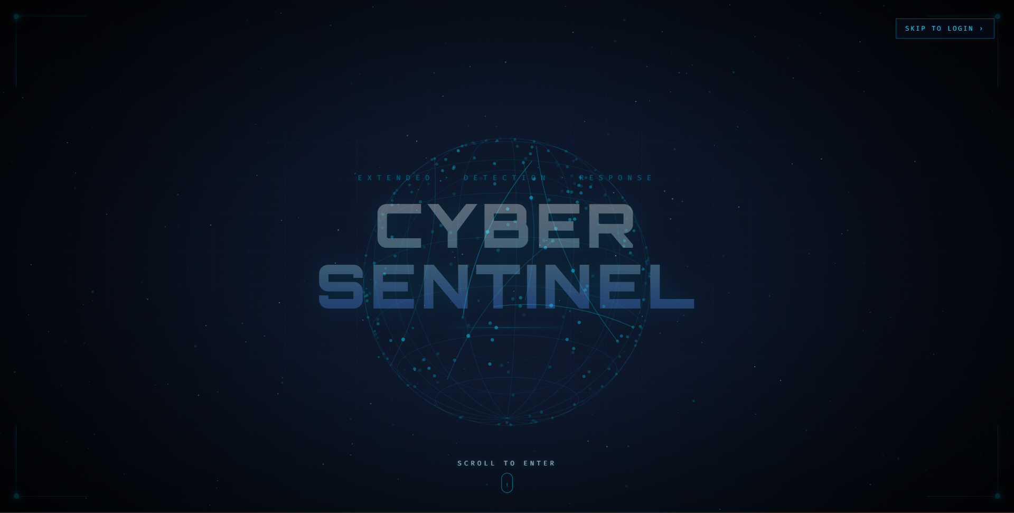
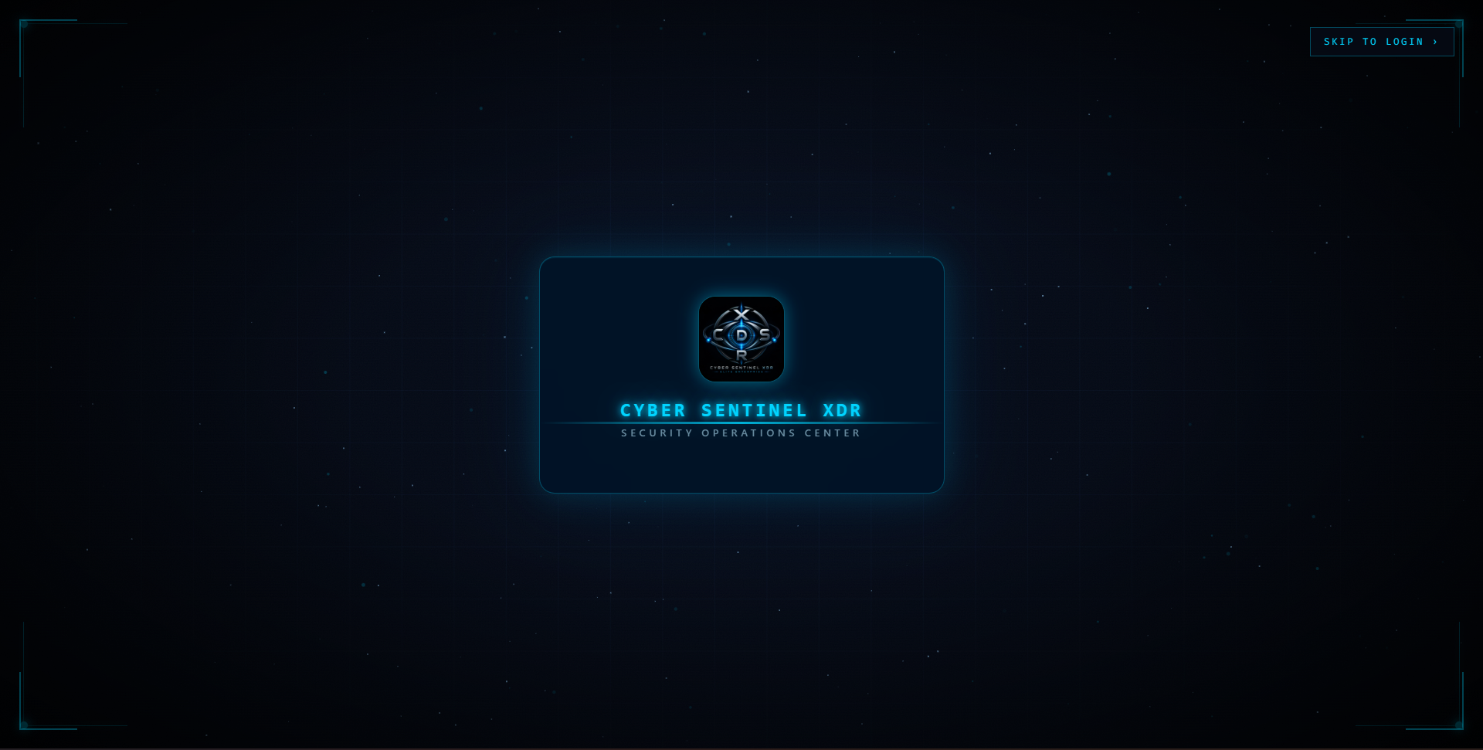
WALKTHROUGH · SCREENS 1–2
01 Cinematic Startup Sequence
02 Brand Reveal
Animated globe intro establishing the XDR brand before the analyst ever logs in.
CDSR shield logo and product identity card, transitioning into the login flow.
CYBER SENTINEL XDR

Slide 57
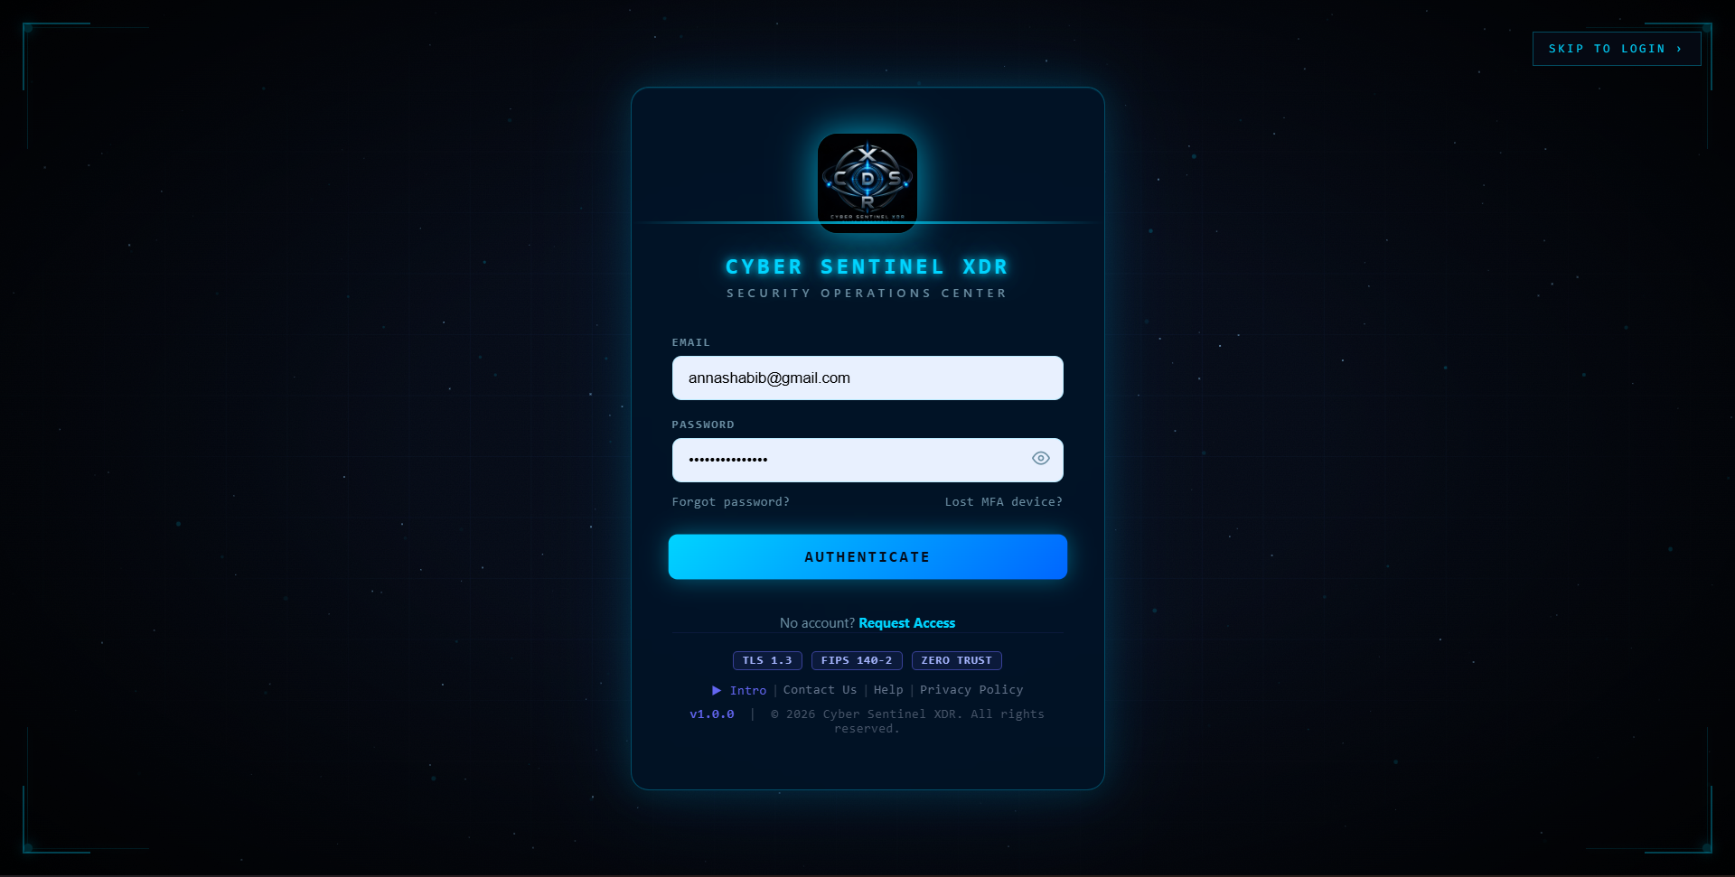
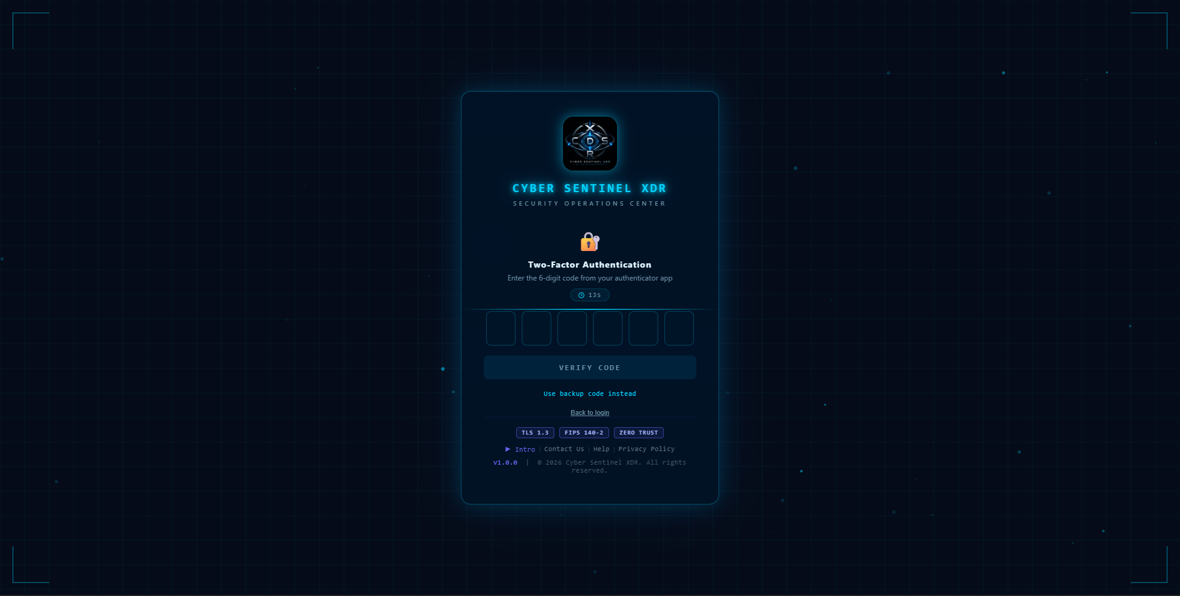
WALKTHROUGH · SCREENS 3–4
03 Secure Login
04 Two-Factor Authentication
Email/password gate with TLS 1.3, FIPS 140-2, and Zero Trust posture badges.
TOTP code entry with a live countdown and backup-code fallback.
CYBER SENTINEL XDR

Slide 58
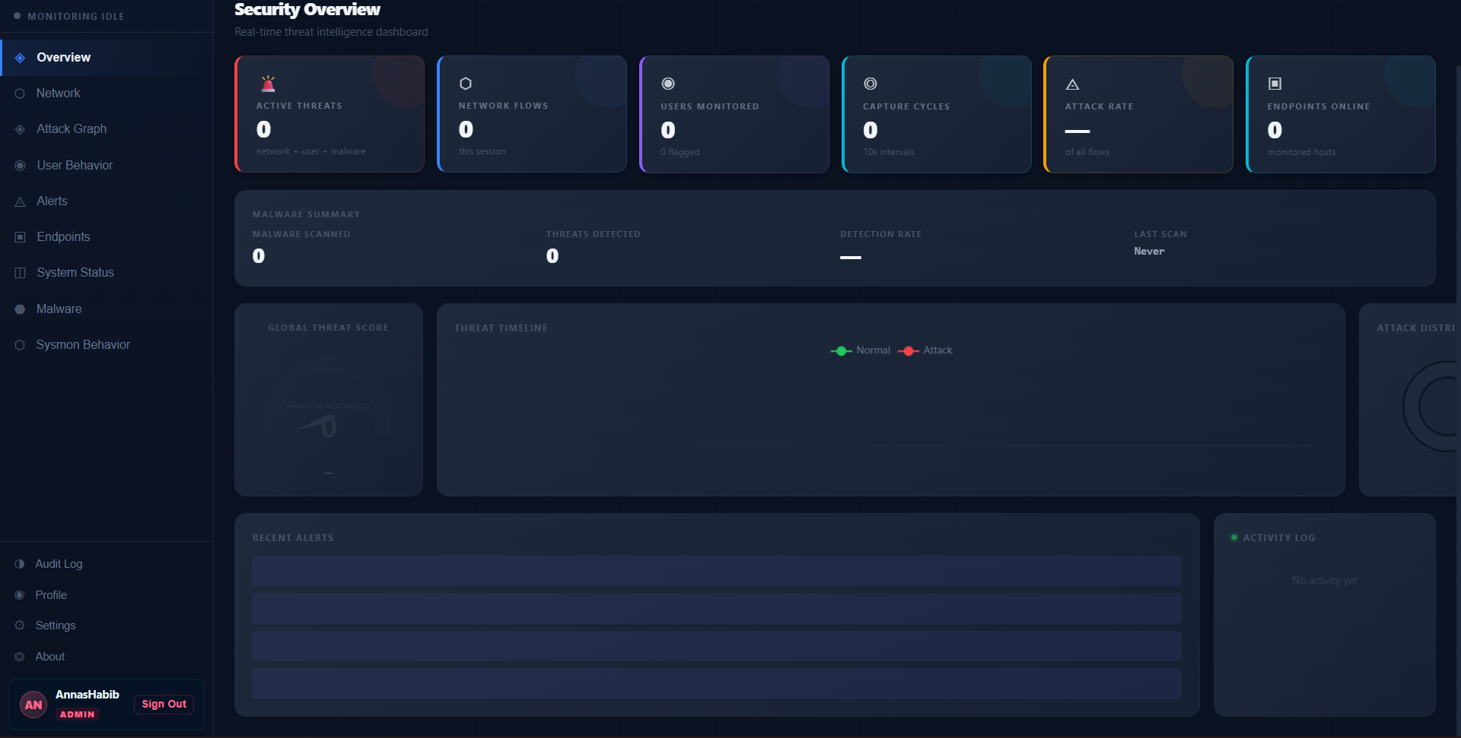
WALKTHROUGH · SCREENS 5–6
05 Security Overview — Idle State
06 Full Navigation Sidebar
Dashboard at rest before monitoring starts; every metric reads zero honestly.
All twelve views exposed, role-gated per the RBAC table (Admin shown here).
CYBER SENTINEL XDR

Slide 59
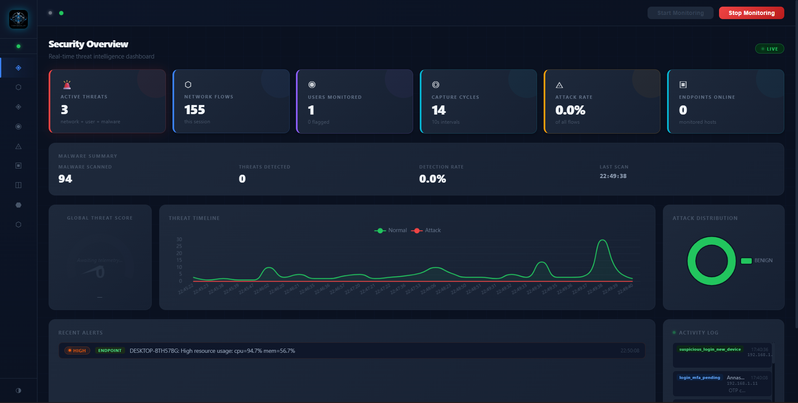
WALKTHROUGH · SCREENS 7–8
07 Live Monitoring — Real-Time Telemetry
Same dashboard seconds after Start Monitoring — real flows, real alerts, real threat timeline.
CYBER SENTINEL XDR

Slide 60
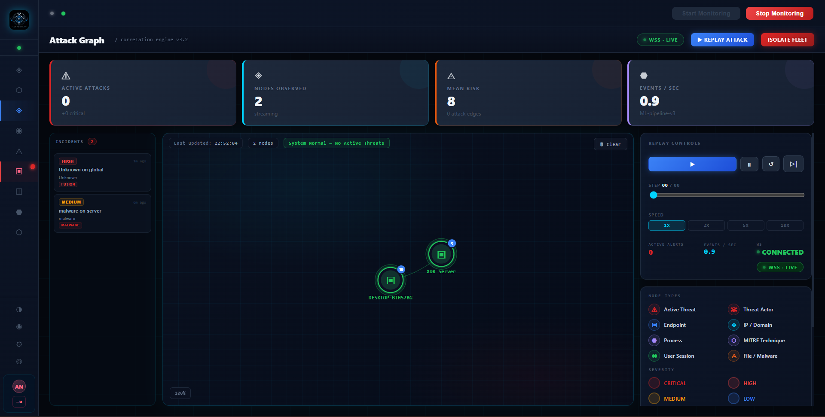
WALKTHROUGH · SCREENS 7–8
08 Attack Graph — Correlation Engine v3.2
Live force-graph linking an endpoint to the XDR server, with replay controls for past incidents.
CYBER SENTINEL XDR

Slide 61
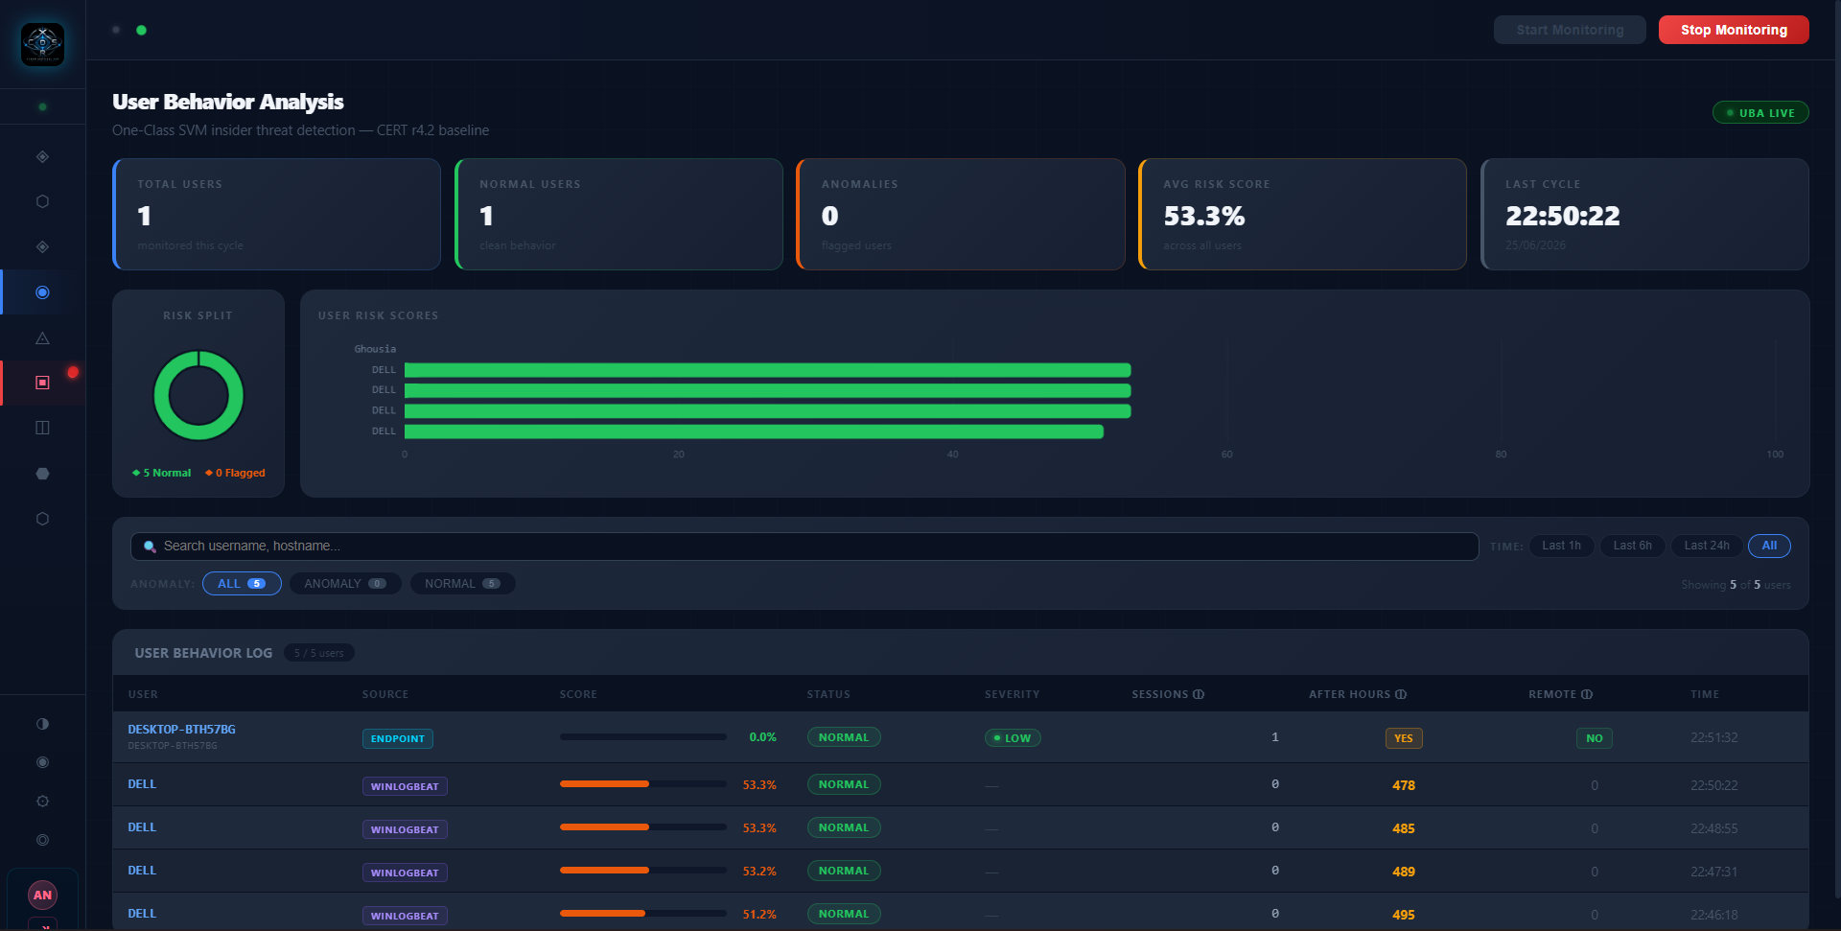
WALKTHROUGH · SCREENS 9–10
09 User Behavior Analysis
Per-user risk scoring against the CERT r4.2 baseline, with live Winlogbeat-fed sessions.
CYBER SENTINEL XDR

Slide 62
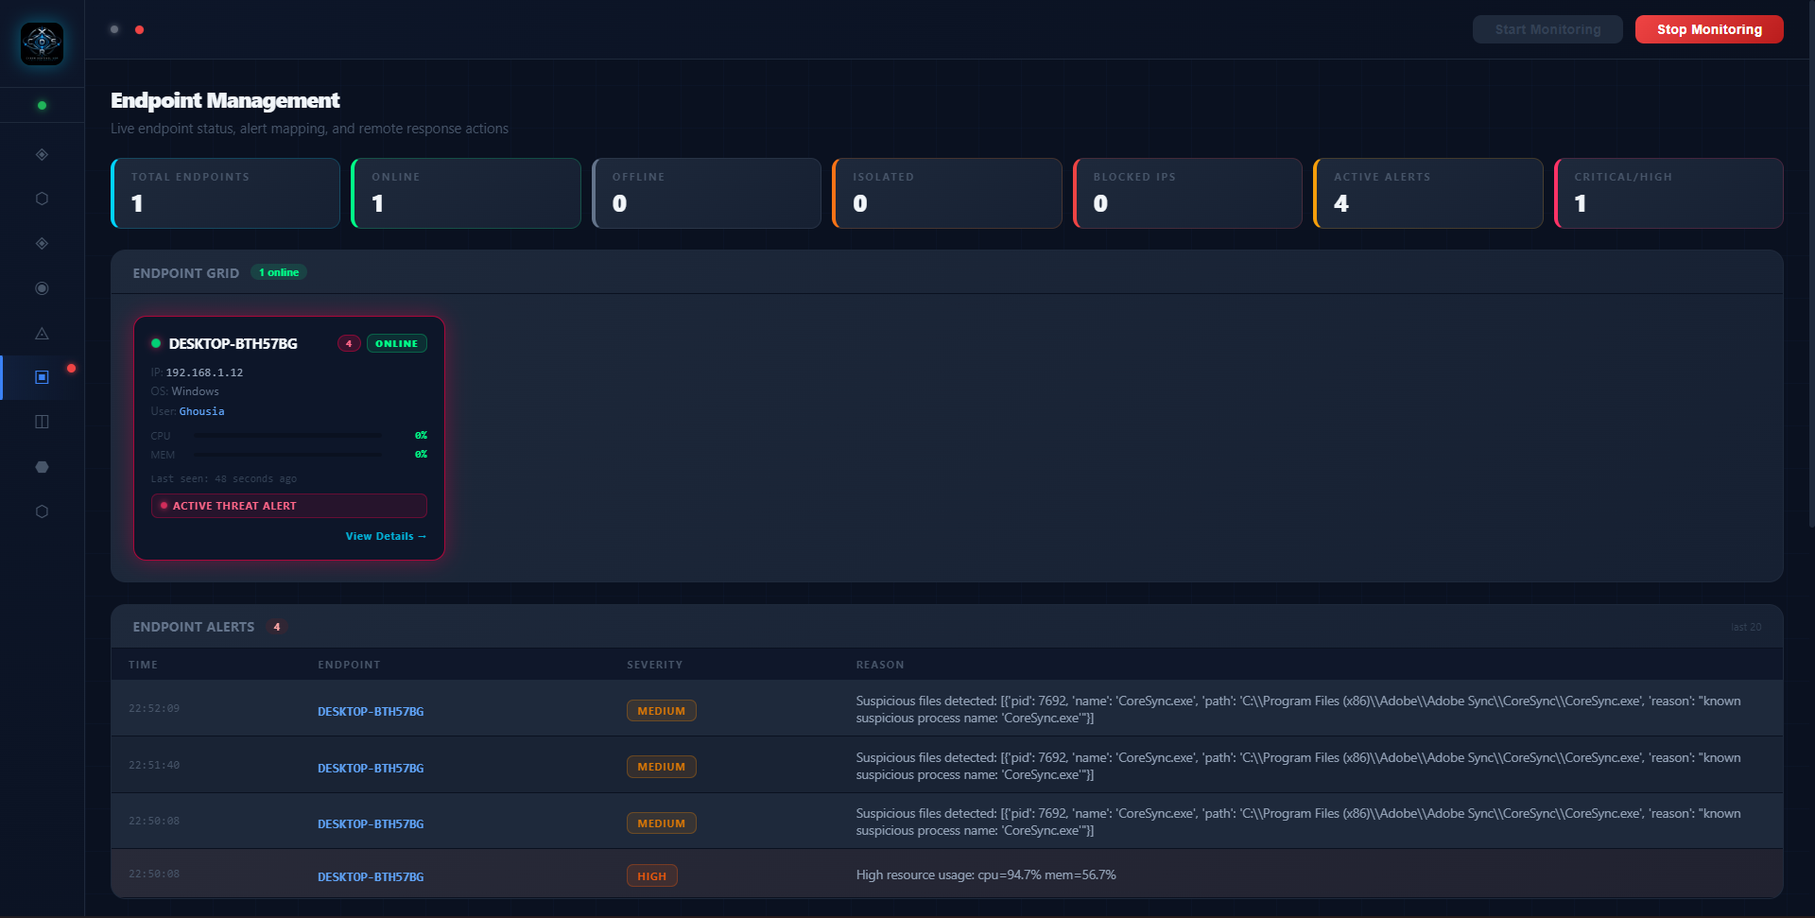
WALKTHROUGH · SCREENS 9–10
10 Endpoint Management
Fleet-wide online/offline status, isolation state, and a live active-threat alert.
CYBER SENTINEL XDR

Slide 63
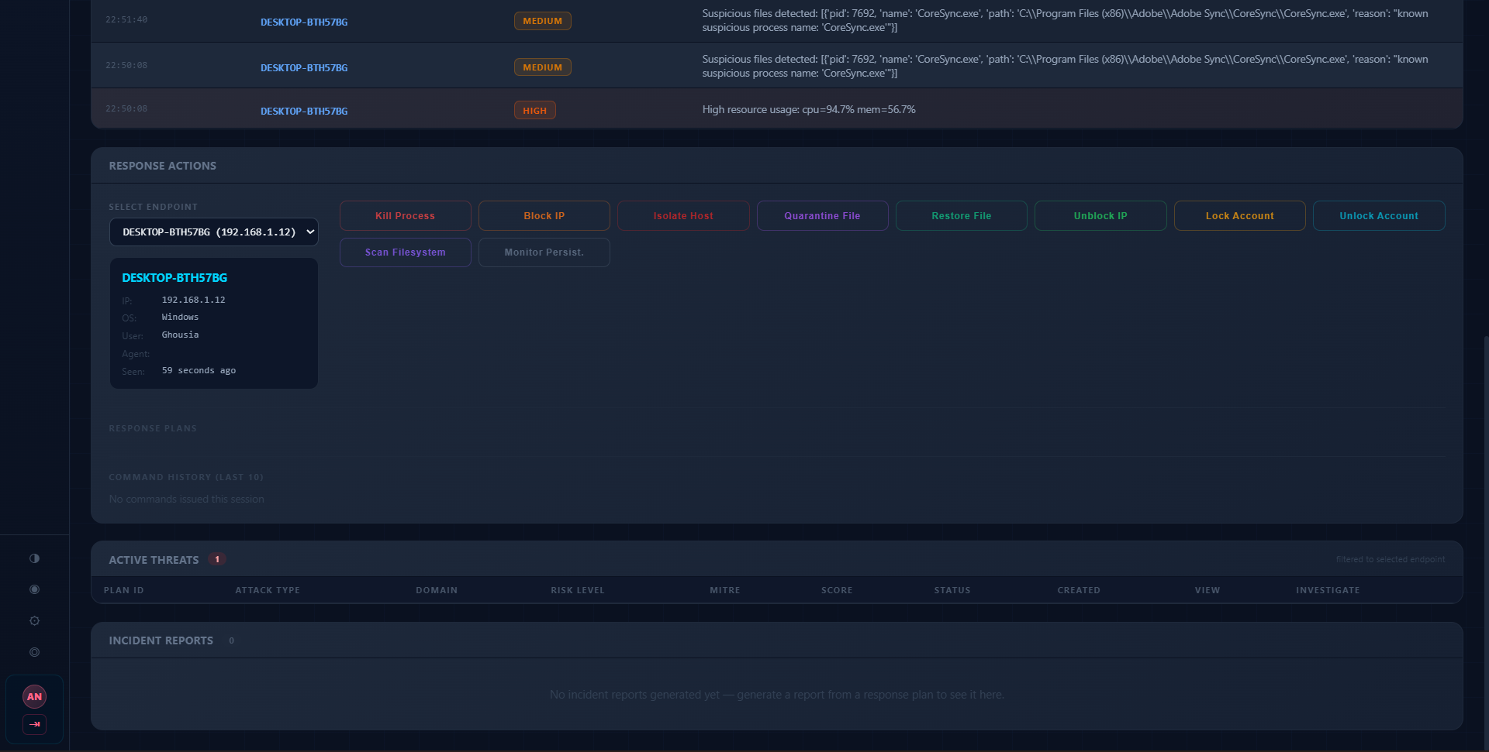
WALKTHROUGH · SCREENS 11–12
11 SOAR Response Actions
Nine executable response actions wired to the selected endpoint, from Kill Process to Monitor Persistence.
CYBER SENTINEL XDR

Slide 64
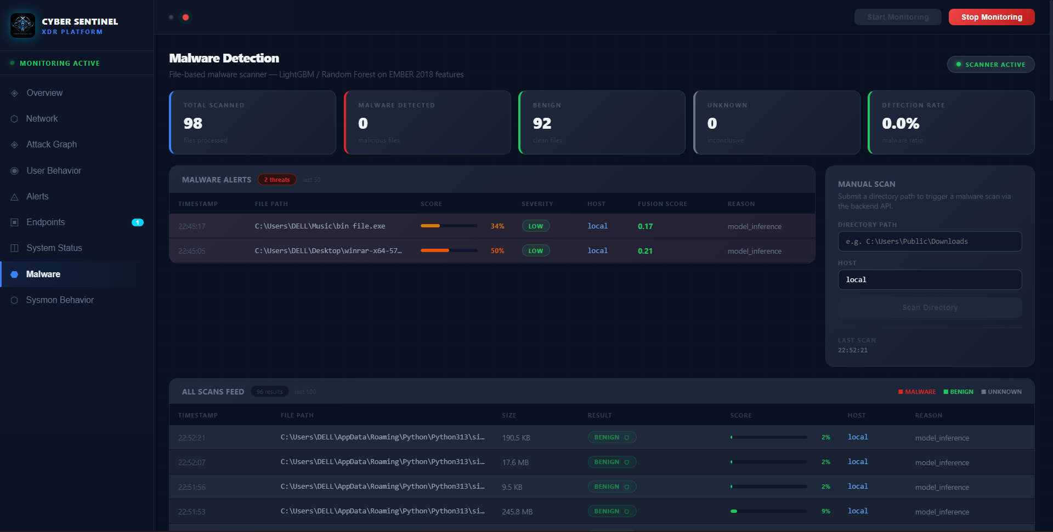
WALKTHROUGH · SCREENS 11–12
12 Malware Detection — LightGBM Scanner
On-demand and background file scanning with per-file confidence scores.
CYBER SENTINEL XDR

Slide 65
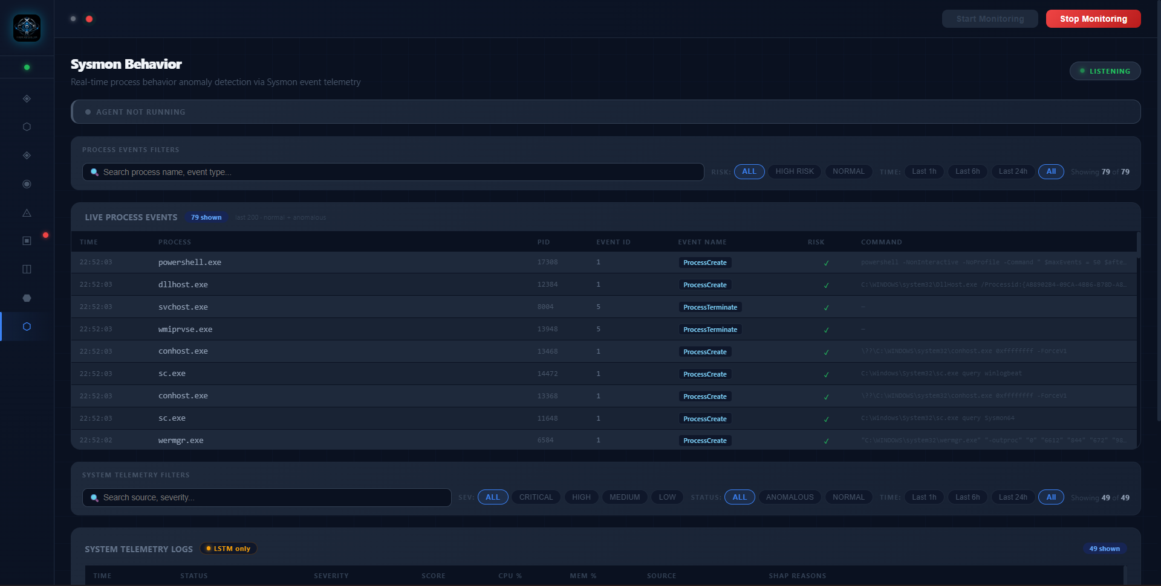
WALKTHROUGH · SCREENS 13–14
13 Sysmon Behavior — Process Telemetry
Live ProcessCreate/Terminate event stream with per-event risk flags.
CYBER SENTINEL XDR

Slide 66
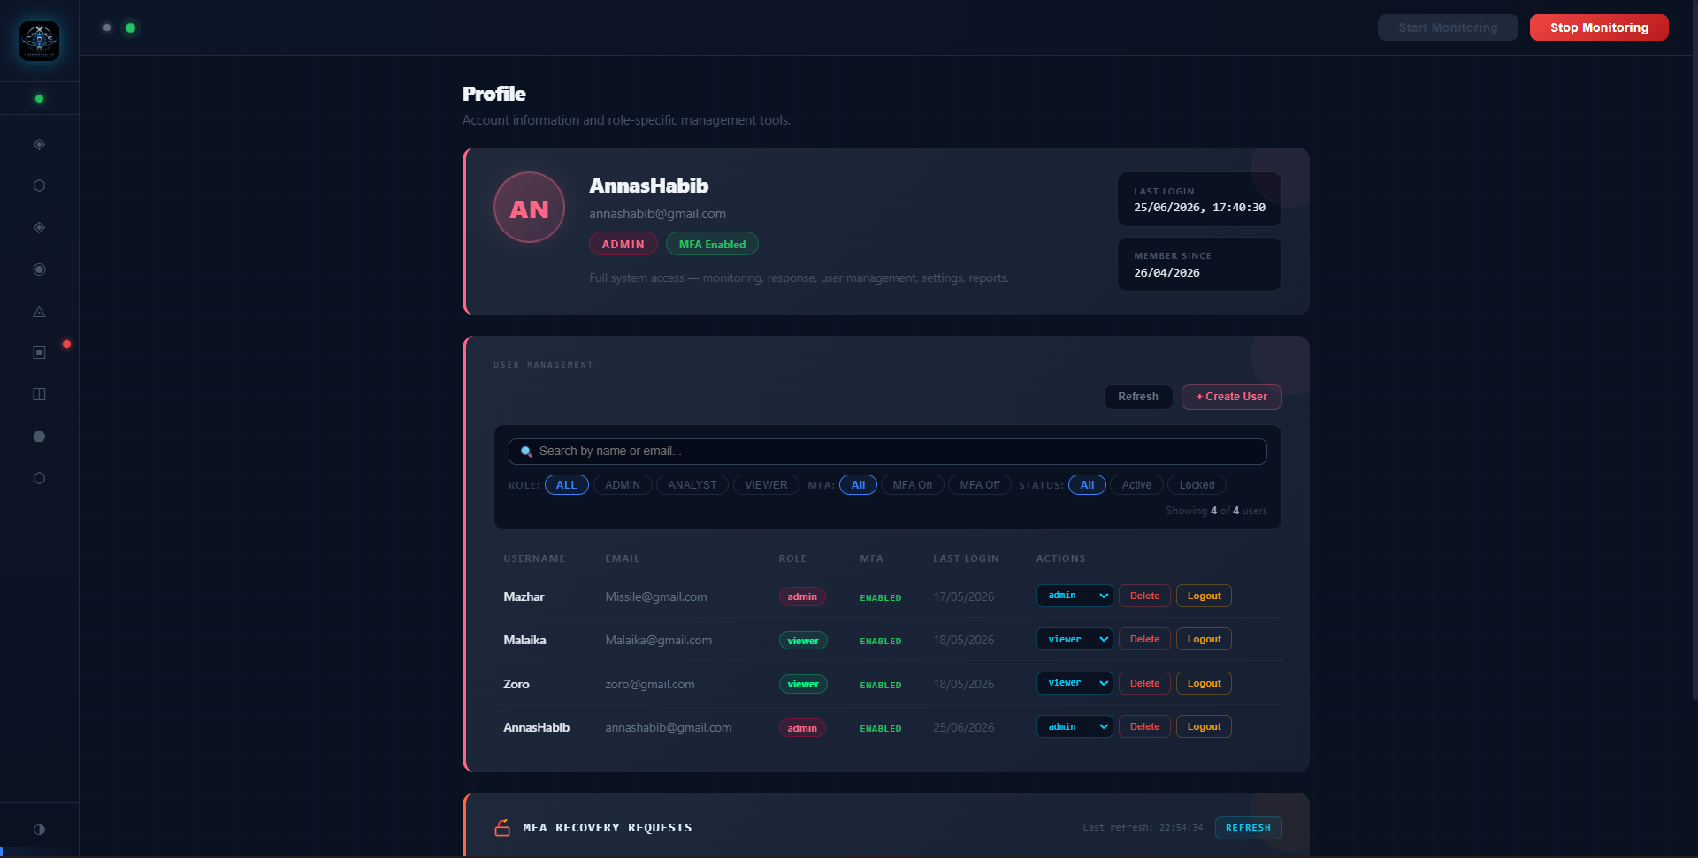
WALKTHROUGH · SCREENS 13–14
14 Profile & User Management
Admin-only role management, MFA status, and pending MFA recovery requests.
CYBER SENTINEL XDR

Slide 67
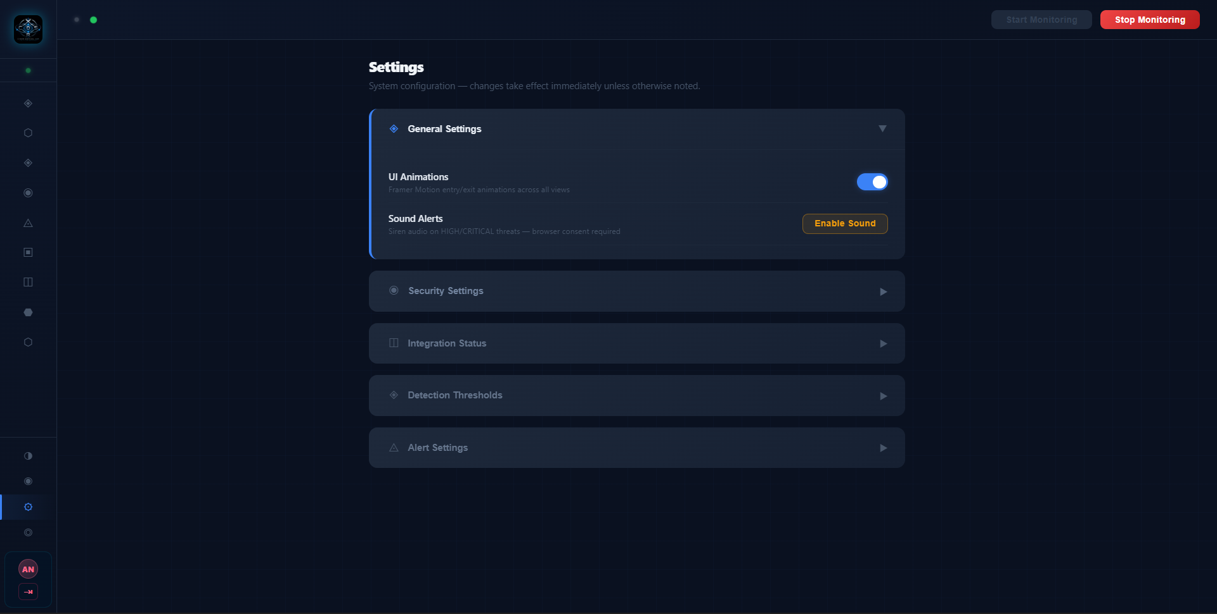
WALKTHROUGH · SCREENS 15–16
15 Settings — System Configuration
Toggleable UI, security, integration, and detection-threshold controls.
CYBER SENTINEL XDR

Slide 68
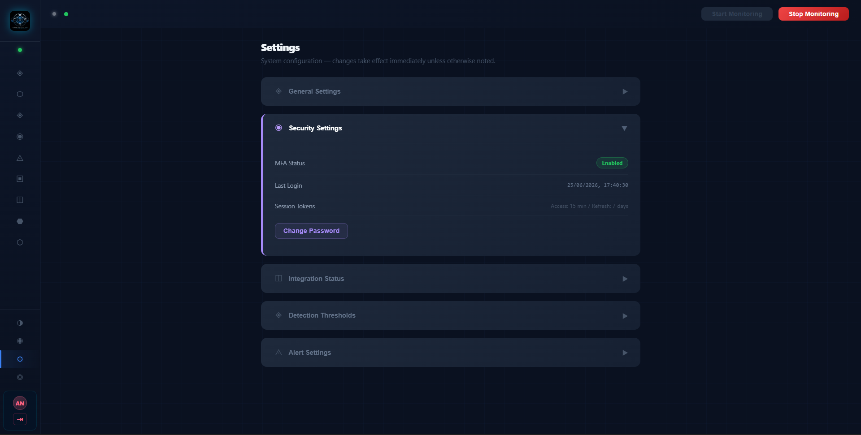
WALKTHROUGH · SCREENS 15–16
16 Security Settings
MFA status, session token lifetimes, and password rotation, all visible at a glance.
CYBER SENTINEL XDR

Slide 69
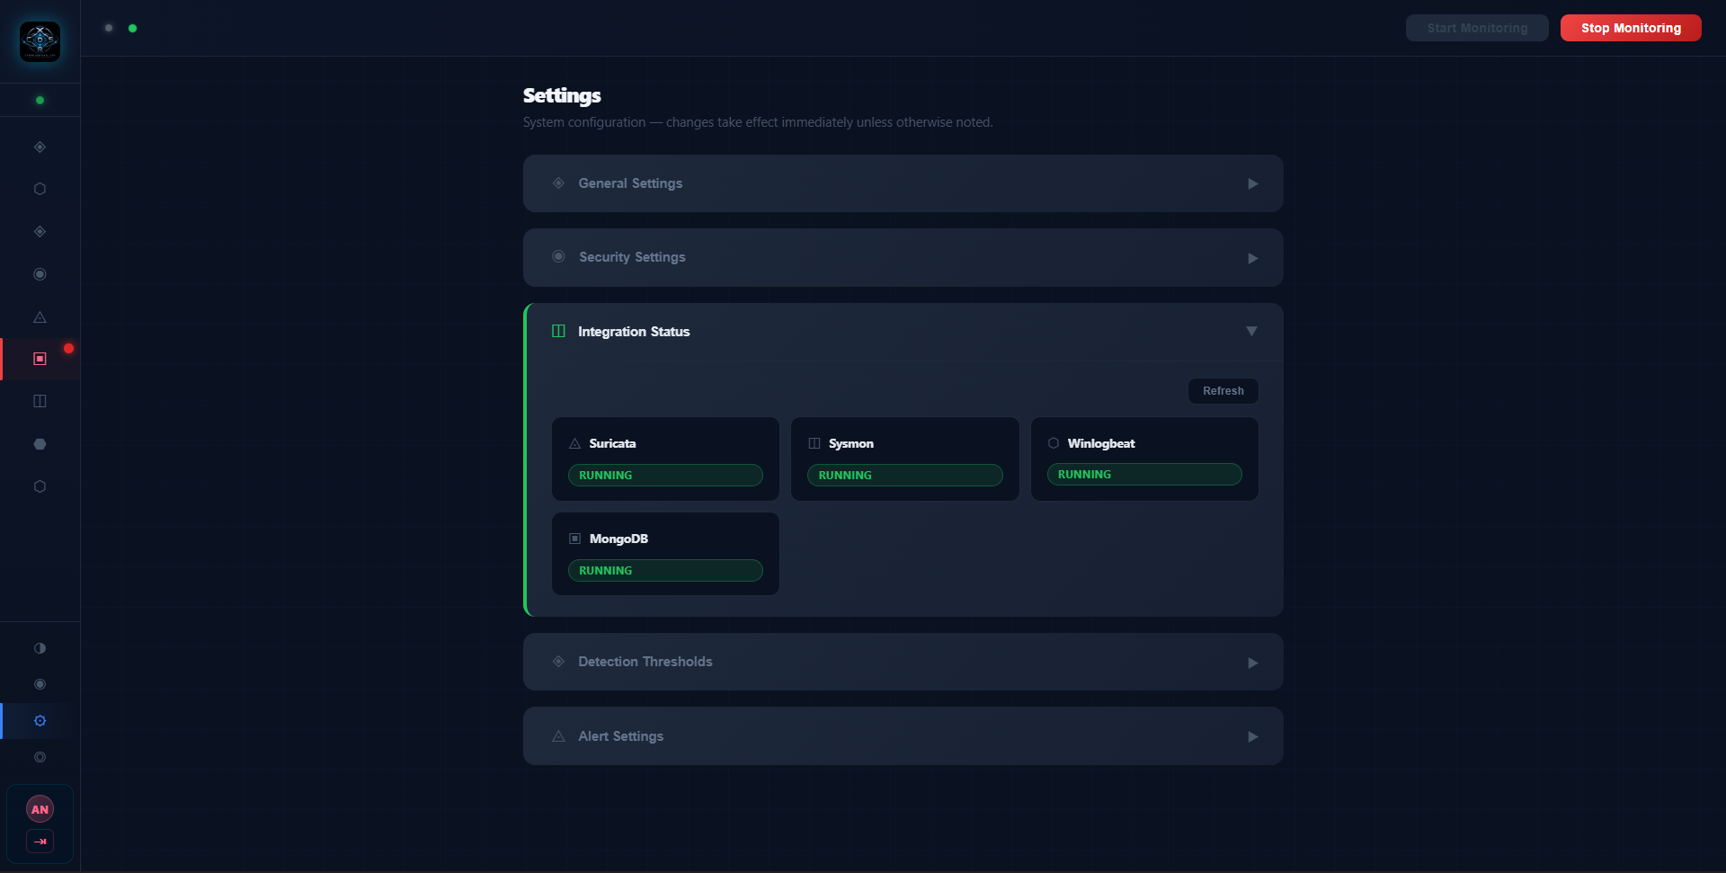
WALKTHROUGH · SCREENS 17–18
17 Integration Status
Live health checks confirm Suricata, Sysmon, Winlogbeat, and MongoDB are all running.
CYBER SENTINEL XDR

Slide 70
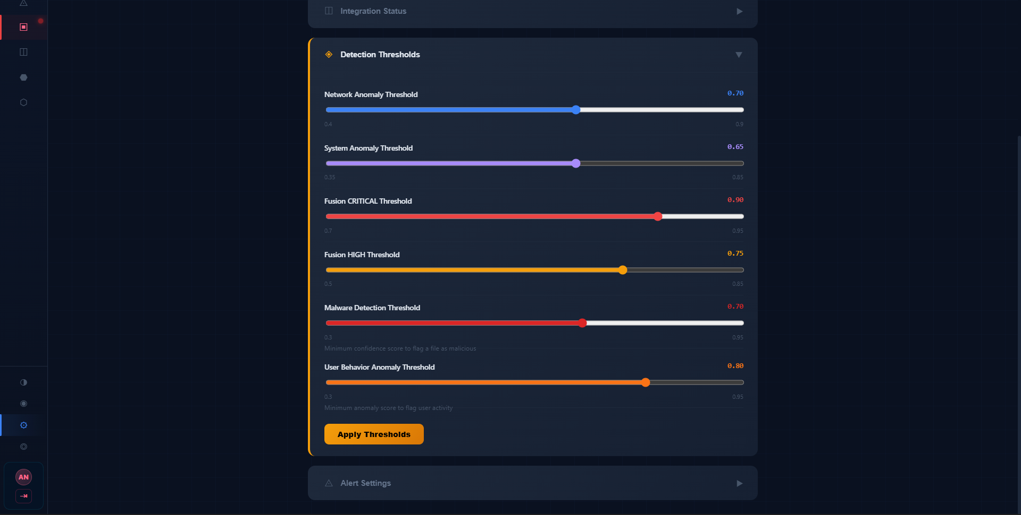
WALKTHROUGH · SCREENS 17–18
18 Detection Thresholds
Per-agent anomaly and fusion severity cutoffs, tunable live without a redeploy.
CYBER SENTINEL XDR

Slide 71
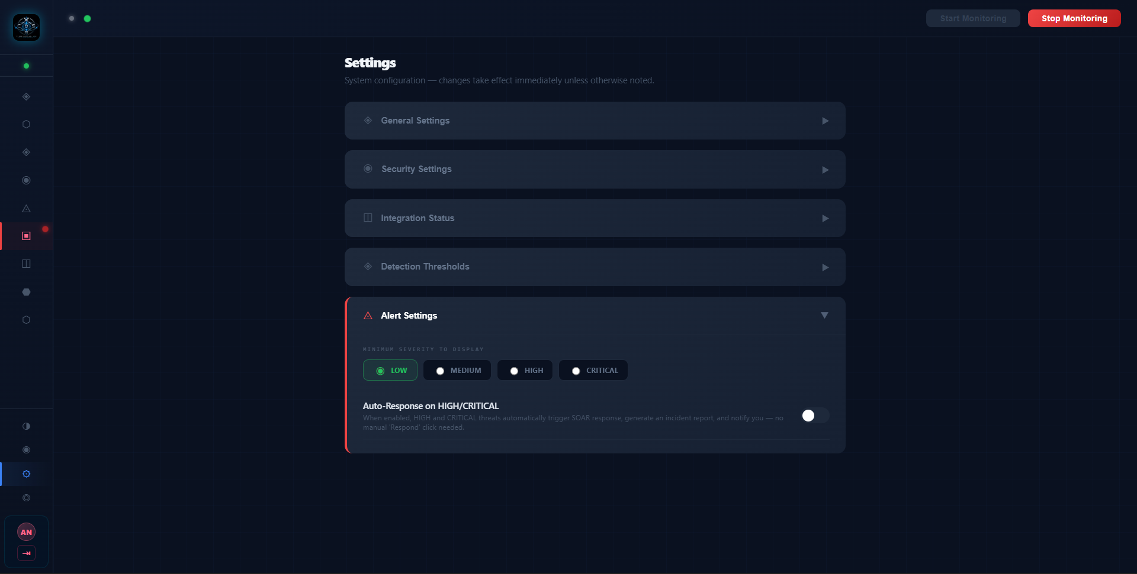
WALKTHROUGH · SCREENS 19–20
19 Alert Settings
Minimum severity filter and the auto-response toggle that gates CRITICAL-only SOAR execution.
CYBER SENTINEL XDR

Slide 72
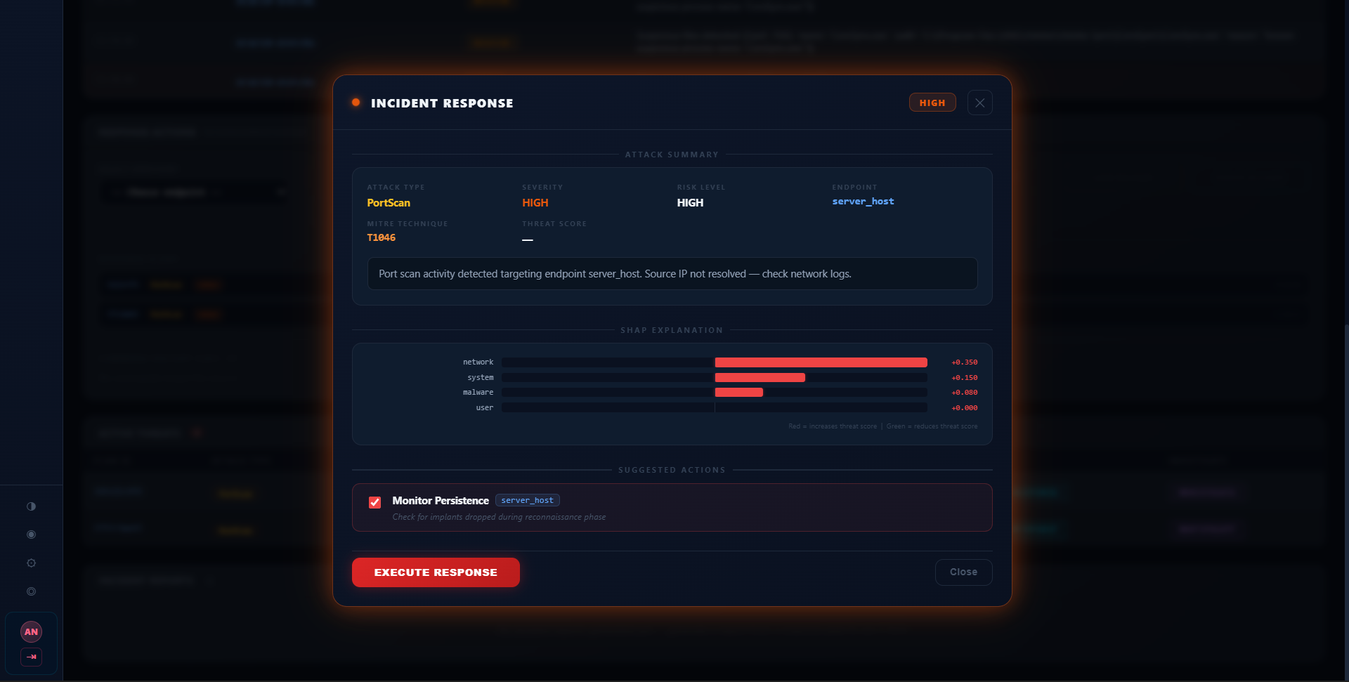
WALKTHROUGH · SCREENS 19–20
20 Incident Response — Attack Summary
A live PortScan/T1046 alert with its SHAP contribution breakdown, ready for analyst review.
CYBER SENTINEL XDR

Slide 73
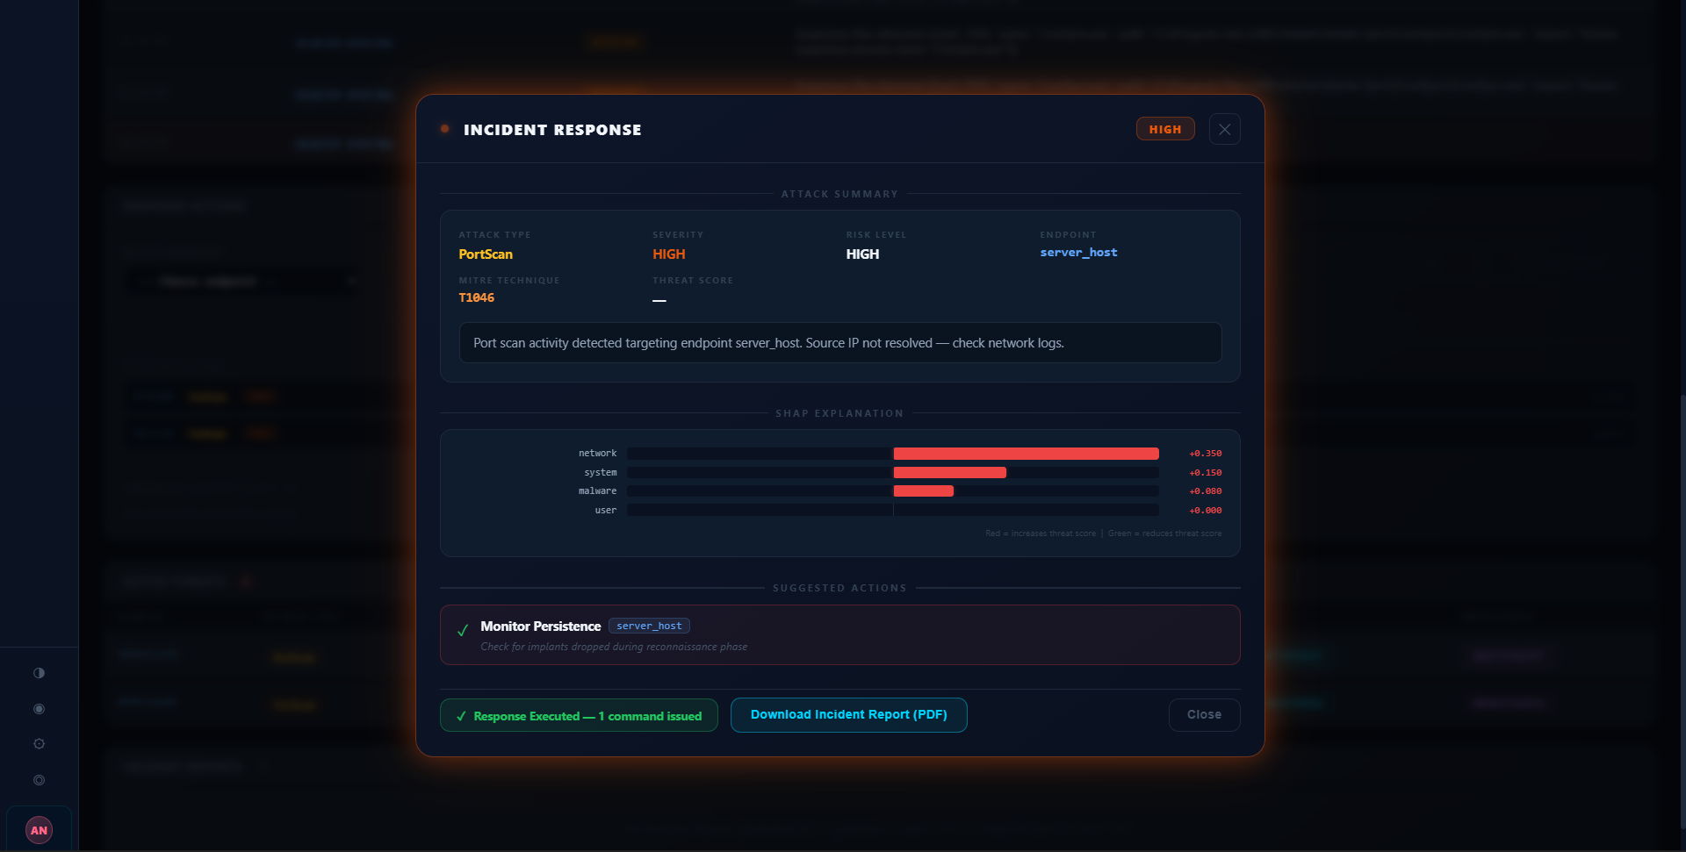
WALKTHROUGH · SCREENS 21–22
21 Response Executed
Monitor Persistence confirmed complete; the incident report is now ready to download.
CYBER SENTINEL XDR

Slide 74
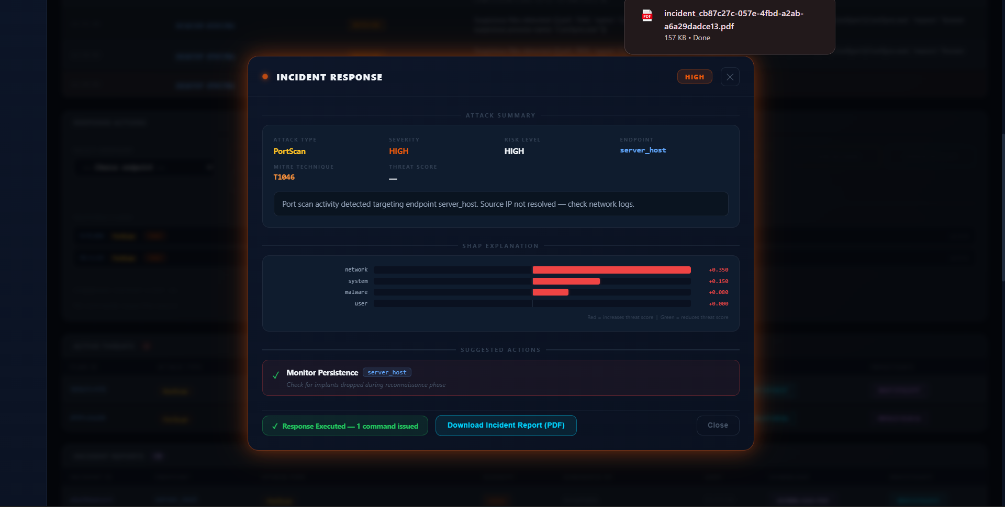
WALKTHROUGH · SCREENS 21–22
22 Incident Report Generated
The signed PDF lands directly in the browser's downloads tray.
CYBER SENTINEL XDR

Slide 75
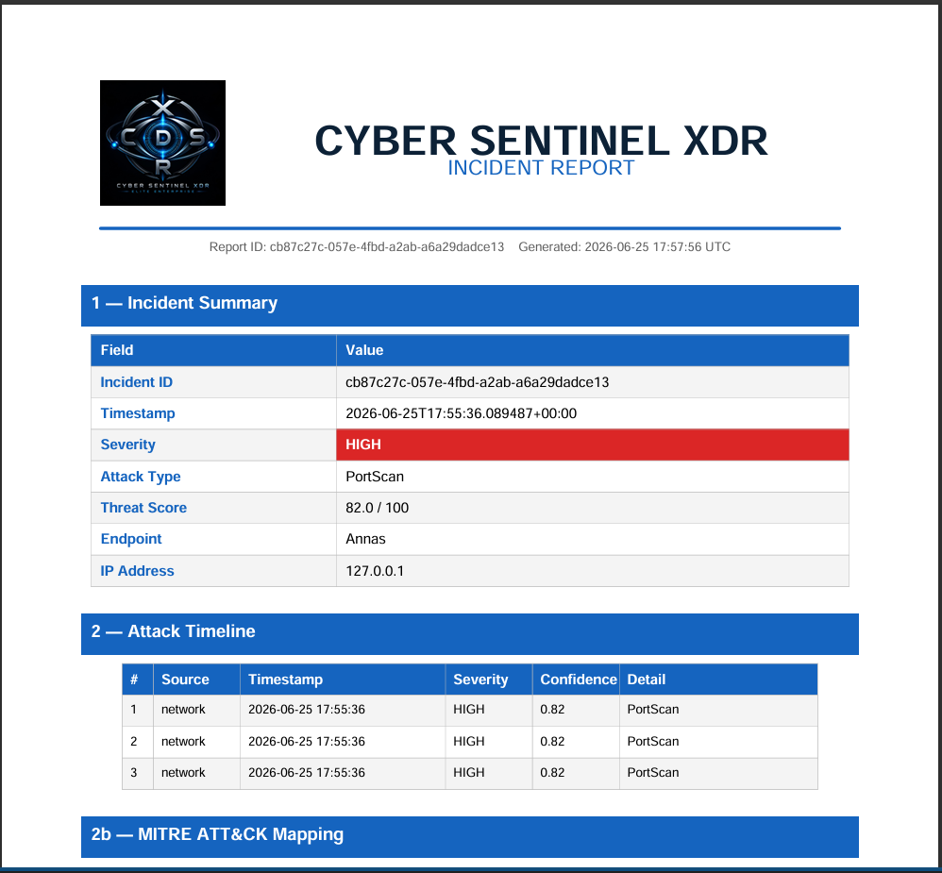
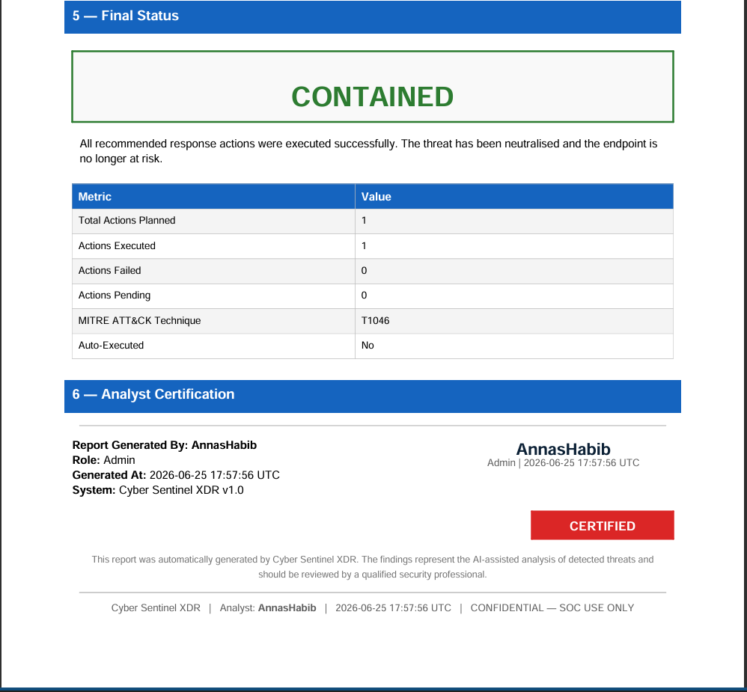
WALKTHROUGH · SCREENS 23–24
23 Incident Report — Page 1
24 Incident Report — Page 2
Incident summary and attack timeline, branded and ready for stakeholders.
Final containment status and analyst certification close out the report.
CYBER SENTINEL XDR

Slide 76
SECTION 09
Results & Comparison
What the system achieves end-to-end, and an honest account of where it currently falls short.
CYBER SENTINEL XDR · FINAL YEAR PROJECT DEFENSE

Slide 77
WHAT WORKS END-TO-END
System Capabilities — Verified
Enterprise authentication & self-service recovery
Fusion engine produces stable severity bands
SHAP explanation on every CRITICAL/HIGH alert
JWT + TOTP two-factor login, bcrypt-12 hashing, rate-limited lockouts, and a full MFA-gated account recovery flow — verified end-to-end in the live login and recovery screens.
LOW/MEDIUM/HIGH/CRITICAL thresholds (0.50/0.70/0.85) hold consistently across single-domain and correlated multi-domain test scenarios.
Verified in the live Incident Response modal — network/system/malware/user contribution breakdown shown per alert, not just an opaque score.
SOAR auto-response on CRITICAL severity
End-to-end PDF incident reporting
Role-based access control
isolate_host, block_ip, kill_process, and quarantine_file confirmed executing via the endpoint agent and logged in command history.
Verified: a real PortScan/T1046 alert produced a downloadable, two-page signed incident report with MITRE mapping and final containment status.
Admin / Analyst / Viewer roles verified functioning in the live Profile & User Management screen with per-user MFA status.
CYBER SENTINEL XDR
49

Slide 78
SECTION 10
Future Work
Summary, what we'd do differently, and where this project goes next.
CYBER SENTINEL XDR · FINAL YEAR PROJECT DEFENSE

Slide 79
ROADMAP
Future Work
01
02
03
Event-streaming ingestion via Kafka
Containerized, Kubernetes-orchestrated deployment
Threat intelligence feed integration
Replace the synchronous FastAPI fan-out with a Kafka event bus, so each agent consumes its own topic independently and telemetry can be replayed for retraining.
Package the backend, four agents, and frontend as Docker containers behind Kubernetes, scaling elastically across hundreds of endpoints instead of one server process.
Enrich detections with external IOC context from MISP, VirusTotal, and AlienVault OTX, instead of relying solely on internally trained models.
04
05
06
Long-term analytics data lake
Cloud and multi-cloud endpoint support
SOAR ecosystem integrations
Move historical telemetry out of MongoDB's capped collections into Elasticsearch or ClickHouse for trend analysis beyond the current rolling windows.
Extend agents beyond on-prem Windows hosts to AWS / Azure / GCP workloads, broadening XDR coverage to hybrid infrastructure.
Push response plans and incident reports into Jira, ServiceNow, and Slack, so containment fits into existing SOC ticketing workflows.
CYBER SENTINEL XDR
53

Slide 80

CS
DEPT
CYBER SENTINEL XDR
AI-Powered Multi-Agent Extended Detection & Response System
Annas Habib | Syed Mazhar Hussain Shah | Malaika Rashid Supervisor: Dr. Syed Nasir Shah
INTRODUCTION / PROBLEM STATEMENT
TELEMETRY INGEST — Endpoint & Server Feeds (5-second cycle)
RESULTS / OUTCOMES
Background Modern cyber attacks operate across multiple domains simultaneously. An attacker conducts network reconnaissance, spawns malicious processes, abuses stolen credentials, and deploys malware — all as coordinated steps of a single intrusion. The Problem Existing tools — SIEM, EDR, NDR — each monitor only one domain, forcing SOC analysts to correlate across 3+ unconnected dashboards. This creates:
277 days average breach dwell time (IBM, 2023)
$4.45M average breach cost (IBM Cost of Data Breach, 2023)
68% of breaches involve a human element (Verizon DBIR, 2023)
Analyst fatigue from manually correlating 3+ unconnected tools per incident
NETWORK
DETECTION
IsolationForest
→ RandomForest
CIC-IDS2017
2.8M flows | 63 features
Accuracy: 94.25%
ROC-AUC: 0.9862
Precision: 98.86%
Recall: 86.05%
USER
BEHAVIOR
IsolationForest
CERT Insider Threat r4.2
330,452 user-days | 19 features
ROC-AUC: 0.8302
Threshold: 0.50
Signal: Confirmed
Class imbalance: ~0.4%
Network Detection — RandomForest (CIC-IDS2017)
SYSTEM
MONITOR
LSTM Autoencoder+TF-IDF → IF → XGBoost
GHC Call Traces
ADFA-WD validation | 12 classes
ROC-AUC: 0.7344
12 attack classes
Dual path: max
(LSTM,
DETECTOR1)
MALWARE
ANALYSIS
LightGBM (binary)
+ 22-rule IOC heuristic
EMBER 2018
280-dim PE vector | 15,000 files
Accuracy: 93.37%
ROC-AUC: 0.9841
Precision: 91.46%
Recall: 95.64%
94.25% Accuracy
0.9862 ROC-AUC
98.86% Precision
86.05% Recall
Malware Analysis — LightGBM (EMBER 2018)
93.37% Accuracy
0.9841 ROC-AUC
91.46% Precision
95.64% Recall
User Behavior — IsolationForest (CERT r4.2)
FUSION ENGINE Score = 0.35·Network + 0.30·User + 0.15·System + 0.20·Malware
0.8302 ROC-AUC
330,452 User-days
74.2% Precision
68.9% Recall
MOTIVATION & SIGNIFICANCE
SHAP EXPLAINABILITY — Feature Attribution per Agent on Every Alert
System Monitor — DETECTOR1 (ADFA-WD)
XDR (Extended Detection & Response) solves this by unifying cross-domain telemetry. Cyber Sentinel XDR takes this further: each of the four agents is independently trained on its own domain-specific dataset, making their failure modes statistically uncorrelated. A real multi-stage intrusion necessarily crosses domains and triggers multiple agents. Coincidental false positives in two unrelated models simultaneously are exponentially less likely — this is the statistical basis for the system's false-positive suppression without sacrificing recall on real attacks.
SOAR RESPONSE — 10 Automated Actions | MITRE ATT&CK Mapped
0.7344 ROC-AUC
12 Attack types
max(dual) Fusion
ADFA-WD Validation
TRAINING DATASETS
ROC-AUC COMPARISON
Agent | Dataset | Size & Scope | Core Algorithm
Network Detection | CIC-IDS2017 | 2.8M flows | 63 features (trained) | RandomForest (200 trees, max_depth=20)
User Behavior | CERT Insider Threat r4.2 | 330,452 user-days | 19 features | IsolationForest (contamination=0.001)
System Monitor | GHC Traces / ADFA-WD | 12 attack classes | n-gram 1–3 TF-IDF | TF-IDF → IsolationForest → XGBoost
Malware Analysis | EMBER 2018 | 15,000 PE files | 280-dim vector | LightGBM (binary classifier)
OBJECTIVES
Train four independently-specialized AI/ML models on domain-specific, publicly available threat datasets
Build a weighted fusion engine correlating cross-domain signals into one unified 0–1 threat score
Attach SHAP-based feature attribution to every generated alert for SOC analyst interpretability
Implement a SOAR response layer with 10 automated actions mapped to MITRE ATT&CK techniques
Deliver a real-time, role-aware SOC dashboard (Admin / Analyst / Viewer) with live fleet-wide monitoring
CONCLUSION
TECHNOLOGY STACK
Cyber Sentinel XDR demonstrates that four independently-trained ML models — one per telemetry domain — can be fused into a single explainable, actionable threat score with fully automated MITRE-mapped response at CRITICAL severity. Key Contributions
First FYP-scale XDR system at IST covering Network, User, System & Malware simultaneously in one platform
Cross-domain correlation gate requiring ≥2 independent agents to agree before CRITICAL escalation, statistically suppressing correlated false positives
SHAP-attached alerts providing human-readable reasoning on every HIGH/CRITICAL alert for SOC analysts
End-to-end SOAR pipeline verified from live telemetry ingest to downloadable, signed PDF incident report
Role-based SOC dashboard with live threat monitoring, 2FA, and MFA-gated account recovery
FastAPI Backend API
React.js SOC Dashboard
Python/scikit-learn ML Training
MongoDB Data Storage
Suricata / Sysmon Sensors
Winlogbeat Event Logs
Socket.IO Real-time Alerts
SHAP / LightGBM Explainability
METHODOLOGY / SYSTEM DESIGN
MITRE ATT&CK COVERAGE
T1486
Ransomware Activity (Malware + System) → isolate_host + quarantine_file + restore_file
A five-layer, agent-based XDR architecture. All four AI agents run concurrently on every 5-second telemetry cycle from each monitored endpoint, independently, then fused into a single threat score.
T1071
C2 Beaconing (Network + System) → block_ip + isolate_host
T1068
Privilege Escalation (User + System) → lock_account + kill_process + monitor_persistence
T1021
Lateral Movement (Network + User) → isolate_host + block_ip
T1110
Brute Force (Network Agent) → lock_account + block_ip
Department of Computer Science • Institute of Space Technology, Islamabad

Slide 81
References & Acknowledgments
Academic & Industry Sources
Datasets & Core Algorithms
Additional Resources
[1] Olteanu I.C., “Evaluating the response effectiveness of XDR technology” (TU/e).
[2] “XDR: The Evolution of Endpoint Security Solutions,” ResearchGate.
[3] “The Rise of Extended Detection and Response,” S&P Global (whitepaper).
[4] CICIDS2017 dataset (UNB) — training data for intrusion detection.
[5] NCCS — National Centre for Cyber Security (NED University).
[6] Sharafaldin, Lashkari & Ghorbani, “Toward Generating a New Intrusion Detection Dataset and Intrusion Traffic Characterization,” ICISSP, 2018.
[7] Glasser & Lindauer, “Bridging the Gap: A Pragmatic Approach to Generating Insider Threat Data,” IEEE S&P Workshops, 2013.
[8] Anderson & Roth, “EMBER: An Open Dataset for Training Static PE Malware ML Models,” arXiv:1804.04637, 2018.
[9] Liu, Ting & Zhou, “Isolation Forest,” IEEE ICDM, 2008.
[10] Ke et al., “LightGBM: A Highly Efficient Gradient Boosting Decision Tree,” NeurIPS, 2017.
[11] Lundberg & Lee, “A Unified Approach to Interpreting Model Predictions” (SHAP), NeurIPS, 2017.
[12] MITRE Corporation, “MITRE ATT&CK Framework,” attack.mitre.org.
[13] “Cyber Security Challenges in Pakistan: An Assessment” — Research Article.
[14] Gartner, “Innovation Insight for Extended Detection and Response (XDR)” (industry report).
Acknowledgments
We would like to thank our supervisor, Dr. Syed Nasir Shah and Ma’am Sehrish, for their invaluable guidance and support throughout this project.

Slide 82
Thank You
Thanks To All Of You For Your Valuable Time And Attention
CYBER SENTINEL XDR
Supervisor: Prof. Dr. Syed Nasir Mehmood Shah
Annas Habib · Syed Mazhar Hussain Shah · Malaika Rashid
Institute of Space Technology, Islamabad

