Slide 1

Earth Integrated Heating and Cooling System
CP301
Group 04
Amit Bhuradia 2019chb1037
Anchal Gupta 2019chb1038
Arpita Singh 2019chb1042
Manasi Sardesai 2019chb1048
M. Mazhar Laljee 2019chb1051
Course Instructors
Dr. Navin Gopinathan
Dr. Sarang Gumphekar

Slide 2
Introduction
Excessive greenhouse gas emission is a serious concern worldwide, hence alternatives to existing HVAC technologies are needed.
Ground coupled heat exchangers exchange energy with the ground for heating and cooling purposes.
Extensive research on increasing the performance and reducing emissions from the same is being done.
GCHE systems are highly energy-efficient, environmentally friendly, easy to control, noise-free, cost-effective, provide good thermal comfort.
In this study we modeled two GCHE technologies namely earth air heat exchanger (EAHE) and ground source heat pump (GSHP) for a two storey building in New Delhi.
Notes:
Underground heat exchangers (geothermal based) that exchange energy with the ground for heating and cooling purposes are called Ground Coupled Heat Exchangers (GCHEs). The ground, whose temperature is relatively constant throughout the year, acts as a heat source in winters and as a heat sink in summers.

Slide 3
Objectives
In this project we propose environment friendly methods for heating and cooling of houses in winters and summers respectively using GCHE technology.
We intend to develop two: systems EAHE (Earth Air Heat Exchanger) and GSHP (Ground source heat pump), and compare them.
Our main aim is to build an efficient system that can be used during extreme climatic conditions in India while keeping cost in mind.
Specifically, we are proposing this model for a two storey residential building in New Delhi occupied by 4 people.
The area of each storey is 300 sq ft, giving the total area of the building as 600 sq ft.
Notes:
Due to climate change and rise in global temperatures, it has become important to ensure indoor thermal comfort.

Slide 4
Work Done
Design builder simulation to estimate heating and cooling loads
Deriving heat transfer governing equations
GCHE systems
EAHC systems
GSHP systems

Slide 5
Work Done: EAHE System
EAHE systems
Checking the derived equation accuracy
Calculating the building’s ventilation requirement
Air filter and tube material selection
Developing air density, viscosity, & temperature correlations
Deciding system configurations
Calculating outlet temperature, heat duty, COP, effectiveness, and plotting
Pressure drop calculations
Cost analysis

Slide 6

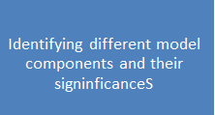



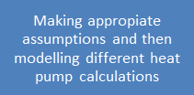



Work Done: GSHP System

Slide 7
Results & Discussion

Slide 8
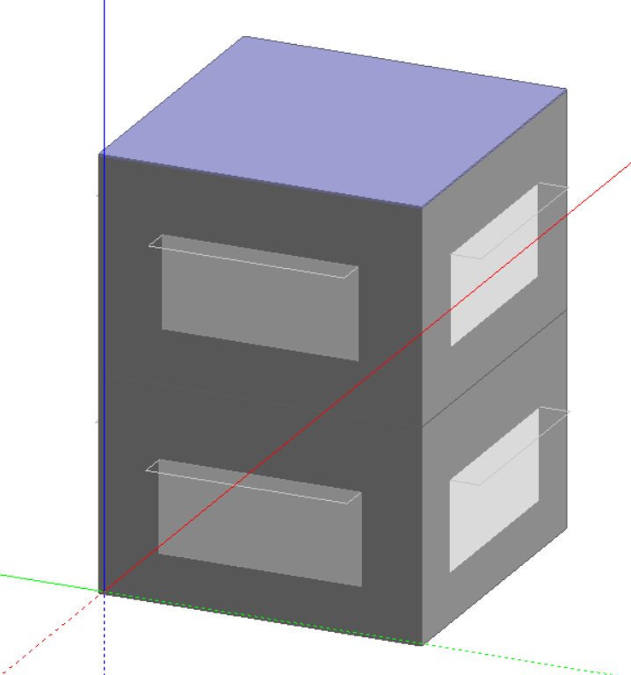
Determining Heating and Cooling Loads
Fig 1. : Target Building Mockup

Slide 9
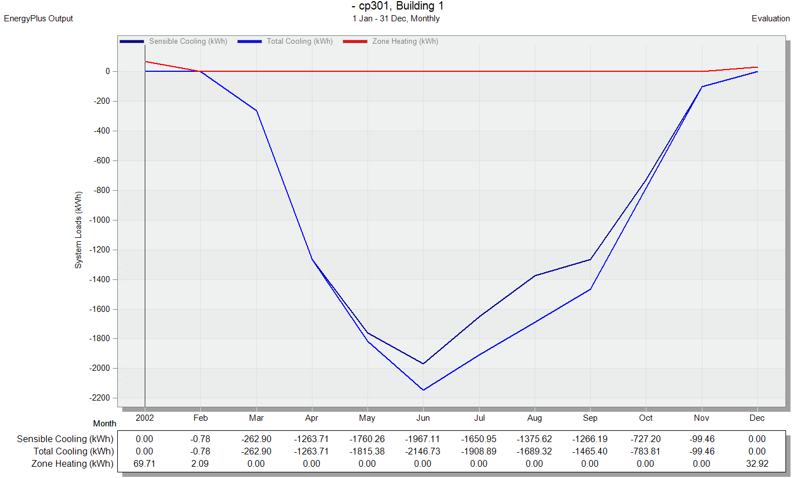
Determining Heating and Cooling Loads
Fig 2. : Heating and Cooling Loads

Slide 10


Heat Transfer Governing Equation
Ground
dx
CV
T_{w}
Ground
T
T + dT
Fig. 3: Pipe Section
Assumptions:
Steady state
Uniform flow
Constant earth temperature
Temperature of pipe wall equals earth temperature
Resistance is only due to air convection
Energy balance:
Upon solving:

Slide 11
EAHE System

Slide 12
Accuracy of Derived Equation: Ajmer Case Study
Pipe dimensions: diameter = 0.15 m, length = 23.42 m
Heat transfer coefficient = 2.8 + 3v**
January: inlet air temperature = 20.6 ºC, earth temperature = 26 ºC (heating)
March: inlet air temperature = 43.7 ºC, earth temperature = 30 ºC
 | 2 m/s | 3.2 m/s | 4 m/s | 5 m/s
Experimental Exit temperature (Heating/Cooling) | 25.4/ 31 | 25.1/ 32 | 24.9/ 32.5 | 24.7/ 33.7
Calculated Exit temperature (Heating/Cooling) | 25.42/ 31.47 | 25.24/ 31.92 | 25.17/ 32.1 | 25.11/ 32.26
% difference (Heating/Cooling) | 0.076%/ 1.527% | 0.567%/ 0.242% | 1.092%/ 1.228% | 1.664%/ 4.287%
Table 1 : Experimental vs Calculated Results for Heating
Data source: V. Bansal et al. Performance analysis of earth–pipe–air heat exchanger for winter heating. Energy and Buildings, 2009, 41(11) and V. Bansal et al. Performance analysis of earth–pipe–air heat exchanger for summer heating. Energy and Buildings, 2010, 42(5)
**Source: A. Chel et al. Stand-alone photovoltaic (PV) integrated with earth to air heat exchanger (EAHE) for space heating/cooling of adobe house in New Delhi (India). Energy Conversion and Management, 2010, 51(3)

Slide 13
Building Ventilation Requirements
R_{p} (air flow per person) | 5 cfm/person
P (no. of occupants) | 4
R_{a} (air flow per unit area) | 0.06 cfm/sq ft
A (ventilation zone area) | 600 sq ft
Table 2: Ventilation Requirement Data
Source: Ventilation for Acceptable Indoor Air Quality. ASHRAE Standard 62.1, 2010
Q = R_{p}P + R_{a}A = 56 cfm
ACH = 60*Q/Space Volume = 0.49 > 0.35 (Acceptable)

Slide 14
EAHE Configurations
Pipe inner diameter = 0.15 m
Pipe length = 30.48 m (100 ft)
Heat transfer area = 14.363 m²
Air velocity = 1.4956 m/s
Heat transfer coefficient h = 2.8 + 3v = 7.2868 W m⁻² K⁻¹
Temperature dependent air density and viscosity: from correlations

Slide 15
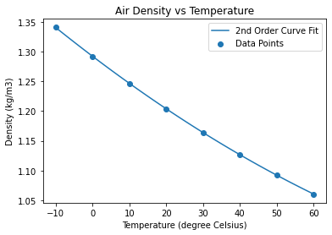
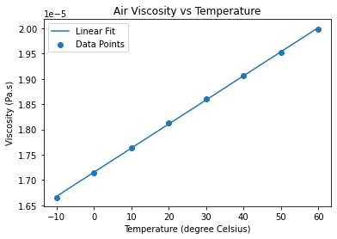
Air Density and Viscosity Correlations
Fig. 4: Air Density vs Temperature with Curve Fit
Fig 5 : Air Viscosity vs Temperature with Curve Fit
Curve: aT² + bT + c
Training data: R² = 0.999975, RMSE = 0.000464
Testing data: R² = 0.999707, RMSE = 0.000779
Curve: aT + b
Training data: R² = 0.999756, RMSE = 1.708e-8
Testing data: R² = 0.998698, RMSE = 1.936e-8
Source: Air - Density, Specific Weight and Thermal Expansion Coefficient vs. Temperature and Pressure, and Air - Dynamic and Kinematic Viscosity. The Engineering Toolbox.

Slide 16
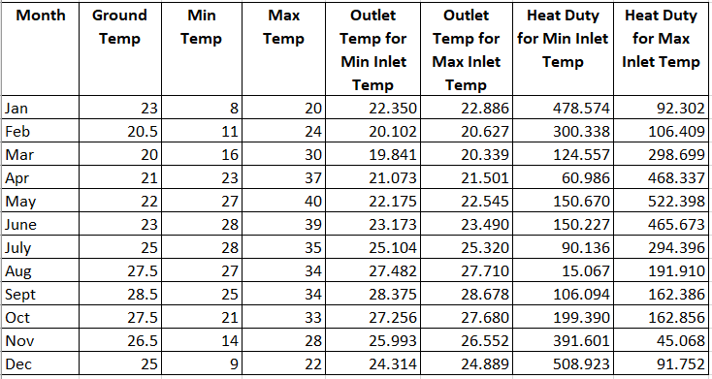
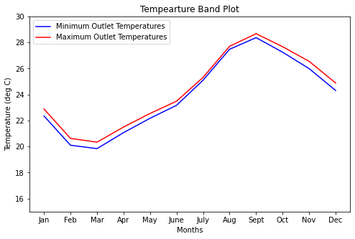
Outlet Temperature and Heat Duty
Table 3: Outlet Temperature and Heat Duty for Each Month
Fig. 6: Temperature Band
Outlet temperature range = 19.841-28.678 ºC

Slide 17
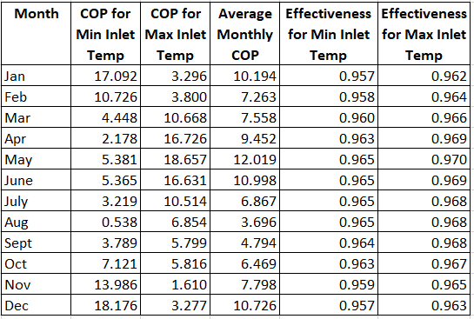
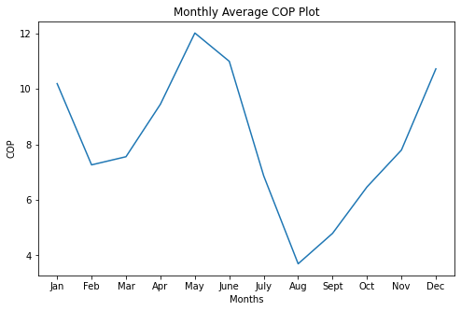
COP and Effectiveness
Table 4: COP and Effectiveness for Each Month
Fig. 7: Monthly Average COP
Annual average effectiveness = 0.964
Annual average COP = 8.153

Slide 18
Viscosity and Density Calculations through correlations
Month | Ground Temp | T avg | Viscosity(Pa.s) | Density(kg/m3)
Jan | 23 | 15.175 | 0.00001801 | 1.213
Feb | 20.5 | 15.551 | 0.00001791 | 1.222
Mar | 20 | 17.9205 | 0.00001803 | 1.212
Apr | 21 | 22.0365 | 0.00001822 | 1.196
May | 27 | 21.5875 | 0.0000182 | 1.197
June | 23 | 25.5865 | 0.00001839 | 1.182
July | 25 | 26.552 | 0.00001844 | 1.178
Aug | 27.5 | 27.241 | 0.00001847 | 1.175
Sept | 28.5 | 26.6875 | 0.00001845 | 1.177
Oct | 27.5 | 24.128 | 0.00001832 | 1.187
Nov | 26.5 | 19.9965 | 0.00001813 | 1.204
Dec | 25 | 16.657 | 0.00001797 | 1.218
Table 5: Viscosity and Density calculations

Slide 19

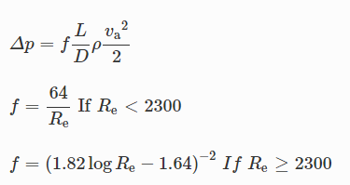
Pressure drop calculations
Reynold’s number: =
Velocity = Flow rate/flow area = 1.4956 m/s
For a smooth pipe pressure drop is given as:
f is the friction factor
Re is the Reynolds number
va is the velocity
L is length of the tube(30.48 m)
D is diameter of the tube(0.15 m)
Source: DQ Kern. Process Heat Transfer. McGraw-Hill International Book Company, 1983
Notes:
Manasi

Slide 20
Pressure drop calculations
Month | Viscosity(Pa.s) | Density(kg/m3) | Reynolds no. | friction factor | Pressure drop
Jan | 0.00001801 | 1.213 | 15109.62909 | 0.02809 | 7.743497473
Feb | 0.00001791 | 1.222 | 15306.72697 | 0.028 | 7.77595714
Mar | 0.00001803 | 1.212 | 15080.42596 | 0.02811 | 7.742622519
Apr | 0.00001822 | 1.196 | 14726.16026 | 0.02829 | 7.689334396
May | 0.0000182 | 1.197 | 14754.66923 | 0.02827 | 7.69032298
June | 0.00001839 | 1.182 | 14419.24307 | 0.02844 | 7.639618813
July | 0.00001844 | 1.178 | 14331.48156 | 0.02849 | 7.627151283
Aug | 0.00001847 | 1.175 | 14271.76502 | 0.02852 | 7.615738243
Sept | 0.00001845 | 1.177 | 14311.55447 | 0.0285 | 7.623351481
Oct | 0.00001832 | 1.187 | 14535.56659 | 0.02838 | 7.655749788
Nov | 0.00001813 | 1.204 | 14898.25483 | 0.0282 | 7.716142085
Dec | 0.00001797 | 1.218 | 15205.6828 | 0.02805 | 7.764344111
Table 6: Pressure drop calculations

Slide 21
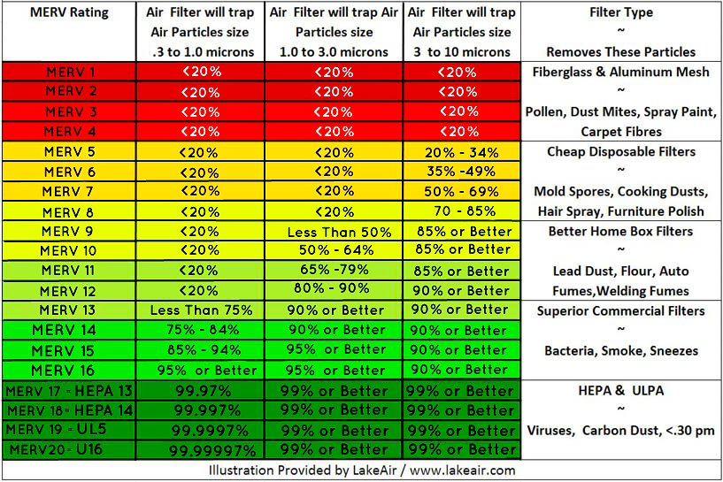
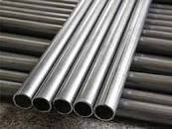
Air filter and Tube Material selection
Fig 9: Aluminium tubes to be laid under the ground
Fig 8: MERV ratings for different types of filters
https://www.mfcp.com/our-blog/bid/94802/what-type-of-pipe-should-i-use-for-my-air-compressor
https://www.lakeair.com/merv-rating-explanation/
Notes:
The MERV value is from 1 to 20. Higher MERV values correspond to a greater percentage of particles captured on each pass, with a MERV 16 filter capturing more than 95% of particles over the full range.
MERV stands for Minimum Efficiency Reporting Values.
The scale is designed to represent the performance of a filter when dealing with particles in the range of 0.3 to 10 micrometers.
HEPA filters were thus chosen for our system.
We take aluminium as a tube material. It has good thermal conductivity, better corrosion resistance and leak free.
PVC pipes are generally used as they are readily available, inexpensive, and easy to install.
gets brittle over time and can crack, break, or even shatter. The presence of air compressor oils in the line and heat from the compressed air accelerates the degradation of PVC. These failures, combined with air under pressure, are potentially fatal due to the airborne, razor-sharp shrapnel.
It is non-corrosive, and remains leak free unlike black pipe systems. Considering high cost of producing compressed air, reducing compressed air consumption by eliminating leaks over the life of the system.
https://www.mfcp.com/our-blog/bid/94802/what-type-of-pipe-should-i-use-for-my-air-compressor

Slide 22
Cost Analysis
Electricity: (28 W air blower)
Annual electricity consumption: 81.76 kWh/year
Cost of grid electricity in India: Rs 3/kWh
Fixed charges per year: Rs 240/kW (Rs 20/kW/month)
Annual electricity cost:
Rs (245.28/year + 23476.8/year) = Rs 23770.26/year
Annual maintenance cost(10% of total cost): Rs 2377.026/year
Total annual cost: 23770.26 + 2377.026 = Rs 26094.288/year
Air filters:
Filter type used: HEPA filters
Cost: Rs 6000/- per piece
Air blower: (28 W)
Type: MB840-D by Oriental motor
Inner diameter: 3.15 in
Cost: Rs 5769.73/-

Slide 23
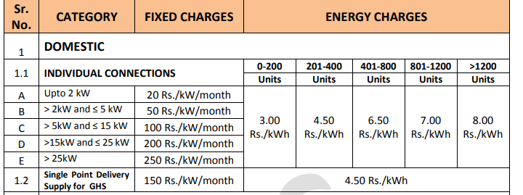
Electricity tariffs
Table 7: Electricity tariffs for domestic usage in Delhi
https://tatapower-ddl.com/Editor_UploadedDocuments/Content/Press_Release_2022_Eng_30.09.2021.pdf

Slide 24
Cost Analysis
S.no. | Equipment/Energy | Cost | Principle amount
1 | HEPA filter | 6000/- | ✔
2 | Motor | 5769.73/- | ✔
3 | Electricity | 26094.288/year | x
4 | Tubes | 15802.63/- | ✔
5 | Installation Cost | 4823.58/- | ✔
 | Total cost = ∑ sum of all costs | Rs. 58490.228/- | P = Rs 32395.94/-
Table 8: Cost analysis of the EAHE system

Slide 25
GSHP System

Slide 26
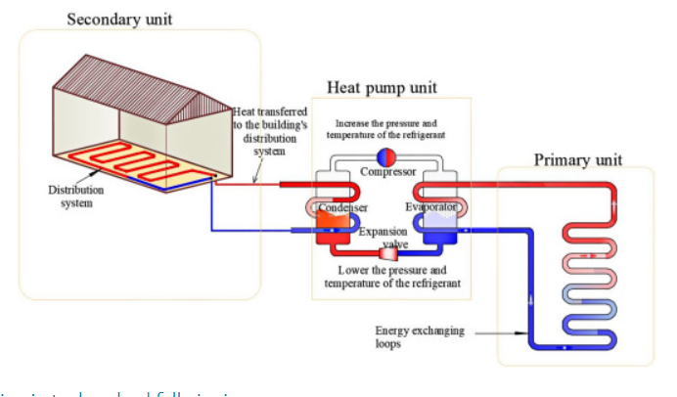
GSHP System Model
Heat Exchanger Unit
Facilitating heat transfer to and from the ground
Heat Pump Unit
Extracting heat from primary loop and transferring it to secondary loop
Fig 10: Ground Source Heat Pump Schematic
Secondary Loop
Comprises of radiant heating/ cooling unit for transfer of heat in and out of the building
[8] “Ground Source Heat Pump System - an overview | ScienceDirect Topics,” Ground Source Heat Pump System - an overview | ScienceDirect Topics. https://www.sciencedirect.com/topics/engineering/ground-source-heat-pump-system (accessed Apr 29, 2022).
Notes:
Heat Exchanger Unit: Facilitates transfer of heat to or from the ground to the circulating fluid which is ultimately brought in thermal contact with the circulating fluid in the heat pump.
Heat Pump Unit: Extraction of heat from the circulating fluid in the heat exchanger and
transferring it to the liquid in the secondary loop or the building loop
Secondary Loop/Building Loop: Comprises of a piping network for transfer of heat in and out of the building

Slide 27
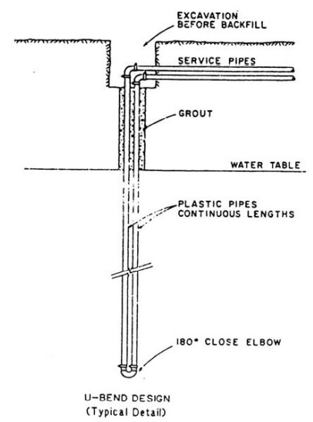
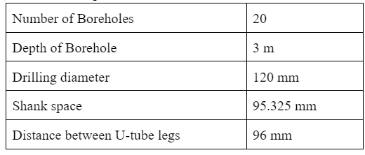
Heat Exchanger Unit
Fig 11: Borehole field specifications
Fig 12: U-Bend design heat exchanger
Notes:
Reference

Slide 28
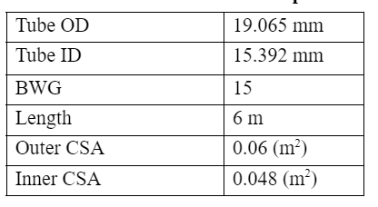


Heat Exchanger Calculations
Assumptions:
Ground surface temperature is heat exchangers inlet temperature.
Temperature does not vary with depth
Velocity of water
u = mass flow rate / ( 𝘱*Inner CSA)
Convective heat transfer coefficient of water
Heat exchanger duty (Q)
Table 9 : Pipe Specifications

Slide 29


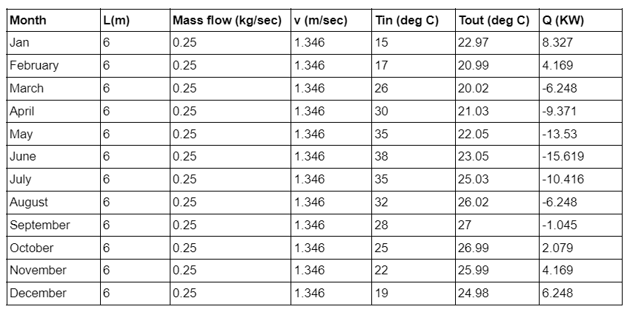
Heat Exchanger Results
Table 10 : Heat Exchanger Results

Slide 30
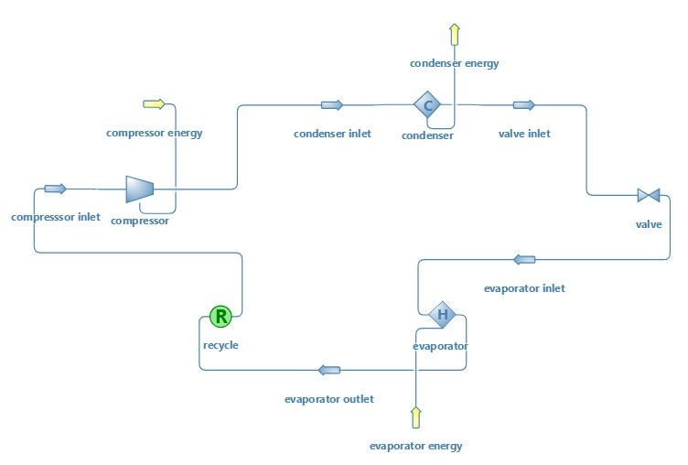
Heat Pump DWSIM Model
Fig 13. Heat Pump DWSIM Model

Slide 31
Heat Pump DWSIM Analysis
In this DWSIM model we have chosen propane as the refrigerant which has zero ozone depletion potential and negligible global warming potential.
Assumptions:
We have assumed 100% efficiency of the evaporator and taken pressure drop as 7 Pa (after much research on maximum allowable pressure drop from literary sources).
For the compressor we assumed adiabatic process and 100% adiabatic efficiency.
We assume there is no heat loss and heat is transferred directly from the circulating fluid of the heat exchanger (water) to the refrigerant in the heat pump.
Notes:
We have assumed 100% efficiency of the evaporator and taken pressure drop as 7 Pa (after much research on maximum allowable pressure drop from literary sources).
For the compressor we assumed adiabatic process and 100% adiabatic efficiency.

Slide 32


DWSIM Heat Pump Model Analysis
The energy input to the evaporator was taken as the heat duty for the heat exchanger unit as calculated earlier.
Coefficient of performance is calculated using equation given below,
where,
Q_{comp} : power that needs to be supplied to the compressor
Q_{cond} : output power of the heat pump.
Table 11: Master Property Table for the Month of January

Slide 33
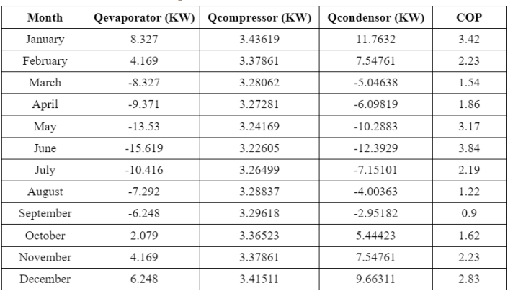
DWSIM Simulation Results
Table 12: Heat Pump Results

Slide 34
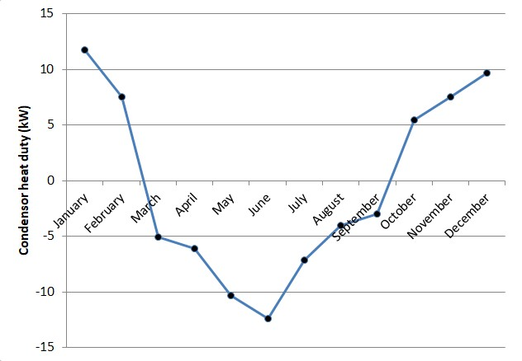
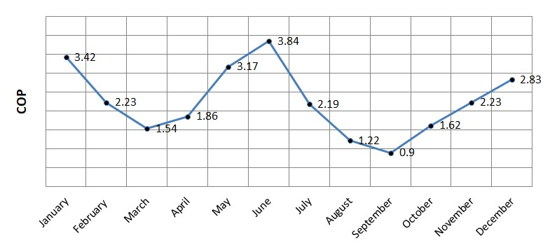
DWSIM Simulation Results
Monthly COP Range: 0.9 -3.8
Average Annual COP: 2.25
Fig 15. COP versus Month
Fig 14: Condenser Heat Duty versus Month

Slide 35

Radiant Heating/Cooling Unit Analysis
Assumptions:
Complete heat transfer between the condenser of the heat pump and the circulating fluid (water).
No Power losses
Piping network in the ceiling and two walls opposite to each other on both floors
Total radiant surface area of the entire building is given by:
The total amount of heat removed by a radiant surface is calculated
separately using a combined heat transfer coefficient as
recommended by ISO 11855.
Dimensions:
Square base: 300ft²(27.87 m²)
dimensions of the base = (5.28m * 5.28m)
Height = 7.5 m
Height of each floor = 3.75 m
h_{tot} = 8.29 W/m² K
[11] J. (Dove) Feng, “Design and Control of Hydronic Radiant Cooling Systems,” Design and Control of Hydronic Radiant Cooling Systems, Nov. 02, 2015. https://escholarship.org/uc/item/6qc4p0fr (accessed Apr. 29, 2022).
Notes:
The building has a square base of 300ft²(27.87 m²) making the dimensions of the base 17.32 ft 17.32 ft (5.28m 5.28m). The total height of the building is 7.5m making the height of each floor 3.75m.

Slide 36
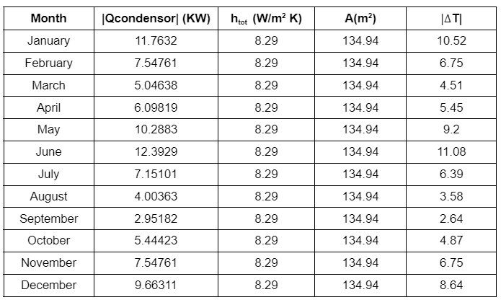
Radiant Heating/Cooling Unit Analysis
Table 13: Radiant Heating/Cooling Unit Results

Slide 37
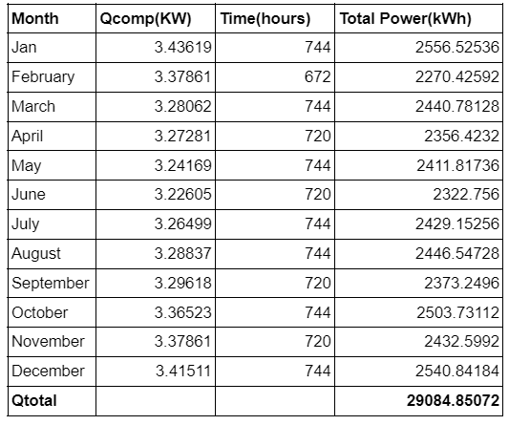
GSHP System: Electricity Cost Analysis
Cost of grid electricity in India = Rs 3/kWh
Annual electricity consumption of the GSHP system = 29084.85072 kWh/year
Therefore, Annual electricity cost = Rs (3*29084.85072) = Rs 87254.55 /year
Table 14: Heat Pump Electricity Consumption

Slide 38
Solar Panel

Slide 39
Solar Panel
A solar panel generates the direct current (D.C) electricity that uses the sunlight as an energy source.
Integrated solar is when solar electricity is built in as part of the original structure rather than as a separate module.
Performance and efficiency analysis of solar panels :
Solar cells convert solar energy into electricity with a very low efficiency of less than 20%.
Solar panels have 2 types which are crystalline and non-crystalline and 80% solar panels are based on crystalline technology which are monocrystalline and polycrystalline.
Poly-crystalline panels are cheaper and easier to manufacture whereas mono-crystalline panels are most efficient but production cost is high.
Non crystalline technology based on thin-film solar panels.

Slide 40
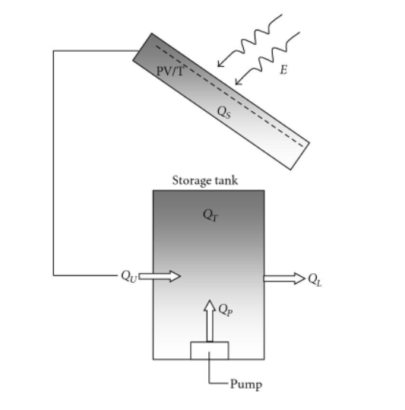
Efficiency of the solar cells are defined as the electrical and thermal efficiency.
Electric efficiency is defined as follows
η_{el} = η₀[1+ β(T_{cell}- 298 K)
Η0 : Efficiency of the cell at 298 K,
β : Silicon efficiency temperature coefficient
T_{cell} : Temperature of one cell.
Thermal efficiency is defined as follows,
η_{T} = (Q_{U} + Q_{S} )/E .S = (Q_{T} + Q_{L} – Q_{P} + Q_{S} )/E .S
S : Heat absorber panel surface area,
Qt : Total heat collected in the storage tank,
Qp : Constant heat input from a circulation pump,
Qu : Useful energy gain delivered by the collector to the storage tank.
Qs : Stored energy as specific heat in the panel.
Fig 16:- Energy flow in the system

Slide 41
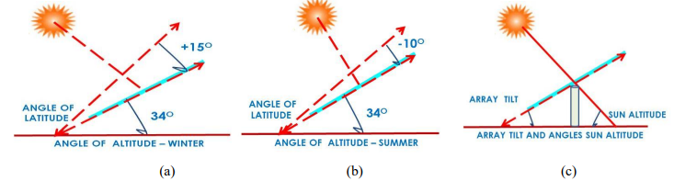
Efficiency Relation with Angle of Panels
Efficiency of solar panels depends on the angles as well.
Integration of solar panels panels should be done in the right direction with an optimum angle.
At optimum angle sunlight on the arrays will be maximum hence efficiency will be maximum.
Energy produced by a solar panel is can be calculated as,
E = A × r × H × PR
Where, A = solar panel area(m² ), r = solar panel efficiency, H = Annual average solar radiation, PR = performance ratio (default value = 0.75)
Fig 17: Angle of Altitude and latitude in different seasons

Slide 42
Gaps and Future Scope
Explore proper integration of solar panels with our systems to determine their viability and the fulfillment of electrical energy demanded.
Variation in ground temperature with time can be considered for theoretical modelling.
Combining the heat exchanger and house models into a comprehensive whole with the help of simulation.
Proper integration of solar panels and heat exchangers to determine viability.
Notes:
Combining the two of heating, cooling loads and heat exchanger into a comprehensive whole with the help of a suitable simulation software to get a theoretical understanding of the thermal conditions which would prevail indoors when the heat exchangers are in action.
These houses include features like upgraded insulation, roofing and vapor barrier system that make it 30% more efficient.

Slide 43
Conclusion
Two viable heating and cooling techniques have been developed: EAHE and GSHP.
Both the systems have high COP and are hence energy efficient.
Temperature of air can be significantly changed to provide thermal comfort.
For June, the GSHP provides a temperature reduction of 11.08 ºC while the EAHE provides a reduction of 15.51 ºC.
COP of EAHE: 8.153, COP of GSHP: 2.25.
Thus, the EAHE is more efficient and better fulfills its functions.

Slide 44
References
[1] Increasing Efficiency of Building Systems and Technologies. AN ASSESSMENT OF ENERGY TECHNOLOGIES AND RESEARCH OPPORTUNITIES, September 2015, p 2. [Online] Available from: https://www.energy.gov/sites/prod/files/2017/03/f34/qtr-2015-chapter5.pdf [Accessed 25 April 2022]
[2] Th. Frank. Climate change impacts on building heating and cooling energy demand in Switzerland. Energy and Buildings, November 2005, 37(11), p 1175. [Online] Available from: https://www.sciencedirect.com/science/article/abs/pii/S0378778805001106 [Accessed 25 April 2022]
[3] Demand for air conditioning is set to surge by 2050. The Economist, 10 August 2021. [Online] Available from:https://www.economist.com/graphic-detail/2021/08/10/demand-for-air-conditioning-is-set-to-surge-by-2050 [Accessed 25 April 2022]
[4] S.K. Soni et al. Ground coupled heat exchangers: A review and applications. Renewable and Sustainable Energy Reviews, July 2015, 47, p84. [Online] Available from: https://www.sciencedirect.com/science/article/pii/S1364032115001598 [Accessed 25 April 2022]
[5] T. S. Bisoniya, A. Kumar, P. Baredar, and Hindawi, “Study on Calculation Models of Earth-Air Heat Exchanger Systems,” Study on Calculation Models of Earth-Air Heat Exchanger Systems, Sep. 04, 2014. https://www.hindawi.com/journals/jen/2014/859286/ (accessed Apr. 29, 2022).

Slide 45
References
[6] R. Winchell, “What Type of Pipe Should I Use for My Air Compressor?,” What Type of Pipe Should I Use for My Air Compressor? https://www.mfcp.com/our-blog/bid/94802/what-type-of-pipe-should-i-use-for-my-air-compressor (accessed Apr. 29, 2022).
[7] “MERV Filter Rating Charts – Filter Application Chart,” LakeAir, Oct. 08, 2021. https://www.lakeair.com/merv-rating-explanation/ (accessed Apr. 29, 2022).
[8] “Ground Source Heat Pump System - an overview | ScienceDirect Topics,” Ground Source Heat Pump System - an overview | ScienceDirect Topics. https://www.sciencedirect.com/topics/engineering/ground-source-heat-pump-system (accessed Apr 29, 2022).
[9] DQ Kern. Process Heat Transfer. McGraw-Hill International Book Company, 1983
[10] A. Ouadha, M. N. Nasser, and O. Imine, “(PDF) Thermodynamic modelling of a water-to-water heat pump using propane as refrigerant,” ResearchGate.
https://www.researchgate.net/publication/245402209_Thermodynamic_modelling_of_a_water-to -water_heat_pump_using_propane_as_refrigerant (accessed Apr. 29, 2022).
[11] J. (Dove) Feng, “Design and Control of Hydronic Radiant Cooling Systems,” Design and Control of Hydronic Radiant Cooling Systems, Nov. 02, 2015. https://escholarship.org/uc/item/6qc4p0fr (accessed Apr. 29, 2022).

Slide 46
Thank You !

