Slide 1

Accounts Management
School Management System

Slide 2
OBJECTIVE
This module is used to manage all the accounts of a school according to standard double entry system.

Slide 3
Features
  Chart of Accounts ( four levels )
  Financial Years
  Voucher ( Journal , Bank Payment, Bank Receiving, Cash Payment, Cash Receiving )
  Vouchers Browsing ( Search by different criteria )
  Financial Reports

Slide 4
Reports
Chart of Accounts
Account Balances
Voucher
Vouchers Summary
Account Ledgers
Trail Balances
Income Statement
Balance Sheet
Other Financial Reports
And other requested reports

Slide 5
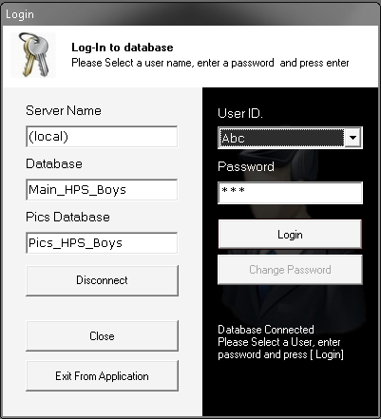
User Login Form
Database
Connection
User
Login

Slide 6
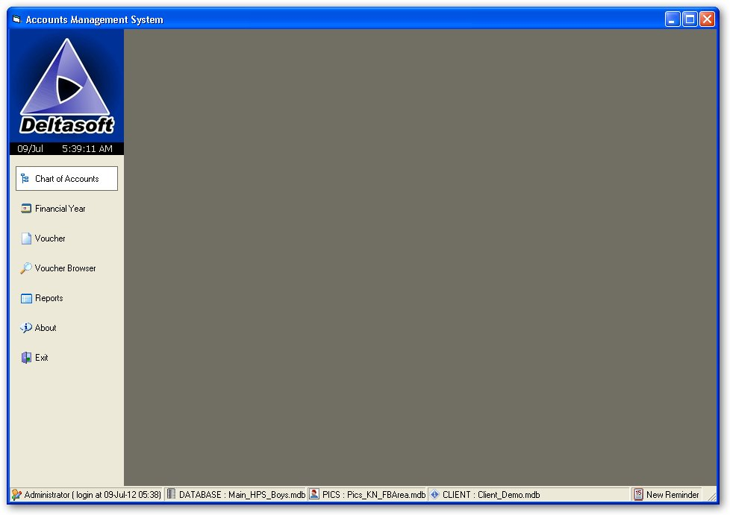




Main Form Interface
User Info
Database Info
Main Menu
School Monogram

Slide 7
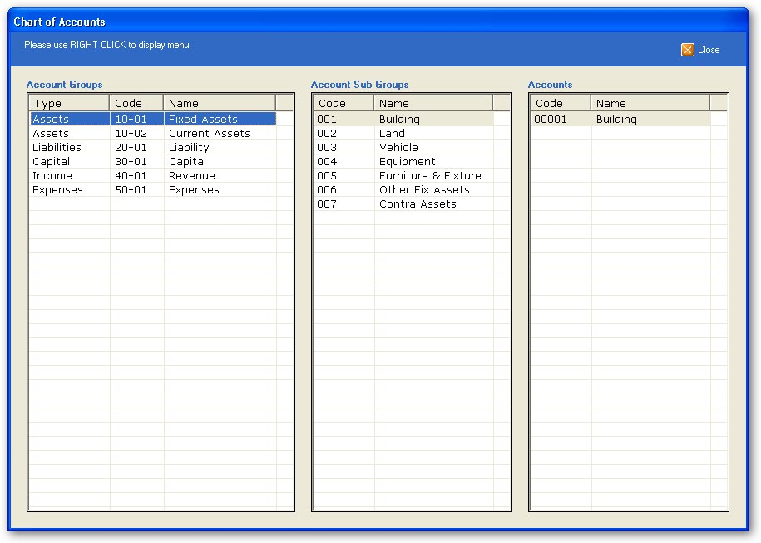
Company Chart of Accounts

Slide 8
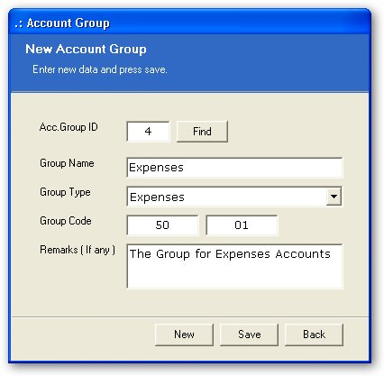
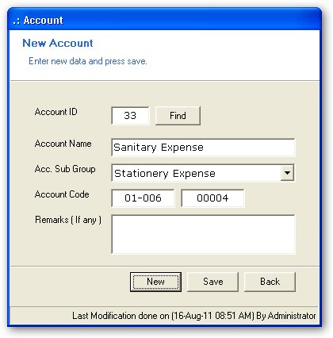
Creation of Accounts

Slide 9
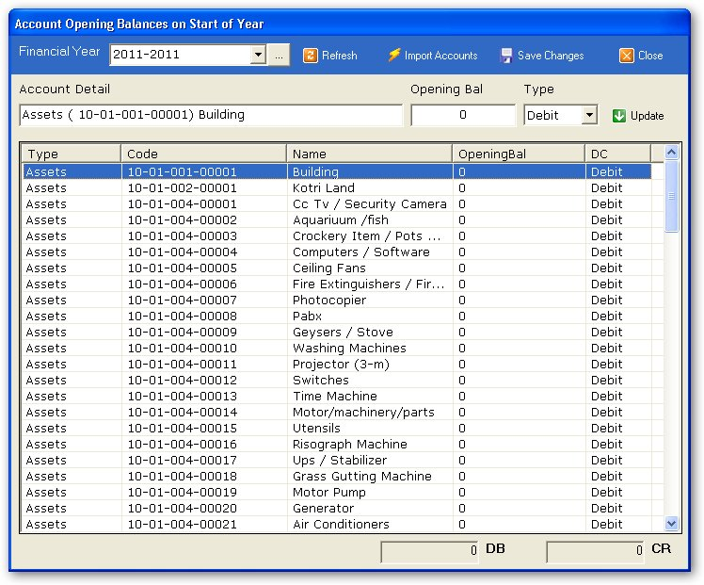
Financial Years

Slide 10
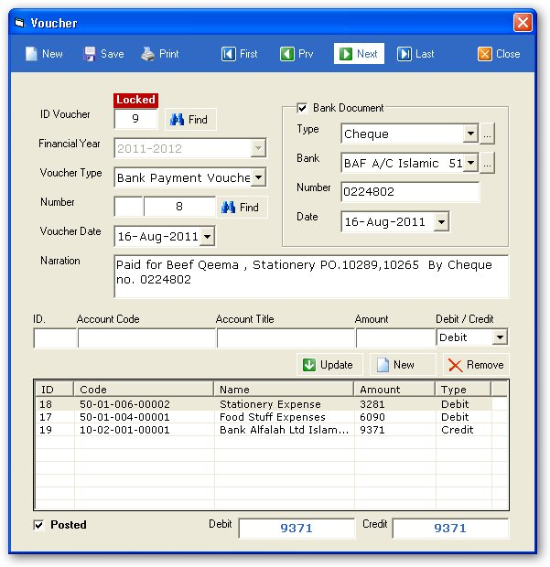
Voucher Creation

Slide 11
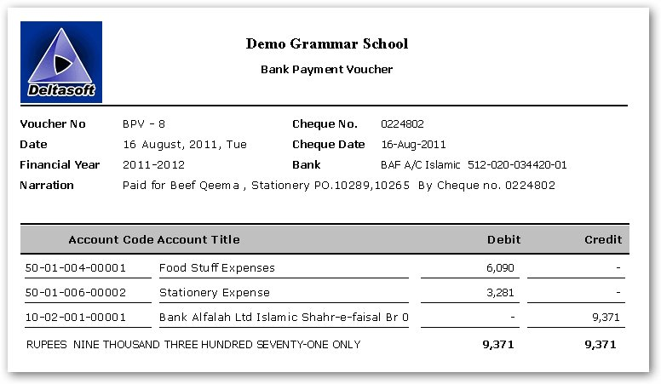

Voucher Print

Slide 12
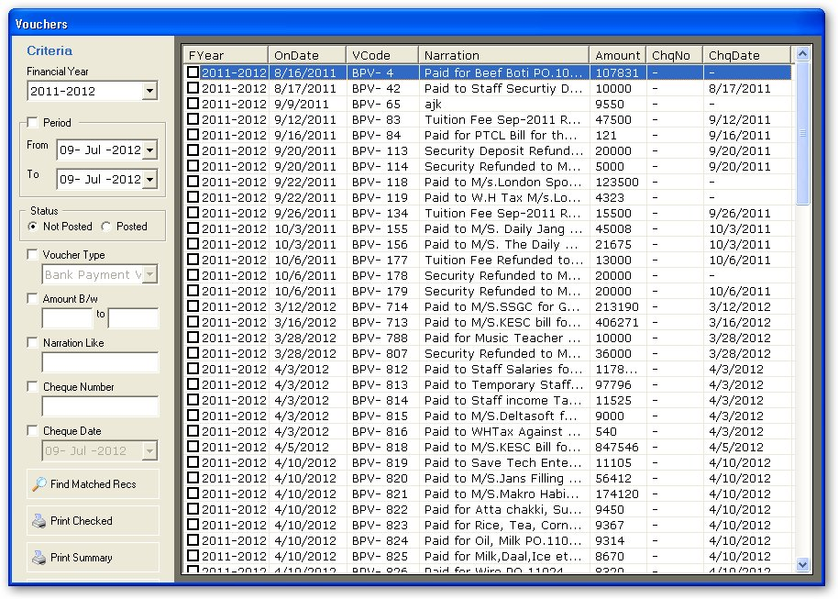
Voucher Search

Slide 13
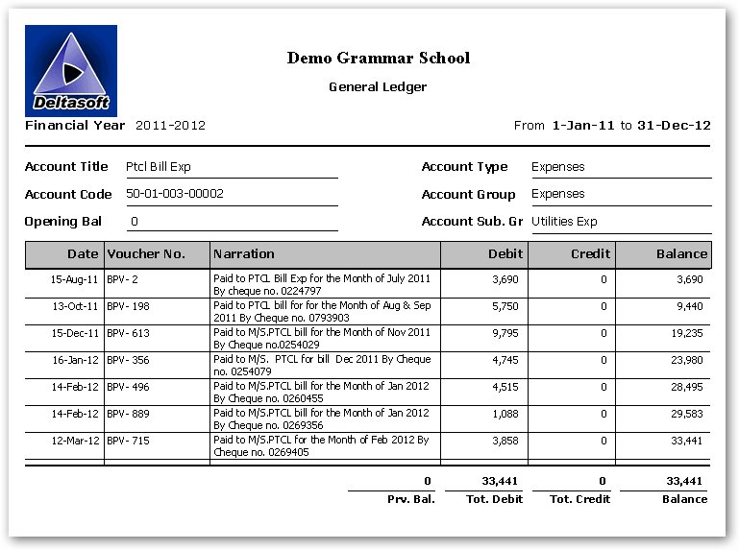
Account Ledger

Slide 14
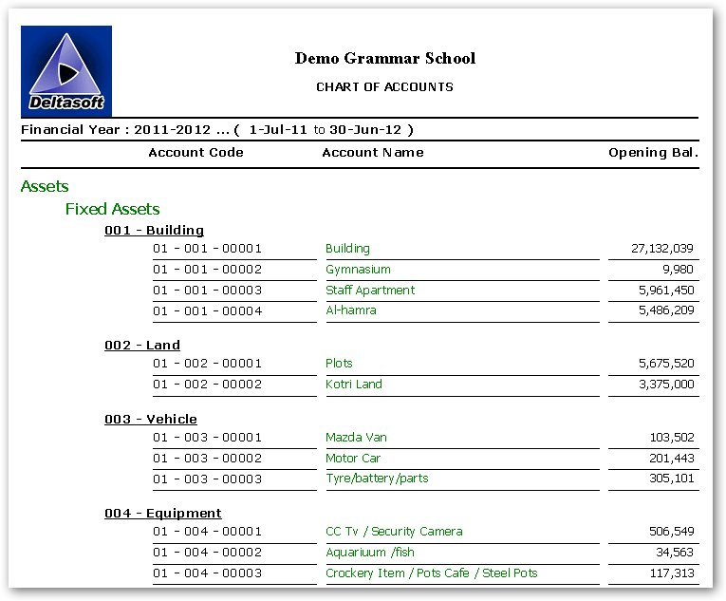
Chart of Accounts

