Slide 1

Student Examination System
School Management System

Slide 2
OBJECTIVE
This module is used to manage examination process in a school. Just create schedules of classes. Enter obtained marks of students as simple as in an Excel sheet. Mark sheets will be generated automatically.

Slide 3
Features
  Creation of Examination Schedule
  Entrance of obtained marks ( current + Sub ) of students
  Editable mark sheets are generated automatically.
  Attendance summary on marks sheet will be include ( if attendance system is installed too )
  Ranks / Positions are assigned automatically but they are editable
  Check top students of the school to check performance
  Marks sheets will be uploaded on school website.

Slide 4
Reports
Examination Schedule Print
Blank list for obtained marks
Single subject results summary
All subject result summary
All subject result detailed
Mark Sheet ( School / Student Copy)
Top 3 students of each section
Top 3 students on each class
Top 10 students of school
And other requested reports

Slide 5
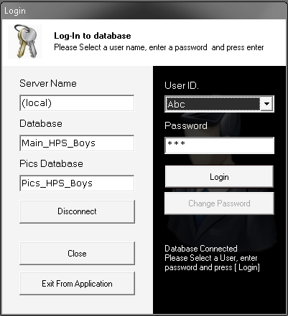
User Login Form
Database
Connection
User
Login

Slide 6
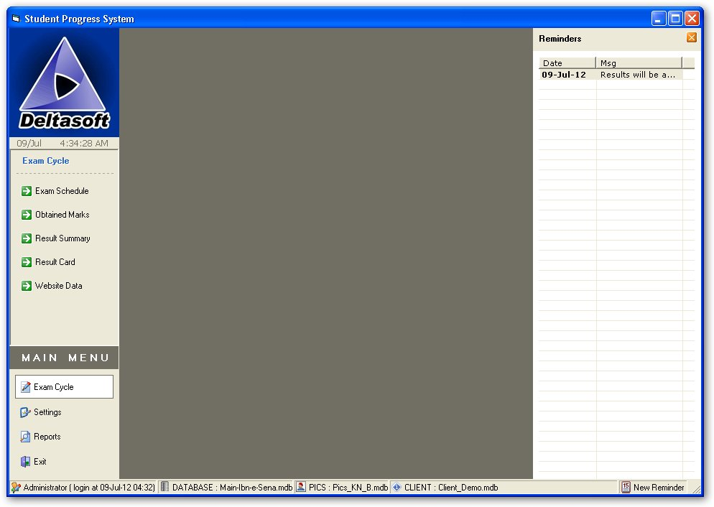






Main Form Interface
User Info
Database Info
Main Menu
Sub Menu
School Monogram
Reminder List

Slide 7
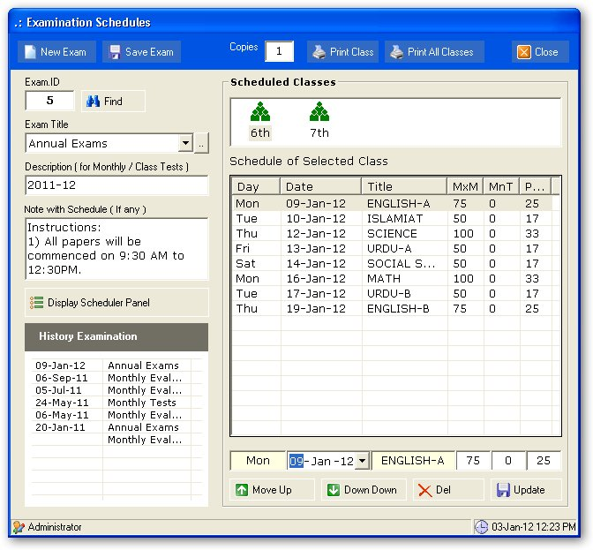
Exam Schedule
Creation of exams
Terms, Semesters, Monthly Tests
Just select date ranges , classes and marks. Default schedule for all the classes will be generated immediately.
Marks and dates could be changed later.

Slide 8
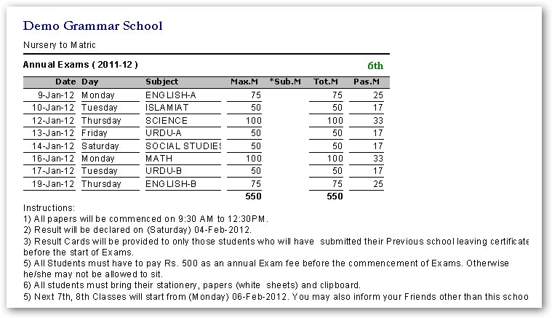
Print of Exam Schedule

Slide 9
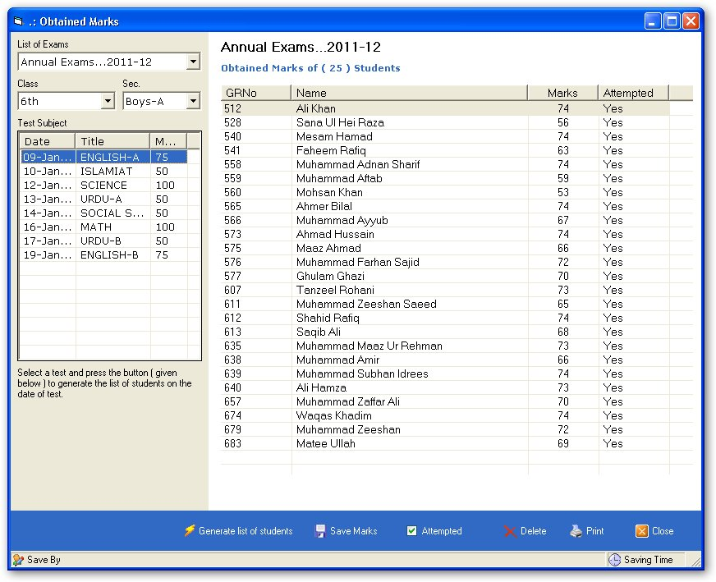
Enter Obtained Marks
Select a subject and
generate list of students
Students list with blank
spaces will be created.
Enter marks just like excel
And press save.

Slide 10
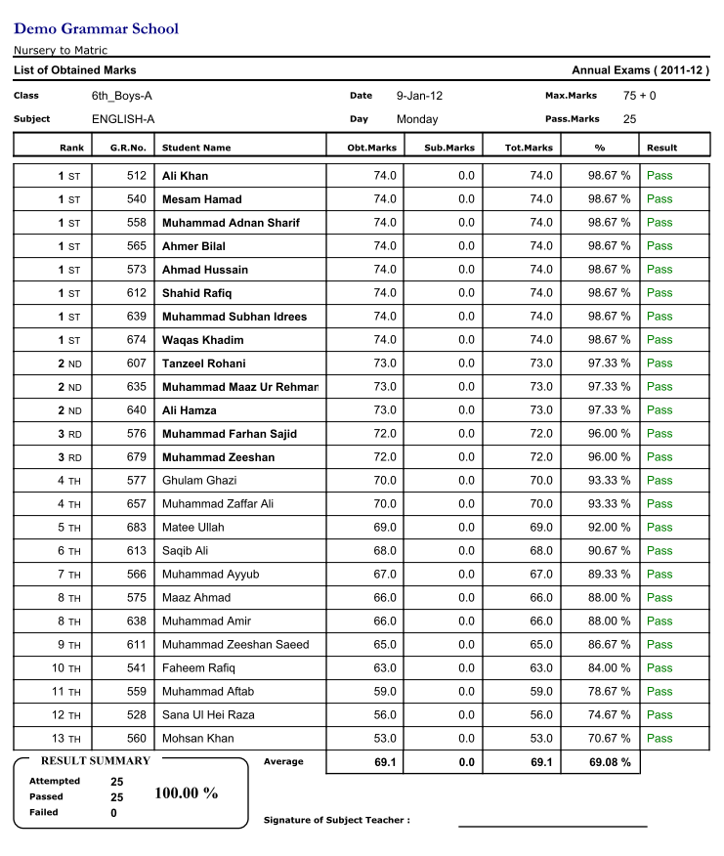
Obtained Marks of Subject
After entrance of obtained marks full summary of result will be generated.
Which is helpful not only to check the result of students but also the performance of teacher.
When obtained marks posting is complete then mark sheet and other reports are generated automatically.

Slide 11
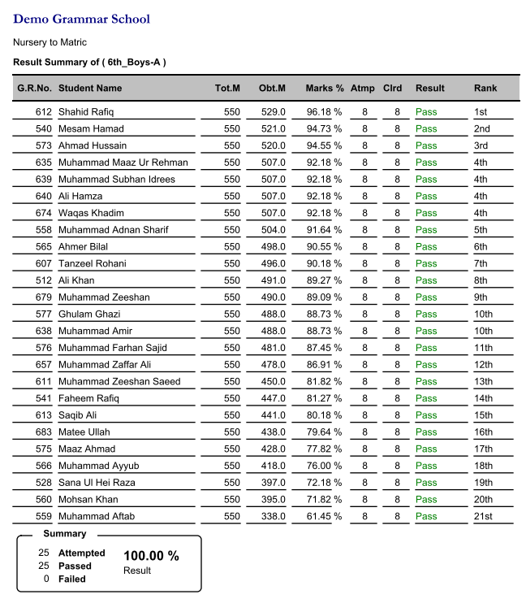
Result of all subjects Summary

Slide 12
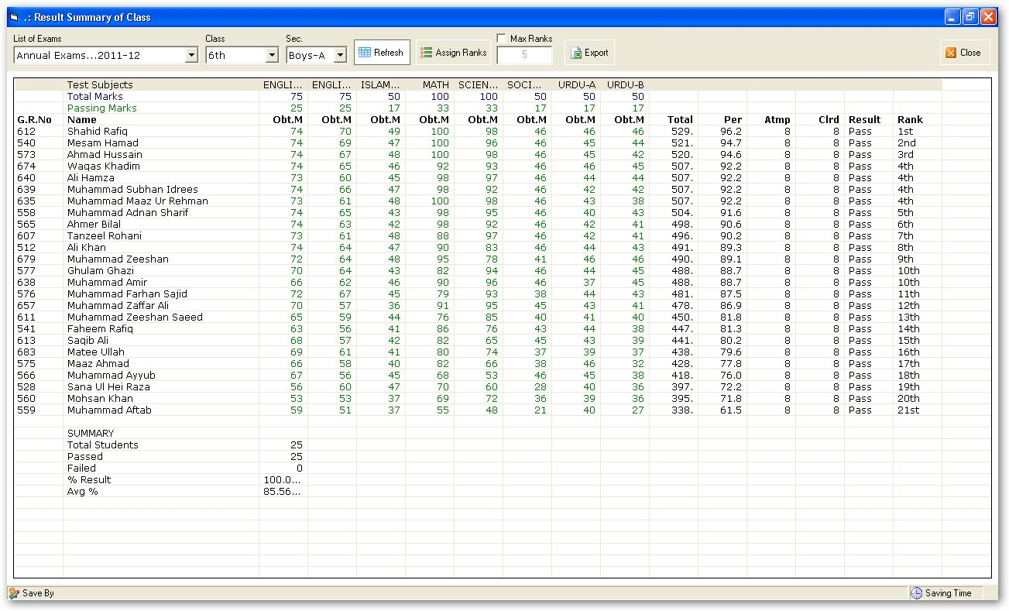
Class Result + Ranks Assignment

Slide 13
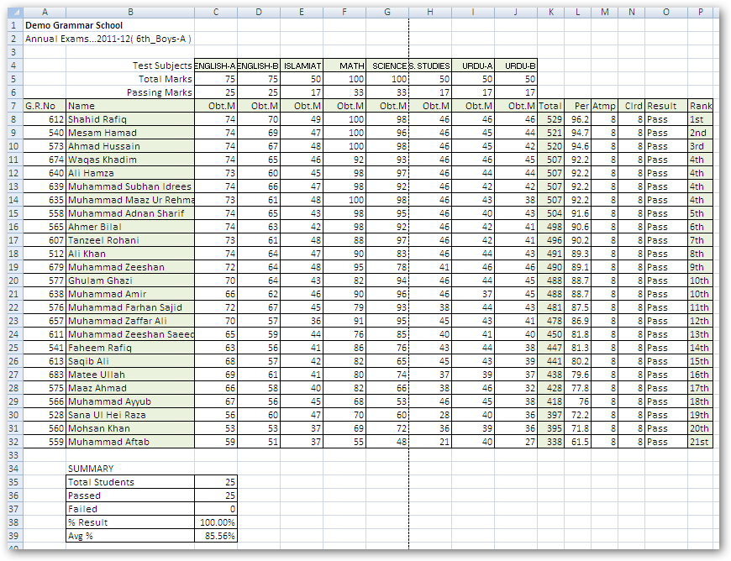
Class Result of all Subjects

Slide 14
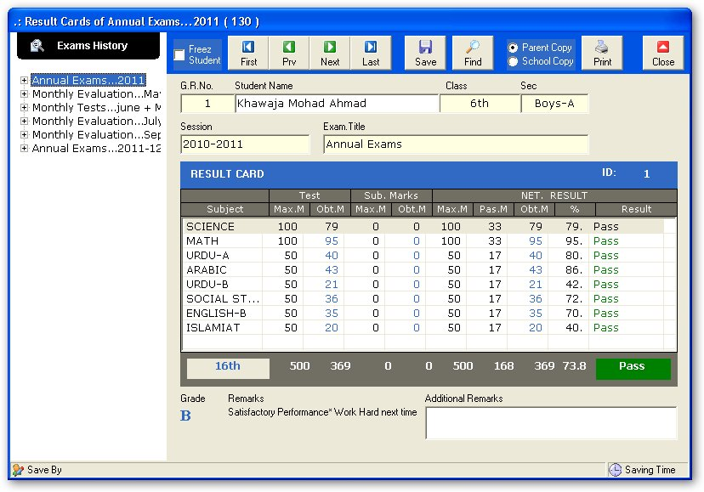
Mark sheet

Slide 15
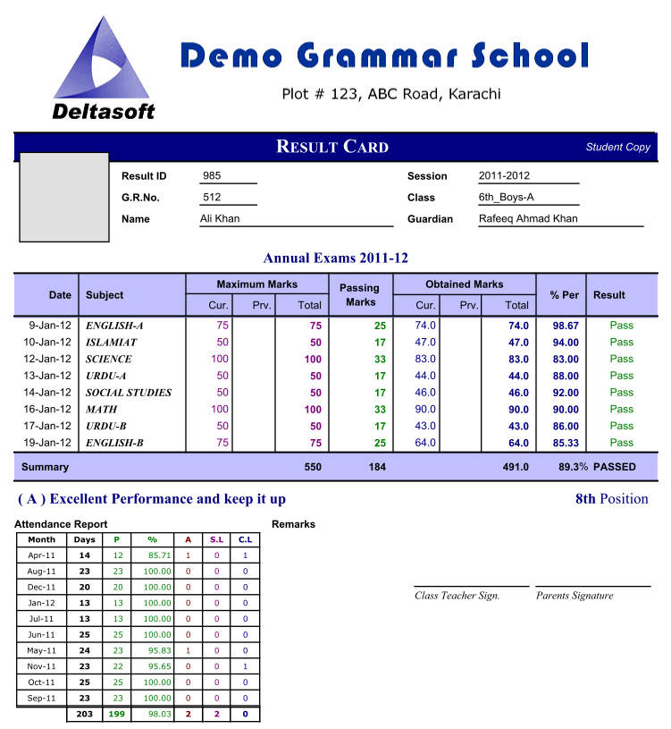
Mark Sheet Print
Mark Sheet
Photo option
All subjected detailed result
Grade, Percentage, Rank and Remarks
Attendance summary

Slide 16
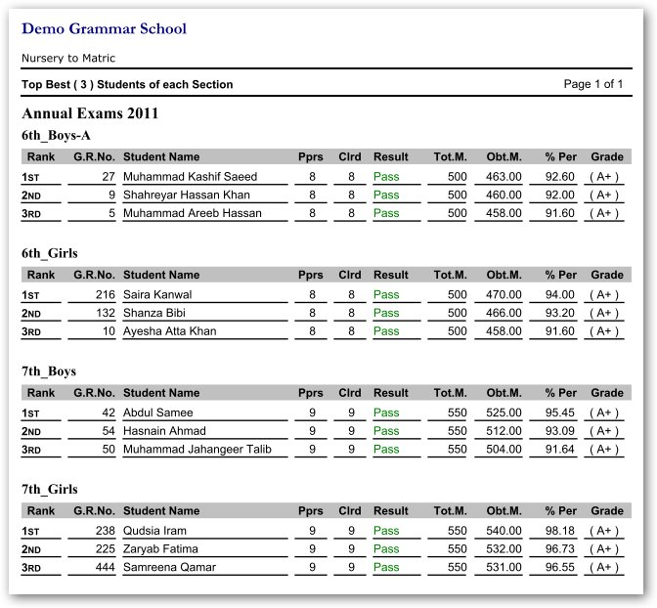
Top students of school
Top performance reports
Top 3 of each section
Top 3 of each class
Top 10 in whole school
Top 3 of each section

