Slide 1

Fee Collection System
School Management Systems

Slide 2
OBJECTIVE
This module is used to manage all the tasks required to collect the fee of students. Both options ( Collection at Office / Collection by Bank ) are available.
How it Works
In start of each fee period just click on [ Generate Voucher ] button and all the vouchers ( current fee and arrear calculation ) will be generated.
Defaulters lists, Notices and SMS are also available with many helpful reports.

Slide 3
Features
  One click fee vouchers generation ( current Fee + Arrears )
  Cash Voucher / Bank Voucher
  Customizable fee structures of classes
  Concession option for certain students
  Installment option on Voucher
  Student Ledgers ( Voucher wise )
  Bulk operations on fee vouchers
  User wise management
  Integrated with main accounts

Slide 4
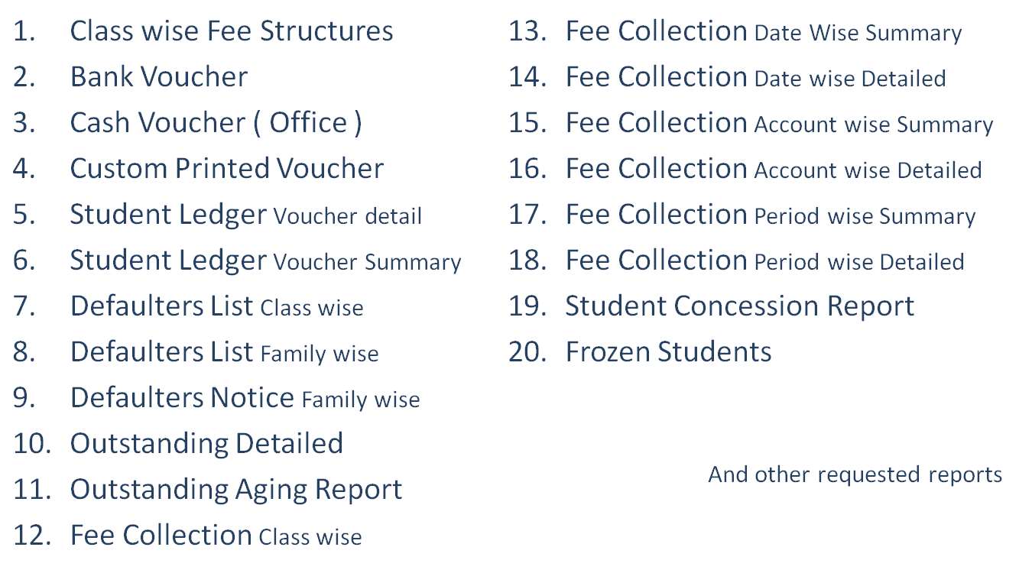
Reports

Slide 5
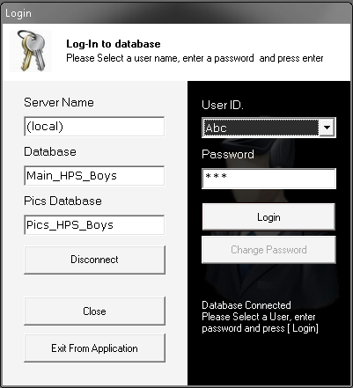
User Login Form
Database
Connection
User
Login

Slide 6
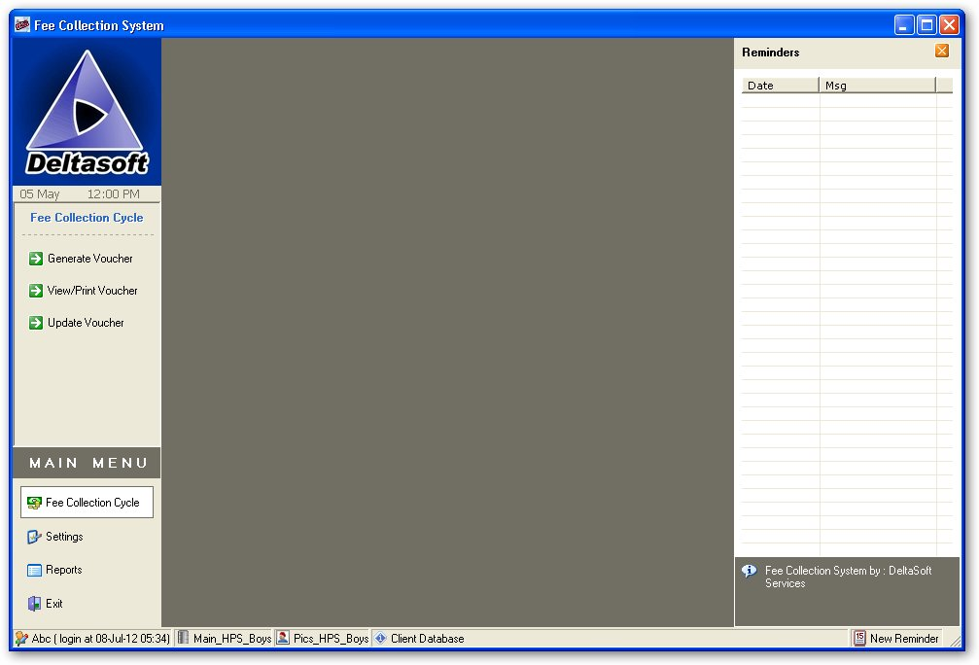






Main Form Interface
User Info
Database Info
Main Menu
Sub Menu
School Monogram
Reminder List

Slide 7
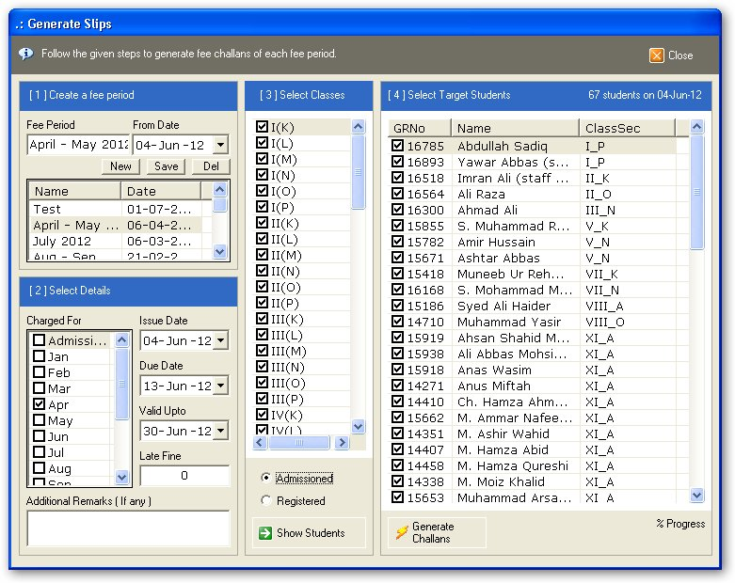
Fee Voucher Generation
Multiple fee Periods
Customizable dates
Single OR multiple months charging option.
Late fine (if any)
Message to print on vouchers ( If any )
Selective students operation
One click Fee Voucher Generation

Slide 8
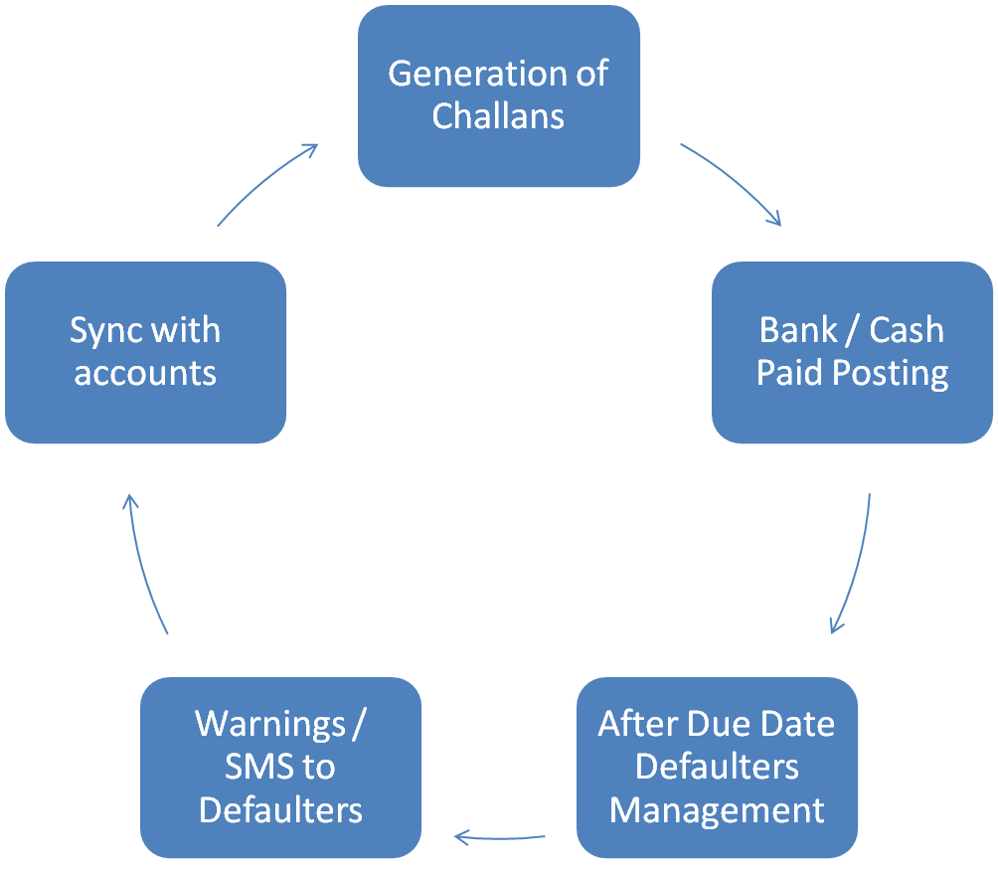
Main Cycle

Slide 9
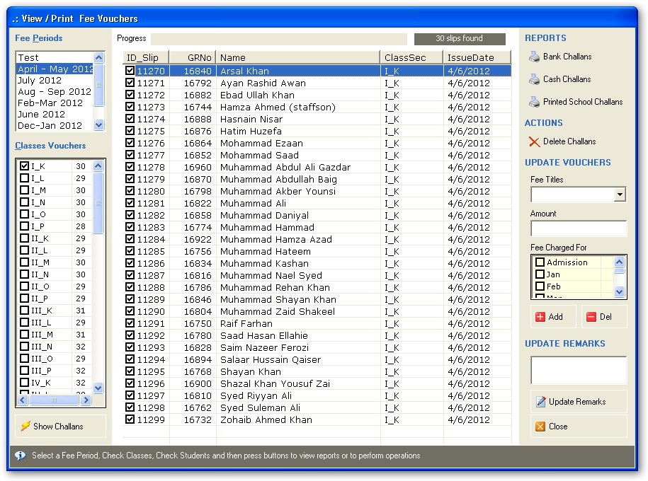
Voucher Browser
Select target students of target classes
Print Vouchers
Bank Voucher
Cash Voucher
School Printed Voucher
Operations
Delete vouchers
Update vouchers
Update details

Slide 10
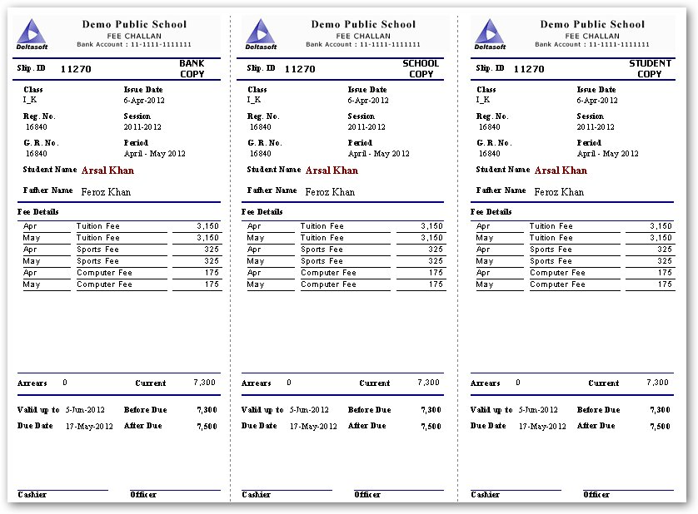
Bank Voucher Print

Slide 11
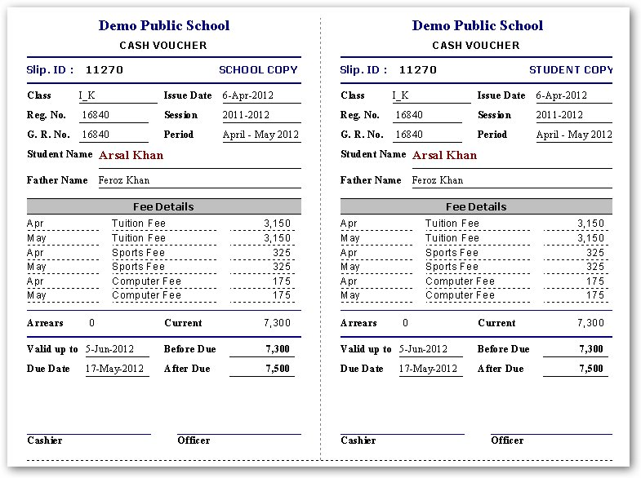
Cash Fee Voucher

Slide 12
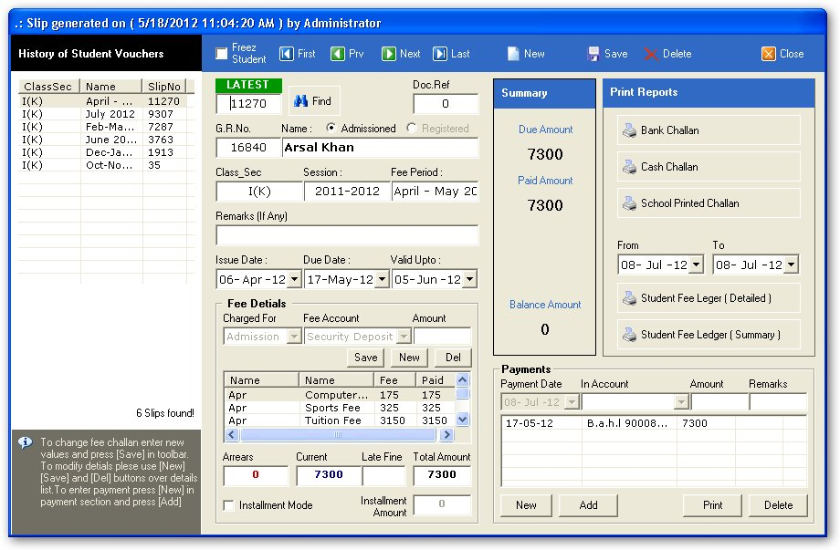
Fee Voucher Form
History
Previous vouchers list
Operations
Create new
Edit existed
Delete
Payments
Cash or Bank collection
Installment option
Prints
Bank Challan
Cash Challan
Ledgers
Summary
Detailed

Slide 13
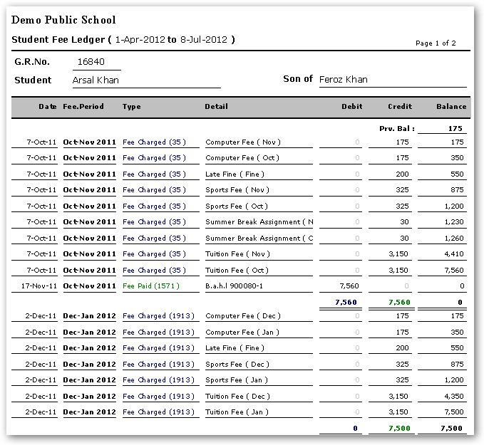
Student Ledger Detailed

Slide 14
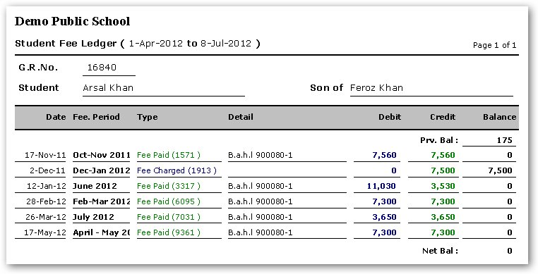
Student Ledger Summary

Slide 15
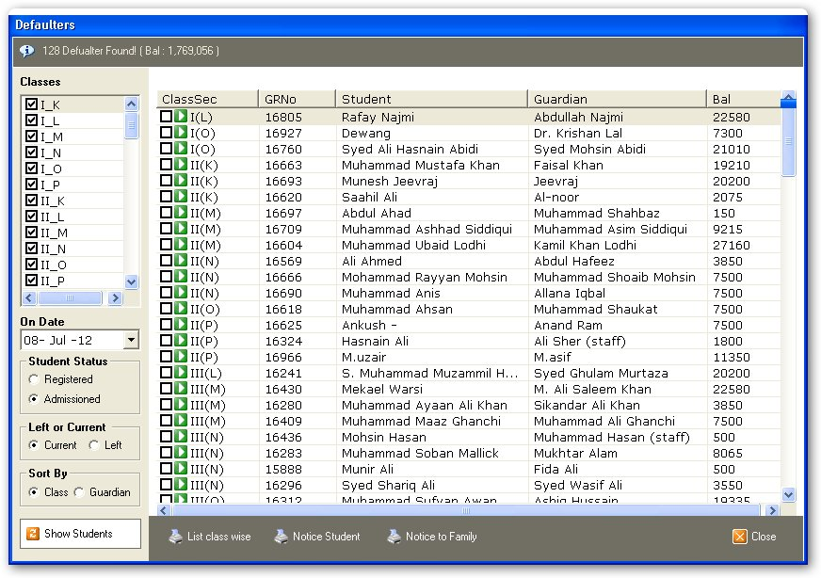
Defaulters

Slide 16
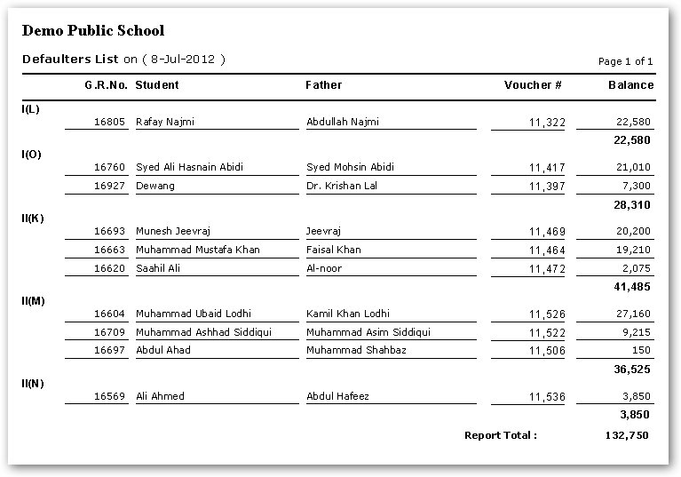
Class wise Defaulters

Slide 17
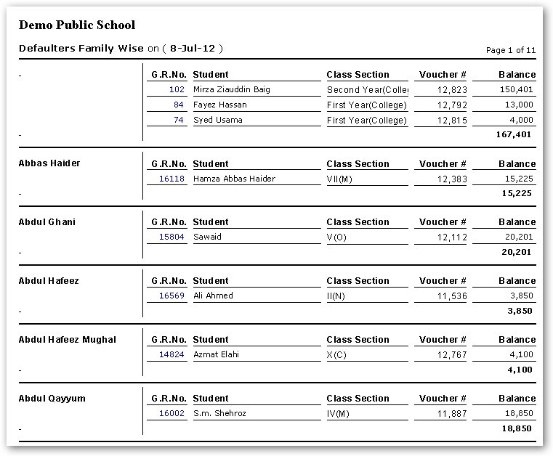
Family wise Defaulters

Slide 18
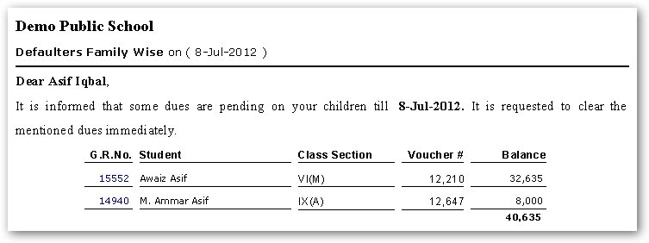
Defaulter Notice ( family )

Slide 19
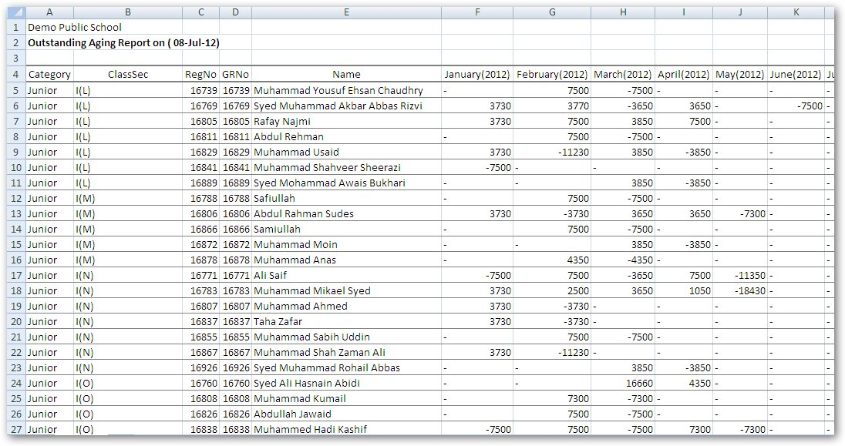
Defaulter Aging Report ( Excel )

Slide 20
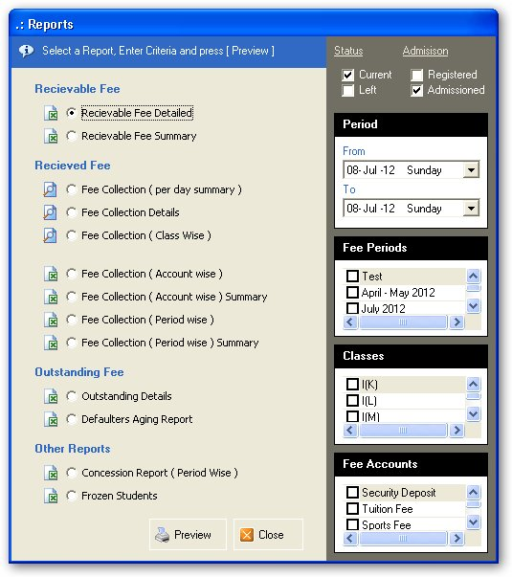
Reports

Slide 21
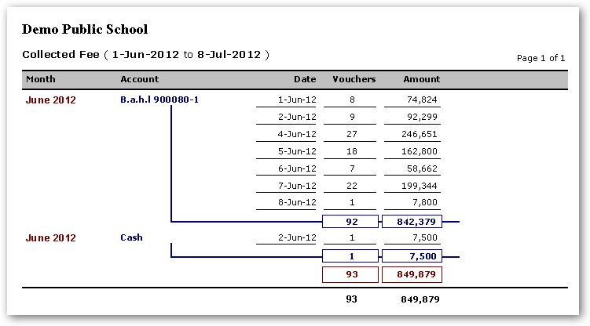
Fee collection Summary

Slide 22
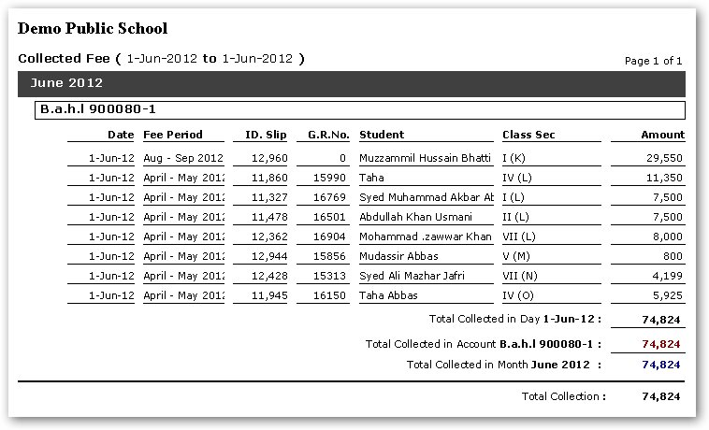
Fee Collection Details

Slide 23
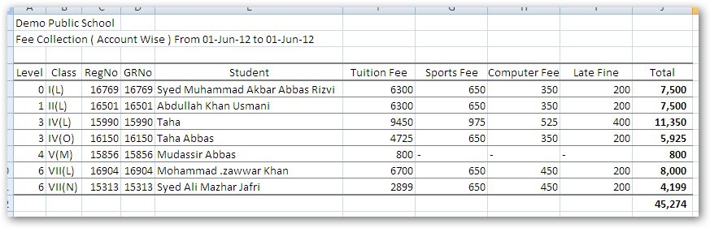
Fee Collection ( Account Wise )

Slide 24
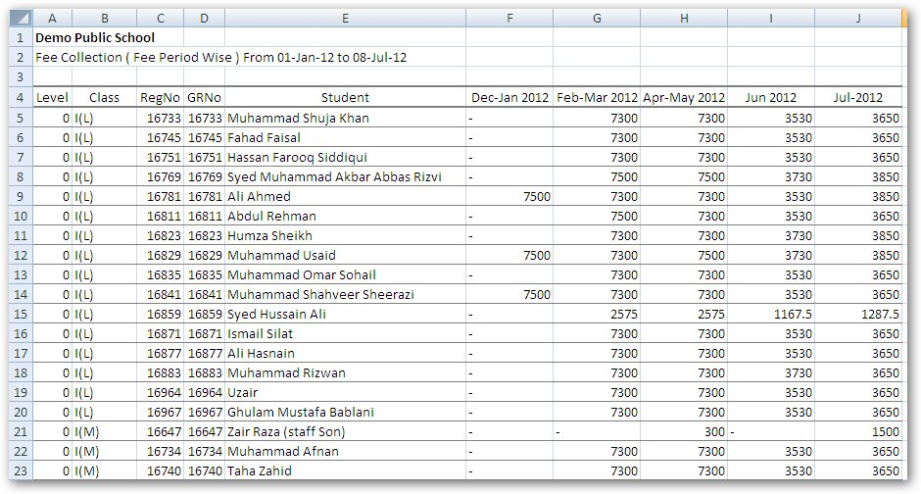
Fee Collection ( Period wise )

Slide 25
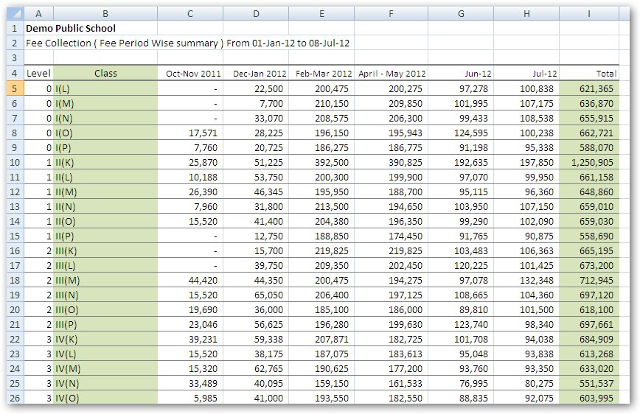
Fee Collection ( Class wise ) Per Period Collection

Slide 26
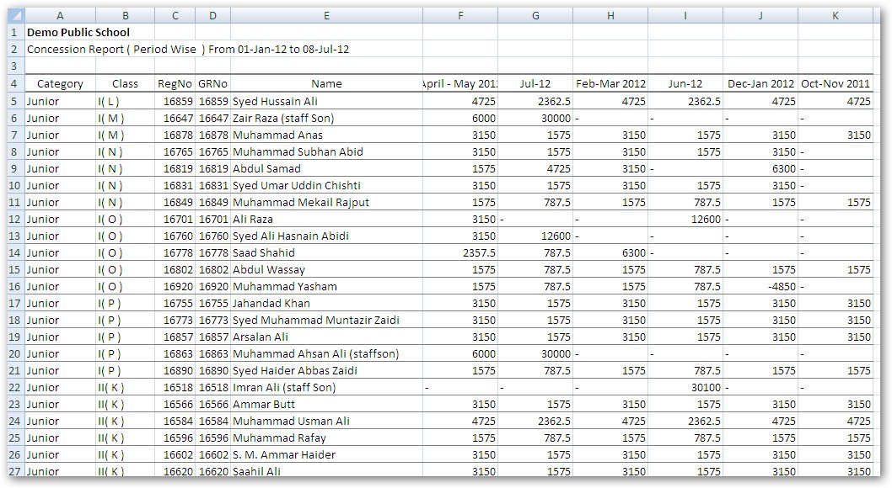
Concession Report

Slide 27
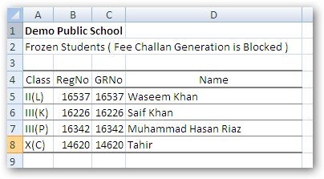
Frozen Students Reports
Some times the fee challan generation of some students is required to stopped.
For example some students are 100% free because they are the children of a staff member.

Slide 28
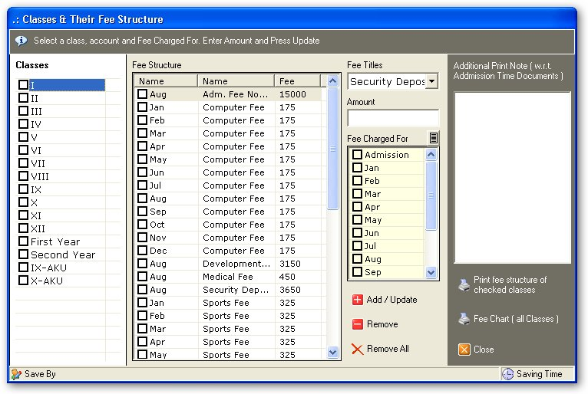
Class wise fee structures

Slide 29
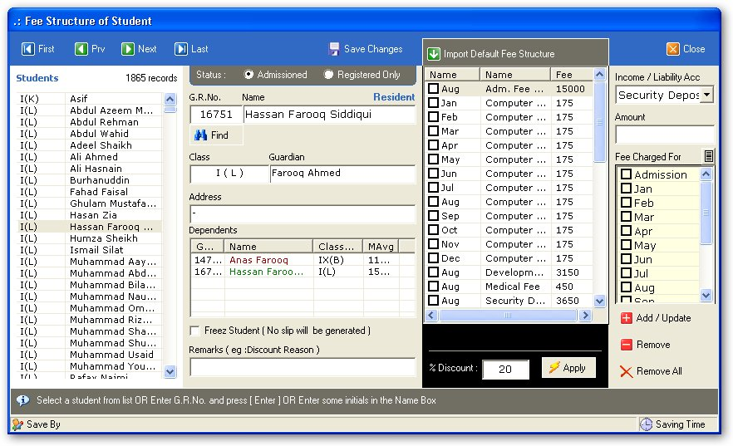
Customizable fee structure of student

Slide 30
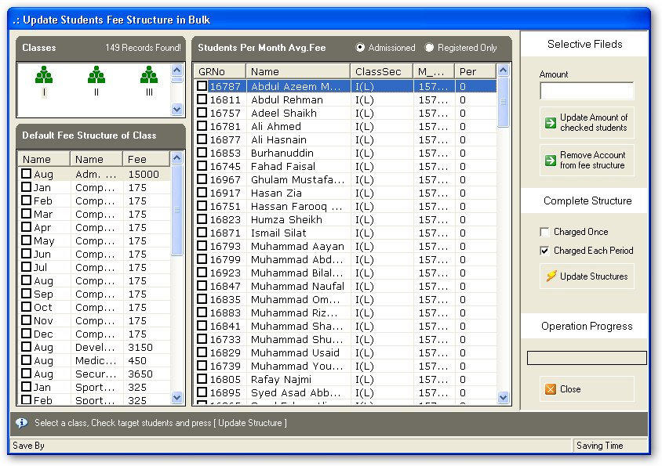
Fee structure operations in bulk

