Slide 1

Student Information System
School Management Systems

Slide 2
OBJECTIVE
This is the essential module of the software which stores all personal data of the student and keeps track of his class/grade session by session.

Slide 3
Features
  Registration
  Admission
  Promotion into new classes
  Family management
  School leaving process
  ID card generation for each session
  Creation of certificates
  General reports

Slide 4
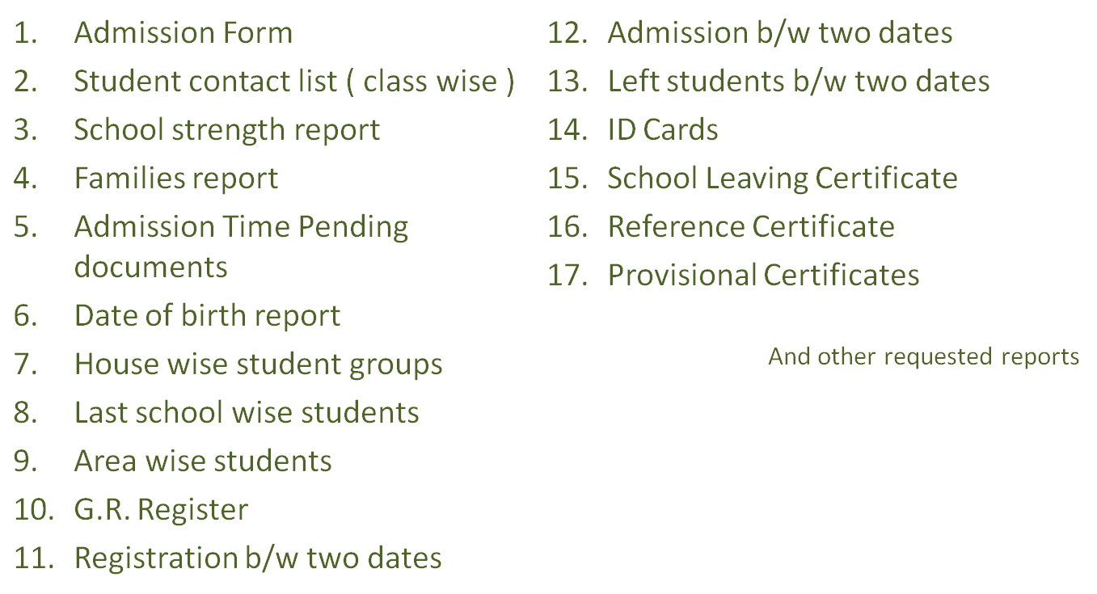
Reports

Slide 5
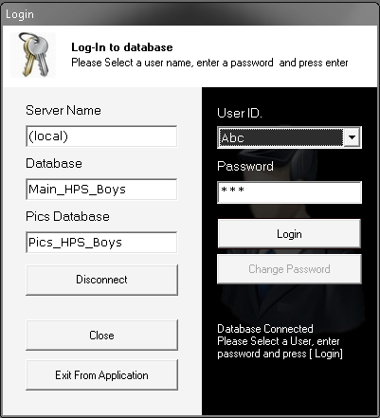
User Login Form
Database
Connection
User
Login

Slide 6
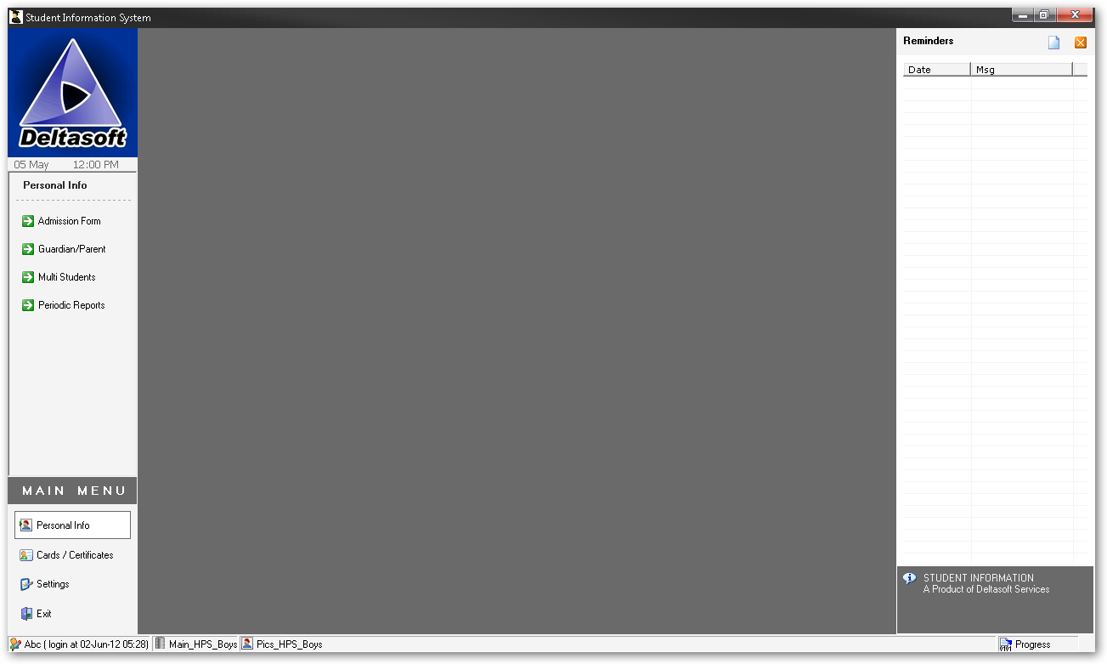
Main Form Interface
User Info
Database Info
Main Menu
Sub Menu
School Monogram
Reminder List

Slide 7
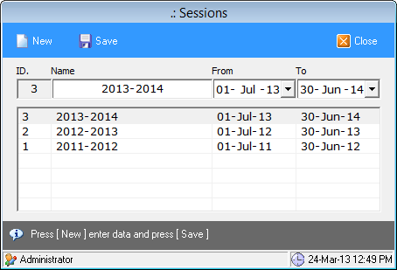
Sessions Management

Slide 8
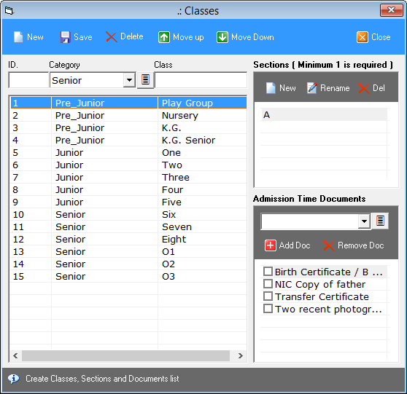
Classes Management
Sections
In Each Class
Classes
Record
Documents
Collected at
Admission
Time

Slide 9
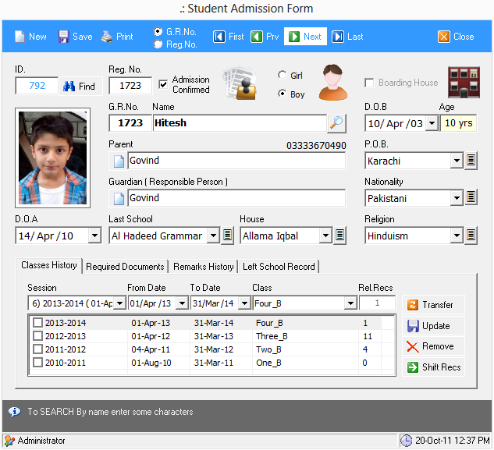
Admission Form
Registration Data
Registration No. and Date
Admission Data
G.R.No. and Date
G.R. Register Data
Gender, Religion, Nationality
Family Management
Brothers and Sisters
House Management
Red, Green, Blue etc.
Classes History
Document Management
Necessary Documents required at the time of admission
Remarks History
School Leaving Process

Slide 10
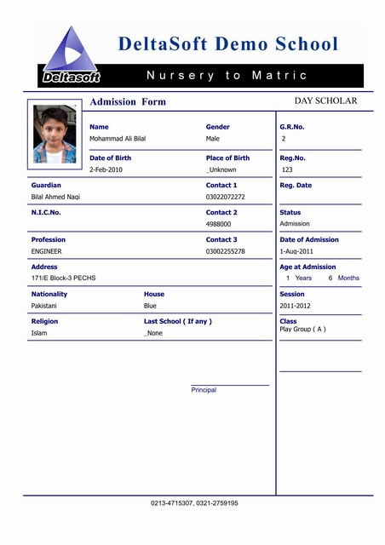
Admission Form Print
ADMISSION FORM
A print preview of admission form Is available in the application.
Which could be used to keep the hard copy of admission form.

Slide 11
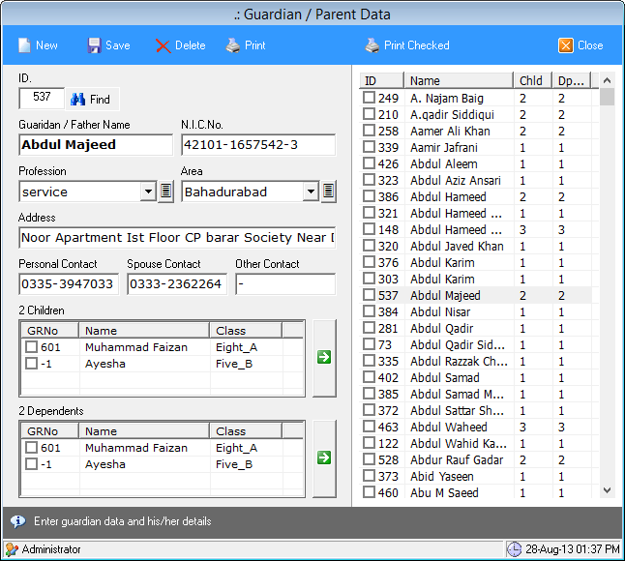
Parent / Guardian Form
Parent Information
Name, N.I.C.No. and Profession
Address
Area wise management
Contact Numbers
Could be used to send SMS
Children
Children of person as Parent.
Dependants
The students who are responsibility of person as Guardian

Slide 12
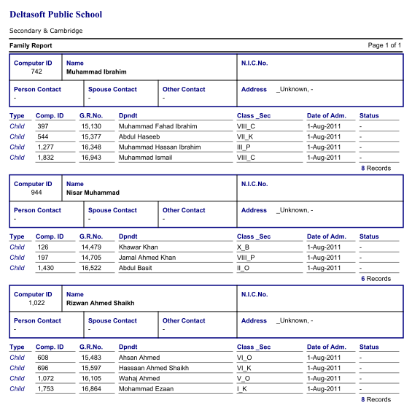
Family Report ( Print )

Slide 13
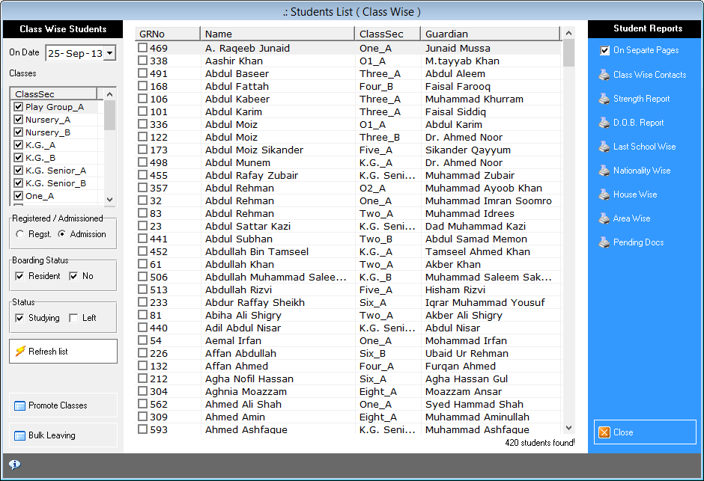
Student Browser
Student Browser is used to view list of students class wise.
Transfer into new classes and School leaving operation could be done on selected students
Different reports could be view and printed of selective students.

Slide 14
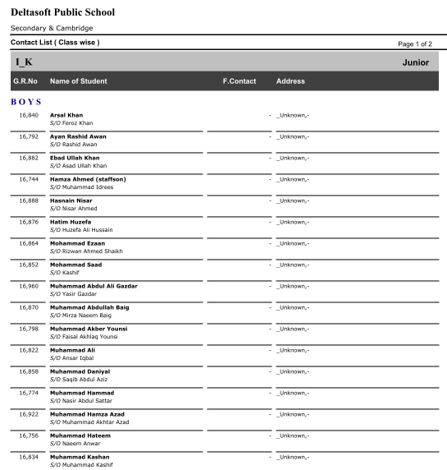
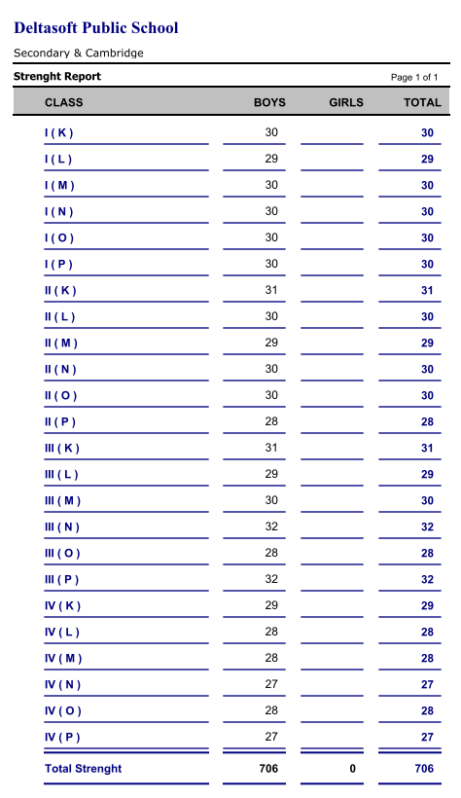
Contact List & Strength Reports

Slide 15
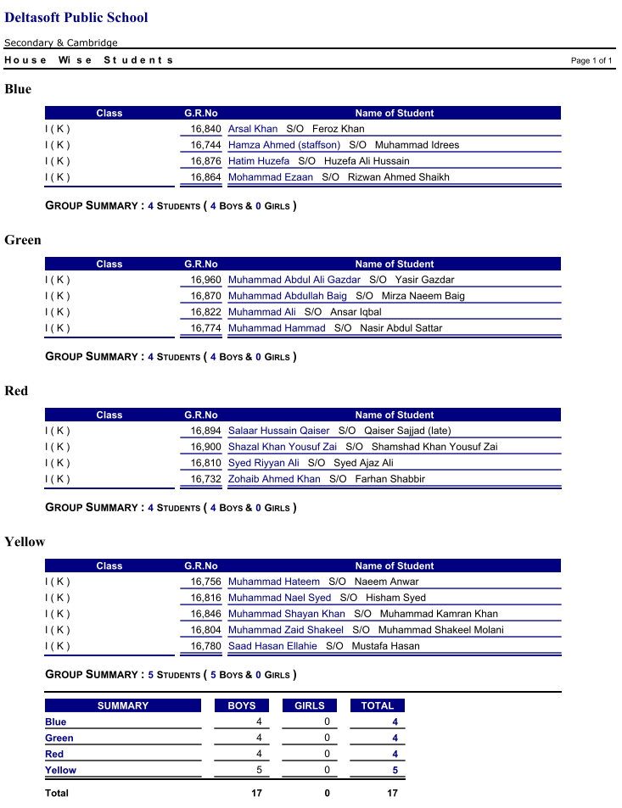
House Wise Student Groups
Group Wise Students
Different reports could be get depending on different criteria.
Such as :
House wise students
Area wise Students
Nationality wise students
Religion wise students
Etc.

Slide 16
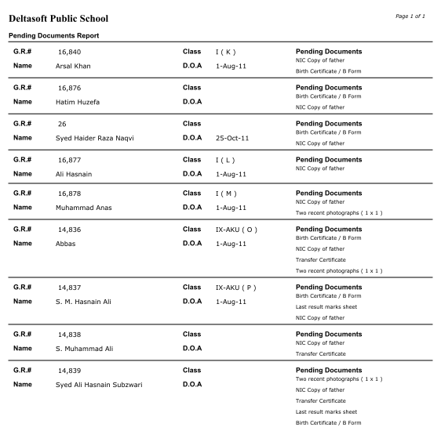
Pending Documents
Documents Management
Each school needs to collect sets of different documents according to each class.
In this application when a set of documents is assigned to a class then on each admission this list is assigned to a student. Just check the collected documents.
Pending document report helps us to manage this job.

Slide 17
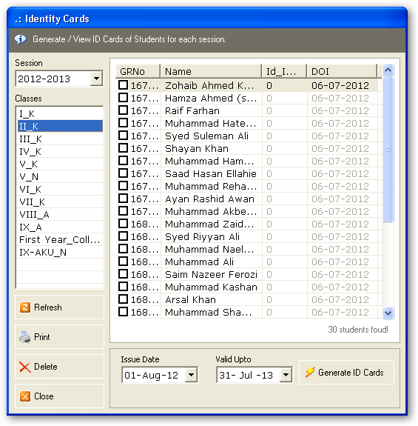
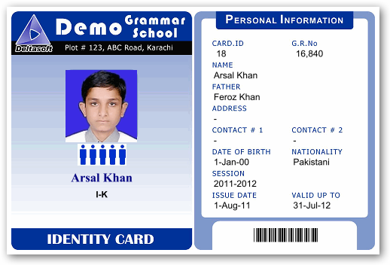
Student ID Cards
House Color
Bar code

Slide 18
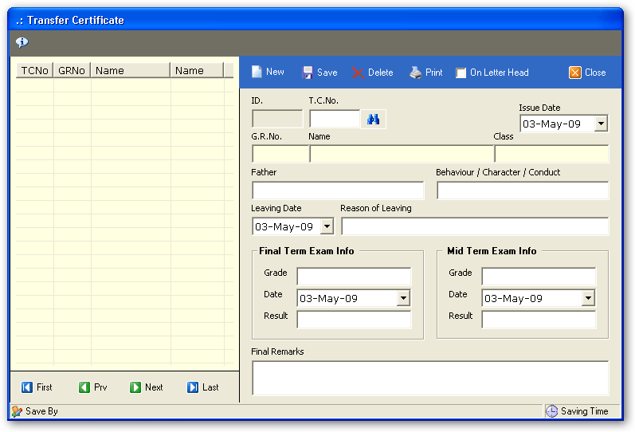
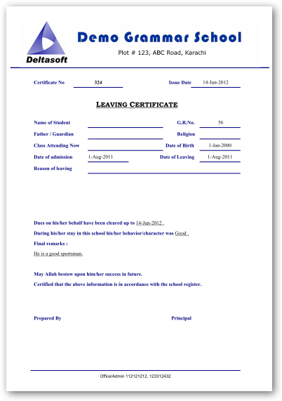
Transfer Certificate
Certificates
School Leaving / Transfer Certificate
Student Reference Certificate
Provisional Certificate
Etc.

Slide 19
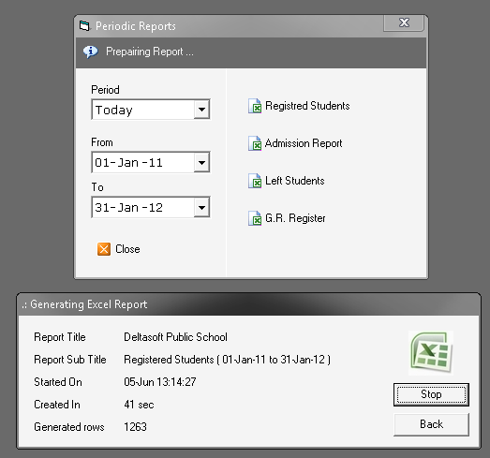
Reports ( Export to Excel )

Slide 20
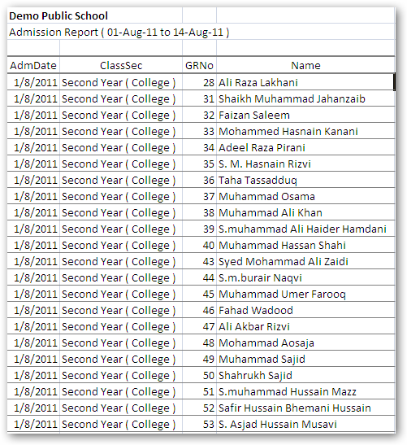
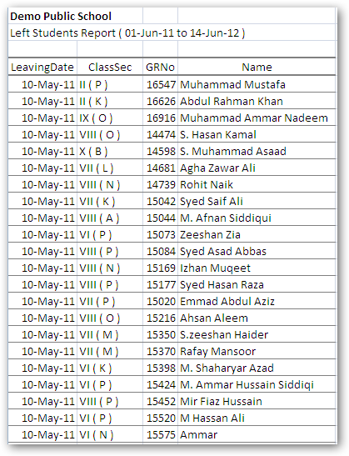
Other Reports
Admission Report
Left Students Report

Slide 21
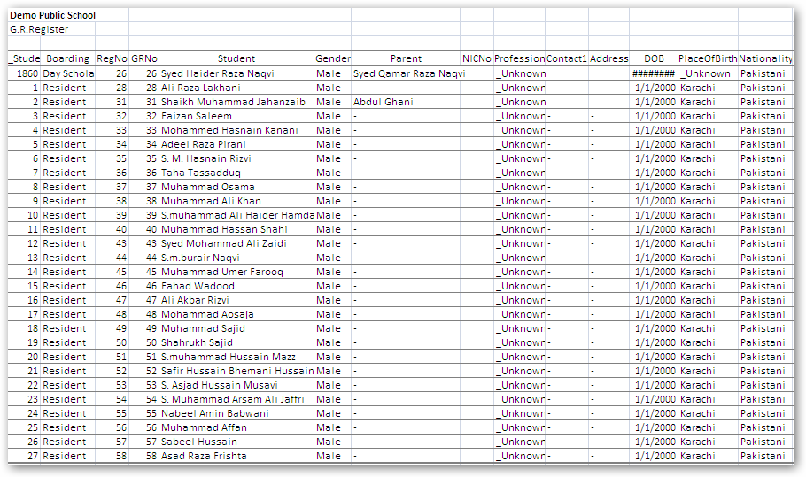
Other Reports
G.R. Register ( Excel Format )

