Slide 1
Welcome
PSP COURSE PROJECT
MOVIE TICKET.C

Slide 2
NAME: HT.NO:
T. SAIKUMAR 2203A51653
M. VISHWA TEJA 2203A51642
CH. AKSHITH REDDY 2203A51656
T. RASANYA 2203A51654
N. SRIKANTH 2203451646

Slide 3
Introduction
The movie ticket booking program is designed to provide a convenient and user-friendly platform for users to book movie tickets. This program is implemented using the C programming language, which offers flexibility, efficiency, and control over system resources. The primary goal of this project is to create a reliable and efficient system that allows users to browse available movies, select show timings, and book tickets seamlessly.

Slide 4
PROBLEM STATEMENT
Develop a C Application for booking movie tickets, which allows storing and managing the details of the reservations made by customers.
The application should store the following information for each reservation: customer's Name, Seat Number , Movie Name, and Ticket Price. The data should be stored in dynamically allocated memory using a structure

Slide 5
MODULES
Movie Ticket Booking System. It allows users to view available seats in a theater, select seats, buy selected seats, and exit the program. Here's a breakdown of the code:
DisplayTheaterView():
This function displays the current theater seating arrangement.It uses ANSI escape codes to set colors for available, selected, and bought seats.
ISSeatAvailable():
This function checks if a seat at a given row and column is available. It returns 1 if the seat is available, otherwise 0.

Slide 6
SelectSeat (): This function marks a seat at a given row and column as selected
BuySeat():
This function marks a seat at a given row and column as bought. It also displays a success message with the seat details.
ClearInputBuffer ():
This function clears the input buffer to prevent any unwanted input.
ProcessPayment ():
This function simulates the payment processing. It calculates the total price based on the number of selected seats.
It asks the user for their bank account number and PIN. It returns 1 to simulate a successful payment.

Slide 7
Control Statements (if, if-else, switch)
Loop Statements (while/do while, for)
Arrays (1D/2D-arrays)
Strings (Strings and Table of strings) and its functions (strcpy, strcmp)
Functions (Any type of user defined functions)
Structure (structures and nested structures)
Pointers (pointer to strings and pointers to structures)
Dynamic Memory Allocation (malloc/ calloc/ realloc)

Slide 8

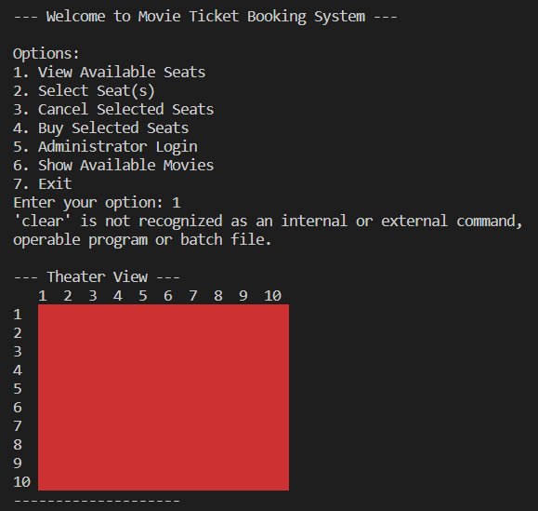
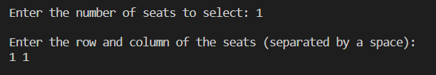
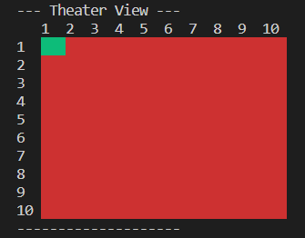
Result :

Slide 9
THANK YOU
“Programming is the art of bringing order to chaos”

