Slide 1
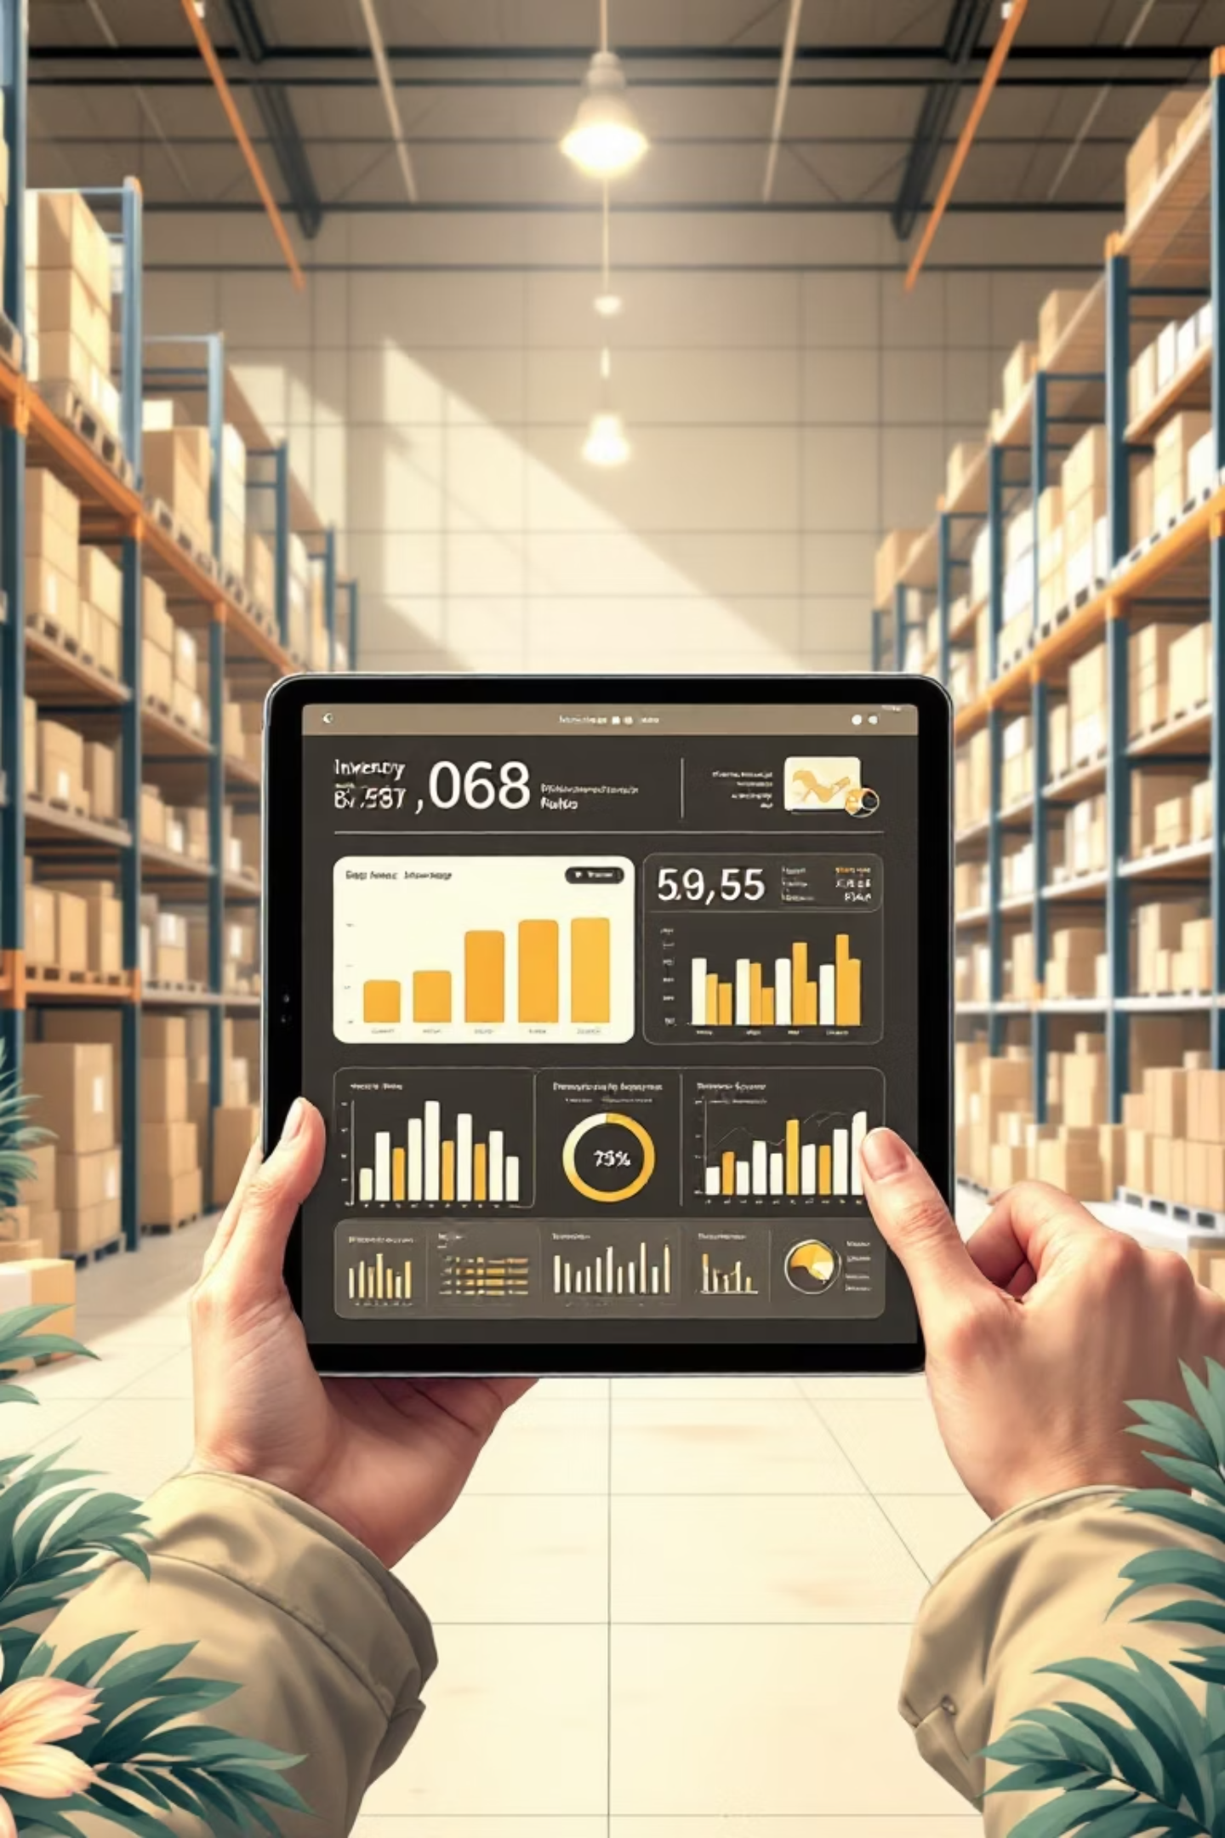
Smart Inventory Management System for Small Businesses
Developed by:
Enoch Oduro – FCM.41.018.197.23
Rockson Kumah - FCM .41.018.162.23
Samuel Nii Dodoo Obrempong Amo - FCM.41.018.052.23
Ernest Akugri Akolwini - FCM.41.018.030.23
Azumah Elorm Rapheal - FCM.41.018.089.23
Course: Software Engineering | August 2025

Slide 2


Bridging the Gap
Addressing Small Business Inventory Challenges
The Problem
Our Solution
Small businesses often rely on manual inventory tracking, leading to critical inefficiencies. This antiquated approach frequently results in costly stockouts, leading to lost sales, or detrimental overstocking, tying up valuable capital. Furthermore, manual systems severely limit real-time visibility into sales performance and inventory levels.
Our Smart Inventory Management System aims to revolutionize this by automating core processes. Our primary objectives include robust stock management, real-time sales tracking, proactive low-stock alerts, and comprehensive report generation, all designed to enhance operational efficiency and profitability for small and medium-sized enterprises (SMEs).

Slide 3






Core System Capabilities
Product Management
Automated Sales & Stock Updates
Seamlessly add, update, and remove product information, including stock levels, pricing, and descriptions.
Effortlessly record sales transactions, with the system automatically deducting sold items from inventory in real-time.
Low-Stock Alert System
Comprehensive Reporting
Receive immediate notifications when product quantities fall below a predefined reorder threshold, preventing stockouts.
Generate and export detailed inventory reports, sales summaries, and stock movement analytics for informed decision-making.
Supplier Management
Role-Based Access Control
Maintain a database of suppliers, linking products to their respective vendors for streamlined procurement.
Ensure data security and operational integrity with distinct login roles for Administrators and Sales Clerks.

Slide 4




Our Agile Approach
Software Development: Iterative Model
We adopted the Iterative Model for its inherent flexibility and emphasis on continuous improvement. This approach allowed us to develop the system in cycles, integrating frequent testing and feedback at each stage. This significantly reduced the risk of project failure and ensured the final product met evolving user needs.
Planning
Development
Define scope and initial requirements for the iteration.
Implement features based on the planned increment.
Our development roadmap included five key iterations, progressively building out functionality: User Login, Product Management, Sales Tracking, Automated Alerts, and final System Polish.
Testing
Feedback
Rigorously test developed features for functionality and bugs.
Gather user feedback to refine requirements for next iteration.

Slide 5
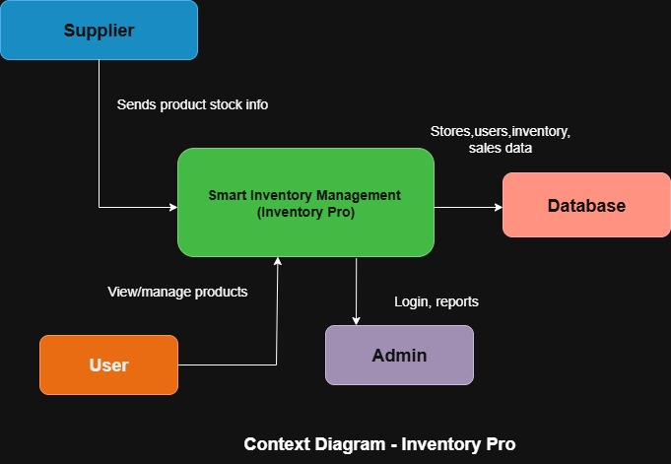
System Overview: Context Diagram
This diagram illustrates the Smart Inventory Management System as a central entity, showing its interactions with external entities and the flow of information between them.
The system processes inputs such as product data and sales records, and generates outputs like detailed reports and proactive alerts, serving both internal users and external suppliers.

Slide 6
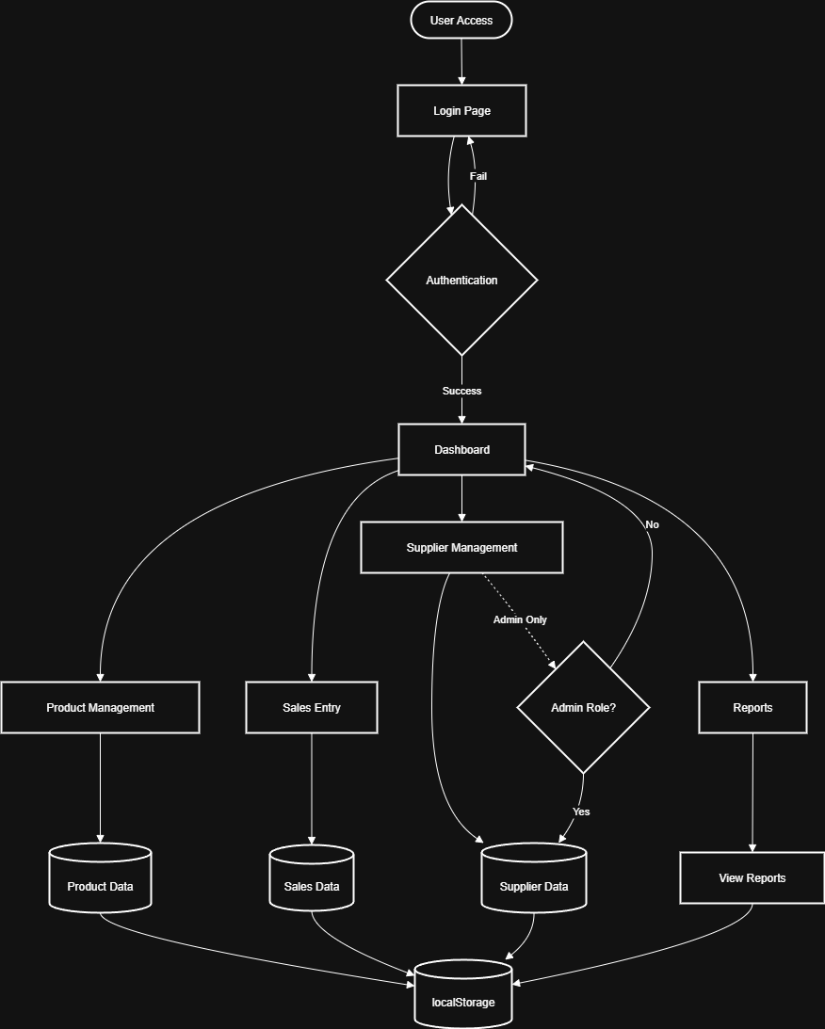






Operational Flow:
A Step-by-Step Process
User Login
Role Verification
Users initiate by logging into the system securely.
The system verifies user credentials and assigned role (Admin/Sales).
Stock Adjustment
Alert Trigger
Inventory levels are automatically
updated post-sale, reflecting real-time stock.
Low-stock alerts are automatically generated if product quantities fall below predefined thresholds.
Sales Recording
Product Management
Sales Clerks record customer transactions within the system.
Administrators manage inventory by adding, updating, or deleting products.

Slide 7
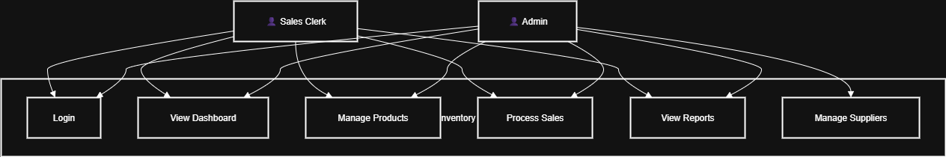
User Interactions: Use Case Diagram
The Use Case Diagram visually represents the system's functionality from the perspective of its users.
It highlights the various interactions users have with the Smart Inventory Management System, detailing key actions and responsibilities for each role:
Record Sale: Sales Clerks efficiently process customer transactions, leading to automatic inventory adjustments.
Login: Both Administrators and Sales Clerks securely access the system.
View Reports: Users can generate and view comprehensive reports on sales, stock levels, and other operational data, tailored to their access level.
Add Product: Administrators manage the inventory by adding new
products, updating details, or removing obsolete items.
Receive Alerts: The system provides real-time notifications for critical events, such as low stock levels, ensuring timely action.

Slide 8
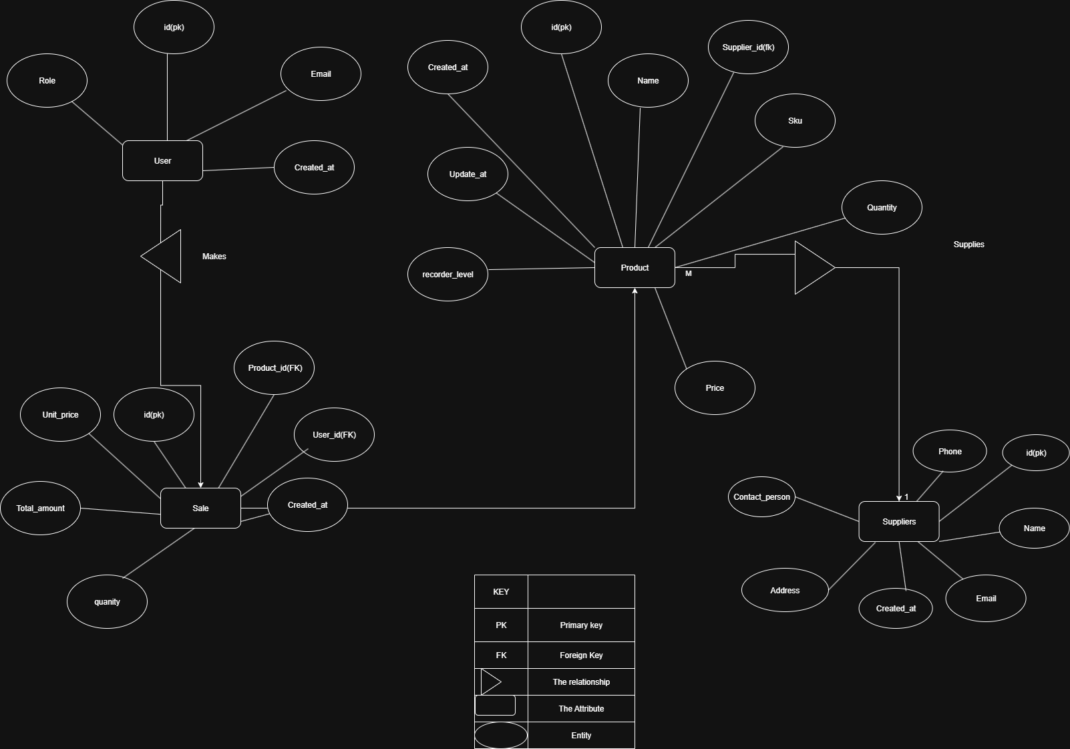
Data Structure: Entity-Relationship Diagram
The ER Diagram outlines the relationships between the critical
data entities within our Smart Inventory Management System.
Key tables include Users, Products, Sales, and Suppliers, demonstrating
how products are linked to suppliers and how sales records are tied to
both products and the users who processed them.

Slide 9

Ensuring Reliability: Our Testing Approach
Our testing strategy involved a rigorous examination of UI inputs and their corresponding expected outputs. We meticulously tested core functionalities:
Black-box Testing
We exclusively utilized Black-box Testing, focusing on the system's external behavior without delving into its internal code structure. This method allowed us to validate functionalities from an end-user perspective, ensuring a seamless user experience.
Secure user login and role-based access.
Accurate product entry and modification.
Flawless sales transaction recording.
Timely and accurate low-stock alert generation.
This comprehensive approach ensured the system performs reliably and meets all specified user requirements with high fidelity.

Slide 10

Conclusion & Future Enhancements
Project Accomplishments
Future Scope
Our Smart Inventory Management System successfully achieves its primary objective: providing small businesses with an automated, secure, and user-friendly solution for inventory control. The system is robust, functional, and designed to significantly enhance operational efficiency.
To further enhance the system, we envision several additions:
Barcode Scanning Integration: For rapid and error-free product entry and sales.
SMS Alerts: To provide critical notifications even when not logged into the system.
Key successes include:
Advanced Analytics Dashboard: Offering deeper insights into sales trends, popular products, and inventory turnover.
Robust automated stock management.
Intuitive sales tracking interface.
Reliable alert and reporting mechanisms.
Mobile Application: For on-the-go inventory management and sales recording.
Secure role-based access.

