Slide 1
CY376: NETWORK MONITORING, SECURITY AND AUDITING
Simulated Privilege Escalation &
Domain Compromise Briefing
An Assumed-Breach Red Team Assessment of INLANEFREIGHT.LOCAL Domain
Presenter: Enoch Nana Tabi Oduro | Index: CY376-2026-REG | Track: Red Team Assessment
Target Domain: INLANEFREIGHT.LOCAL | Assessment Framework: Assumed-Breach Lifecycle

Slide 2
CY376 RED TEAM BRIEFING
1. Engagement Scope & Assumed-Breach Strategy
Assumed-Breach Threat Model
• Realistic Adversary Scenario: Simulates an insider threat or compromised low-privilege employee workstation.
• Initial Access Vector: Pre-authenticated foothold established as user 'hporter' (Domain User).
• Scope Boundaries: Active Directory domain controllers, member servers, and network share infrastructure.
• Zero Prior Privileges: No administrative rights or privileged group memberships provided upfront.
KEY FINDING: Validates security posture against real-world post-exploitation adversary TTPs.
Primary Technical Objectives
• Privilege Escalation Validation: Demonstrate end-to-end lateral movement and privilege escalation to Domain Admin.
• Misconfiguration Mapping: Identify excessive ACL delegations, stored credentials, and unsecure services.
• DCSync Replication: Exfiltrate directory credentials via NTDS replication rights.
• Remediation Roadmap: Provide actionable, prioritized defense-in-depth guidance aligned with CIS Benchmarks.
KEY FINDING: Objective: 100% compromise of INLANEFREIGHT.LOCAL Active Directory forest.

Slide 3
CY376 RED TEAM BRIEFING
2. Lab Target Environment & Network Architecture
DC01 (172.16.8.3)
• Role: Primary Domain Controller
• OS: Windows Server 2019
• Services: Active Directory DS, Kerberos, LDAP, SMB, DNS
MS01 (172.16.8.50)
• Role: Internal Member Server
• OS: Windows Server 2019
• Services: WinRM, Sysax Automation Service, SQL Server
DEV01 / DMZ01 (172.16.8.10)
• Role: Web Pivot / Internal Web Server
• OS: Ubuntu 22.04 LTS
• Services: HTTP Apache, SSH, Internal Web Apps
Attacker Station (10.10.15.145)
• Platform: Kali Linux Red Team Workstation
• Tooling Suite: NetExec, Impacket, bloodyAD, Mimikatz, BloodHound
• Network Path: Routable subnet to target lab 172.16.8.0/24

Slide 4
CY376 RED TEAM BRIEFING
3. 12-Stage Attack Chain Overview & Chained Vectors
Chained Attack Progression (hporter -> Domain Admin)
• Foothold & Recon (Stages 1-2): Validate hporter credentials; BloodHound ACL query identifies ForceChangePassword over ssmalls.
• ACL Reset & Share Harvesting (Stages 3-4): bloodyAD resets ssmalls password; NetExec share spider finds backupadm credentials in backup script.
• Lateral Movement & LSA Dump (Stages 5-8): Evil-WinRM onto MS01 as backupadm; exploit Sysax service for SYSTEM; Mimikatz dumps mssqladm secrets.
• Kerberoasting & Group Addition (Stages 9-10): GenericWrite over ttimmons -> SPN injection & Hashcat crack (Repeat09); GenericAll self-addition to Server Admins.
• DCSync & Domain Takeover (Stages 11-12): DCSync replication dumps Administrator NTLM hash; Pass-the-Hash Evil-WinRM shell on DC01.
KEY FINDING: 12 distinct technical stages successfully chained together to achieve total domain takeover.

Slide 5
[STAGE 01] CY376 RED TEAM BRIEFING
Stage 1: Initial Access & Foothold Verification
Stage 1 Details
• Objective: Verify initial assumed-breach credentials for user hporter.
• Target Host: DC01 (172.16.8.3) over SMB.
• Tool Employed: NetExec (nxc smb 172.16.8.3 -u hporter -p 'Gr8hambino!')
• Execution Syntax: nxc smb 172.16.8.3 -u hporter -p 'Gr8hambino!'
• Outcome: Returned SMB [+] status, confirming valid domain authentication.
KEY FINDING: Foothold established under INLANEFREIGHT\hporter identity.
Figure 1: NetExec SMB Credential Verification for hporter against DC01

Slide 6
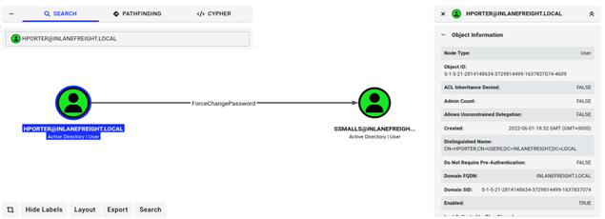
[STAGE 02] CY376 RED TEAM BRIEFING
Stage 2: Active Directory Enumeration (BloodHound)
Stage 2 Details
• Objective: Enumerate Active Directory ACLs and locate escalation paths from hporter.
• Tool Employed: BloodHound / SharpHound ingestor & Cypher query engine.
• Cypher Query: MATCH p=(u:User {name:'HPORTER@INLANEFREIGHT.LOCAL'})-[r]->(t) RETURN p
• Discovered Abusable Right: ForceChangePassword ACL over user ssmalls.
• Significance: Allows resetting target user password without knowing existing credentials.
KEY FINDING: Path identified: hporter possesses ForceChangePassword authority over ssmalls.
Figure 2: BloodHound ACL Analysis Revealing ForceChangePassword Right over ssmalls

Slide 7
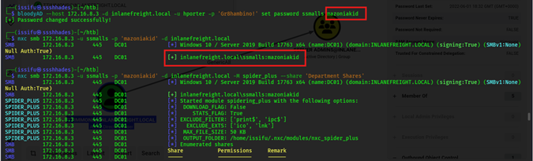
[STAGE 03] CY376 RED TEAM BRIEFING
Stage 3: Abuse of ForceChangePassword ACL
Stage 3 Details
• Objective: Force reset ssmalls' password over LDAP using bloodyAD.
• Tool Employed: bloodyAD & NetExec SMB verification.
• Command Syntax: bloodyAD -u hporter -p 'Gr8hambino!' -d inlanefreight.local --host 172.16.8.3 set password ssmalls 'mazoniakid'
• Verification Syntax: nxc smb 172.16.8.3 -u ssmalls -p 'mazoniakid'
• Outcome: LDAP password reset successful; SMB login validated under ssmalls identity.
KEY FINDING: Identity takeover complete: Control of ssmalls account secured.
Figure 3: Password Reset Execution over ssmalls via bloodyAD and NetExec SMB Verification

Slide 8
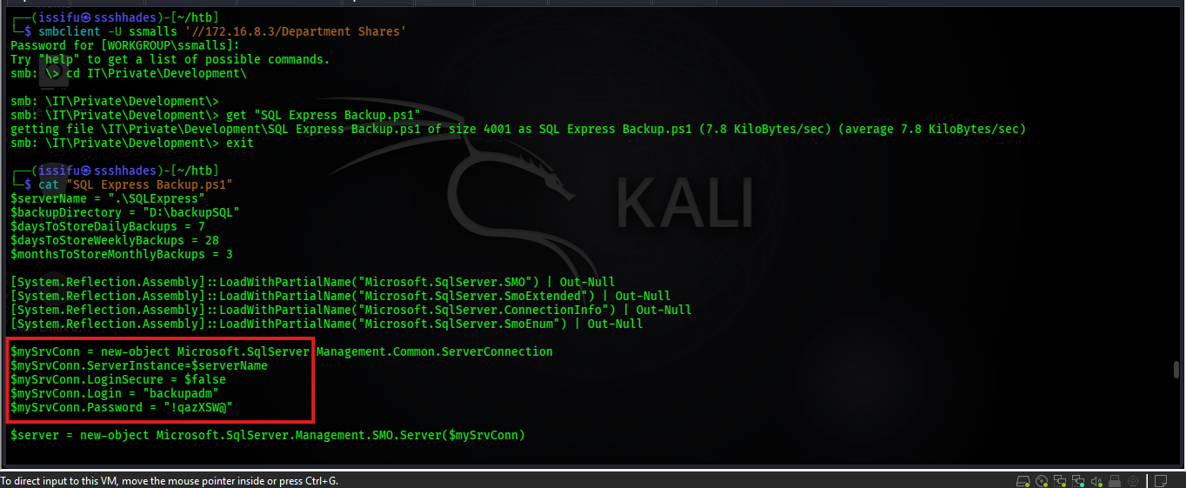
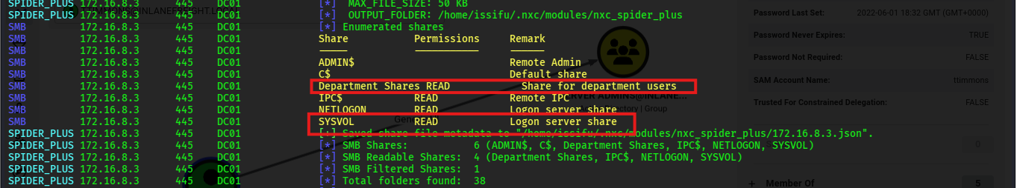
[STAGE 04] CY376 RED TEAM BRIEFING
Stage 4: File Share Credential Harvesting
Stage 4 Details
• Objective: Harvest plaintext credentials from network file shares accessible to ssmalls.
• Share Enumeration: NetExec SMB spidering against DC01 ('Department Shares').
• Artifact Discovered: 'SQL Express Backup.ps1' backup script in IT directory.
• Credentials Extracted: backupadm : !qazXSW@
• Risk Factors: Hardcoded service account credentials stored in unencrypted scripts.
KEY FINDING: Recovered cleartext credentials for backupadm service account.
Figure 4a: SMB Share Spidering Output
Figure 4b: Extraction of Plaintext Credentials from Backup Script

Slide 9
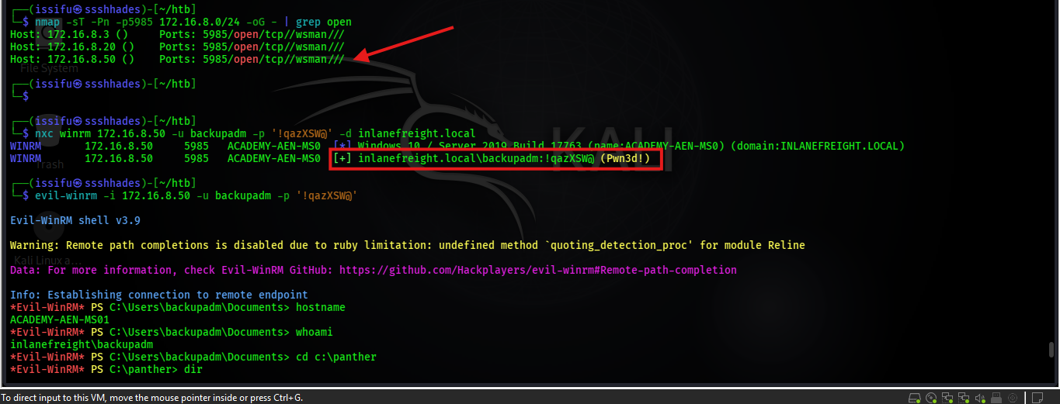
[STAGE 05] CY376 RED TEAM BRIEFING
Stage 5: WinRM Host Discovery & Lateral Movement
Stage 5 Details
• Objective: Pivot laterally onto member server MS01 using harvested credentials.
• Service Discovery: WinRM (TCP 5985) listening on MS01 (172.16.8.50).
• Tool Employed: Evil-WinRM remote shell client.
• Execution Syntax: evil-winrm -i 172.16.8.50 -u backupadm -p '!qazXSW@'
• Outcome: Established interactive Remote PowerShell session on MS01 as backupadm.
KEY FINDING: Lateral movement successful: Interactive shell obtained on MS01.
Figure 5: Evil-WinRM Remote Interactive Shell Established on MS01 as backupadm

Slide 10
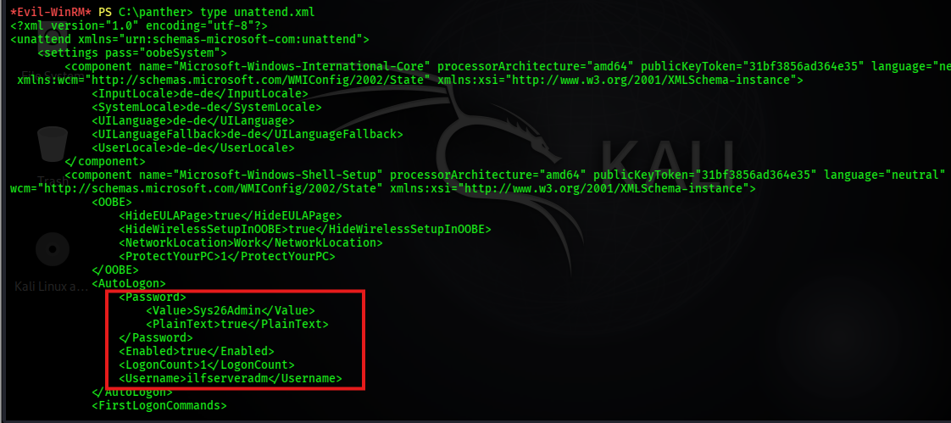
[STAGE 06] CY376 RED TEAM BRIEFING
Stage 6: Leftover Deployment Artifact Exposure
Stage 6 Details
• Objective: Inspect MS01 file system for leftover OS installation/deployment artifacts.
• Artifact Located: C:\panther\unattend.xml (Unattended Windows Setup configuration).
• Tool Employed: Evil-WinRM file system inspection (Get-Content C:\panther\unattend.xml).
• Credentials Recovered: ilfserveradm : Sys26Admin
• Impact: Unencrypted deployment file contained sensitive administrative credentials.
KEY FINDING: Discovered cleartext credentials for ilfserveradm in Panther setup log.
Figure 6: Discovery of Plaintext Credentials for ilfserveradm in C:\panther\unattend.xml

Slide 11
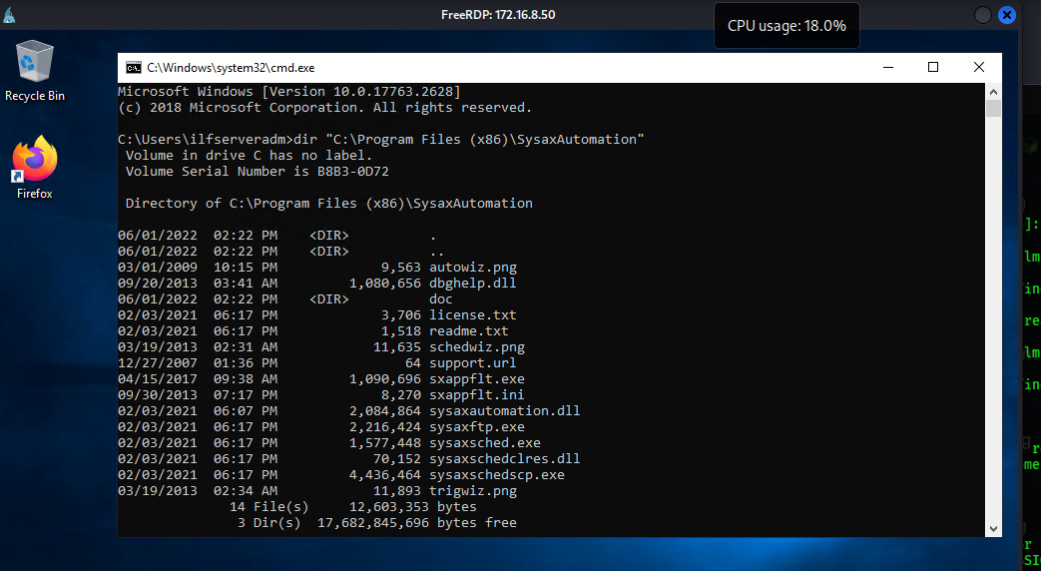
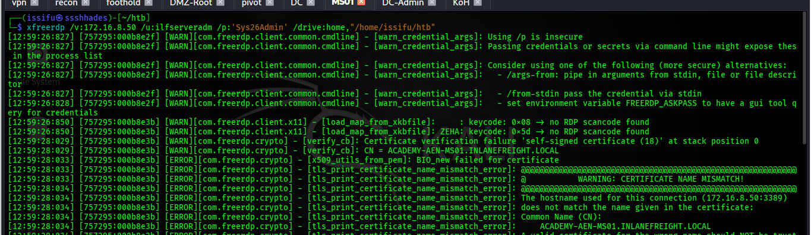
[STAGE 07] CY376 RED TEAM BRIEFING
Stage 7: Local Privilege Escalation on MS01 (Sysax Service)
Stage 7 Details
• Objective: Escalate privileges to NT AUTHORITY\SYSTEM on member server MS01.
• Vulnerability: Sysax Automation Service running as SYSTEM with web GUI on TCP 88.
• Exploitation Method: Configured Sysax custom event trigger to execute batch script.
• Batch Script Action: net localgroup Administrators ilfserveradm /add
• Outcome: ilfserveradm successfully added to MS01 Local Administrators group.
KEY FINDING: Privilege escalation complete: Local Administrative control secured on MS01.
Figure 7: Sysax Automation Service Web Interface
Figure 8: Execution of Custom Batch Script Adding ilfserveradm to Local Admins

Slide 12
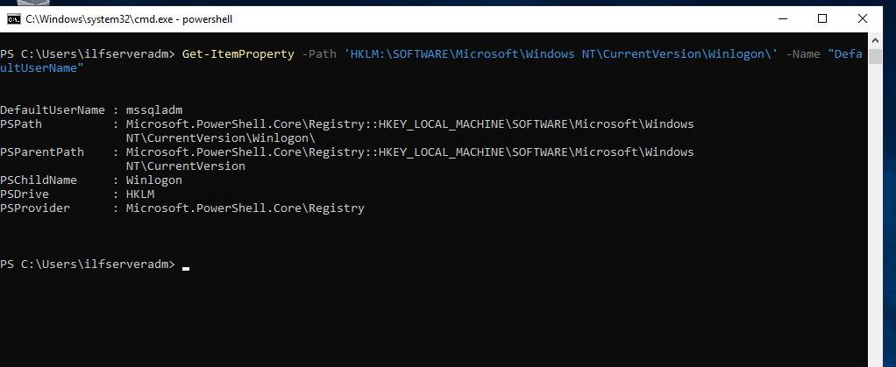
[STAGE 08] CY376 RED TEAM BRIEFING
Stage 8: LSA Secrets Dump on MS01 (Autologon Secrets)
Stage 8 Details
• Objective: Dump Local Security Authority (LSA) registry secrets from MS01 memory.
• Prerequisite: Local Administrator / SYSTEM privileges on MS01.
• Tool Employed: Mimikatz lsadump::secrets & Winlogon registry query.
• Target Account: mssqladm (SQL Server Administrator).
• Credentials Recovered: mssqladm : DBAilfreight1!
KEY FINDING: LSA memory dump yielded cleartext password for mssqladm.
Figure 9: Registry Winlogon DefaultUserName Query & Mimikatz LSA Dump for mssqladm

Slide 13
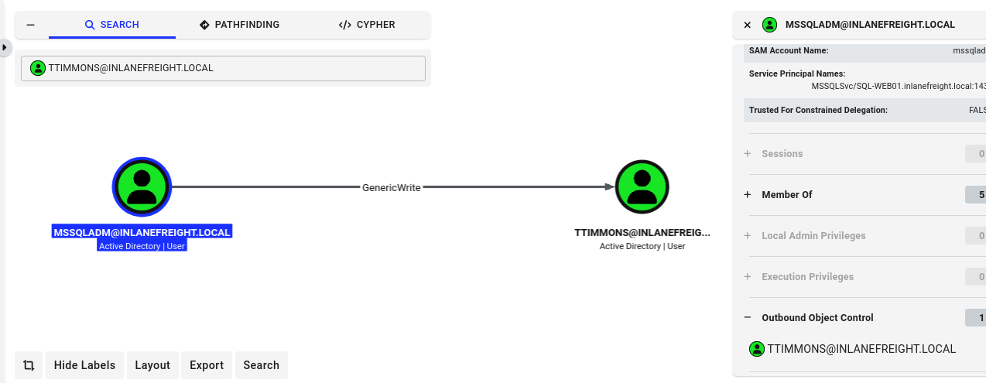
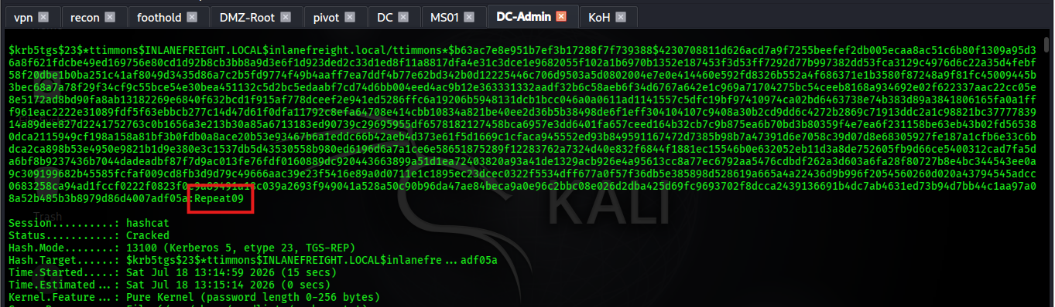
[STAGE 09] CY376 RED TEAM BRIEFING
Stage 9: Targeted Kerberoasting via GenericWrite Delegation
Stage 9 Details
• Objective: Compromise target user ttimmons via Targeted Kerberoasting.
• Delegation Right: mssqladm possessed GenericWrite control over ttimmons object.
• SPN Injection: bloodyAD set SPN 'mssql/MS01' on ttimmons account.
• Ticket Request: Impacket GetUserSPNs.py requested Kerberos TGS ticket.
• Offline Cracking: Hashcat (Mode 13100) cracked TGS hash -> 'Repeat09'.
KEY FINDING: Targeted Kerberoasting successfully compromised ttimmons : Repeat09.
Figure 11: Targeted SPN Injection on ttimmons via bloodyAD
Figure 12: Hashcat Offline TGS Ticket Cracking (Repeat09)

Slide 14
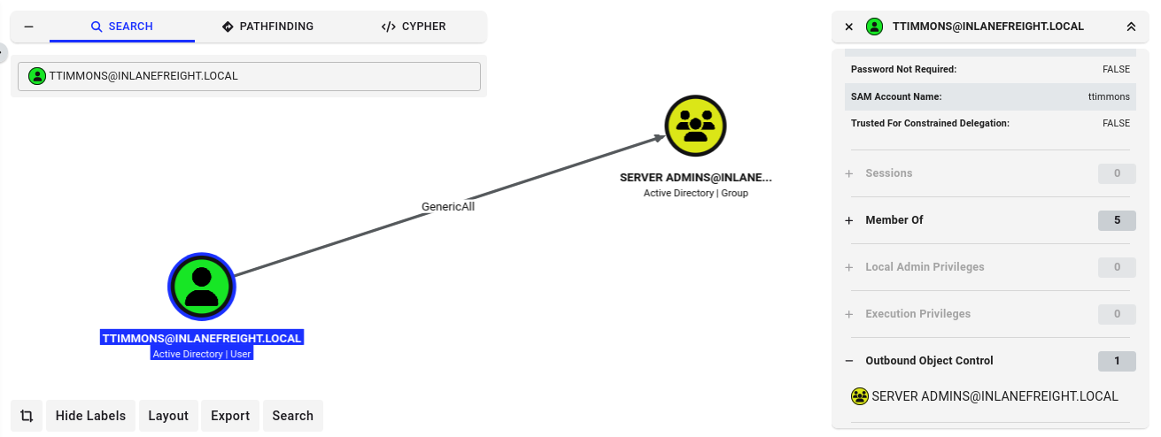
[STAGE 10] CY376 RED TEAM BRIEFING
Stage 10: Privileged Group Self-Addition (Server Admins)
Stage 10 Details
• Objective: Elevate ttimmons to a high-privilege domain security group.
• Abusable ACL: ttimmons possessed GenericAll control over 'Server Admins' group.
• Tool Employed: bloodyAD group membership addition.
• Execution Syntax: bloodyAD -u ttimmons -p 'Repeat09' -d inlanefreight.local --host 172.16.8.3 add groupMember 'Server Admins' ttimmons
• Inherited Rights: Server Admins group possesses Directory Replication (DCSync) rights.
KEY FINDING: Self-addition complete: ttimmons joined Server Admins group.
Figure 13: Group Membership Query Confirming ttimmons Addition to Server Admins Group

Slide 15
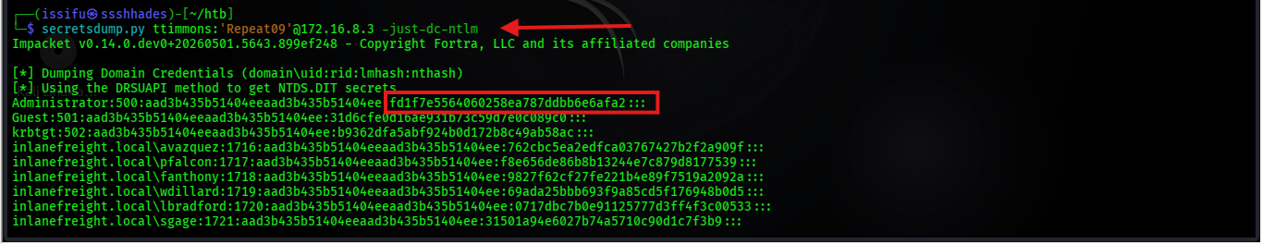
[STAGE 11] CY376 RED TEAM BRIEFING
Stage 11: DCSync Attack - Full Domain Credential Extraction
Stage 11 Details
• Objective: Extract all Active Directory user NTLM hashes via Directory Replication.
• Attack Technique: DCSync attack utilizing DS-Replication-Get-Changes-All extended right.
• Tool Employed: Impacket secretsdump.py.
• Execution Syntax: python3 secretsdump.py inlanefreight.local/ttimmons:'Repeat09'@172.16.8.3
• Exfiltrated Hashes: Administrator NTLM hash: 161cff084477ae097a9f726700ad71a4
KEY FINDING: Full NTDS database dump achieved: All domain hashes exfiltrated.
Figure 14: Impacket secretsdump.py Performing DCSync Replication Dumping NTLM Hashes

Slide 16
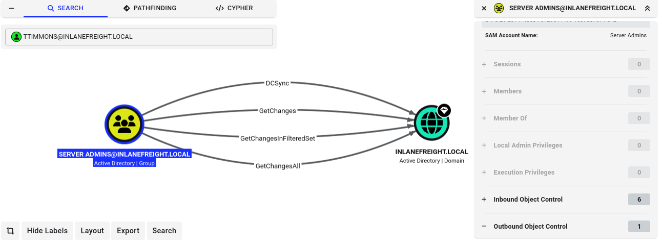
[STAGE 12] CY376 RED TEAM BRIEFING
Stage 12: Proof of Domain Compromise (Pass-the-Hash)
Stage 12 Details
• Objective: Prove 100% full domain compromise by gaining interactive shell on DC01.
• Attack Technique: Pass-the-Hash (PtH) authentication over WinRM.
• Tool Employed: Evil-WinRM remote shell client.
• Execution Syntax: evil-winrm -i 172.16.8.3 -u Administrator -H 161cff084477ae097a9f726700ad71a4
• Final Identity: INLANEFREIGHT\Administrator (SYSTEM privilege on Domain Controller DC01).
KEY FINDING: 100% Domain Compromise Proven: Full interactive Domain Admin shell on DC01.
Figure 15: BloodHound Full Attack Path Visualizing Chained Escalation to DCSync

Slide 17
CY376 RED TEAM BRIEFING
6. Root-Cause Misconfigurations & Chained Risk Analysis
Chained Vulnerability Impact Summary
• Excessive ACL Delegations: ForceChangePassword, GenericWrite, and GenericAll assigned to standard users enabled unauthorized password resets and SPN injection.
• Cleartext Credential Exposure: Hardcoded service passwords in SMB share scripts ('SQL Express Backup.ps1') and unencrypted unattend.xml setup files.
• Unsecure Third-Party Services: Sysax Automation Service running under SYSTEM context allowed local privilege escalation via Web GUI batch triggers.
• Over-Privileged Group ACLs: Server Admins group possessed Directory Replication (DCSync) rights, allowing non-Domain Admin accounts to dump NTDS database.
KEY FINDING: A single low-privilege breach was amplified into full domain takeover due to cumulative misconfigurations.

Slide 18
CY376 RED TEAM BRIEFING
7. Prioritized Defensive Remediation Roadmap (CIS Benchmarks)
Defensive Action Plan & CIS Alignment
• 1. Revoke Directory Replication Rights (CRITICAL): Immediately strip GetChanges and GetChangesAll rights from non-DC accounts including Server Admins.
• 2. Remediate Excessive ACL Delegations (HIGH): Audit AD ACLs using BloodHound Enterprise; purge ForceChangePassword & GenericWrite on user objects.
• 3. Migrate Service Accounts to gMSAs (HIGH): Replace static service passwords with Group Managed Service Accounts (120-char auto-rotated passwords).
• 4. Enable LSA Protection & Credential Guard (MEDIUM): Deploy HKLM\SYSTEM\CurrentControlSet\Control\Lsa\RunAsPPL=1 to block LSASS memory dumping by Mimikatz.
• 5. Implement Microsoft Tiered Administration (STRATEGIC): Enforce administrative tier boundaries (Tier 0 DC, Tier 1 Servers, Tier 2 Endpoints) to prevent credential theft escalation.
KEY FINDING: Priority: Implement immediate DCSync revocation and ACL cleanup within 24 hours.

Slide 19
CY376 RED TEAM BRIEFING
8. Conclusion & Technical Q&A
Summary of Assessment Key Outcomes
• Domain Compromise Proven: 12-stage attack chain successfully executed from low-privilege hporter to full DC01 Administrator.
• Zero False Positives: All stages empirically validated with CLI outputs, screenshots, and BloodHound graphs.
• Actionable Defense Strategy: Clear prioritised remediation steps provided to break every link in the attack chain.
• Deliverables Delivered: Comprehensive Pentest Report (DOCX/PDF) and Executive Briefing Slide Deck (PPTX).
KEY FINDING: Thank you! Open for Questions & Technical Discussion.

