Slide 1
CY376: NETWORK MONITORING, SECURITY AND AUDITING
Simulated Privilege Escalation & Domain Compromise
An Assumed-Breach Active Directory Penetration Test of INLANEFREIGHT.LOCAL
Presenter: Enoch Nana Tabi Oduro | Index: CY376-2026-REG | Track: Red Team Assessment
Submission Date: Monday, 3rd August 2026
GitHub Repository: https://github.com/Mazonia/privilege-escalation-n-dom-compromise

Slide 2
CY376 RED TEAM BRIEFING
1. Engagement Scope & Assumed-Breach Threat Model
Assumed-Breach Threat Strategy
Realistic Threat Model: Simulates an insider threat or an adversary with an established internal network foothold.
Starting Credential: Low-privileged user hporter : Gr8hambino! on INLANEFREIGHT.LOCAL.
Perimeter Bypass: Focuses evaluation strictly on internal AD object permissions, service isolation, and delegation oversights.
Zero-Day Independent: Proves how native Windows protocols and ACL flaws concatenate into full domain compromise.
Primary Engagement Objectives
1. Privilege Escalation Validation: Determine if low-privileged hporter can reach Domain Administrator rights.
2. Structural Misconfiguration Audit: Map ACL oversights (ForceChangePassword, GenericWrite, GenericAll).
3. Credential Hygiene Assessment: Identify cleartext credentials in scripts, unattend files, and LSA autologon registry secrets.
4. DCSync Replication Impact: Demonstrate business risk of unmonitored GetChanges / GetChangesAll replication rights.
5. Defensive Hardening Roadmap: Formulate prioritized remediations aligned with CIS Benchmarks & MITRE ATT&CK.

Slide 3
CY376 RED TEAM BRIEFING
2. Lab Target Environment & Network Architecture
DC01 (172.16.8.3)
Role: Domain Controller | OS: Windows Server 2019
Primary Active Directory Domain Controller for INLANEFREIGHT.LOCAL. KDC, LDAP, and DNS server.
MS01 (172.16.8.50)
Role: Member Server | OS: Windows Server 2019
General-purpose member server hosting WinRM, SQL Express backup routines, and Sysax Automation Service.
DEV01 / DMZ01 (172.16.8.10)
Role: Web Pivot Host | OS: Ubuntu 22.04 LTS
Internal web host utilized for initial credential discovery during assumed-breach phase.
Attacker Station (172.16.8.100)
Role: Red Team Platform | OS: Kali Linux 2026.2
Assessment platform equipped with NetExec, BloodHound, Impacket, Mimikatz, and Hashcat.

Slide 4
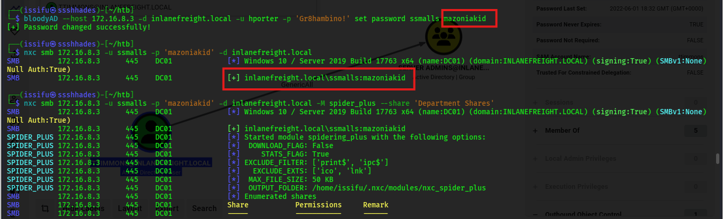
CY376 RED TEAM BRIEFING
3. Attack Chain Phase 1: Foothold Verification & Host Compromise
Stage 1: Foothold Validation Validated hporter : Gr8hambino! credentials against DC01 via NetExec SMB.
Stage 2-3: ForceChangePassword ACL BloodHound graph analysis exposed ForceChangePassword over ssmalls. Forcefully updated password to mazoniakid via bloodyAD.
Stage 4: File Share Credential Harvesting Spidered IT department share as ssmalls; extracted backupadm : !qazXSW@ from SQL Express Backup.ps1.
Stage 5: WinRM Lateral Movement Authenticated to member server MS01 via WinRM using backupadm credentials.
Stage 6-7: Unattend.xml & Sysax LPE Discovered cleartext ilfserveradm credentials in C:\panther\unattend.xml. Escalated to local SYSTEM via vulnerable Sysax Automation service.

Slide 5
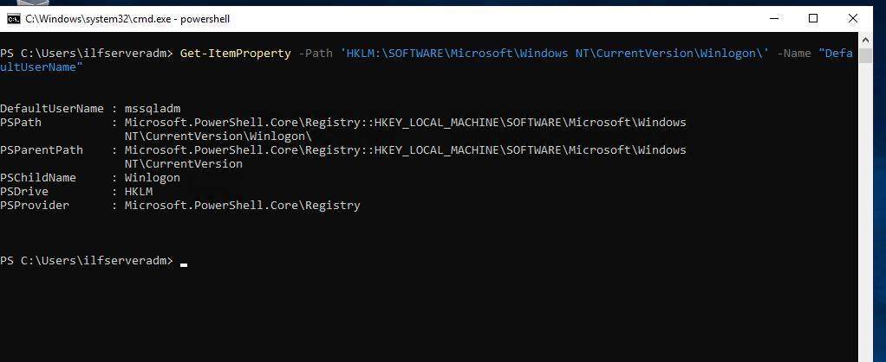
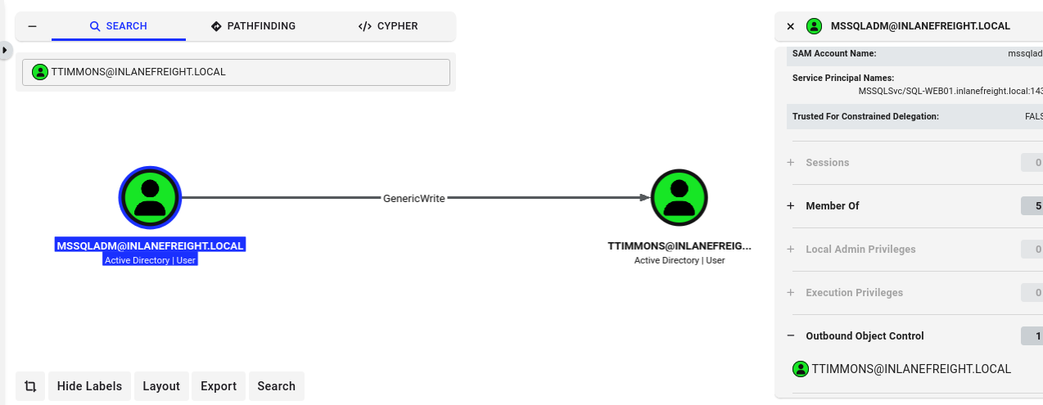
CY376 RED TEAM BRIEFING
4. Attack Chain Phase 2: LSA Autologon Secrets & Targeted Kerberoasting
Stage 8: Mimikatz LSA Secrets Dump Extracted cleartext autologon registry secrets (HKLM\SECURITY) on MS01; recovered domain service account mssqladm : DBAilfreight1!.
Stage 9: Targeted SPN Injection via GenericWrite mssqladm possessed GenericWrite rights over user ttimmons. Used bloodyAD to write a fake Service Principal Name (acmetesting/LEGIT), forcing ttimmons to become Kerberoastable.
Offline Kerberos TGS Ticket Cracking Requested TGS ticket via Impacket GetUserSPNs.py. Cracked Kerberos hash offline via Hashcat (Mode 13100), recovering ttimmons : Repeat09.

Slide 6
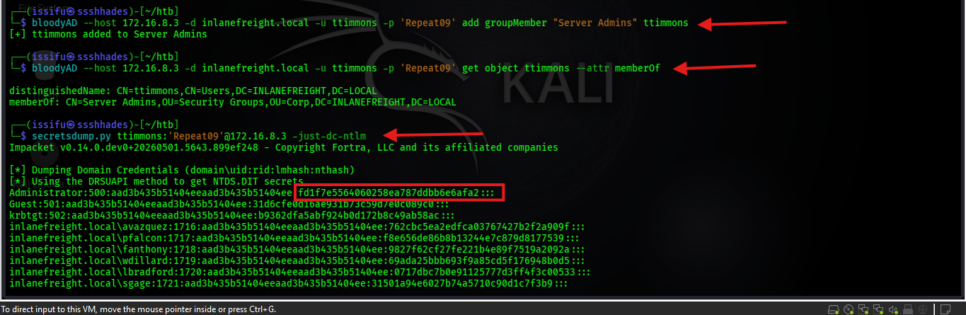
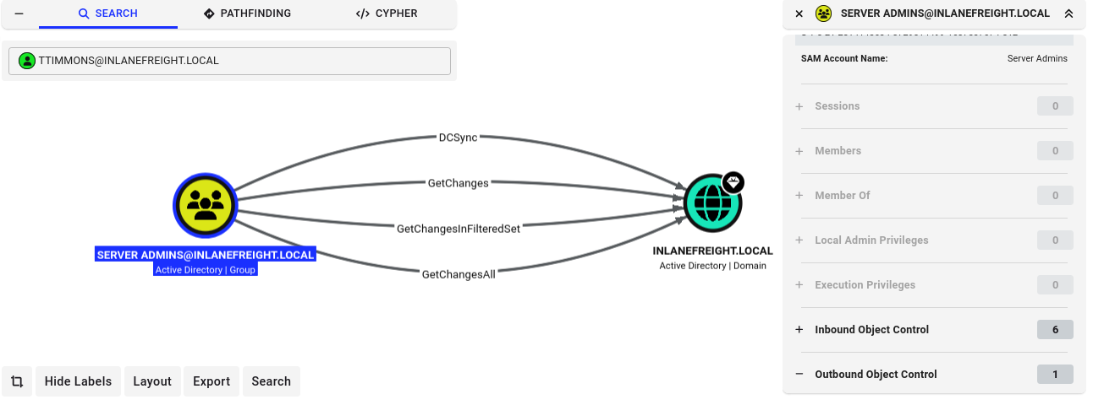
CY376 RED TEAM BRIEFING
5. Attack Chain Phase 3: Group Self-Addition & DCSync Domain Takeover
Stage 10: Server Admins Group Self-Addition ttimmons possessed GenericAll control over the Server Admins security group. Used bloodyAD to self-add ttimmons directly into Server Admins.
Stage 11: DCSync Domain Credential Replication Server Admins group held GetChanges/GetChangesAll replication rights on the domain root. Dumped full NTDS.DIT database via secretsdump.py (Administrator hash: fd1f7e5564060258ea787ddbb6e6afa2).
Stage 12: Pass-the-Hash Domain Control Authenticated directly to Domain Controller DC01 via WinRM using the extracted Administrator NTLM hash, confirming 100% domain takeover.

Slide 7
CY376 RED TEAM BRIEFING
6. Root-Cause Misconfigurations Chained Across Assessment
# | Identified Misconfiguration | Severity | Impact in Attack Chain
1 | ForceChangePassword ACL Delegation | High | Allowed account takeover of ssmalls without password knowledge.
2 | Plaintext Credentials in Share Script | High | Exposed backupadm credentials on accessible IT share.
3 | Excessive Service Account WinRM Access | Medium | Permitted lateral movement of backupadm onto member server MS01.
4 | Unattended Setup Answer File (unattend.xml) | High | Exposed cleartext local administrator setup credentials.
5 | Vulnerable Scheduled Task Service (Sysax) | Critical | Enabled local privilege escalation to NT AUTHORITY\SYSTEM on MS01.
6 | Autologon Registry Cleartext Storage (LSA) | High | Exposed mssqladm service account password in LSA registry secrets.
7 | GenericWrite ACL Delegation on User Object | High | Allowed targeted SPN injection on ttimmons for Kerberoasting.
8 | Weak Password Policy (RC4 Kerberoastable) | Medium | Enabled offline brute-force cracking of ttimmons TGS hash.
9 | GenericAll ACL Control over Security Group | High | Allowed ttimmons to self-add into privileged Server Admins group.
10 | Extended Directory Replication Rights (DCSync) | Critical | Root Cause of Domain Compromise: Allowed NTDS.DIT replication dump.

Slide 8
CY376 RED TEAM BRIEFING
7. Prioritized Defensive Remediation Roadmap (CIS Benchmarks)
1. Revoke Directory Replication Rights (Immediate Critical Priority)
Immediately remove GetChanges and GetChangesAll replication rights from non-DC groups (Server Admins). Restrict replication exclusively to Domain Controllers.
2. Remediate Excessive ACL Delegations (High Priority)
Audit AD object ACLs via BloodHound Enterprise / PingCastle. Revoke ForceChangePassword, GenericWrite, and GenericAll from unprivileged accounts.
3. Migrate Service Accounts to gMSAs (High Priority)
Deploy Group Managed Service Accounts (gMSAs) with automatic 120-character password rotation for backupadm and mssqladm.
4. Enable LSA Protection & Credential Guard (Medium Priority)
Configure HKLM\SYSTEM\CurrentControlSet\Control\Lsa\RunAsPPL = 1 via Group Policy to prevent Mimikatz LSASS memory dumping.
5. Implement Microsoft Tiered Administration Model (Strategic Priority)
Enforce strict boundary separation between Tier 0 (Domain Controllers), Tier 1 (Servers), and Tier 2 (Workstations).

Slide 9
CY376 RED TEAM BRIEFING
8. Conclusion & Presentation Wrap-up
Summary of Key Outcomes
• Full Domain Takeover Demonstrated: 12-stage attack chain successfully escalated hporter to Domain Administrator & DCSync control.
• Zero Exploits Needed: Entire compromise path relied strictly on misconfigured permissions, cleartext credentials, and unmonitored directory rights.
• Defense-in-Depth Required: Implementing the remediation roadmap will sever the attack path at multiple independent stages.
• Complete Deliverables Pushed: Written Report (DOCX/PDF), Presentation Slides (.pptx), Execution Scripts, Evidence Logs, and Screenshots pushed to GitHub.
Thank You! Open for Questions & Interview Walkthrough.

