Slide 1
Lab4
Taghreed Alanazi

Slide 2
Recording link:
https://drive.google.com/file/d/1LKUfRgfrK-R92kDa0eWlVJs0-rgyGuN2/view?usp=sharing

Slide 3
Retrieval Practice and Learning
Retrieval practice is a learning technique that involves actively trying to recall information from memory, rather than simply reviewing or rereading the material.
This method has been shown to significantly boost long-term retention and understanding of the material.
For this lab, we have a study: Karpicke and Blunt (2011) demonstrated that retrieval is more effective for learning than activities designed to promote effective encoding.
We will dive into their data and analyze it.

Slide 4
Understanding Codebooks
A codebook is a comprehensive document used in research to provide information about the variables in a dataset.
Key Components:
Variable names: The labels as they appear in the dataset.
Descriptions: Explanation of what each variable represents.
Value labels/codes: For categorical variables, the possible values and their meanings.
Measurement type: The type of measurement (nominal, ordinal, interval, ratio).
Units: Units of measurement.
Source: How or where the data was obtained.
Special Codes: Indicators for missing or inapplicable data.

Slide 5
Importance of a Codebook:
Ensures clarity and transparency in research.
Facilitates data sharing among researchers.
Aids in accurate data analysis.
Preserves the integrity of data across time and different analysts.
Example:
From our Lab4 datasets, there are 2 datasets:
data.csv which contains raw data collected from an experiment.
It contains data with columns like ID, Age, Gender, Date.P1, Date.P2, Condition, etc.
This is the actual data collected from the experiment. But how do we interpret it?
codebook.csv which explains the data in "data.csv". For each variable in the raw data, the codebook provides explanation in details.
Show the columns for ID, Date.P1, Date.P2, and Condition from the codebook.csv and their descriptions.
The codebook provides the details needed to understand the raw data.

Slide 6
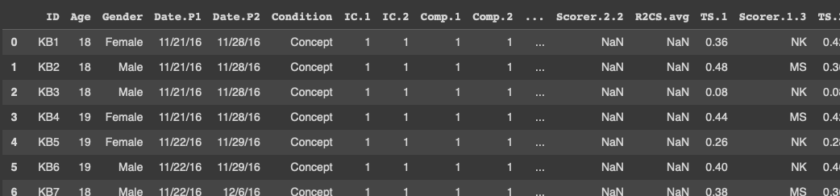
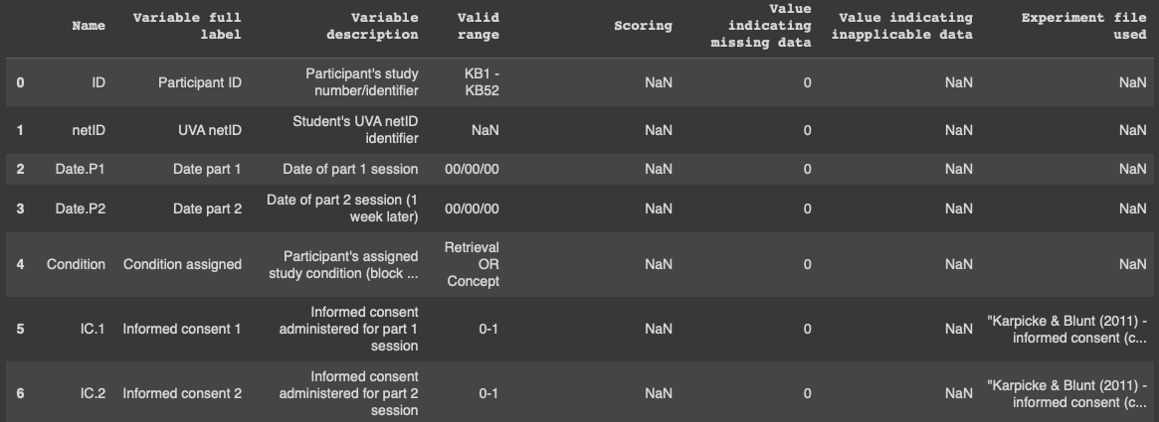
data.csv
codebook.csv

Slide 7
Learning statistic functions from Lab4 examples!

Slide 8
Lab4 assignment

Slide 9
Revisits the pivot tables introduced in our previous labs. Recall that pandas pivot tables take 3 main parameters:
values - the dependent variable(s) of interest
index - the independent variable(s) of interest
aggfunc - how you want to summarize your data (e.g. sum, mean, count, min/max).
Read the csv files into a Pandas dataframe: data.csv and codebook.csv. and display the initial rows.
Question 1:
Group the dataframe by “condition” and compute the mean of “PR.2” column for each category (What is “PR.2” column) ; Let’s call the output X.
Visualize X (Which type of plot is the best choice for X, as a categorical variable?)
Use: pivot_table(data= ?, values='?', index='?', aggfunc=?)
Question 2:
Repeat the same steps as Q1, instead of “PR.2”, consider the “TS.avg” column. (What is “TS.avg”?)
Use: pivot_table(data= ?, values='?', index='?', aggfunc=?)

Slide 10
Question 3:
You can plot values from Questions 1 and 2 side by side by passing in both columns as the values parameter:
use: pivot_table(data= ?, values= [ 'col1' , 'col2' ] , index='?', aggfunc=?)
Question 4:
Use both and compare:
pivot_table(data=..., values=..., index=..., columns='Age', aggfunc='count')
pivot_table(data=..., values=..., index=..., columns='Gender', aggfunc='count')

