Slide 1
CS105 Lab 1 Introduction
Taghreed Alanazi

Slide 2
TA information
Name: Taghreed Alanazi
Email:
talan002@ucr.edu
taghreed.alanazi@email.ucr.edu
OH:
OH reservation through this link: https://calendly.com/talan002/cs-105-oh
Wednesday 2:00 to 4:00 pm
Thursday 12:00 to 2:00 pm
Room to meet: WCH 110
If you have any question or concern, please reach me out through my email or Slack (Direct message).

Slide 3
Lab work and grading procedure
Lab attendance is required, 7 to 8 lab assignments.
Student are highly encouraged to team up to finish the lab work (no more than 2 students in the group) or individually.
Each group submits one assignment. Both students will receive the same credit (unless requested otherwise).
For gaining scores of your lab work:
Directly demo the work to us.
Submitting files for grading.
NOTE: you still need to submit you file online before the due day.
Each lab must be demoed. If a student (or a group) fails to submit or demo the assignment, he/she receives a "0".
Late submission → 20% off.

Slide 4
Demo
Each group need to demo during the lab time (the due day is on Tuesday), or can come and show the work during OHs.
During demo, both group members need to show up and contribute to answer questions and explanations.
You still need to submit your ipynb file and your pdf file online before the due date.
Scores are totally dependent on your demo. You can get feedback immediately.

Slide 5
How to demo and the programming language used
You can use Anacoda (check Anaconda Installation Guide pdf).
We will use → Python programming language.
Widely Used: Python is a popular language for data analysis, machine learning, AI, web development, and more.
Simple and Readable: Python is known for its clear and human-readable syntax.
No need for semicolons to end statements.
Lines end by themselves, making code more readable.
Dynamic Typing: No need to declare variable types upfront.
Indentation Matters: Unlike many languages, Python uses indentation to denote code blocks.
Ensure consistent whitespace for logical blocks of code.

Slide 6
Basic Python concepts
Data Types:
Integers: Whole numbers (e.g., 5, -3, 0)
Floats: Decimal numbers (e.g., 3.14, -0.001, 5.0)
Strings: Text (e.g., 'Hello', "Python")
Booleans: True or False values (True, False)
Variables:
Store and reference data by a name.
Example:
age = 25
name = "Alice"
Basic Operations:
Arithmetic: +, -, *, /
Concatenation for strings: 'Hello' + ' World!'
Comparison: ==, !=, <, >, <=, >=
Print Function:
Display values to the screen.
Example:
print("Hello, World!")

Slide 7
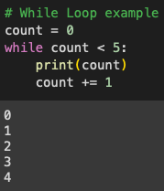
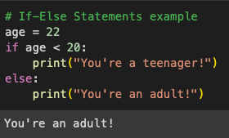
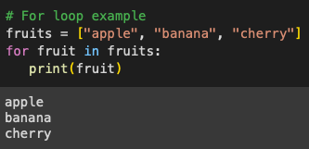
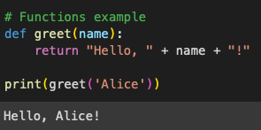
Lists: Collection of items (can be of mixed types).
Example: fruits = ["apple", "banana", "cherry"]
Tuples: Similar to lists but immutable (can't be changed after they're created).
Example: coordinates = (4, 5)
Dictionaries: Key-value pairs.
Example: person = {"name": "Alice", "age": 25}
Control Structures:
If-Else Statements: Conditional execution based on a test.
Loops:
For Loop: Iterate over sequences (like lists or ranges).
While Loop: Execute as long as a condition remains true.
Functions: Blocks of reusable code.
Examples:

Slide 8
In data analysis, we do:
Data Cleaning:
Handling missing data.
Data transformation and normalization.
Exploratory Data Analysis (EDA):
Understanding the data's main characteristics, often using statistical graphics, plots, and information tables.
Data Preprocessing:
Feature engineering.
One-hot encoding, normalization, etc.
… and more!
We want to introduce some libraries and tools that are frequently used in Data analysis field.

Slide 9
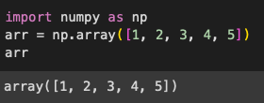
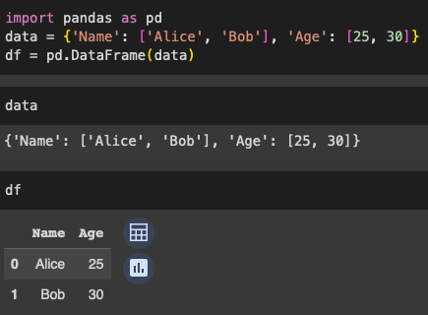
Libraries and tools (with examples)
Numpy:
Fundamental package for scientific computing in Python.
Provides support for large multi-dimensional arrays and matrices.
Pandas:
Essential for data manipulation and analysis.
Provides data structures like DataFrame for handling and analyzing structured data.

Slide 10
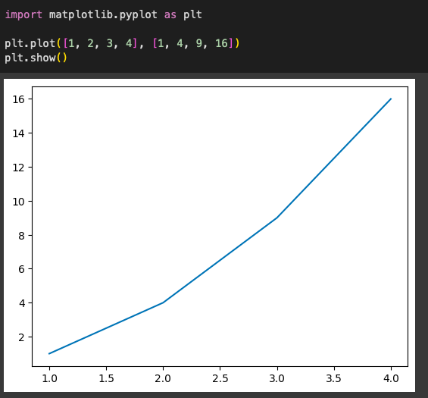
Libraries and tools (with examples)
Matplotlib & Seaborn:
Libraries for data visualization.
Plot graphs, histograms, scatter plots, etc.
Scipy:
Used for high-level computations.
Provides modules for optimization, integration, interpolation, eigenvalue problems, and more.

Slide 11
Useful Python resources
You can learn more with these tutorials:
https://docs.python.org/3/tutorial/
Also, you can try Code Academy: https://www.codecademy.com/learn/learn-python-3

Slide 12
Hints of useful functions for Lab1
Question 0: Give your best guess and explain your thought process behind your answer.
Question 1: set_index(col)
Question 2: Instead of using a for loop to change all the values of a column, we can use special functions offered by pandas that can modify entire columns at a time. For example, if we wanted to cast a column of floats (eg. df.col1) as integers, we might use the following line of code: df.col1 = df.col1.astype(int), also, we can visualize a series of numbers using value_counts() and plot().
Question 3: Here we do the same thing as Q2, but we are extracting the last digit. An easy way to index the last digit is by using -1 (e.g. ‘hello’[-1] returns o).
Question 4: Here we again are doing something similar to Q2. (But which index should we be using?)
More examples about the functions please refer to the “Lab1 Examples_w23.ipynb”.

