Slide 1
{prg} {my} {bp}
Virtual Build Report – AME T&F
Status at end of {bp}
No of Processes Reviewed | {npr}
No of AIMS raised | {nar}
Build date: {firstDay} – {lastDay}

Slide 2
{prg} {my} {bp}
Report Content
T&F Manufacturing Team
Breakdown of Pre-AIMS
Breakdown of AIMS
% of Issues Solved During Build Event
Incompatible CAD Processes
Pre-AIMS Contribution by Module Team
AIMS Contribution by Module Team
AIMS Contribution by Module Team & CoC
Top Issues

Slide 3
{prg} {my} {bp}
T&F Manufacturing Team
{MfgTeam1}
{MfgTeamMembers1}
{MfgTeam2}
{MfgTeamMembers2}

Slide 4
{prg} {my} {bp}
Breakdown of Pre-AIMS

Slide 5
{prg} {my} {bp}
Breakdown of AIMS

Slide 6
{prg} {my} {bp}
% of Issues Solved During Build Event

Slide 7
{prg} {my} {bp}
Incompatible CAD Processes

Slide 8
{prg} {my} {bp}
Pre-AIMS Contribution by Module Team

Slide 9
{prg} {my} {bp}
AIMS Contribution by Module Team

Slide 10
{prg} {my} {bp}
AIMS Contribution by Module Team & CoC

Slide 11
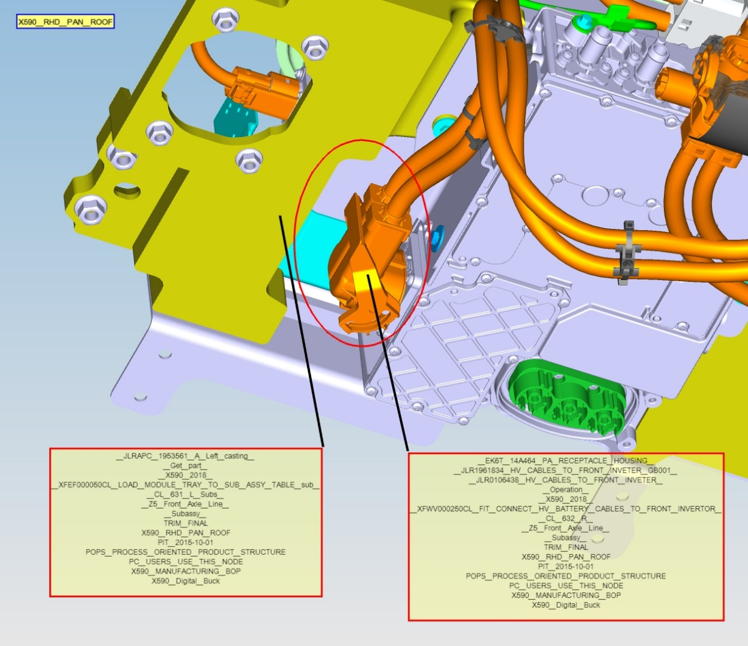
{prg} {my} {bp}
Top Issues
AIMS No. : {aimsNumber}
Raised By : {originator}
Raised On : {raisedOn}
Severity : {severity}
Description:
{description}

