Slide 1
Large scale distributed
reconstruction of retweet cascades
Master‘s Thesis
Bernhard Lutz

Slide 2

Motivation

Slide 3
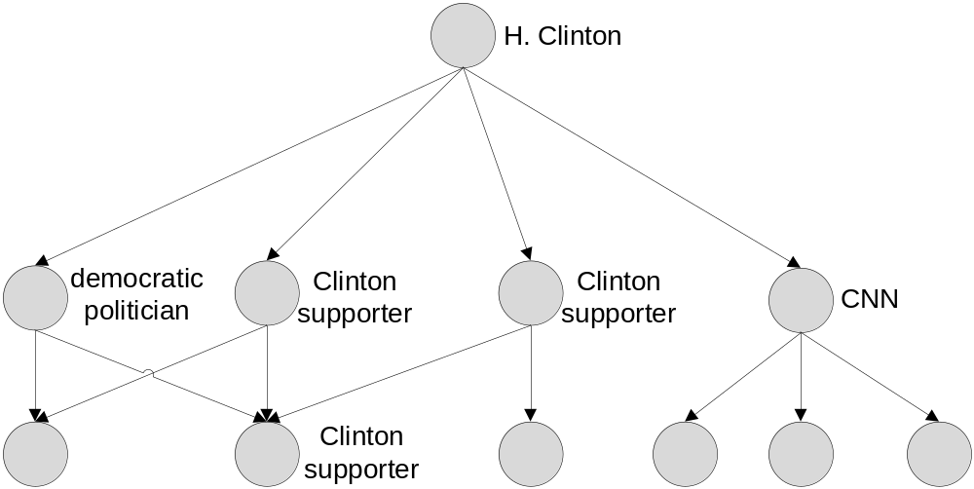
Information diffusion in social networks
Content can spread quickly when shared by many users
Sharing users are influenced by others
Twitter: tweets can be shared by retweeting
  Intermediate retweeters cannot be obtained
  Assumption: influence comes only from social connections
  Calculation of influence graph

Slide 4
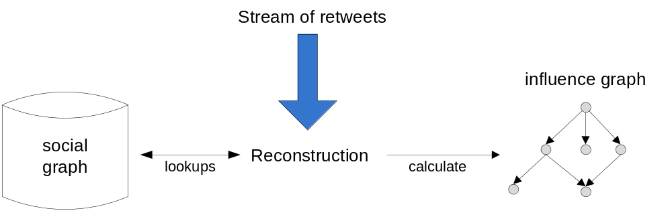
Reconstruction of retweet cascades
Challenge 1: data rates
  6,000 tweets per second on average
  Twitter peak: 143,000 tweets per second
Challenge 2: social graph size
  Users not known before, whole social graph needed
    Several terabytes
  Must be stored in main memory for realtime reconstruction
    Too large for average computer
      Distribute among several nodes

Slide 5
System state before this work started
Working distributed system for reconstruction based on stream processing framework Apache Storm
  Application written in shape of directed acyclic graph, called topology
  Source nodes are called spouts, act as source of data
  Inner nodes are called bolts, perform processing logic
Reconstruction only when cascade is finished, blocking behavior
Reconstruction takes 12min for a cascade with 60,000 retweets
  Quadratic runtime in number of retweets
System not completely understood
  Lot of Idle time that could not be explained

Slide 6
Social graph partitioning
Several social graph partitionings have been evaluated
Uniform distribution of users among all nodes performs best
  Exploitation of parallelism
  Creation quite simple
More sophisticated strategies analyzing social graph structure were shown to perform worse

Slide 7
Task of this work
Implement reconstruction algorithm with runtime: O(n*k)
  n number of retweets, k average number of friends
Implement incremental reconstruction, e.g. perform reconstruction every 1,000 retweets or every 10 seconds
Think of other optimizations and implement them
Identify remaining bottlenecks
Scaling evaluation

Slide 8
How the system works…

Slide 9
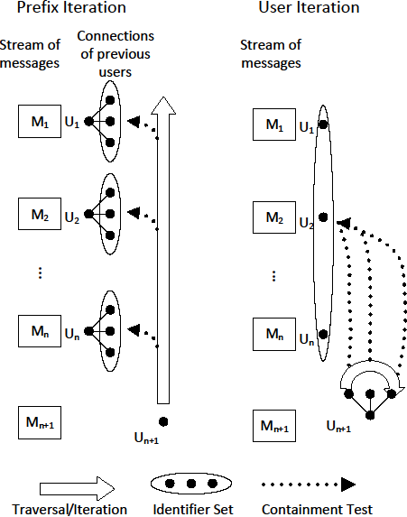
Current reconstruction algorithm
Runtime: O(n²)
n: number of retweets
d
new user contained in follower sets of previous retweeters?

Slide 10
Distributed system
Reconstruction always performed with respect to a given cascade
  Performed on the root node
    Node storing the author of original tweet
    Other nodes are called remote nodes
    Expected to have biggest influence
      Otherwise lots of messages from „real root node“ to node performing reconstruction
Usually not all users of a cascade on root node
  Missing social graph information must be sent to root node
  Root node must know when all messages from remote nodes have arrived
    Sychronization needed, considered to be costly
      Performed only once when cascade is finished

Slide 11
Distributed system
Message ordering crucial for correct results
Assumption: FIFO property holds, no messages lost
  Messages are received and processed in the order they were sent
RoutingBolt knows social graph partitioning
  Forward retweets to root node
  Broadcast remote requests to remote nodes
  Buffering of remote requests desired
    Not realizable with native Apache Storm concepts

Slide 12
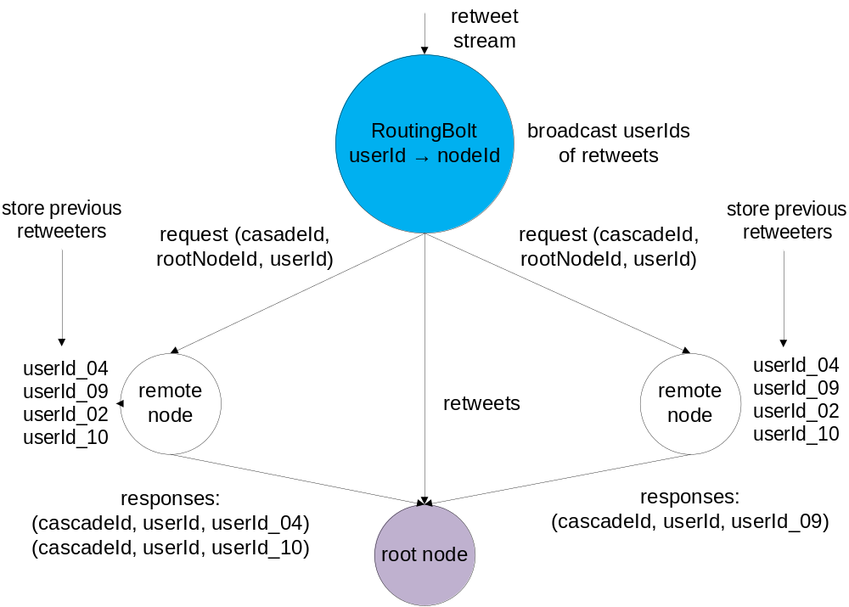
Distributed system – lookup, distributed computation

Slide 13
Optimizations made in this work
User Iteration algorithm
  Runtime: number of retweets x average number of friends
More efficient datastructures
  Less data in more efficient representation
Incremental reconstruction
Batch processing of remote requests
Multithreading
  Current implementation single-threaded
    Exploit available cpu cores

Slide 14
User Iteration algorithm
Runtime: O(n*k)
n: number of retweets
k: avg number of friends
d
friends of new user contained in previous retweeters?

Slide 15
User Iteration vs Prefix Iteration: theoretical aspects
Runtimes
  Prefix Iteration: number of retweets x number of retweets
  User Iteration: number of retweets x average friend count
Cascade length heavily skewed, lots of small cascades, few longer cascades
  90% of all cascades have at most 47 retweets
Friend count
  Average: 102 according to a study made in 2012
  90% of all users in biggest dataset have at most 884 friends
Prefix Iteration should perform better for small cascades, break even around 100 retweets

Slide 16
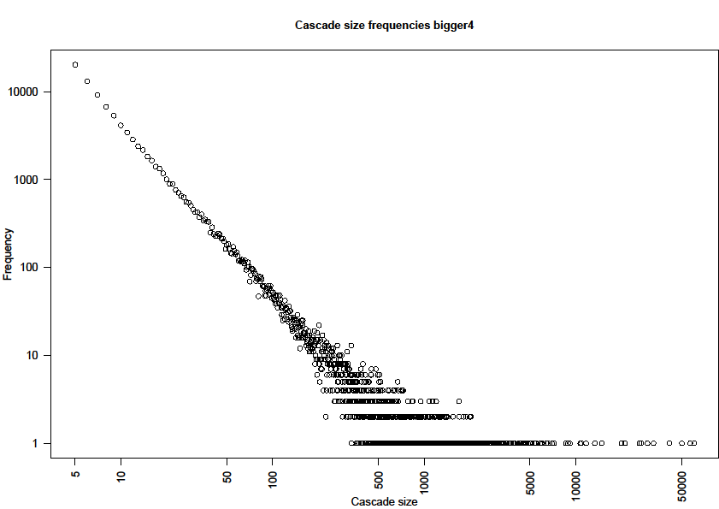
Distribution of cascade sizes

Slide 17
User Iteration vs Prefix Iteration: results for single node reconstruction
Datasets taken from Olympics 2012
Total time for all cascades with at least 5 retweets
(3.6 mio retweets in total)
  User Iteration: 85 seconds
  Prefix Iteration: 56 minutes
Total time for cascades with 6-100 retweets
  User Iteration: 24.6 seconds
  Prefix Iteration: 17.7 seconds
User Iteration performs better in general, small cascades are still reconstructed quickly

Slide 18
Efficient datastructures
Retweet objects from Twitter API
  Contain lot of unnecessary information like profile image, location, timezone,…
  Represented as nested map: key → value
Custom retweet format written
  only relevant attributes
  flat datastructure
Enumeration serializer in Java: poor performance
  Use integer constants instead
Increase transfer rate of retweet objects by a factor of 28

Slide 19
Incremental reconstruction
So far: reconstruction after cascade is finished
  No clear definition of finished
Earlier results are desired: incremental reconstruction
  Perform reconstruction every N retweets
  Perform reconstruction every M retweets per cascade
Synchronization necessary
    Root node must know whether all necessary remote responses have been received, otherwise incorrect results
Tradeoff between latency and throughput

Slide 20
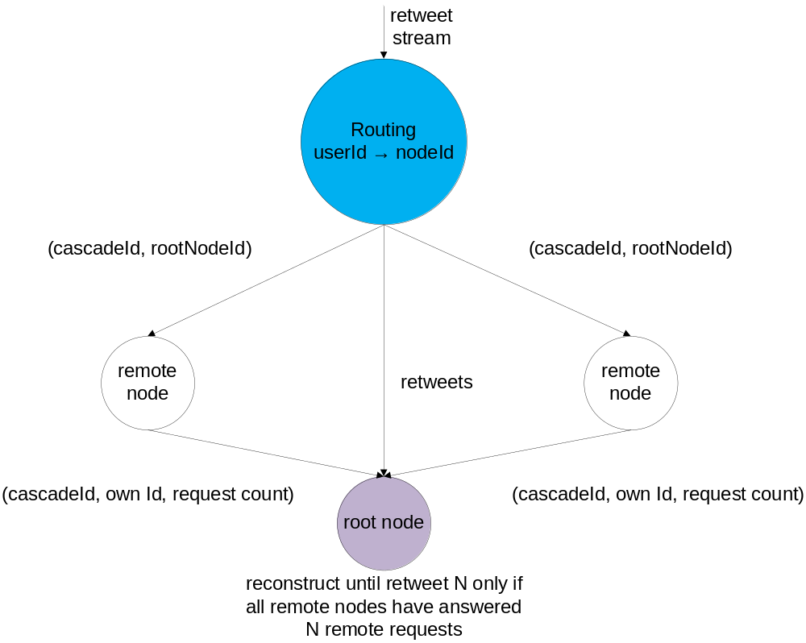
Sychronization before reconstruction

Slide 21
Batch processing of remote requests
During incremental reconstruction, system must wait for retweets
Buffer remote requests
  Instead of sending M messages with one userId each,
  send one message with M userIds
  Iterate over userIds, perform same logic as for small messages
  Increases throughput significantly
Use incremental reconstruction together with batch processing of remote requests

Slide 22
Incremental reconstruction: global batches
Collect M retweets, reconstruct corresponding cascades
Remote request:
([windowIds], [rootNodeIds], [userIds])
all arrays of same size
Remote response:
([windowIds], [childIds], [parentIds], {windowId→requestCount})
No explicit synchronization needed, only one request per batch
  requestCounts are added to remote response
  Only one remote response from each remote node

Slide 23
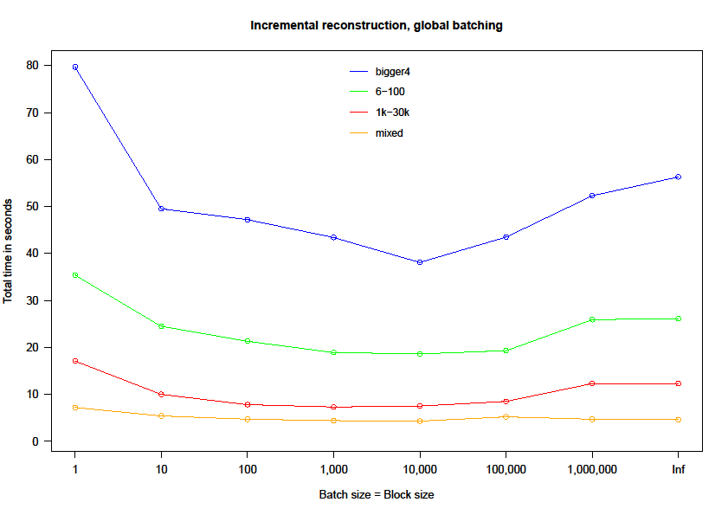
Global Batching – batch sizes

Slide 24
Incremental reconstruction: batches per cascade
Collect M retweets for a cascade, reconstruct this cascade
Remote request:
(windowId, rootNodeId, [userIds])
Remote response:
(windowId, [childIds], [parentIds])
Requires synchronization, but allows exploitation of multithreading

Slide 25
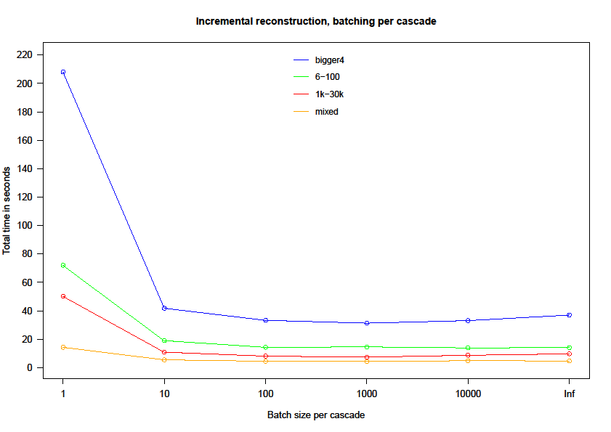
Batches per cascade – batch sizes

Slide 26
Multithreading
Exploit available resources
Distribute cascades among several threads
  Reconstruct in parallel
Share social graph among several threads
  All accesses are read-only: sharing without locking
3 threads per node gave optimal results
  Throughput increased by 30%
  CPUs have 12 cores, why not using all of them?
    Results could not be explained

Slide 27
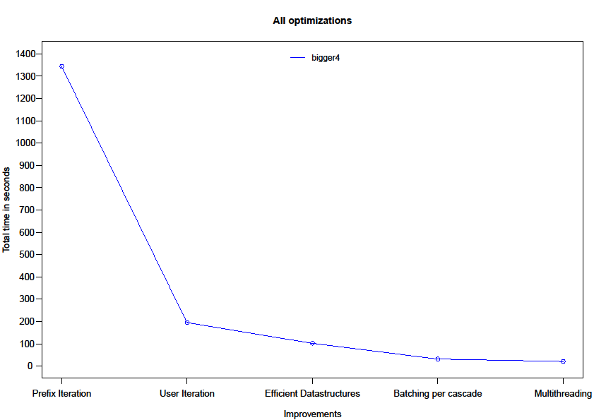
Impact of optimizations - summary
Dataset of 3.6 million retweets from Olympics 2012

Slide 28
Summary
Following settings should be used in realtime reconstruction
  User Iteration algorithm
  Incremental reconstruction with batches per cascade
  Batch size 10
  Use several threads for each node
System can reconstruct about 200,000 retweets per second
  Above twitter peak and way above average tweets per second
Scaling not completely understood, more research necessary
Remaining bottlenecks: probably network link and hard drive

