Slide 1
Evaluation of social graph partitioning strategies and improvement of distributed reconstruction of retweet cascades
Master‘s Project
Bernhard Lutz

Slide 2
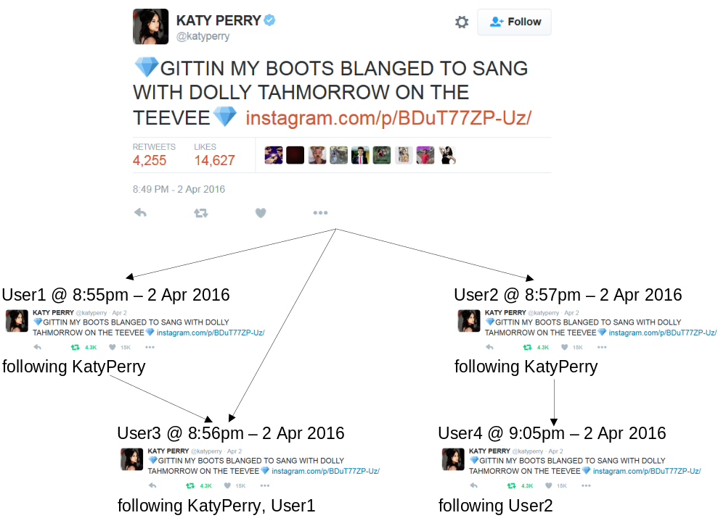
Motivation

Slide 3
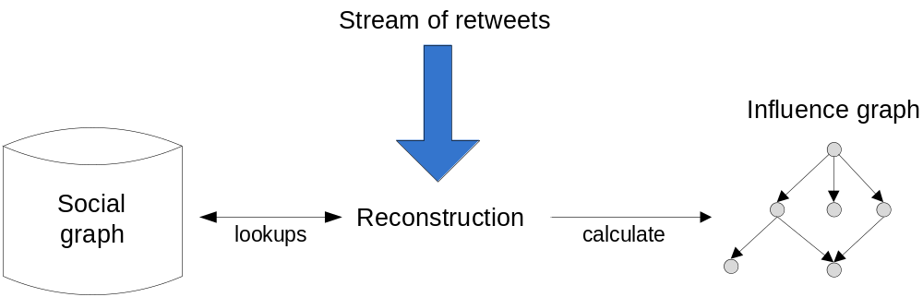
Reconstruction of retweet cascades

Slide 4
Previous work
Reconstruction of influences using Apache Storm (stream processing framework)
Social graph: stored as a map:
user → followerList
Complete social graph of twitter several hundreds of gigabytes
→ main memory of single machine too small
→ distributed reconstruction, hope to improve performance too

Slide 5
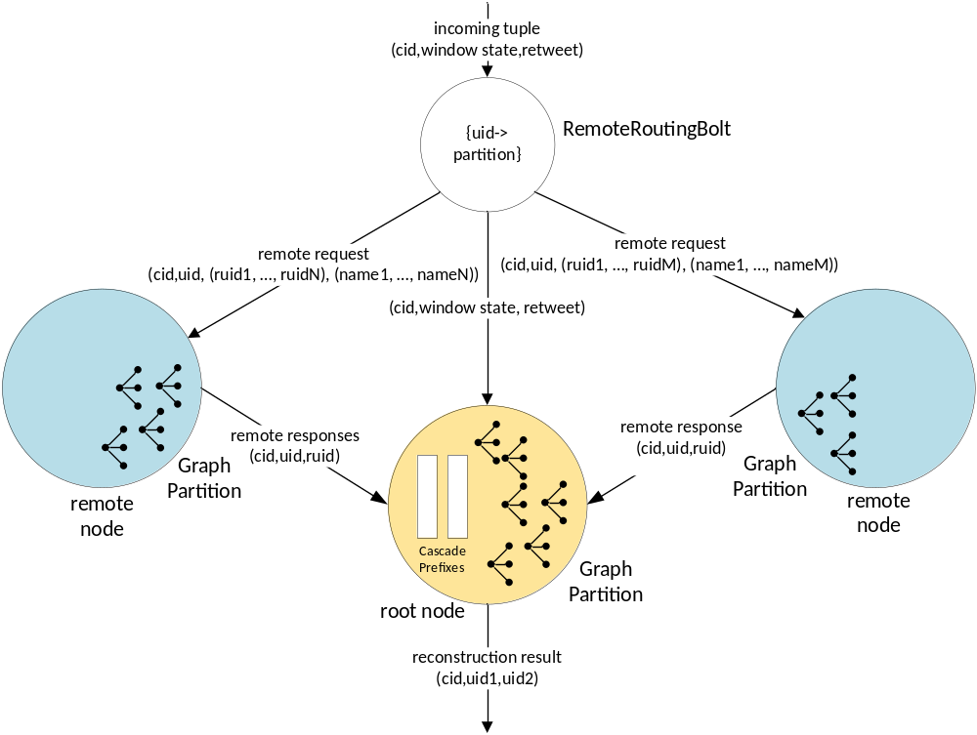
Protocol for exchanging follower information

Slide 6
Previous work: partitioning strategies
Activity graph used for partitioning
  Perfect Information about who retweeted whom
Community-based partitioning:
  Identify groups of users that have retweeted each other, allocate groups on the same partition
Min cut partitioning with METIS
  Minimize crossing edges between partitions

Slide 7
Task of this master‘s project
Further understanding of distributed reconstruction
Identify bottlenecks, based on that: define a cost model
Evaluate different graph partitioning strategies
Implement small-scale improvements

Slide 8
Changes on the implementation
Sequential spout:
  Strange message times for parallel spout
  Sequential: Only one cascade is reconstructed at the same time
Fixing bugs:
  All nodes were loading the whole part of the social graph
  Store remote edges separately

Slide 9
Changes on the implementation
Introduce state-based protocol for exchanging follower information
  So far, whole local prefix sent over and over again
  Remote node remembers current prefix
  Only delta prefix is sent

Slide 10
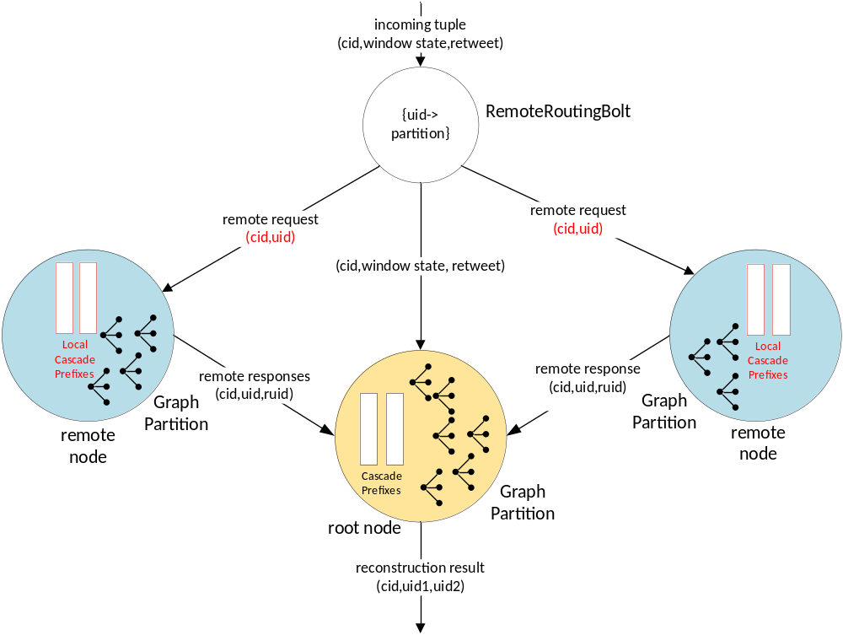
State-based protocol

Slide 11
Methodology: comparison of partitioning strategies
Analysed strategies:
  Activity graph
    Community based partitioning (community)
    Min cut partitioning of activity graph (metis ag)
    Random partitioning of activity graph as a baseline (random ag)
  Social graph
    Min cut partitioning (metis sg)

Slide 12
Metrics: exchanging follower information
Remote users: users not stored on the root node
Remote requests: about the same for every partitioning → not part of cost model
Remote responses: counterpart of remote requests

Slide 13
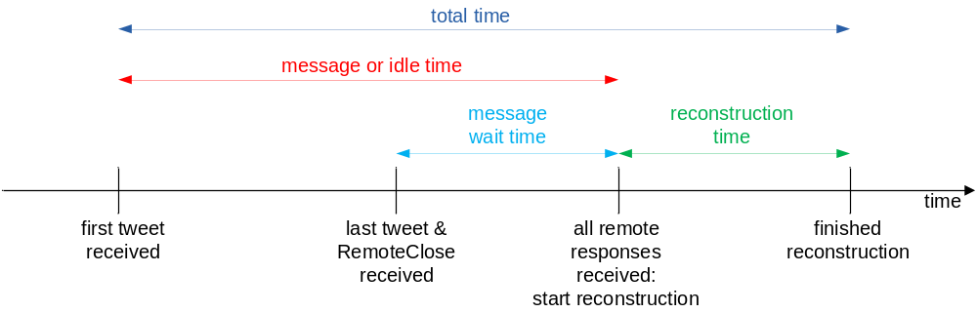
Metrics: time intervals at root node

Slide 14
Cost Model
Remote users
Remote responses
Message or idle time
Total time
Reconstruction time
Every metric should be minimized
  Especially message or idle time

Slide 15
Expectations
Correlation between remote users and remote responses
State-based protocol should decrease message or idle time
In total time: metis ag and community should perform best, metis sg slightly worse and random ag worst
Reconstruction time: no significant difference

Slide 16
Results: Remote users and remote responses

Slide 17
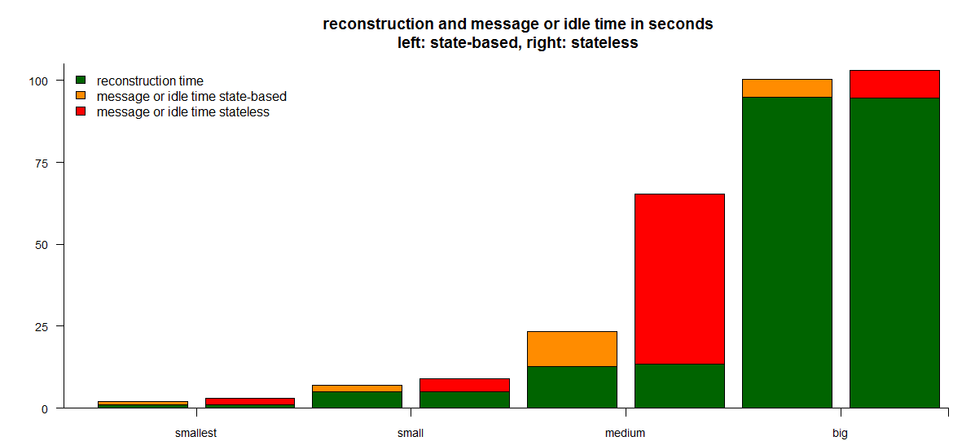
Results: state-based vs stateless protocol

Slide 18
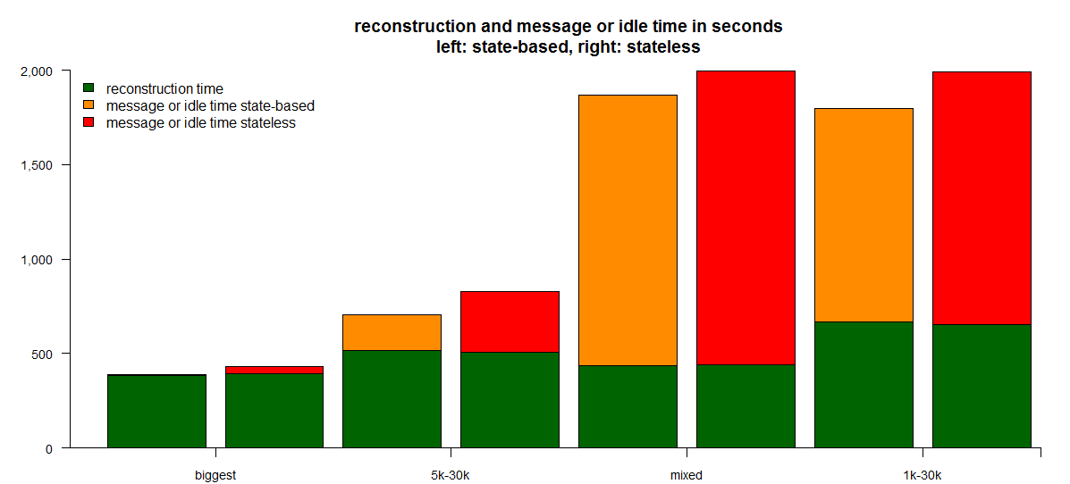
Results: state-based vs stateless protocol

Slide 19
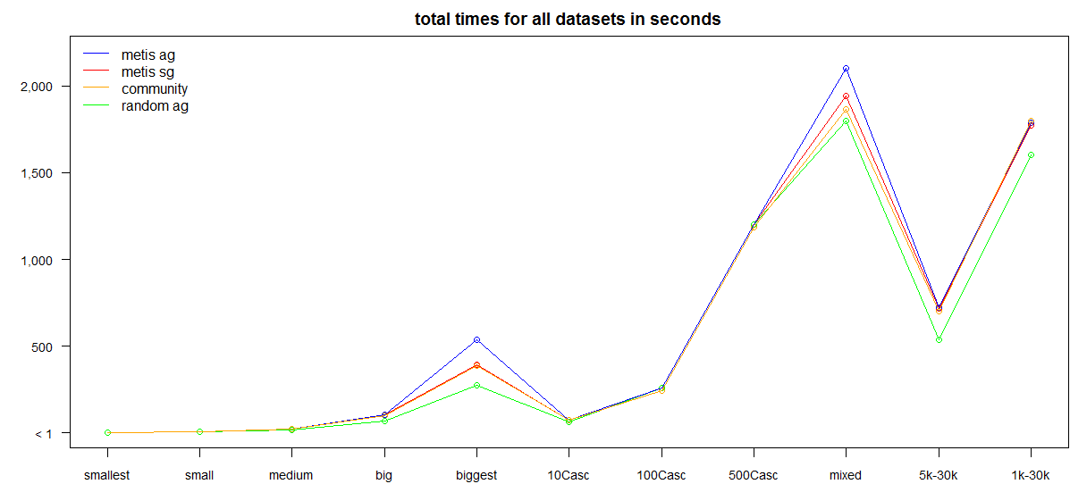
Totaltime all partitioning strategies

Slide 20
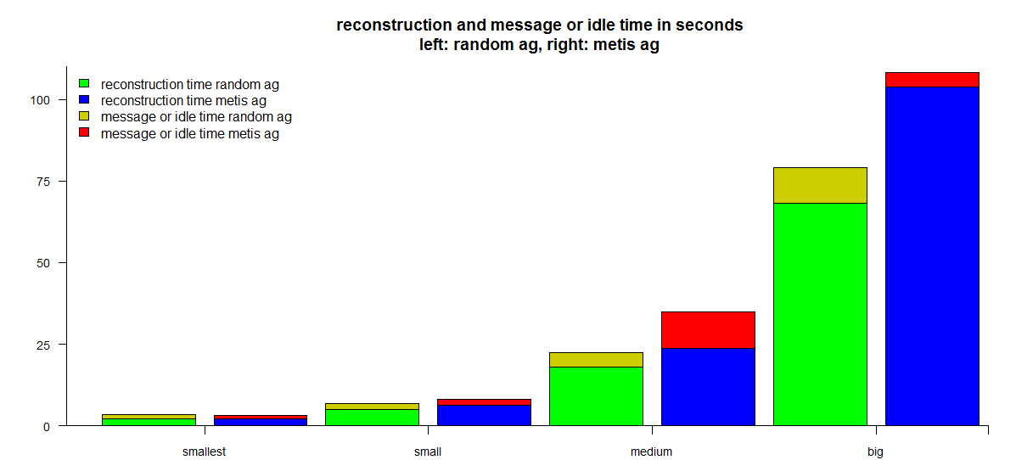
Results: random vs metis cost breakdown

Slide 21
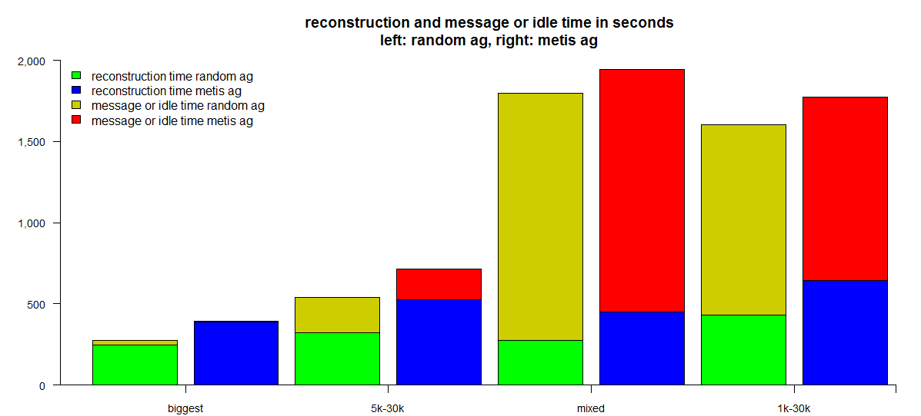
Results: random vs metis cost breakdown

Slide 22
Explanation for difference in reconstruction time
Prefix Iteration:
  For localEdges and remoteEdges
    User existance check
    Follower containment check
Consider leaf user of influence graph
  No influence on anybody
  Random: probability 7/8 for remote → skip containment check
  Metis: probability very high for local → perform containment check
    That is were the difference comes from

Slide 23
Discussion
Remote users and remote responses are correlated for „smart“ partitioning strategies
State-based protocol performs significantly better than stateless version
Random performs better than any „smart“ partitioning strategy, even with perfect information from activity graph

Slide 24
Future work
Merge of remote edges
User Iteration
Migrate to newest version of Storm
Change of root node
Incremental reconstruction

