Slide 1

DESIGNING, DEVELOPING AND DEPLOYING A RESULTS BASED MONITORING AND EVALUATION SYSTEM
RESILIENT NATURAL RESOURCE MANAGEMENT FOR
TOURISM AND GROWTH PROJECT- REGROW (P150523)
Kick Off Meeting
Ministry of Natural Resources and Tourism (MNRT)

Slide 2
Agenda
Our Understanding of the TORs
Approach and Methodology
Timeline
Expectations from the Client

Slide 3
Our Understanding of the TORs

Slide 4
Our Understanding of the TORs
Coverage and Scope
Problems we are trying to solve
Key features envisioned in IMIS

Slide 5
Coverage and Scope
Key features envisioned in IMIS
Problems we are trying to solve
Planning
M& E Plans
Monitoring
Periodic Reports
Analysis
System Generated Reports
Data Dissemination
Real Time Dashboards
Work Plans
Indicator Data
GIS Maps

Slide 6






Key features envisioned in IMIS
Problems we are trying to solve
Multitude of templates and data submission workflows
Different reporting periods
Different location of data storage / data in silos
Inconsistency/Disparity in data from different sources
Gaps in data collection
Inability in aggregating and analysing data due to difference in content and form

Slide 7
Key features envisioned in IMIS
Role based access for users at different levels such as Ministry, Province, District, Ward, or Service Provider, etc.
Standardized templates for data reporting and convergent data submission processes.
Weekly, Monthly, Quarterly, Semi-Annual, and Annual Reporting periods and ad-hoc event registers.
Automatic alerts/reminders for report submissions
Consistency checks and validation on data entry forms
Analytical reports with aggregation of data at ward, district, province, and national/ministry levels
Report builder with multiple filters and column selections

Slide 8
Questions?

Slide 9

Approach and Methodology
Agile Methodology

Slide 10
Agile Methodology
Discover
Build
1
2
Iterative Development
4
3
Refine
Test

Slide 11
Agile Methodology
Discover
1
Document and Systems Review
System Requirement Study
Development Backlog

Slide 12
Agile Methodology
High Level Requirements
Requirement Refinement
Collaborative Development
Defined during the Discover Phase divided in sprint sized group of tasks.
Build
2
Detailed discussion on templates and processes including effort estimation.
Continuous review with the product owner / steering committee.

Slide 13

Agile Methodology
Joint review of the built functionality
Testing of formulae and calculations
Review of design elements
Forms & Templates
Validations
Workflows & Processes
Aggregation
Report Formulae
Dashboards Figures
Color Scheme
Logos and Icons
Dashboard Design
3
Test

Slide 14
Agile Methodology
Review comments and suggestions on features reviewed.
Comments reviewed jointly with product owner
Conflicting comments resolved before going to next step
Assign ‘MoSCoW’ categories
Must: These modifications are mandatory and shall be included in the same sprint.
Should: These modifications can be described as great to have, but not top priority. Can be assigned to future sprints.
Could: These are small-scale improvements that don’t take considerable resources, but they aren’t essential. Can be included in same or future sprint depending on time and resources available.
Won’t: These are either of lowest importance or take so much
4
Refine
Test

Slide 15
Approach and Methodology
Discover
Build
1
2
Questions?
4
3
Refine
Test

Slide 16
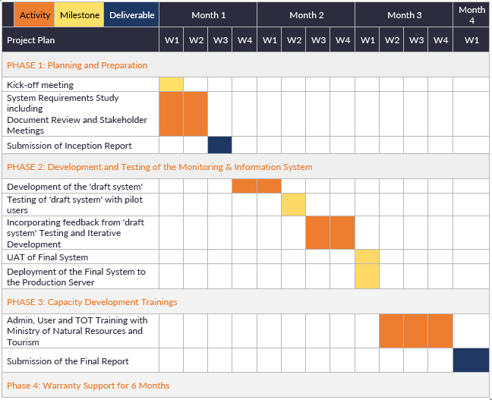
Timeline

Slide 17
Expectations from the Client
Nomination of Product Owner to take decisions on behalf of the Project Sponsor
Ready Templates and Formats for Data Collection
Process Manual and Data Flow Diagrams
Clear Report and Dashboard Requirements
Access to Stakeholders for Interviews
Sample Data for Testing
Access to Third Party Systems to be Integrated including APIs or Database Access

Slide 18
Thank You
Questions ??

