Slide 1

San Francisco Payroll
Course Name: Data Visualization
Professor name: Reza Jafari
Present By:
Mahtab Barkhordarian

Slide 2
Today’s Discussion:
Introduction
Dataset description
Preprocessing
Outlier detection
PCA
Normality test
Data transformation
Heatmap
Data visualization
Summary

Slide 3
Introduction
The purpose of this project is to observe the peoples ‘income who live in San Francisco with different job titles . The reason for choosing this dataset is, the most high tech companies are on those area and I wanted to know are the base pay and others pay is related to job title or even other variables or not.

Slide 4
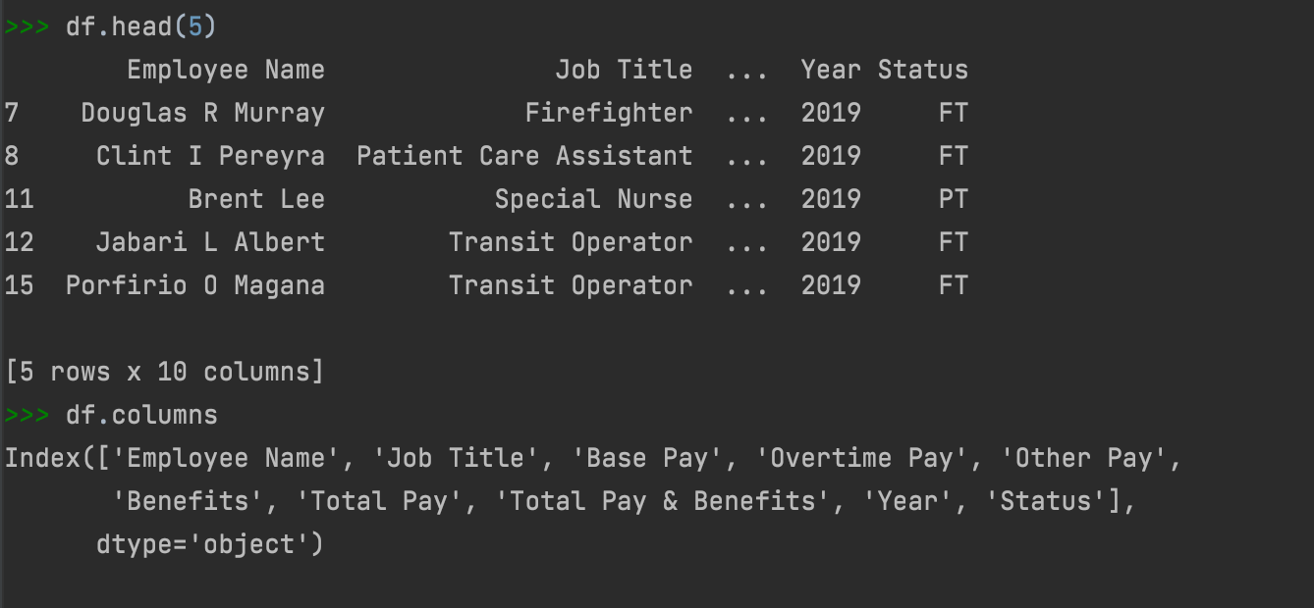
All about dataset
The dataset is from Kaggle
This dataset contains the California public employee salaries from years 2011 to 2019.
10 variables(3 categorical, 7 numerical)
205906 observations before preprocessing and 54647 after.

Slide 5
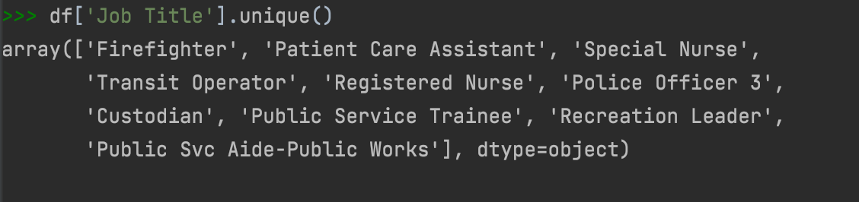
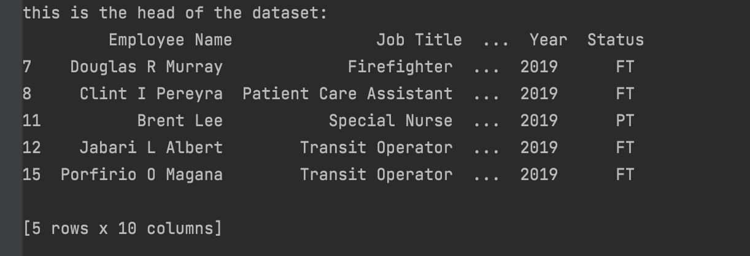
Preprocessing
Remove the nans
Slicing the data with the greatest community job titles
Checking the nan of columns and remove them if the percent is more than 50%
Convert the object variables to numeric

Slide 6
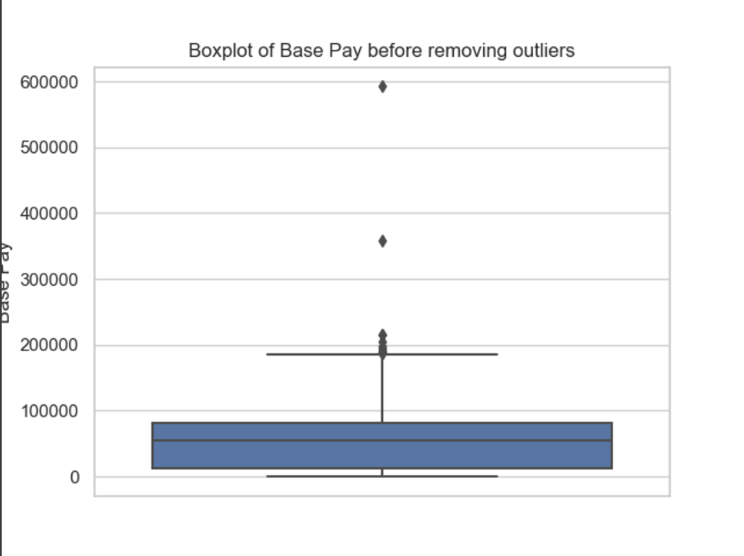
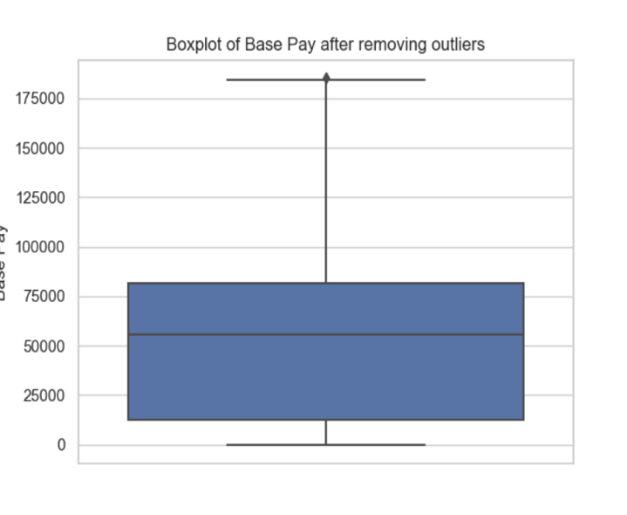
Outlier detection and removal
These are some examples of the plots before and after outlier detection

Slide 7
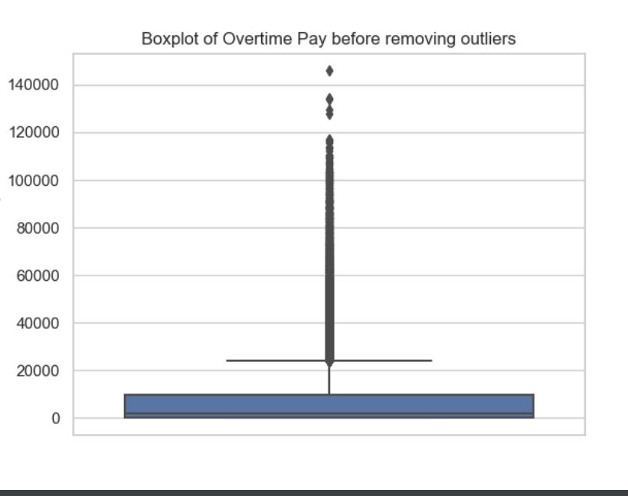
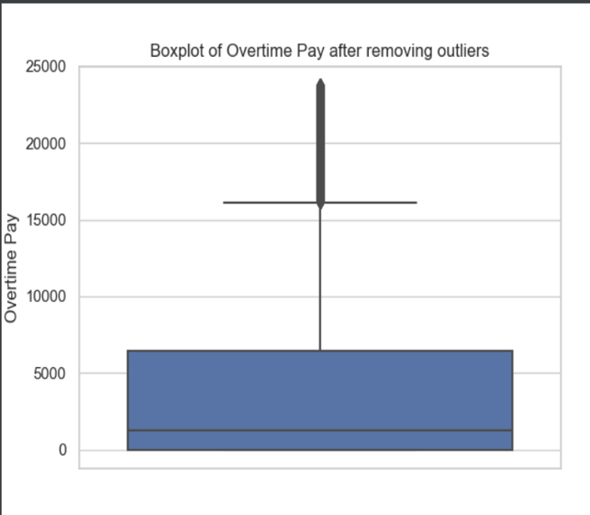
Outlier detection

Slide 8
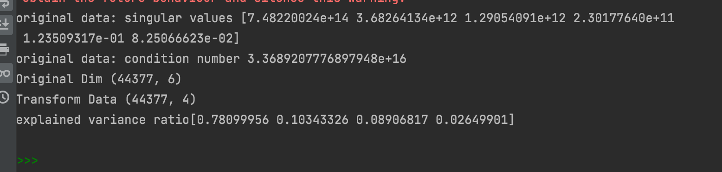
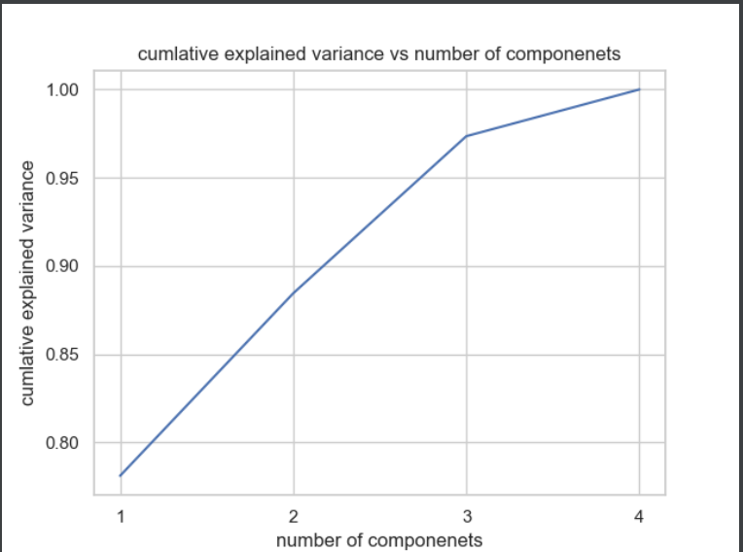
Principal component Analyze
from this PCA we can realize that we can have the explained variance ratio more that 95 percent with only just 4 features.

Slide 9
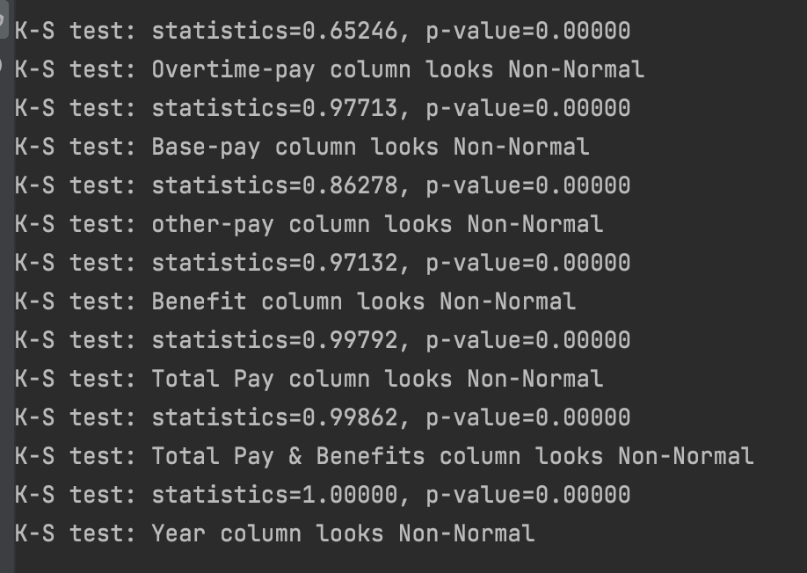
Normality Test
None of the variable are distributed normally.

Slide 10
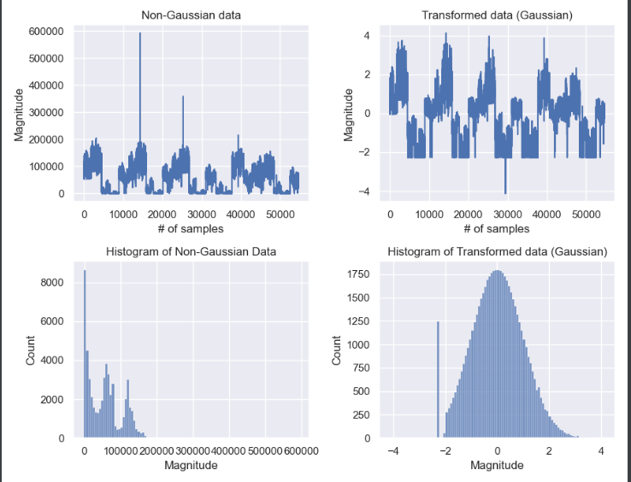
Transformation
non-gaussian to gaussian
Method to make the data normal

Slide 11
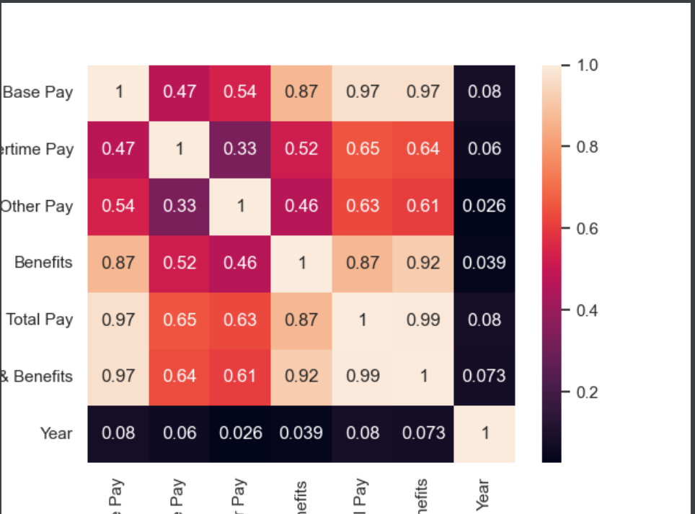
Heatmap and Pearson coefficient
The columns from lefts are :Base pay, overtime pay, other pay, Benefits, Total Pay, Total pay and benefits and year.
As you can see Base pay and total pay and total pay & Benefits have some high correlation. Total pay and total pay & Benefits have the high correlation which makes sense.
Also Base pay and Benefits and Base pay and total pay have the high correlation together.

Slide 12
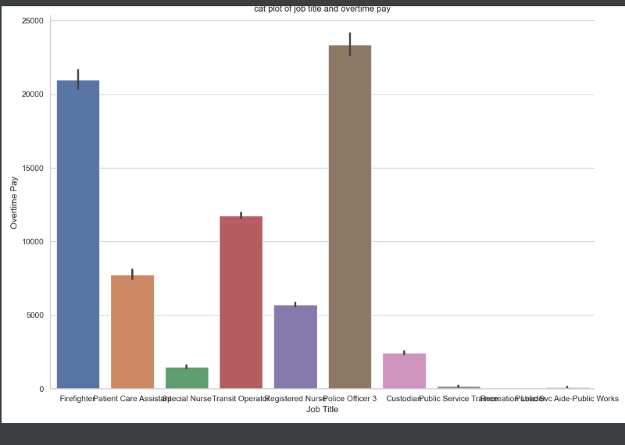
Data Visualization(Seaborn)
From this Cat plot , I can realize that the jobs with the most overtime pay. Police officers have the most overtime pay and then Fire fighters . The least overtime pay is for patient care assistance and public workers.

Slide 13
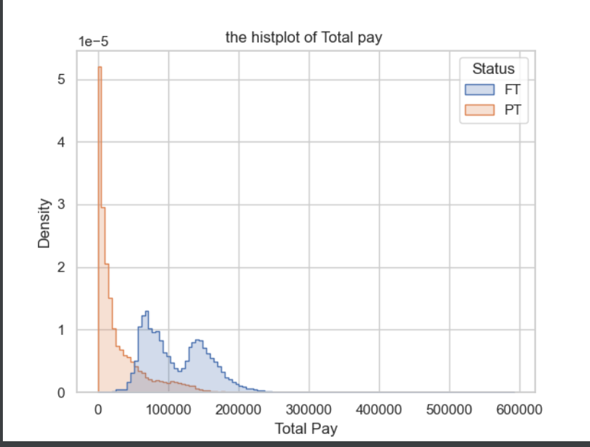
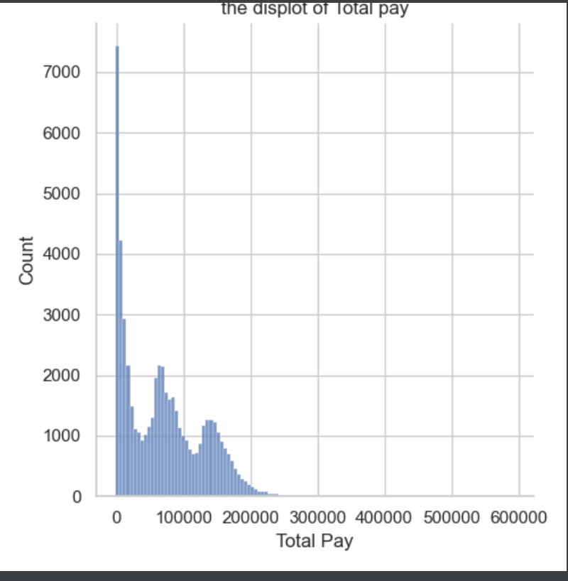
Data Visualization

Slide 14
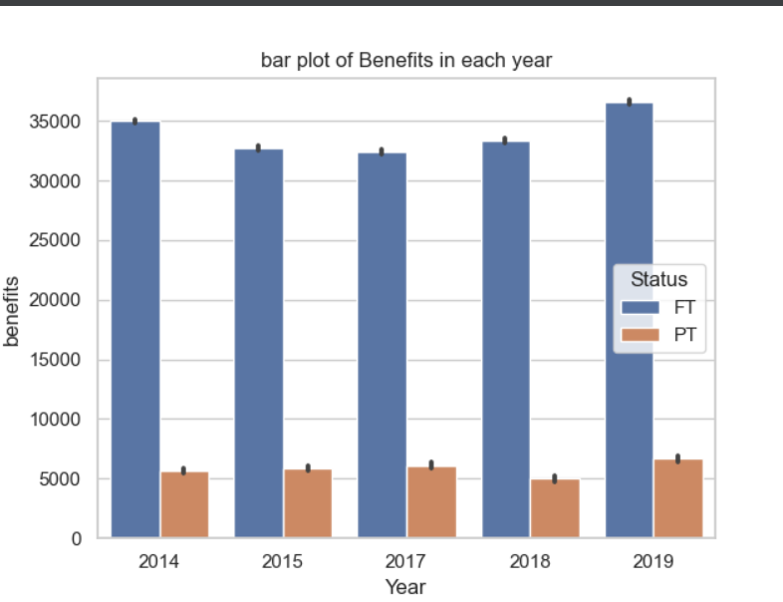
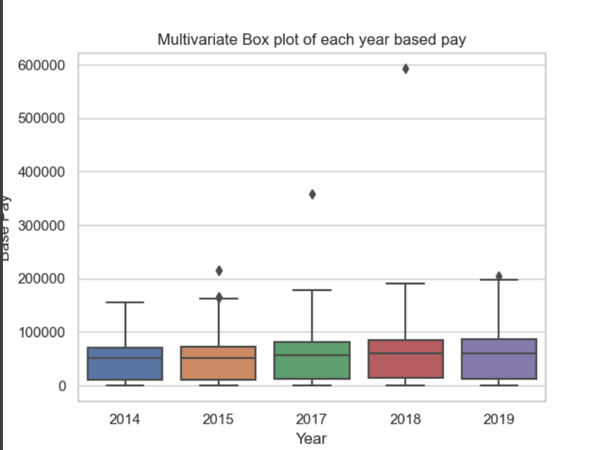
Data Visualization

Slide 15
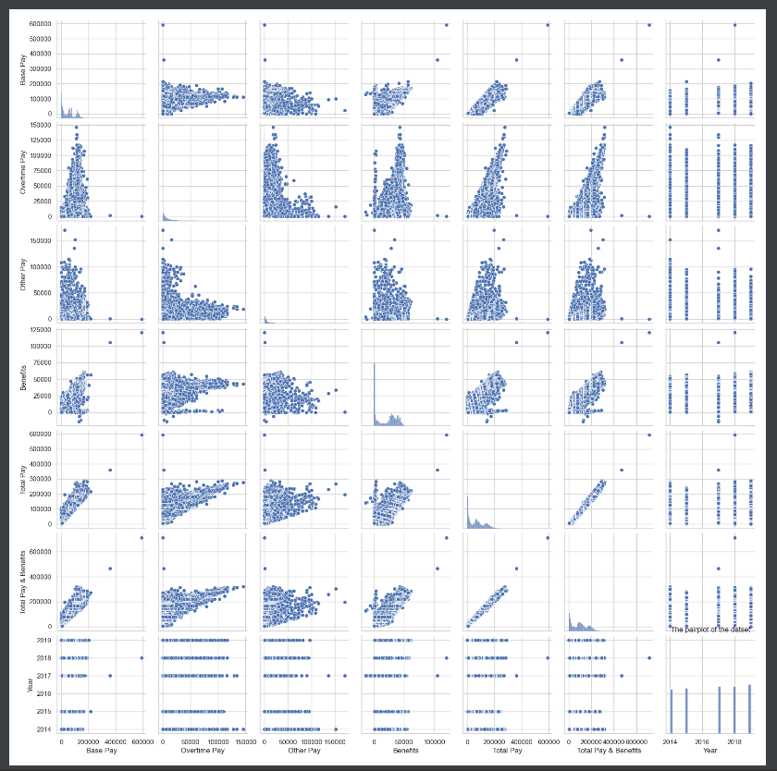
Pair plot

Slide 16
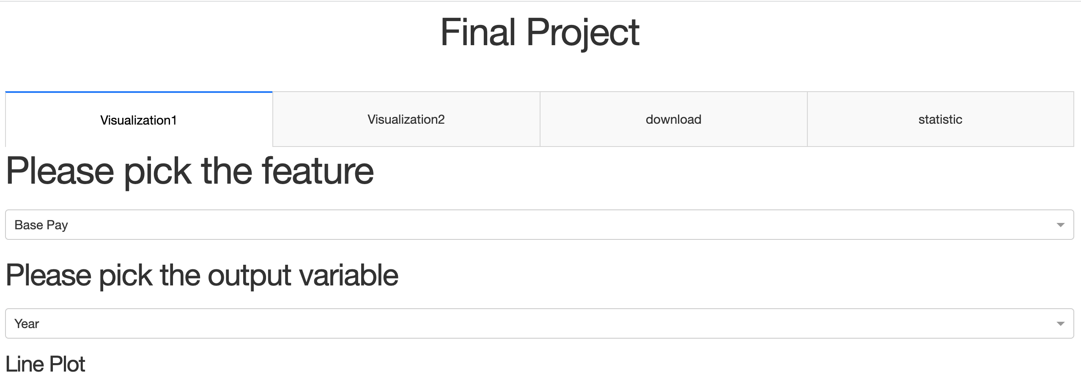
Dashboard

Slide 17
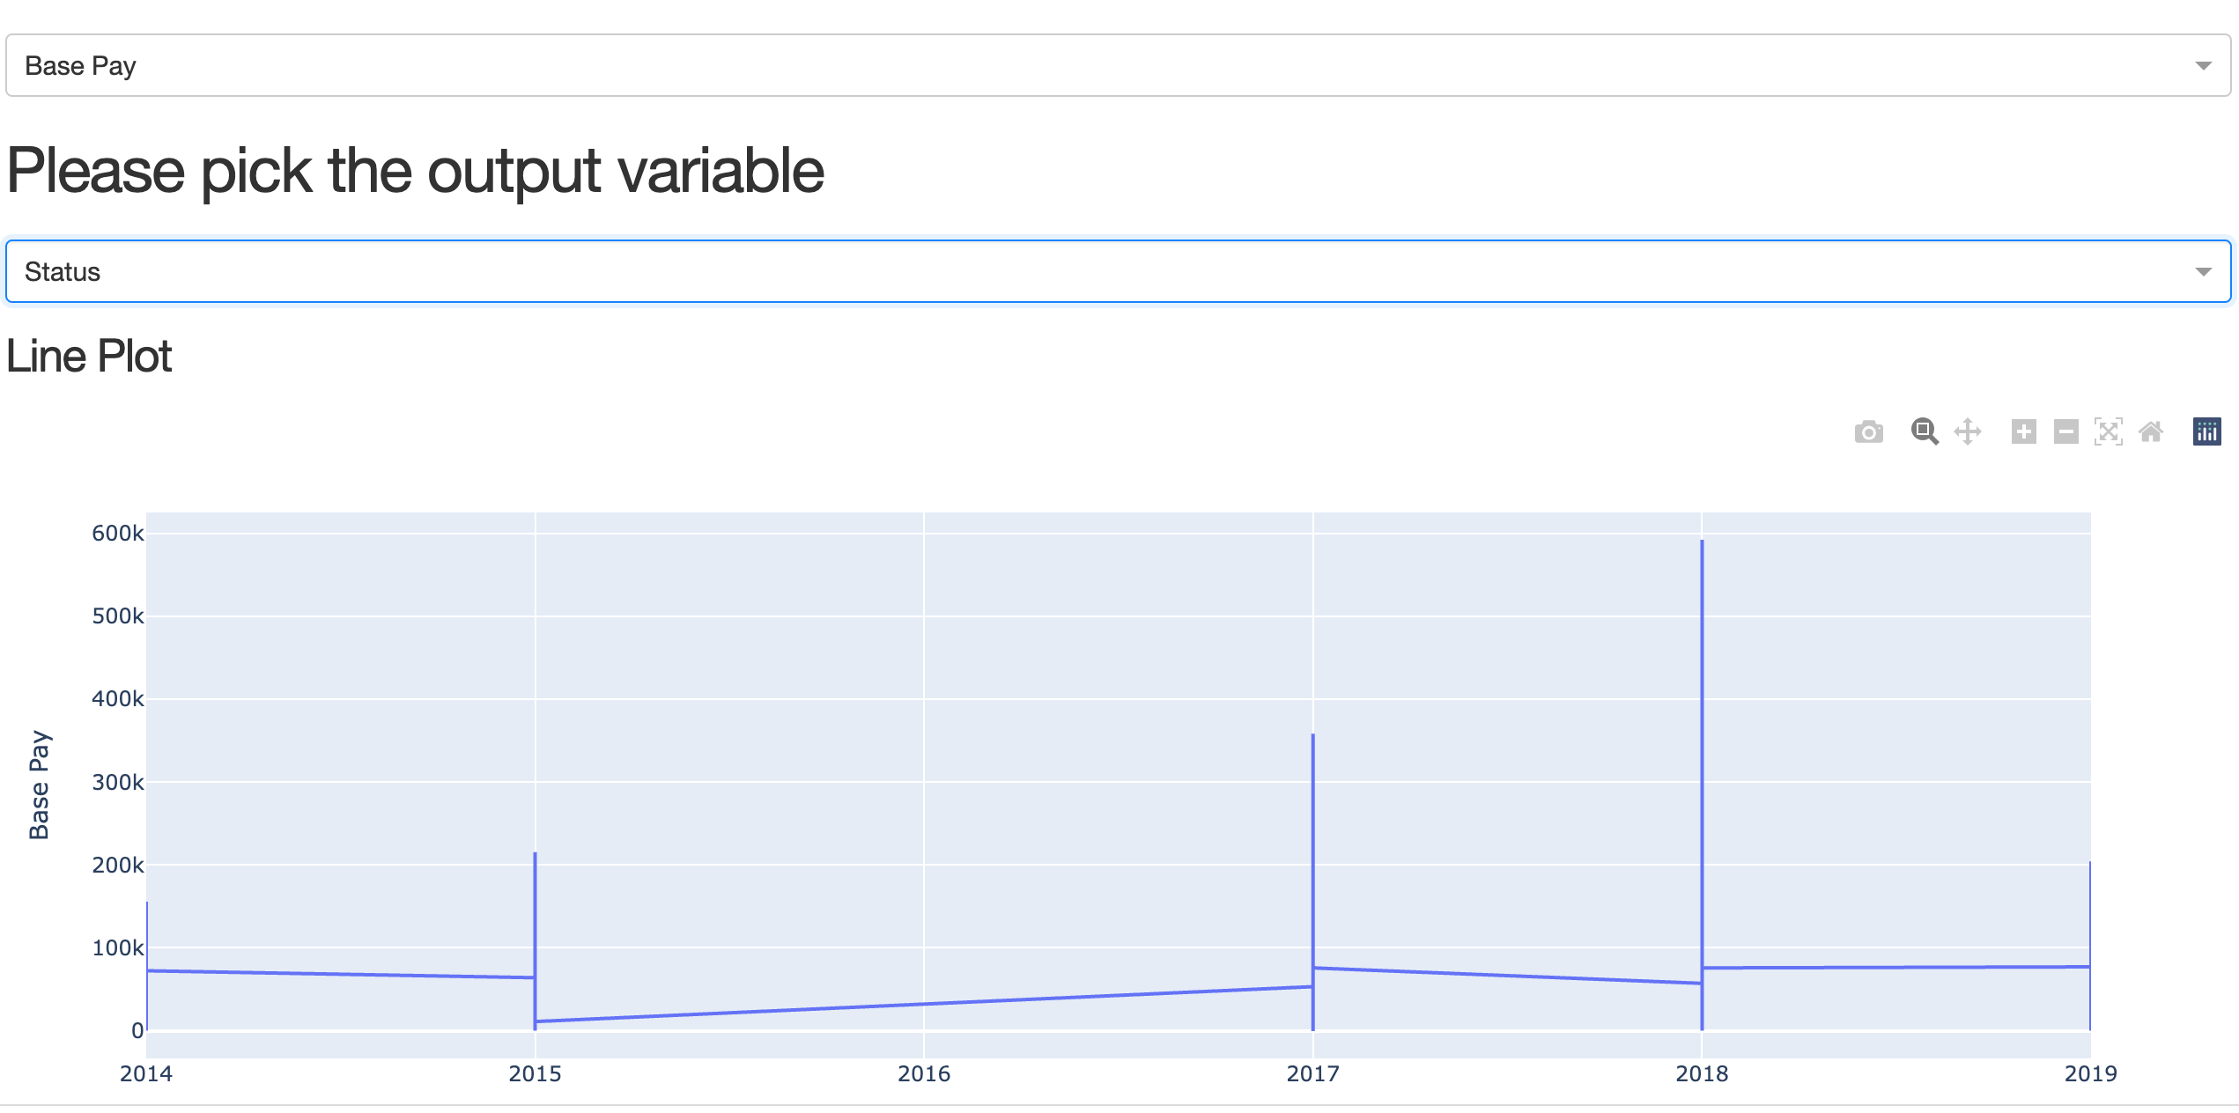
Dashboard

Slide 18
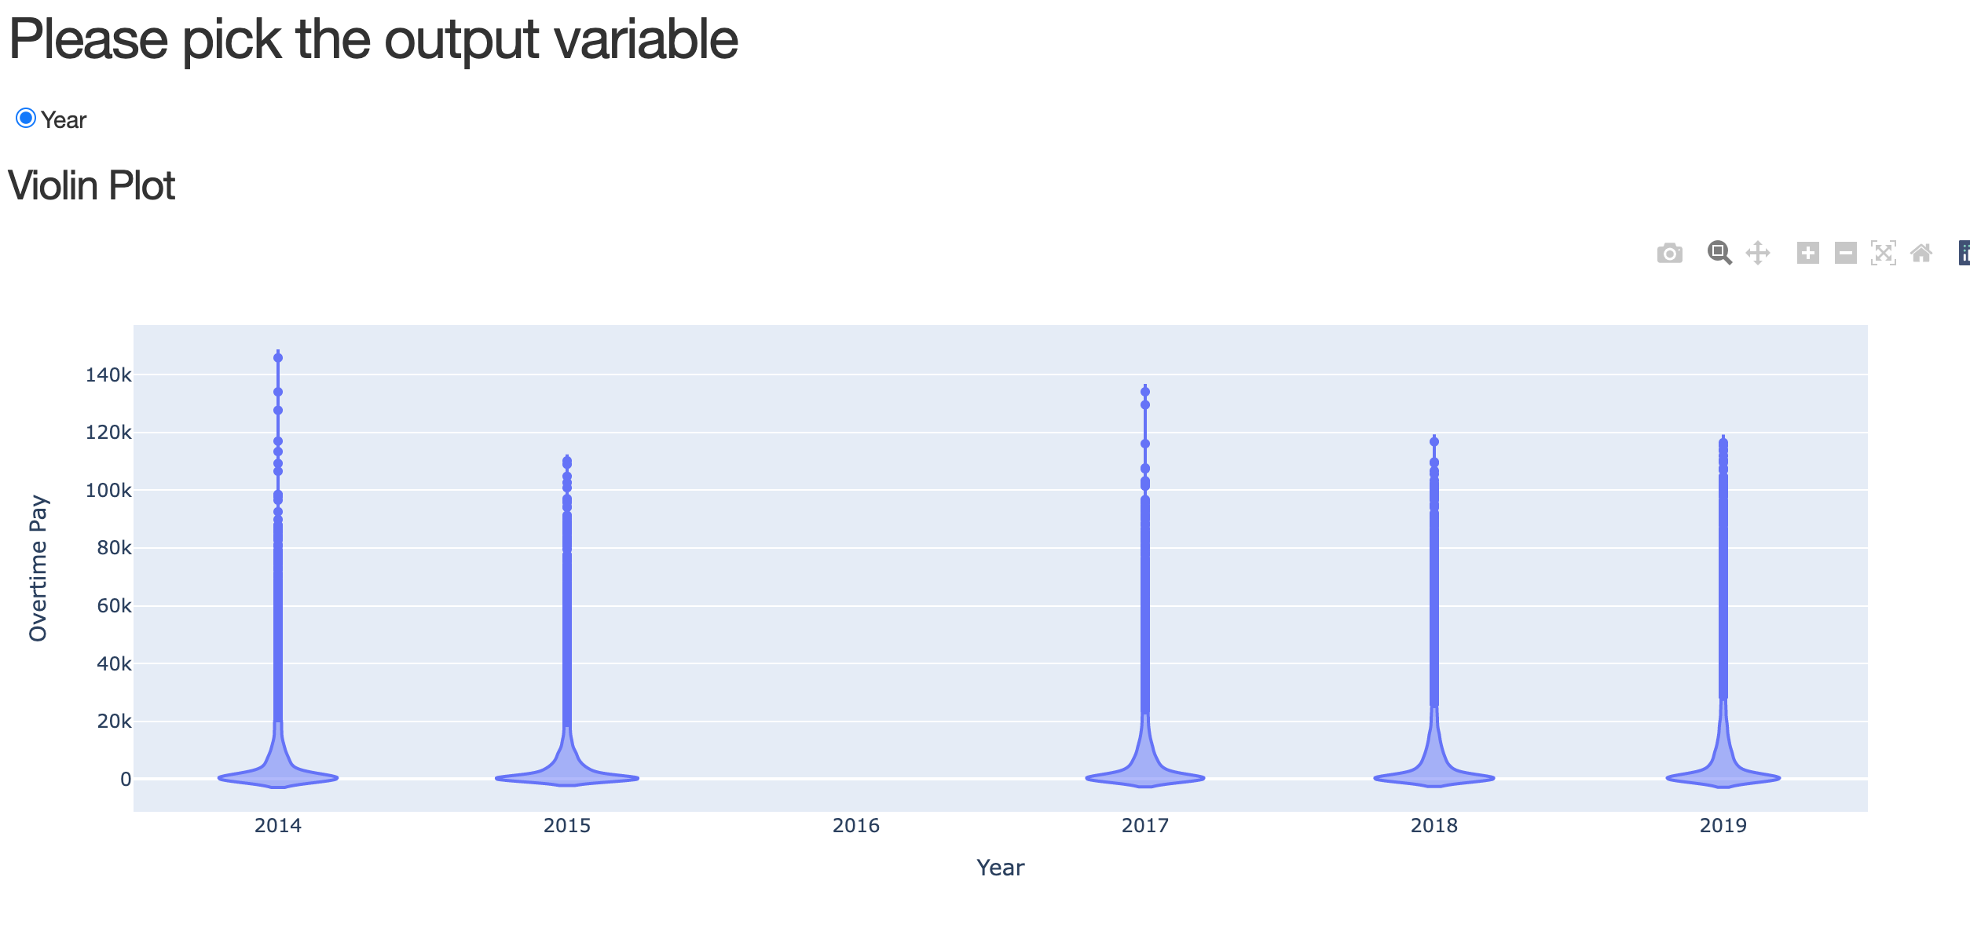
Tab1/second Graph

Slide 19
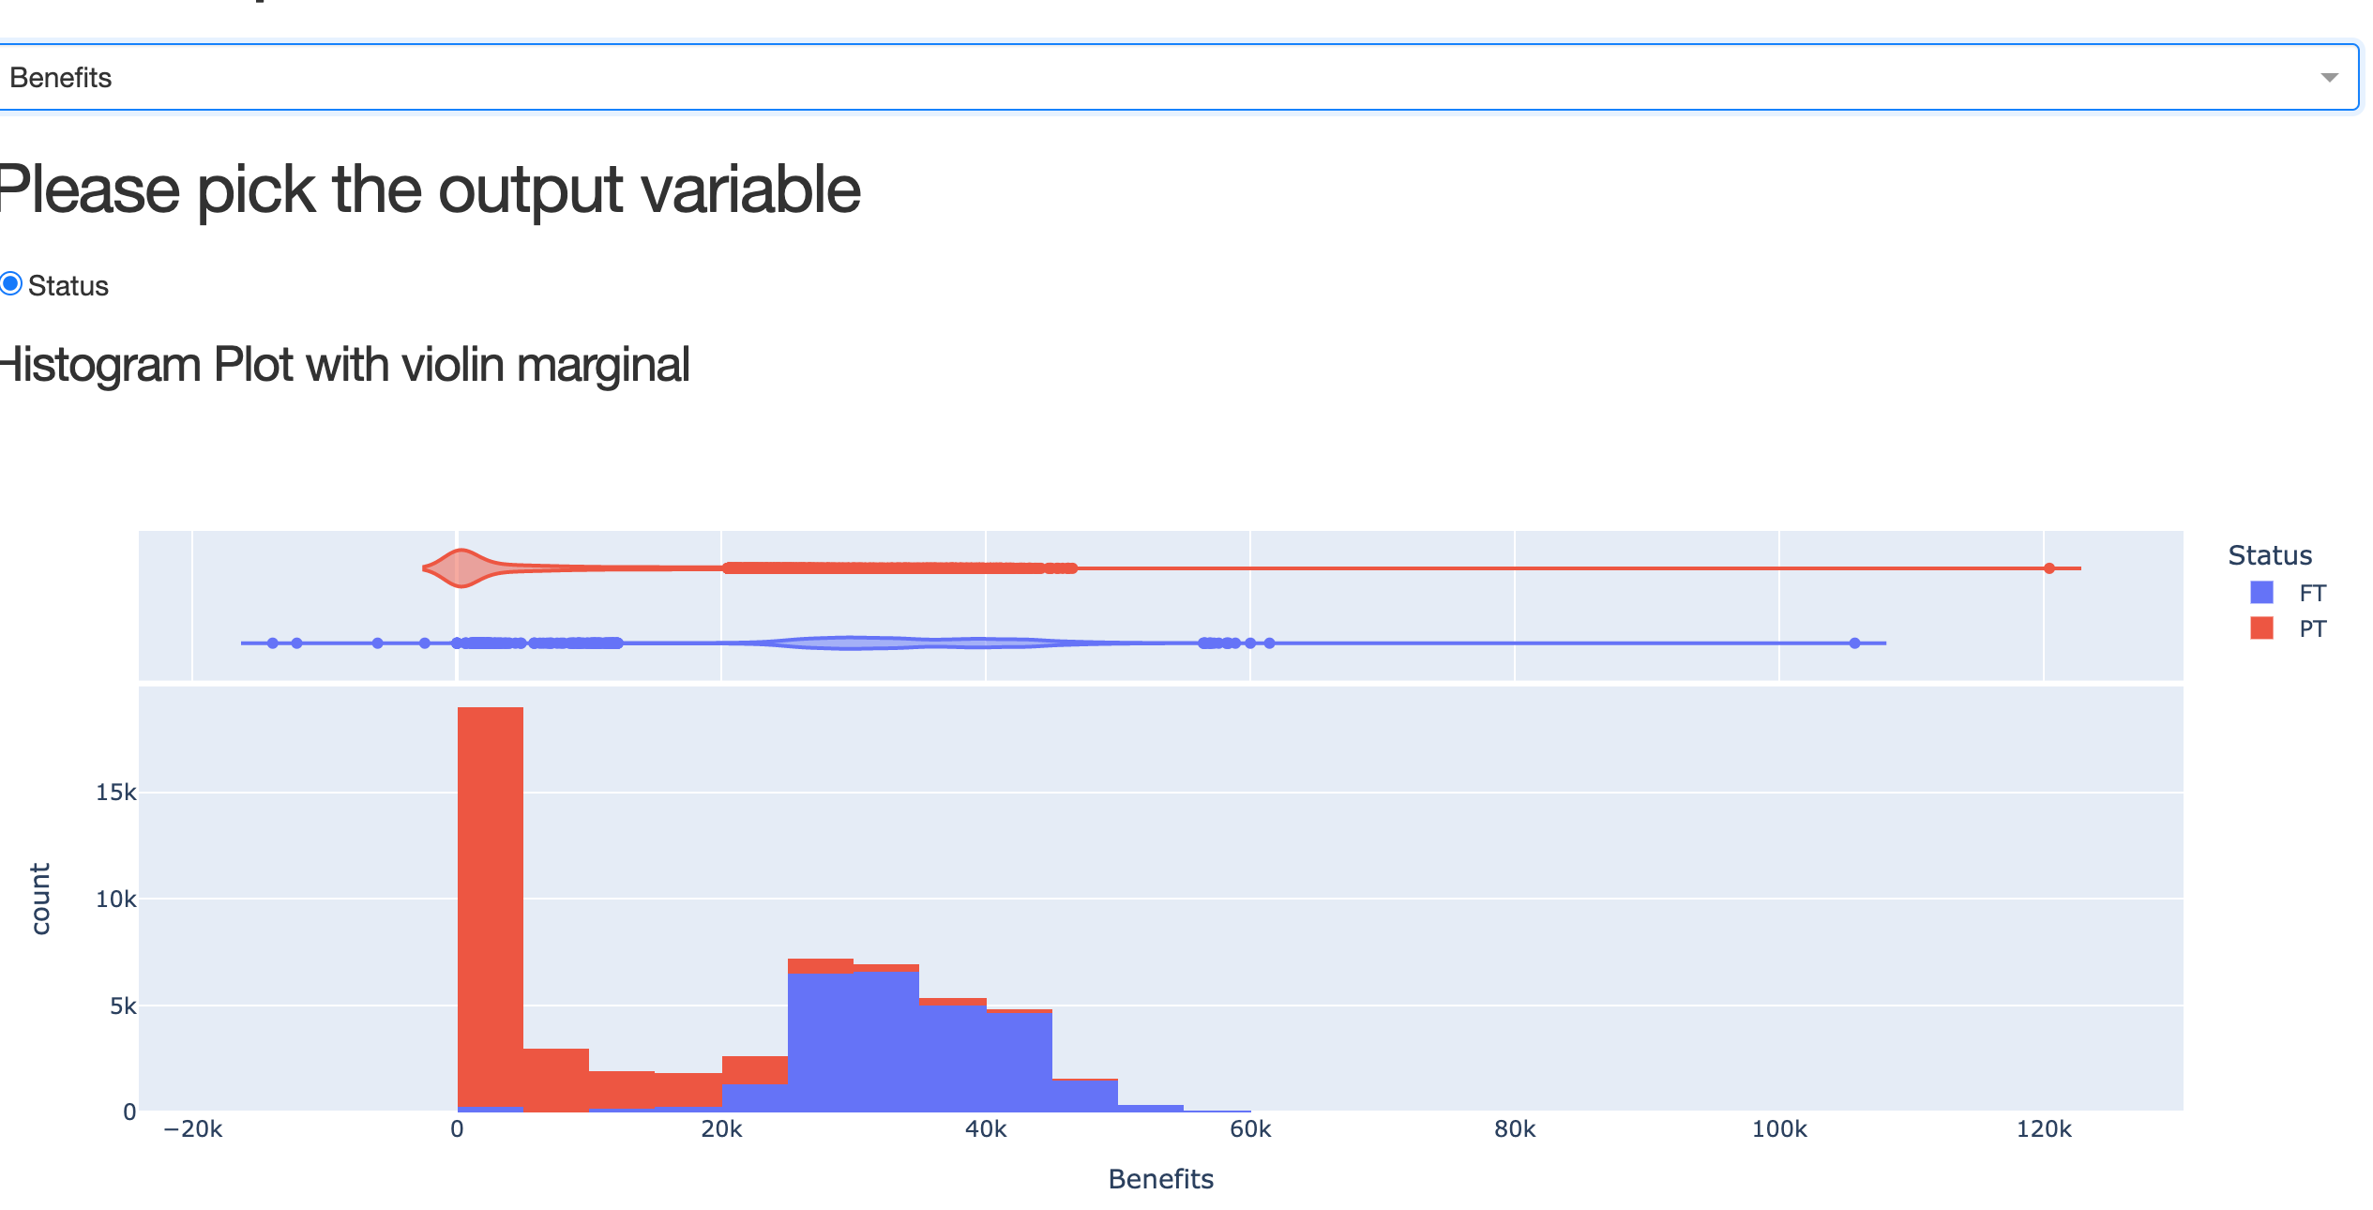
Tab2

Slide 20
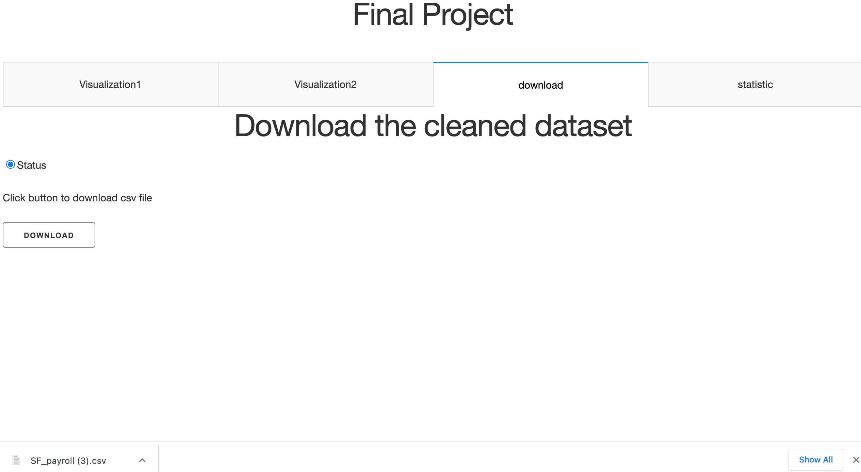
Tab3/down;oad

Slide 21
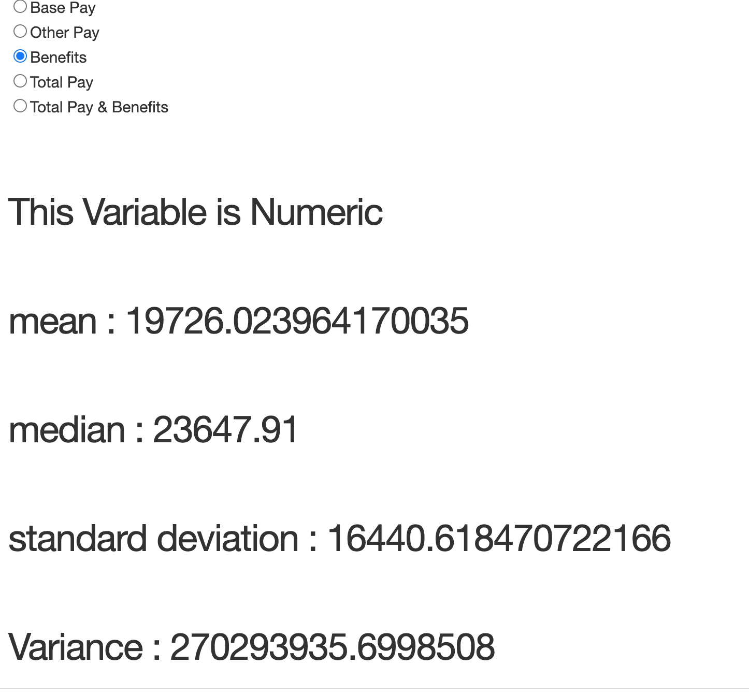
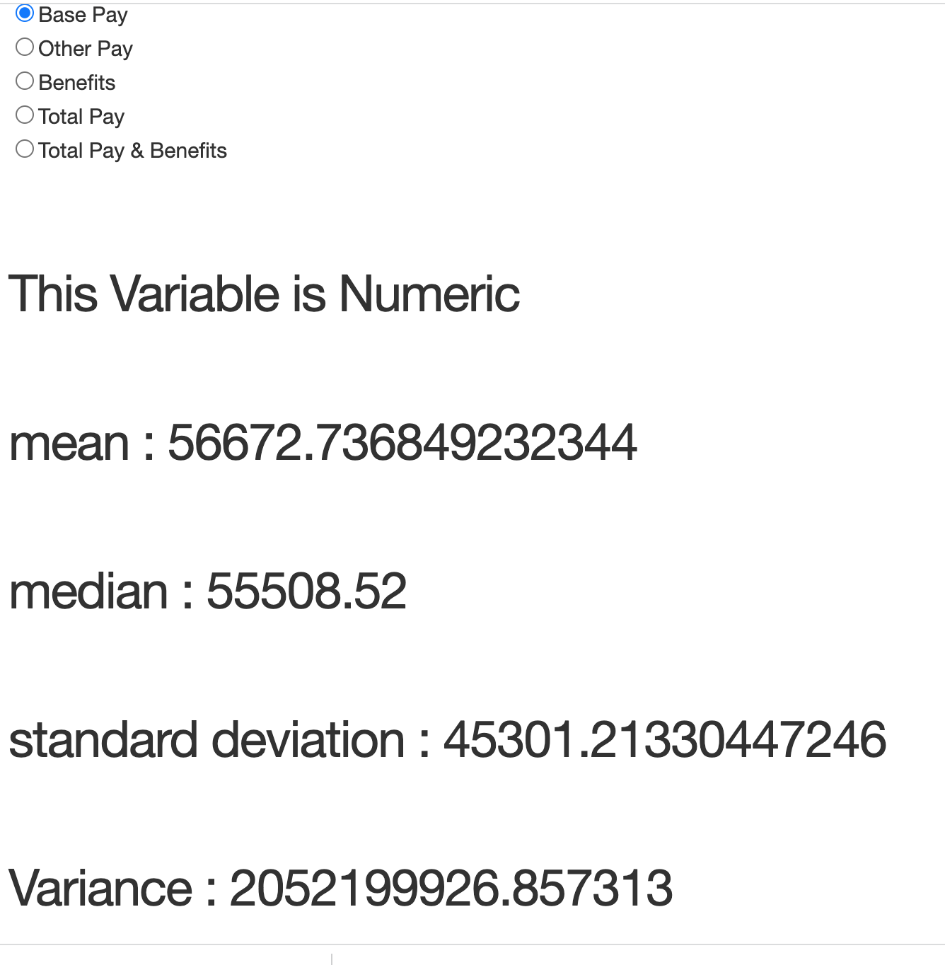
Tab4/statistic

Slide 22
Summary
As we see in the plots the income is increasing perfectly in San Francisco Area
It’s not enough to judge , we need to explore the expenses over there and compare(which may be the next step for this project)
For the more and Normal benefits, you need to work Full time there
Just some particular jobs have the good overtime pay there.

Slide 23
Refrencess
https://images.search.yahoo.com/yhs/search;_ylt=AwrC3OuxmXJiDiEAIEEPxQt.;_ylu=Y29sbwNiZjEEcG9zAzEEdnRpZAMEc2VjA3BpdnM-?p=san+francisco+pictures&type=q3020_A1Q52_gn_bsfq&hsimp=yhs-remarklist&hspart=ima&ei=UTF-8&fr=yhs-ima-remarklist#id=5&iurl=https%3A%2F%2Fa9p9n2x2.stackpathcdn.com%2Fwp-content%2Fblogs.dir%2F1%2Ffiles%2F2020%2F04%2FiStock-1125604286.jpg&action=click
https://www.kaggle.com/datasets/tomtillo/san-francisco-city-payrollsalary-data-20112019

Slide 24
Questions?
Email me at : mbarkhordarian@gwu.edu

Slide 25
Thank You!

