Slide 1
Under Water Surface Temperature Timeseries Data Set
Instructor: Reza Jafari
Course: Time Series
Present by: Mahtab Barkhordarian

Slide 2
Today’s Discussion:
Description of dataset
Stationary
Holt-trend Method
Feature selection
Base Models
Multi Linear Regression
ARMA
Final Model Selection
Forecast Model

Slide 3
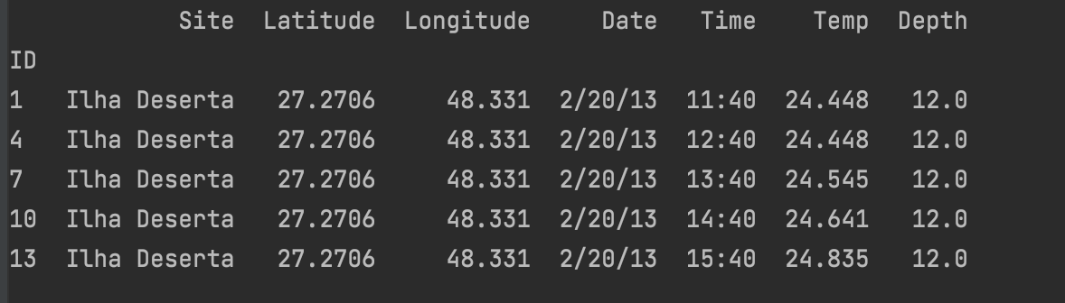
All About data set
The source of the dataset is from Kaggle
This dataset contains underwater temperature (°C) data from seven islands and two submerged rocky reefs along the Santa Catarina coast, southern Brazil, between 24 and 28°. Temperature records were acquired every 20 minutes, between December 2012 and July 2014.
It has 7 variables (3 categorical- 4 numeric)
408639 observation before cleaning- 136213 observations after cleaning

Slide 4
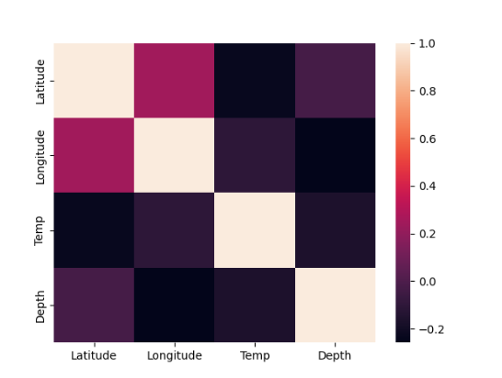
Heatmap:

Slide 5
Pre Processing
The target variable is Temperature here.
Temperature records appended every 20 minuities , which are converted to hourly now.
For the numeric value (Temperature), I had two null which I’ve covered with the mean of the dataset.

Slide 6
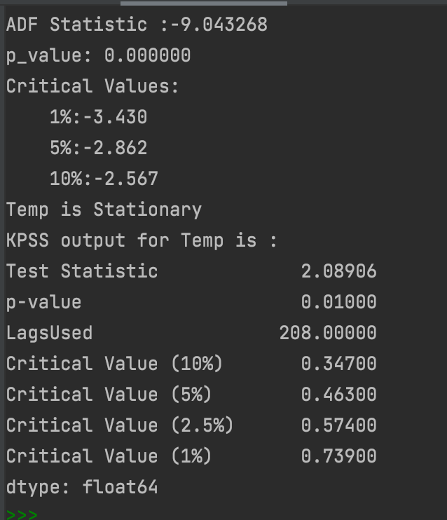
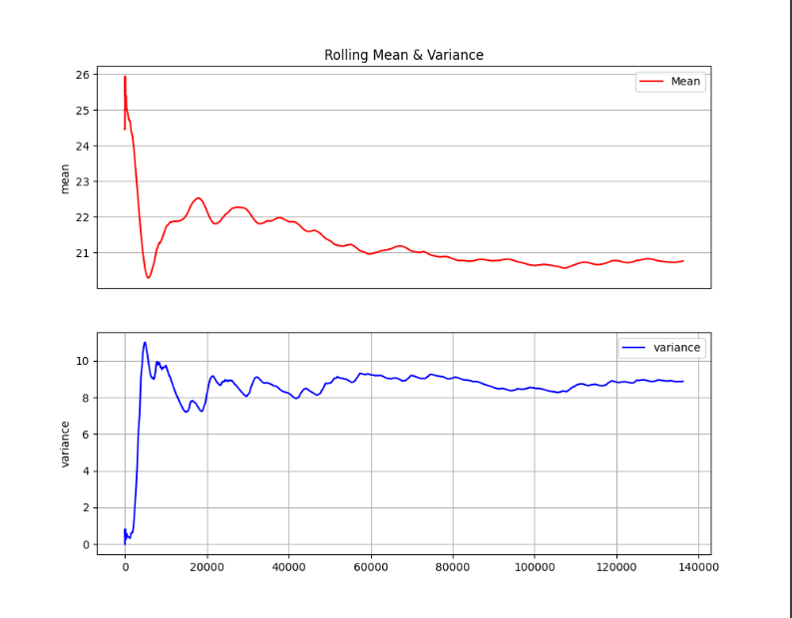
stationary

Slide 7
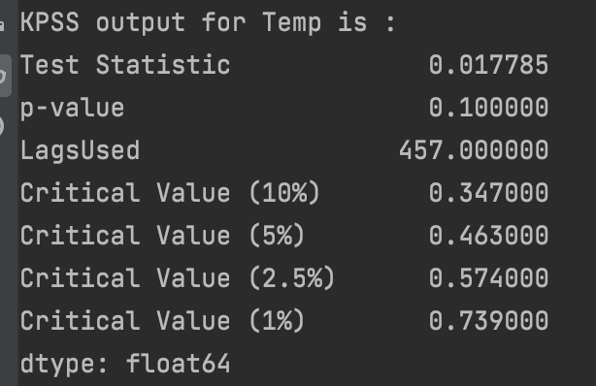
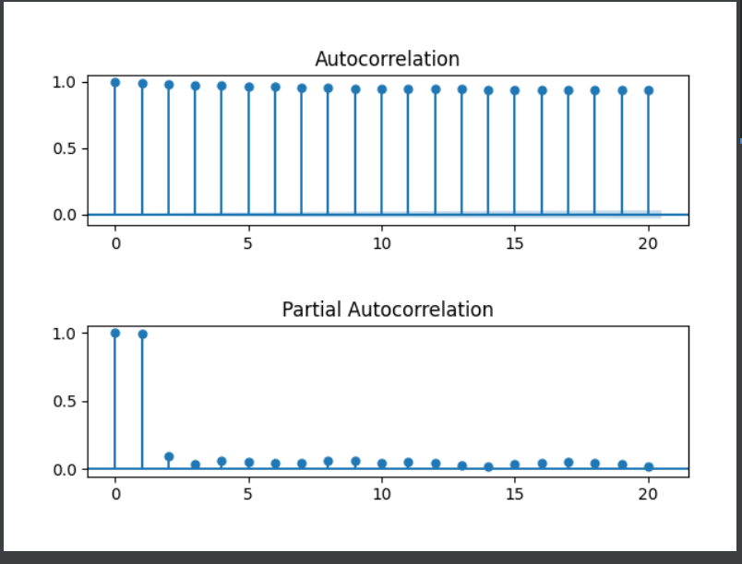
ACF/PACF
KPSS after
The first
Differencing:

Slide 8
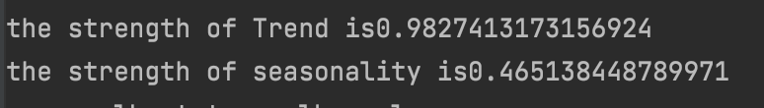
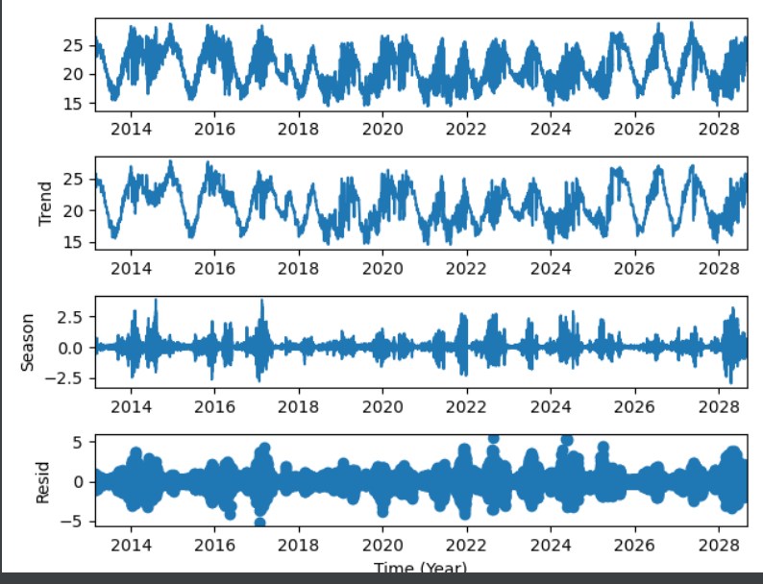
Decomposition:
This data is highly trended
The seasonality is weak here

Slide 9
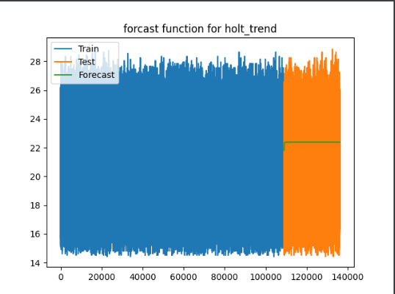
HOLT-Trend Method
The data is trended then used the Holt-trend method
The forecast is not good and it’s not white

Slide 10
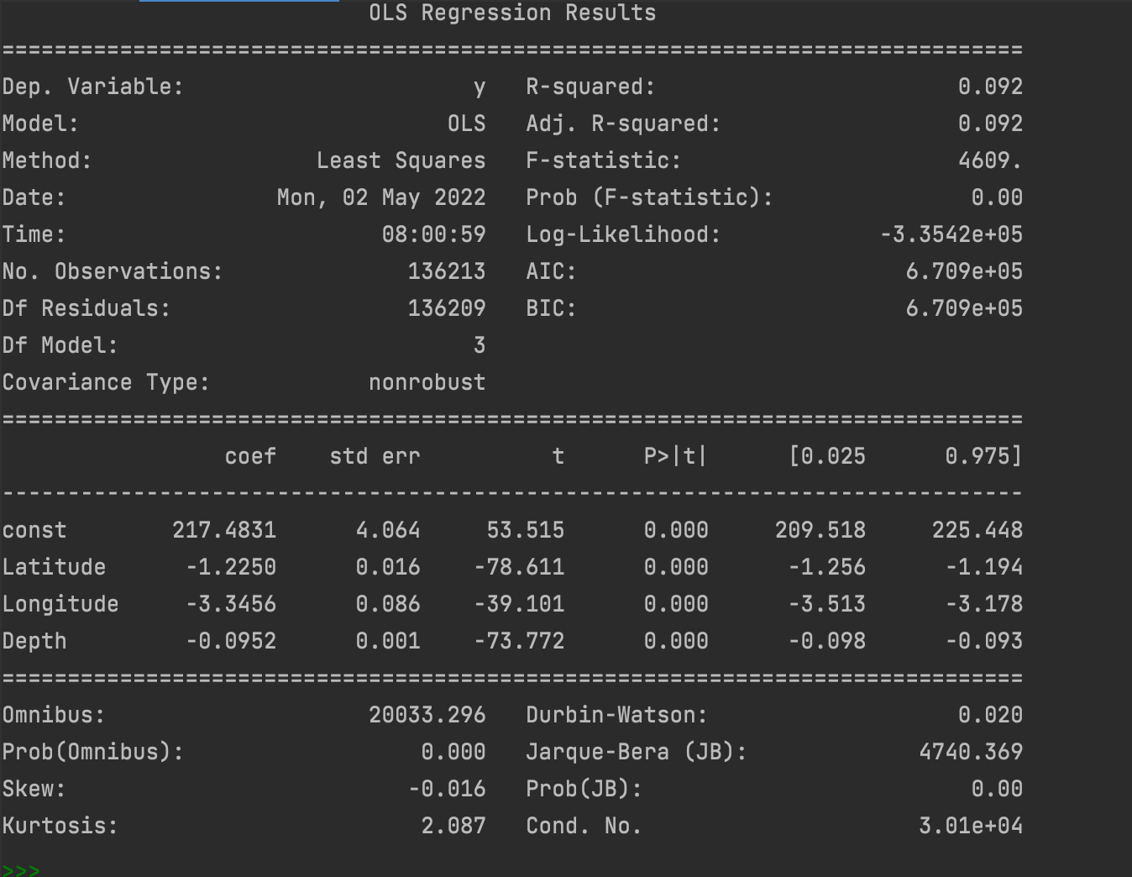
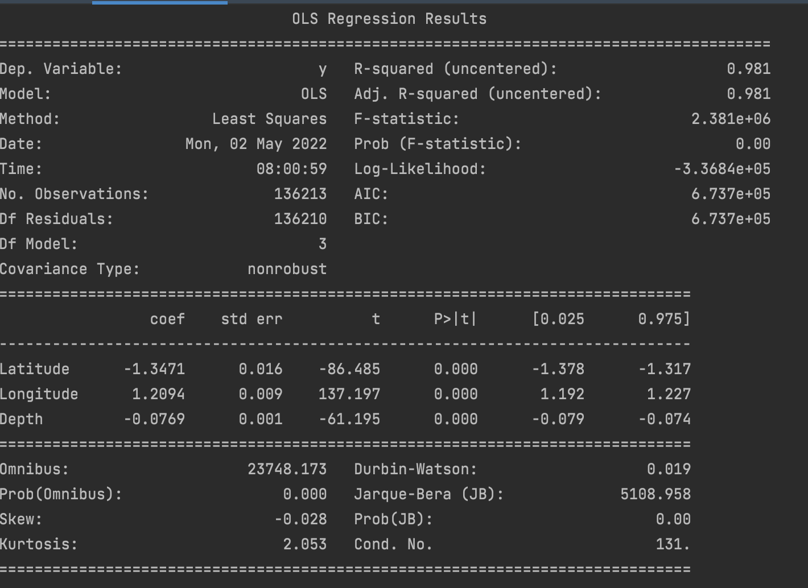
Feature selection
The constant is added to the model
After the observation the constant is removed because of its std error
Final features are: Depth, latitude and longitude
R-squared increased which shows the model got better

Slide 11
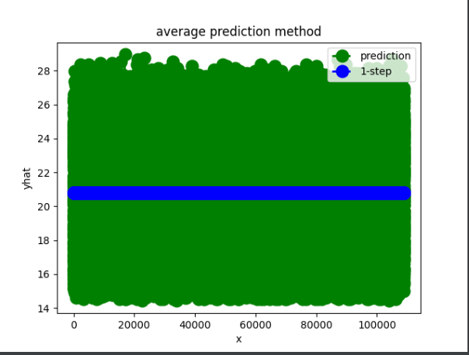
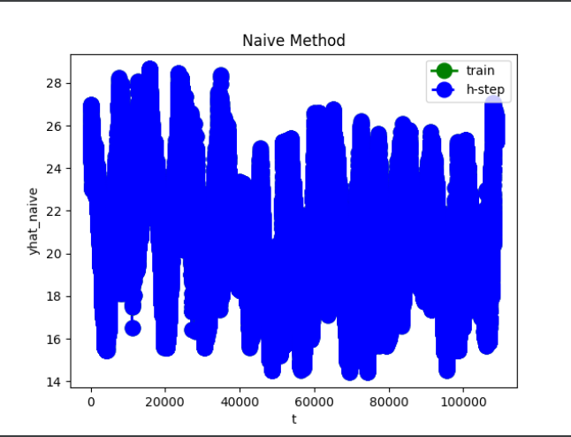
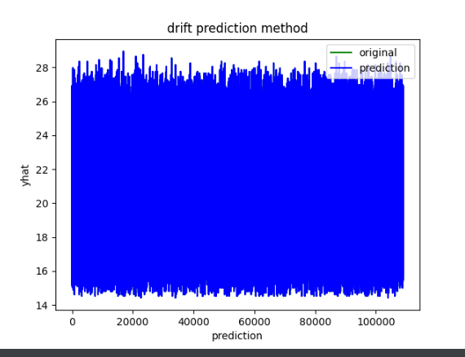
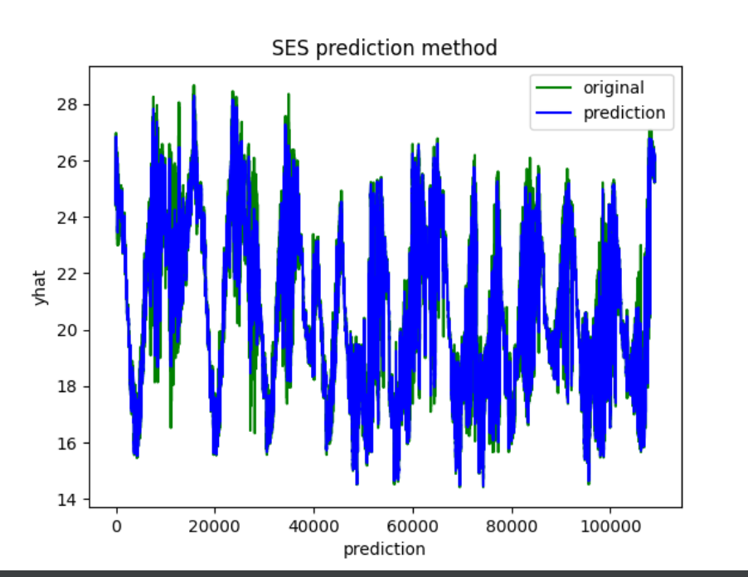
Base Models
Q^2 test shows that the residual error in average method is white

Slide 12
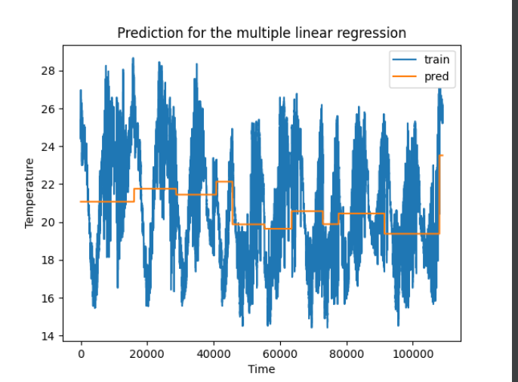
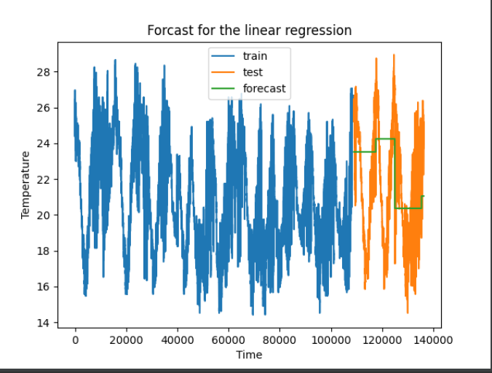
Multiple Linear regression method:

Slide 13
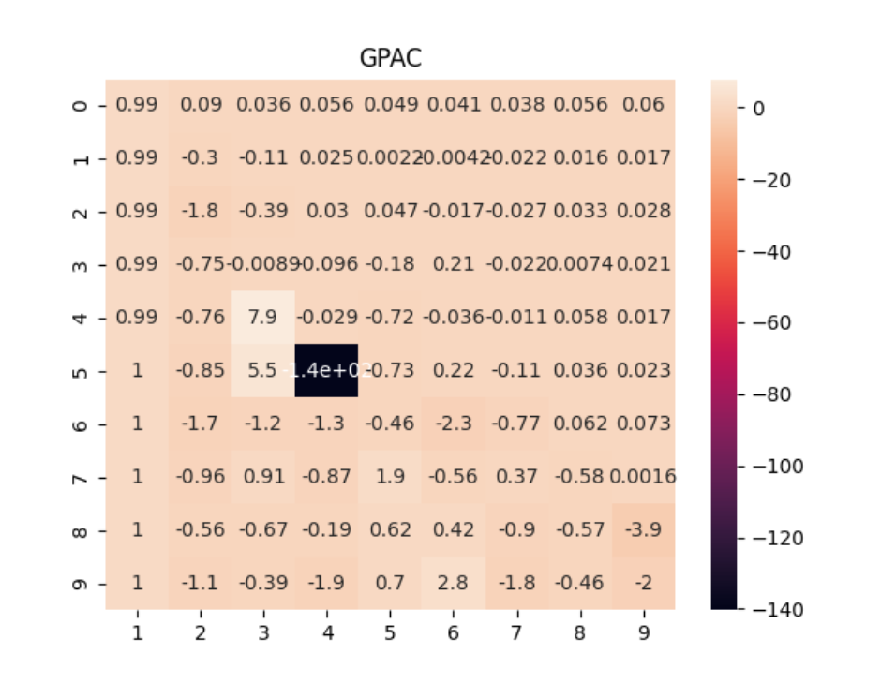
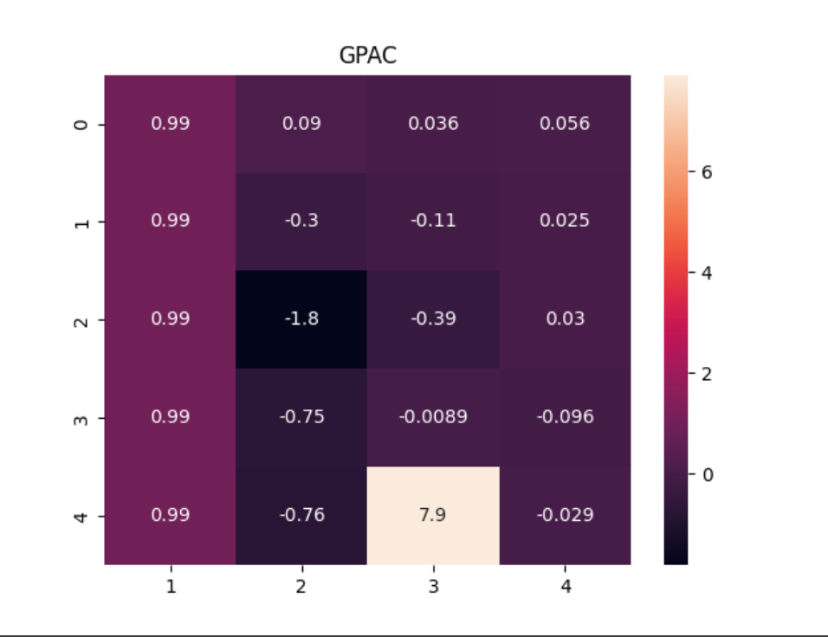
GPAC
Both GPAC shows na=1,nb=0

Slide 14
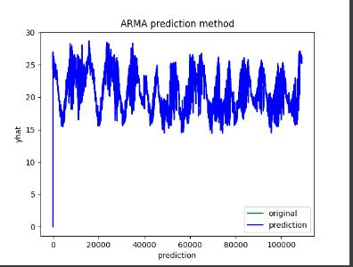
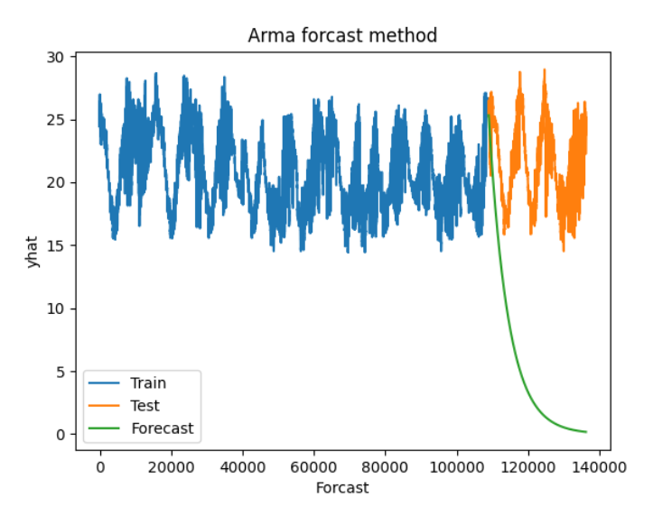
ARMA

Slide 15
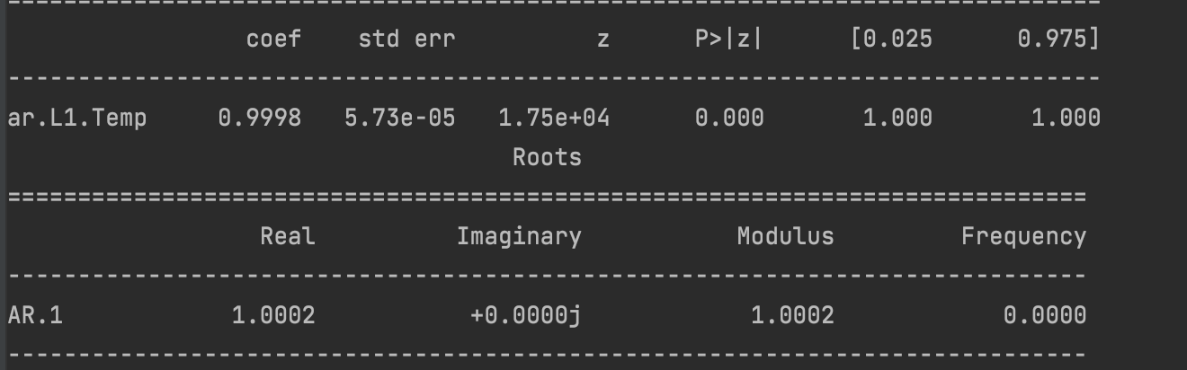
LM Algorithm
The estimated coefficient is 1, and the LM algorithm shows 0.99 which is pretty closed , but the model is not unbiased.

Slide 16
Final Model Selection
 | Q value | MSE residual | MSE Forcast | Er_Var_prediction | Er_Var_forcast | Variance ratio | residuWhite
Holt-trend | 241.978138 | 8.5226 | 11.4932 | 9.0335 | 8.9389 | 1.0105 | No
Average | 104.303532 | 8.8661 | 8.9370 | 8.8655 | 8.93739774 | 0.9919 | Yes
Naïve | 2.054394e+06 | 0.1628 | 26.0597 | 17.2968 | 8.93739774 | 1.93 | No
Drift | 27507.384 | 17.8162 | 17.8162 | 17.8162 | 17.904191 | 0.9950 | No
SES | 84174.7361 | 0.2382 | 29.1275 | 0.238257 | 8.937397 | 0.02 | No
OLS | 8.456688e+06 | 7.7052 | 11.9939 | 7.705281 | 10.723044 | 0.7185 | No
ARMA | 30458.815462 | 0.296434 | 304.764 | 1.265082 | 0.0002821 | 0.0044 | No

Slide 17
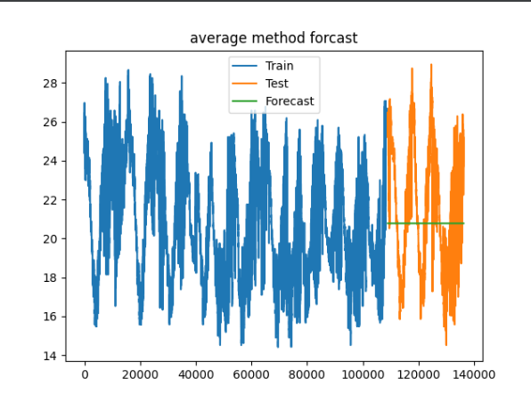
Forecast model

Slide 18
Summary
The best model is average after the chi square test we can realize that the residual error is white and also the MSE forecast is less that others.
After average method, the best method is Holt-trend, however it’s not white.
I didn’t use ARIMA because my data was stationary and I didn’t used the differenced data
I didn’t used SARIMA because the dataset wasn’t seasonal

Slide 19
References
https://www.kaggle.com/datasets/shivamb/underwater-surface-temperature-dataset
https://github.com/rjafari979
In-class , lectures, recordings codes and videos

Slide 20
Thank you
Any Questions?
Please email me at mbarkhordarian@gwu.edu

