Slide 1
ECO346 | DATA VISUALIZATION TECHNIQUES FOR ECONOMISTS
Education spending and literacy in KP rural
Variant 4 - Khyber Pakhtunkhwa, rural
PSLM 2019-20 person and household files
FA24-BEDS-052 | Section B | Fall 2026

Slide 2
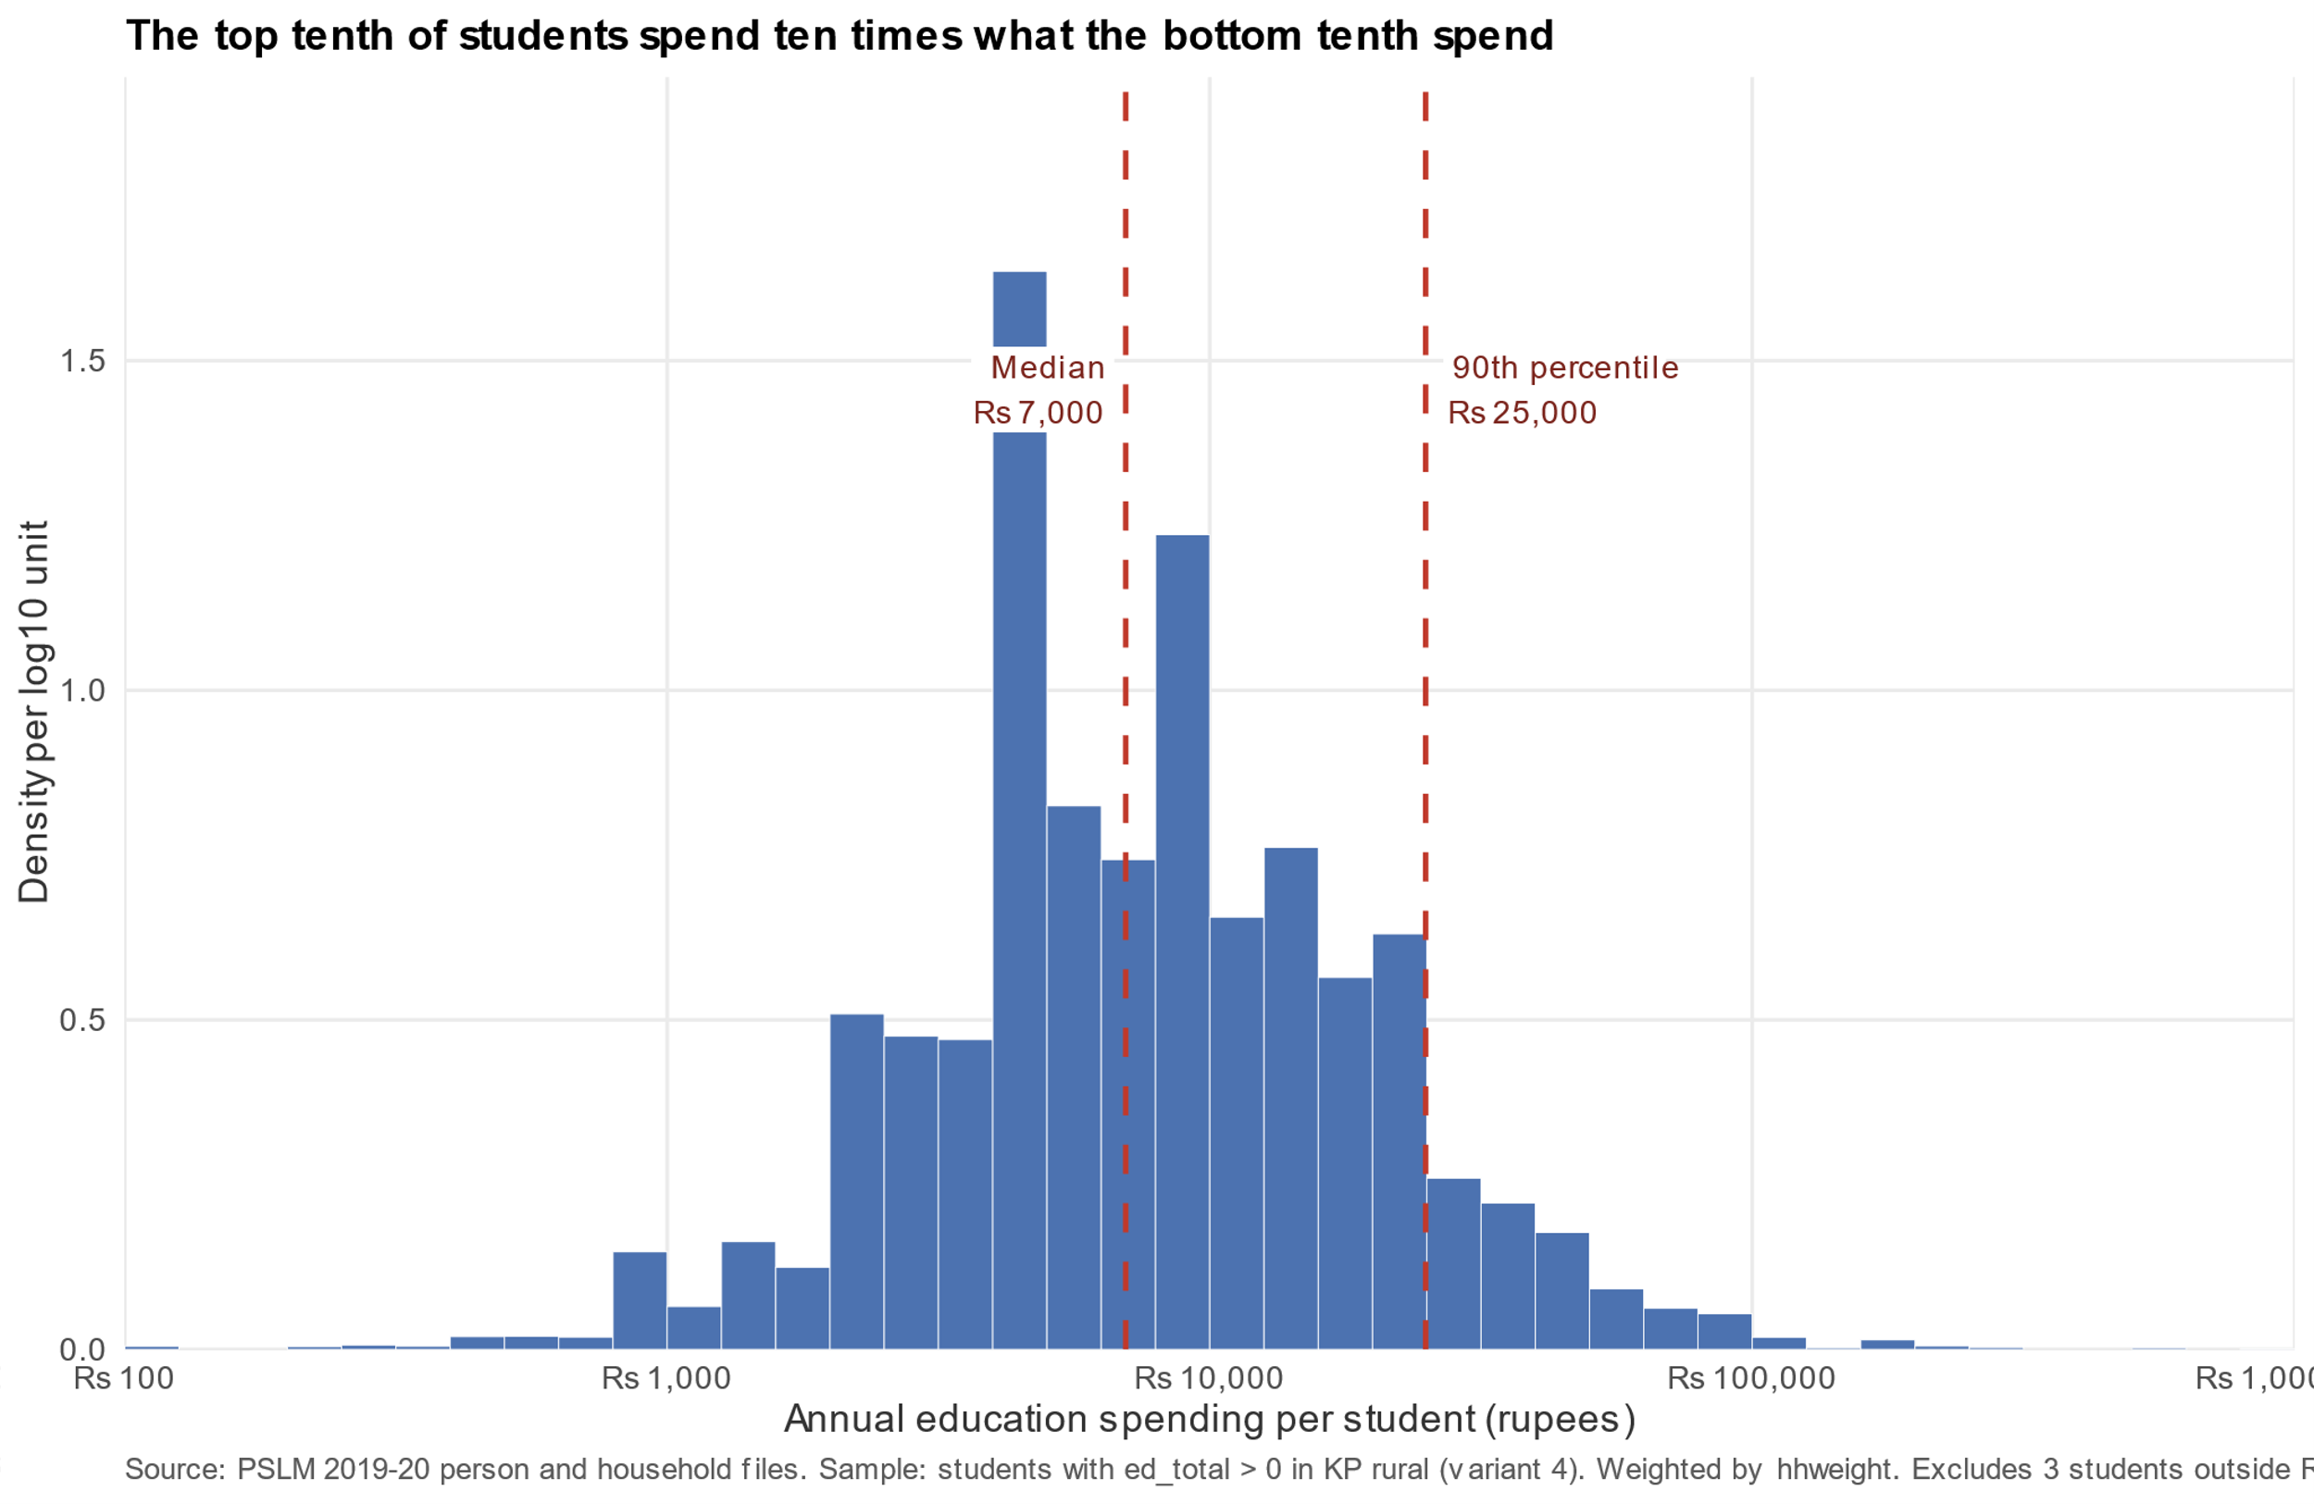
Spending is right-skewed: the 90th percentile is ten times the 10th
4,912
students with education spending > 0
Rs 7,000
weighted and unweighted median
Rs 2,500 -> Rs 25,000
weighted 10th to 90th percentile
10.00x
p90 / p10 ratio
3 students excluded outside Rs 100 - Rs 1,000,000
Source: PSLM 2019-20; KP rural students; weighted by hhweight.

Slide 3
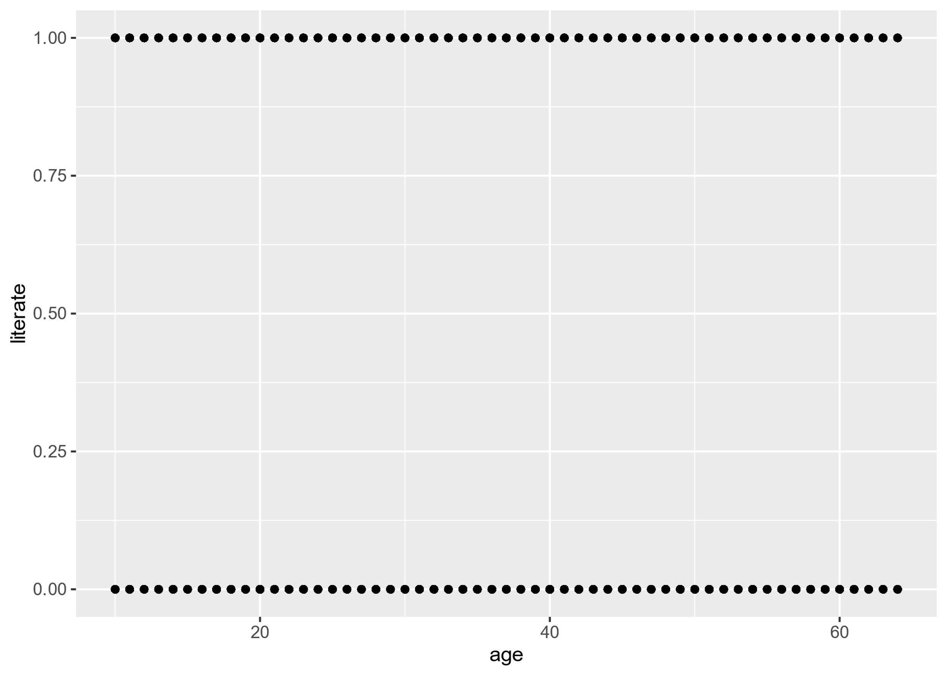
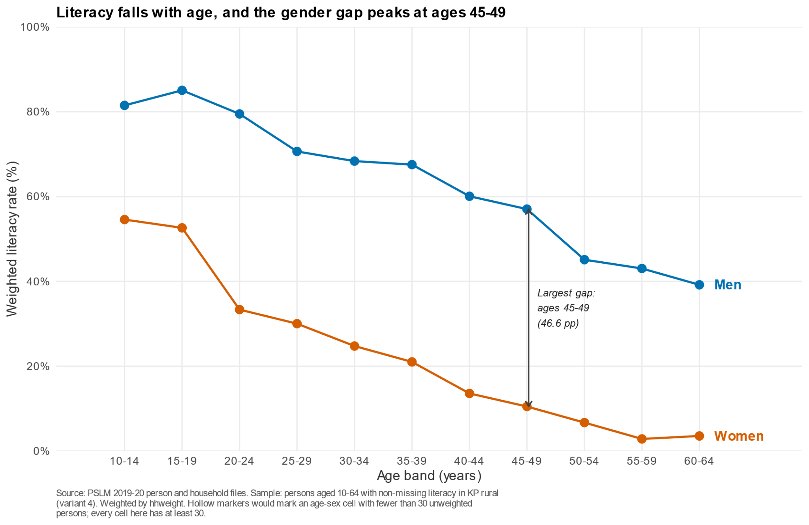
Makeover: from 13,200 points to weighted conditional means
DEFAULT (Q4)
REDESIGN (Q3)
One point per person; no visible age pattern
Weighted literacy rate by age band and sex
Overplotting removed | sex mapped to colour | direct labels | y-axis fixed at 0-100% | thin cells hollow

Slide 4
Key finding: a 46.6-point literacy gap at ages 45-49
WOMEN
15-19: 52.6%
55-59: 2.9%
MEN
15-19: 85.1%
55-59: 43.0%
Largest gap at 45-49
10.5% vs 57.0%
Caveat: a cross-section cannot show when literacy was acquired, or whether schooling caused it.
Source: PSLM 2019-20; persons aged 10-64; weighted by hhweight.

