Slide 1
MCB ISLAMIC BANKING DATAMART

Slide 2
Project Team Overview:
Habiba Yasmin
Bilal Shahid
Arooj Khalid
Umair
Usman Touseef

Slide 3
What is Data-Ware House:
Introduction:
A relational database that is designed for query and analysis rather than for transaction processing.
It separates analysis workload from transaction workload and enables an organization to consolidate data from several sources.
process of gathering data and delivering it to business users.

Slide 4
Project Overview:
We are going to develop data mart on project” MCB ISLAMIC BANKING”
And our main focus is
HRM
CRM
INTERNET BANKING
CORE BANKING

Slide 5
Roles And Responsibilities
Name | Role | Responsibility
Saleem Raza | Resource Provider | Sign-off the Business Requirements Document Provide business requirements. Support the requirement gathering process, and attend requirements workshops. Support establishing the testing requirements. Sign-off the Business Requirement Document
Habiba Yasmin | Project Manager | Architecture, STG, project plane
Arooj Khalid | Business Analyst | BRD, STG
Muhammad Bilal Shahid | Lead ETL Architect | STM, STG, DataMart Jobs
Umair idrees | Lead ETL Architect | Dimensional Model, STG, DataMart Jobs
Usman Touseef |  | ISD, STG

Slide 6
Business Requirements Definition:
Source Data Requirements
Source | # | Data Category | Description
Customer Database | C1 | Client Demographics | Customer Identification information e.g. CID, CNIC, Customer Name, Employment details,
MASTER_CUST_ACCOUNT | C2 | Client | Account info, CIF, customer name, email address, phone. etc.
online banking system | C3 | Client | Customer Identification information e.g. CID, CNIC, Customer Name, bill payed
internet banking system | C4 | Client | Customer Identification information e.g. CID, CNIC, Customer Name, make transfers, auto-payments
HR department | C5 | Employee Demographics | Employee Identification information e.g. CID, CNIC, Employee Name, Employment details,
Finance department | C6 | Employee | Employee Identification information e.g. CID, CNIC, Employee Name, Employment details,
Treasure department | C7 | Employee | Employee Identification information e.g. CID, CNIC, Employee Name, Employment details,
ITG department | C8 | Employee | Employee Identification information e.g. CID, CNIC, Employee Name, Employment details,
Felxcube(corebanking) | C9 | Employee | Employee Identification information e.g. CID, CNIC, Employee Name, Employment details,
Help desk department | C10 | Client | General help like how to open an account

Slide 7
Business Requirements Definition(contd..)
Initial Load Requirements
Data Retention Requirements
Data Analysis and Reporting Requirements
Data Reconciliation Requirements
Data Load Requirements

Slide 8
Issues:
Issue | Action Plan
If you are not getting the correct requirement, this will lead you at a dead end. | Should conduct some meetings with the client and make sure you extract the all requirements.
Design making and making correct dimension and fact tables is very important. | You should know what you are making. You knew the why we use dimension and fact tables and their difference as well.
Untrained staff | A member should be their who knew the work or train the new staff before sending on a job.
Changing data on daily bases | Should design the project so you can apply Type 1, Type 2, Type 3. If we needed.
Skills are not in place | Define responsibilities correctly.

Slide 9
Risks:
Risk | Mitigation
Delay in getting the source systems schema information can cause delay in the project. | Conduct meeting after 2 days and discus progress.
During data integration, if jobs fail frequently then it can cause delay in the project. | Should schedule the project plan by keeping this in mind and if jobs are failing and you can not tackle it then inform your source provider in time.
Unrealistic schedules of data gathering. | Mostly companies allow to access the data after 10pm. So, every second counts. If any job fails, you should not wait for next day to fix it.
Low cost provider (Budget) | It is very difficult to work on low budget project. So, insure the quality instead of making a long-term project.
Project is over budget. | Should make a project plan and do match the deadlines.

Slide 10
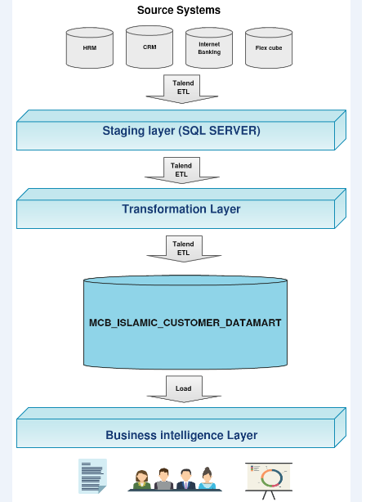
Architecture Diagram:

Slide 11
Information Sourcing Document:
HRM
CRM
INTERNET BANKING
CORE BANKING(flexcube)

Slide 12
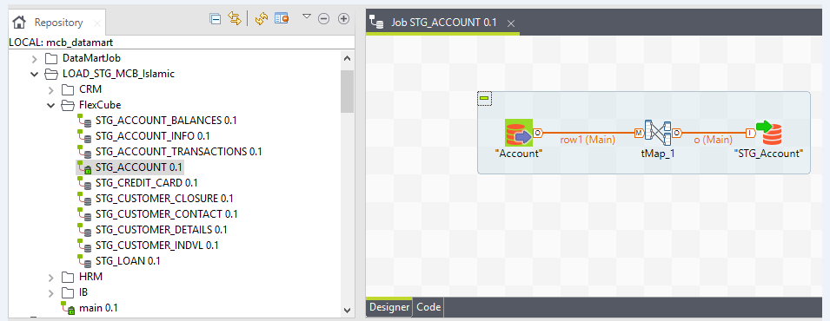
ETL JOBS:

Slide 13
STM

Slide 14
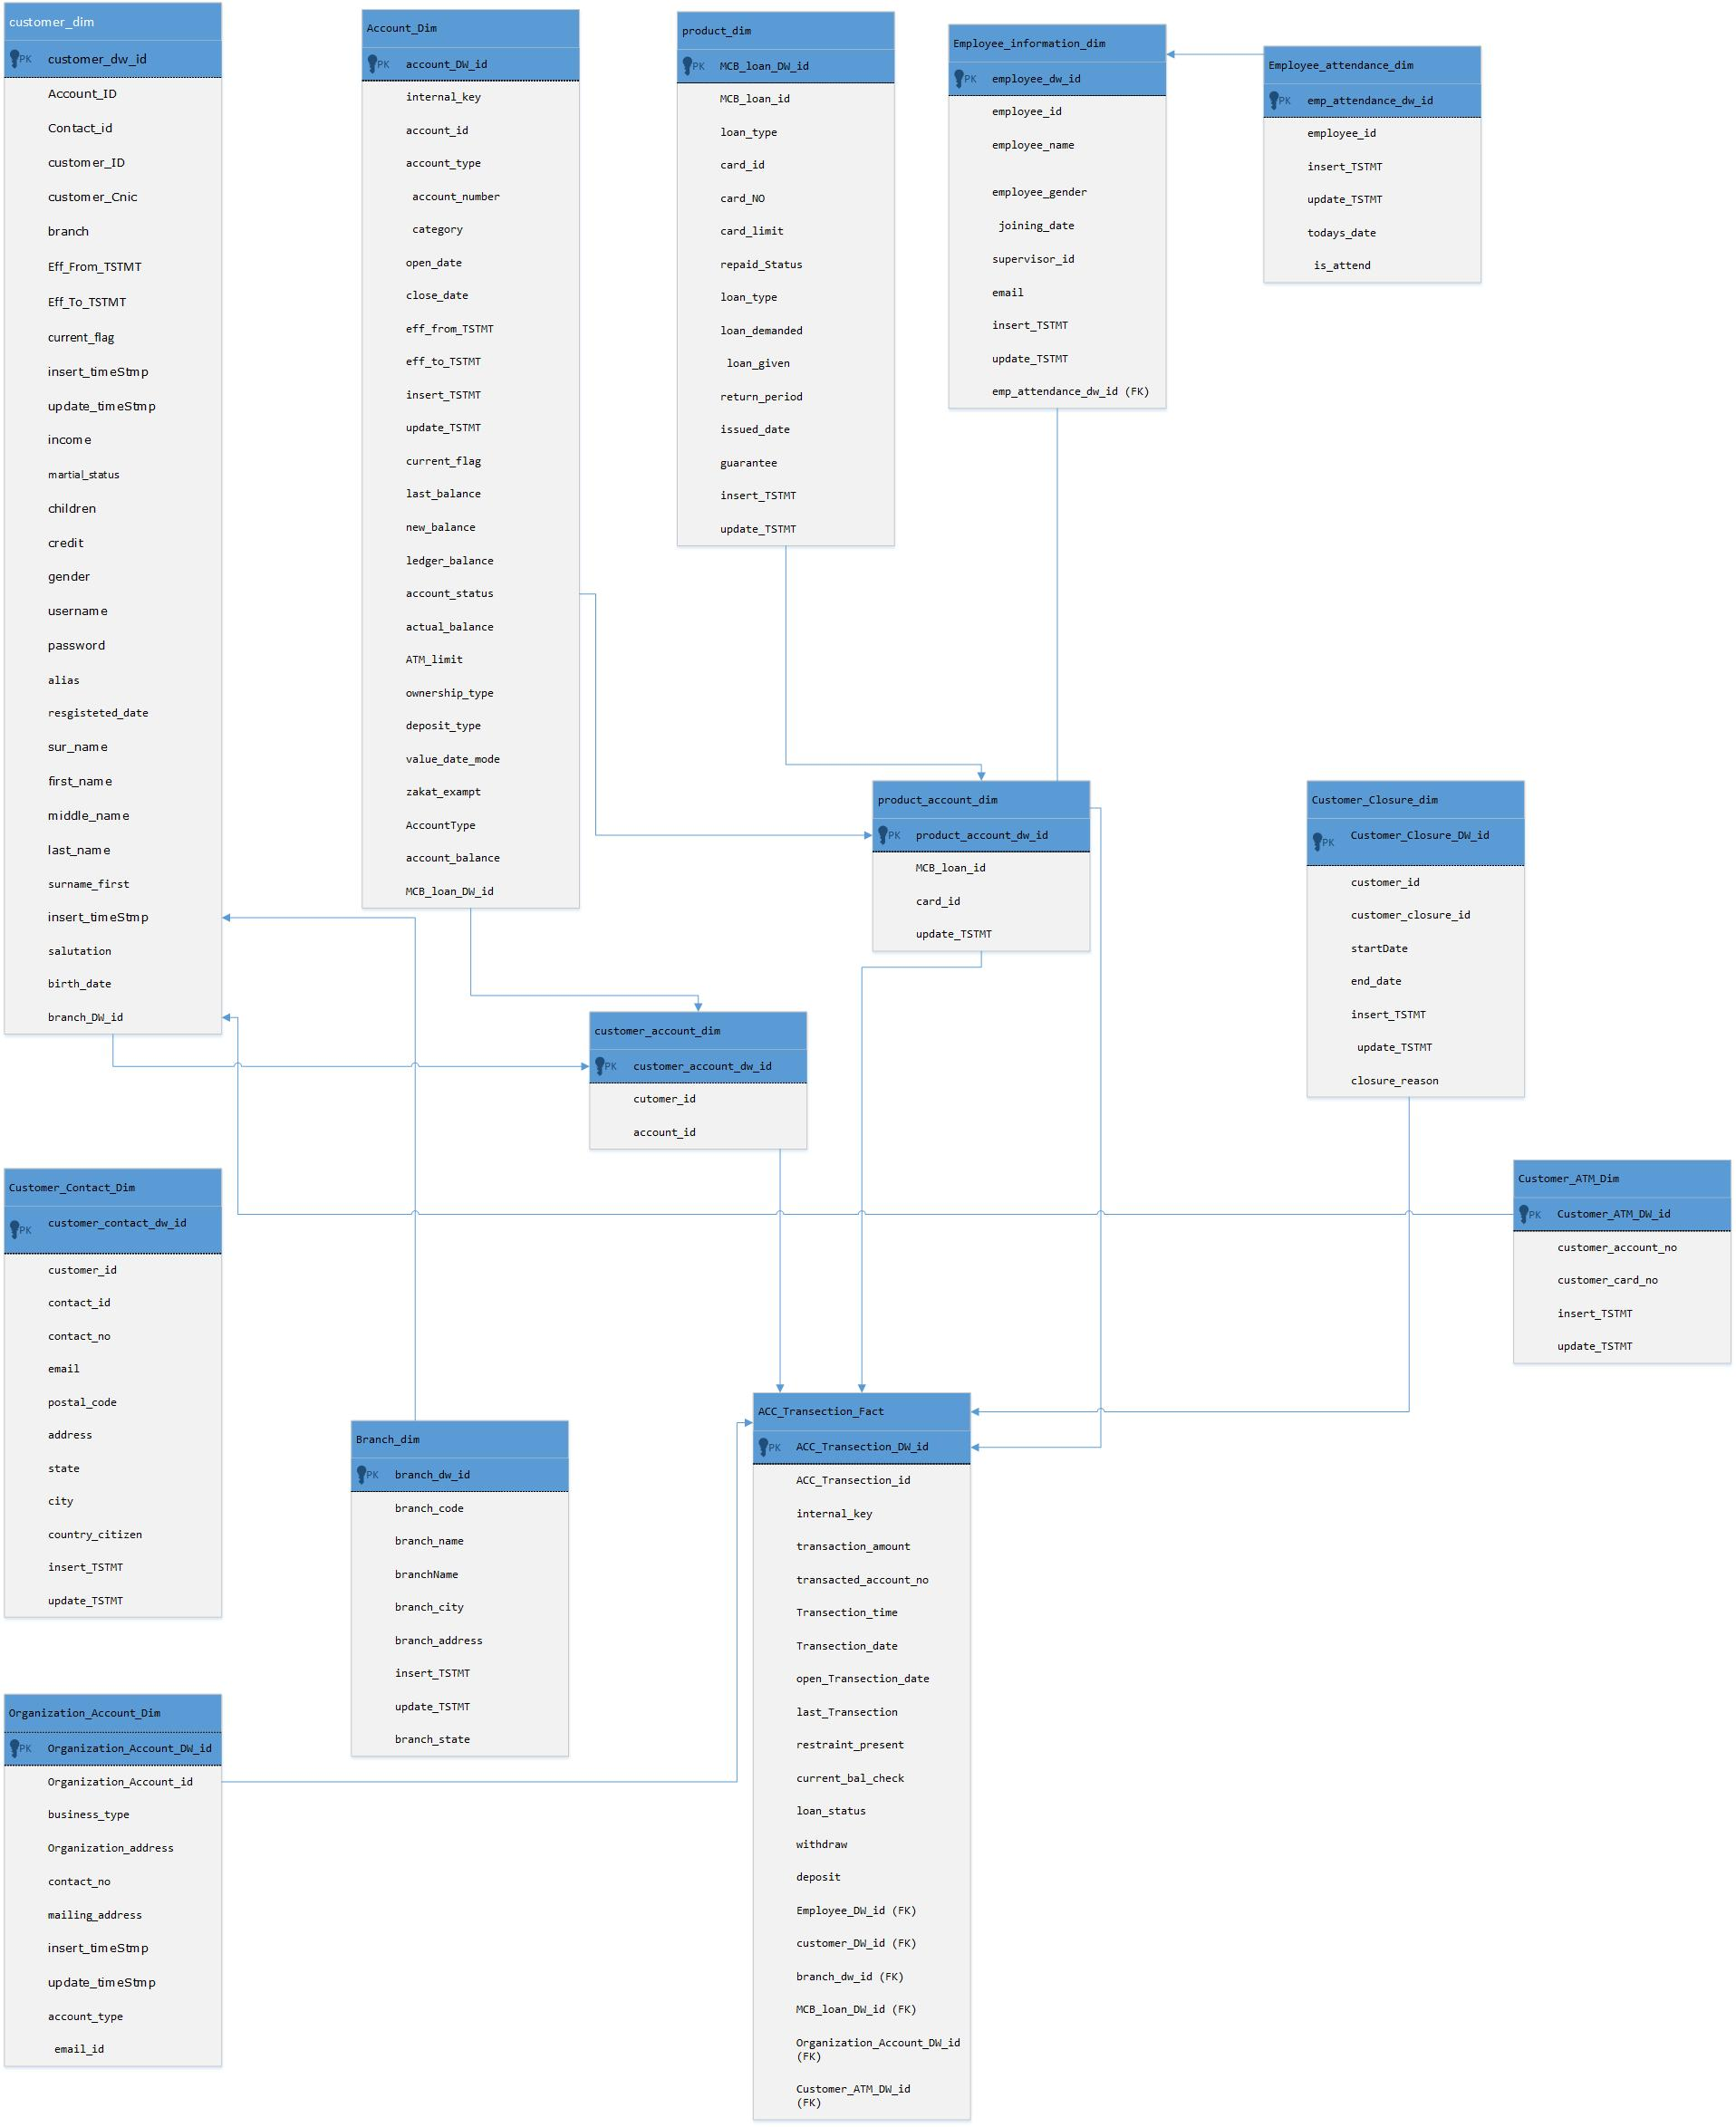
Dimensional Model

Slide 15
Project Completeness Status
BRD Complete
ISD Complete
STG Jobs Complete
STM Complete
Dimensional Model Complete
Data Mart Jobs Partially Complete

